Slide 1
Project Big Data Programming
12002065054 Ali Niaz Butt
12002065100 Umair Ahmad

Slide 2
Dataset Information
We are using the transactional grocery dataset from R data resources.
The dataset consists of transactions, where each transaction is displayed as a row.
It contains 9835 transactions as whole
A single transaction in the dataset comprises of at most 32 products.
We have partitioned the data into seasons where;
Summer: 3085 transactions
Winter: 2979 transactions
Autumn: 1622 transactions
Spring: 2149 transactions
Grocery data: d {P1 [Summer] + P2 [Winter] + P3 [Autumn] + P4 [Spring]}

Slide 3
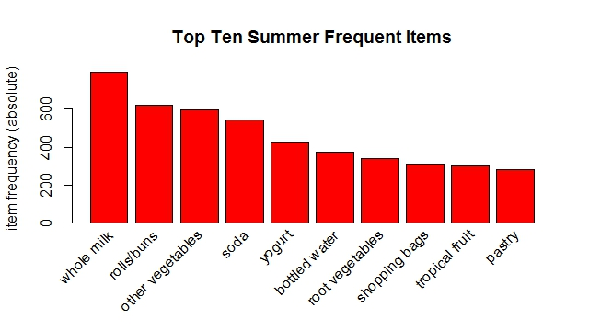
Summer Frequent Items

Slide 4
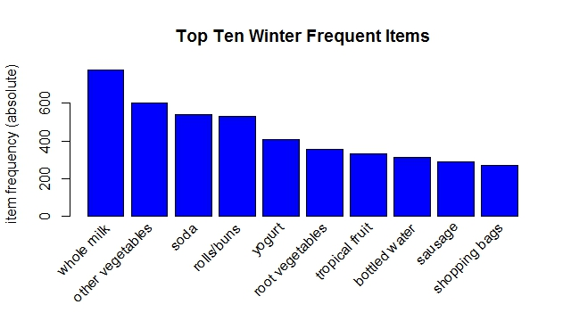
Winter Frequent Items

Slide 5
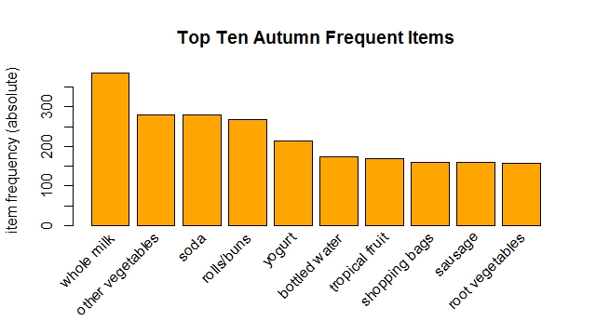
Autumn Frequent Items

Slide 6
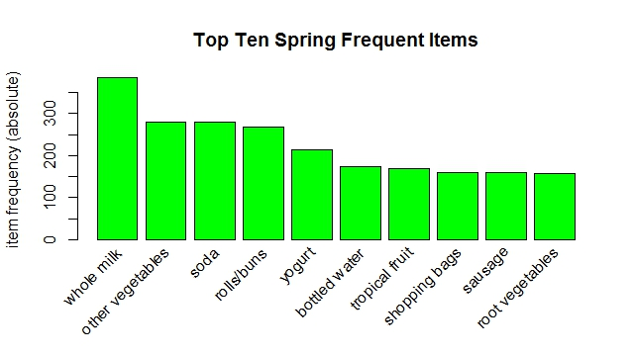
Spring Frequent Items

Slide 7
Question: Which of the products go with each other? Showing Five Rules from Summer Transactions
lhs rhs support confidence lift
1 {cereals} => {whole milk} 0.0045 0.88 3.4
2 {liquor, red/blush wine} => {bottled beer} 0.0016 0.83 10.5
3 {curd, curd cheese} => {other vegetables} 0.0013 1.00 5.2
4 {curd cheese, yogurt} => {other vegetables} 0.0013 1.00 5.2
5 {male cosmetics, yogurt} => {bottled water} 0.0013 0.80 6.6

Slide 8
Question: Which of the products go with each other? Showing Five Rules from Winter Transactions
lhs rhs support confidence lift
1 {honey} => {whole milk} 0.001 1 3.8
2 {organic products} => {other vegetables} 0.001 1 5.0
3 {frozen fruits, shopping bags} => {whipped/sour cream} 0.001 1 13.2
4 {frozen fruits ,
whipped/sour cream} => {shopping bags} 0.001 1 11.1
5 {frozen fruits, shopping bags} => {other vegetables} 0.001 1 5.0

Slide 9
Question: Which of the products go with each other? Showing Five Rules from Autumn Transactions
lhs rhs support confidence lift
1 {rubbing alcohol} => {whole milk} 0.0012 1.0 4.2
2 {brandy} => {root vegetables} 0.0012 1.0 10.3
3 {cocoa drinks} => {whole milk} 0.0012 1.0 4.2
4 {ready soups} => {rolls/buns} 0.0018 1.0 6.1
5 {tea} => {bottled beer} 0.0025 0.8 11.0

Slide 10
Question: Which of the products go with each other? Showing Five Rules from Spring Transactions
lhs rhs support confidence lift
1 {rubbing alcohol} => {whole milk} 0.0012 1.0 4.2
2 {brandy} => {root vegetables} 0.0012 1.0 10.3
3 {cocoa drinks} => {whole milk} 0.0012 1.0 4.2
4 {ready soups} => {rolls/buns} 0.0018 1.0 6.1
5 {tea} => {bottled beer} 0.0025 0.8 11.0

Slide 11
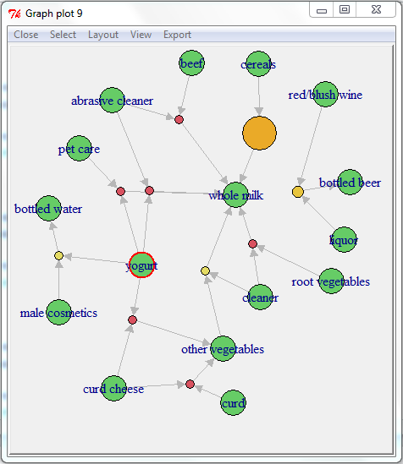
Summer Interactive Plot: Showing Ten Rules

Slide 12
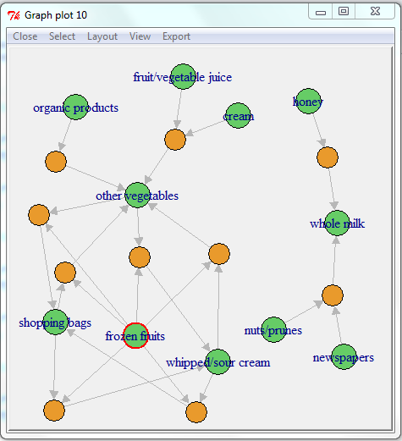
Winter Interactive Plot: Showing Ten Rules

Slide 13
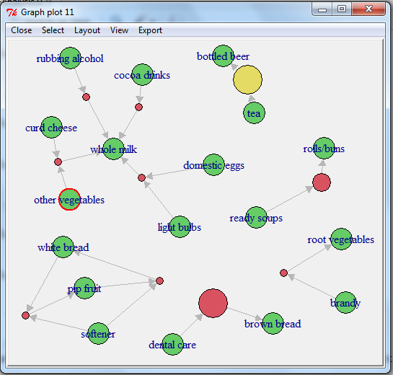
Autumn Interactive Plot: Showing Ten Rules

Slide 14
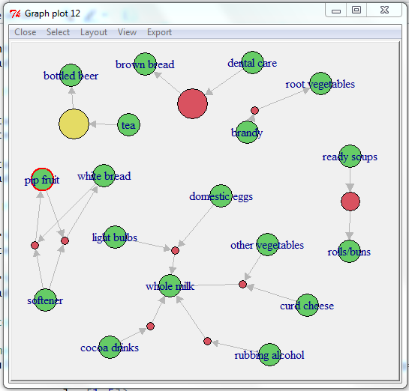
Spring Interactive Plot: Showing Ten Rules

Slide 15
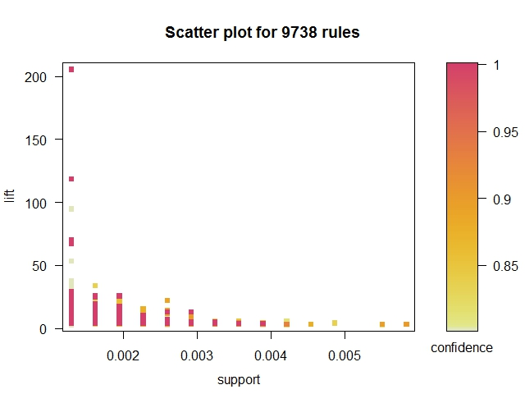
Summer Scatter Plot

Slide 16
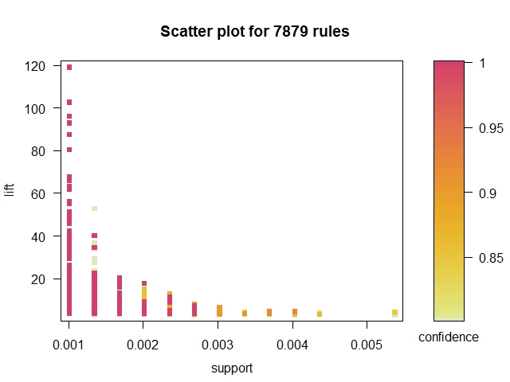
Winter Scatter Plot

Slide 17
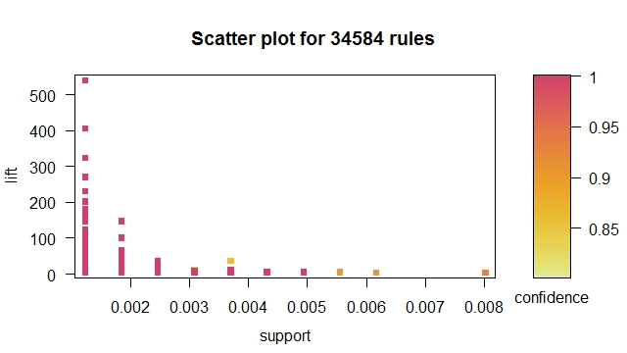
Autumn Scatter Plot

Slide 18
Spring Scatter Plot

Slide 19
What products are usually bought before a certain product? Results in Summer Transactions For “Event-X => Event-(Soda)”
lhs rhs support confidence lift
1 {red/blush wine, white bread} => {soda} 0.0013 1 5.7
2 {frankfurter, pot plants} => {soda} 0.0013 1 5.7
3 {chewing gum, shopping bags,
whole milk} => {soda} 0.0013 1 5.7
4 {ham, processed cheese,
whole milk} => {soda} 0.0013 1 5.7
5 {pastry, processed cheese,
white bread} => {soda} 0.0013 1 5.7

Slide 20
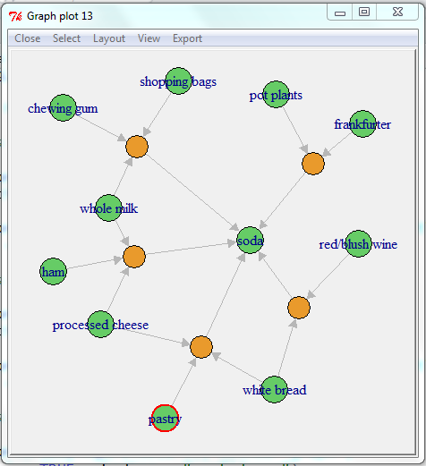
“Event-X => Event-(Soda)” in Summer Transactions Interactive Plot

Slide 21
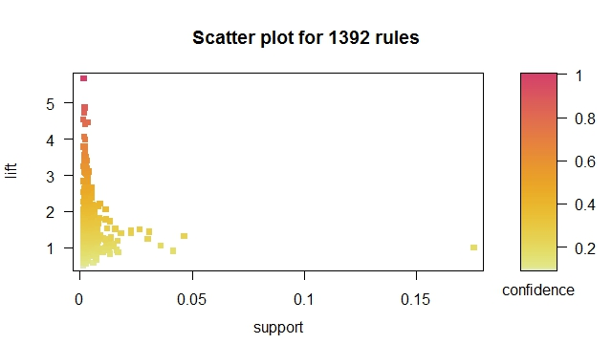
“Event-X => Event-(Soda)” in Summer Transactions Scatter Plot

Slide 22
What products are usually bought before a certain product? Results in Winter Transactions For “Event-X => Event-(whole milk)”
lhs rhs support confidence lift
1 {honey} => {whole milk} 0.001 1 3.8
2 {newspapers, nuts/prunes} => {whole milk} 0.001 1 3.8
3 {bottled water, cocoa drinks} => {whole milk} 0.001 1 3.8
4 {abrasive cleaner, butter} => {whole milk} 0.001 1 3.8
5 {abrasive cleaner,
root vegetables} => {whole milk} 0.001 1 3.8

Slide 23
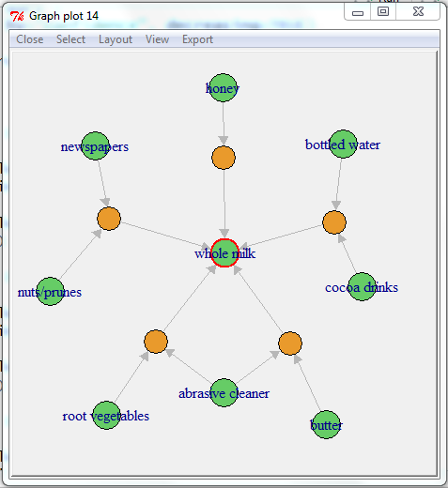
“Event-X => Event-(whole milk)” in Winter Transactions Interactive Plot

Slide 24
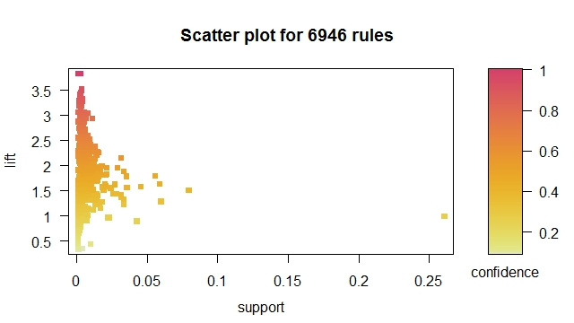
“Event-X => Event-(whole milk)” in Winter Transactions Scatter Plot

Slide 25
What products are usually bought before a certain product? Results in Autumn Transactions For “Event-X => Event-(Yogurt)”
lhs rhs support confidence lift
1 {rolls/buns, whole milk} => {yogurt} 0.015 0.32 2.4
2 {other vegetables,
whole milk} => {yogurt} 0.020 0.31 2.3
3 {newspapers} => {yogurt} 0.022 0.28 2.1
4 {tropical fruit} => {yogurt} 0.027 0.26 2.0
5 {citrus fruit} => {yogurt} 0.022 0.25 1.9

Slide 26
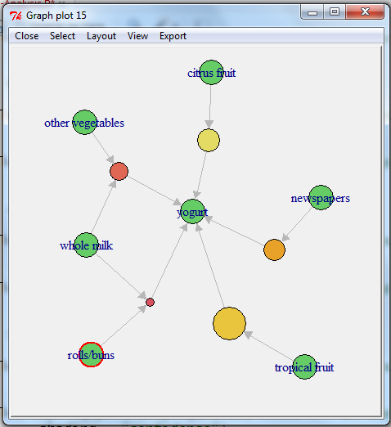
Event-X => Event-(yogurt)” in Autumn Transactions Interactive Plot

Slide 27
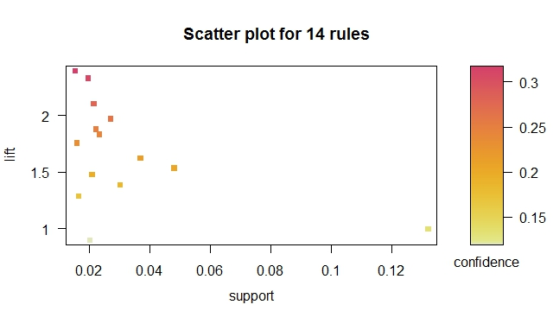
“Event-X => Event-(yogurt)” in Autumn Transactions Scatter Plot

Slide 28
What products are usually bought before a certain product? Results in Spring Transactions For “Event-X => Event-(rolls/buns)”
lhs rhs support confidence lift
1 {sausage} => {rolls/buns} 0.031 0.32 1.9
2 {whole milk, yogurt} => {rolls/buns} 0.015 0.32 1.9
3 {newspapers} => {rolls/buns} 0.018 0.24 1.4
4 {tropical fruit} => {rolls/buns} 0.024 0.23 1.4
5 {yogurt} => {rolls/buns} 0.030 0.23 1.4

Slide 29
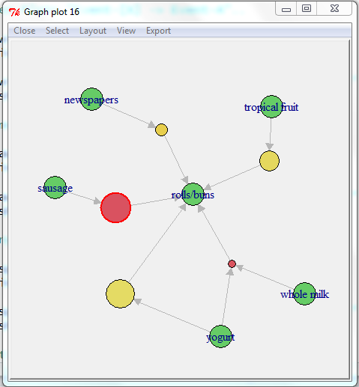
Event-X => Event-(roll/buns)” in Spring Transactions Interactive Plot

Slide 30
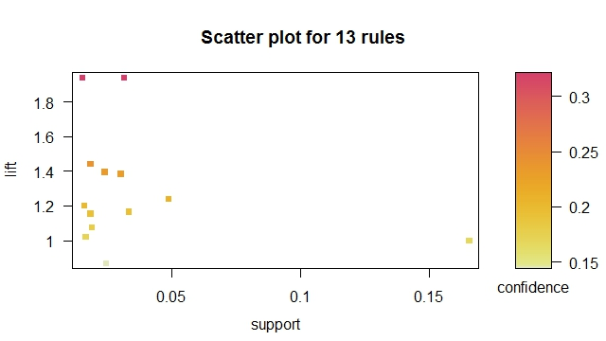
Event-X => Event-(roll/buns)” in Spring Transactions Scatter Plot

Slide 31
Question: What products customers usually buy after buying a certain product? Results in Summer Transactions For “Event-(Yogurt) => Event-X”
lhs rhs support confidence lift
1 {yogurt} => {whole milk} 0.058 0.42 1.6
2 {yogurt} => {other vegetables} 0.047 0.34 1.7
3 {yogurt} => {rolls/buns} 0.037 0.27 1.3
4 {yogurt} => {soda} 0.030 0.22 1.2
5 {yogurt} => {root vegetables} 0.029 0.21 1.9

Slide 32
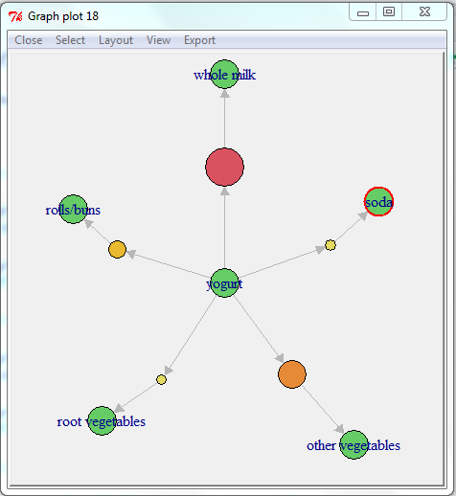
“Event-(Yogurt) => Event-X” in Summer Transactions Interactive Plot

Slide 33
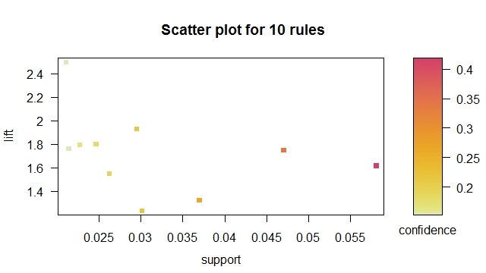
“Event-(Yogurt) => Event-X” in Summer Transactions Scatter Plot

Slide 34
Question: What products customers usually buy after buying a certain product? Results in Winter Transactions For “Event-(ready soups) => Event-X”
lhs rhs support confidence lift
1 {ready soups} => {whole milk} 0.001 0.6 2.3

Slide 35
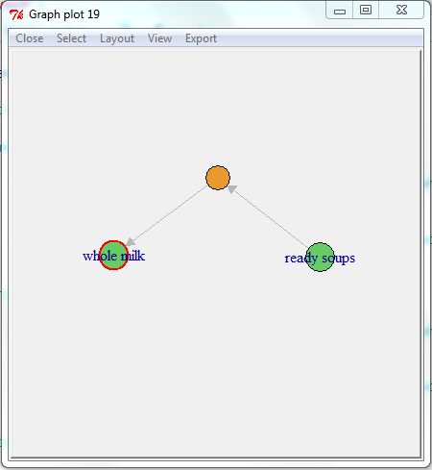
“Event-(ready soups) => Event-X” in Winter Transactions Interactive Plot

Slide 36
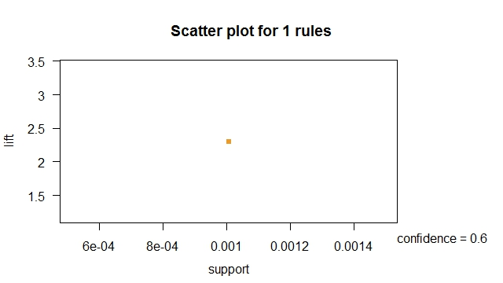
“Event-(ready soups) => Event-X” in Winter Transactions Scatter Plot

Slide 37
Question: What products customers usually buy after buying a certain product? Results in Autumn Transactions For “Event-(bottled beer) => Event-X”
lhs rhs support confidence lift
1 {bottled beer} => {whole milk} 0.017 0.23 0.96

Slide 38
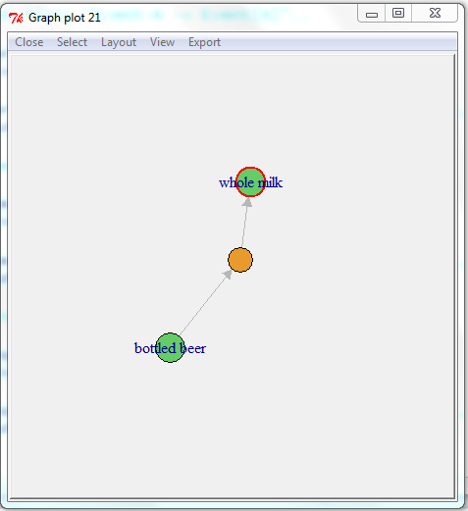
“Event-(bottled beer) => Event-X” in Autumn Transactions Interactive Plot

Slide 39
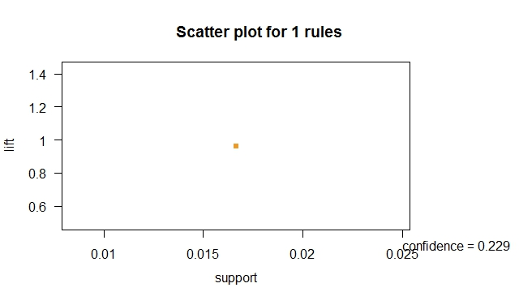
“Event-(bottled beer) => Event-X” in Autumn Transactions Scatter Plot

Slide 40
Question: What products customers usually buy after buying a certain product? Results in Spring Transactions For “Event-(brown bread) => Event-X”
lhs rhs support confidence lift
1 {brown bread} => {whole milk} 0.021 0.33 1.4

Slide 41
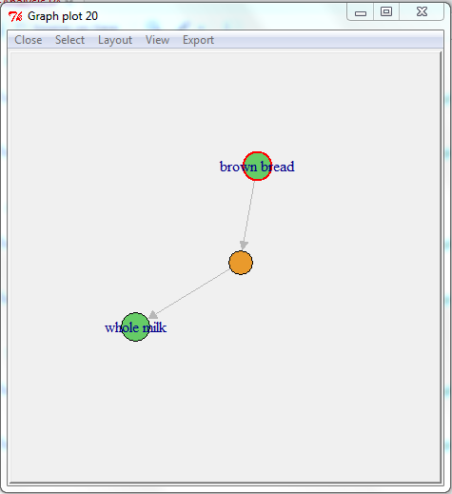
“Event-(brown bread) => Event-X” in Spring Transactions Interactive Plot

Slide 42
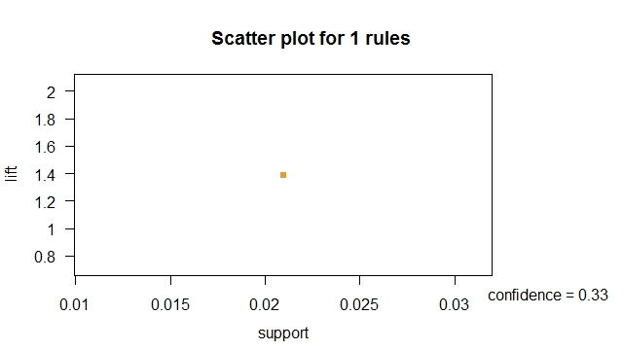
“Event-(brown bread) => Event-X” in Spring Transactions Scatter Plot

Slide 43
The End

