Slide 1
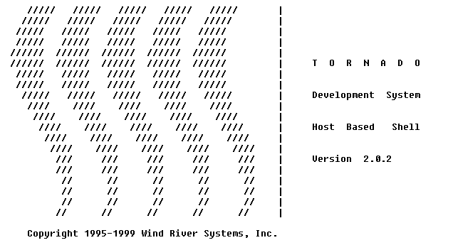
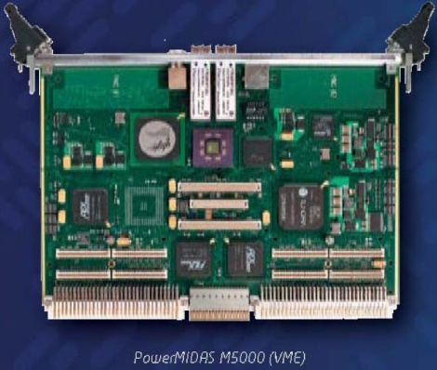
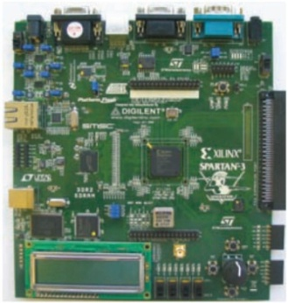
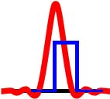
FYS 4220/9220 – 2012 / #3
Real Time and Embedded Data Systems and Computing
Real-Time Operating Systems
VxWorks in particular

Slide 2
What is a Real-Time Operating System (RTOS)?
In general, an operating system (OS) is responsible for managing the hardware resources of a computer and hosting applications that run on the computer. An RTOS performs these tasks, but is also specially designed to run applications with very precise timing and a high degree of reliability. This can be especially important in measurement and automation systems where downtime is costly or a program delay could cause a safety hazard.
To be considered "real-time", an operating system must have a known maximum time for each of the critical operations that it performs (or at least be able to guarantee that maximum most of the time). Some of these operations include OS calls and interrupt handling. Operating systems that can absolutely guarantee a maximum time for these operations are commonly referred to as "hard real-time", while operating systems that can only guarantee a maximum most of the time are referred to as "soft real-time”.
Text borrowed from http://www.ni.com/white-paper/3938/en .
Full white paper on file «2012-3_National_Instrument_RTOS_white_paper.pdf»
FYS4220/9220 - 2012 - Lecture #3

Slide 3
The holy grail of RTOS’s: correct timing:
If programmed correctly (!!), an RTOS can guarantee that a program will run with very consistent timing. Real-time operating systems do this by providing programmers with a high degree of control over how tasks are prioritized, and typically also allow checking to make sure that important deadlines are met. An example: the release of a car’s airbag
    In contrast to real-time operating systems, the most popular operating systems for personal computer use (such as Windows) are called general-purpose operating systems. While more in-depth technical information on how real-time operating systems differ from general-purpose operating systems is given in a section below, it is important to remember that there are advantages and disadvantages to both types of OS. Operating systems like Windows are designed to maintain user responsiveness with many programs and services running (ensuring "fairness"), while real-time operating systems are designed to run critical applications reliably and with precise timing (paying attention to the programmer's priorities).
FYS4220/9220 - 2012 - Lecture #3

Slide 4
RTOS: Important Terminology and Concepts
Determinism: An application (or critical piece of an application) that runs on a hard real-time operating system is referred to as deterministic if its timing can be guaranteed within a certain margin of error.
Soft vs Hard Real-Time: An OS that can absolutely guarantee a maximum time for the operations it performs is referred to as hard real-time. In contrast, an OS that can usually perform operations in a certain time is referred to as soft real-time.
Jitter: The amount of error in the timing of a task over subsequent iterations of a program or loop is referred to as jitter. Real-time operating systems are optimized to provide a low amount of jitter when programmed correctly; a task will take very close to the same amount of time to execute each time it is run.
FYS4220/9220 - 2012 - Lecture #3

Slide 5
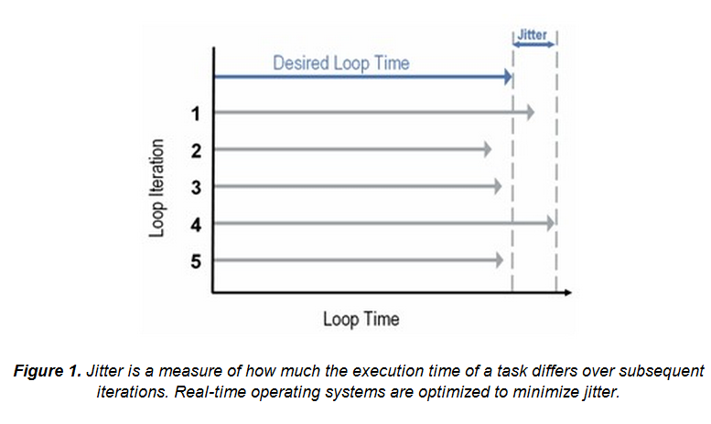
RTOS: Jitter in a control loop
FYS4220/9220 - 2012 - Lecture #3

Slide 6
RTOS: setting Priorities (1)
When programming an application, most operating systems (of any type) allow the programmer to specify a priority for the overall application and even for different tasks within the application (threads). These priorities serve as a signal to the OS, dictating which operations the designer feels are most important. The goal is that if two or more tasks are ready to run at the same time, the OS will run the task with the higher priority.
In practice, general-purpose operating systems do not always follow these programmed priorities strictly. Because general-purpose operating systems are optimized to run a variety of applications and processes simultaneously, they typically work to make sure that all tasks receive at least some processing time. As a result, low-priority tasks may in some cases have their priority boosted above other higher priority tasks. This ensures some amount of run-time for each task, but means that the designer's wishes are not always followed.
FYS4220/9220 - 2012 - Lecture #3

Slide 7
RTOS: setting Priorities (2)
In contrast to (GPOS), real-time operating systems follow the programmer's priorities much more strictly. On most real-time operating systems, if a high priority task is using 100% of the processor, no other lower priority tasks will run until the high priority task finishes. Therefore, real-time system designers must program their applications carefully with priorities in mind.
In a typical real-time application, a designer will place time-critical code (e.g. event response or control code) in one section with a very high priority. Other less-important code such as logging to disk or network communication may be combined in a section with a lower priority.
FYS4220/9220 - 2012 - Lecture #3

Slide 8
RTOS: Interrupt Latency
Interrupt latency is measured as the amount of time between when a device generates an interrupt and when that device is serviced. While general-purpose operating systems may take a variable amount of time to respond to a given interrupt, real-time operating systems must guarantee that all interrupts will be serviced within a certain maximum amount of time. In other words, the interrupt latency of real-time operating systems must be bounded.
The latency comprises two deterministic components and at least two non-deterministic:
Deterministic:
  Hardware switching and entering the Interrupt handler
  Execution of handler code. While the execution time depends on the number of instructions, the time in a specific handler is constant (if it is not interrupted!)
Non-deterministic
  An interrupt will not be served is i) the interrupt system is disabled (permitted by a RTOS) or ii) during servicing of an interrupt with higher hardware priority.
FYS4220/9220 - 2012 - Lecture #3

Slide 9
RTOS: Performance
One common misconception is that real-time operating systems have better performance than other general-purpose operating systems. While real-time operating systems may provide better performance in some cases due to less multitasking between applications and services, this is not a rule. Actual application performance will depend on CPU speed, memory architecture, program characteristics, and more.
Though real-time operating systems may or may not increase the speed of execution, they can provide much more precise and predictable timing characteristics than general-purpose operating systems.
FYS4220/9220 - 2012 - Lecture #3

Slide 10
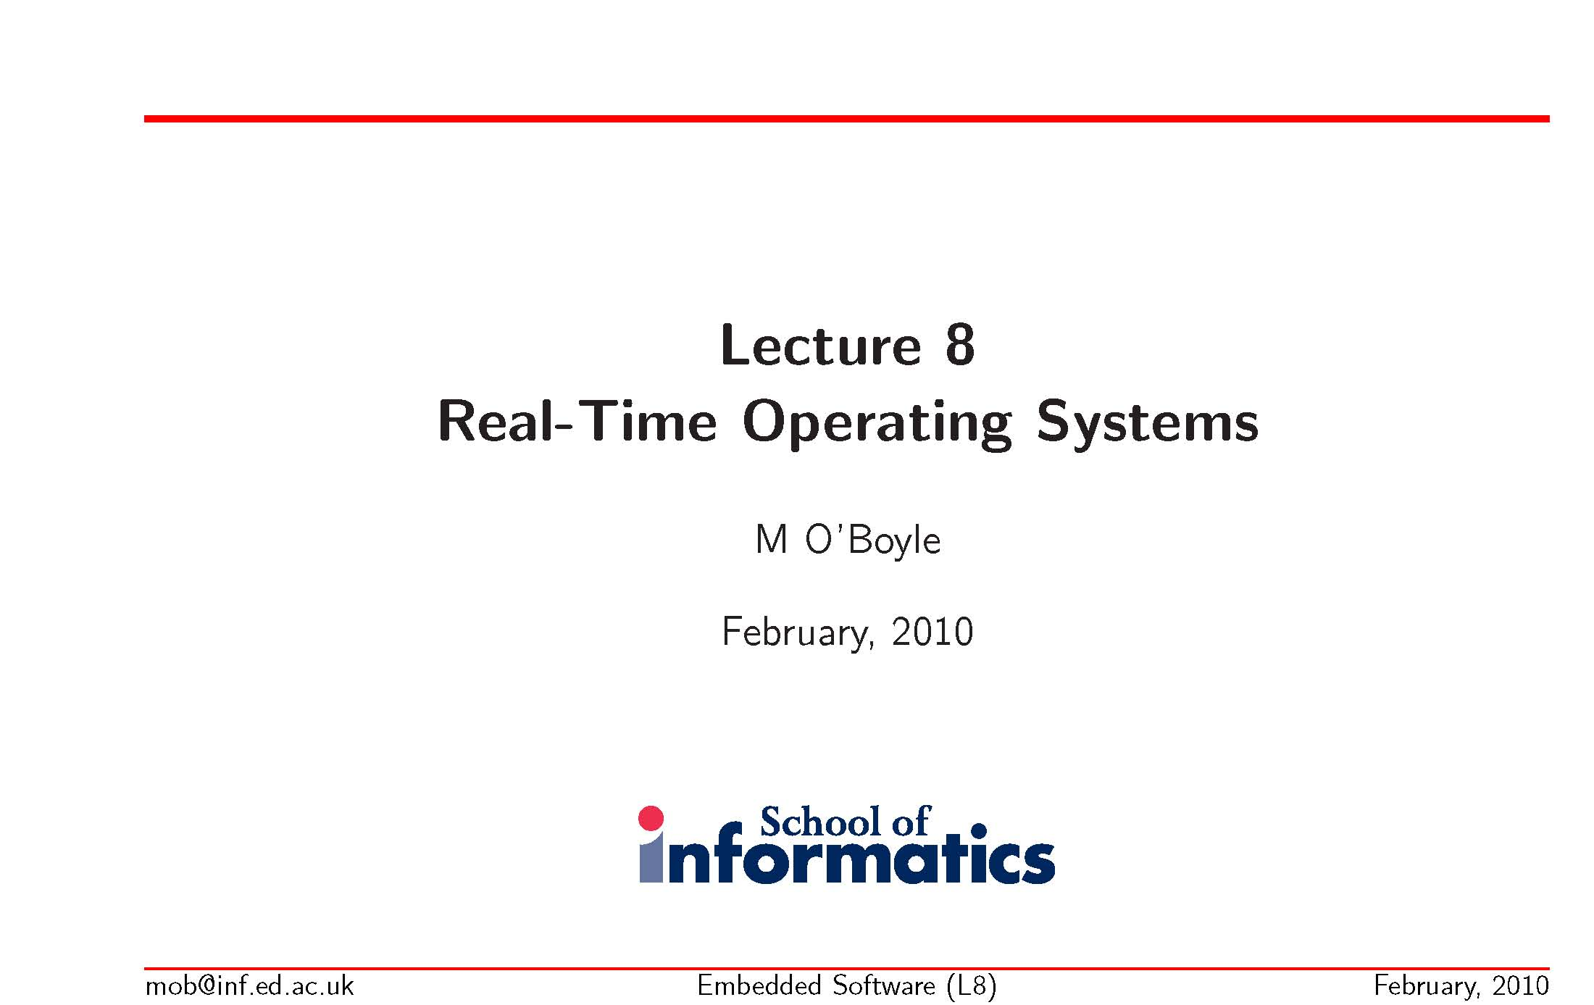
  School of Informatics, University of Edinburgh.
  Prof. Michael O’Boyle, director of Institute for Computing Systems
FYS4220/9220 - 2012 - Lecture #3

Slide 11
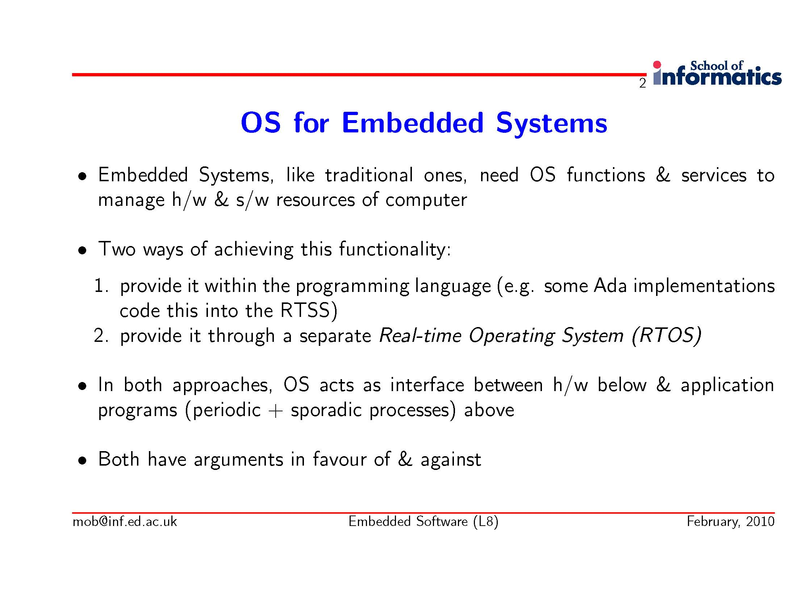
FYS4220/9220 - 2012 - Lecture #3

Slide 12
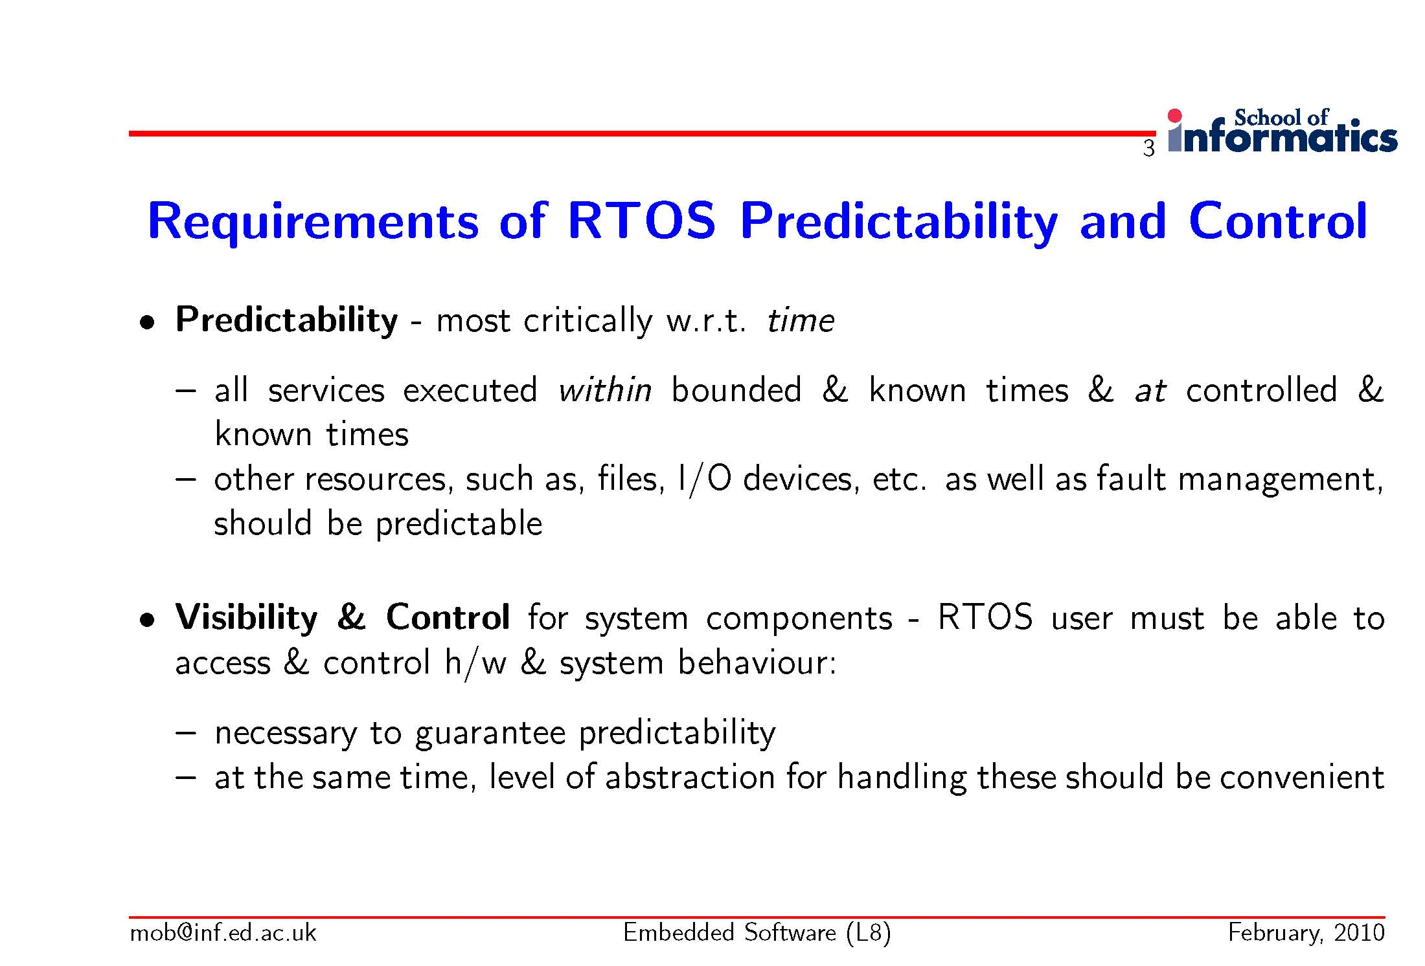
FYS4220/9220 - 2012 - Lecture #3

Slide 13
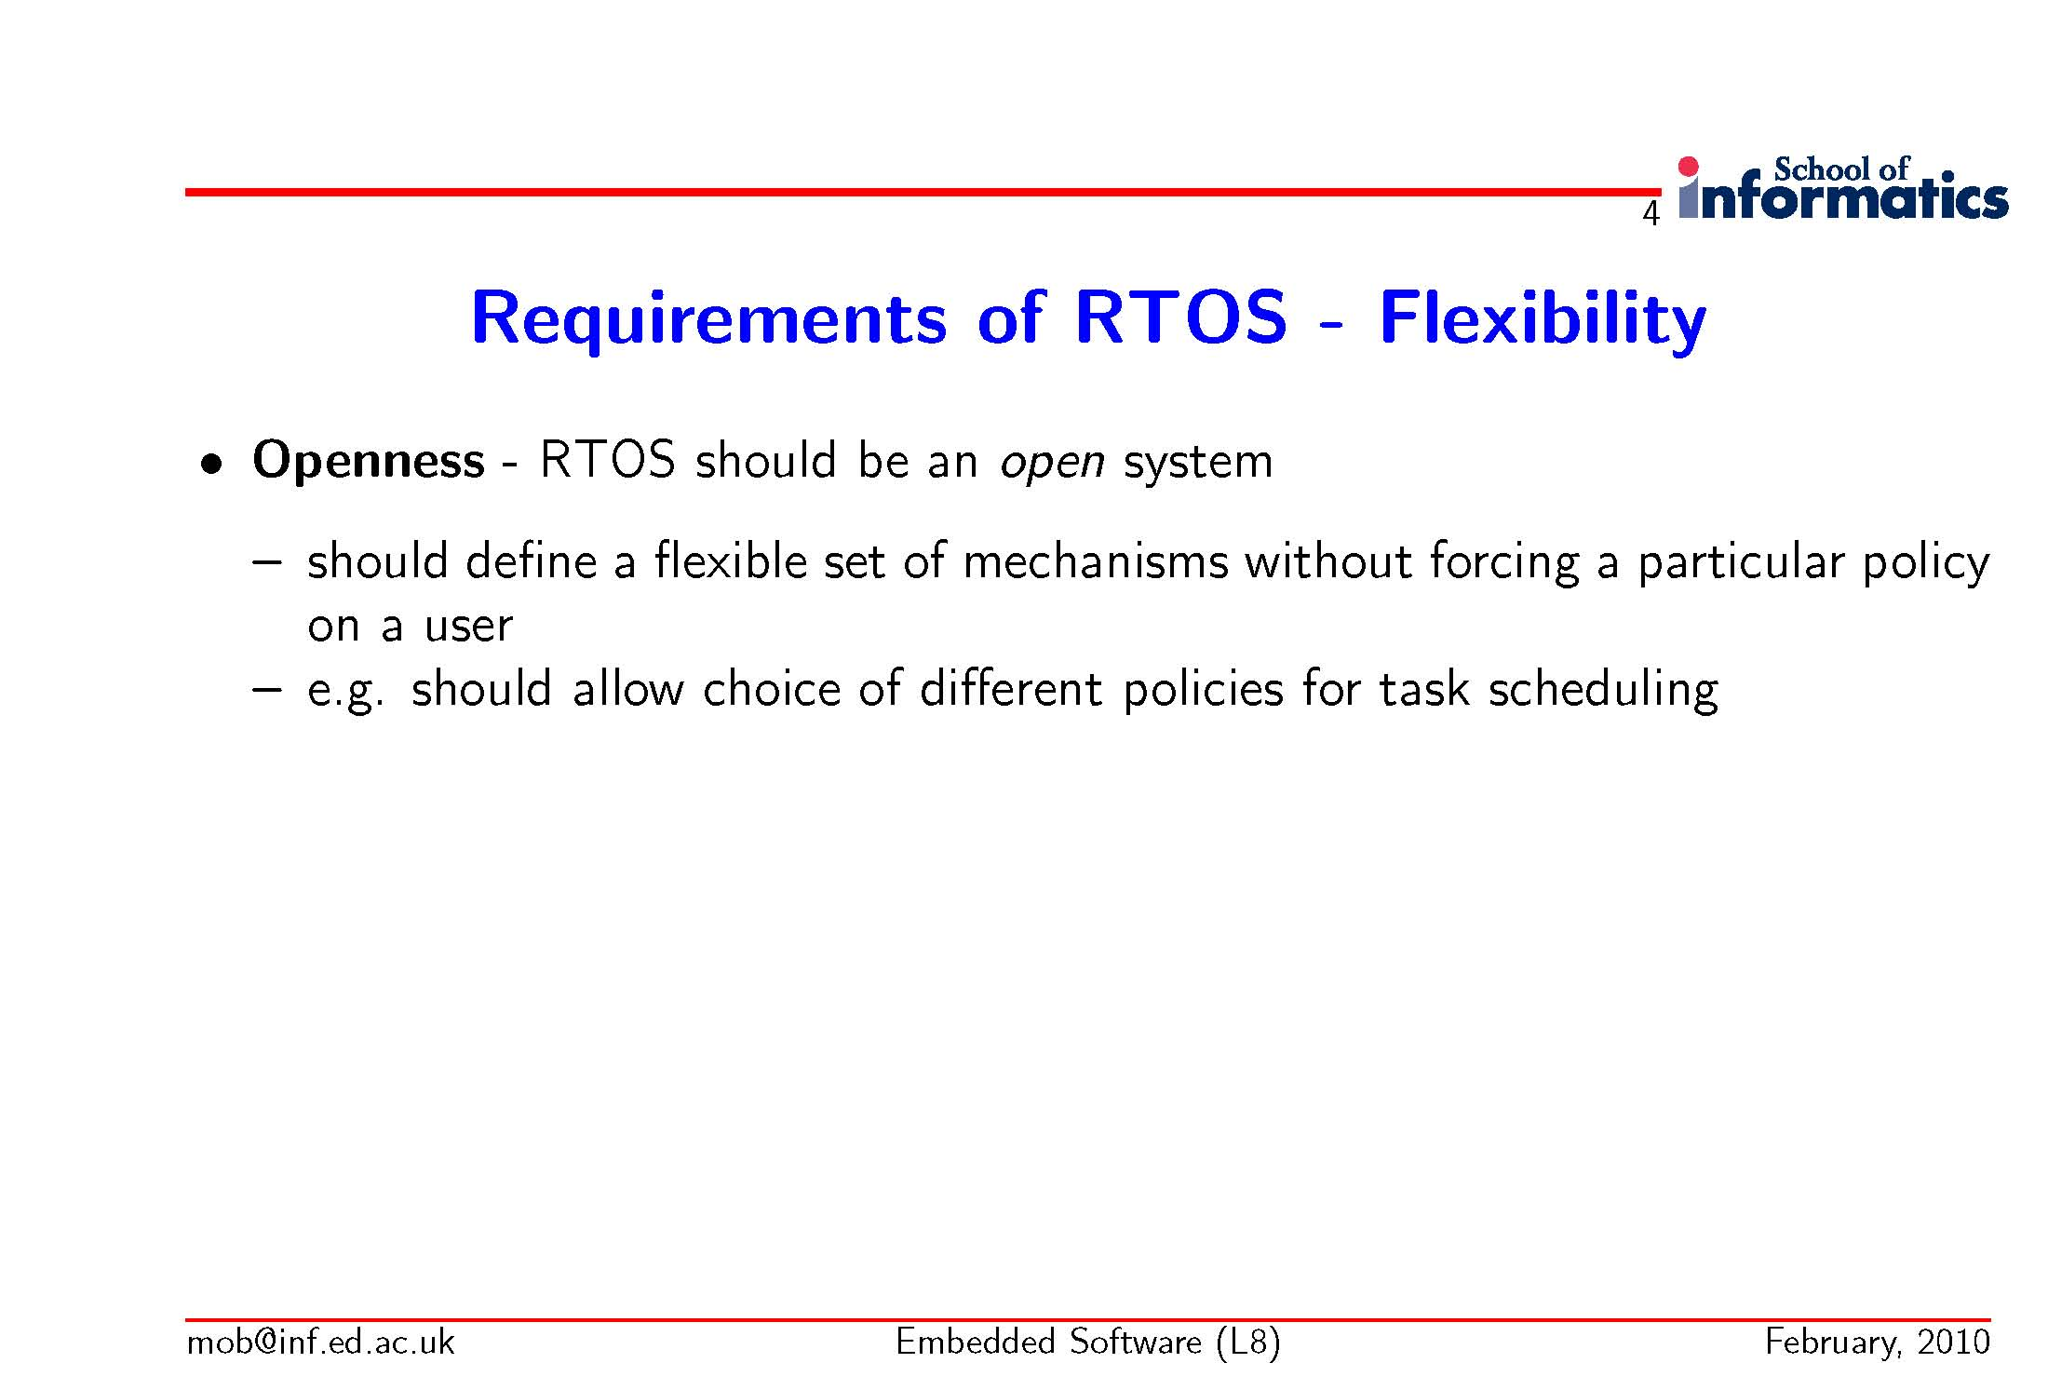
FYS4220/9220 - 2012 - Lecture #3

Slide 14
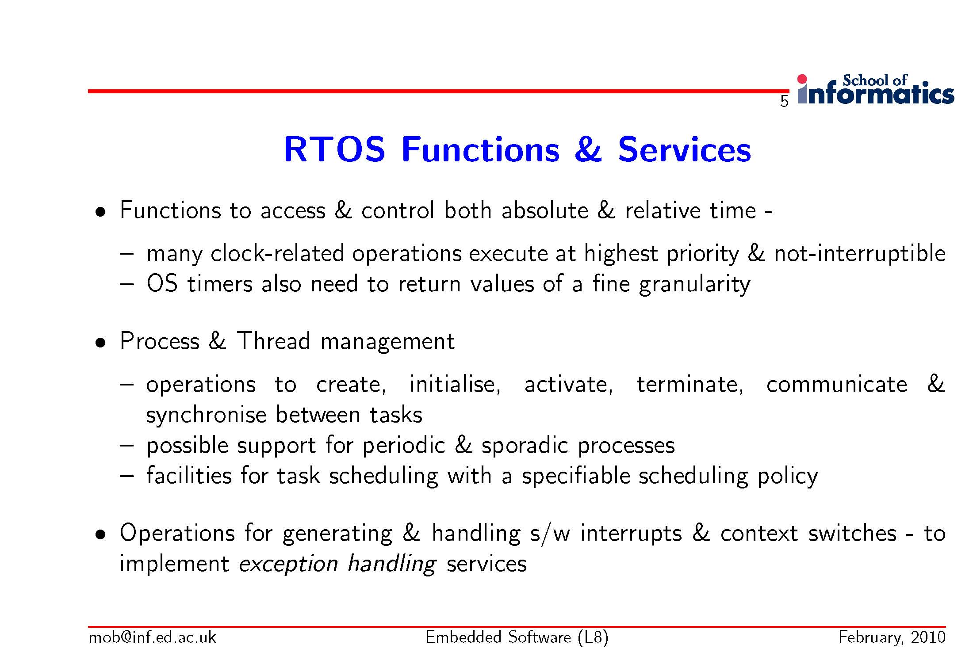
FYS4220/9220 - 2012 - Lecture #3

Slide 15
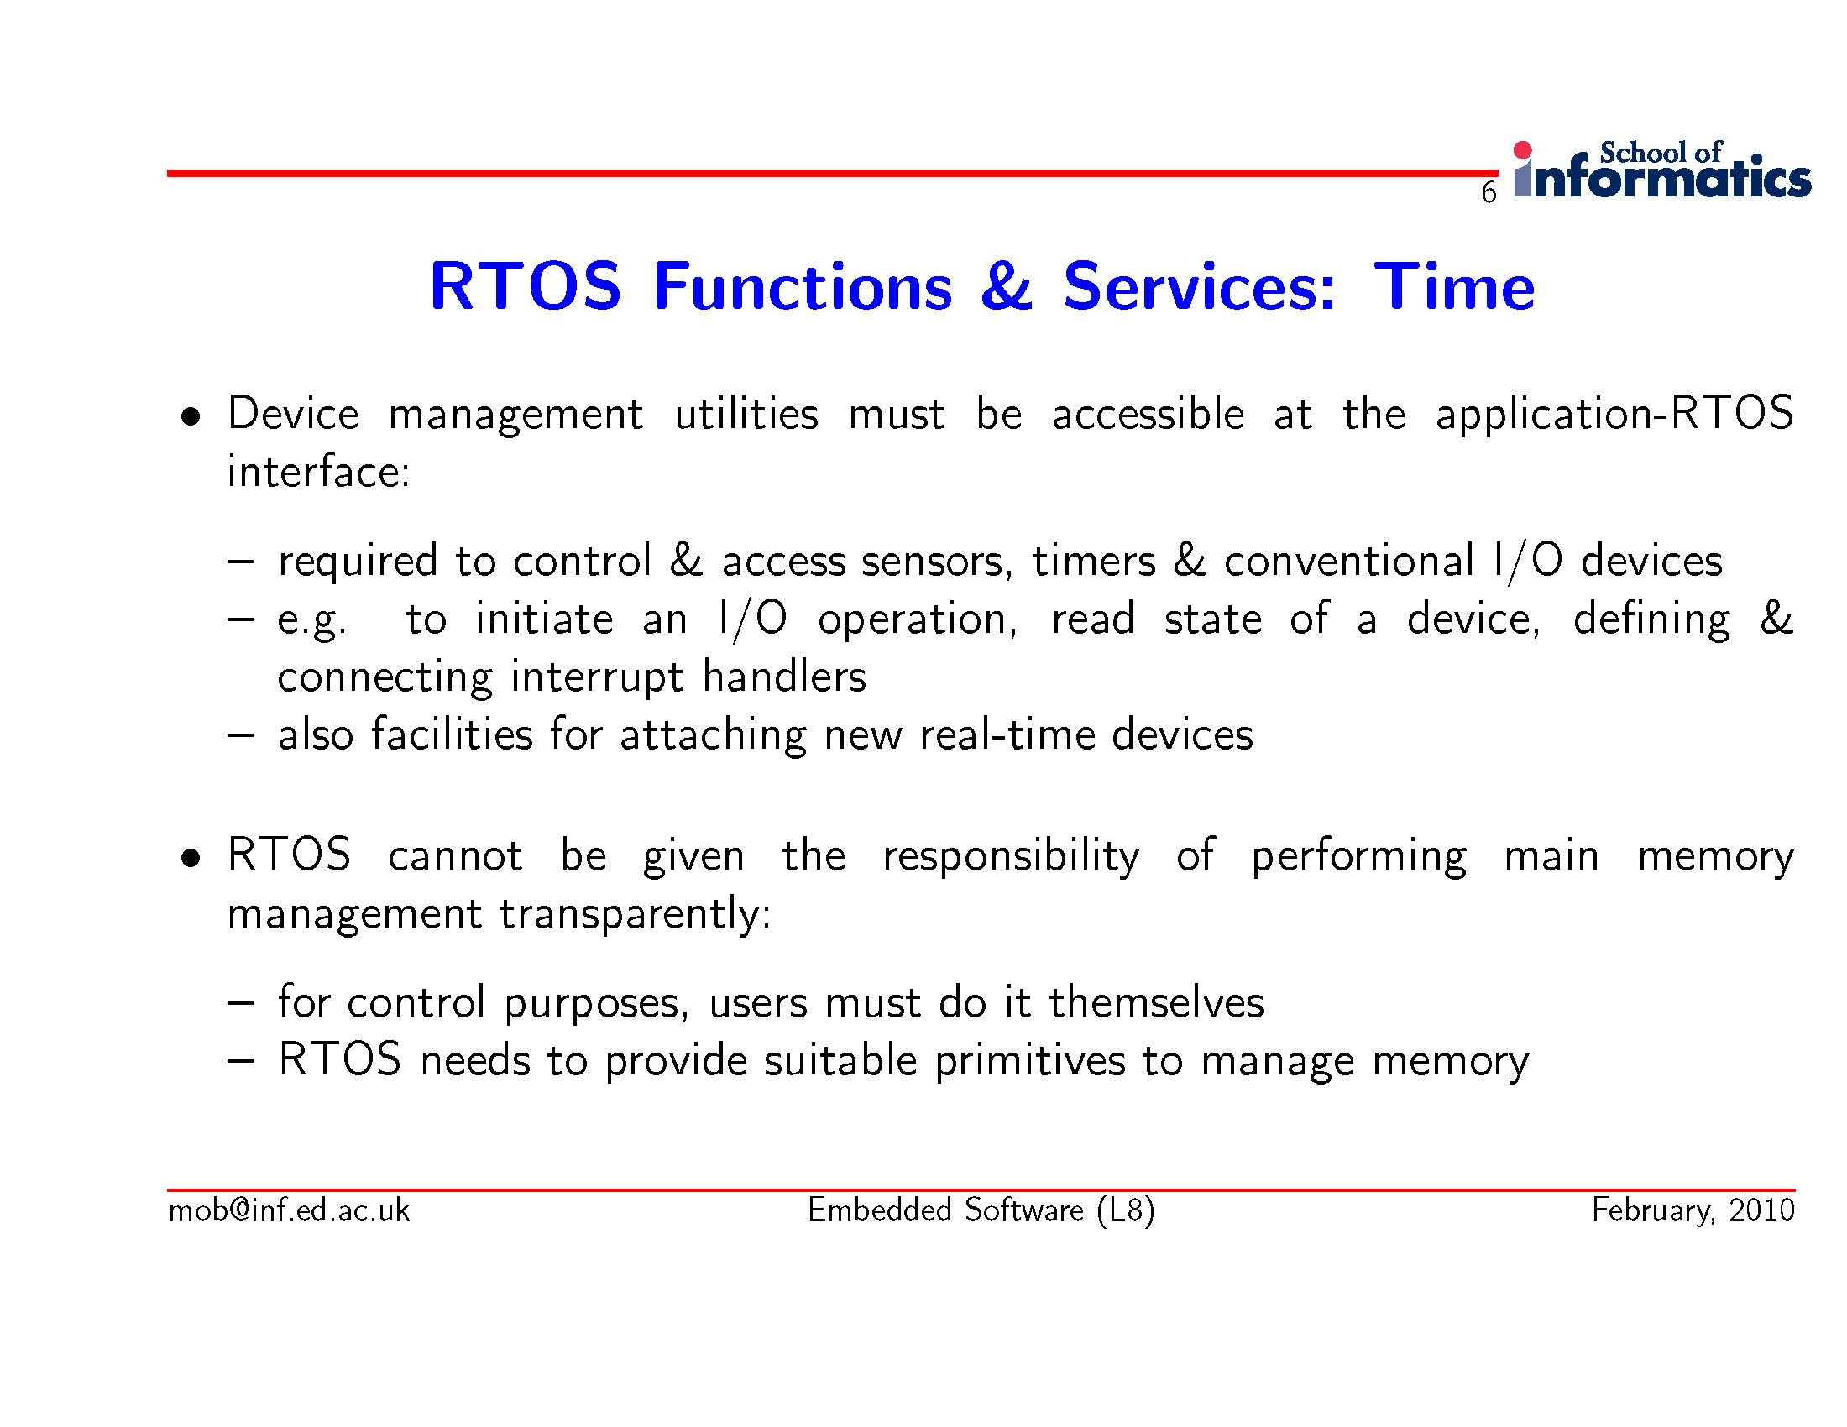
FYS4220/9220 - 2012 - Lecture #3

Slide 16
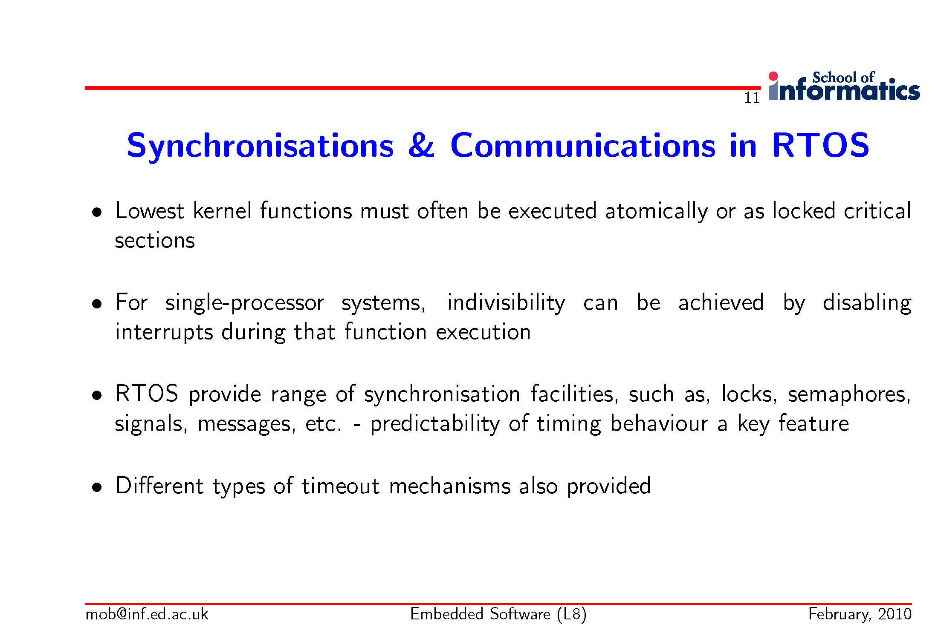
FYS4220/9220 - 2012 - Lecture #3

Slide 17
Additional wish-list for RTOS’s
The possibility of building user specific RT kernels to match the wide range of processing machines for RT/Embedded, from microcontrollers and soft core processors to large distributed systems
Quality assured
An excellent Development Environment
Debugging and test tools
RTOS support of that particular computer architecture you want to use
  See following pages
Portability, that is, POSIX compliant
And of course, ”at the end of the day”, the price is important!
FYS4220/9220 - 2012 - Lecture #3

Slide 18
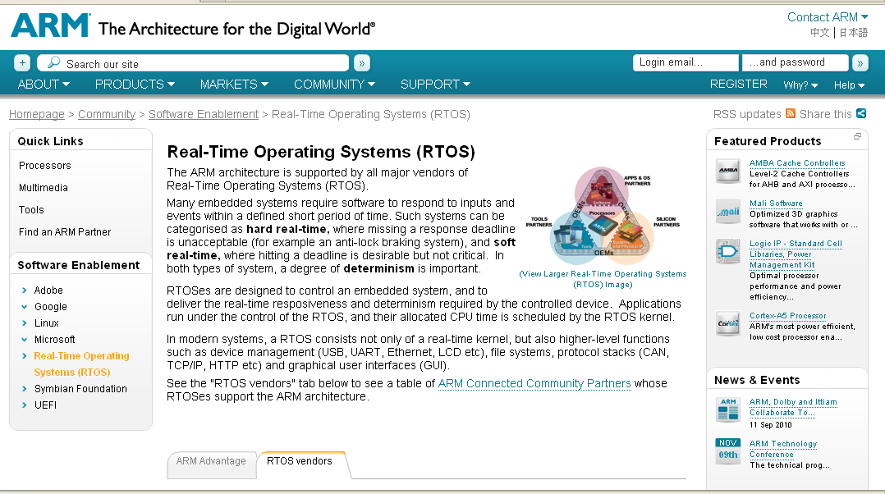
FYS4220/9220 - 2012 - Lecture #3

Slide 19
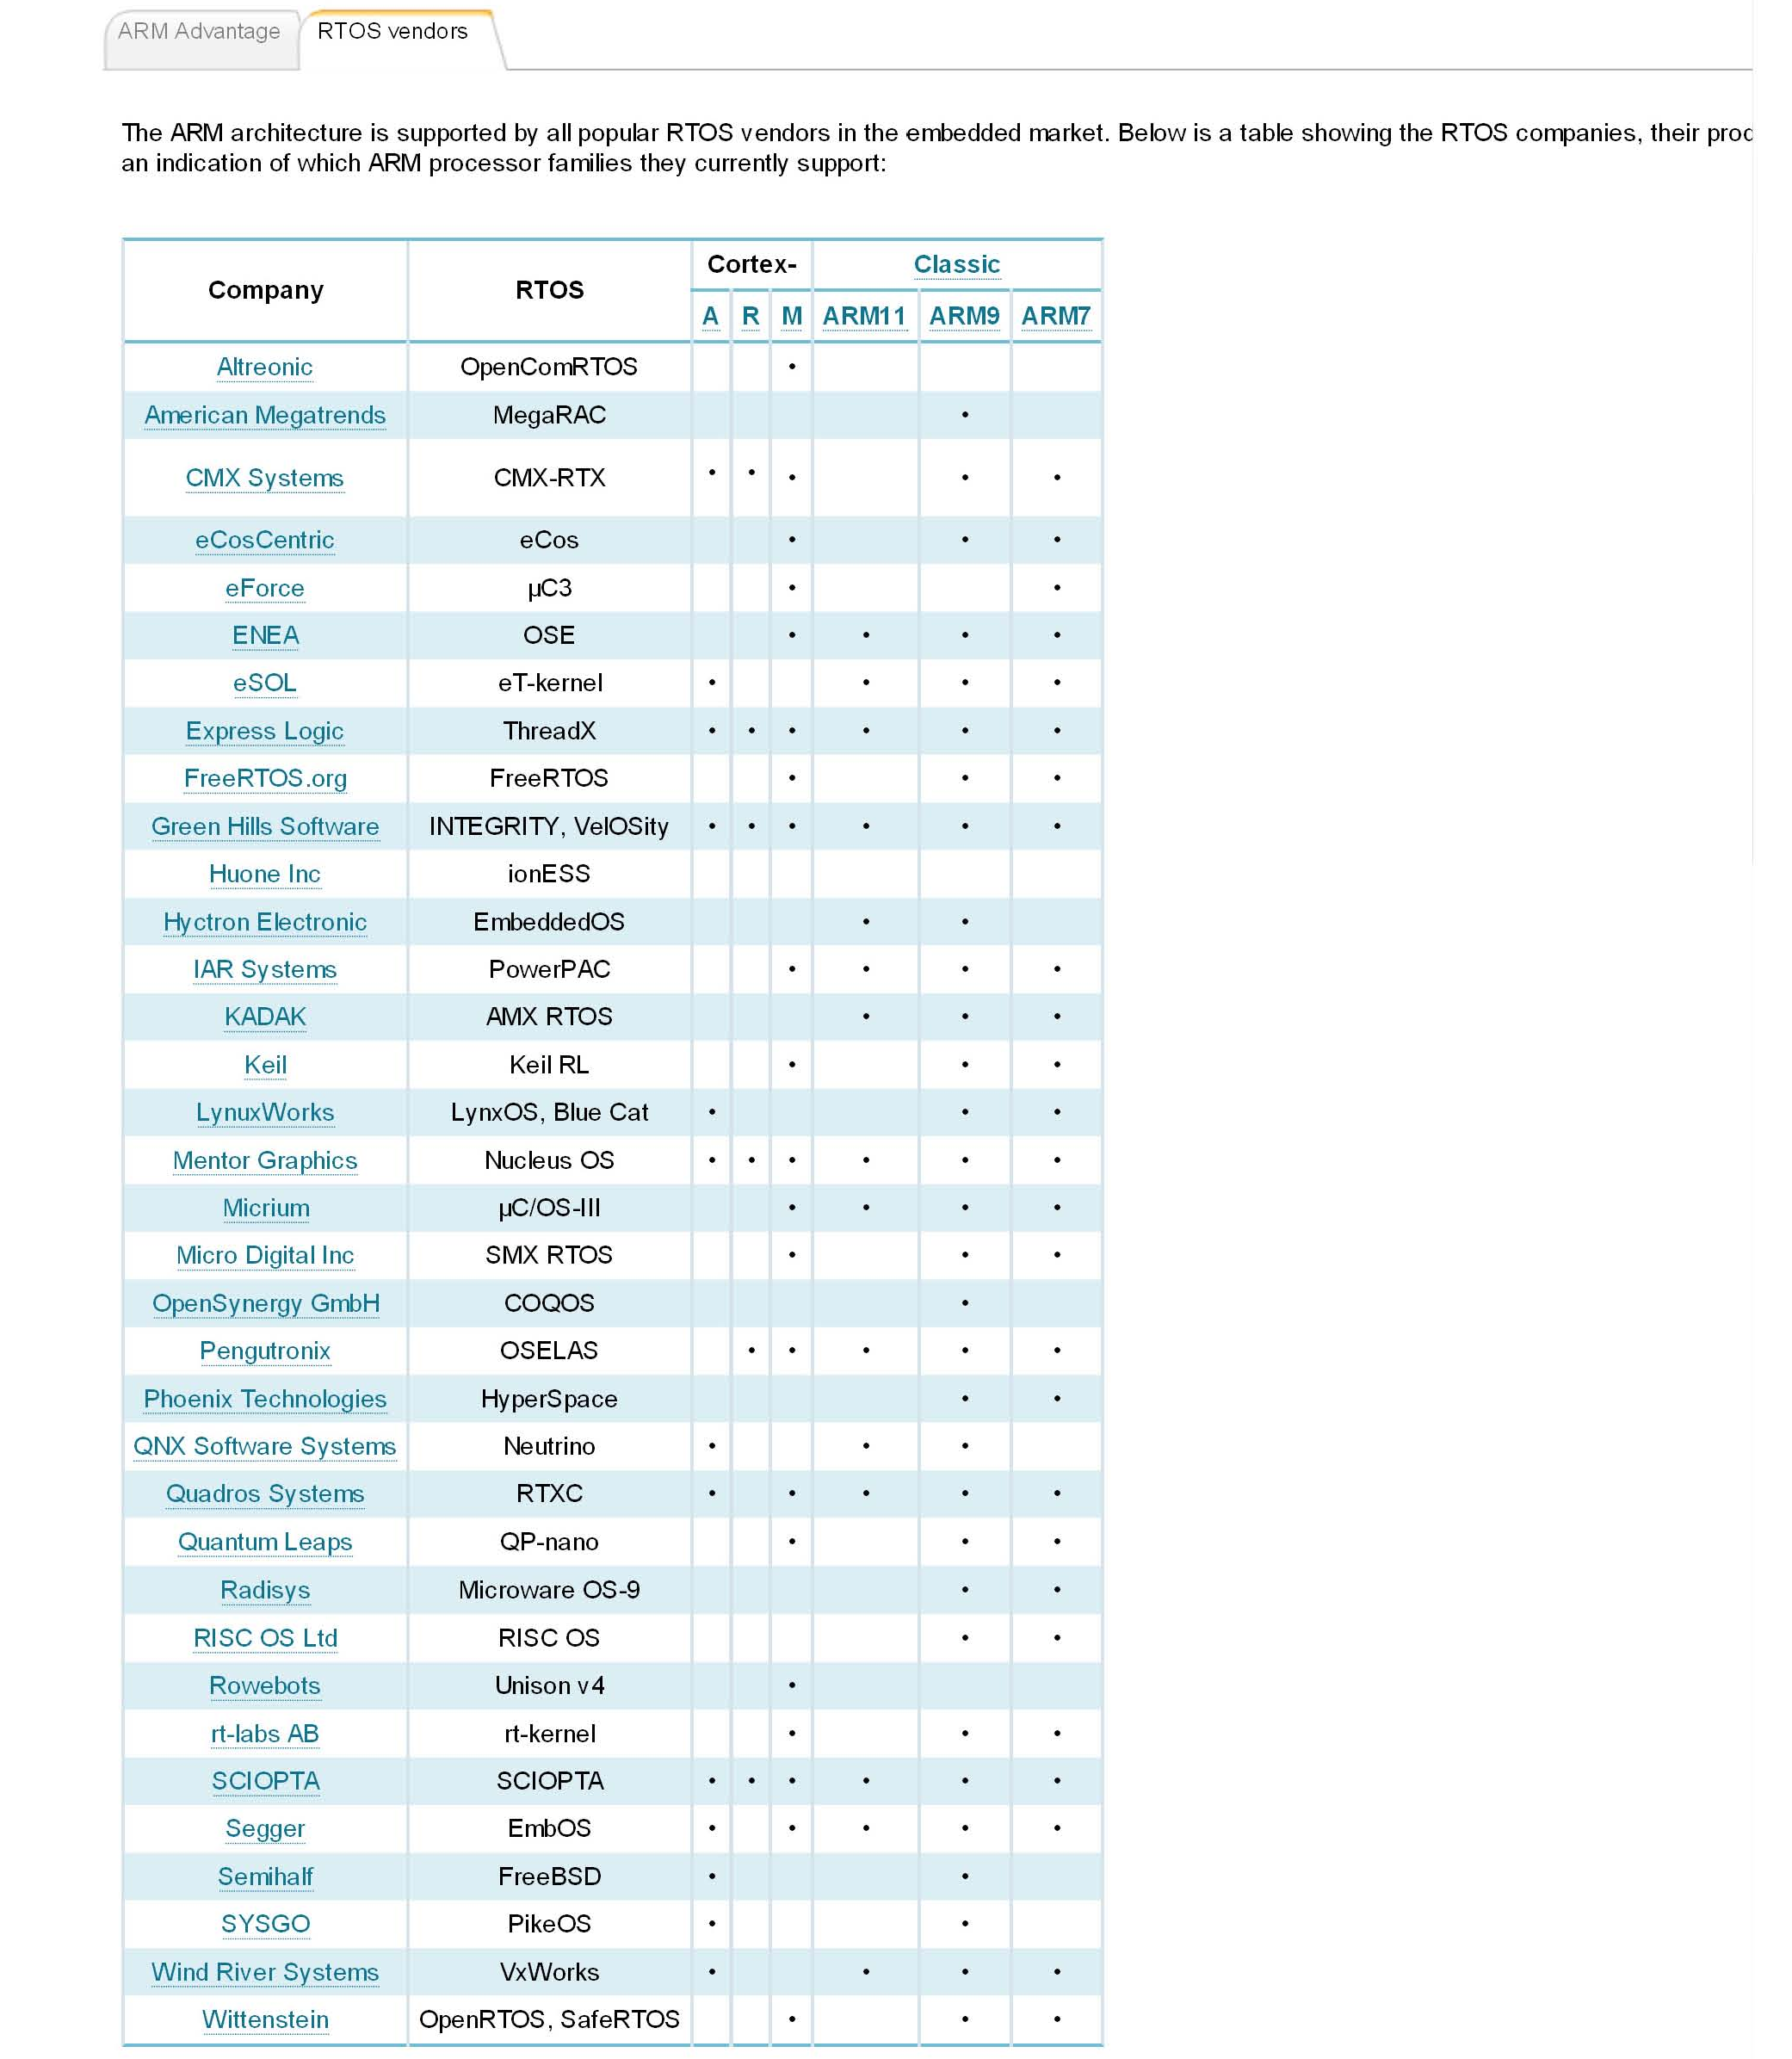
Real-Time OS for the ARM architecture
FYS4220/9220 - 2012 - Lecture #3

Slide 20
The NIOS II soft core embedded processor
Nios II is a 32-bit embedded-processor architecture designed specifically for the Altera family of FPGAs
Nios II is comparable to MicroBlaze, a competing softcore CPU for the Xilinx family of FPGA
Key features:
  the Nios II architecture is a RISC soft-core architecture which is implemented entirely in the programmable logic and memory blocks of Altera FPGAs. The soft-core nature of the Nios II processor lets the system designer specify and generate a custom Nios II core, tailored for his or her specific application requirements
  By using custom instructions, the system designers can fine-tune the system hardware to meet performance goals and also the designer can easily handle the instruction as a macro in C/C++
  Introduced with Quartus 8.0, the optional MMU enables Nios II to run operating systems which require hardware-based paging and protection, such as the Linux kernel. Without an MMU, Nios is restricted to operating systems which use a simplified protection and virtual memory-model: e.g., µClinux and FreeRTOS
  http://www.altera.com/products/ip/processors/nios2/tools/ni2-development_tools.html

Slide 21
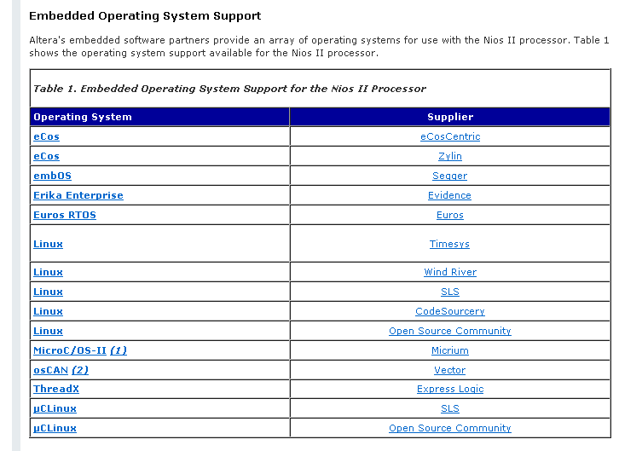
NIOS II embedded Operating system support

Slide 22
Choice of OS for the Real-Time lab exercises
Why use VxWorks
  VxWorks from Wind River is an industry leader in Real-Time systems
  It offers a very wide choice of software components (system calls)
  Based on host – target configuration. The development and cross compilation are done on a host computer, typically a PC. The excutable code is downloaded to the target processor and linked with the target resident (mini)kernel
  Excellent Development Environment based on the Eclipse Platform.
    The Eclipse Platform is an open and extensible platform.
  However, VxWorks is a rather expensive solution, however, free as a Universty program
  Very good tech support in my experience
  For more info on Wind River products, see http://www.windriver.com/
  However, nobody is perfect, see next two pages page
VxWorks Application Programmers Guide
  Selected sections presented in the following
    The VxWorks-6.2_Application_Programmers Guide can be downloaded from FYS 4220 home page
  However, the perfect system does not exist, see following pages
FYS4220/9220 - 2012 - Lecture #3

Slide 23
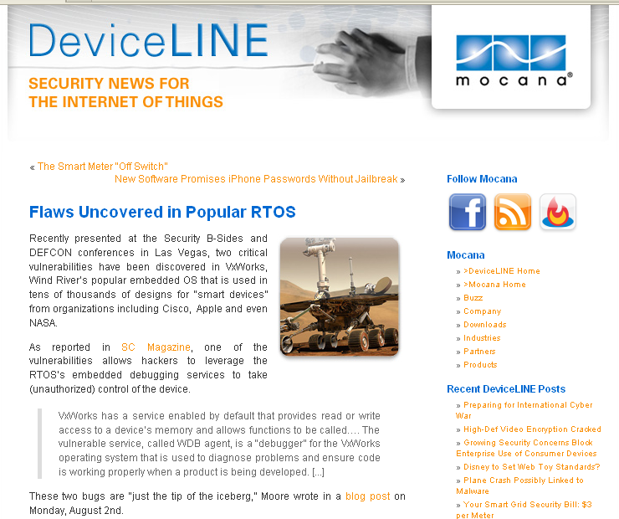
2010
FYS4220/9220 - 2012 - Lecture #3

Slide 24
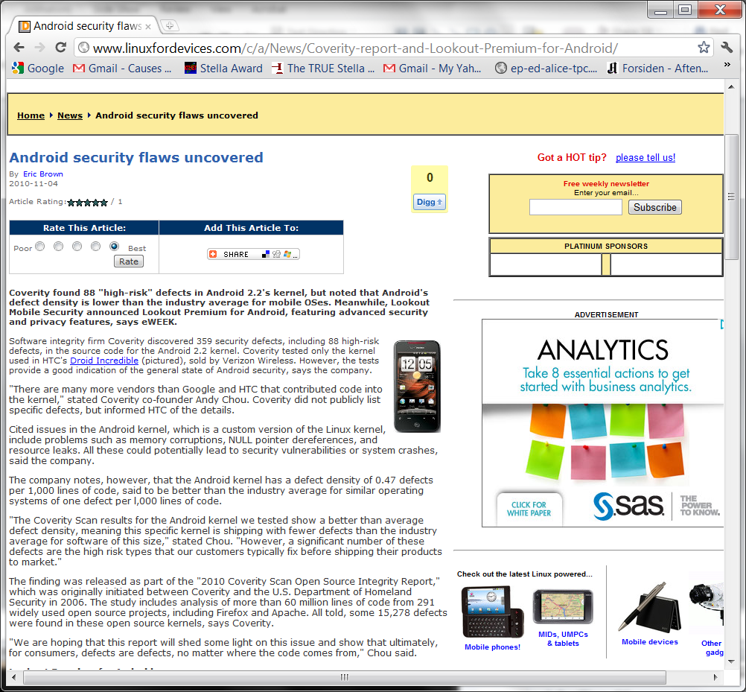
FYS4220/9220 - 2012 - Lecture #3

Slide 25
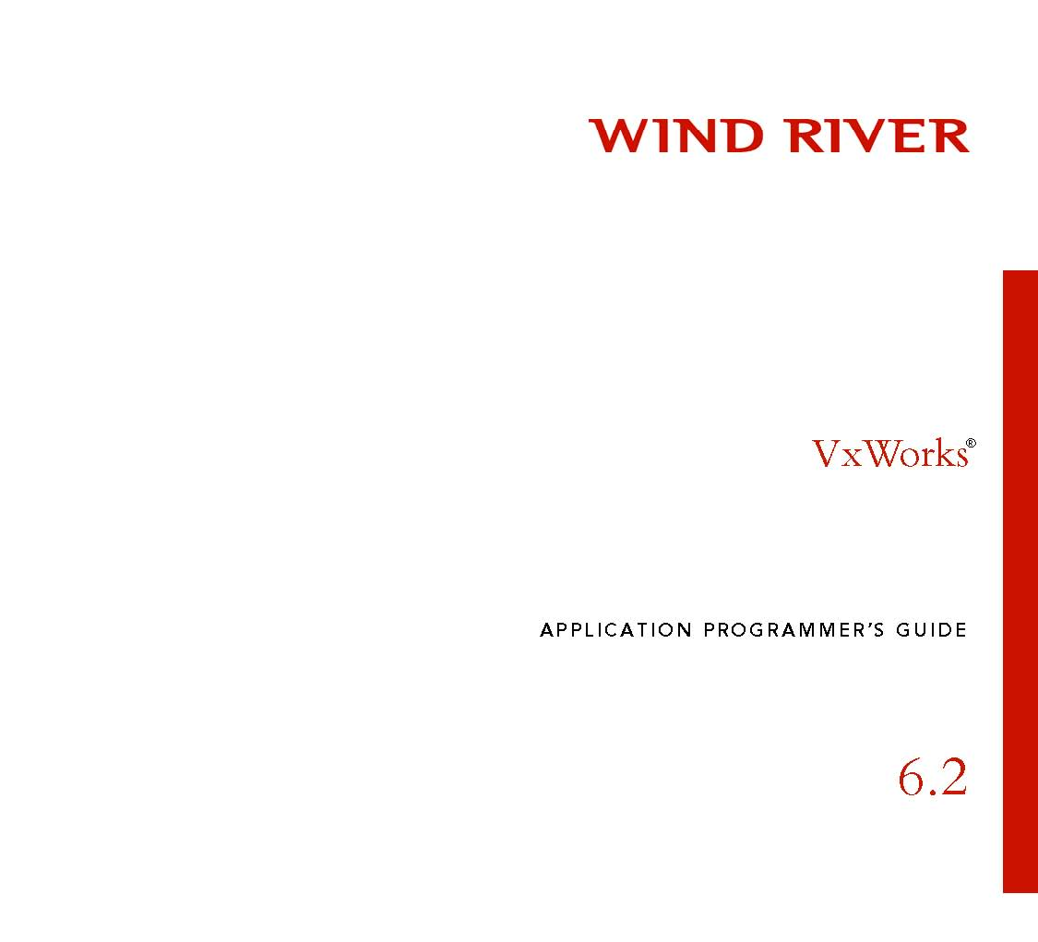
Note! This release of VxWorks runs under Workbench Development platform. An earlier release of VxWorks is also installed in the FYS4220 lab, and runs under the Tornado Development platform
FYS4220/9220 - 2012 - Lecture #3

