Slide 1
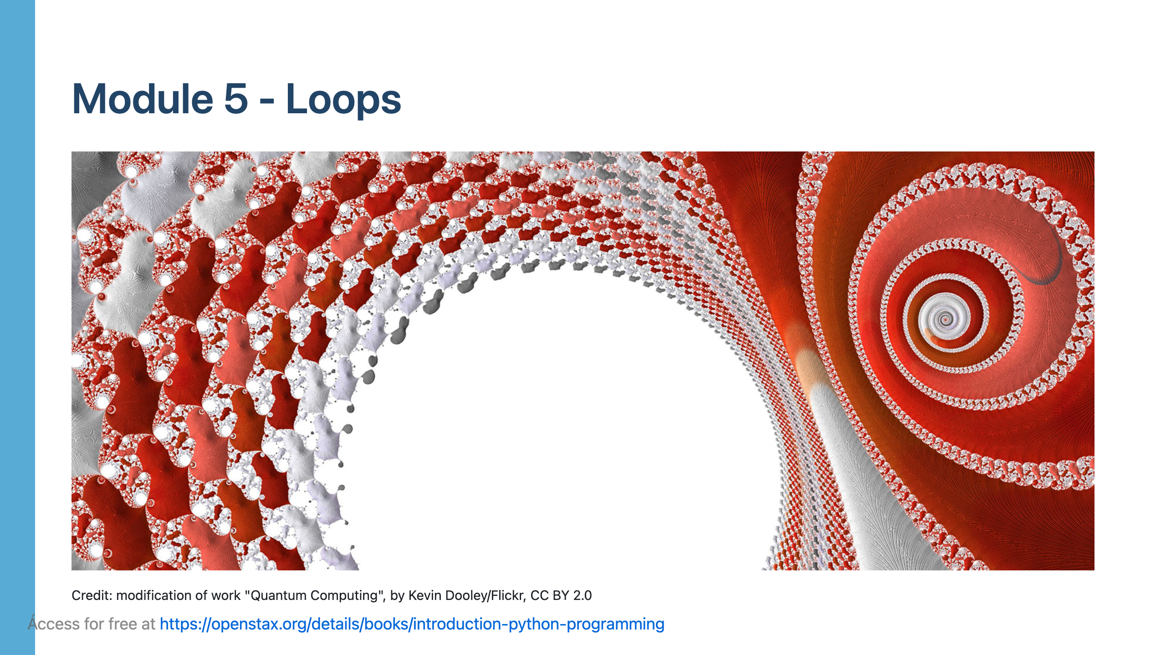

Slide 2
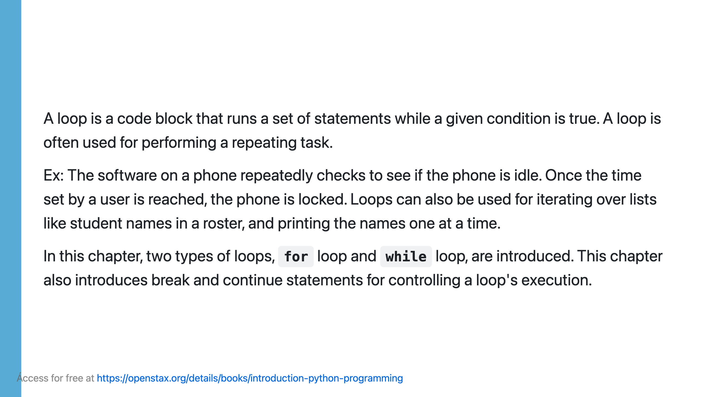

Slide 3
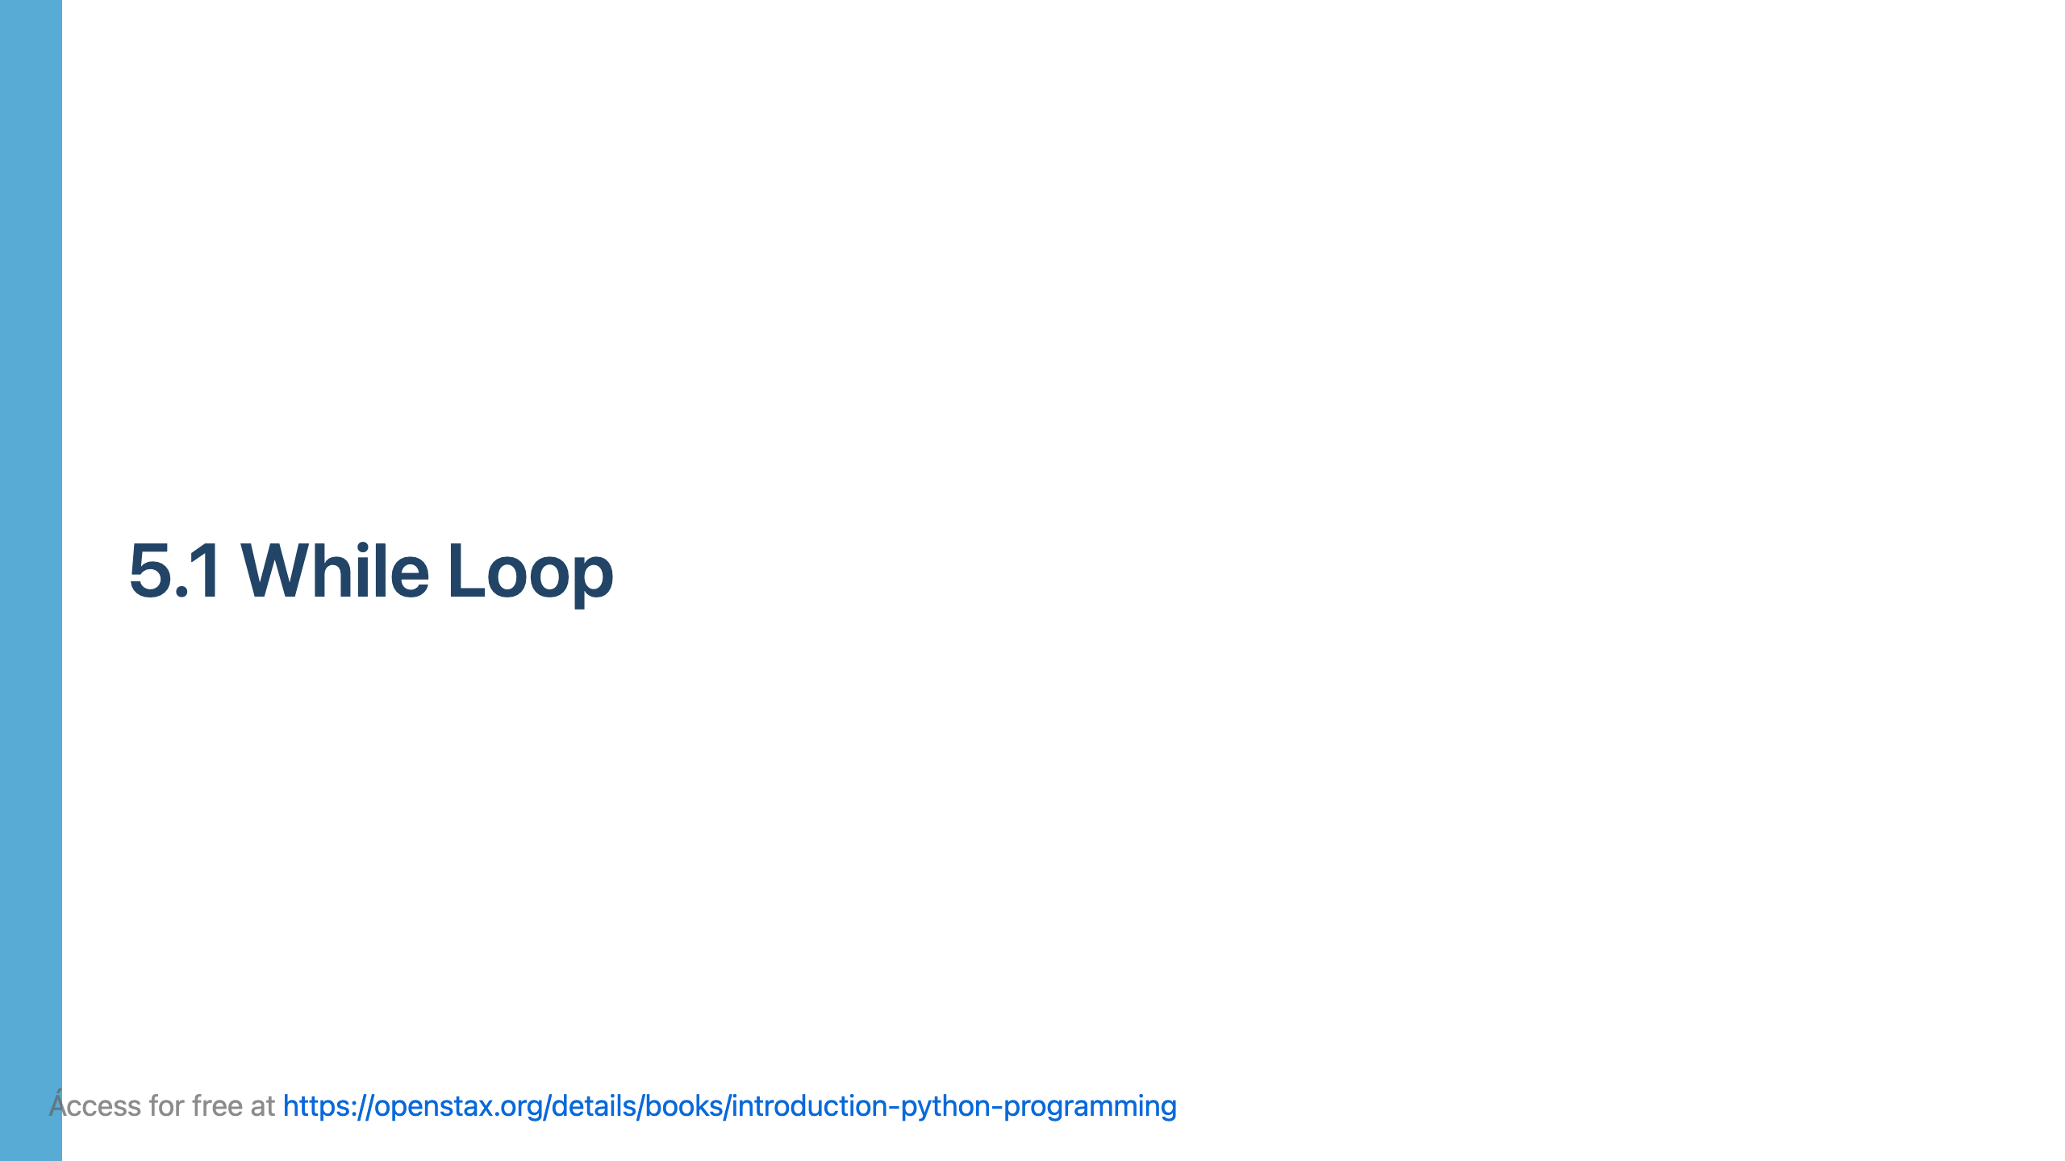

Slide 4
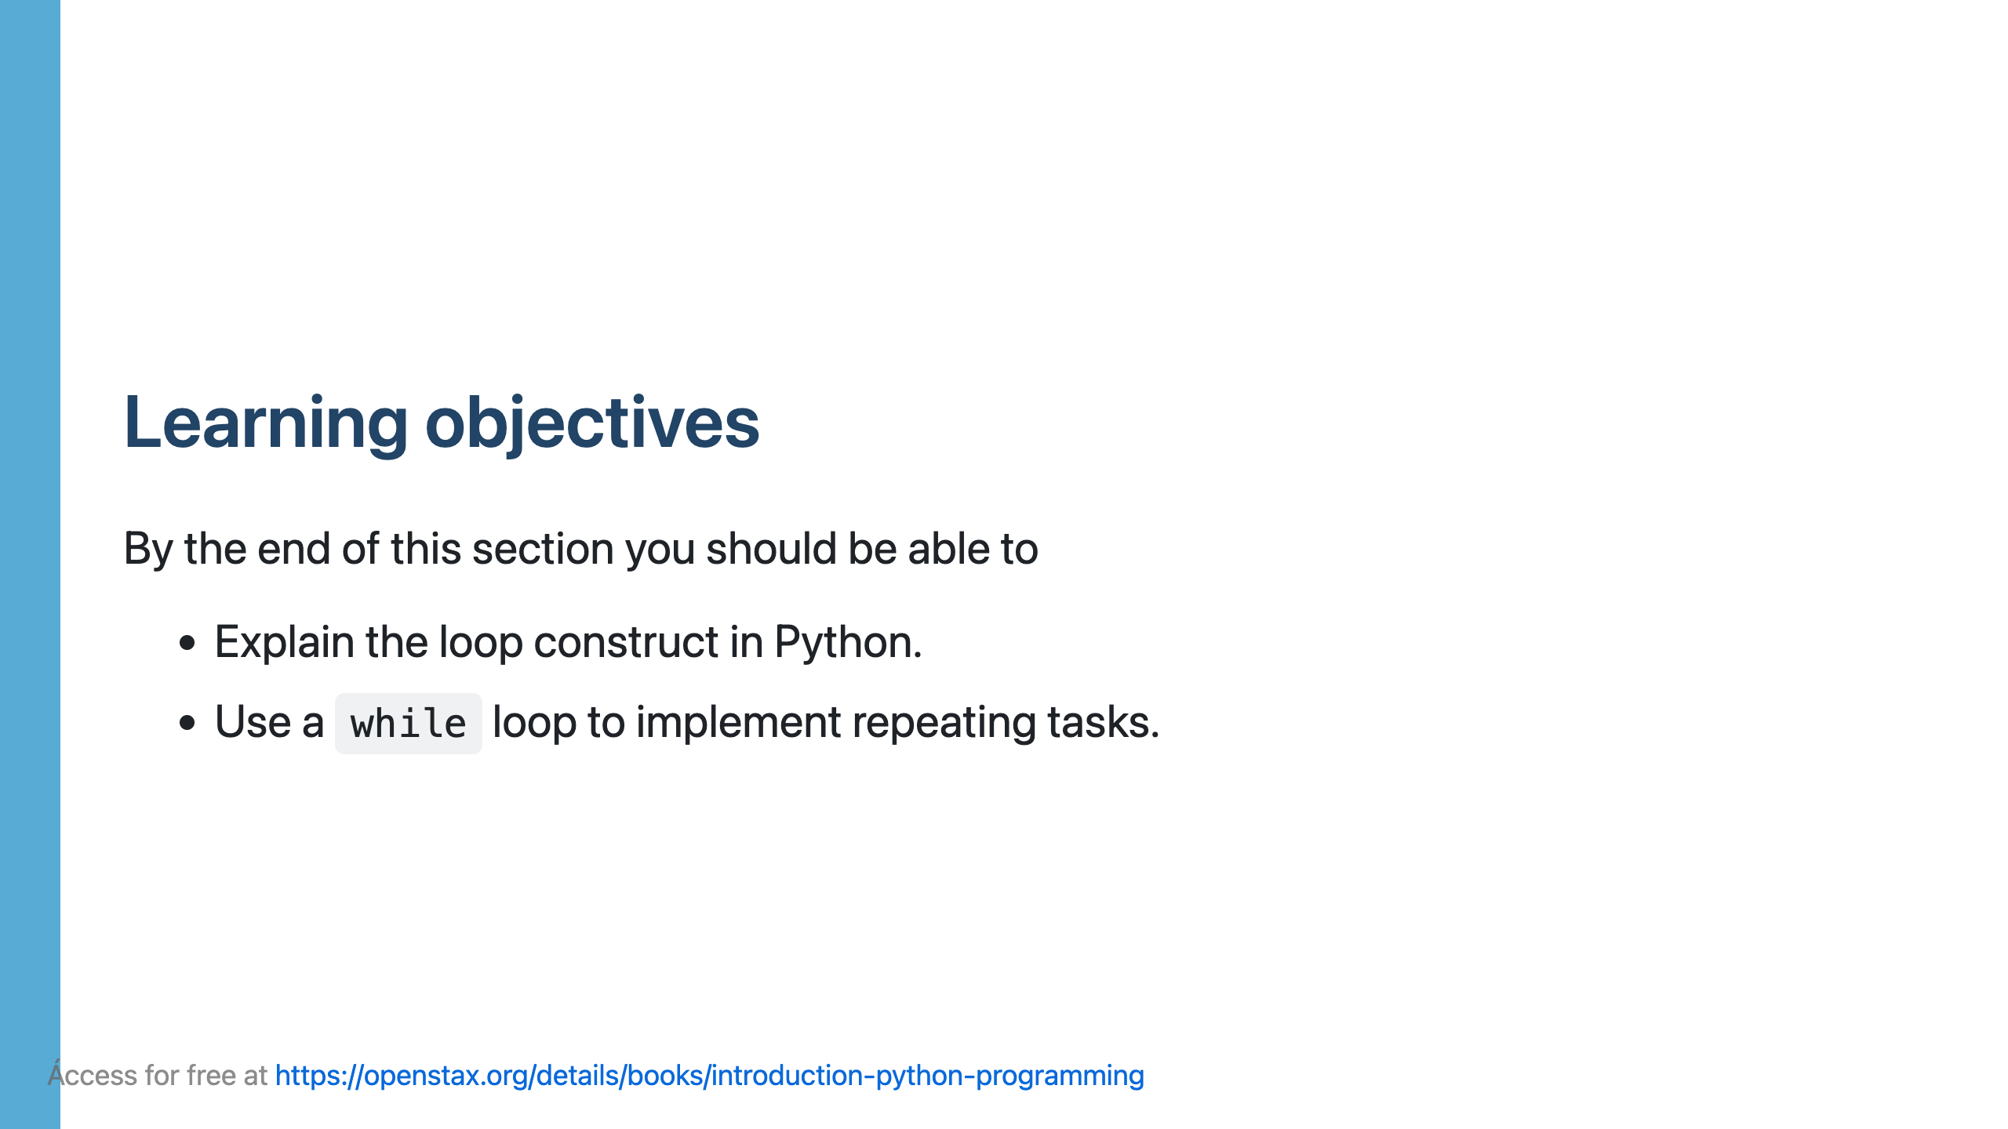

Slide 5
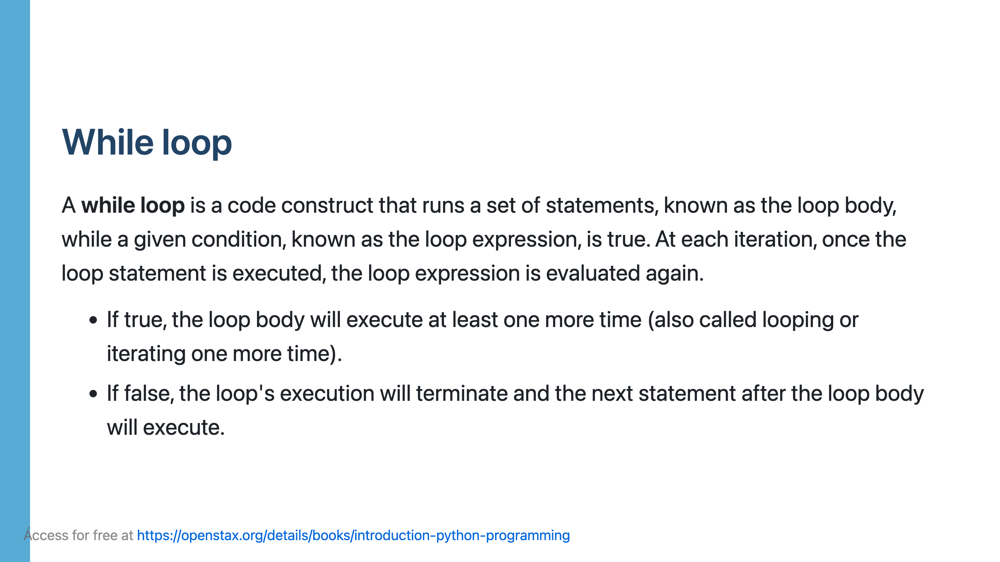

Slide 6
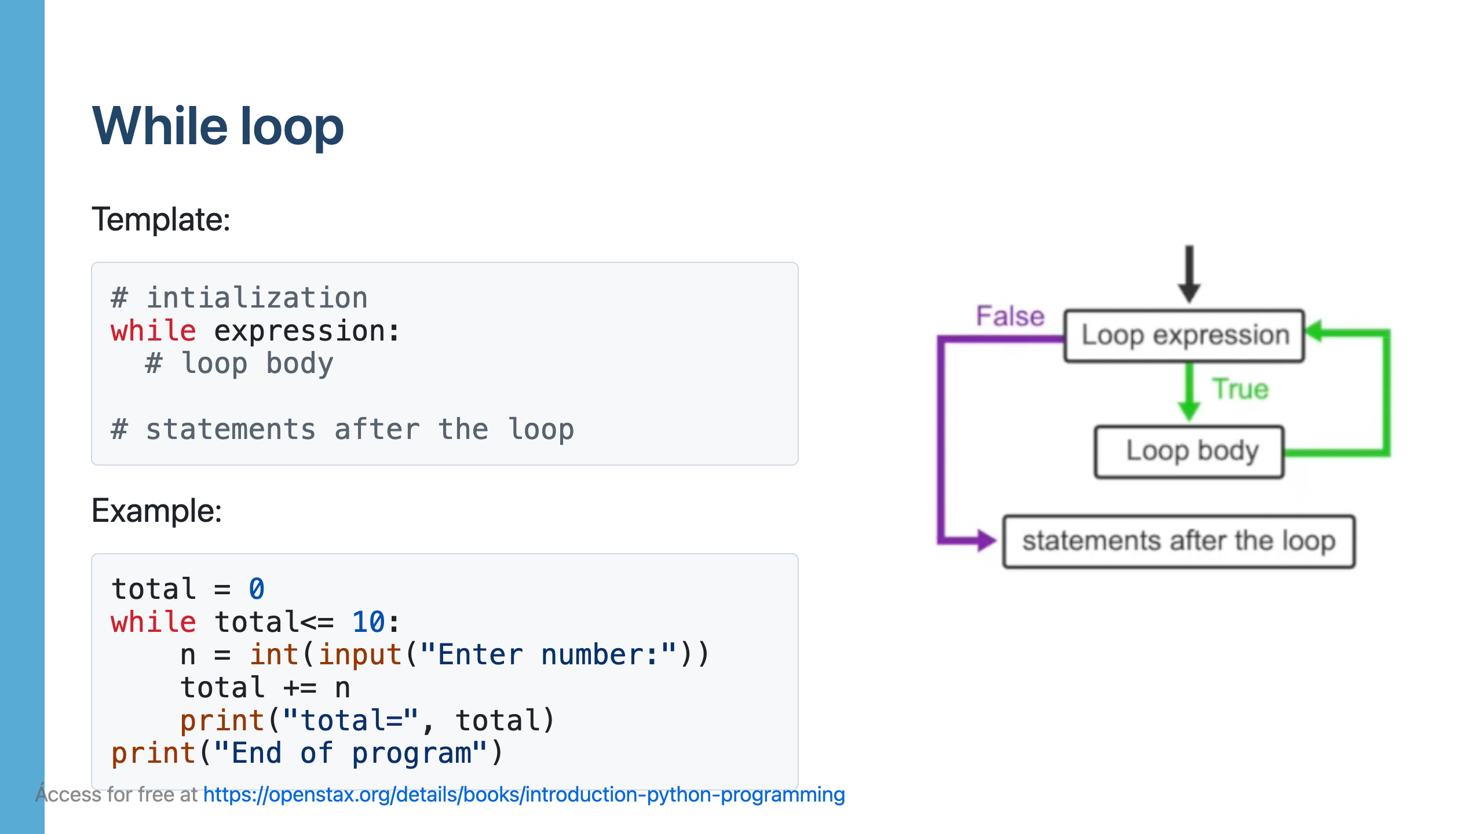

Slide 7
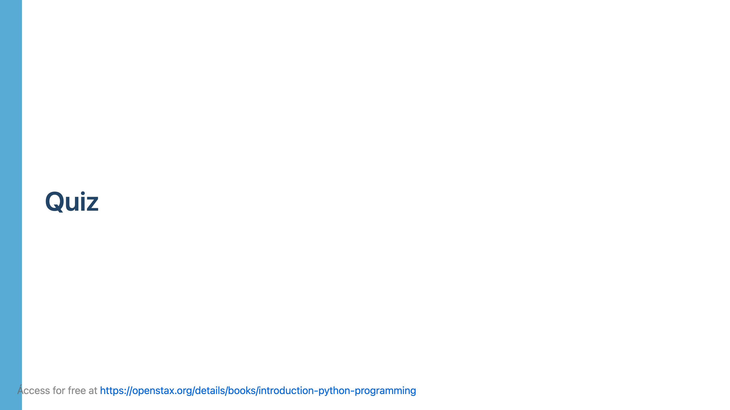

Slide 8
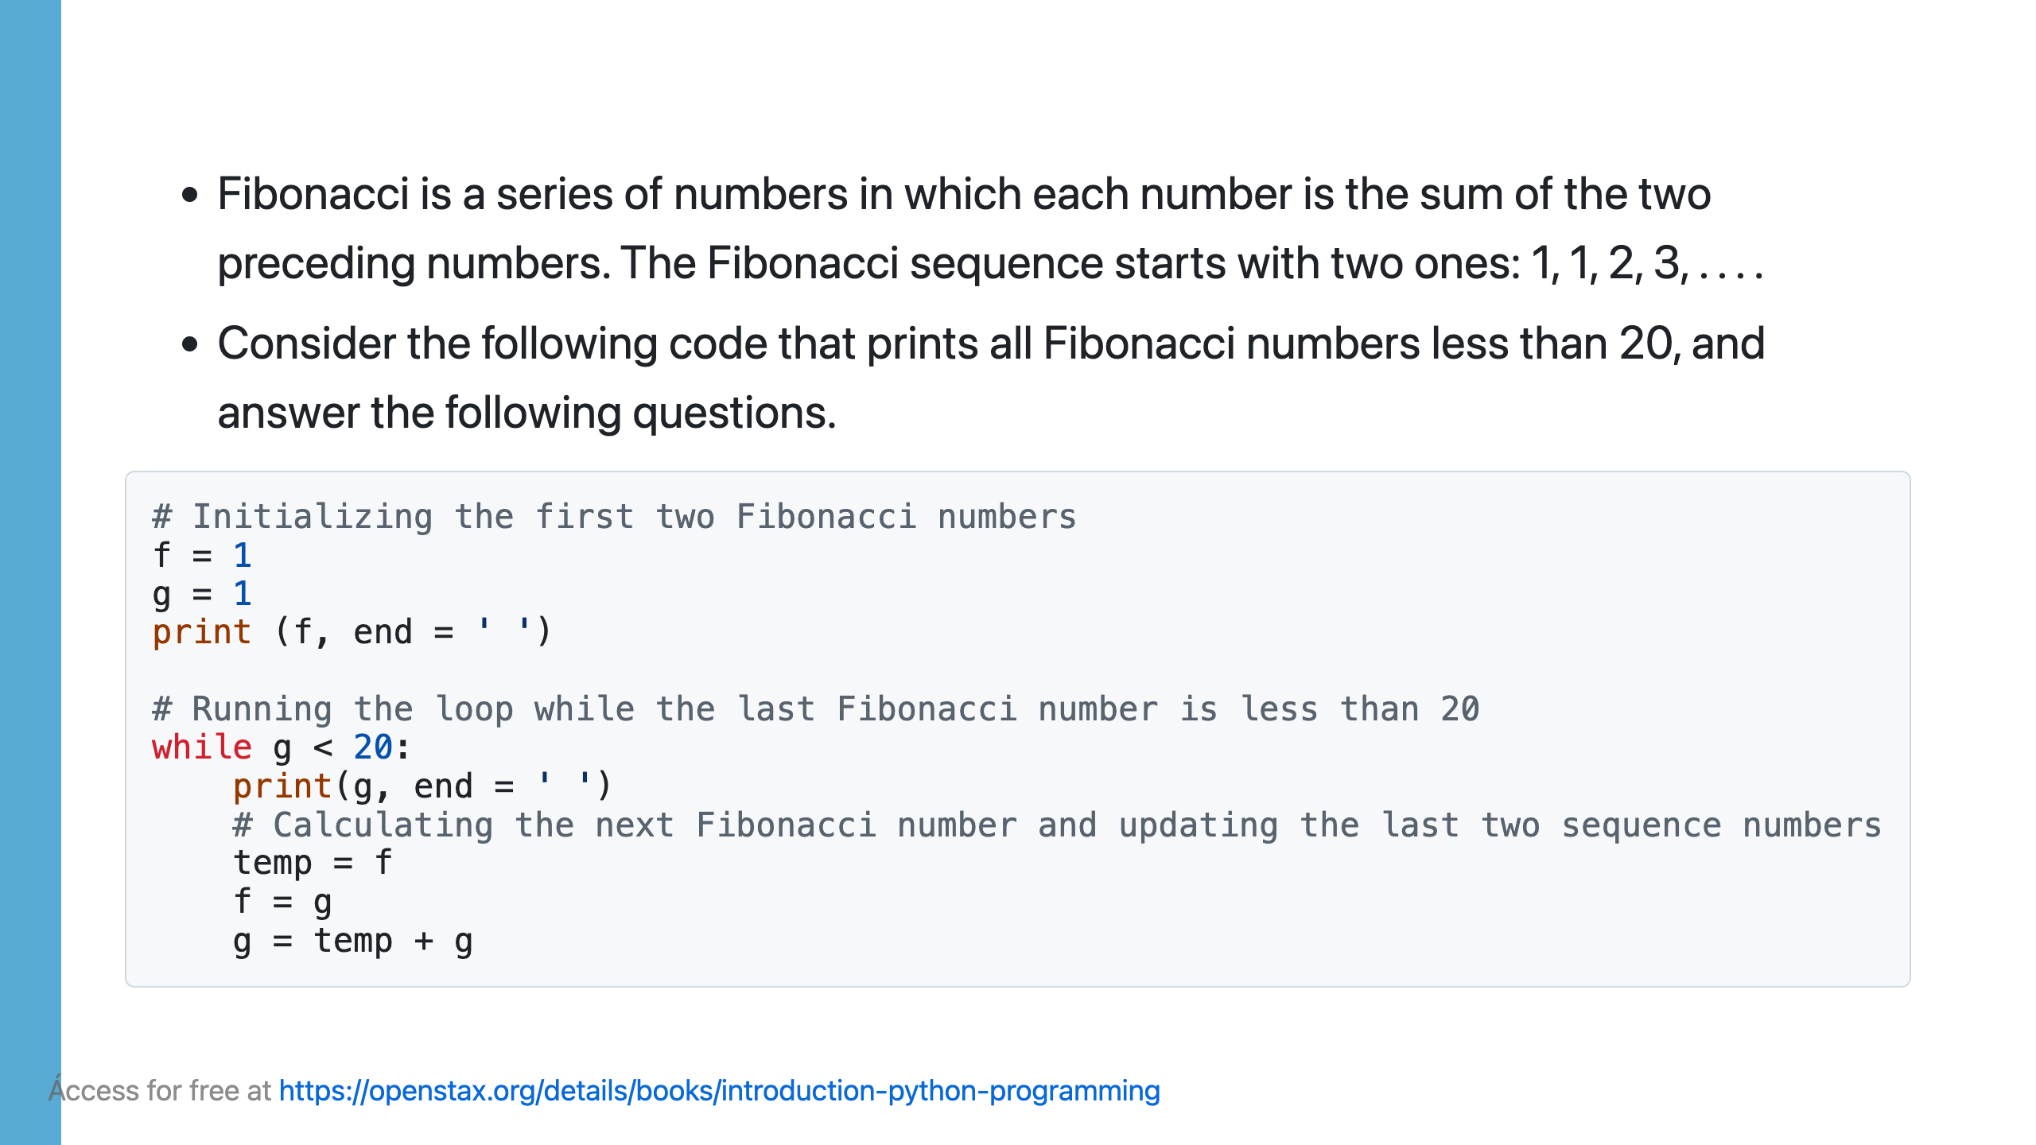

Slide 9
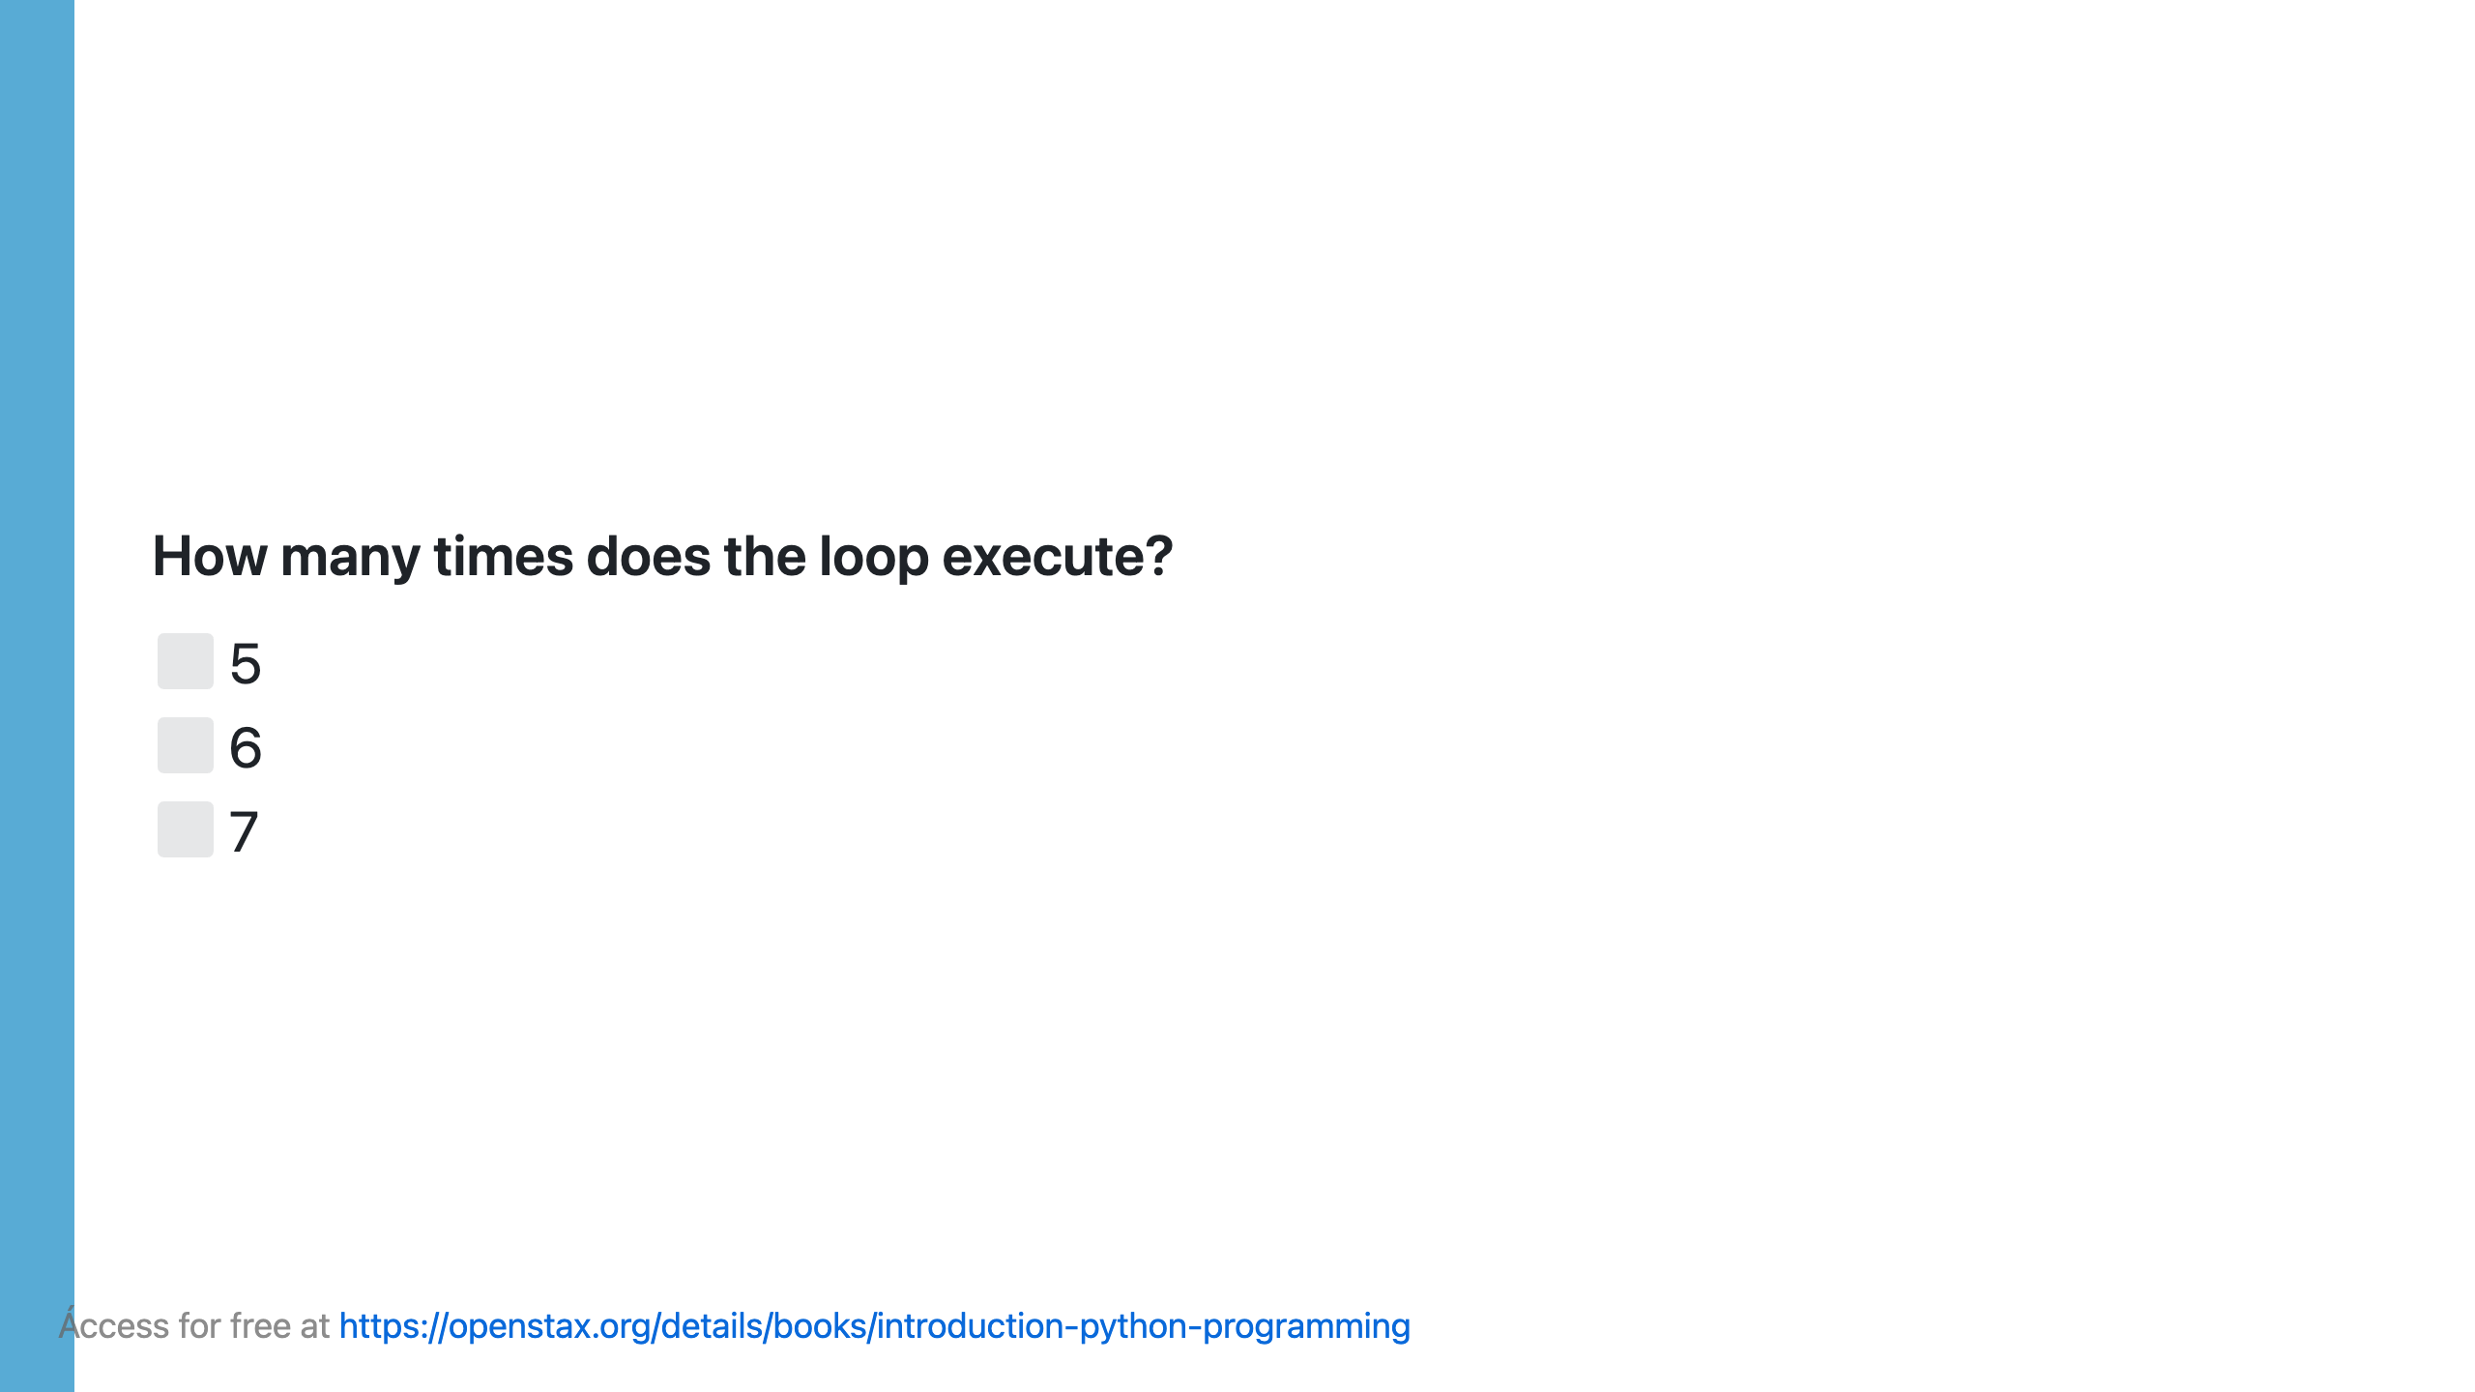

Slide 10
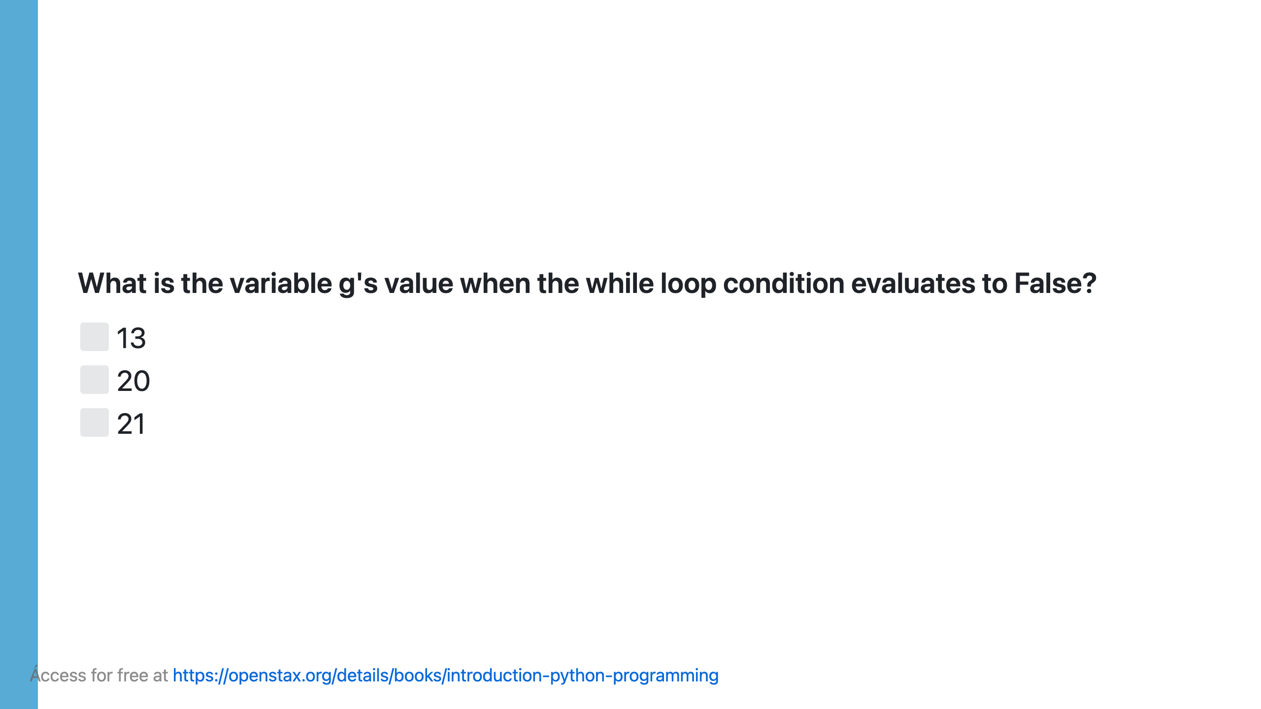

Slide 11
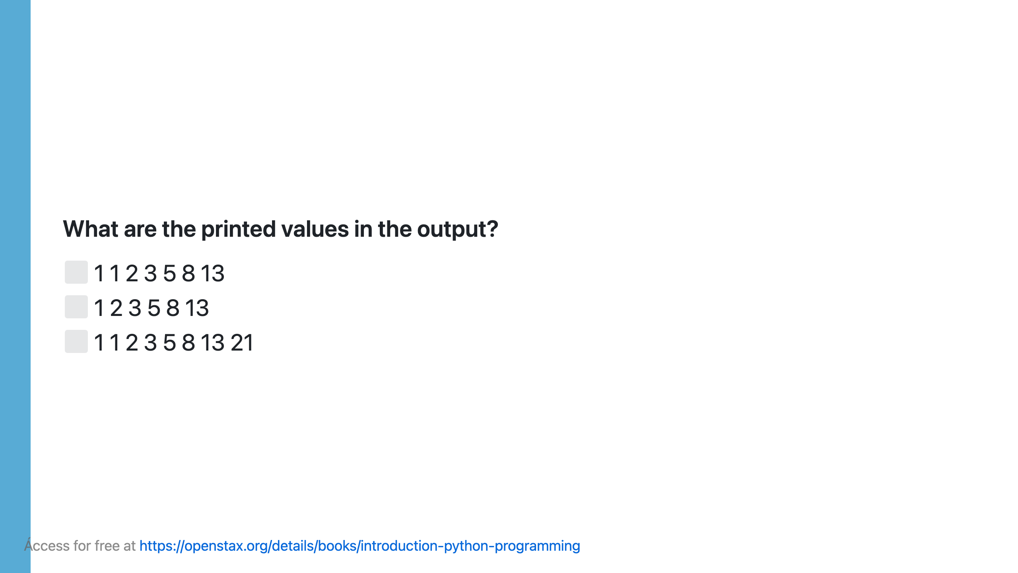

Slide 12
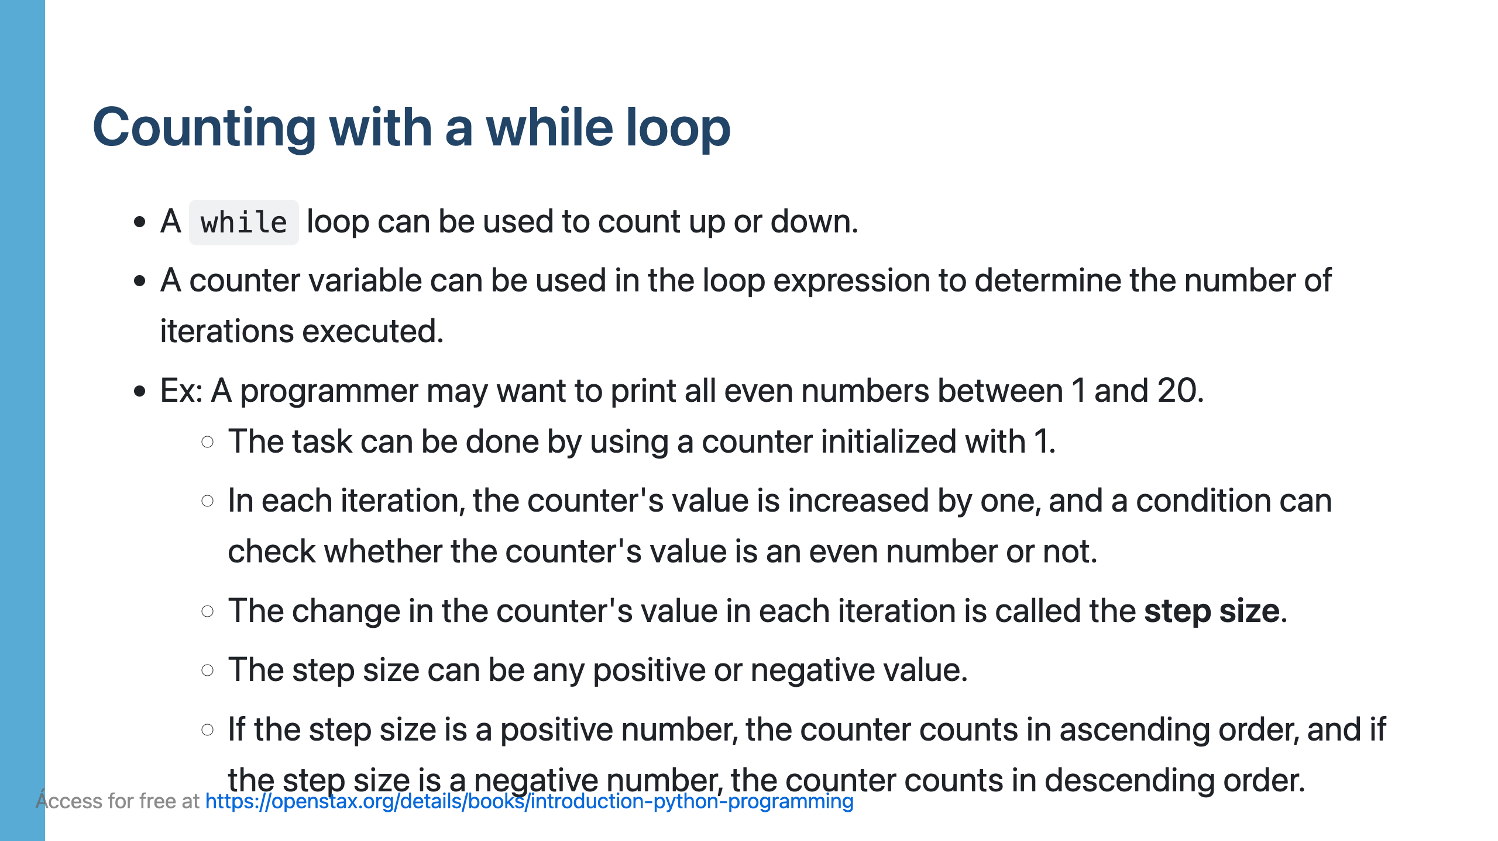

Slide 13
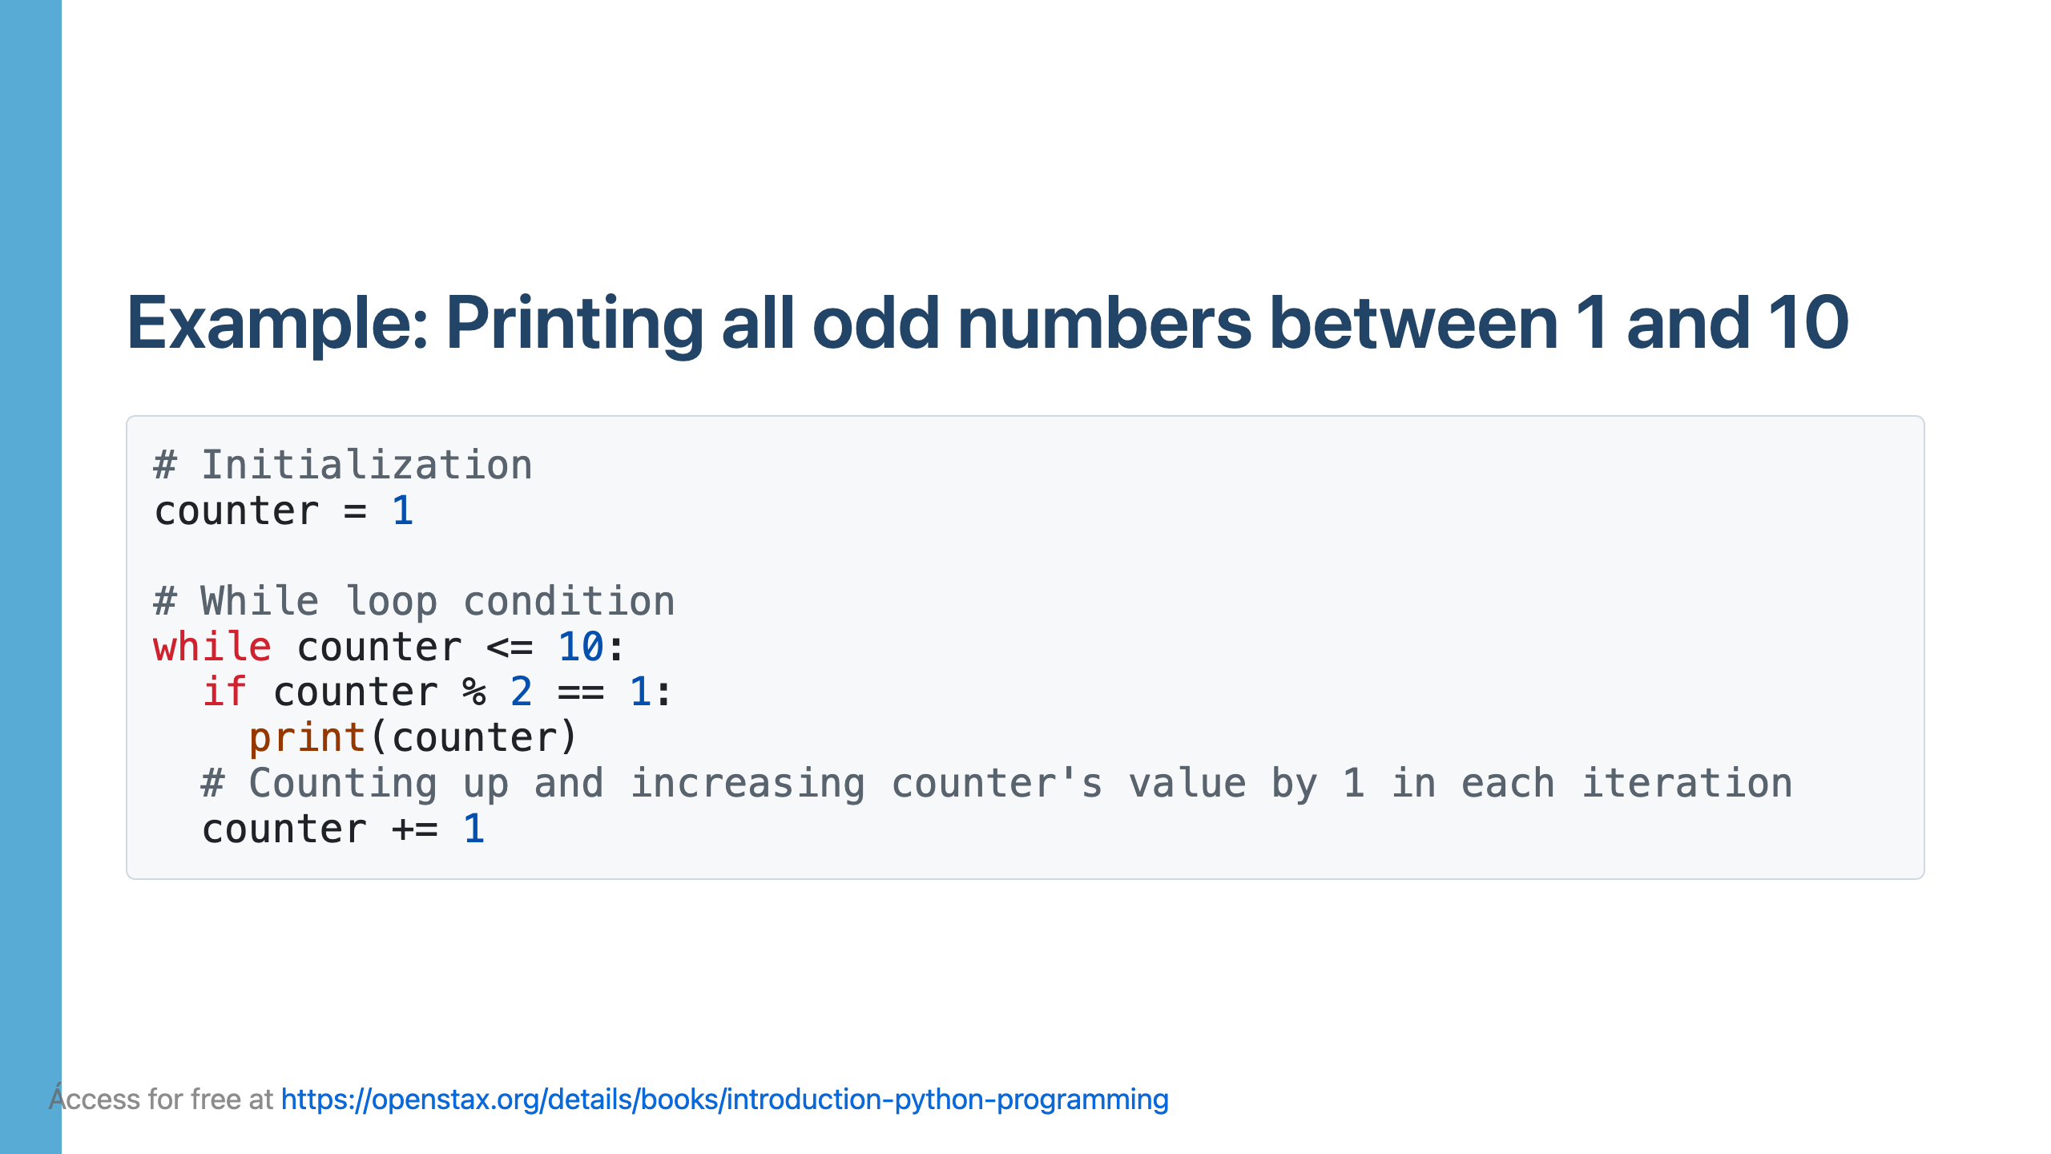

Slide 14
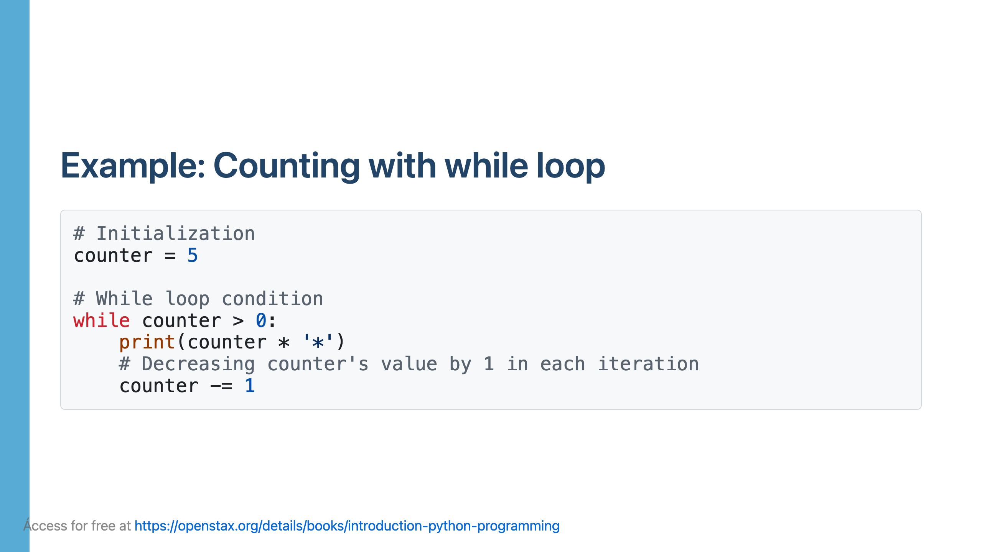

Slide 16
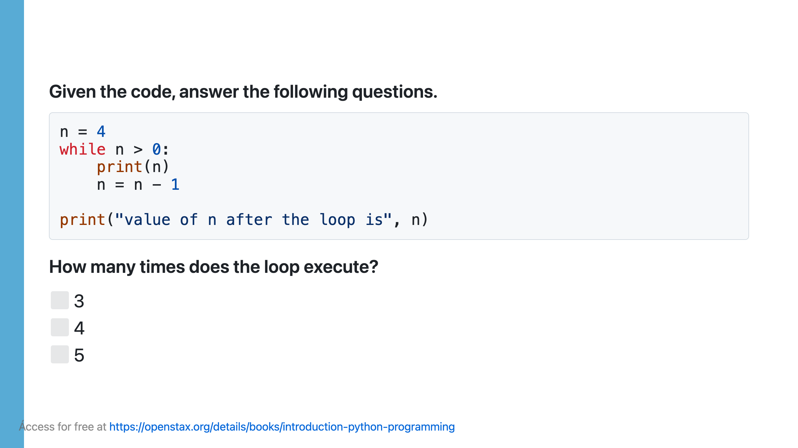

Slide 17
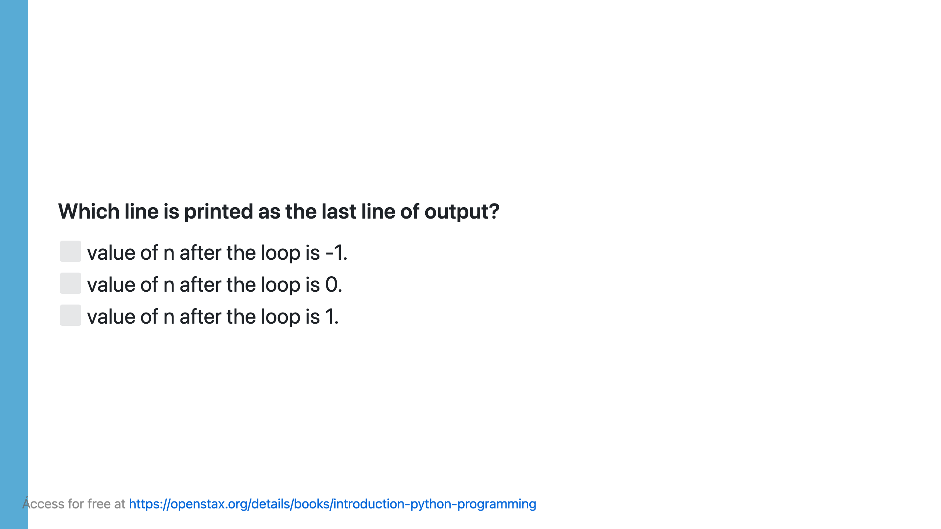

Slide 18
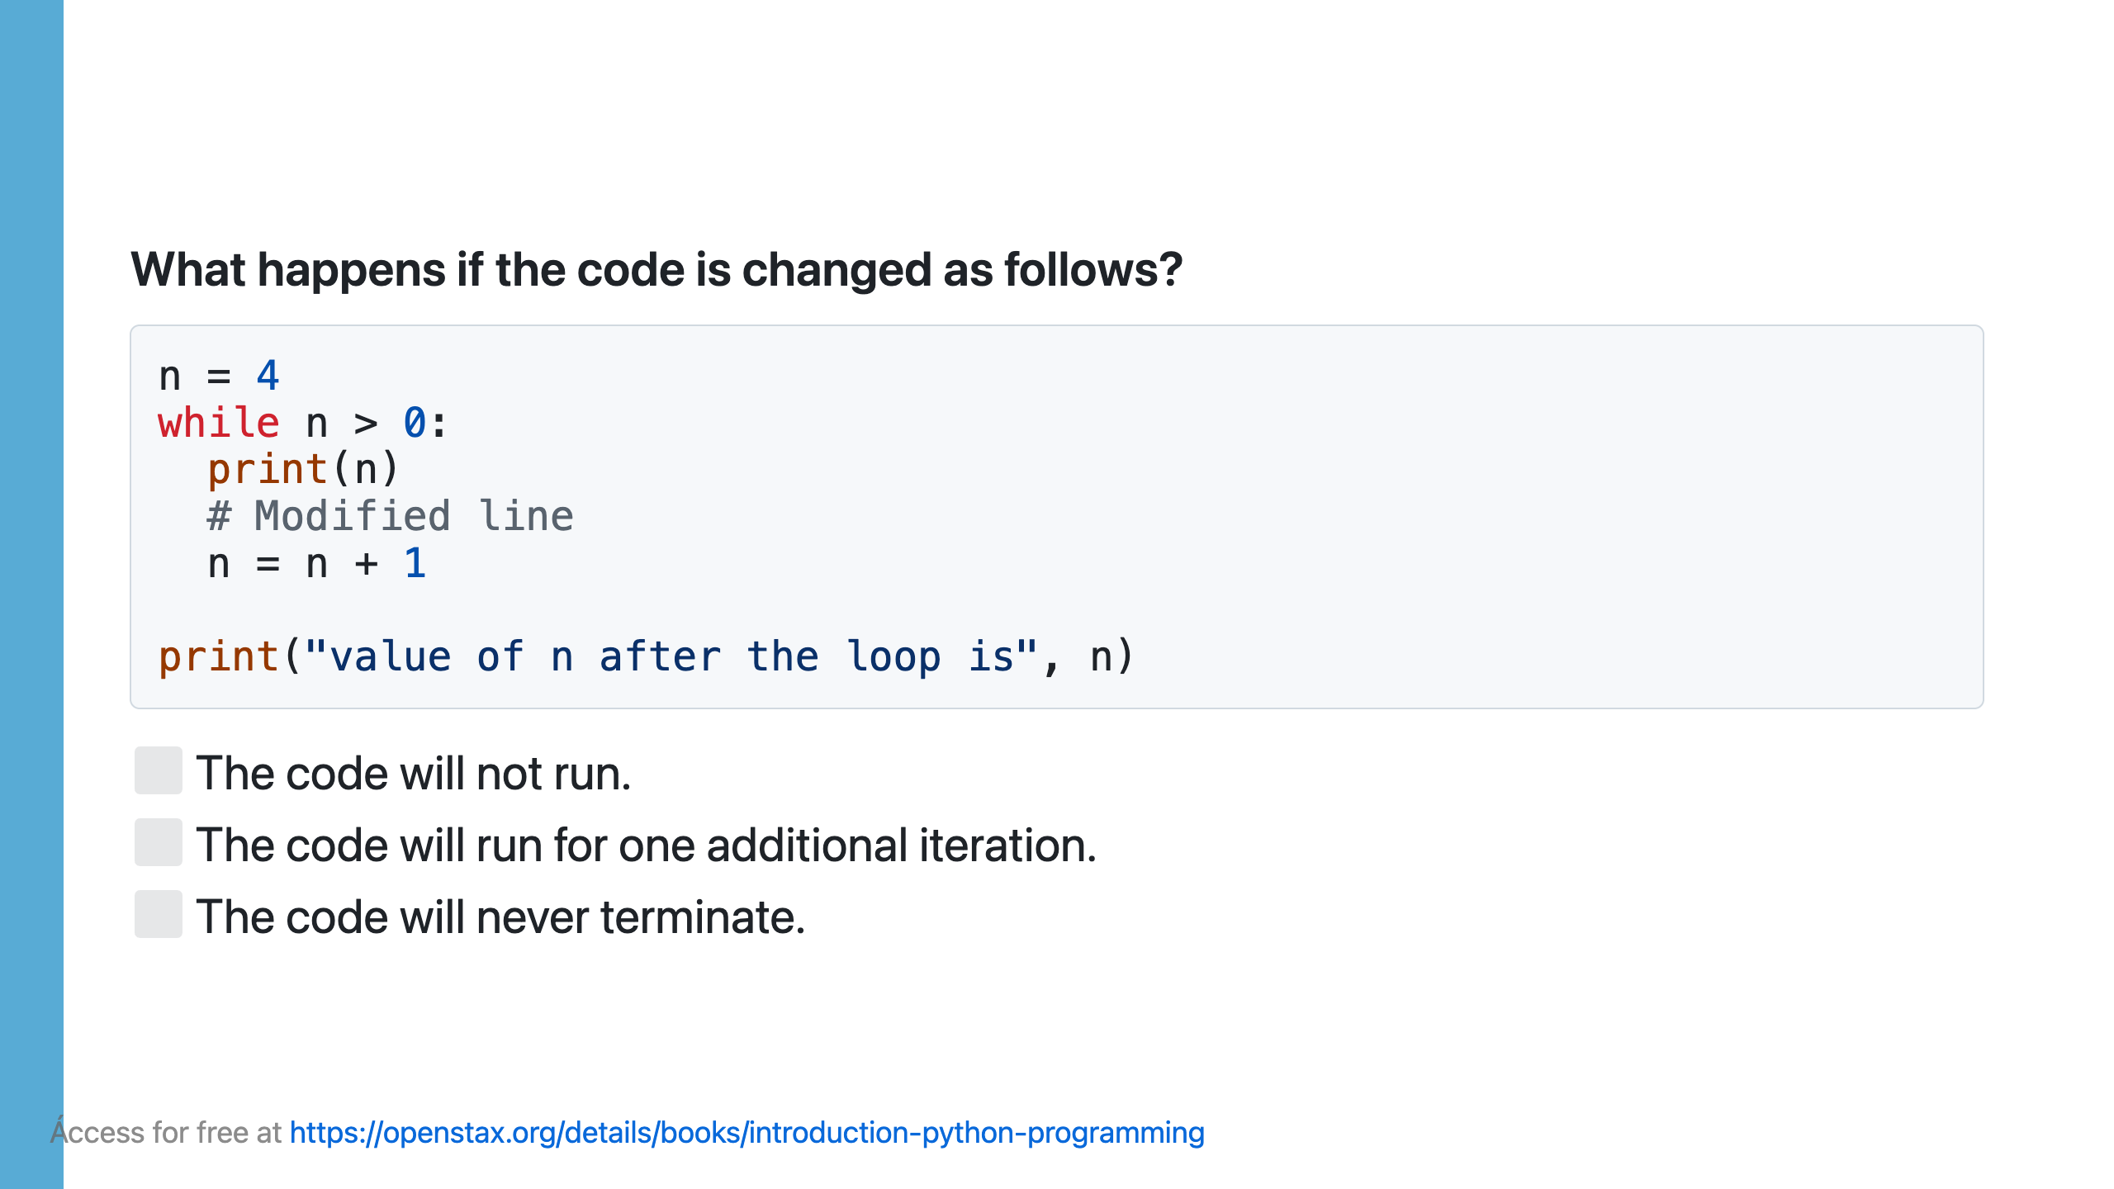

Slide 19
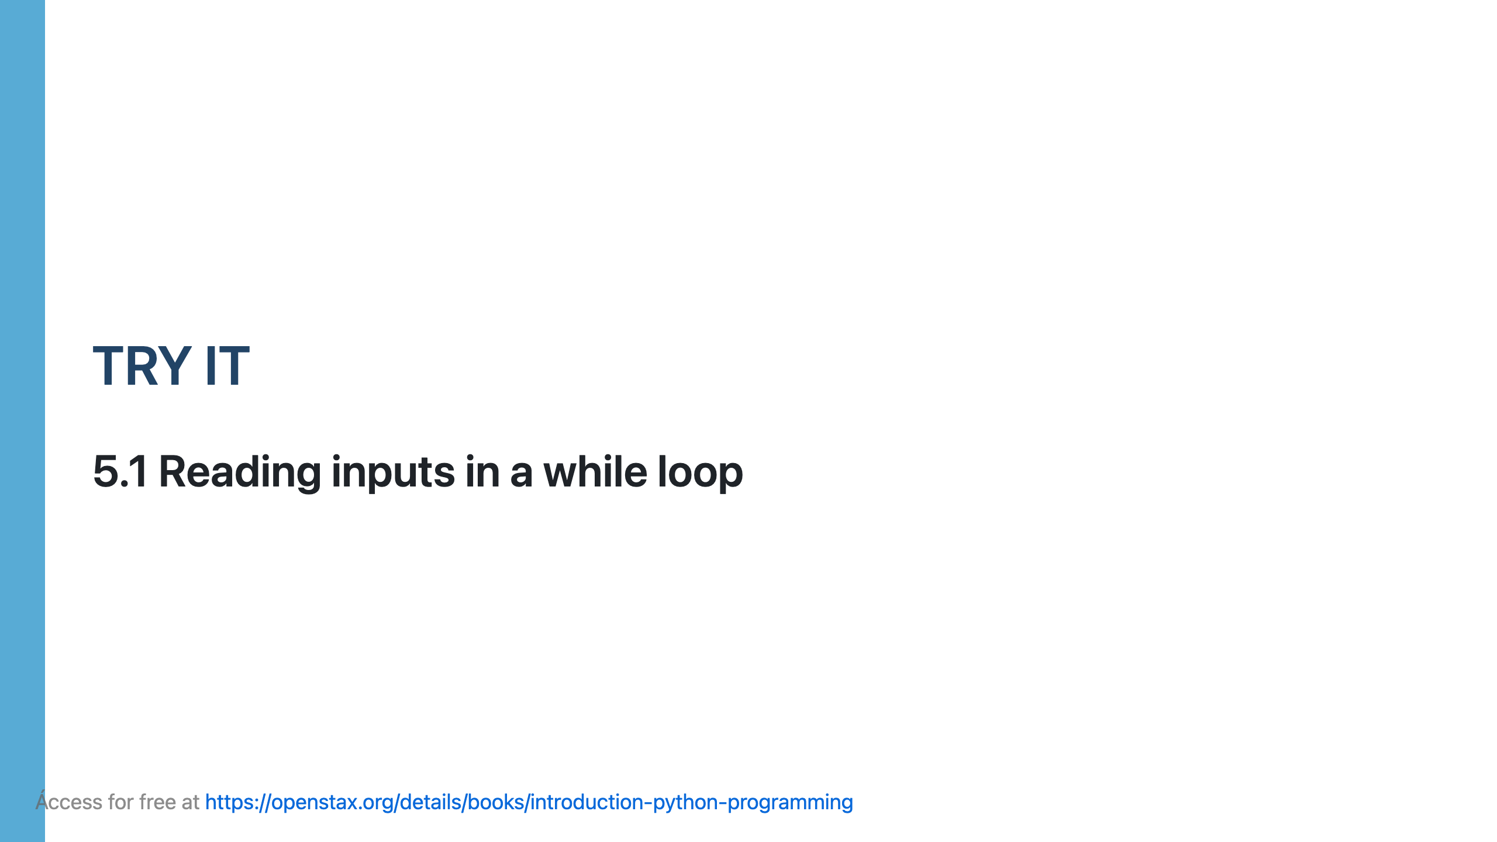

Slide 20
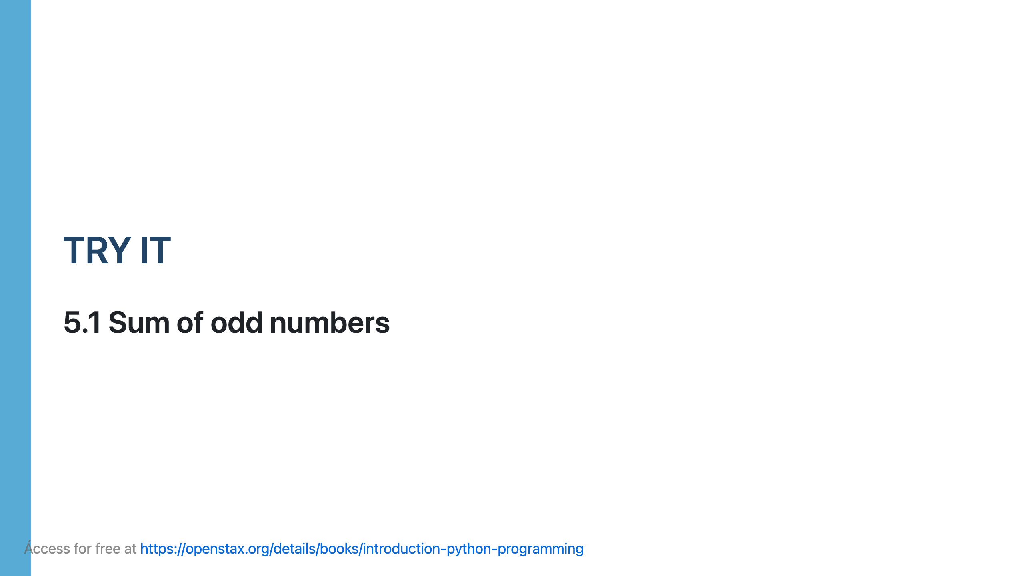

Slide 21
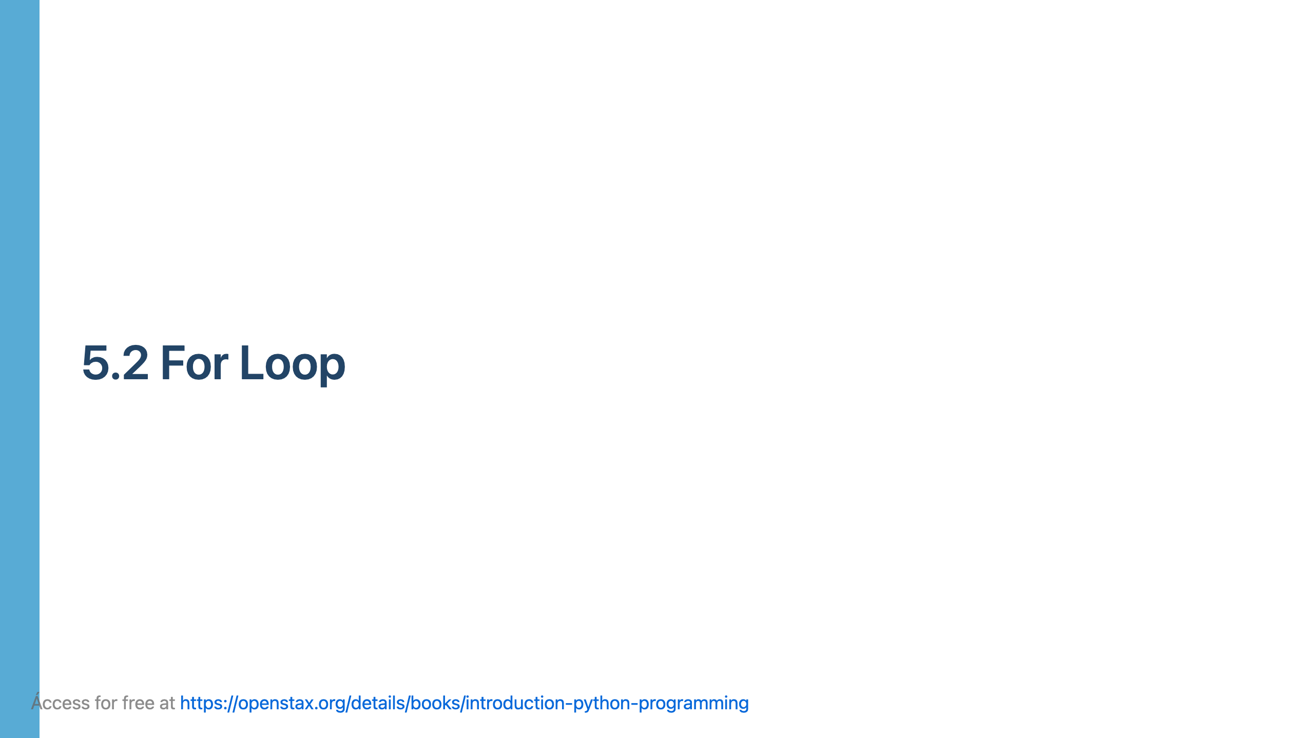

Slide 22
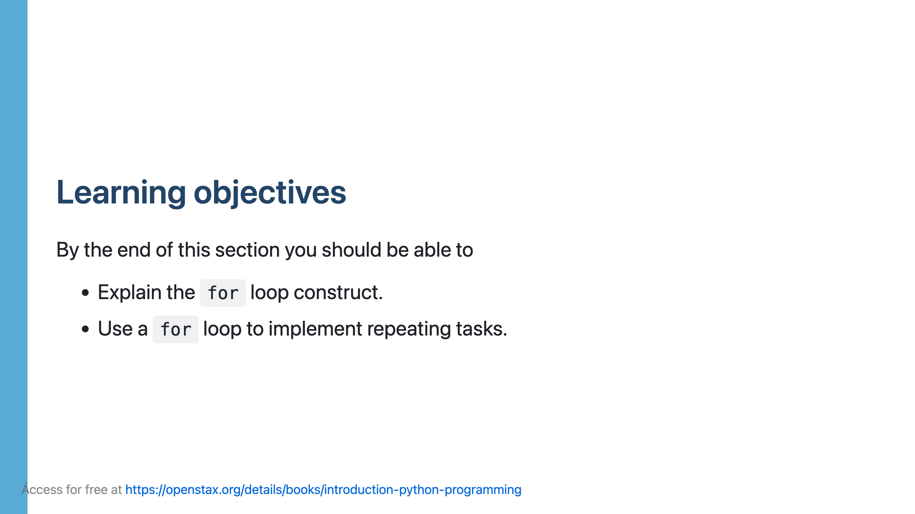

Slide 23
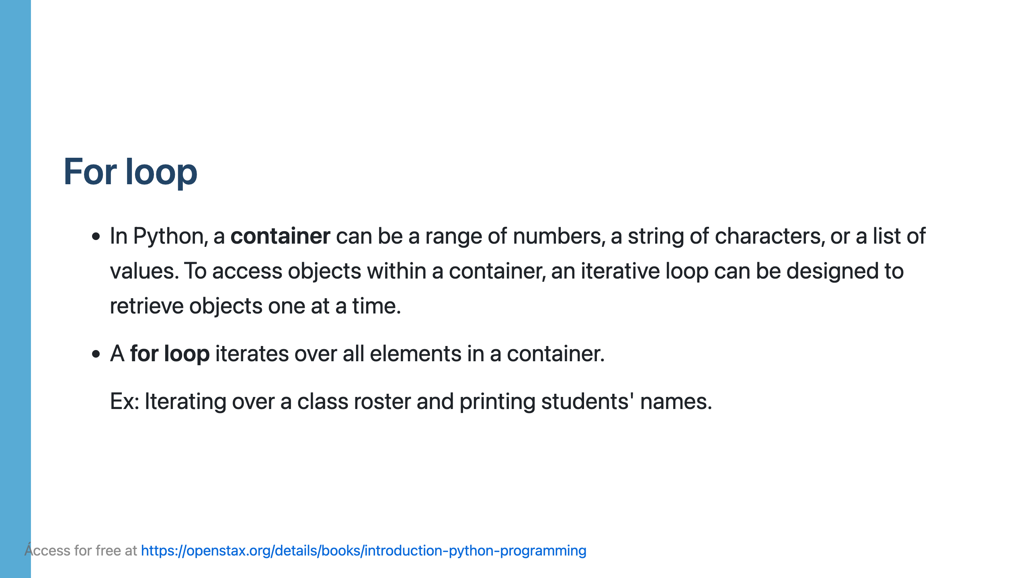

Slide 24
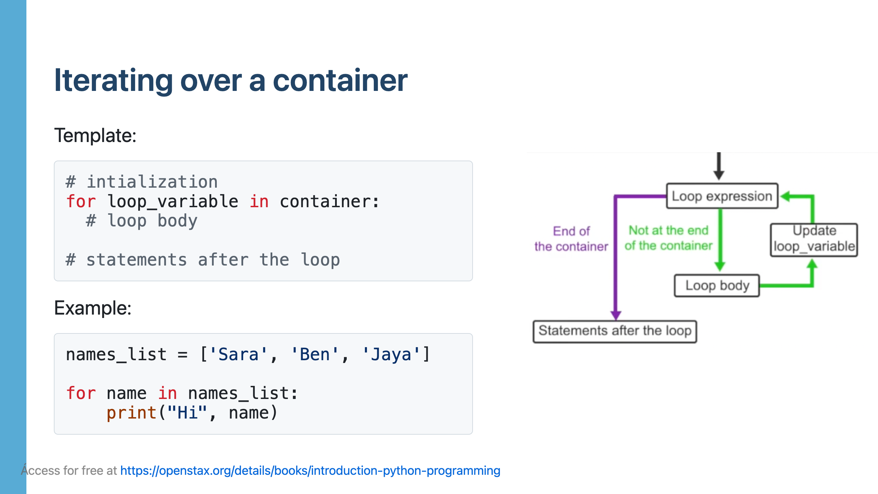

Slide 26
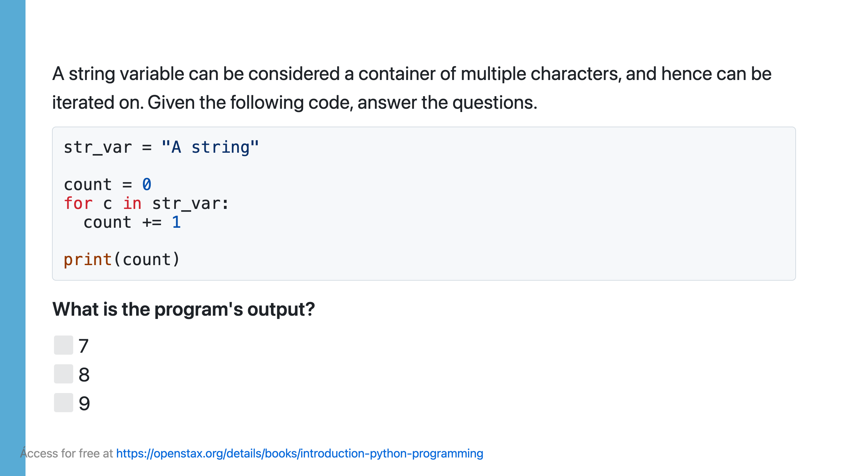

Slide 27
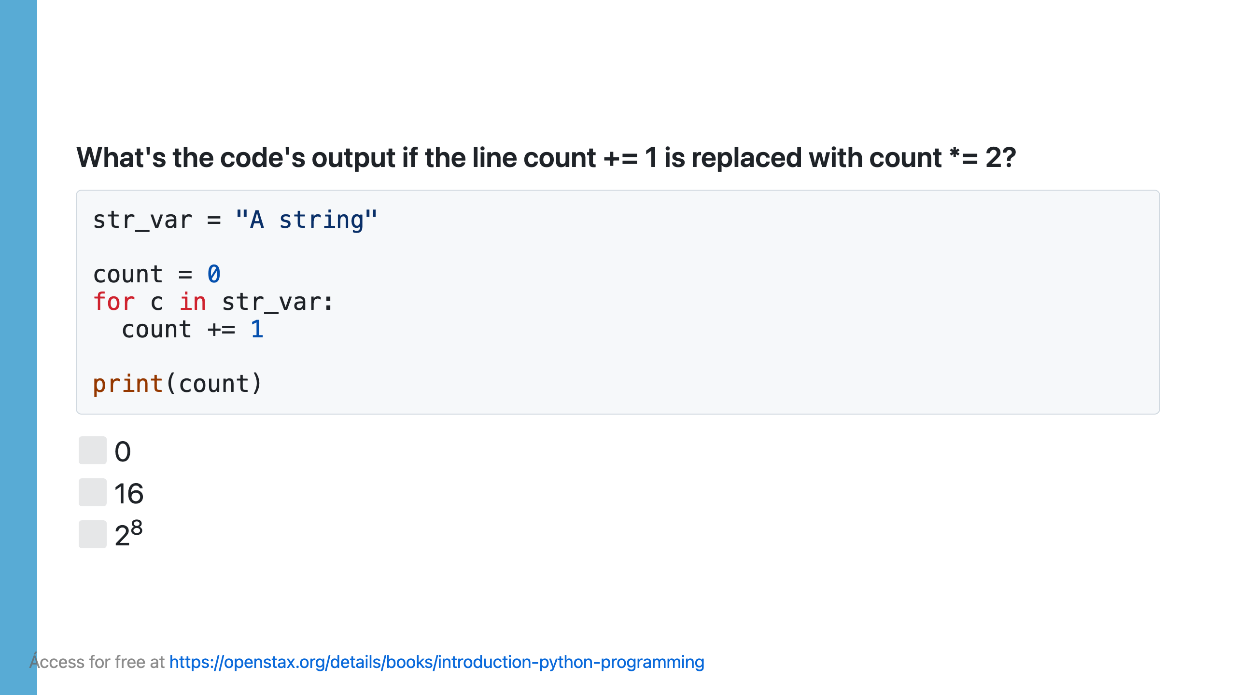

Slide 28
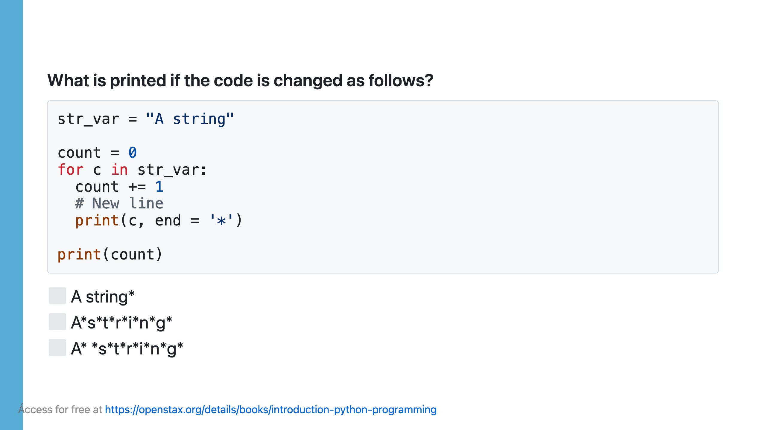

Slide 29
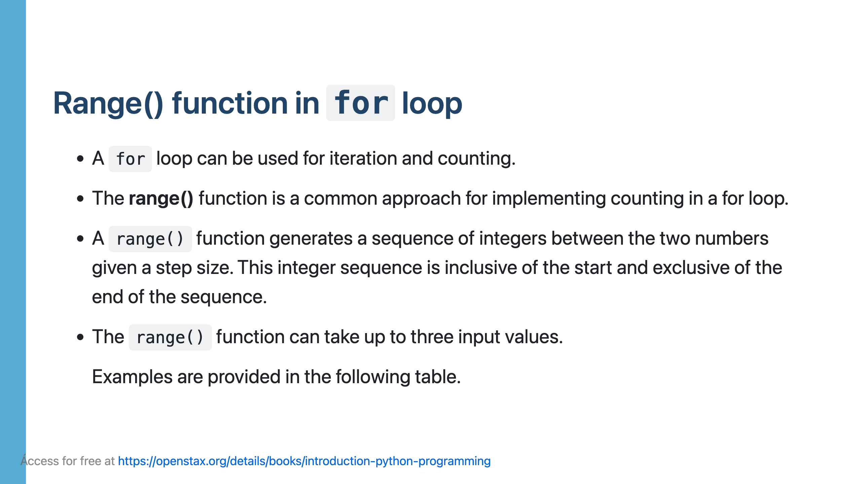

Slide 30
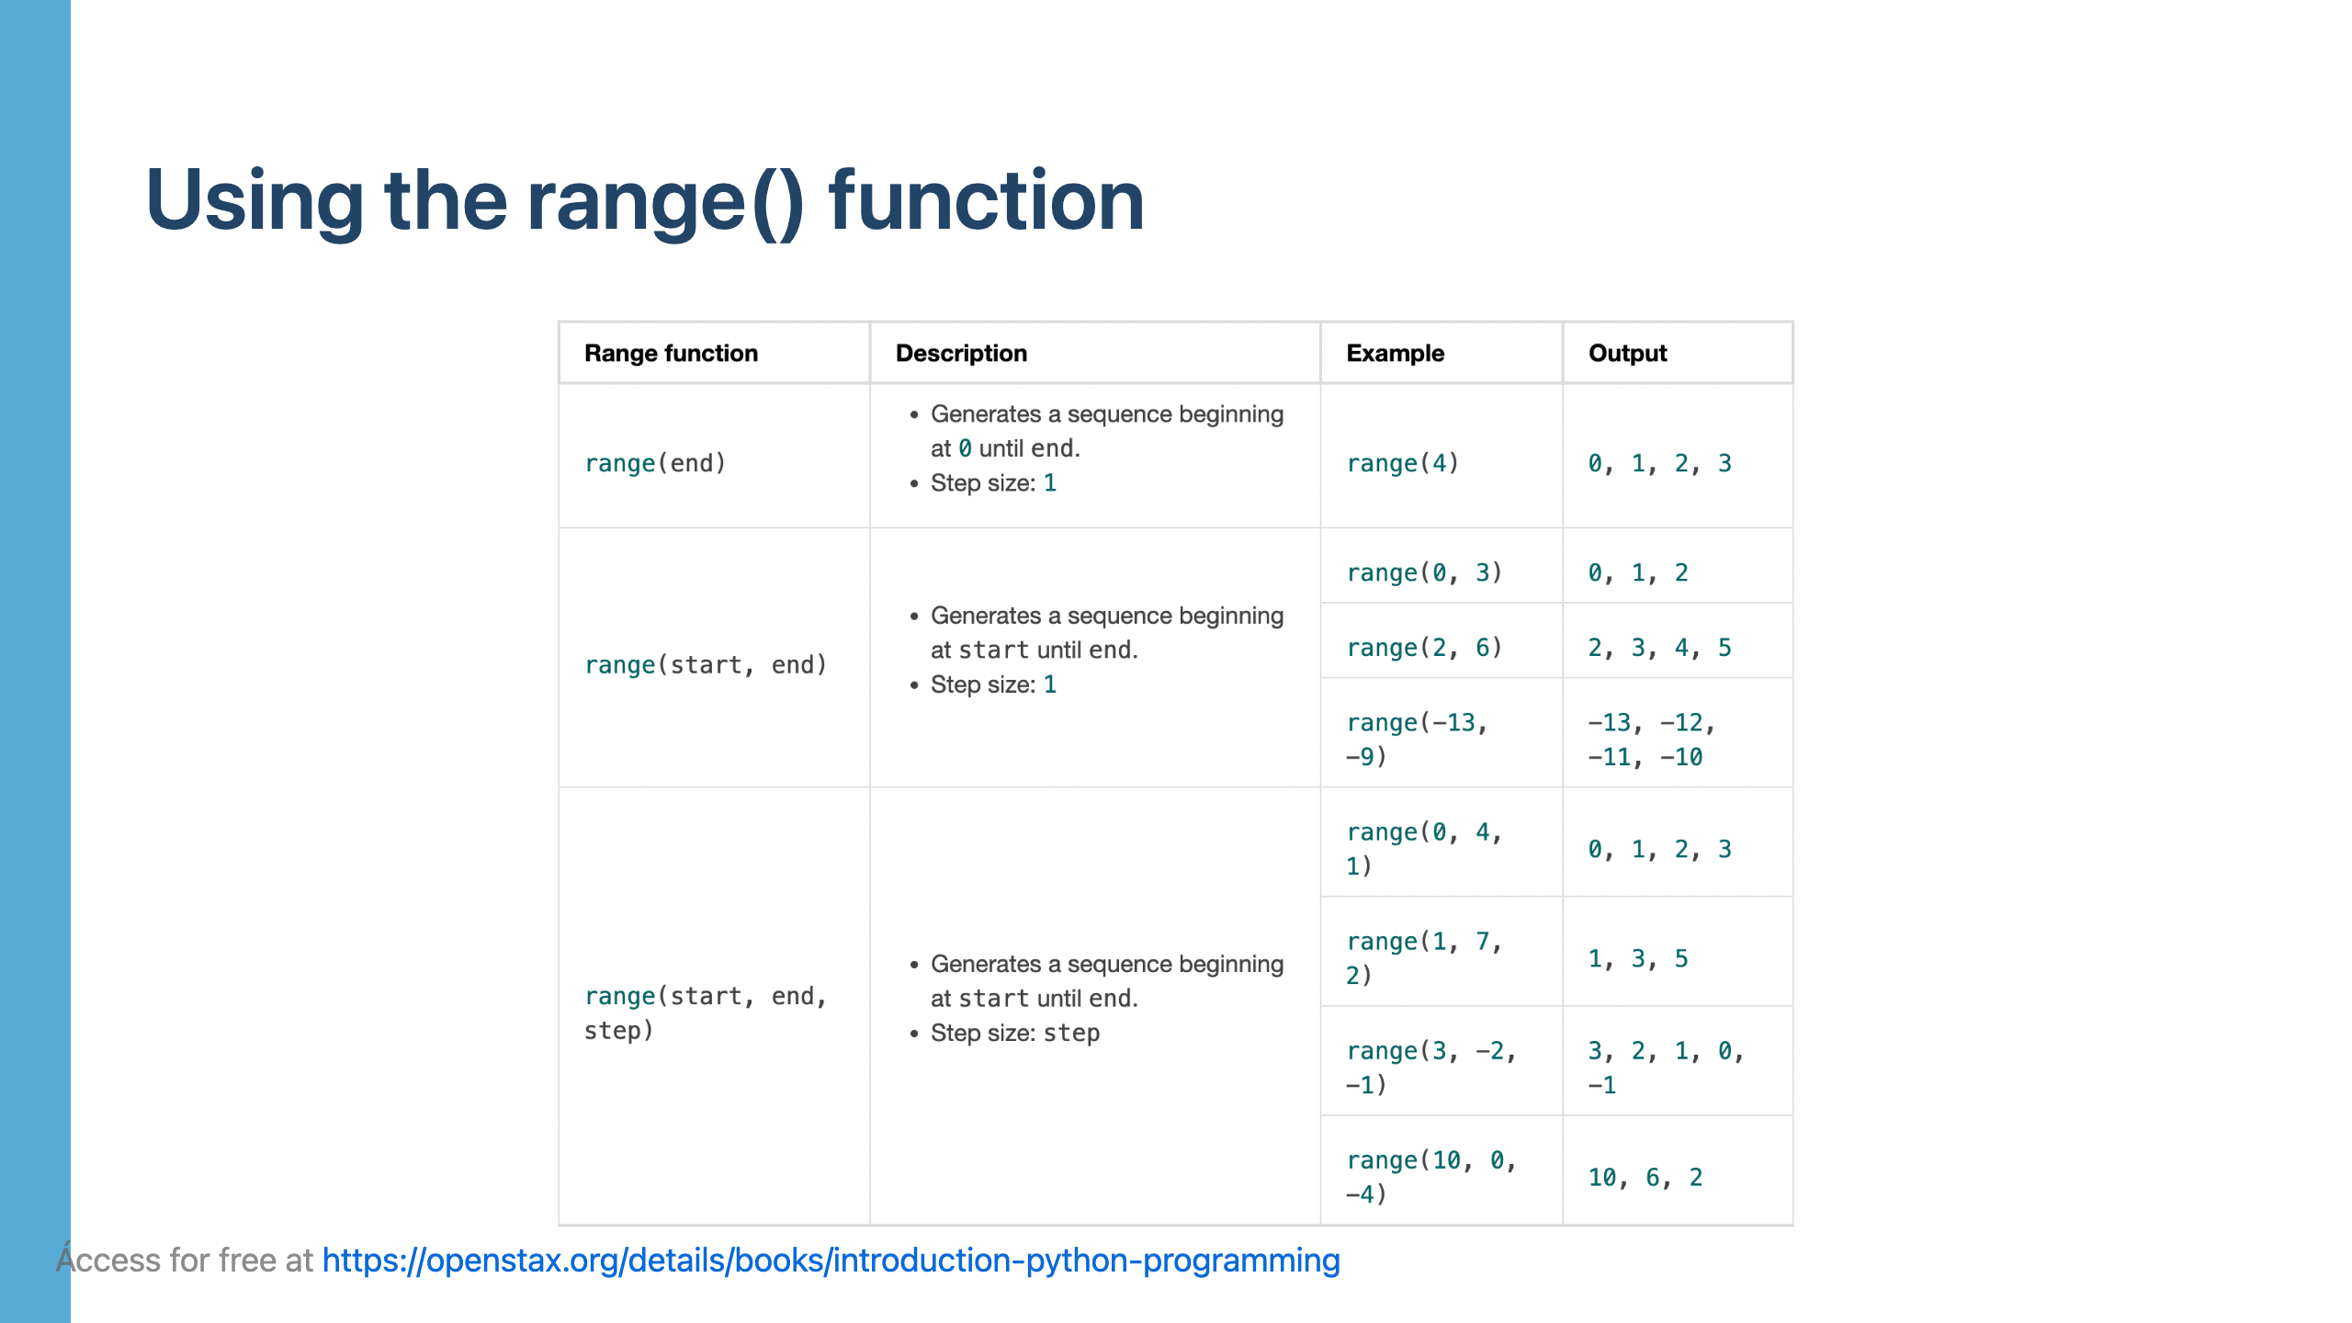

Slide 31
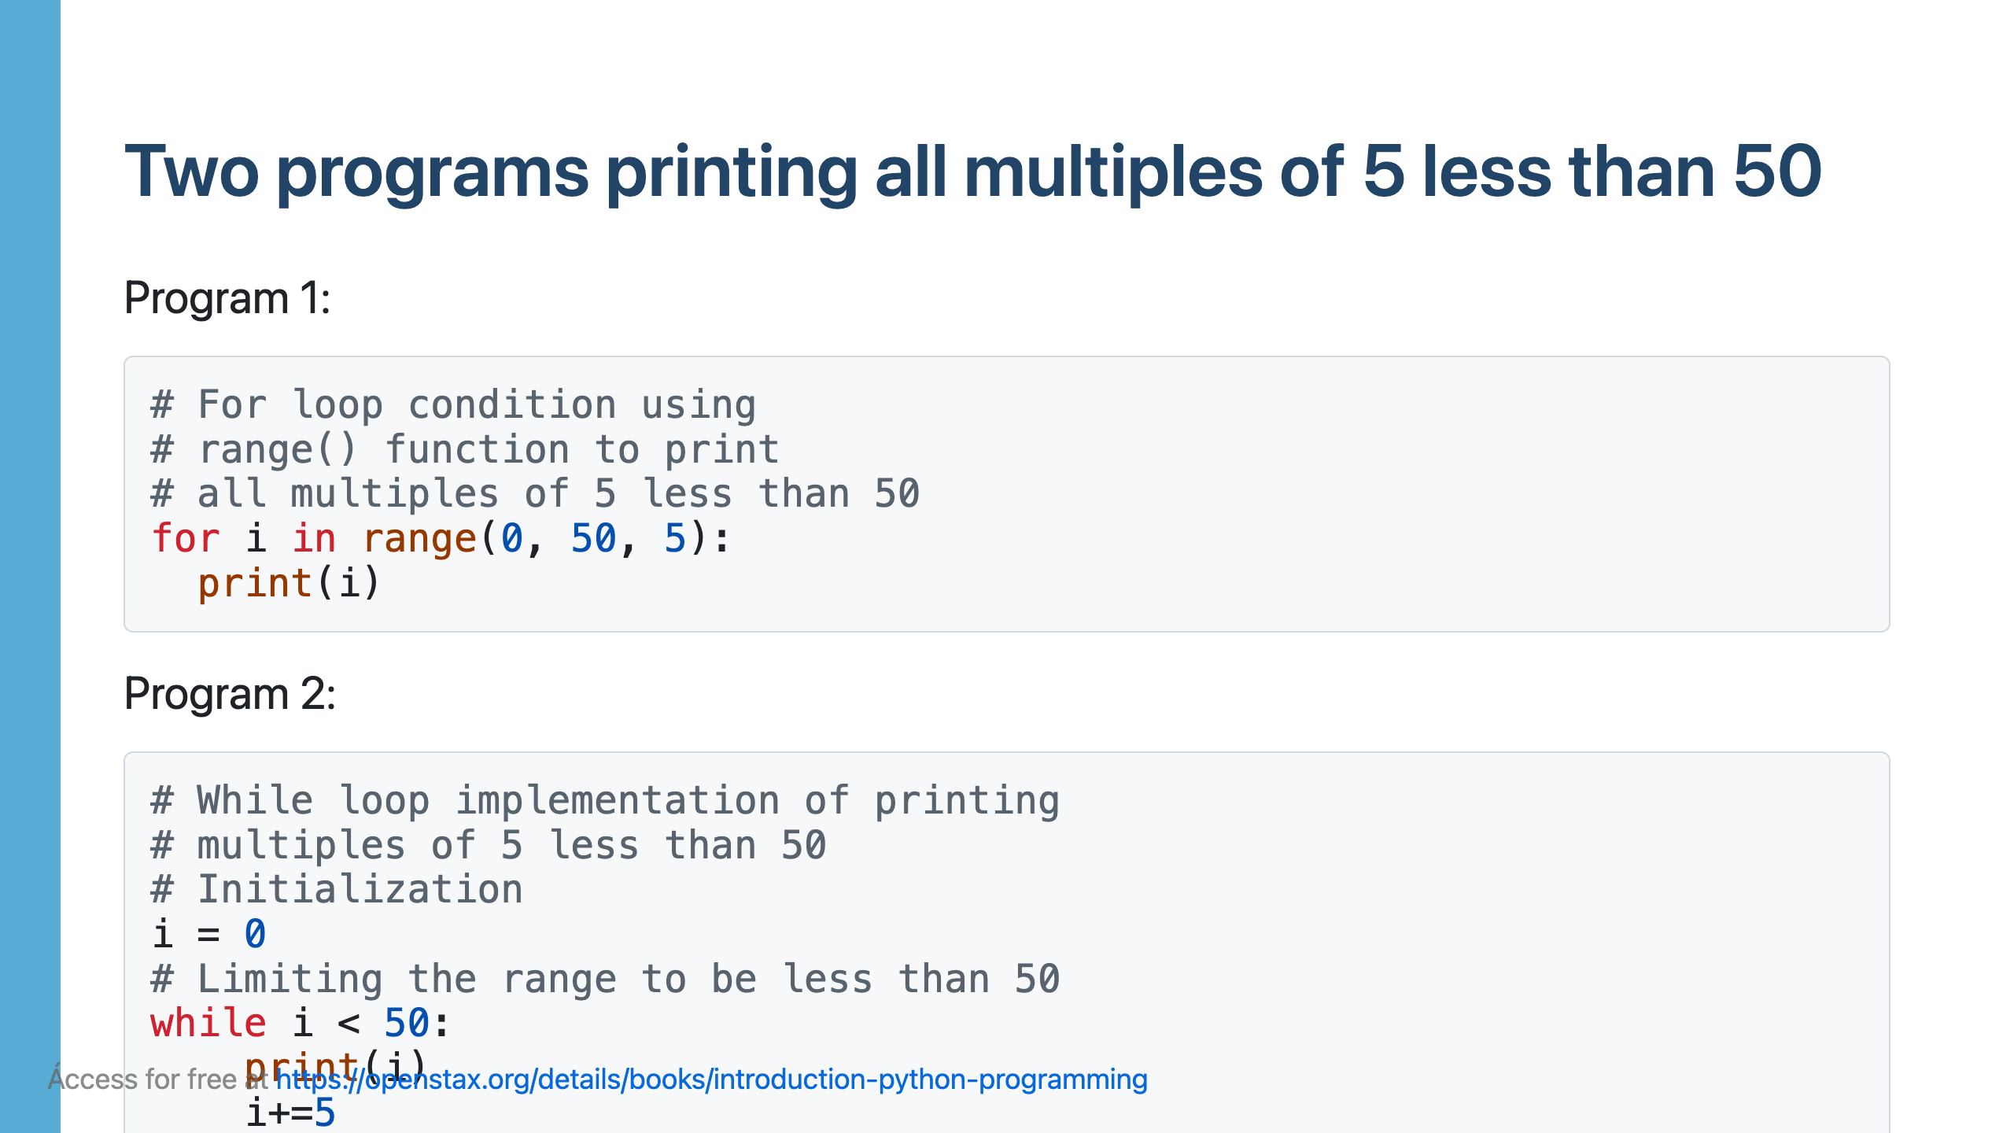

Slide 33
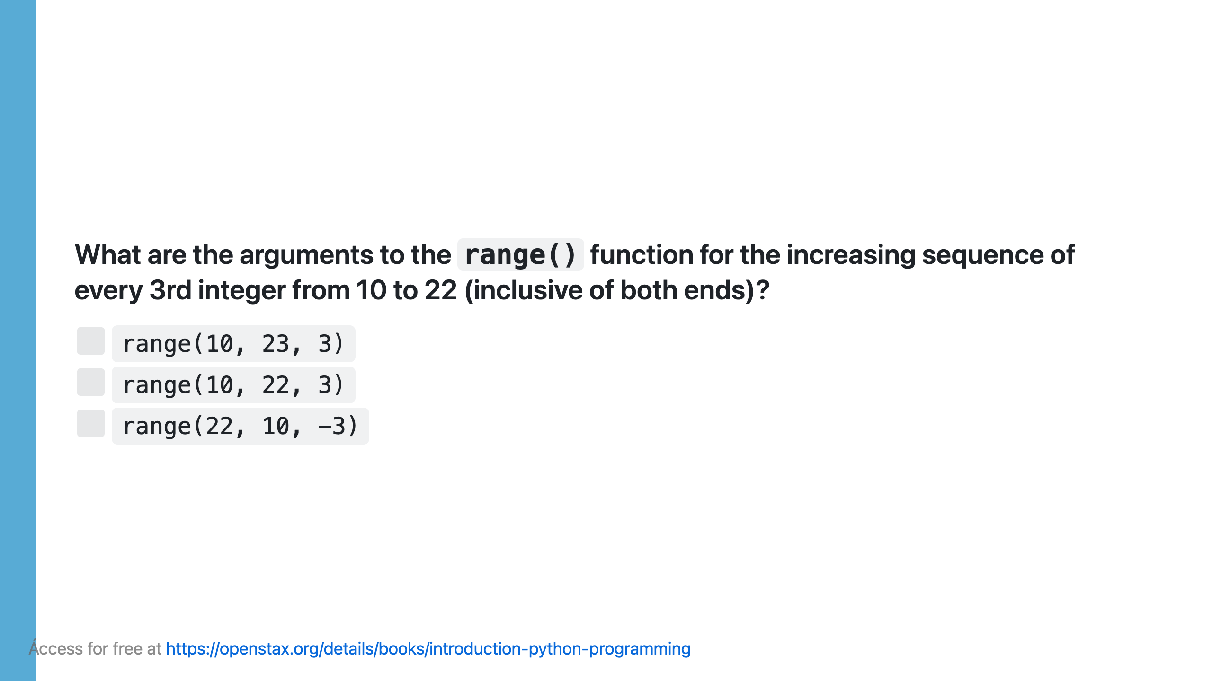

Slide 34
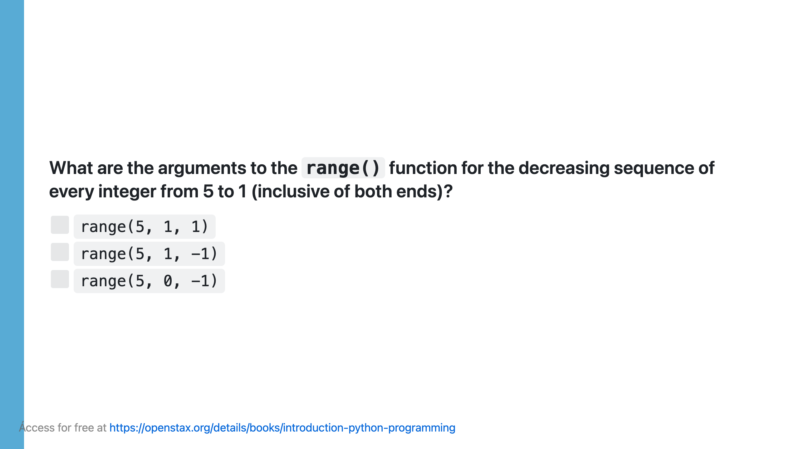

Slide 35
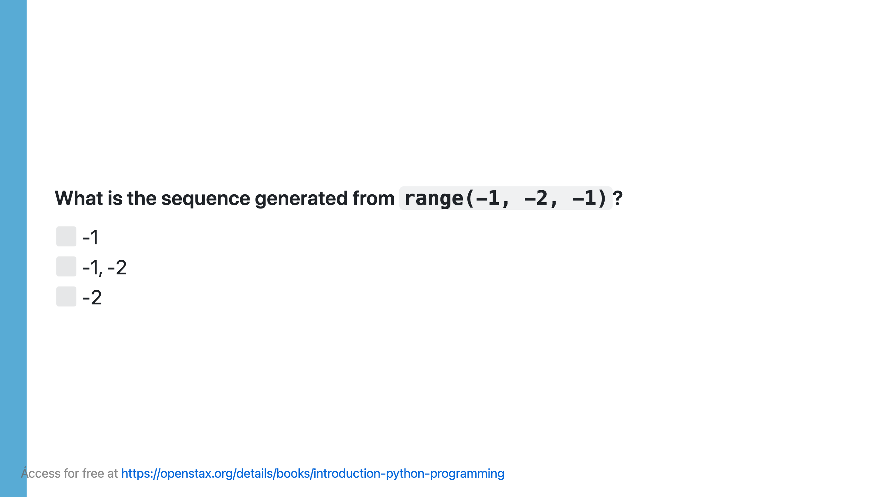

Slide 36
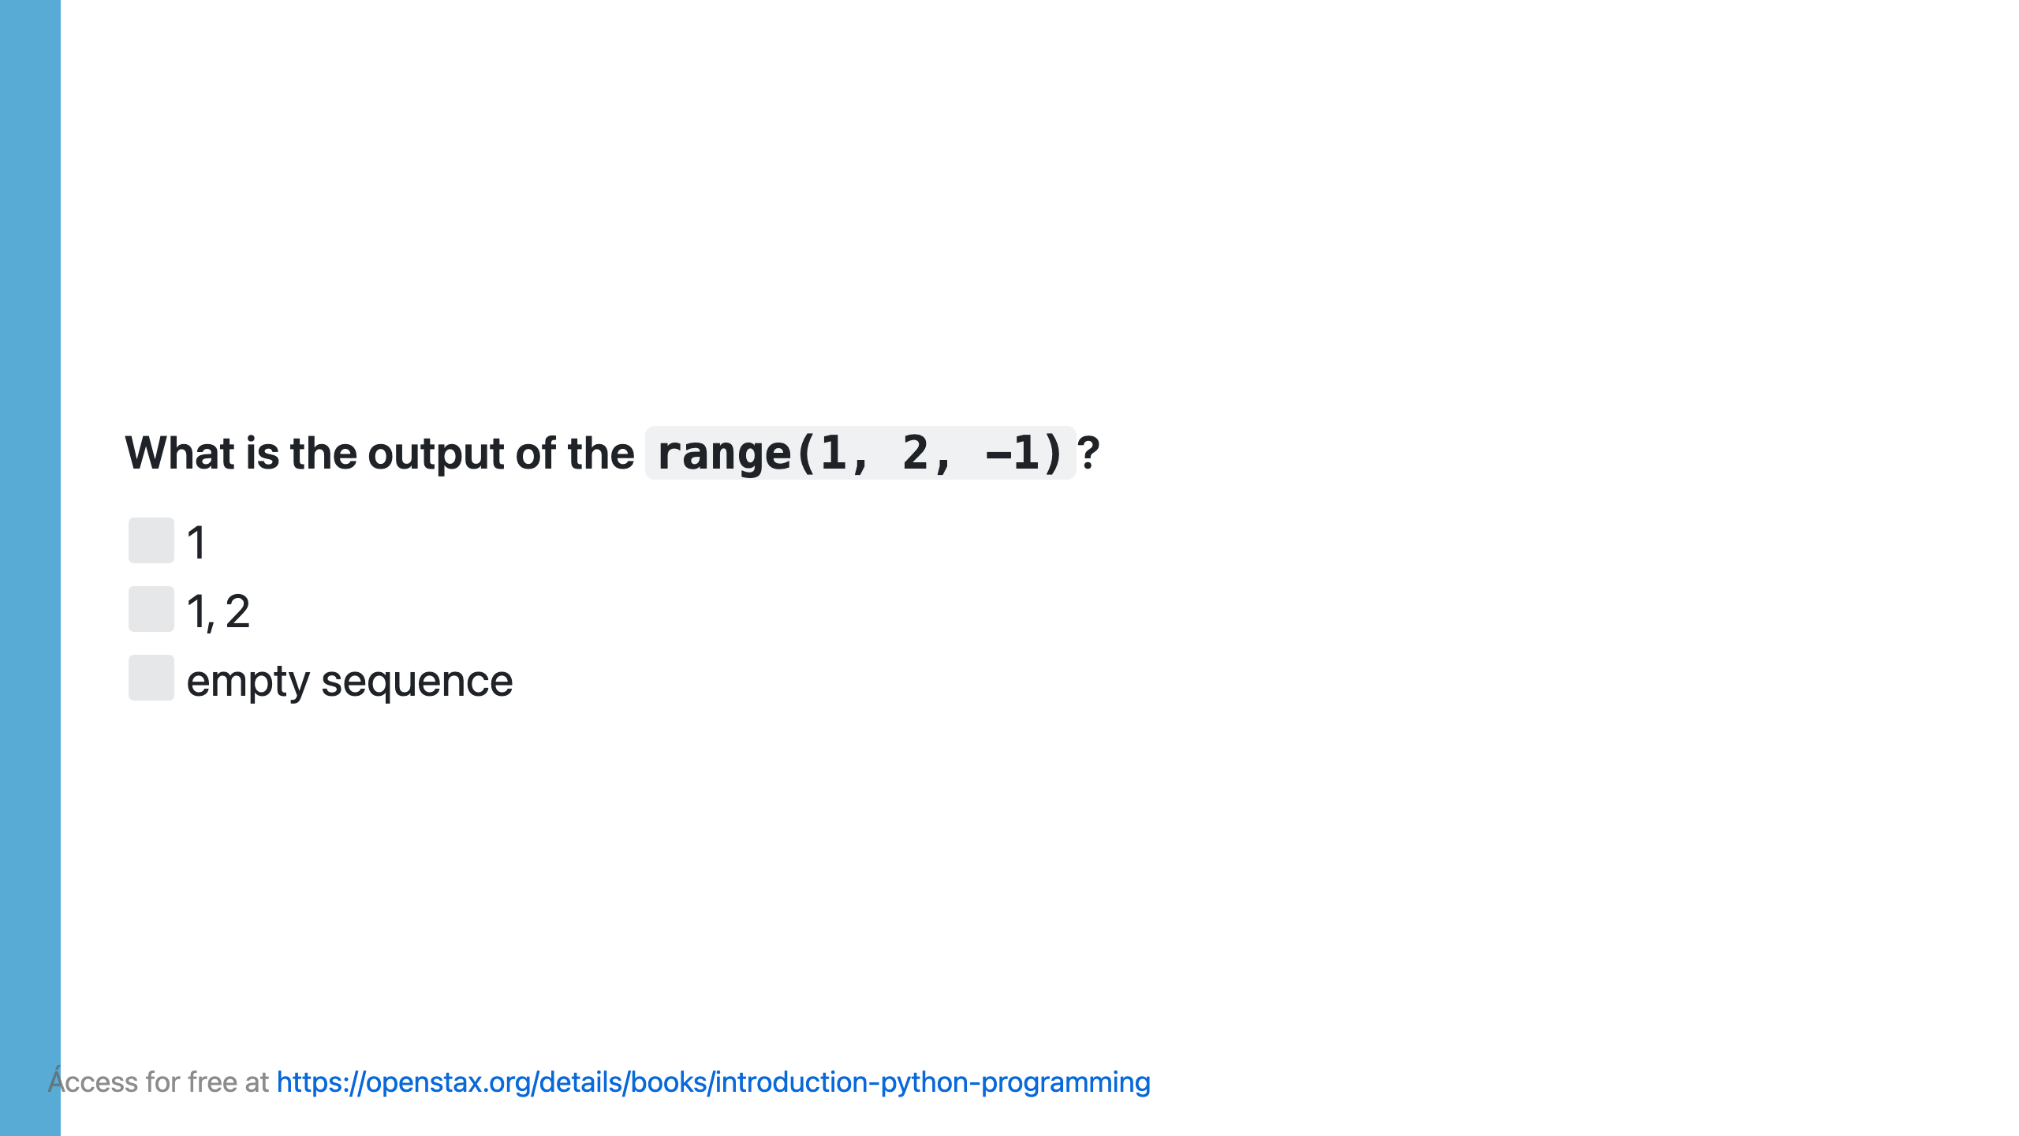

Slide 37
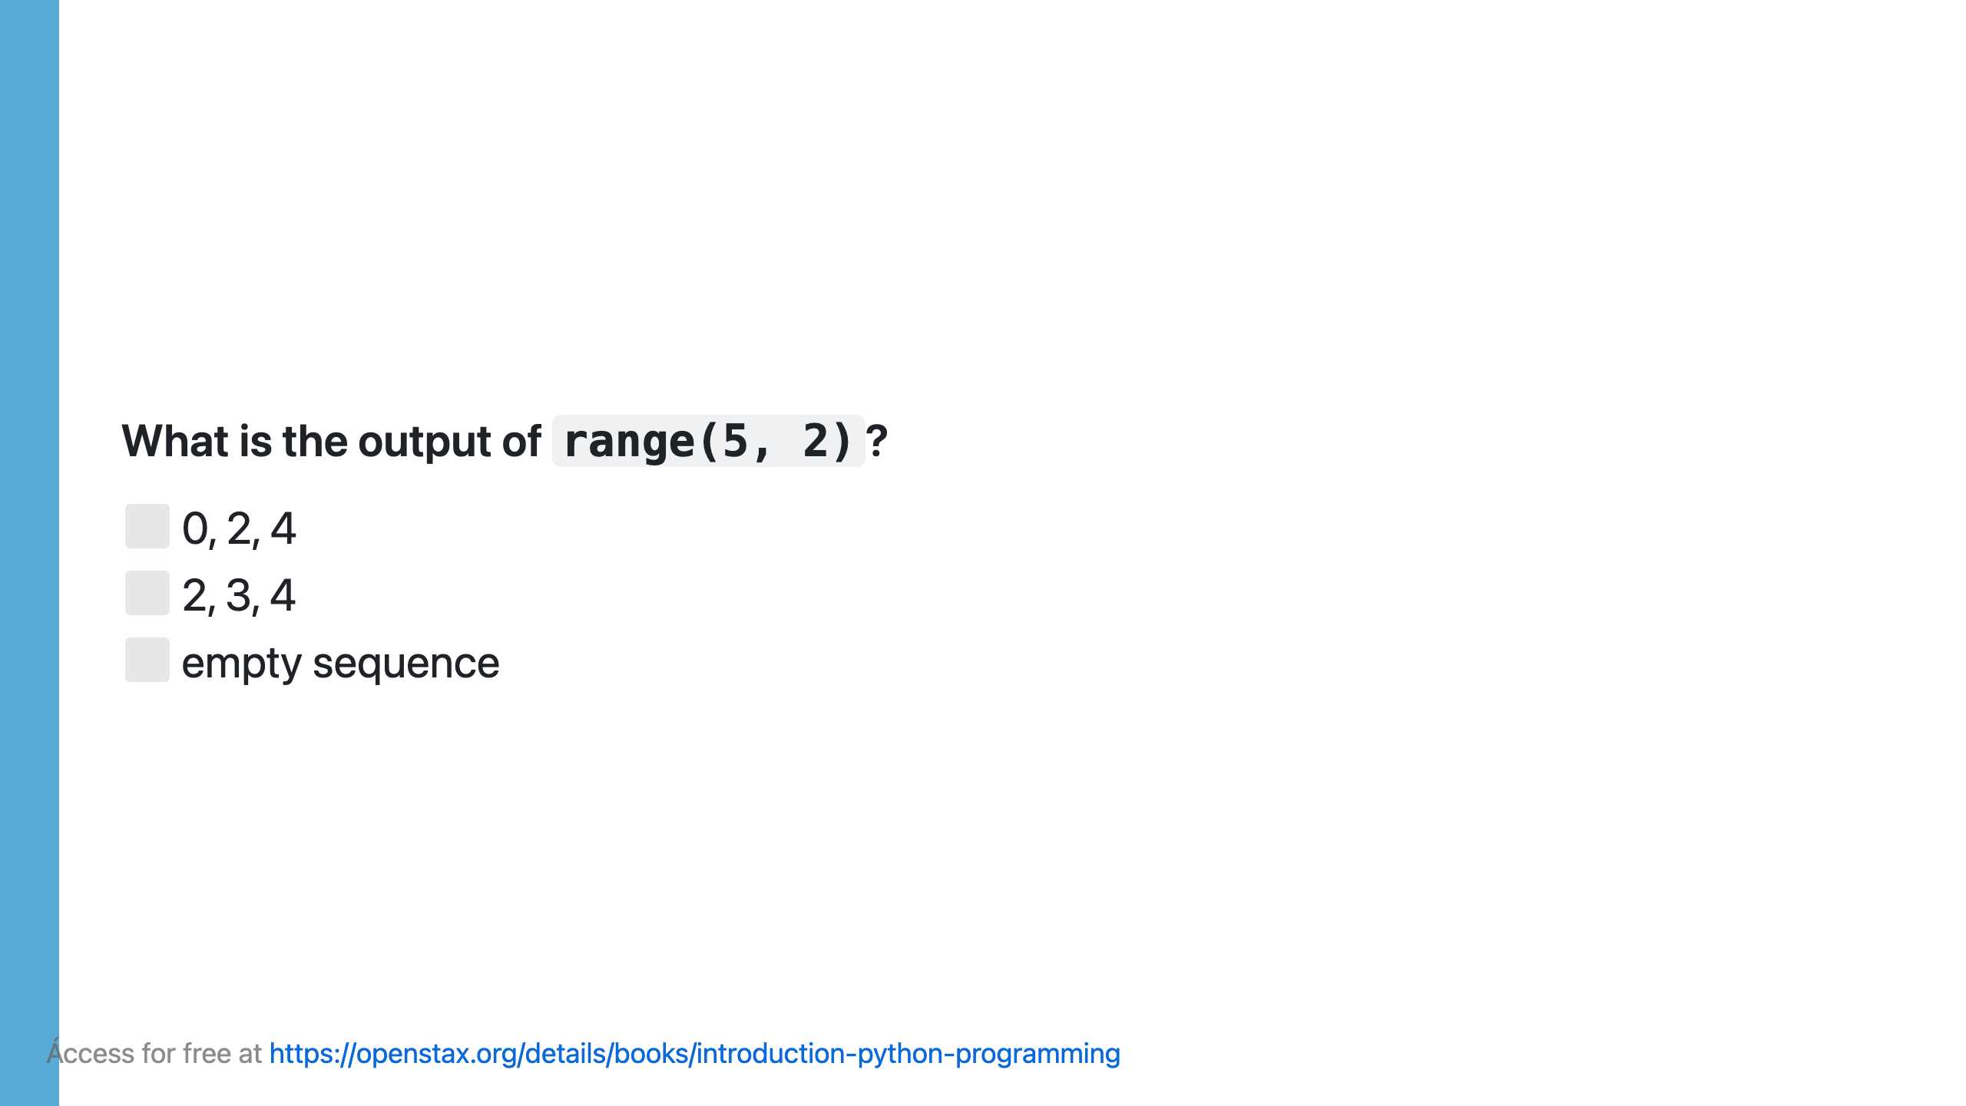

Slide 38
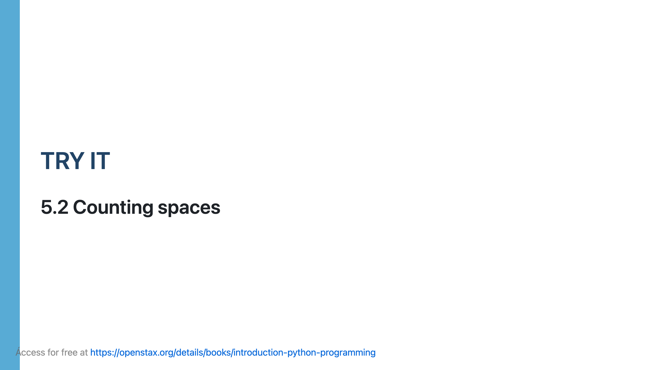

Slide 39
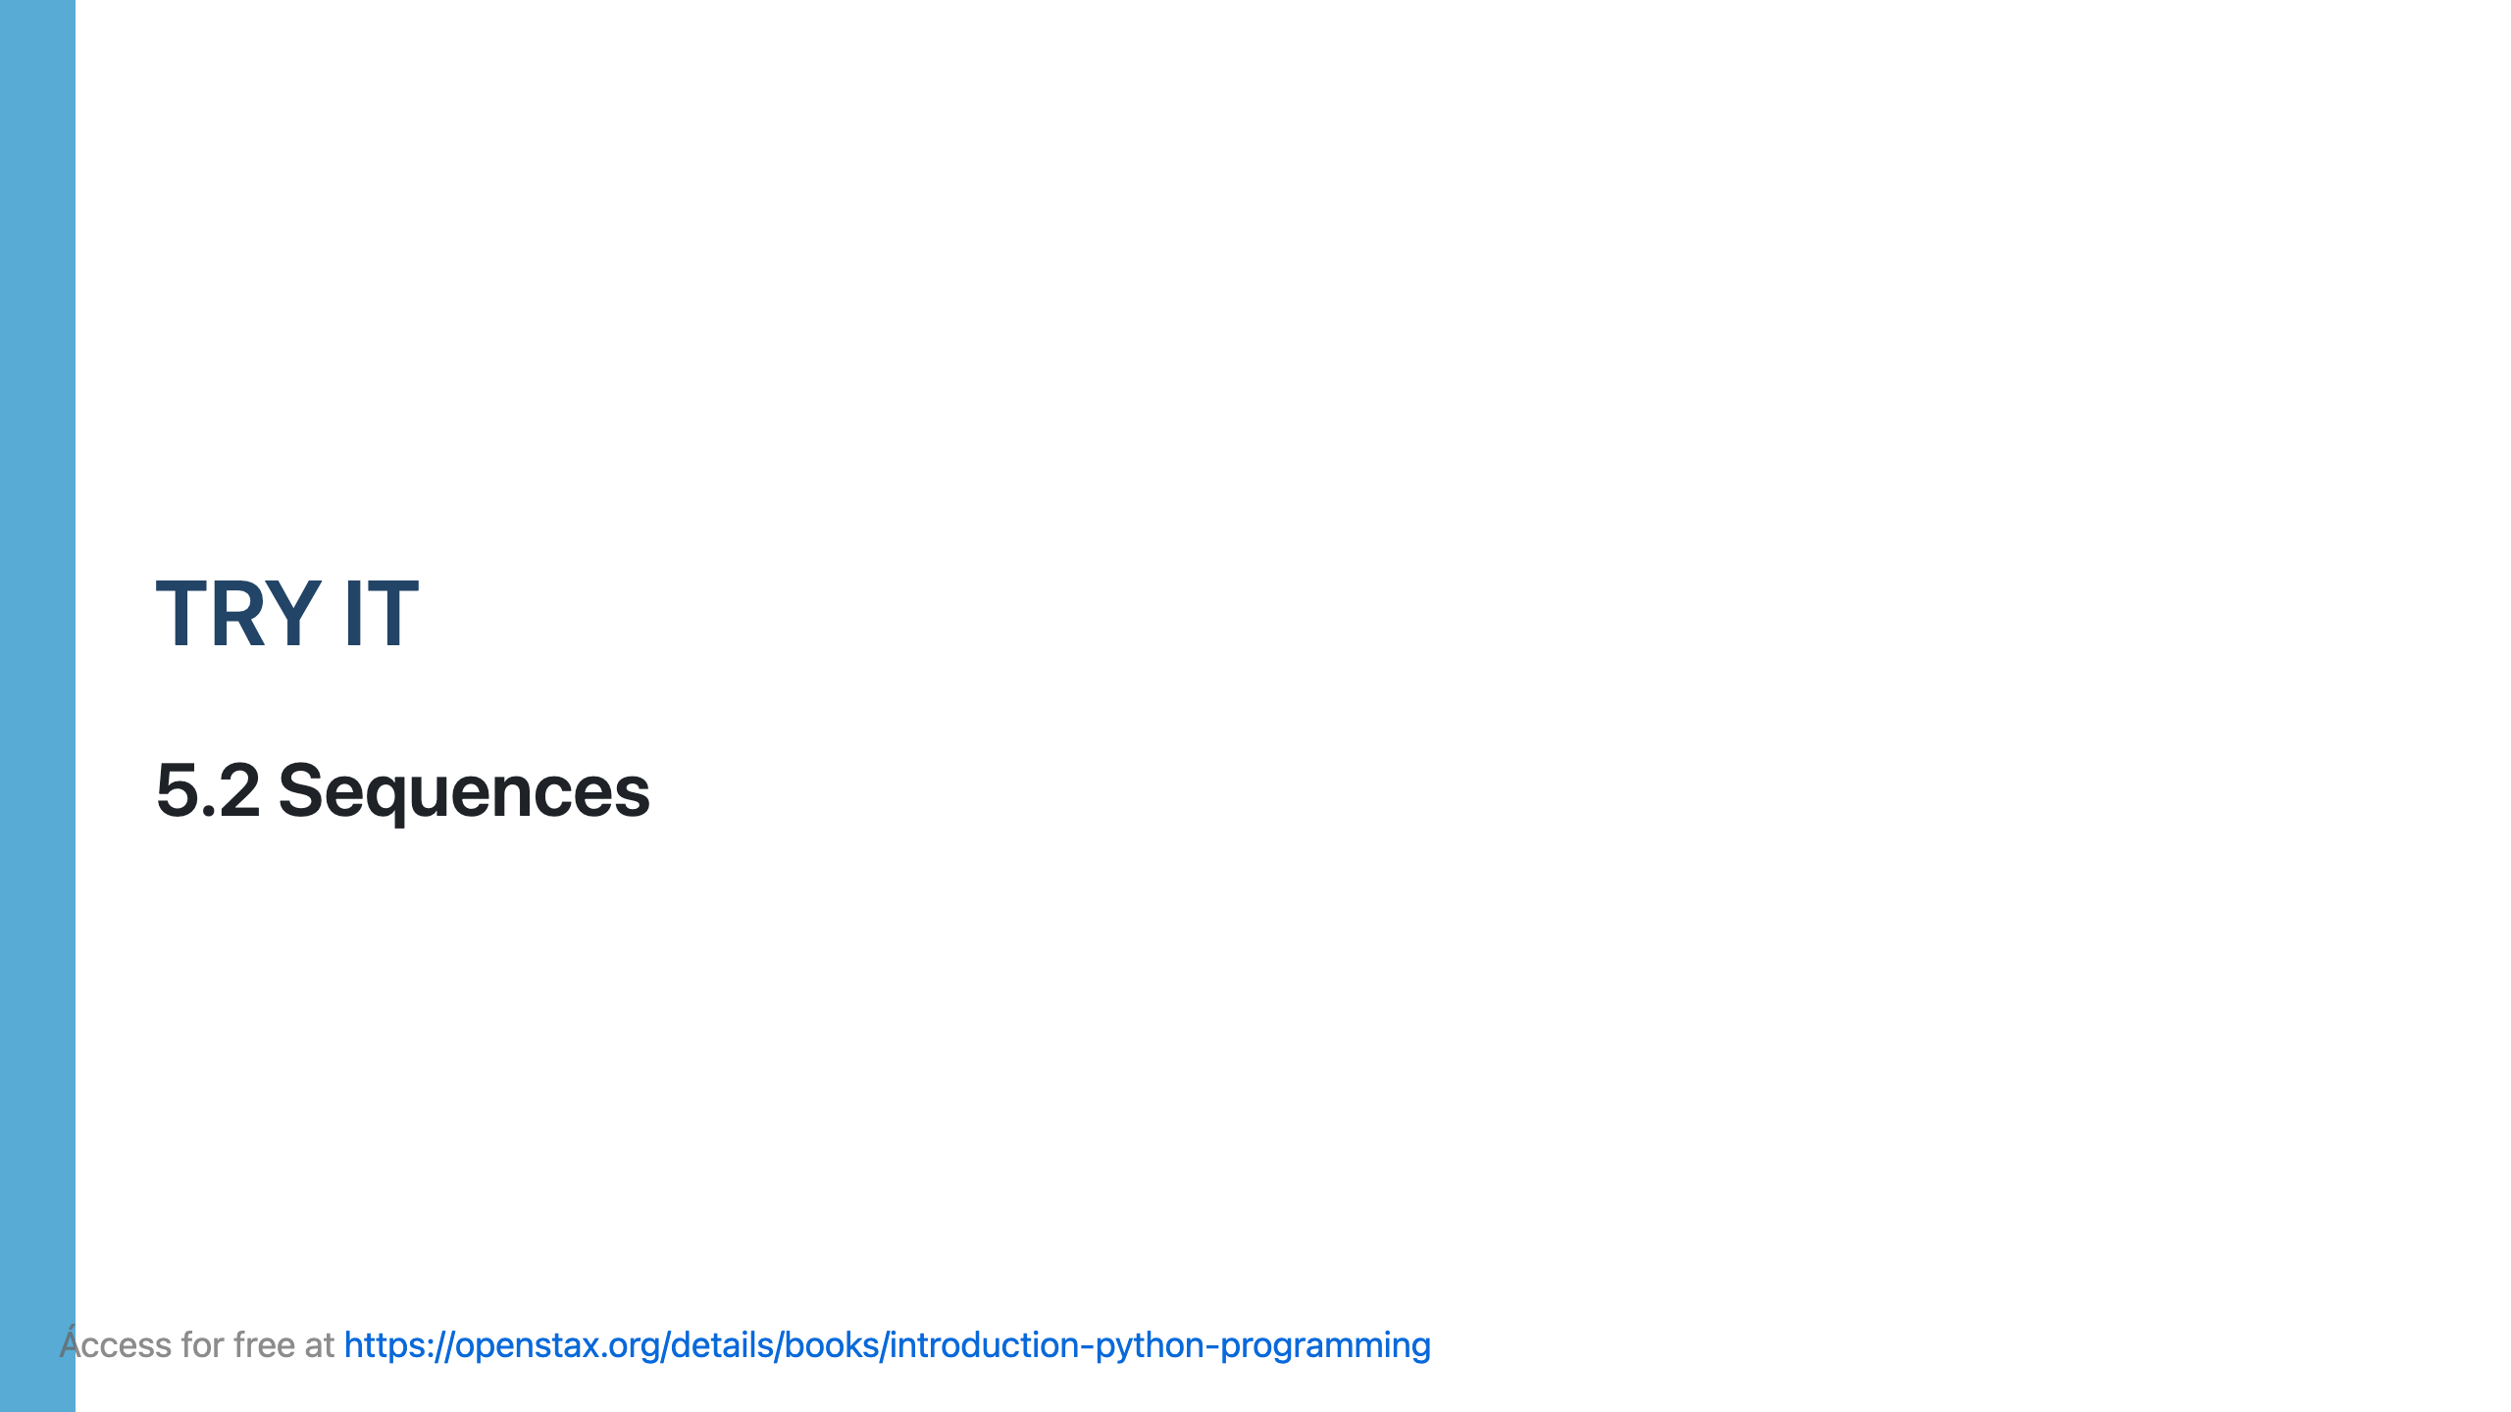

Slide 40
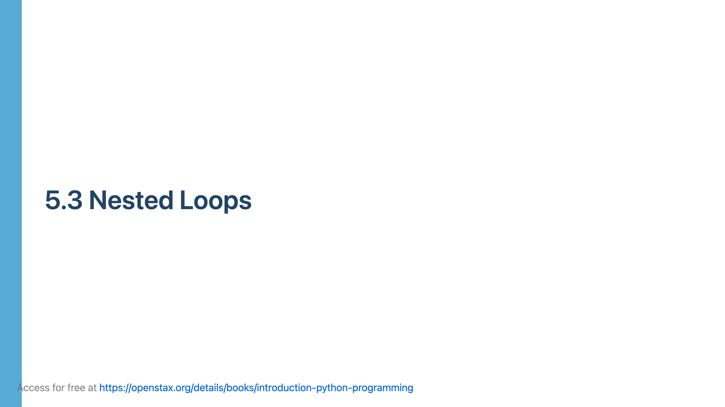

Slide 41
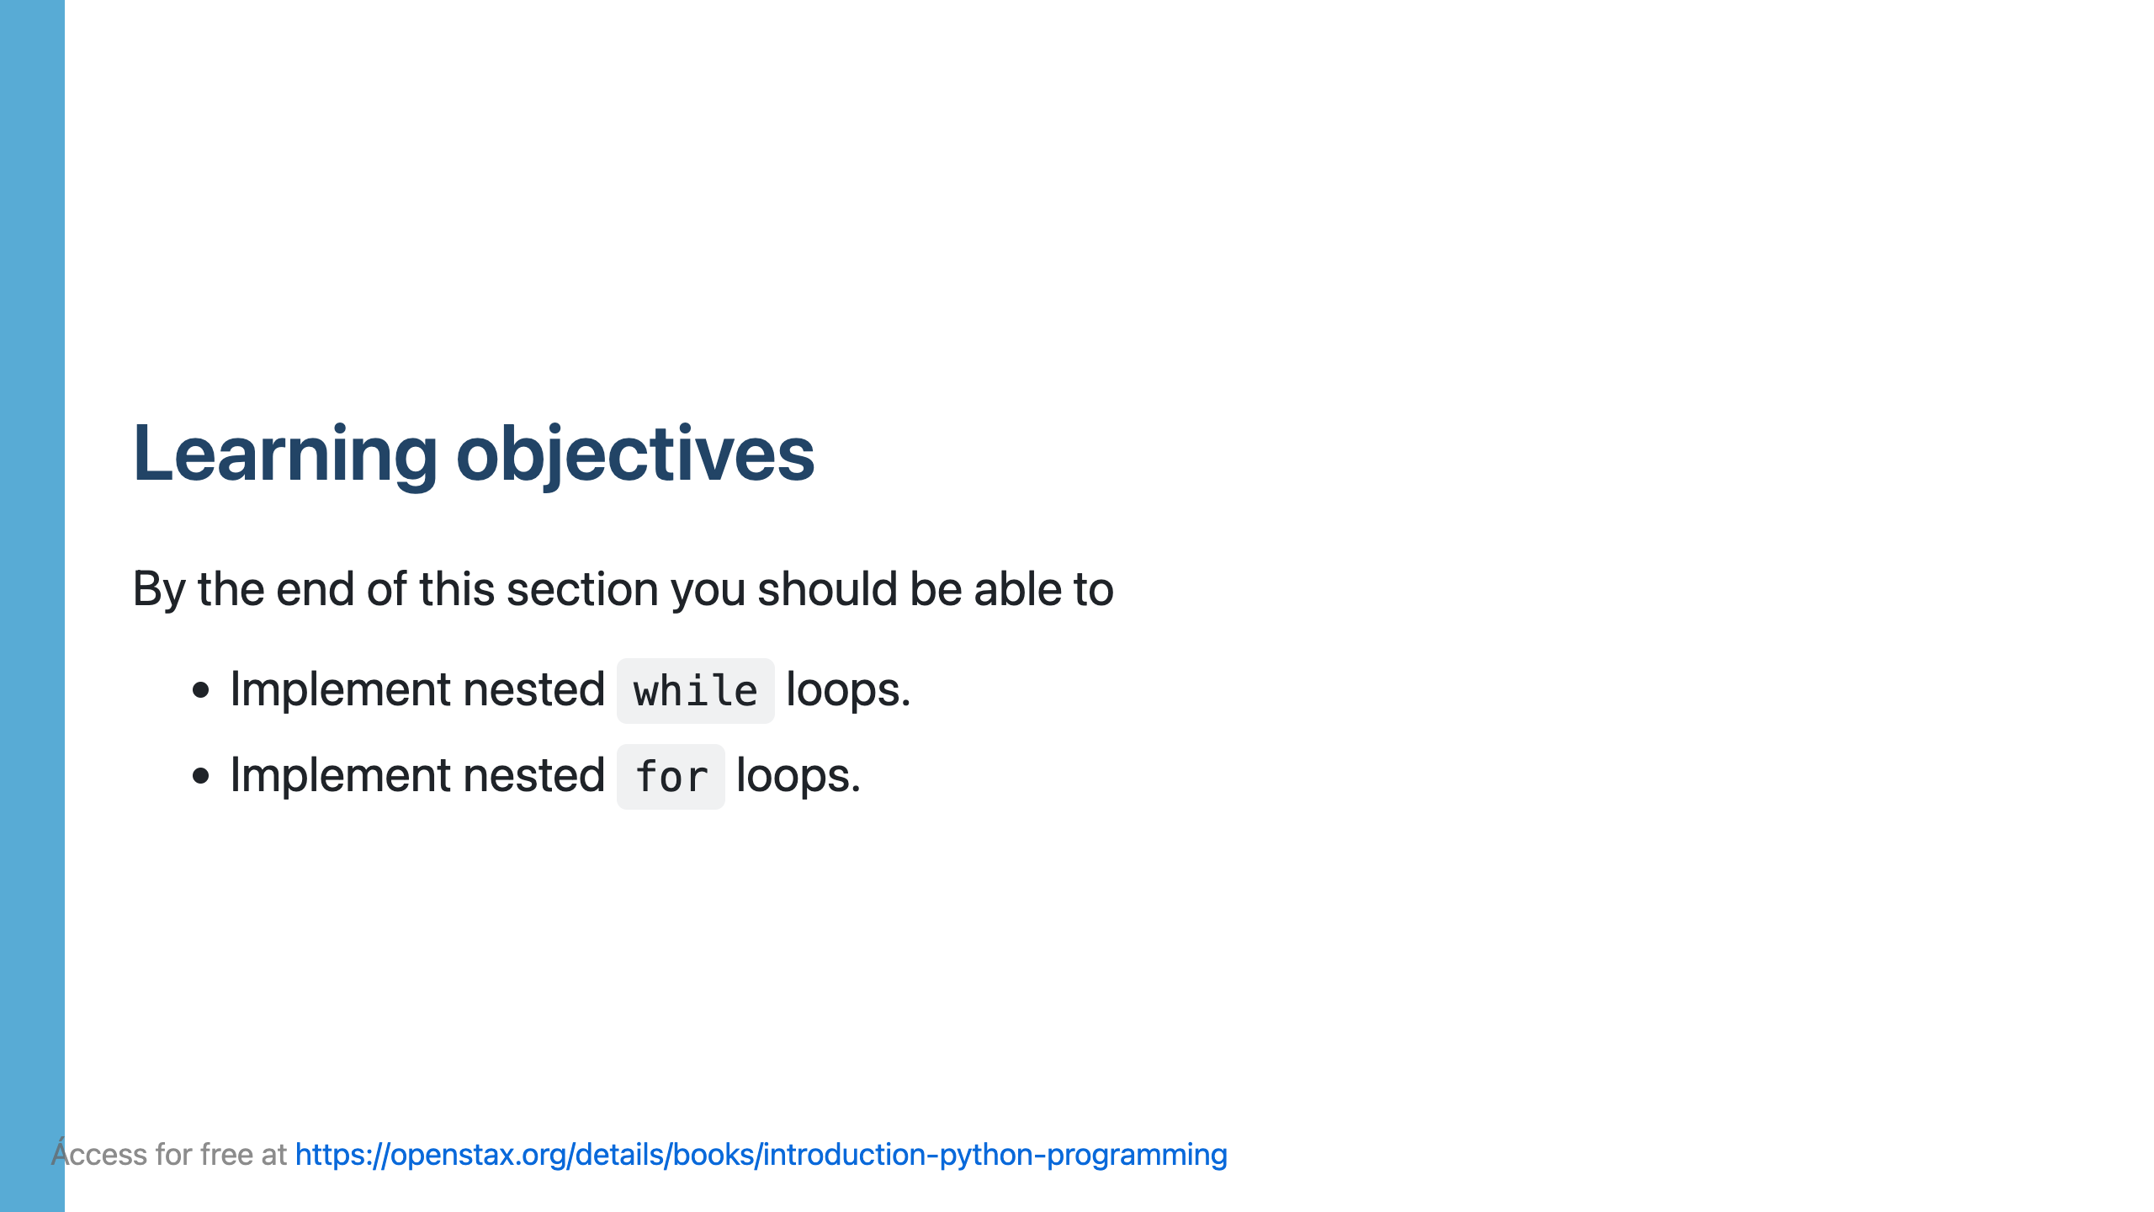

Slide 42
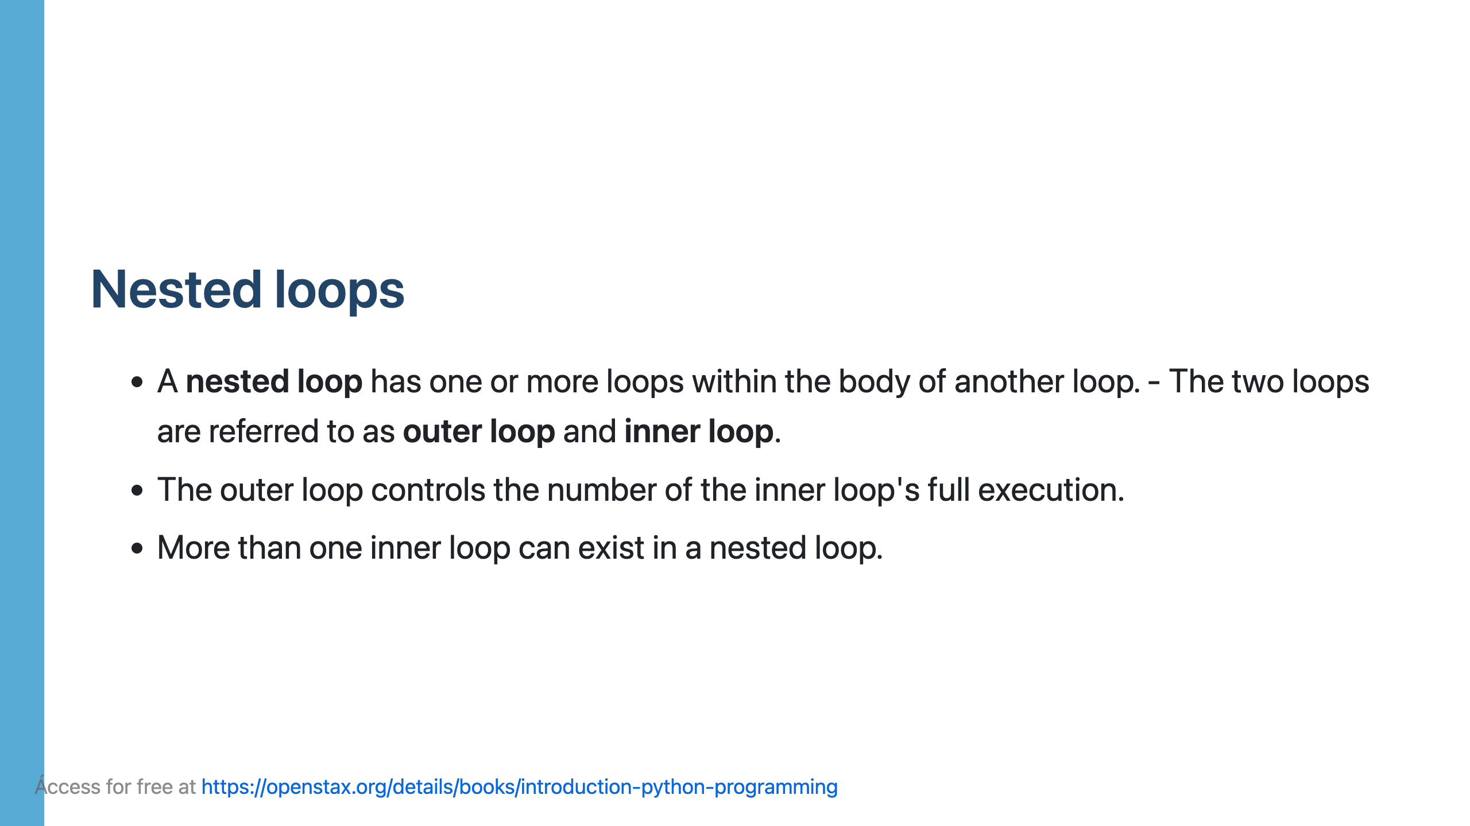

Slide 43
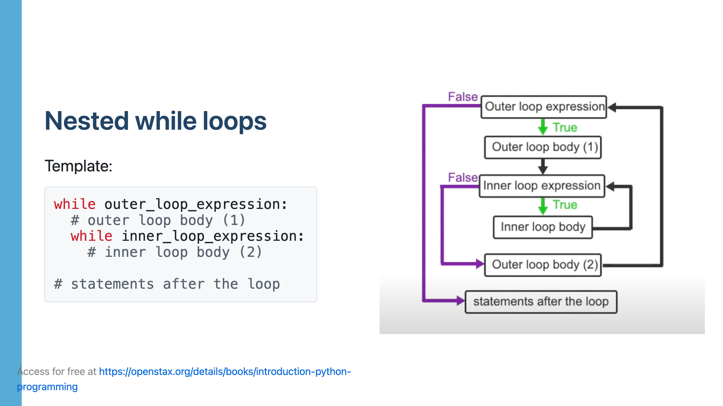

Slide 44
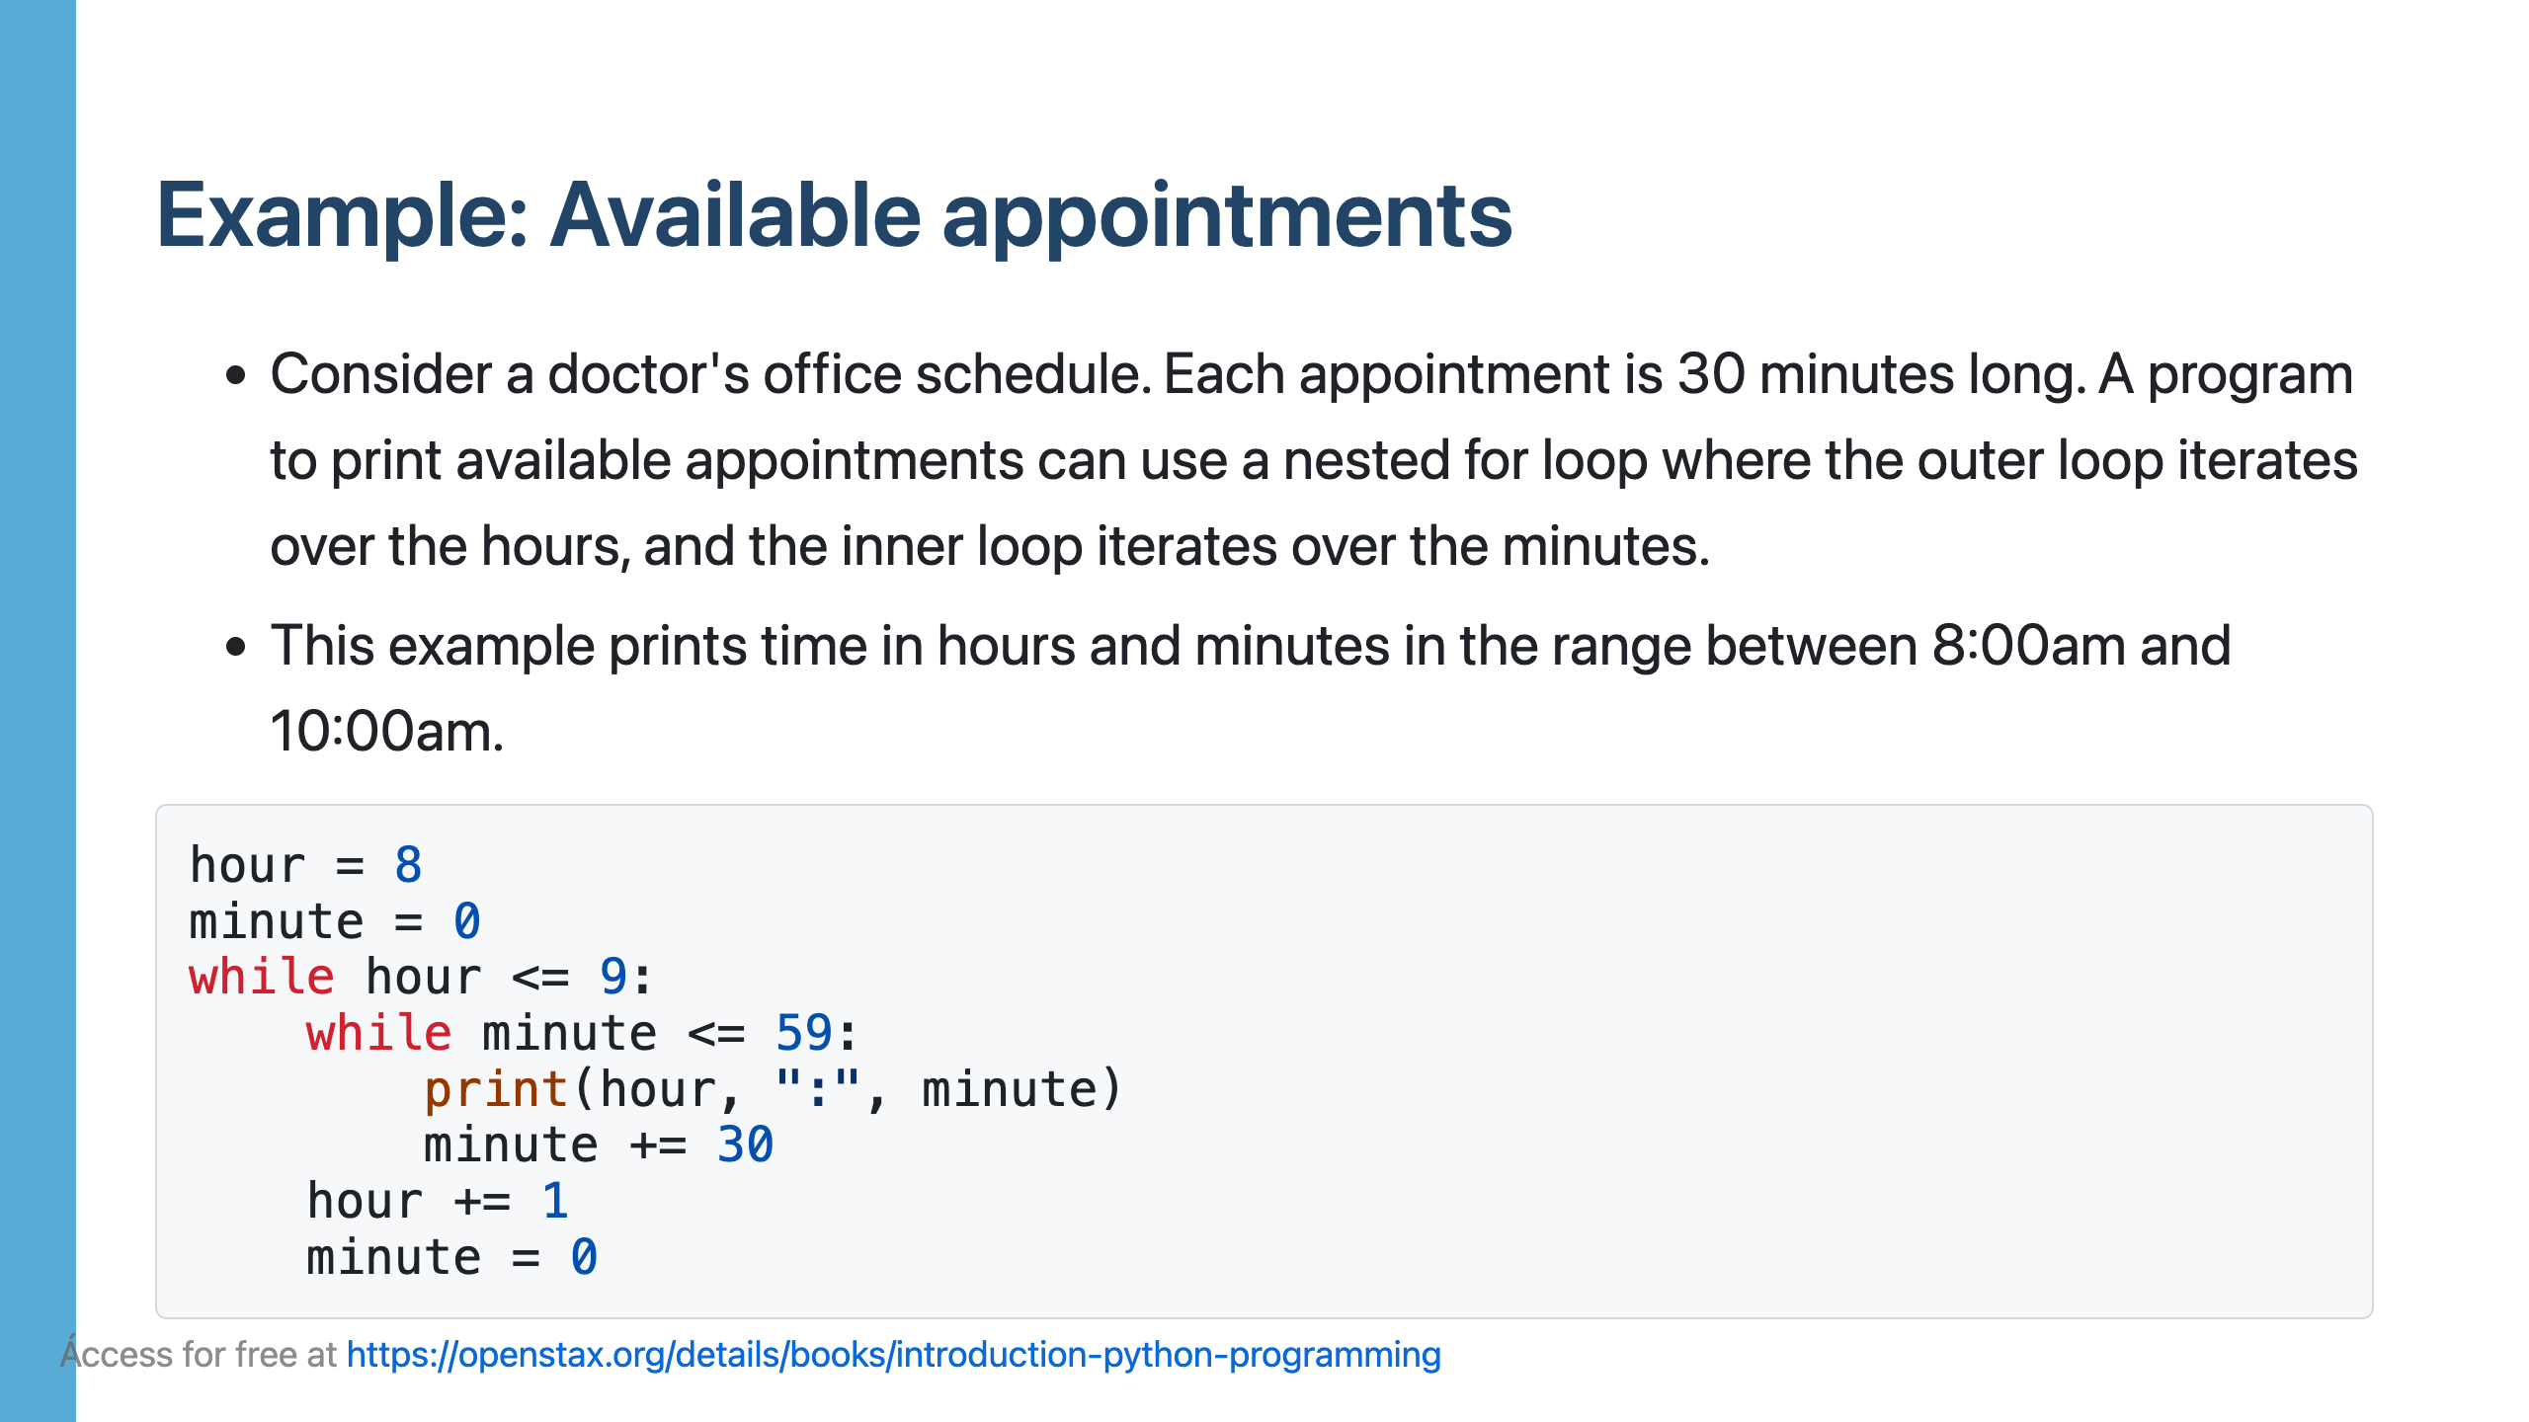
Notes:
The above code's output is: 8 : 0 8 : 30 9 : 0 9 : 30 In this example, the outer loop iterates over the time's hour portion between 8 and 9, and the inner loop iterates over the time's minute portion between 0 and 59.

Slide 46
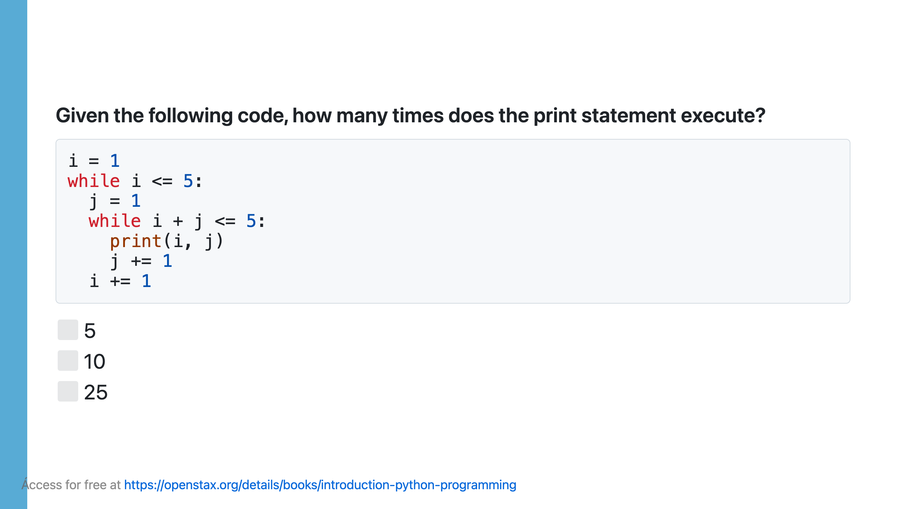

Slide 47
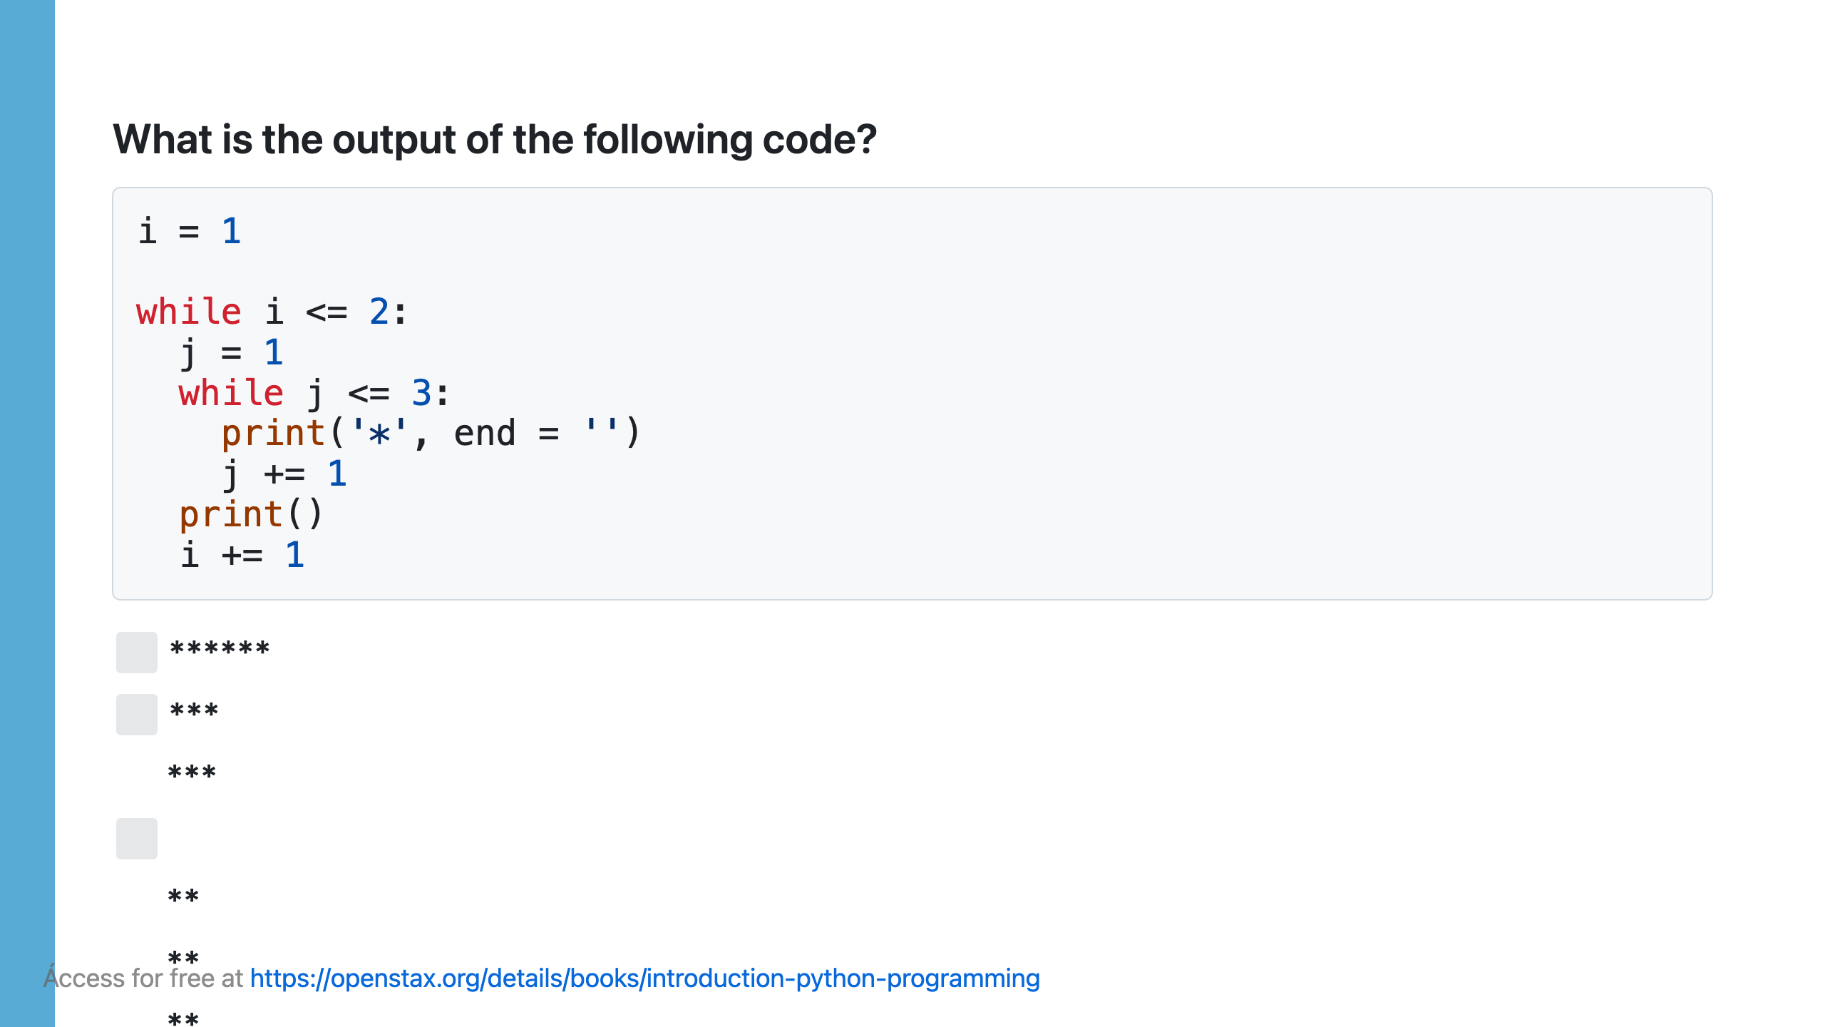

Slide 48
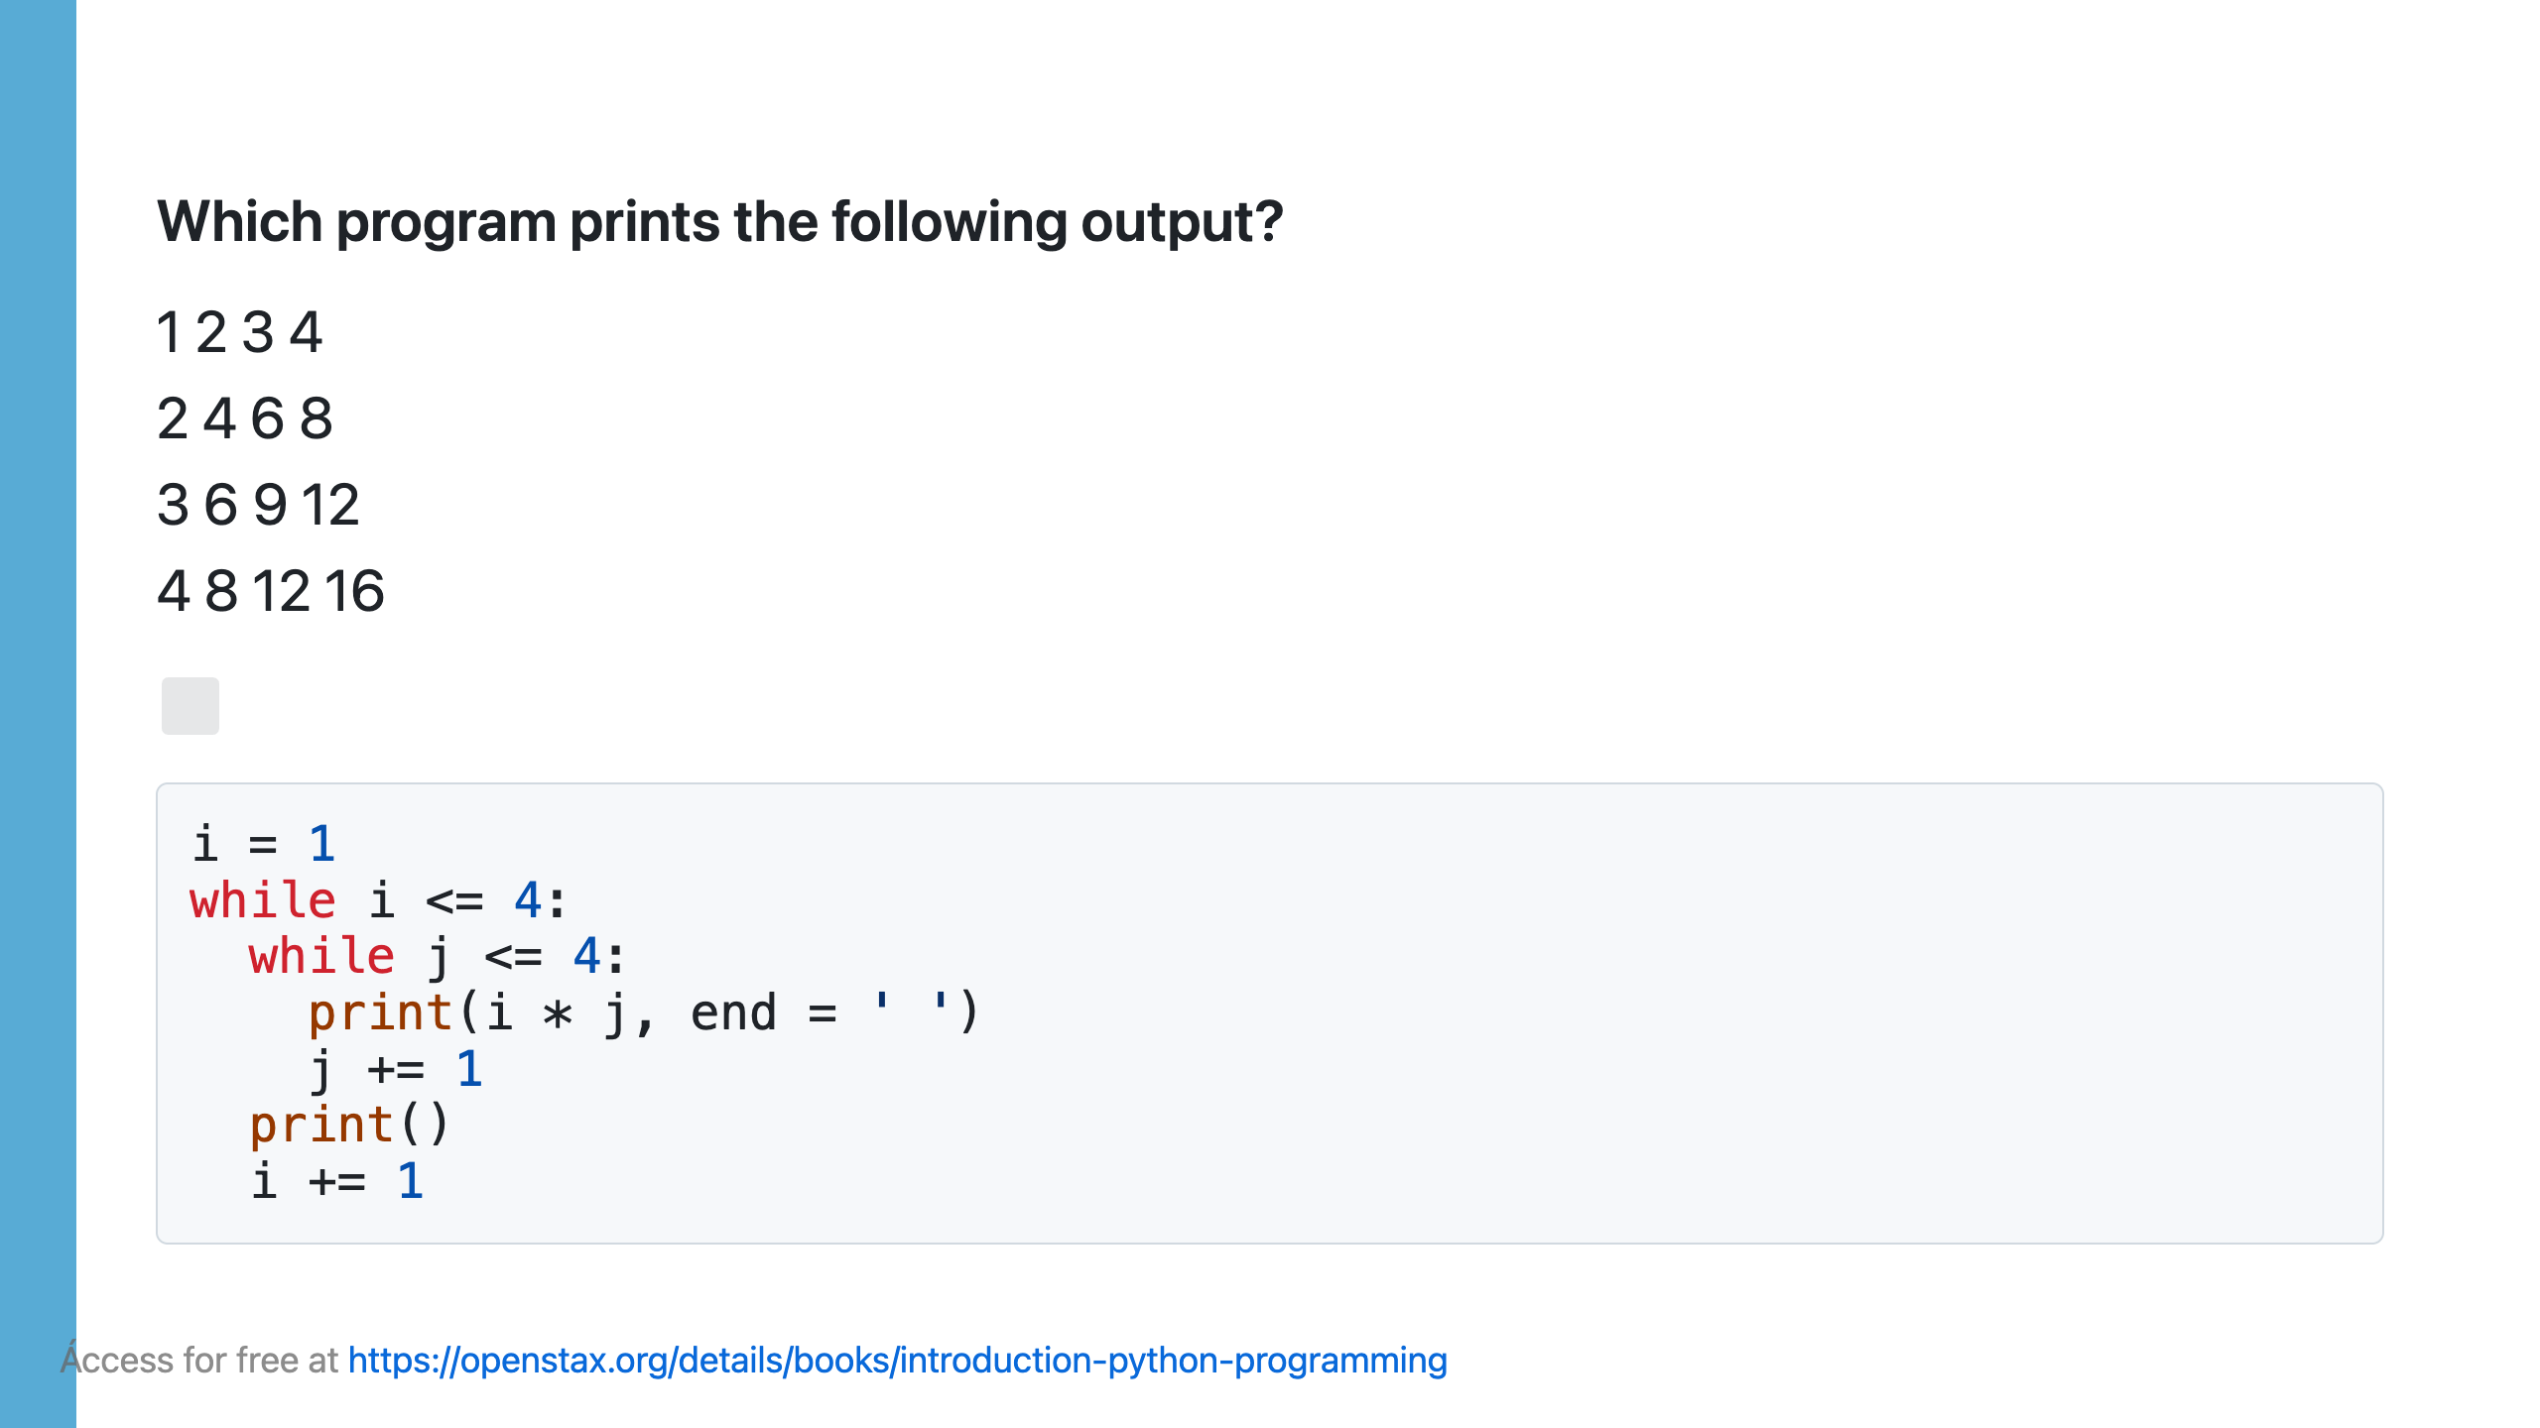

Slide 49
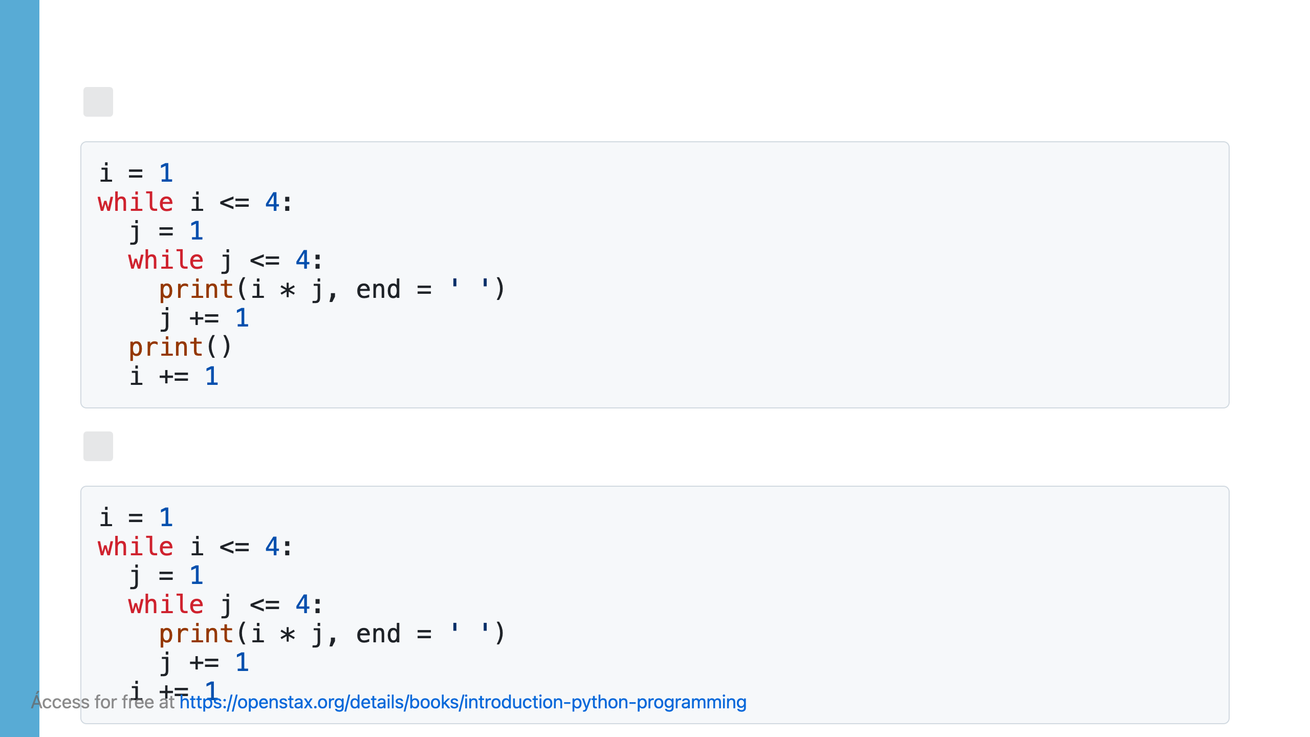

Slide 50
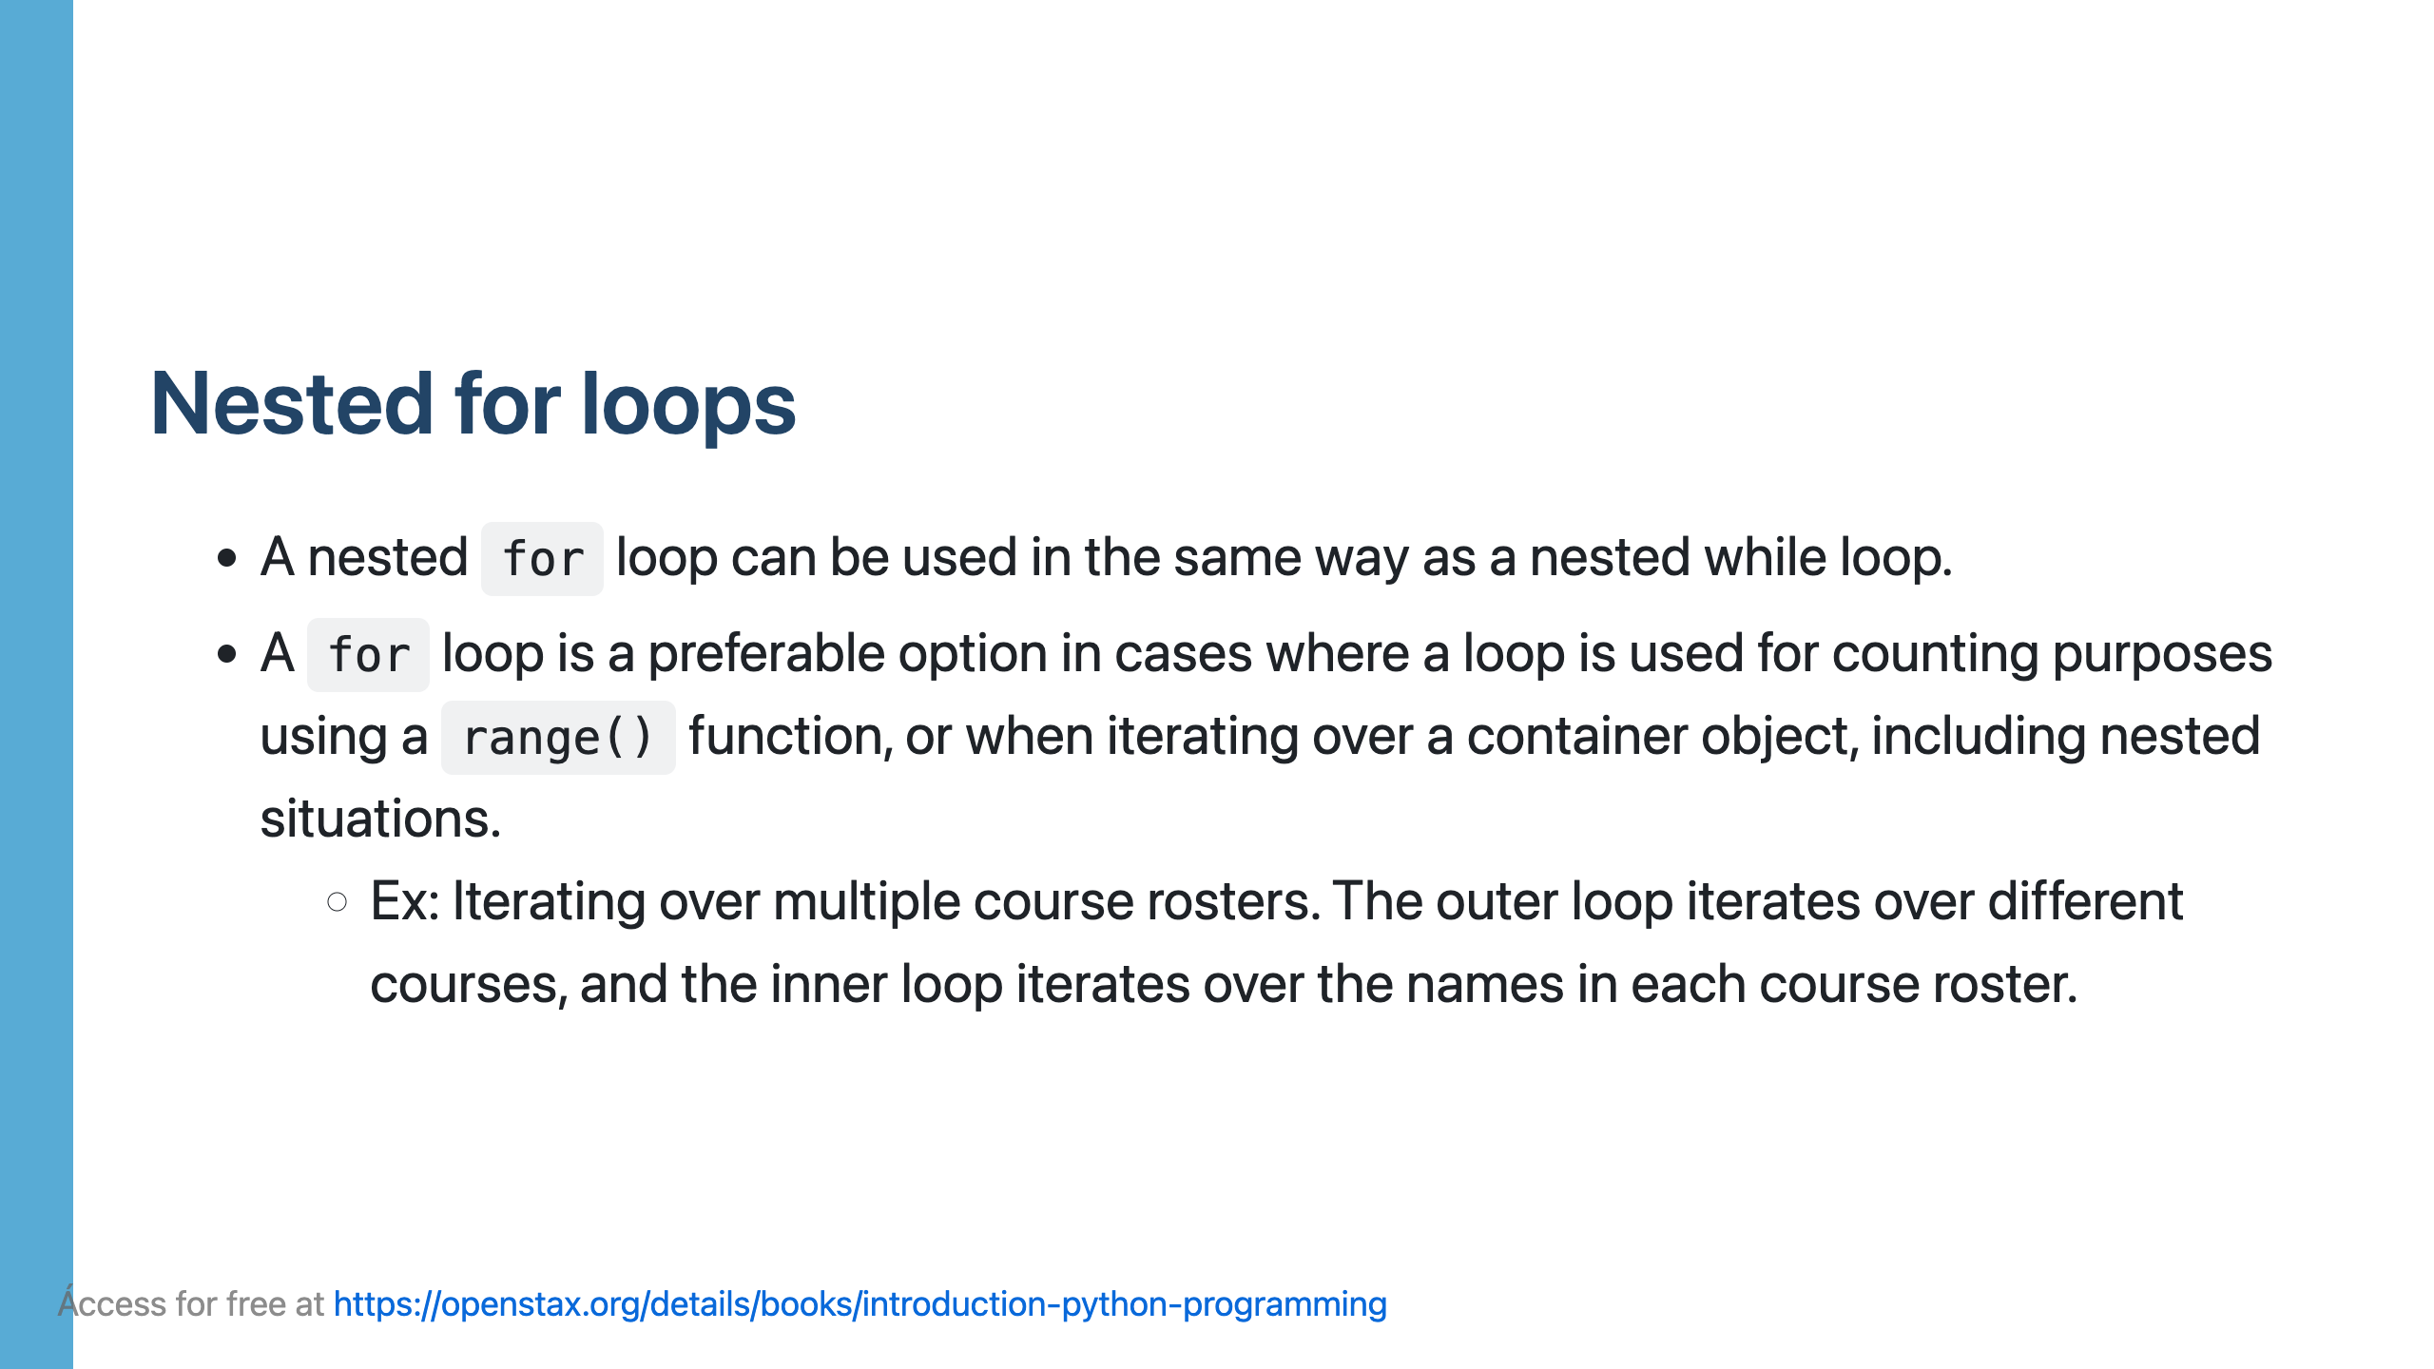

Slide 51
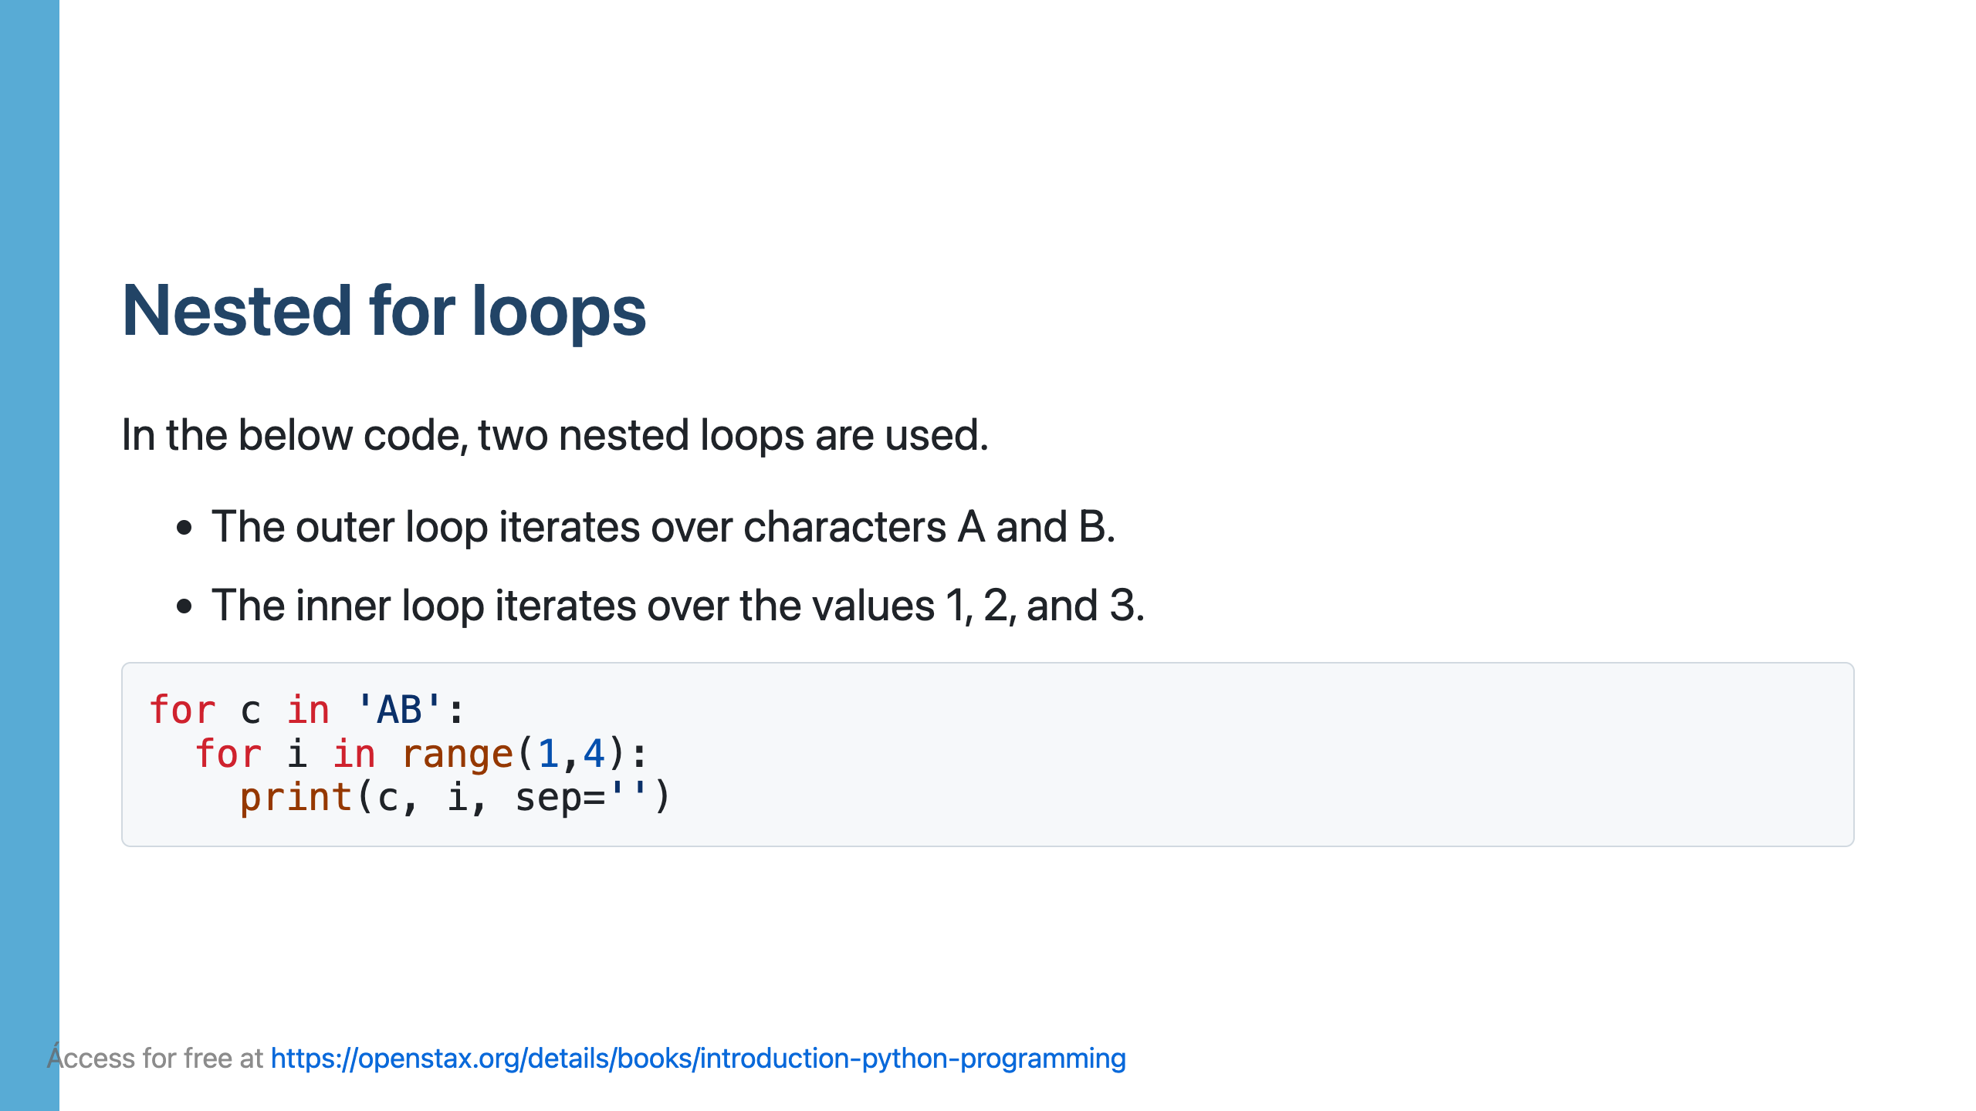

Slide 52
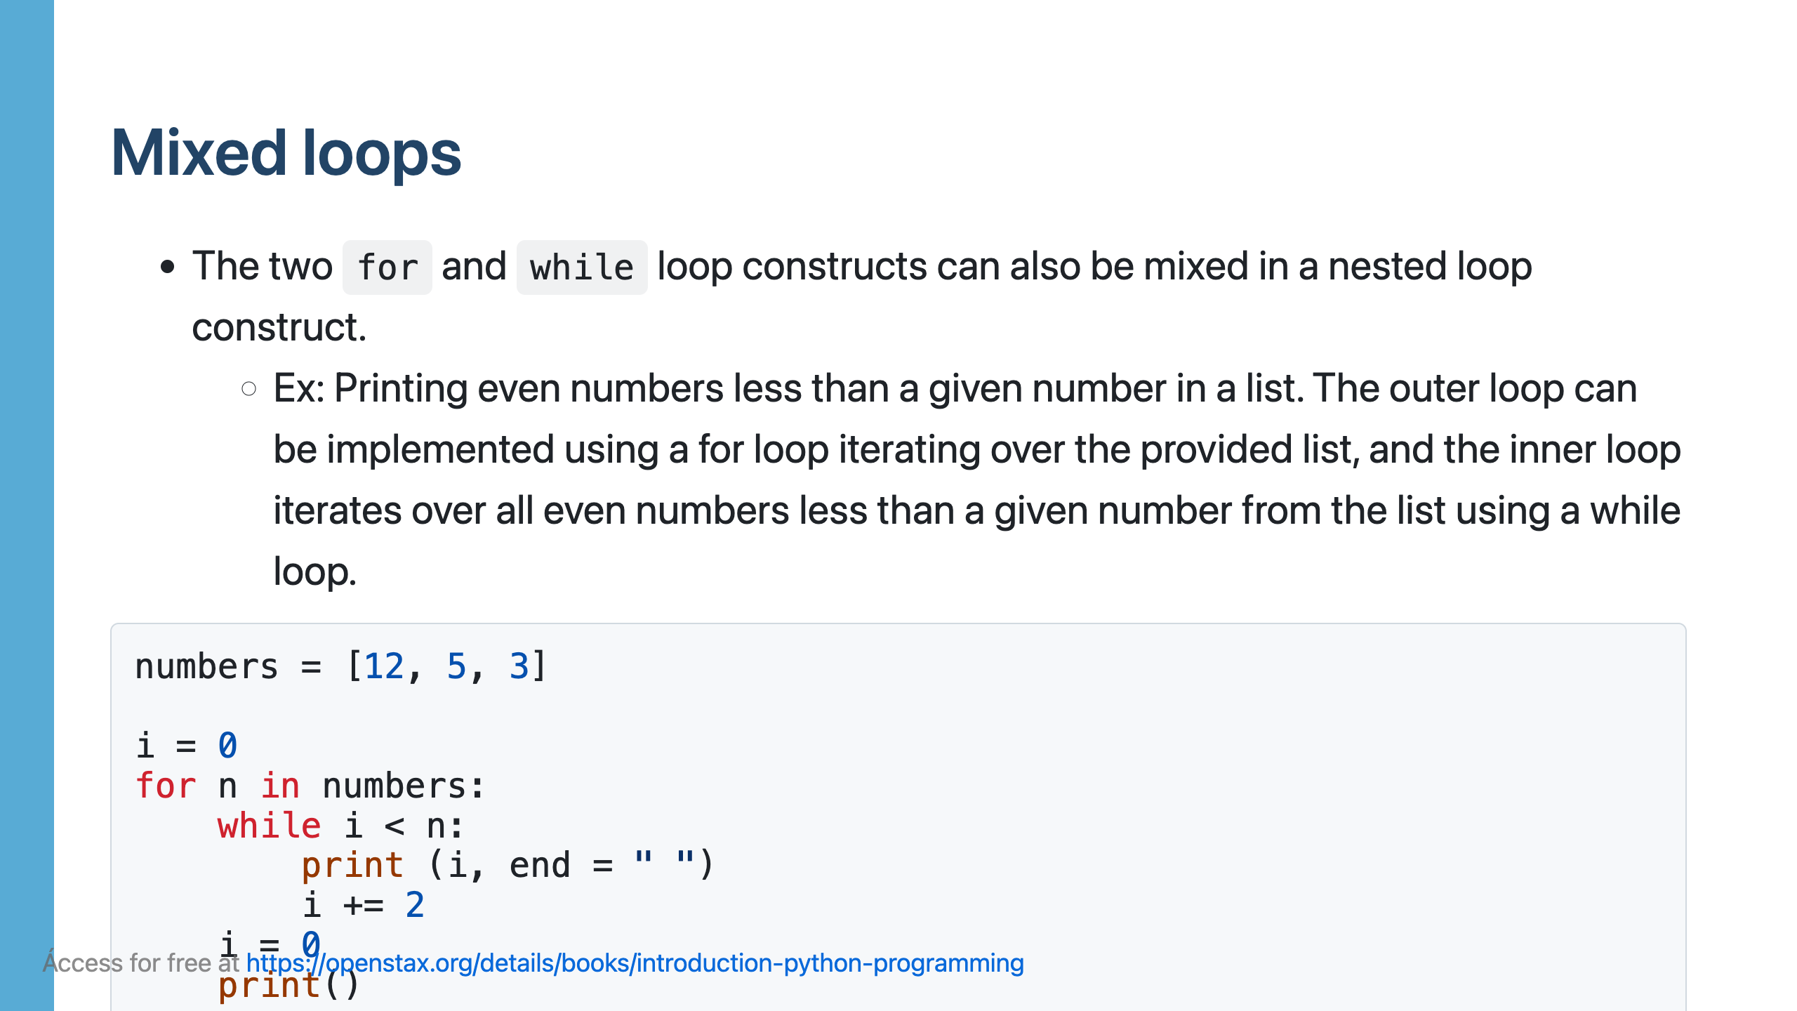

Slide 54
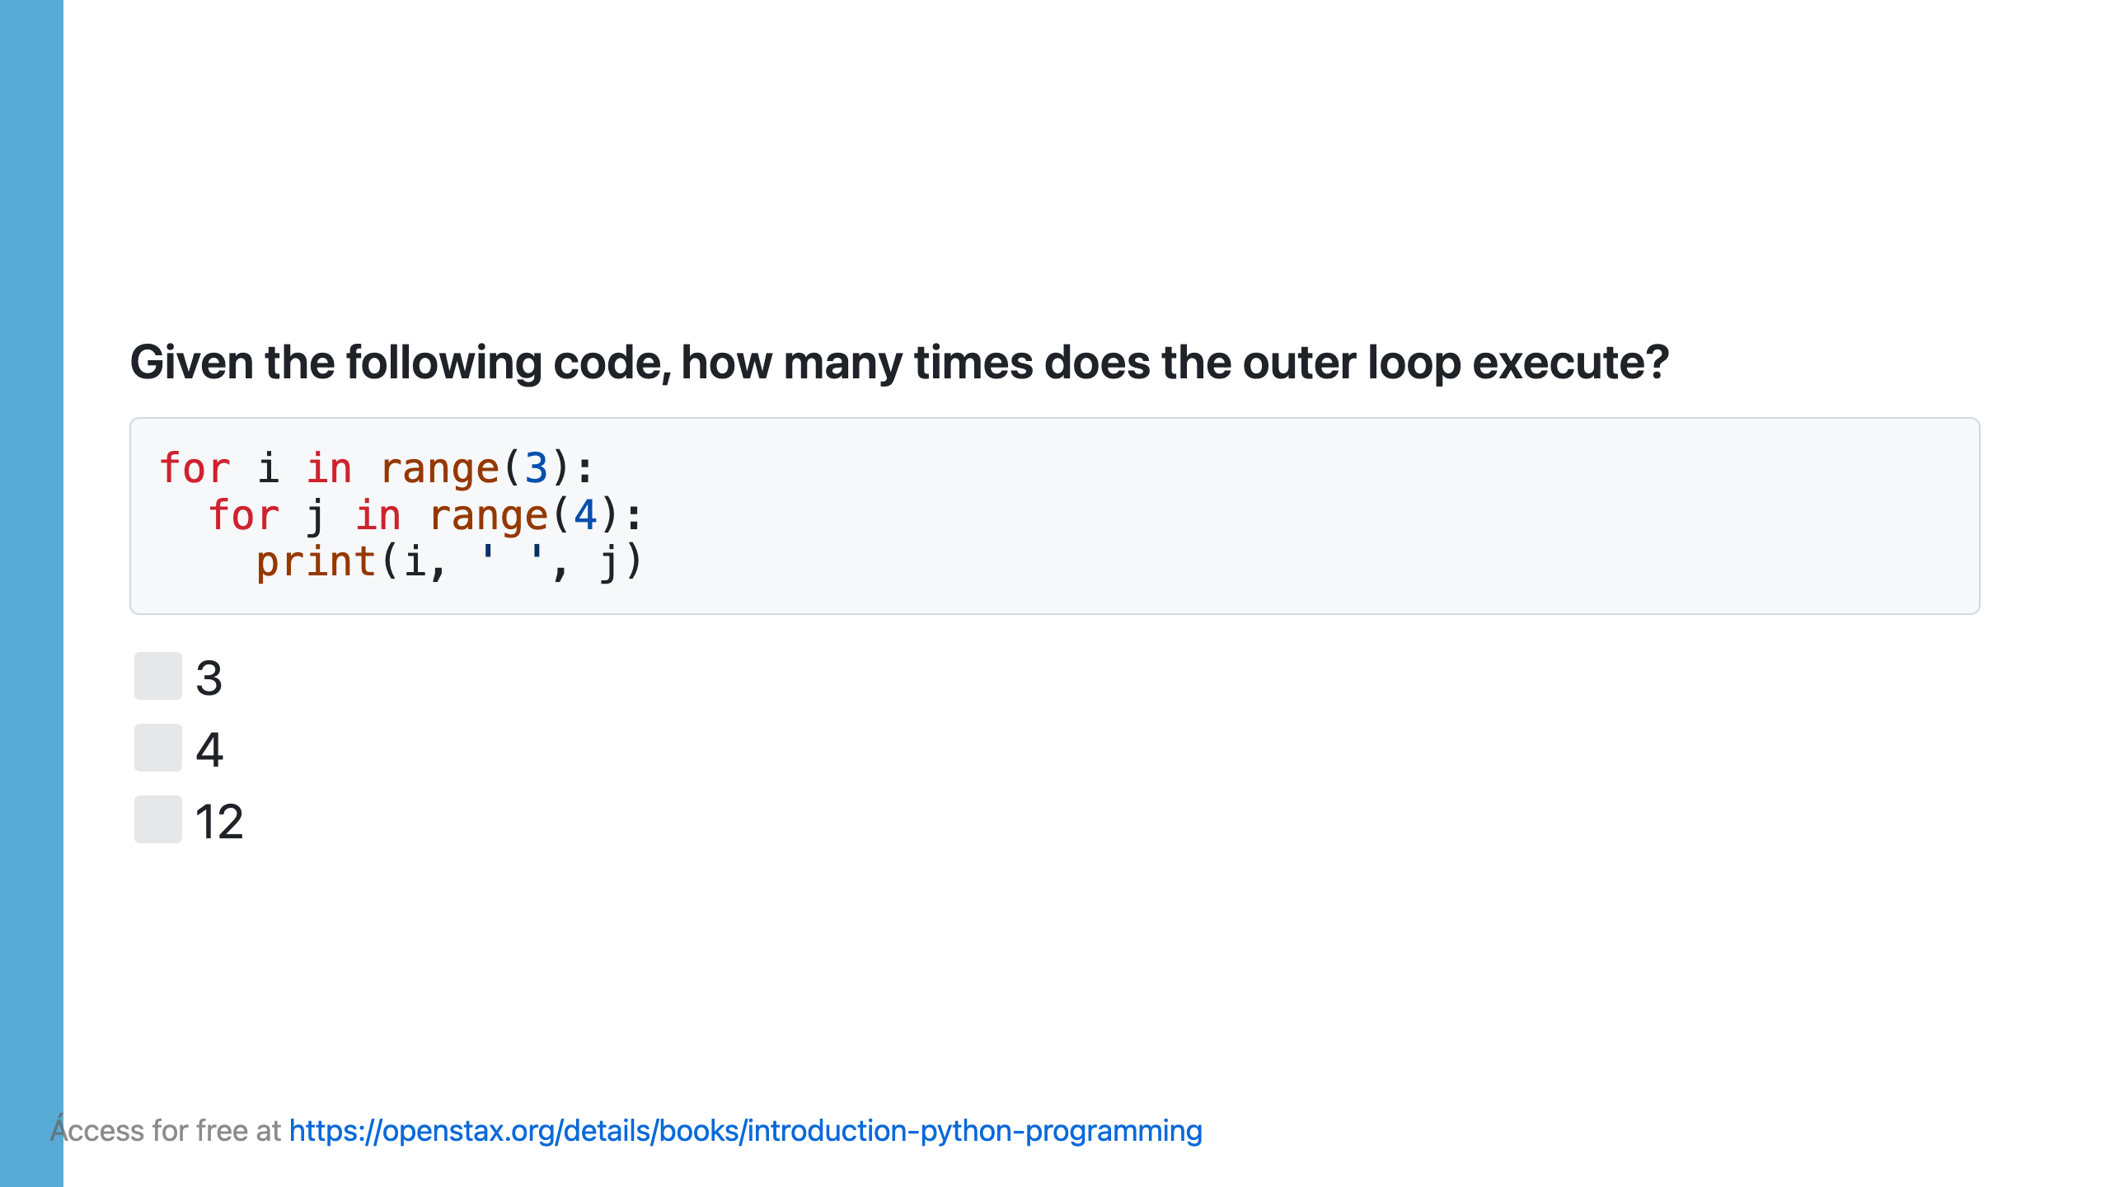

Slide 55


Slide 56
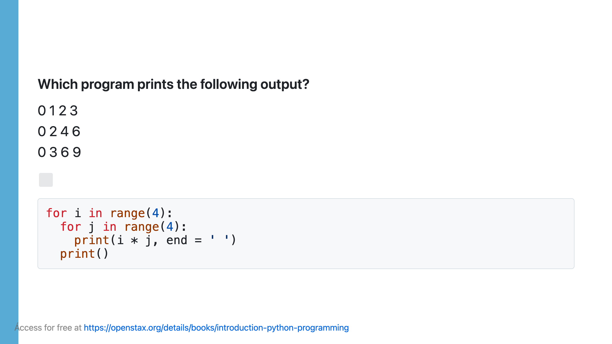

Slide 57


Slide 58


Slide 59


Slide 60


Slide 61


Slide 62

Notes:
The loop below is a regular for loop for going through all the characters of user_string. If the character is found, the break statement takes execution out of the for loop. Since the task has been accomplished, the rest of the for loop execution is bypassed.

Slide 63


Slide 65


Slide 66


Slide 67


Slide 68


Slide 70


Slide 71


Slide 72


Slide 73


Slide 74


Slide 75


Slide 76


Slide 77


Slide 78


Slide 79

Notes:
- In the code examples below, the code on the left prints "Found 10!" if the variable i's value is 10. If the value 10 is not in the list, the code prints "10 is not in the list.". - The code on the right uses the seen Boolean variable to track if the value 10 is in the list. After loop's execution, if seen's value is still false, the code prints "10 is not in the list.".

Slide 81


Slide 82


Slide 83


Slide 84


Slide 85


Slide 86


Slide 87

Notes:
At this point, you should be able to write programs with loop constructs. The programming practice below ties together most topics presented in the chapter.

Slide 88


Slide 89


