Slide 1
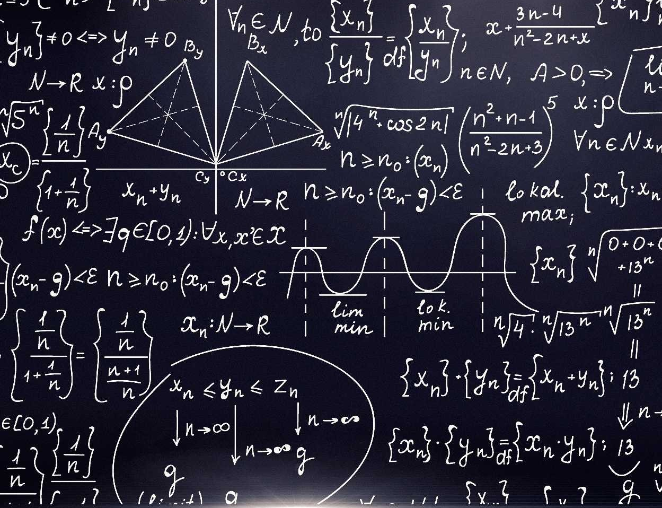


Department of Computer Engineering,
Iran University of Science and Technology
Machine Learning:
Parametric and Non-Parametric Testing
Professor: Dr. Amirkhani
March 21, 2025

Slide 2



Overview
K-Nearest Neighbors Algorithm
Statistical t-Test
Kolmogorov-Smirnov Test
Conclusion

Slide 3
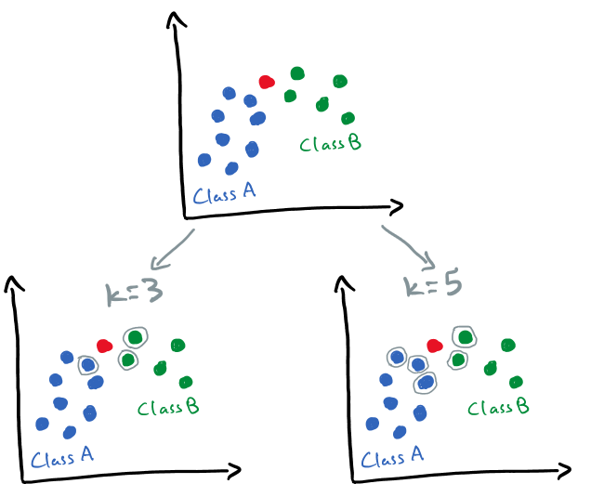
K-Nearest Neighbors Algorithm
Introduction
KNN
Supervised Machine learning algorithm
Classification
Regression
T- Test
Instance-Based Learning
Stores all training data
Kolmogorov-Smirnov
Machine Learning: Parametric and Non-Parametric Testing
Lazy learning: No model training phase
Voting System
Majority vote (classification)
Conclusion
Average (regression)
Ref: ealizadeh.com/blog/knn-and-kmeans/
Hyper-parameters
Number of neighbors (k), distance metric and weighting scheme
Iran University of Science and Technology| 2025/21/04
/21

Slide 4
K-Nearest Neighbors Algorithm
Important Points
KNN
Non-parametric
No assumption about data distribution
T- Test
Pros | Cons
Simple and easy to implement | Computationally expensive for large datasets
Performs well with low-dimensional data | High memory usage due to storing all data
Adaptable to different applications | Sensitive to noise and outliers
Supports various distance metrics | Feature scaling is required for proper distance calculation
Kolmogorov-Smirnov
Machine Learning: Parametric and Non-Parametric Testing
Conclusion
Iran University of Science and Technology| 2025/21/04
/21

Slide 5

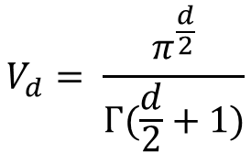
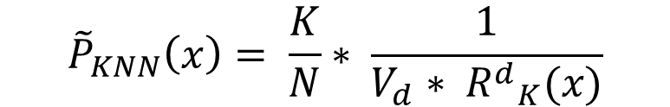
K-Nearest Neighbors Algorithm
Important Points
KNN
Density Estimation with KNN
T- Test
Estimate the probability density of data points in a dataset.
$${\tilde{P}}_{KNN}\left(x\right)= \frac{K}{N}∗ \frac{1}{V_{d}∗ {R^{d}}_{K}(x)}$$
Kolmogorov-Smirnov
Machine Learning: Parametric and Non-Parametric Testing
$$V_{d}= \frac{π^{\frac{d}{2}}}{Γ(\frac{d}{2}+1)}$$
$$Γ\left(n\right)=\left(n−1\right)!$$
Conclusion
Iran University of Science and Technology| 2025/21/04
/21

Slide 6
Statistical t-Test
Introduction
KNN
Statistical method used to compare means under different conditions
significant
randomness and sampling fluctuations
T- Test
Parametric Test
Kolmogorov-Smirnov
require specific assumptions about the distribution of data
Machine Learning: Parametric and Non-Parametric Testing
Normal Distribution
Interval or Ratio Data
Homogeneity of Variances
Conclusion
In the independent t-Test, the variances of the two groups should be equal Otherwise using Welch’s t-Test .
Iran University of Science and Technology| 2025/21/04
/21

Slide 7
Statistical t-Test
states
KNN
One-Sample t-Test
T- Test
Comparison of the sample mean with a known fixed value.
Two Independent Sample t-Test
Comparison of the means of two independent populations with equal variance.
Kolmogorov-Smirnov
Machine Learning: Parametric and Non-Parametric Testing
EXP: Comparison of the average height of two groups of people.
Paired Sample t-Test
Conclusion
Comparison of two dependent variables with equal variance.
Used when a quantitative variable is measured twice per observation
EXP: Effect of blood pressure medication on patients before and after administration
Iran University of Science and Technology| 2025/21/04
/21

Slide 8

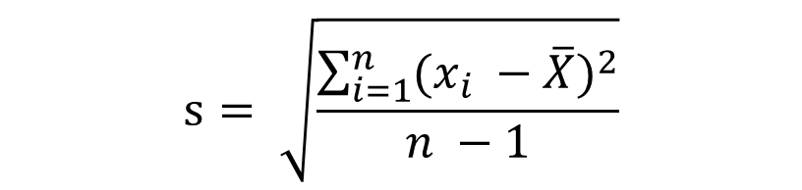

Statistical t-Test
Formula
KNN
One-Sample t-Test
T- Test
Comparison of the sample mean with a known fixed value.
$$s= \sqrt{\frac{\sum_{i=1}^{n}{{(x_{i} −\overline{X})}^{2}}}{n −1}}$$
$$t= \frac{\overline{X} − μ_{0}}{\frac{S}{\sqrt{n}}}$$
Kolmogorov-Smirnov
Machine Learning: Parametric and Non-Parametric Testing
Conclusion
$$df=n−1$$
Iran University of Science and Technology| 2025/21/04
/21

Slide 9
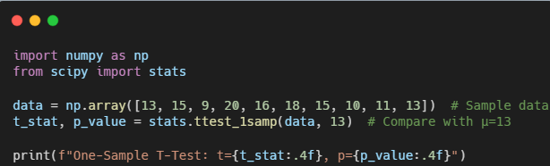
Statistical t-Test
Example Code
KNN
One-Sample t-Test
T- Test
Comparison of the sample mean with a known fixed value.
Kolmogorov-Smirnov
Machine Learning: Parametric and Non-Parametric Testing
Conclusion
Iran University of Science and Technology| 2025/21/04
/21

Slide 10
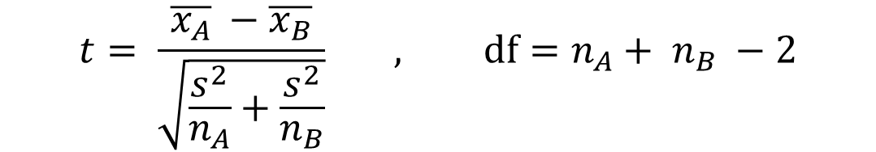
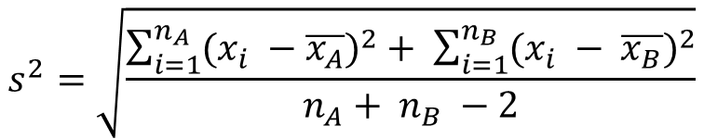
Statistical t-Test
Formula
KNN
Two Independent Sample t-Test
Comparison of the means of two independent populations with equal variance.
T- Test
EXP: Comparison of the average height of two groups of people.
$$t= \frac{\overline{x_{A}} −\overline{x_{B}}}{\sqrt{\frac{s^{2}}{n_{A}}+\frac{s^{2}}{n_{B}}}} , df=n_{A}+ n_{B} −2$$
Kolmogorov-Smirnov
Machine Learning: Parametric and Non-Parametric Testing
Conclusion
$$s^{2}=\sqrt{\frac{\sum_{i=1}^{n_{A}}{{(x_{i} −\overline{x_{A}})}^{2}}+ \sum_{i=1}^{n_{B}}{{(x_{i} − \overline{x_{B}})}^{2}}}{n_{A}+ n_{B} −2}}$$
Iran University of Science and Technology| 2025/21/04
/21

Slide 11
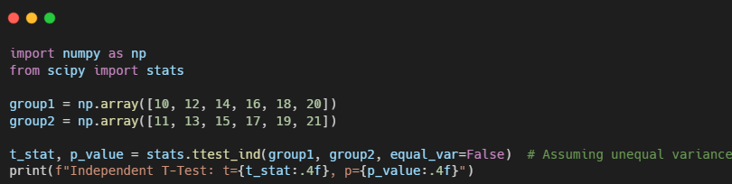
Statistical t-Test
Example Code
KNN
Two Independent Sample t-Test
Comparison of the means of two independent populations with equal variance.
T- Test
Kolmogorov-Smirnov
Machine Learning: Parametric and Non-Parametric Testing
Conclusion
Iran University of Science and Technology| 2025/21/04
/21

Slide 12


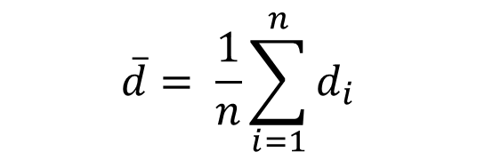

Statistical t-Test
Formula
KNN
Paired Sample t-Test
T- Test
Comparison of two dependent variables with equal variance
Used when a quantitative variable is measured twice per observation
EXP: Effect of blood pressure medication on patients before and after administration
$$\overline{d}= \frac{1}{n}\sum_{i=1}^{n}{d_{i}}$$
Kolmogorov-Smirnov
$$d_{i}= x_{after,i} − x_{before,i}$$
Machine Learning: Parametric and Non-Parametric Testing
$$t= \frac{\overline{d} }{\frac{S}{\sqrt{n}}}$$
Conclusion
$$df=n−1$$
Iran University of Science and Technology| 2025/21/04
/21

Slide 13
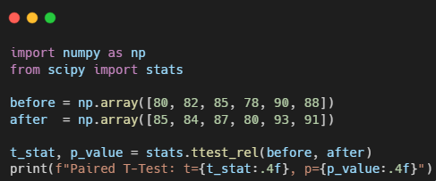
Statistical t-Test
Example Code
KNN
Paired Sample t-Test
T- Test
Comparison of two dependent variables with equal variance
Used when a quantitative variable is measured twice per observation
Kolmogorov-Smirnov
Machine Learning: Parametric and Non-Parametric Testing
Conclusion
Iran University of Science and Technology| 2025/21/04
/21

Slide 14
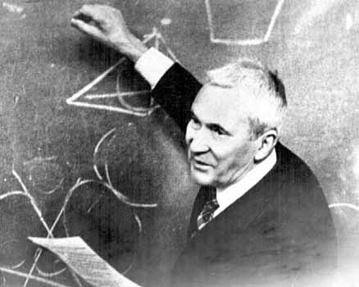
Kolmogorov-Smirnov Test
Introduction
KNN
Two 21th-century Russian mathematicians
Non-Parametric Test
T- Test
Kolmogorov-Smirnov
Machine Learning: Parametric and Non-Parametric Testing
Conclusion
Iran University of Science and Technology| 2025/21/04
/21

Slide 15
Kolmogorov-Smirnov Test
states
KNN
One-sample K-S test
T- Test
Examines whether a sample follows a specific distribution or not.
Two-sample K-S test
Kolmogorov-Smirnov
Examines whether two independent samples come from the same distribution or not.
Machine Learning: Parametric and Non-Parametric Testing
Conclusion
Iran University of Science and Technology| 2025/21/04
/21

Slide 16
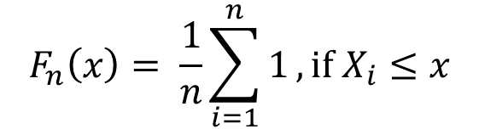

Kolmogorov-Smirnov Test
states
KNN
One-sample K-S test
T- Test
Examines whether a sample follows a specific distribution or not
step one (ECDF): Calculate Empirical Cumulative Distribution Function
$$F_{n}\left(x\right)= \frac{1}{n}\sum_{i=1}^{n}{1},if X_{i}≤x$$
Kolmogorov-Smirnov
Machine Learning: Parametric and Non-Parametric Testing
step two: calculate Theoretical Cumulative Distribution Function
Conclusion
step three: test statistic
$$D_{n}= \sup_{x}|F_{n}\left(x\right)−F\left(x\right)|$$
Iran University of Science and Technology| 2025/21/04
/21

Slide 17
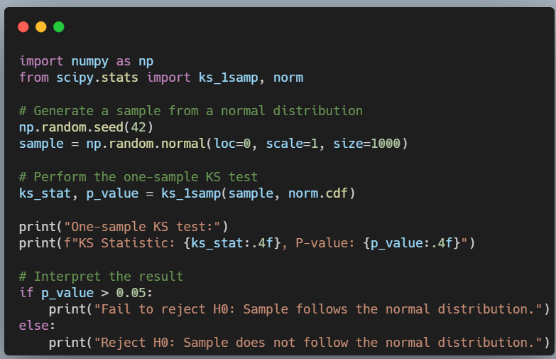
Kolmogorov-Smirnov Test
Example Code
KNN
One-sample K-S test
T- Test
Examines whether a sample follows a specific distribution or not.
Kolmogorov-Smirnov
Machine Learning: Parametric and Non-Parametric Testing
Conclusion
Iran University of Science and Technology| 2025/21/04
/21

Slide 18

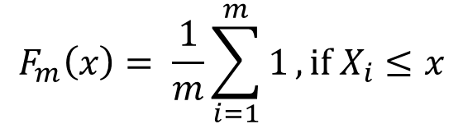
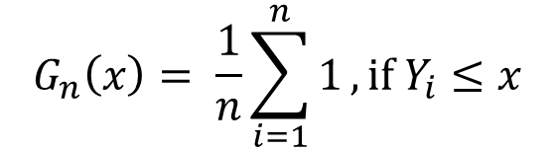
Kolmogorov-Smirnov Test
states
KNN
Two-sample K-S test
T- Test
Examines whether two independent samples come from the same distribution or not
step one (ECDF): Calculate Empirical Cumulative Distribution Function
Kolmogorov-Smirnov
Machine Learning: Parametric and Non-Parametric Testing
$$F_{m}\left(x\right)= \frac{1}{m}\sum_{i=1}^{m}{1},if X_{i}≤x$$
$$G_{n}\left(x\right)= \frac{1}{n}\sum_{i=1}^{n}{1},if Y_{i}≤x$$
Conclusion
step two: test statistic
$$D_{m,n}= \sup_{x}\left|F_{m}\left(x\right)−G_{n}\left(x\right)\right|$$
Iran University of Science and Technology| 2025/21/04
/21

Slide 19
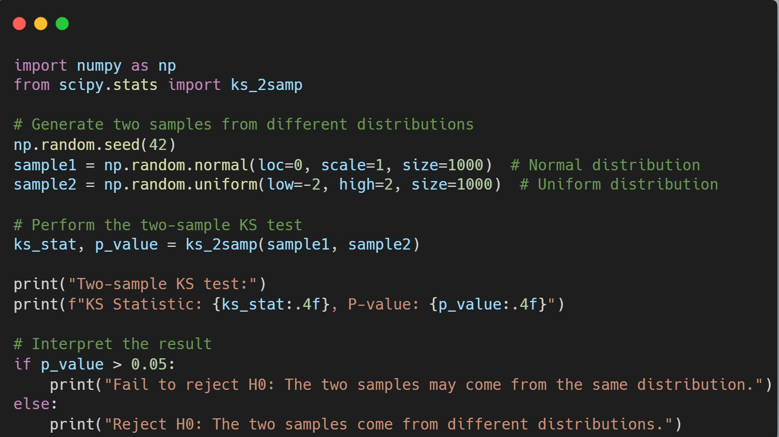
Kolmogorov-Smirnov Test
Example Code
KNN
Two-sample K-S test
T- Test
Examines whether two independent samples come from the same distribution or not
Kolmogorov-Smirnov
Machine Learning: Parametric and Non-Parametric Testing
Conclusion
Iran University of Science and Technology| 2025/21/04
/21

Slide 20
Conclusion
KNN
Statistical t-Test
T- Test
Sensitive to Outliers
The data must follow a normal distribution
The t-Test is only applicable for comparing two means.
Kolmogorov-Smirnov
should use ANOVA to compare more than two groups
Machine Learning: Parametric and Non-Parametric Testing
Statistical Kolmogorov-Smirnov Test
Non-parametric and applicable to any type of distribution
Conclusion
If the data is discrete, the KS test may not perform accurately.
Iran University of Science and Technology| 2025/21/04
/21

Slide 21
THANK YOU
THANK YOU

