Slide 1

IBM – Capstone: Today and Future of Coding
Ali Can TURAN
Associate Data Analyst
05/08/2026
https://github.com/ali-can-turan
ali.can.turan@outlook.com

Slide 2



OUTLINE
Executive Summary
Introduction
Methodology
Results
Discussion
Conclusion
Appendix

Slide 3

EXECUTIVE SUMMARY
Washington DC: the largest quantity of available jobs on the market.
Full-time employees: mainly bachelor’s degree holders.
75% reported earning 100,000 $ or less annually.
500,000 $ or more: more than half are 25-34 years old.
The most stretched and the highest: India and USA respectively. (Appendix for patterns in the top 5 countries.)
The highest for engineering managers and the lowest for academic researchers EXCLUDING students.
Preferred tools and systems:
Windows: (35%)
Amazon Web Services: (32%)
JavaScript: (60%)
PostgreSQL: (34%)
VSC: (72%)
React: (11%)
Job Satisfaction:
Decreases gradually after 3 years of experience and increases considerably after 20 years of work experience.

Slide 4

INTRODUCTION
Aim
To extract popular coding environments and tools,
To explore their relations to education level, compensation and satisfaction levels at job.
Audience
Anyone with the interest in data analysis and coding.
Value
Earn insights for the future’s data analysis sphere to have optimum compensation and satisfaction at job.

Slide 5

METHODOLOGY
Source
Stack Overflow Survey
What to measure
Yearly Compensation
Job Satisfaction
How to measure
Relate to the popular data analysis tools and systems
Products
Languages, databases, platforms, web frames, etc.
Locations
185 Countries
Volume of Data
Over 65000 participation
Wrangling Steps
Inconsistencies, Number Formatting, Duplicates, Missing Values, Outliers, Enrichment, Aggregation, Normalization

Slide 6
Results
https://github.com/ali-can-turan/ibm-capstone

Slide 7
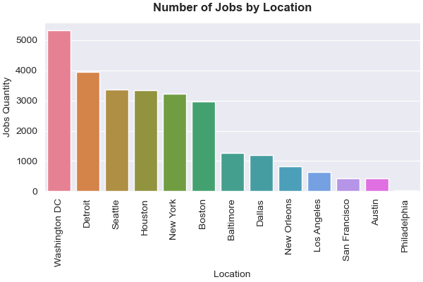
JOB POSTINGS
As seen from the chart, «Washington DC» is the province that has the largest number of jobs available, getting ahead of its nearest rival «Detroit» by a margin of more than 35%.

Slide 8
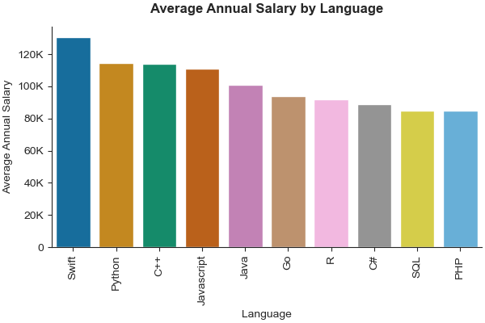
POPULAR LANGUAGES
As seen from the chart, «Swift» is the programming language of which the users earn the highest salary: 130K, «Python» being the second with 115K.

Slide 9
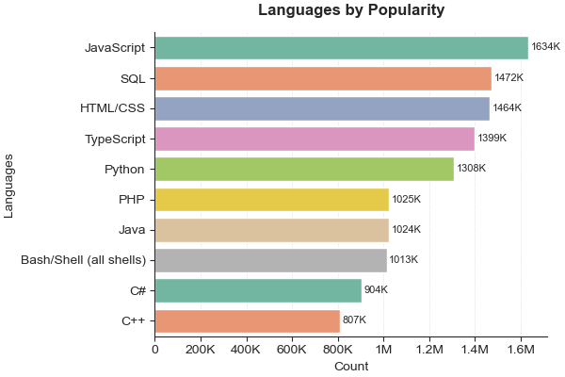
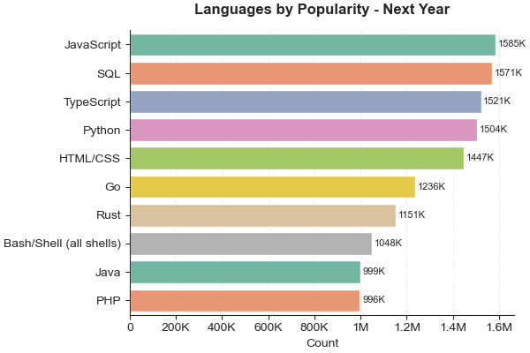
PROGRAMMING LANGUAGE TRENDS
Top 5 in either graph are comprised of the same languages. However, HTML/CSS seems to be going to lose ground next year.
Next year, it seems that C# and C++ will drop from the top 10 and that Go and Rust will get in the list from a high ground overtaking PHP, Java and Shell languages.

Slide 10
PROGRAMMING LANGUAGE TRENDS - FINDINGS & IMPLICATIONS
Findings
Implications
JavaScript is the market leader.
SQL is the second.
TypeScript is gaining ground.
Python is at the first 5.
Go and Rust are fast-moving.
Web page/app developers are dominant, at least, in the survey.
No rival in the realm of database manipulation.
More significance on type, compared to loosely-typed JS.
Seems not to get outdated in the near future.
Will see new breakthroughs from these languages

Slide 11
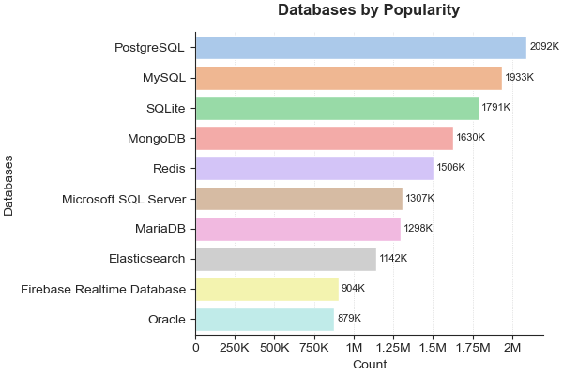
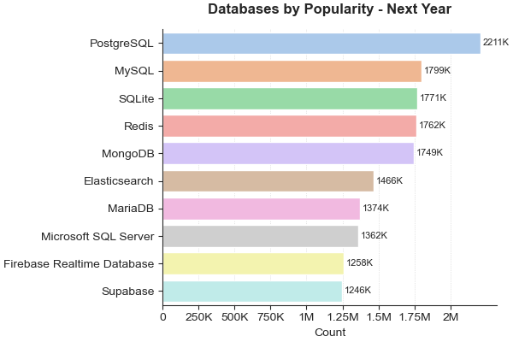
DATABASE TRENDS
There seems to be no difference in database popularity in the near future for the top 3: PostgreSQL, MySQL, SQLite.
On the other hand, slight attack in Redis and Maria DB and moderate gain in Elasticsearch is visible.

Slide 12
DATABASE TRENDS - FINDINGS & IMPLICATIONS
Findings
Implications
PostgreSQL is the market leader.
Decrease in MySQL is overt.
MS SQL Server not catching up.
Seems not to get outdated in the near future.
The rivalry between from the second to the fourth is more evident.
Rivalry at the top, new trends at the bottom; MS SQL Server not in either category

Slide 13

DASHBOARD
https://github.com/ali-can-turan/ibm-capstone

Slide 14
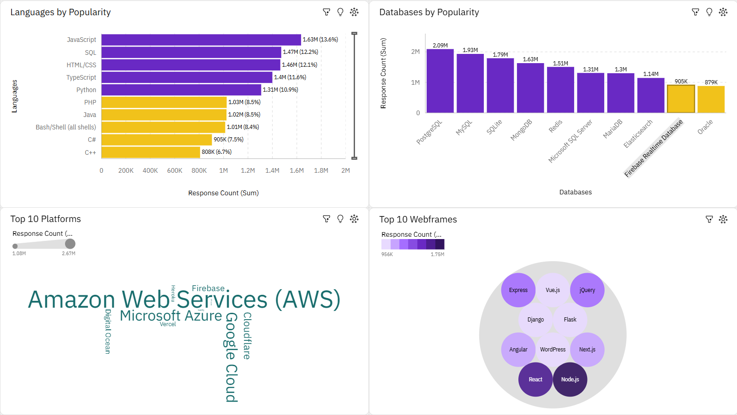
DASHBOARD TAB 1: Current Technology Usage
JS stands out as the leader by a margin of 10% from the closest rival: SQL.
Rivalry between the databases is more eminent compared to the languages, which means no single brand should be overlooked.
Amazon Web Services is visibly the most popular platform leaving the others way behind.
Node.js seems to continue its prominence in the back-end with speed advantages.

Slide 15
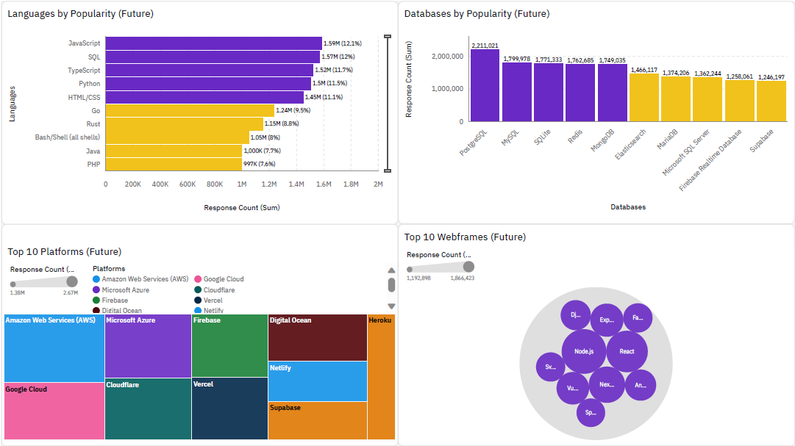
DASHBOARD TAB 2: Future Technology Trends
JS is no longer the by-far-leader. Rivalry is now emminent between the first 5.
There seems that PostgreSQL will solidfy its ground as the first. But rivalry is getting visible between the 4 chasers.
Amazon Web Services seems to protect its place. But now rivals are following more closely.
There seems to be no change in the popularity hierarchy within web frames.

Slide 16
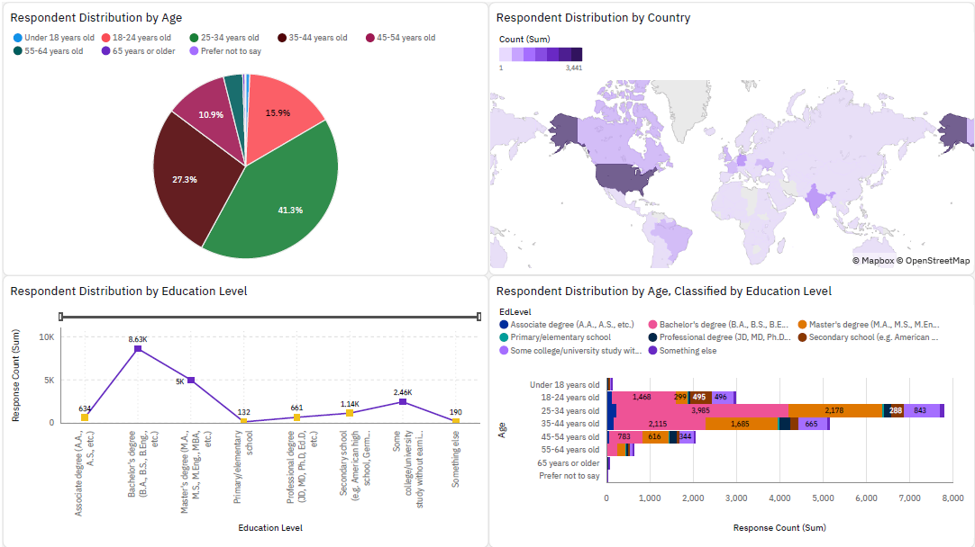
DASHBOARD TAB 3: Demographics
35-44 year-olds are only beaten by the 18-24 and 35-44 year-olds combined.
Majority of respondents are from the USA.
More than 45% of the respondents are bachelor’s degree holders, EXCLUDING no-answers. (Appendix for «Employment vs Education Level» graph)
25-34 year-olds have more bachelor’s degree holders than any other age group both by quantity and rate.

Slide 17
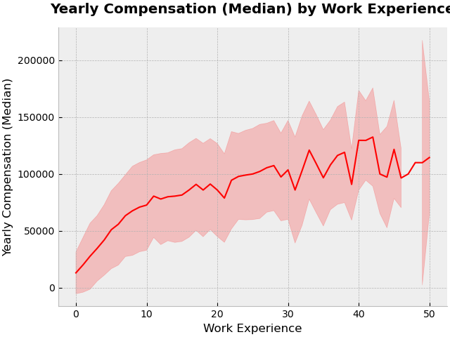
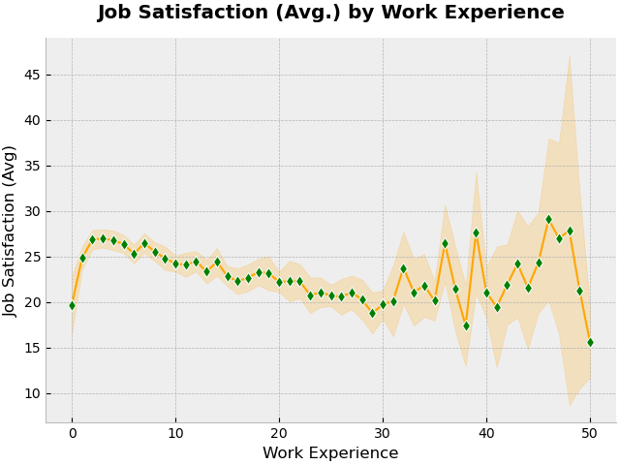
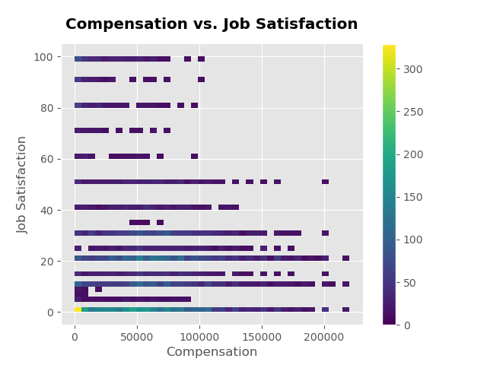
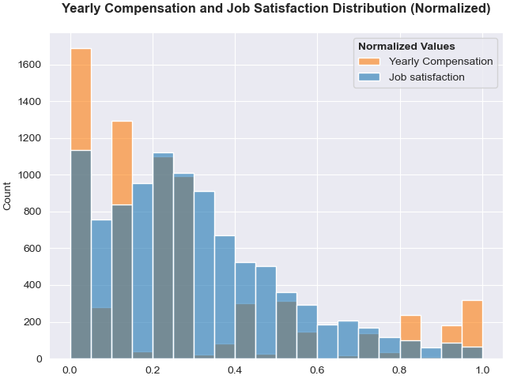
Yearly Compensation – Job Satisfaction
As with the job satisfaction, annual compensation also fluctuates considerably for respondents with more than 32 years of work experience.
More than half of the coders participating in the survey did not provide an answer for the questions about “Job Satisfaction” and “Yearly Compensation” as well as AI related ones.
The correlation between the annual compensation and job satisfaction is positive but moderate.

Slide 18
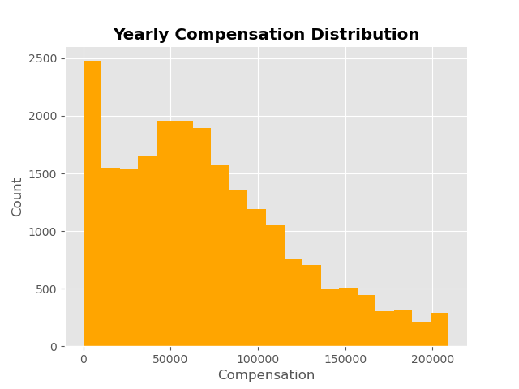
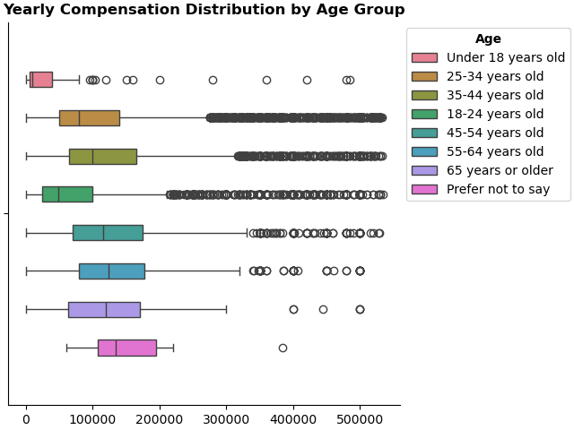
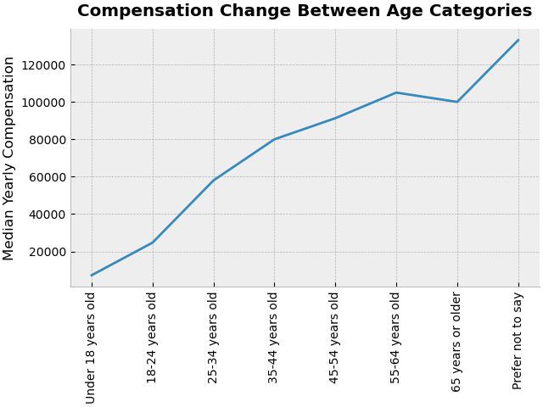
Yearly Compensation
The highest and narrowest yearly compensation comes from the respondents who do not provide their age, EXCLUDING outliers.
Yearly Compensation data is right-skewed, but there is a peak of nearly 2500 respondents with 10000 dollars or less annual income. Nearly 80% of those are between 18-34 years old.
Total compensation seems to be almost linearly and positively correlated with age and work experience, except that the increase halts and reverts to decrease after the age of 65.

Slide 19
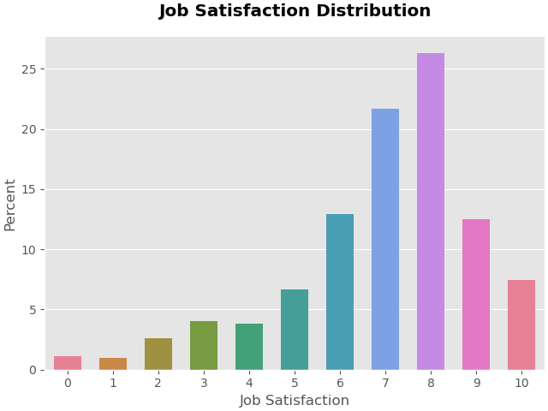
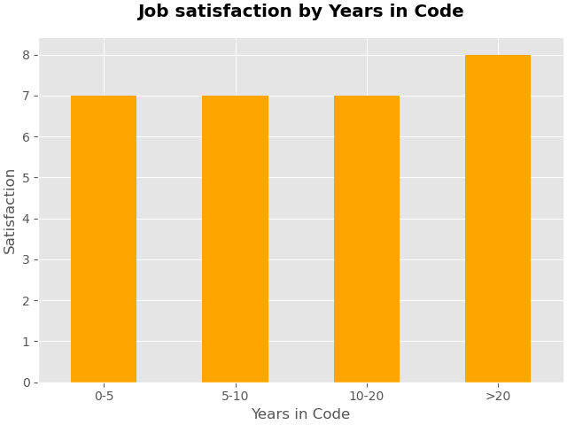
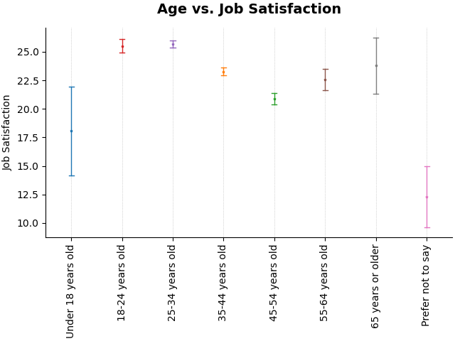
Job Satisfaction
Job satisfaction mean is 8 over 10. This is mainly the result of the unemployed and the ones with the 20 years or more work experience.
Job satisfaction average is at its highest (slightly more than 25 over 100) for the respondents of 18-34 years old.
Job satisfaction is at its low ebb (around 15%) for respondents who indicated Julia and at its peak (around 28%) for respondents who indicated Solidity as languages to work with.
Respondents with the most job satisfaction levels use Raven DB database and/or Gatsby web frame, while some others with the least job satisfaction levels use Couch DB database and/or Django web frame.

Slide 20
DISCUSSION
Jobs quantity in Washington DC is 65% more than that in New York…
…THOUGH the latter is two and a half fold more populated than the former.
C++ is one of four languages whose users earn more than 100K annually…
…DESPITE its unpopularity, not being in top 10.
Front-end developers earn 20% less compared to the full-stack and back-end developers…
…WHILE they constitute one-nineth of the respondents of mentioned 3 categories.
High earners are usually 24-35 year-olds with a bachelor’s degree…
…THOUGH the highest job satisfaction is from the unemployed
Swift is the language whose users earn the most on average…
…BUT the reason for this is not definite.
Rivalry between database brands are overt…
…THOUGH PostgreSQL seems not to bother as a leader.

Slide 21
OVERALL FINDINGS & IMPLICATIONS
Findings
Implications
HTML/CSS is losing gound…
SQL is the market leader…
Rivalry between frameworks are extremely vivid…
PostgreSQL is way ahead of rivals…
Amazon Web Services will keep the ground…
Highest and the lowest job satisfaction average from 2 categories…
DUE TO frameworks that ease the work such as streamlit or dash.
DUE TO unavailability of the rivals out there.
SO MUCH SO THAT React is the leader only with 11% of the market share.
AND this seems not to change in the near future.
BUT the threat from the MS and Google services will grow bigger.
INTERESTINGLY the unemployed and the retired respectively.

Slide 22







CONCLUSION
100K will continue to be the ballpark average for the yearly compensation, with 250K being the virtual top EXCLUDING outliers.
Job satisfaction will still base on work experience, work modes and work stress rather than compensation.
JavaScript, Python, SQL, TypeScript, PostgreSQL, Amazon Web Services, Node.js, React will be the leaders of the near future, not without threatening rivals. Go and Rust are the new age within programming languages
MySQL should be watched carefully in the next years as the popularity decrease might turn into chronic.
HTML/CSS will continue to lose ground as simpler frameworks allow to build estethic and interactive web pages / apps.
University degree will still continue to bring up more job opportunities, but often with in-person work mode.

Slide 23

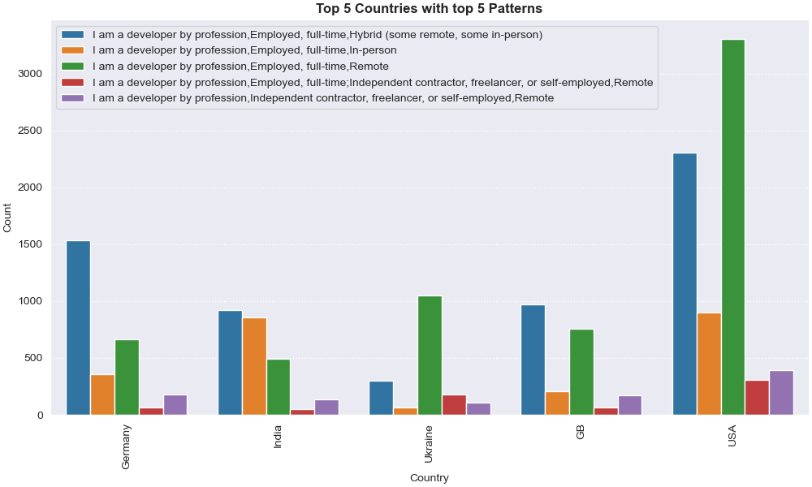
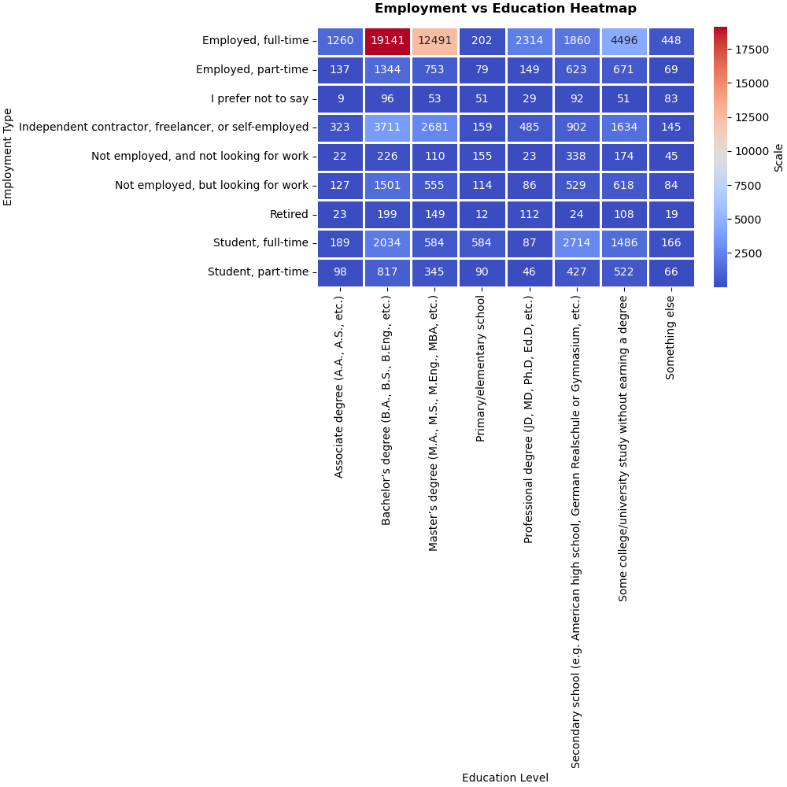
APPENDIX

