Slide 1
An approval policy that cuts losses and keeps 91% of volume
CREDIT RISK CASE STUDY
Default model, profit-driven cutoff and a policy simulator, built on 589k resolved Lending Club loans
Case study: Northvale Credit is a fictional lender. Built on public Lending Club data for learning purposes.
Ali Chamas · MSc Digital Business & Analytics, EMLV · October 2026
Notes:
Northvale Credit is a fictional digital lender I invented to frame this project; the data is the public Lending Club loan book. The credit committee's question: design an approval policy that cuts losses without killing loan volume. I will show why the current grade-based rules are outdated, how I built and audited a default model, and the cutoff I recommend with its projected impact. Every number in this deck is generated by code from one metrics file, so it can be rerun and checked.

Slide 2
Default rates rose from 12.3% to 14.9% between the 2013 and 2015 vintages
THE PROBLEM
The credit committee asked for an approval policy that cuts expected losses without killing loan volume.
14.9%
+3.1 pp
19.4%
2015 vintage default rate
from risk within grades
grade C default, 2015
36-month loans, up +2.6 pp from 12.3% in 2013
Grade mix alone moved it -0.6 pp; loans within each grade got riskier
Up from 15.3% in 2013 while its average rate fell from 15.4% to 13.2%
Resolved 36-month loans: 100,422 issued in 2013, 282,787 in 2015. Default = Charged Off or Default.
Notes:
The book's default rate climbed from 12.3% for 2013 loans to 14.9% for 2015 loans. I split that change: the grade mix actually moved slightly toward safer grades (-0.6 pp), so the whole rise (+3.1 pp) comes from loans inside the same grade defaulting more. A grade C loan defaulted 19.4% of the time in 2015 against 15.3% in 2013, and it was priced lower. That is why rules written on grades are outdated: the letter no longer means the same risk.

Slide 3
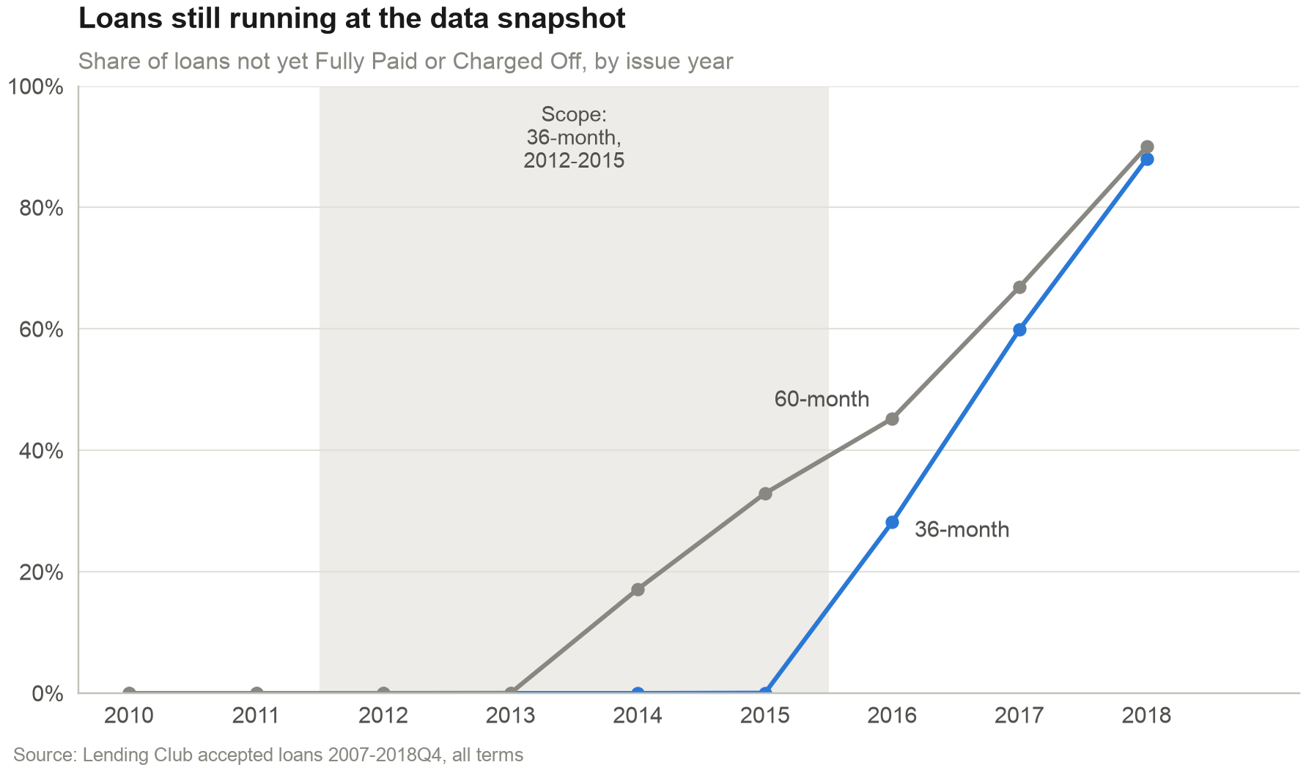
Only 0.02% of 36-month 2012-2015 loans are unresolved, so defaults are not censored
THE DATA
589k
resolved loans, $7.4B issued 2012-2015
28% of 2016 loans still running: keeping them biases defaults
60-month loans excluded: 33% of 2015 still running
Train 2012-14, tune on 2015 H1, test once on 2015 H2
Source: Lending Club accepted loans 2007-2018Q4
Notes:
Lending Club's file stops at the end of 2018, so recent loans have not finished. If I kept only the finished ones, early defaults and early payoffs would be over-represented. I therefore scoped to 36-month loans issued 2012 to 2015: 0.02% are unresolved, against 28% for 2016. That leaves 589,249 loans. The split is out-of-time: models learn on 2012-2014, are tuned on the first half of 2015 and are tested once on the second half, the way they would be used.

Slide 4
Audit the inputs, beat the incumbent grade, then let profit choose the cutoff
APPROACH
1
2
3
4
5
Scope
Audit
Model
Explain
Decide
36-month loans 2012-2015 with final outcomes, split by issue month, never at random
All 151 columns reviewed; post-origination, pricing and proxy fields removed
LC sub-grade benchmark vs WoE scorecard vs LightGBM, recalibrated on 2015 H1
SHAP drivers turned into plain-English reason codes for each decision
Profit per loan from PD, price and loss; cutoff picked on 2015 H1, tested on 2015 H2
Fixed seed 42. The cutoff is never tuned on the test window.
Notes:
Five steps. Scope the data so outcomes are complete. Audit every raw column so the model only sees what a lender knows on the day it decides. Compare three rankers: Lending Club's own sub-grade as the incumbent, a classic weight-of-evidence scorecard, and LightGBM. Explain the chosen model with SHAP so every decline has reasons. Finally, translate default probabilities into money and let expected profit, not AUC, pick the cutoff, then check it on loans the models never saw.

Slide 5
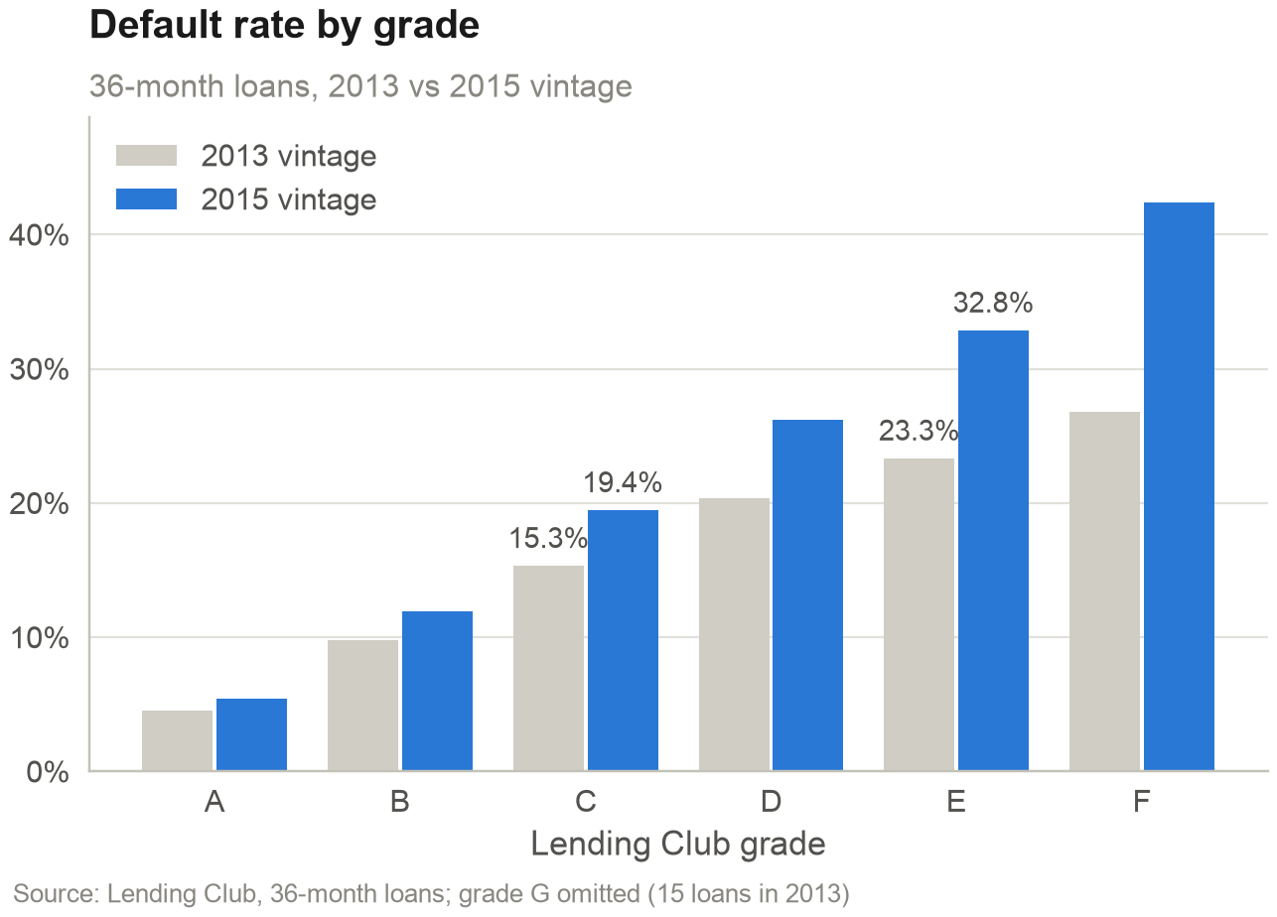
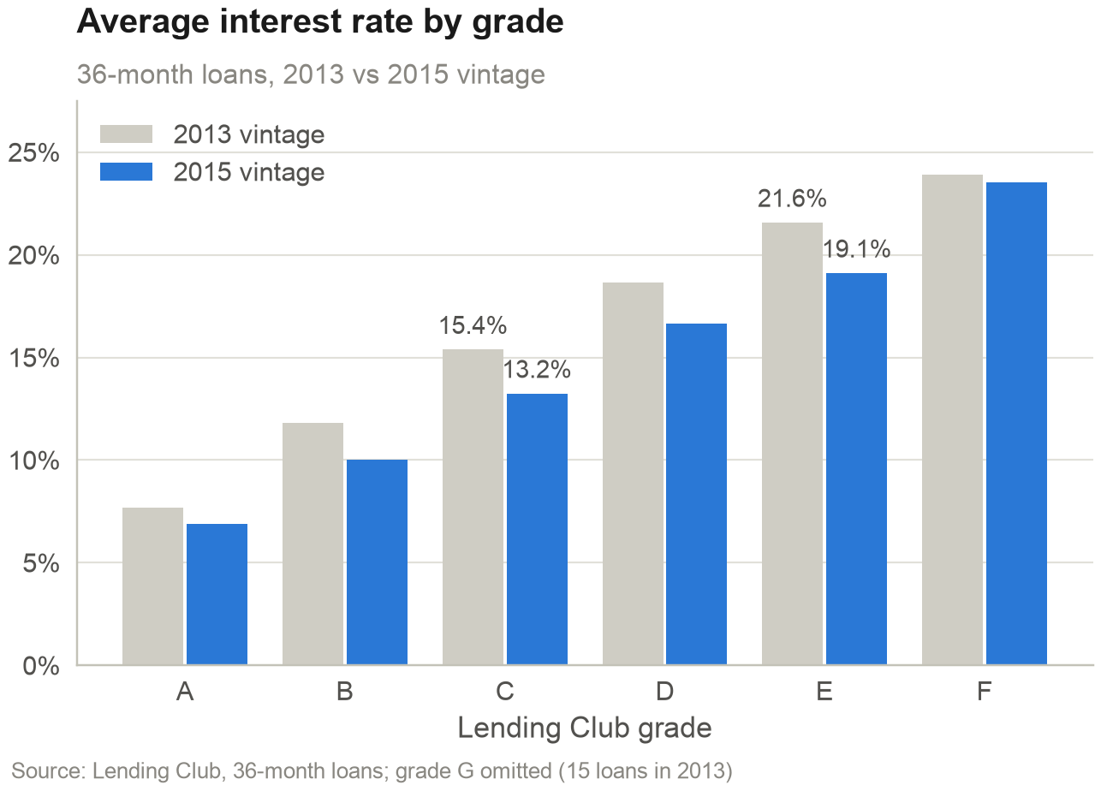
Grade C loans defaulted 19.4% in 2015 against 15.3% in 2013, at a lower price
FINDING 1
Default rates rose inside every grade from A to F.
Interest rates fell in grades A to E over the same period.
Notes:
Left, default rate by grade for the 2013 and 2015 vintages: every grade got riskier, grade E went from 23.3% to 32.8%. Right, the average interest rate by grade fell over the same period. So a rule like 'decline grades E to G' approves more risk for less return than it did when it was written. Northvale needs its own risk measure that does not depend on how Lending Club labels a loan.

Slide 6
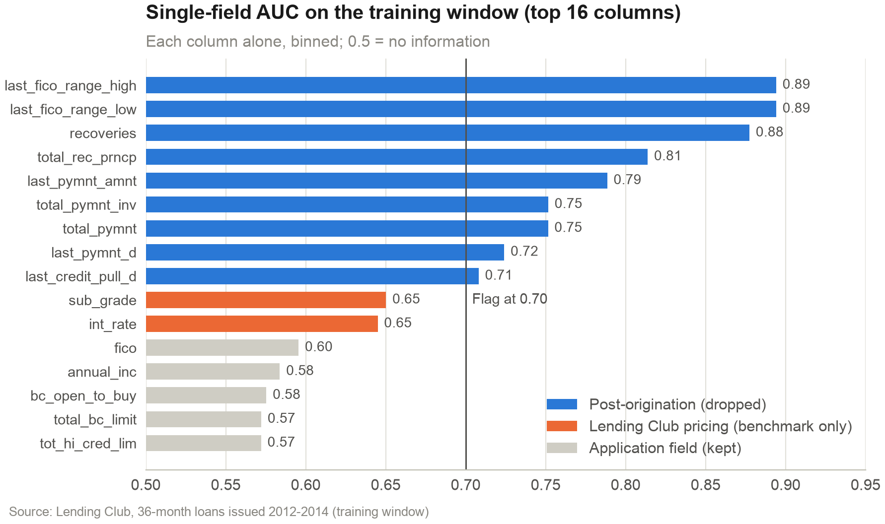
Fields recorded after issuance would lift test AUC from 0.70 to 0.95
FINDING 2
0.95
test AUC with refreshed FICO, vs 0.70 without
9 columns score above 0.70 alone: all post-origination
Best real application field: FICO at 0.60
38 post-origination columns dropped
Audit of 151 columns: docs/feature_audit.csv
Notes:
Each of the 151 raw columns has a documented keep or drop decision. A single-column screen shows the danger: 9 columns separate defaults better than any real application field, and every one of them is recorded after the loan is issued, such as payments received or a FICO score pulled later. Retraining with the refreshed FICO lifts test AUC from 0.70 to 0.95: a model that looks brilliant and is useless on the day of the decision. Grade and interest rate are also excluded as features because they are the incumbent model.

Slide 7
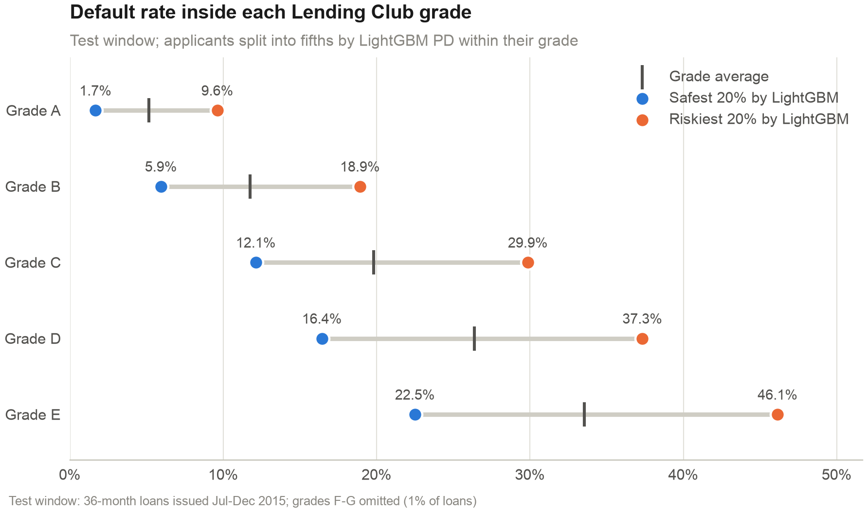
LightGBM separates 12.1% from 29.9% default rates inside grade C
FINDING 3
0.701
test AUC, vs 0.681 for LC sub-grade
KS 0.29 vs 0.27 (grade), 0.25 (scorecard)
Calibrated: mean PD 14.6%, observed 14.7%
Stable: score PSI 0.005 train vs test
Test window: 161,997 loans issued Jul-Dec 2015
Notes:
On the untouched test window LightGBM reaches an AUC of 0.701, against 0.681 for Lending Club's own sub-grade and 0.675 for my scorecard. The gain looks small in AUC, but the chart shows what it means: inside grade C, the fifth of applicants LightGBM rates safest defaulted 12.1%, the riskiest fifth 29.9%. The grade treats them the same. After recalibration on early 2015 the predicted default rate matches the observed one within 0.1 pp, which matters because the cutoff is set in money.

Slide 8
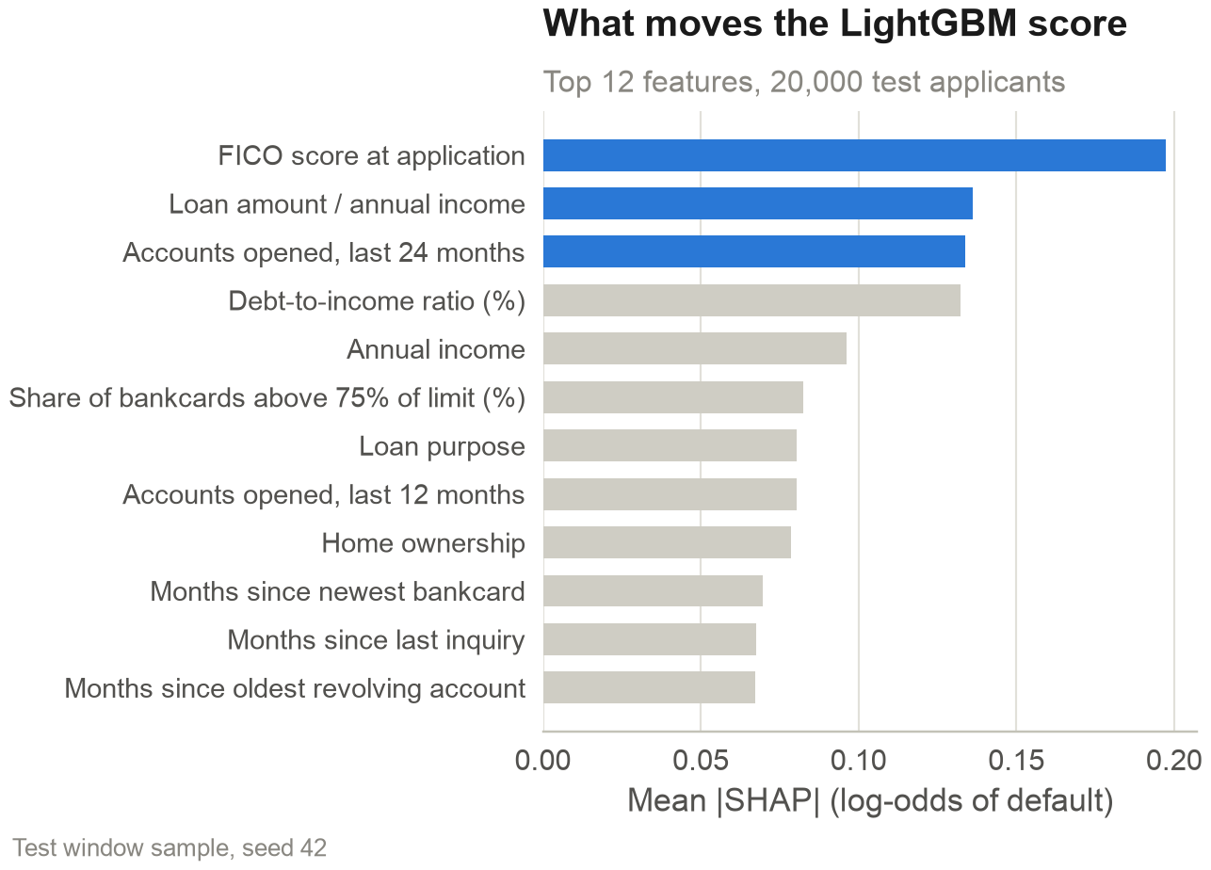
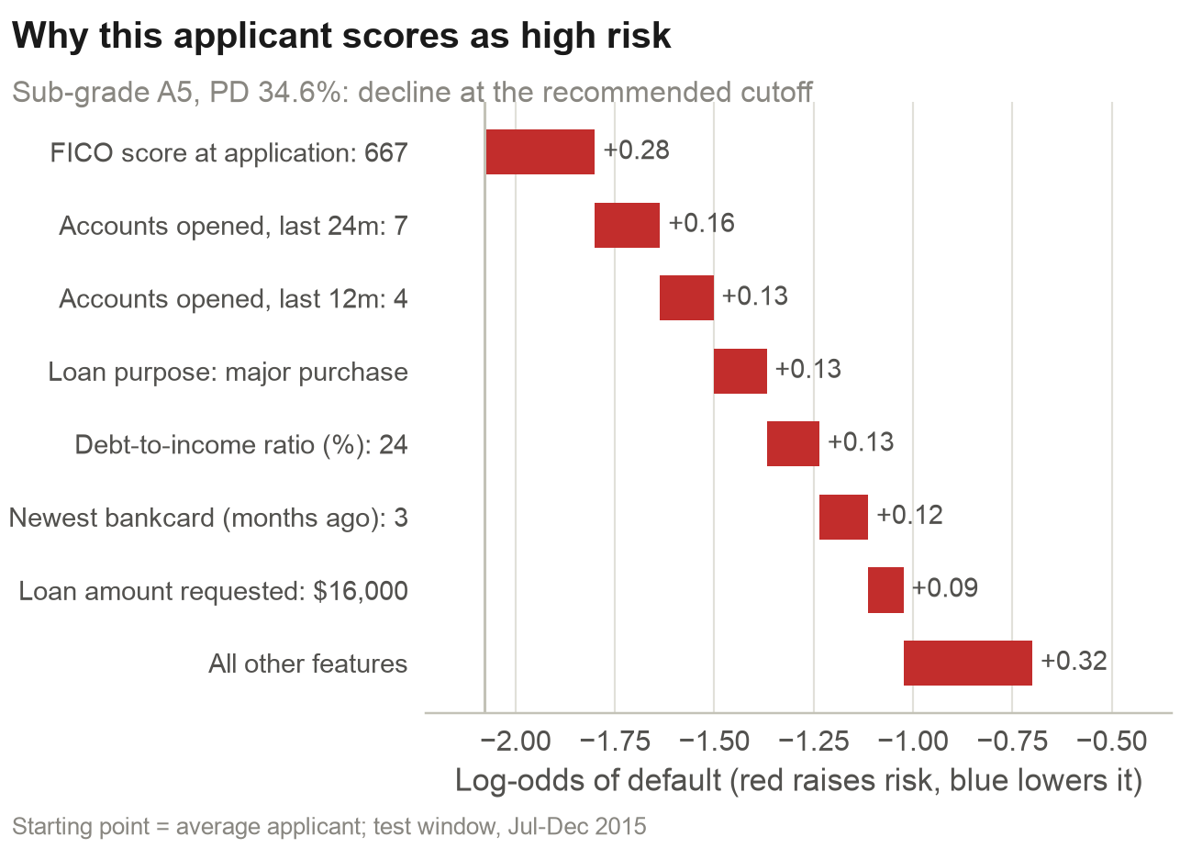
FICO, loan size relative to income and recent credit-seeking drive the score
FINDING 4
Top 5 features carry 28% of the total SHAP effect.
A sub-grade A5 applicant declined: low FICO and recent new accounts.
Notes:
SHAP shows which inputs move the score. FICO matters most, then the loan amount relative to income, accounts opened in the last 24 months and debt-to-income. On the right, one test applicant Lending Club graded A5: the model puts the default probability at 34.6% because of a FICO of 667 and 7 accounts opened in two years. These contributions become reason codes in plain English, which is what an adverse-action notice under US ECOA requires and what the EU AI Act expects from a high-risk credit scoring system.

Slide 9
Adopt the balanced cutoff: decline applicants with a LightGBM PD above 27.9%
RECOMMENDATION
CONSERVATIVE
RECOMMENDED
GROWTH
Keep 82% of applicants
Balanced: keep 91% of applicants
Keep 96% of applicants
Decline PD above 22.7%. Default rate 11.5%. Per half-year vs today: profit +$18.8M, losses avoided $42.7M.
Decline PD above 27.9%. Default rate 12.8%, from 14.7%. Per half-year: profit +$13.8M, losses avoided $26.0M.
Decline PD above 33.3%. Default rate 13.7%. Per half-year vs today: profit +$8.5M, losses avoided $13.8M.
Dollar volume kept: 83.6%
Dollar volume kept: 91.4%
Dollar volume kept: 96.0%
Cutoffs chosen on Jan-Jun 2015 by expected profit; realized results on 161,997 Jul-Dec 2015 loans. Base cost assumptions.
Notes:
Three options, all chosen on early 2015 data and judged on late 2015 loans. The conservative cutoff maximises expected profit but gives up 16% of dollar volume. I recommend the balanced option: it keeps 91% of applicants, as the committee asked, cuts the default rate from 14.7% to 12.8% and adds $13.8M of realized profit in six months. The growth option is the fallback if volume targets tighten. Because we only see loans Lending Club approved, every option tightens; none can safely approve new segments.

Slide 10
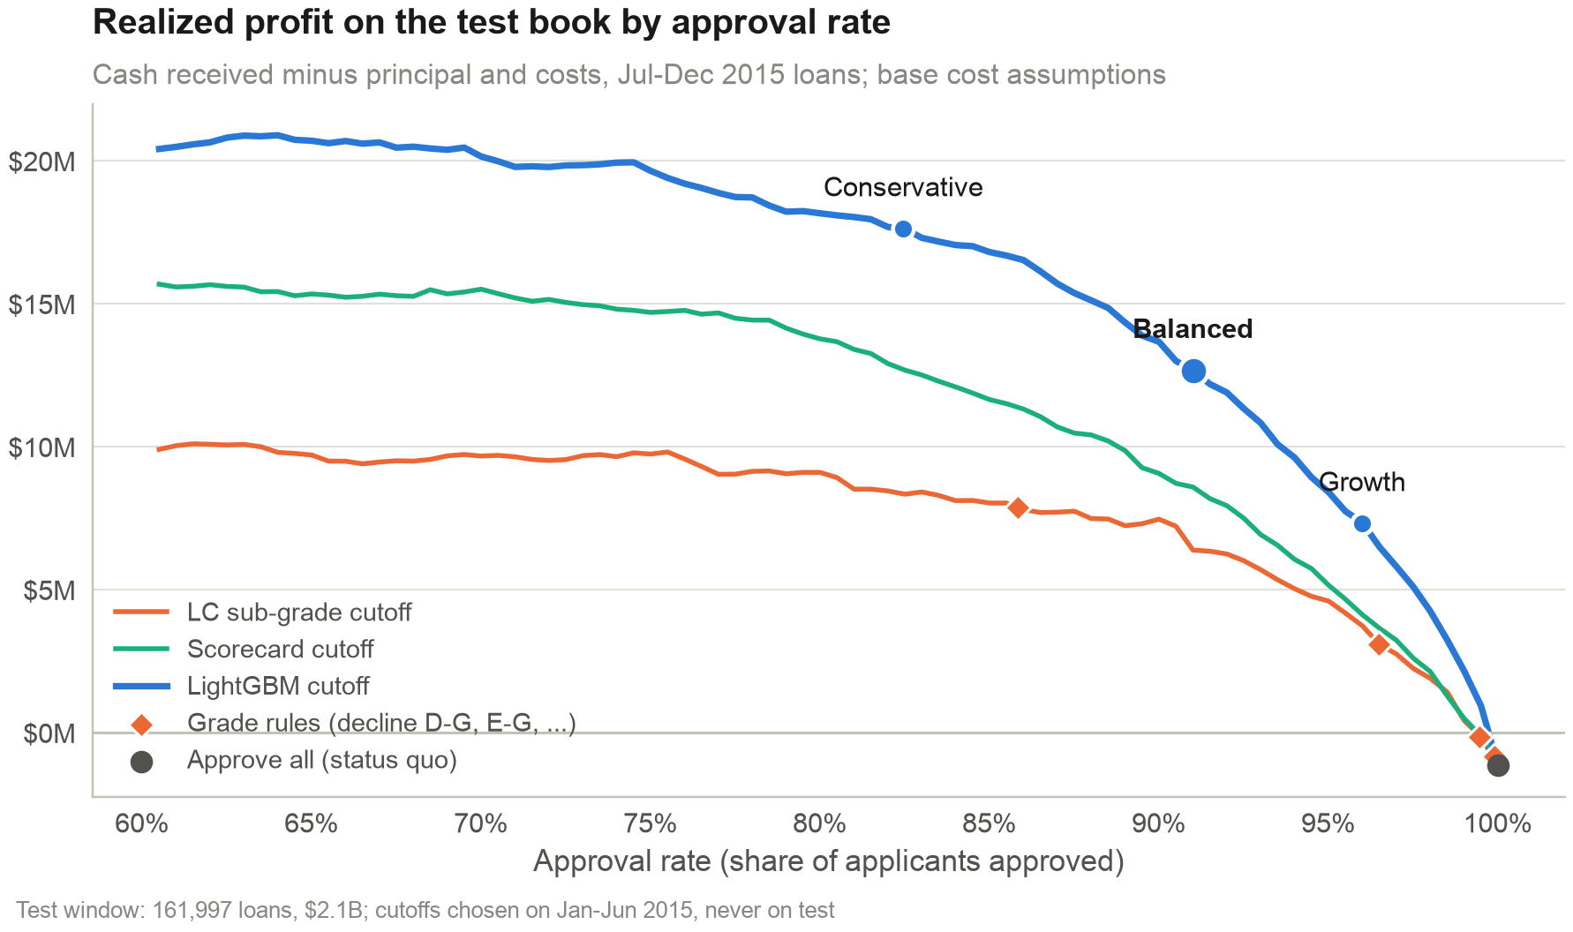
The balanced cutoff turns a -$1.1M half-year into +$12.7M
EXPECTED IMPACT
+$27.6M
profit a year vs approving all, base assumptions
$52.1M of credit losses avoided a year
Same approval as declining D-G: $16.6M vs $7.9M
Range +$21.2M to +$40.5M a year by cost scenario
Annual = 2 x Jul-Dec 2015 book ($4.2B a year)
Notes:
Approving every test loan returned -$1.1M after funding and operating costs: Northvale barely breaks even. With the balanced cutoff the same book returns $12.7M. Annualised by doubling the six-month window, that is $27.6M a year and $52.1M of credit losses avoided. At the approval rate of a 'decline D to G' grade rule, LightGBM earns $16.6M against $7.9M. These are projections under stated cost assumptions, measured on historical loans.

Slide 11
The policy can only tighten: Lending Club's rejected applicants are not in the data
LIMITATIONS AND NEXT STEPS
Data limits
Model limits
Next steps
Approved loans only: no reject inference
FICO floor of 660: no subprime or thin-file view
2015 losses ran above training: 39.4% vs 35.9%
Marketplace data used as a balance-sheet lender
AUC gain over the grade is modest: +0.019
Pricing held fixed; no time value of money
LightGBM needs SHAP; the scorecard is simpler to govern
No fairness test on protected groups yet
Champion-challenger trial on live applications
Re-price the 20%+ band: -$1.4M on test
Monthly PSI, vintage curves and override rates
Add 60-month loans once vintages resolve
Notes:
The biggest limit: Lending Club only publishes loans it approved, so I cannot measure how rejected applicants would have behaved. That is why every option tightens. Losses on 2015 defaults also ran above the 2012-2014 calibration, 39.4% against 35.9%, so expected profit is optimistic and I report realized cash instead. Next, I would run the model as a challenger on live traffic, re-price the highest rate band, and monitor population stability and vintage curves every month.

Slide 12
Methodology
APPENDIX
Target and sample
Default = Charged Off or Default; good = Fully Paid. 589,249 individual 36-month loans issued 2012-2015; 147 unresolved and 239 joint applications excluded.
Split and leakage
Train 2012-2014 (306k), validation Jan-Jun 2015 (121k), test Jul-Dec 2015 (162k). 63 application features kept out of 151 columns.
Models
Scorecard: optbinning WoE, IV >= 0.02, |r| < 0.7, sign checks, 13 characteristics, 600 points at 50:1, PDO 20. LightGBM: 15 leaves, early stopping on validation.
Calibration and metrics
Platt recalibration on validation for every model. Test metrics: AUC, Gini, KS, Brier, decile calibration and PSI of the score between training and test.
P&L
Expected profit = principal x [(1 - PD) x G - PD x L - costs]. G by rate band and L = 35.9% from 2012-2014; costs = 4% funding x 1.30 years + 1% opex.
Policy choice
Cutoff maximises expected profit on Jan-Jun 2015 subject to approving at least 90% of applicants. Realized profit = cash received minus principal and costs on the test loans.
Notes:
This slide is for questions on method. The key choices: an out-of-time split instead of a random one, a documented audit of every column, recalibration on the most recent window, and a cutoff chosen on validation data by expected profit and checked once on test loans. The scorecard is the transparent fallback if LightGBM is not accepted. The repository reproduces every number in this deck with one command, make all, from the raw Kaggle file.

