Slide 1
Student Performance Analysis
Kenzy Younis, Ali Elrogbany, Ganatallah Ayman, Marwan Hamed

Slide 2
Understanding the Dataset
Demographics
Extracurriculars
Academic Performance
Age, Gender, Ethnicity, Parental Education, StudentID
GPA, Grade Class, Study Time, Absences
Participation in Sports, Music, Tutoring, and Volunteering

Slide 3
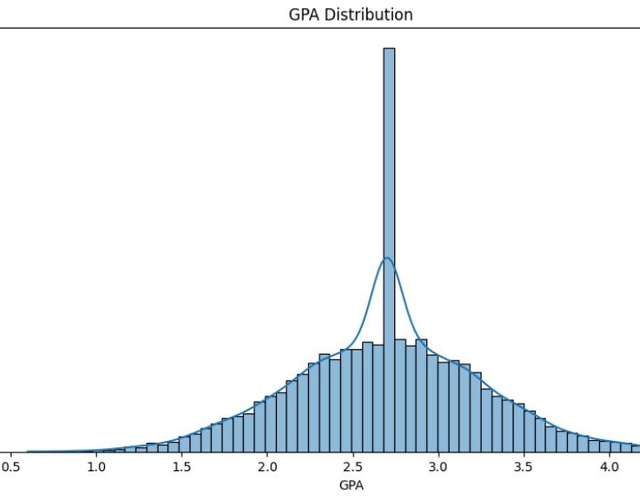
Exploratory Data Analysis (EDA)
GPA Distribution:
Right-skewed, most students achieve GPAs between 2.5 and 3.0
Key Insights:
Most students are middle-performing
Opportunity for improvement programs to most lower scoring students

Slide 4
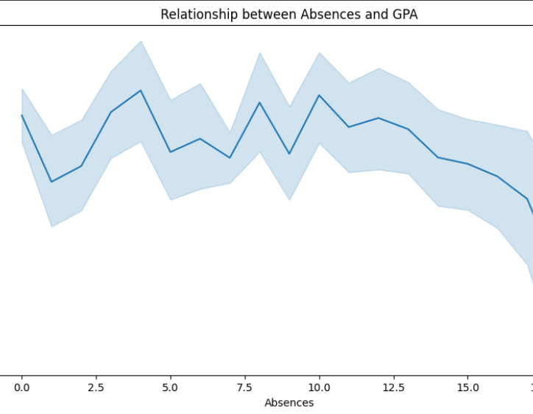
Exploratory Data Analysis (EDA)
Absences vs. GPA:
Key Insights:
Fewer absences are strongly correlated with higher GPAs

Slide 5
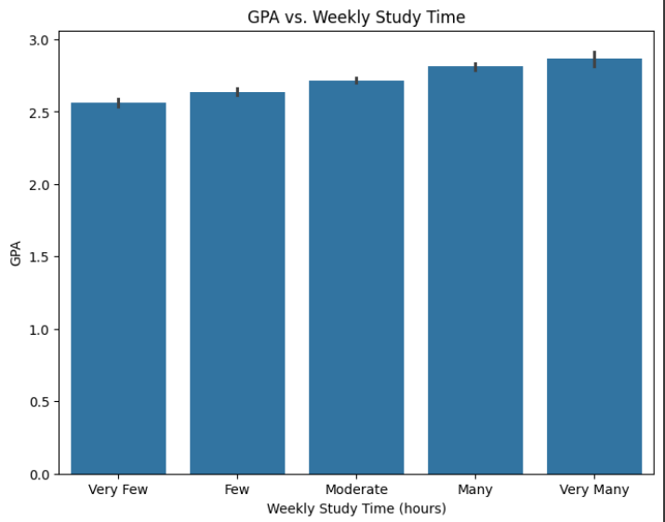
Exploratory Data Analysis (EDA)
GPA vs. Study Time Weekly
Key Insights:
Students who studied more achieved higher GPAs

Slide 6
Insights

Slide 7
Key Takeaways
Attendance
Parental Support
Regular attendance significantly increases GPA.
A key factor for academic success.
Extracurriculars
Tutoring and music show the greatest positive impact.

Slide 8
Thank You!

