Slide 1
Discovering-disease
Ali Faraj
Anil Tarachandani
Alexander Fassio
Matt Margolis
Paul Maschhoff

Slide 2
Goal
Find the cause of diseases by looking at the NHANES database

Slide 3
Method
Exposome × toxicogenomics.
NHANES measures dozens of environmental chemicals in blood and urine, including metals, phthalates, PFAS, pesticides, and VOCs.
Run an exposome-wide association study: for each chemical, regress a health outcome like HbA1c, liver enzymes, or blood pressure on its level, adjusting for age, sex, and other covariates.
Take the significant chemicals into the Comparative Toxicogenomics Database (CTD) and pull their known chemical–gene interactions.
Run pathway enrichment on those genes with Reactome or KEGG.
The result is a population-level association paired with a candidate biological mechanism, which demos well. (It also parallelizes naturally: thousands of independent regressions fan out easily on Modal)

Slide 4
NHANES
Nationally representative — rare for a survey with labs + medications.
Medication use + biomarkers + exposures in the same person — ideal for observational repurposing / pharmacovigilance.
Longitudinal via mortality follow-up — outcomes (death, cause) available with years of follow-up.
Public, stable, well-documented
Standardized weights (WTMEC2YR, WTP2YR, WTMI2YR, …) let you estimate population prevalence.

Slide 5
Association between Blood lead and Diabetes
Association | beta range across specs | men | women
Blood selenium -> log ALT | +0.042 to +0.049 (p <= 1e-4) | +0.044 | +0.038
Blood lead -> log GGT | +0.067 to +0.096 (p <= 6e-4) | +0.083 | +0.057
Blood lead -> HbA1c | -0.105 to -0.139 (p <= 6e-4) | -0.143 | -0.131

Slide 6
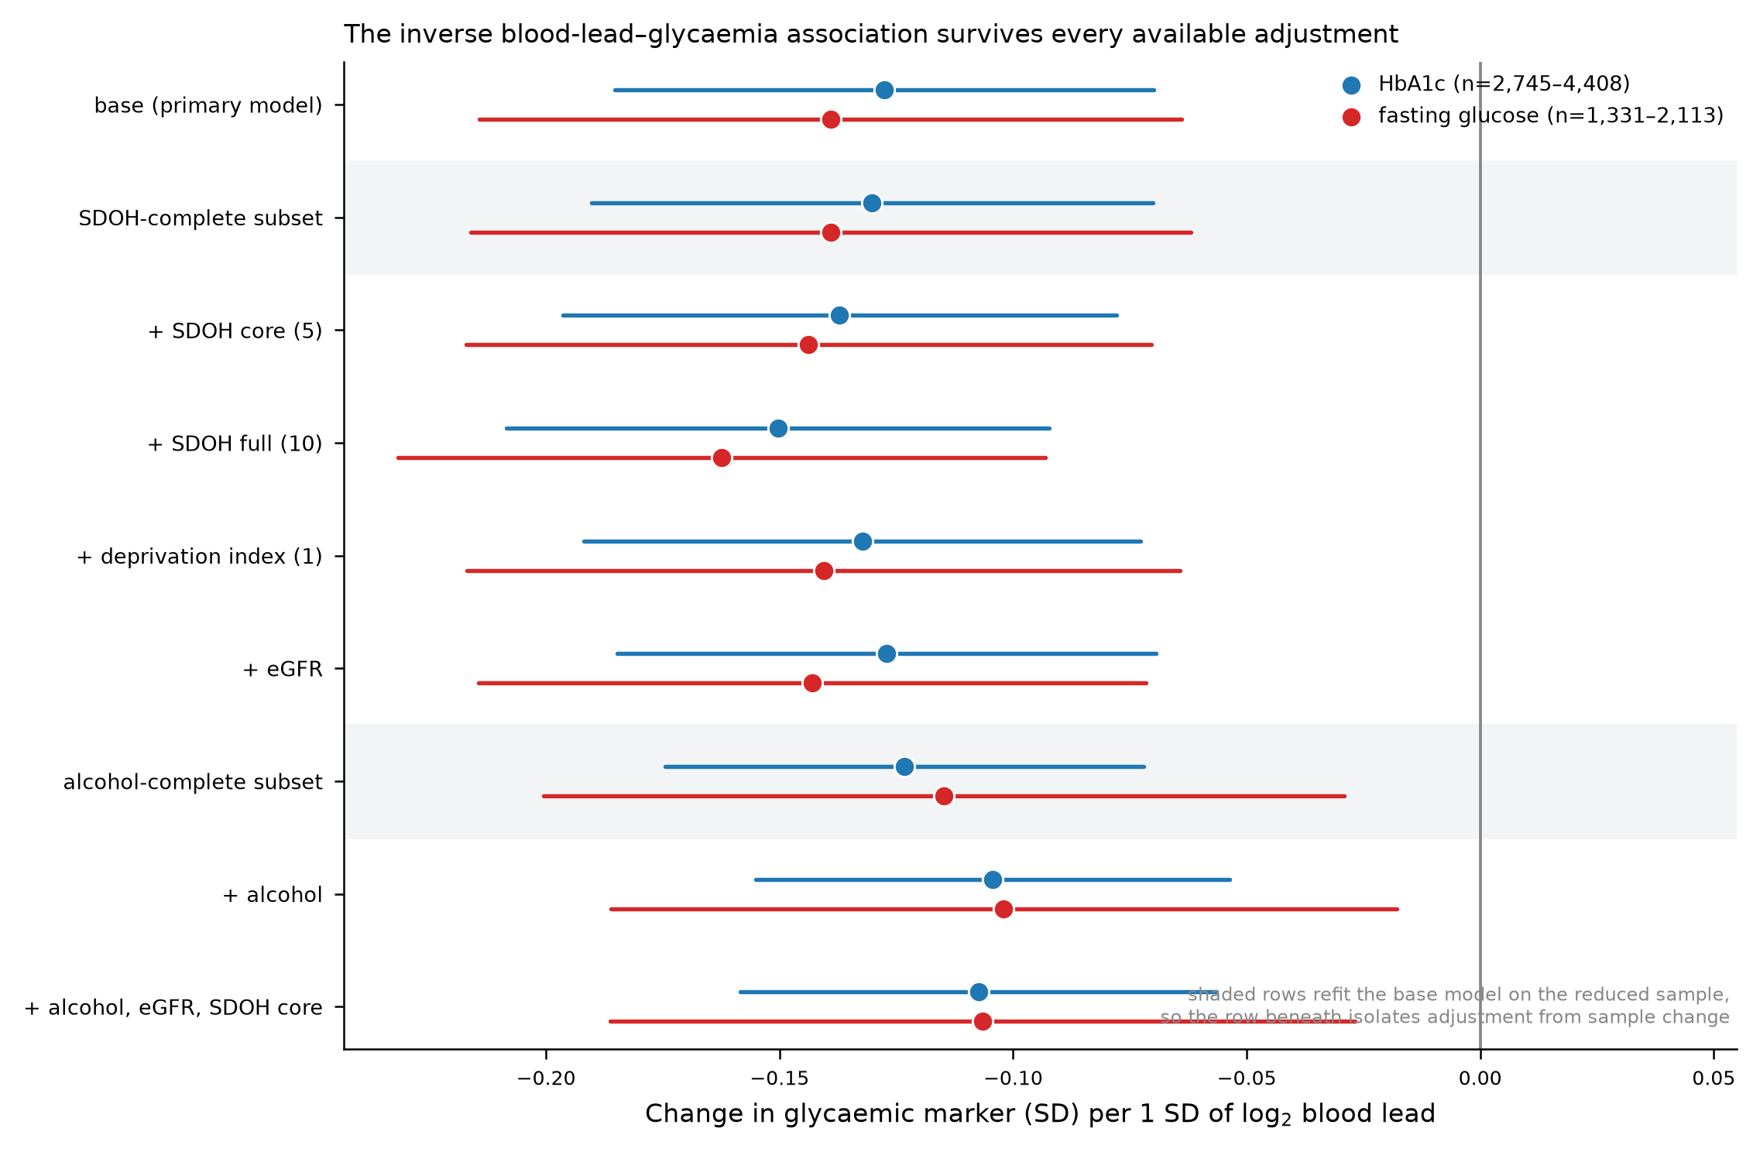
Lead and diabetes

Slide 7
Lead and Diabetes
Test | Result | Verdict
Lead -> fasting glucose | -0.033 per SD, p=0.0013 | glucose does not depend on red-cell lifespan, yet shows the same direction
Lead -> fasting insulin | -0.074 per SD, p=0.0011 | same direction again
Lead -> HbA1c, adjusting Hgb + MCV + RDW | -0.139 -> -0.140 | erythrocyte indices explain none of it
Lead -> haemoglobin | +0.137, p=0.0007 | positive, so no anaemia-mediated story
Lead -> HbA1c, + eGFR | -0.139 -> -0.138 | kidney function explains none of it
Lead -> HbA1c, + alcohol (matched sample) | -0.134 -> -0.114 | alcohol explains 15% (11% for glucose)

Slide 8
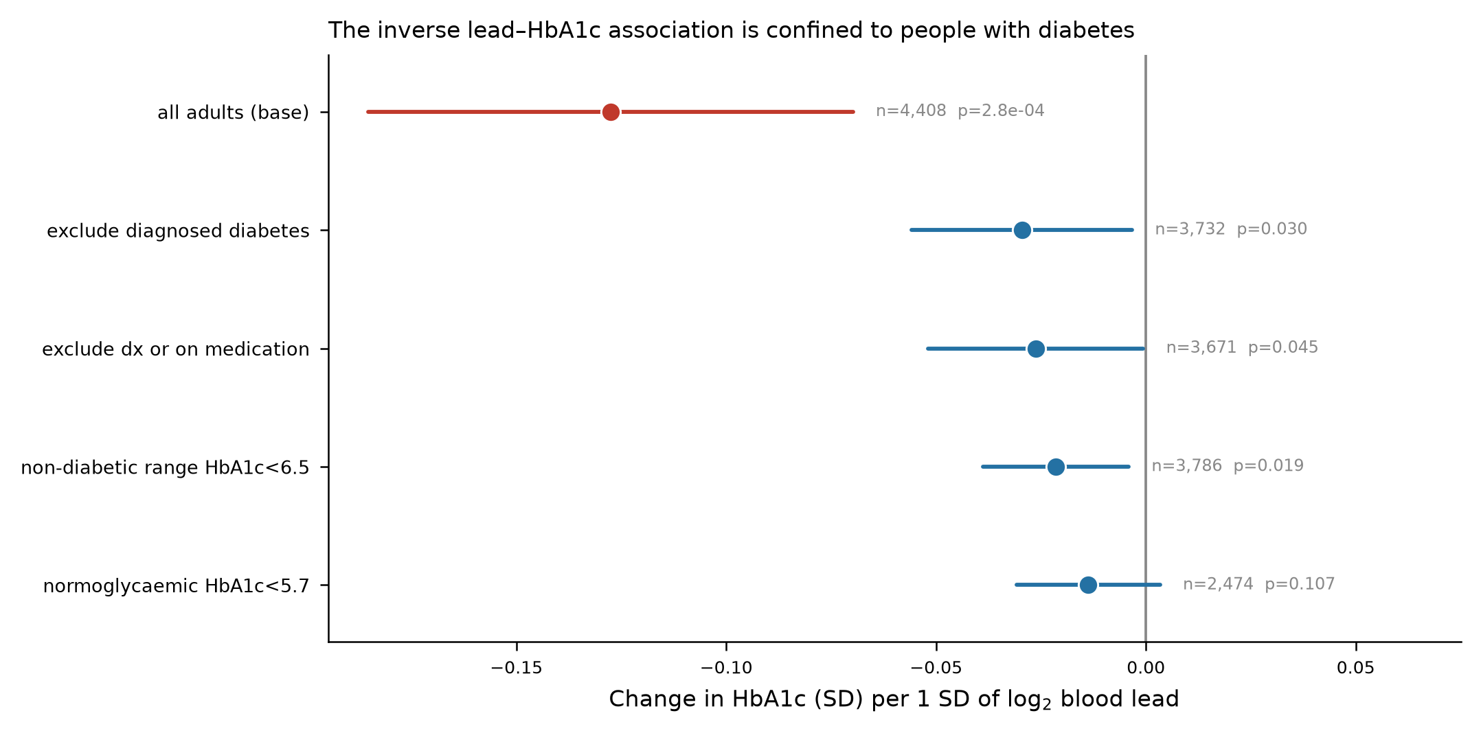
The association is an illusion

