Slide 1
NHS – Missed Appointments
Insights and Analysis

Slide 2
Main areas of focus:
Appointment data
Staffing levels
Capacity utilisation
Appointment types and capacity
Twitter data
Conclusions and next steps

Slide 3
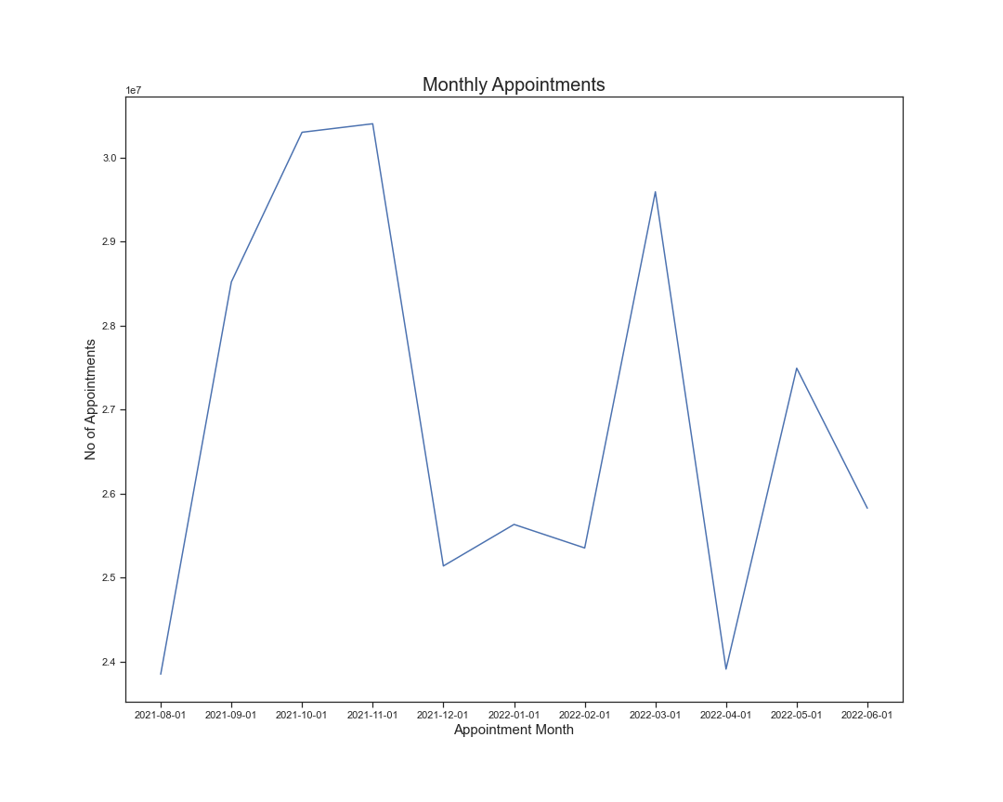

Slide 4
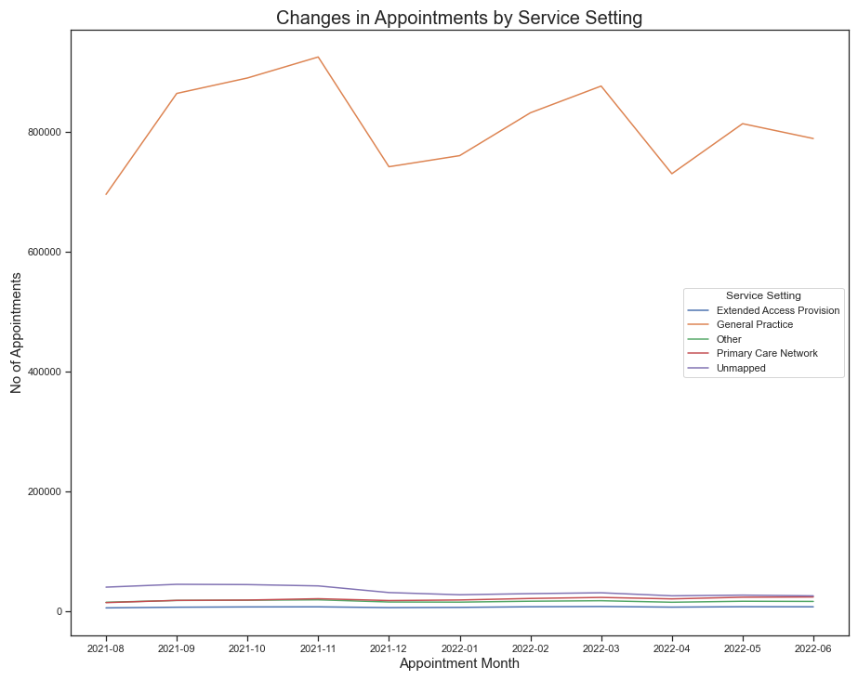
Winter pressures
GP – first port of call

Slide 5
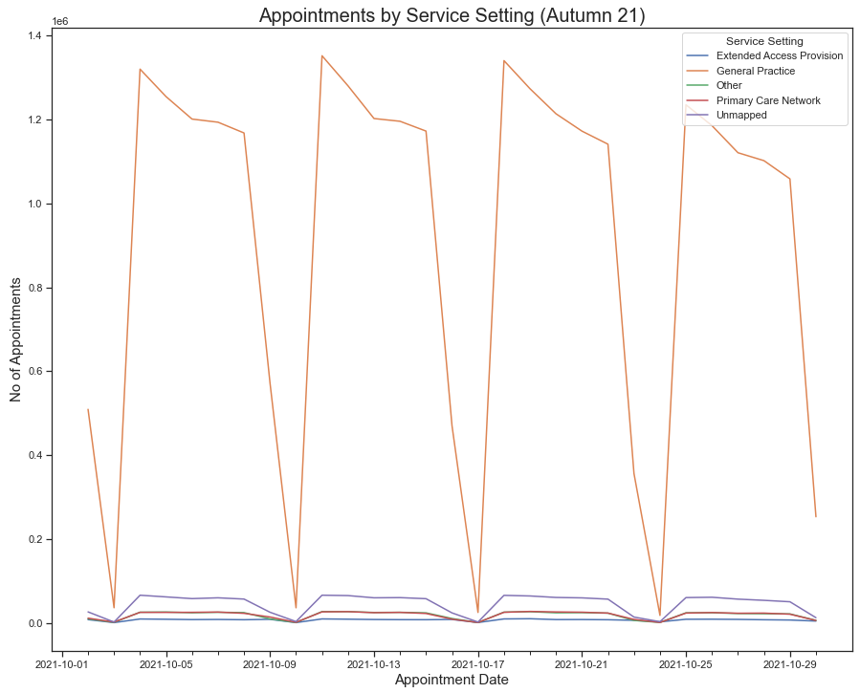
Daily appointment data
Pressure on GP surgeries is high

Slide 6
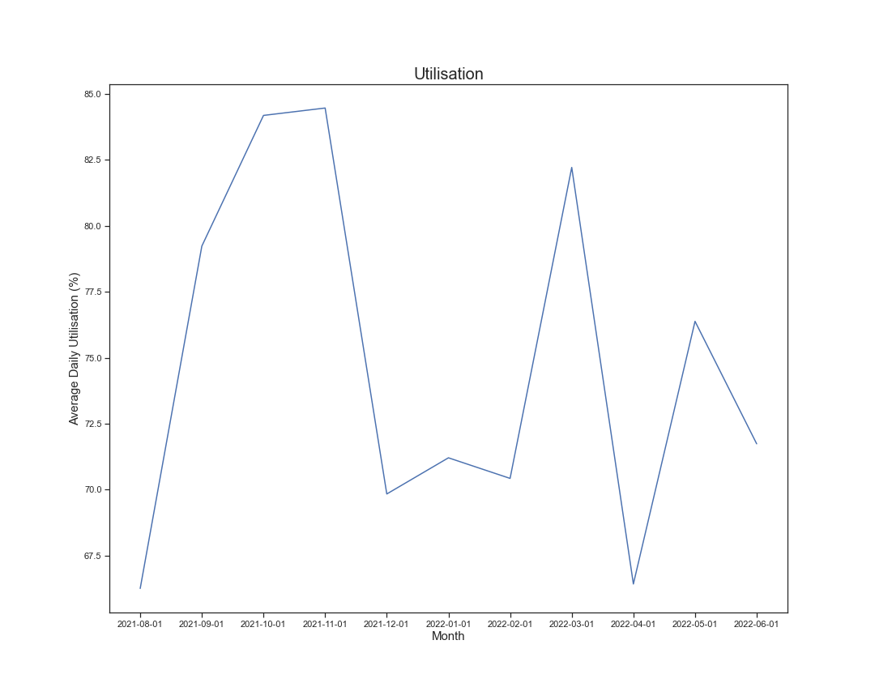
Staffing levels
Increased staff = increased utilisation. True or False?
Insufficient data to draw concrete conclusion
Other factors could be responsible – length of appointment, leadership etc
Prioritise patient care over utilisation figures

Slide 7
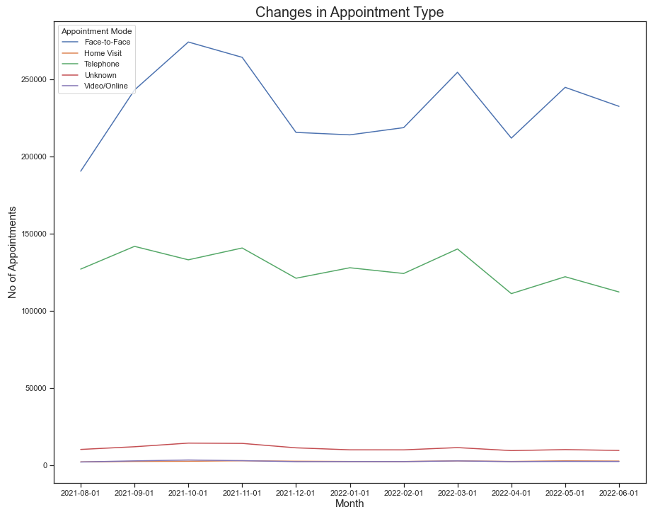
Appointment types and capacity
Mirrored trend – face-to-face and telephone
The case for virtual appointments - opportunity to maximise efficiency?
Further analysis required for October 2021

Slide 8
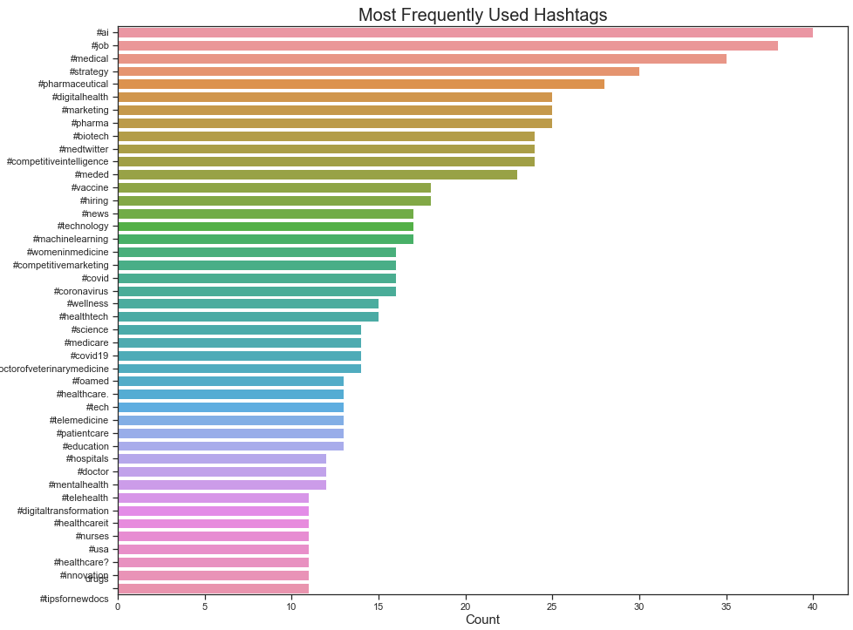
Twitter analysis
Discourse around technology and AI prominent
Caution on Twitter algorithms
Sentiment analysis on patient experience

Slide 9
Conclusions and recommendations
Appointments peak in winter and again in Easter
General Practice by far the most popular
Increased staff could lead to increased utilisation
More data required
Opportunity to increase video/online appointments
Sentiment analysis could provide greater insights

