Slide 1
Turtle Games
Ali Fazel

Slide 2
REVIEWS DATA

Slide 3
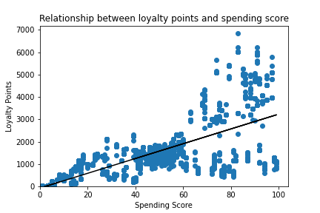
Positive correlation
R-squared: 0.452
Significant relationship

Slide 4
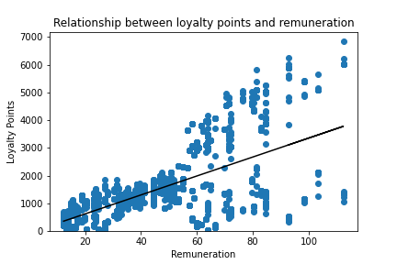
Mild positive correlation
R-squared: 0.380
Significant relationship
Notes:
No relationship between age and loyalty points

Slide 5
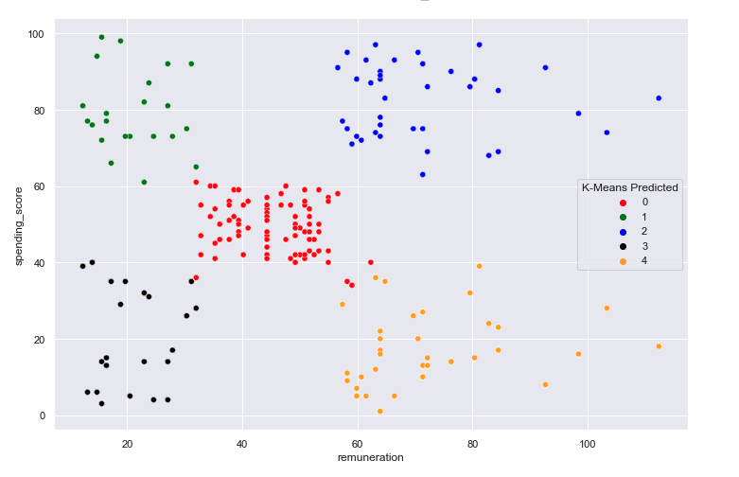
Remuneration vs Spending Score:
exploring clusters of customers
Might wish to focus efforts on specific groups

Slide 6
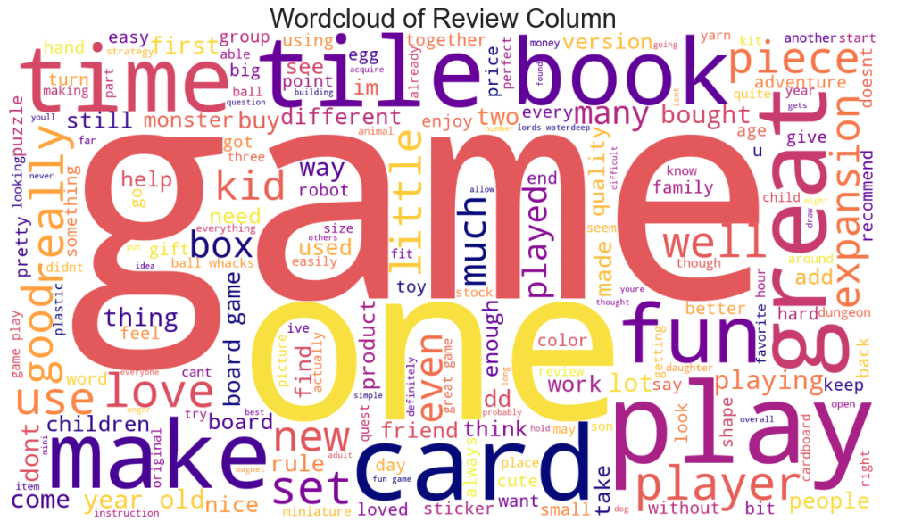

Slide 7
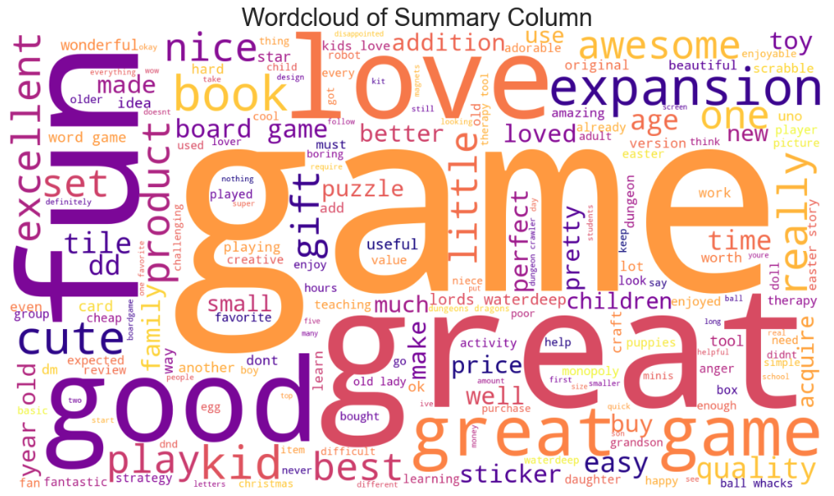

Slide 8
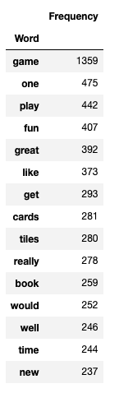
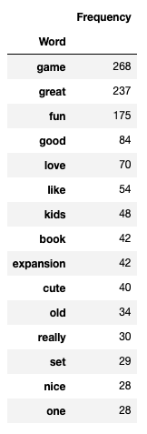
Most common words
Review column:
Summary column:

Slide 9
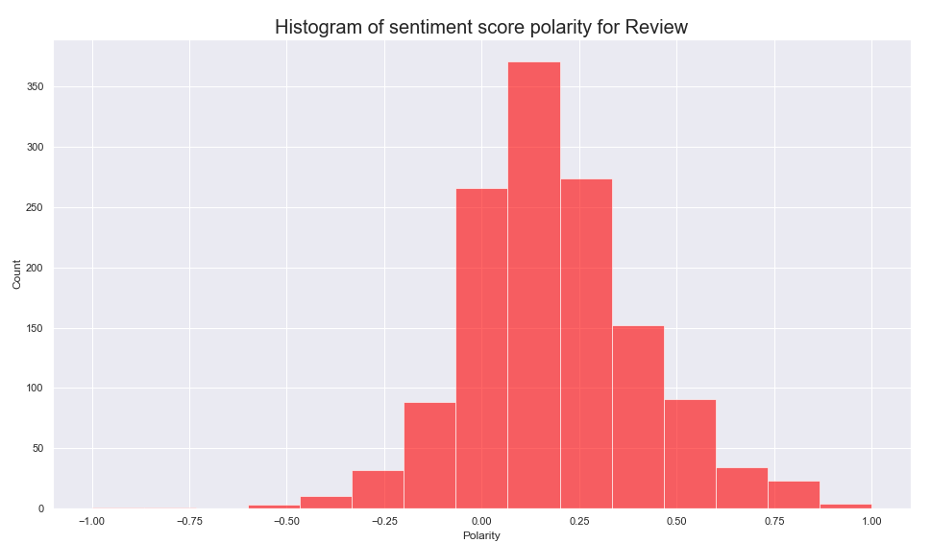

Slide 10
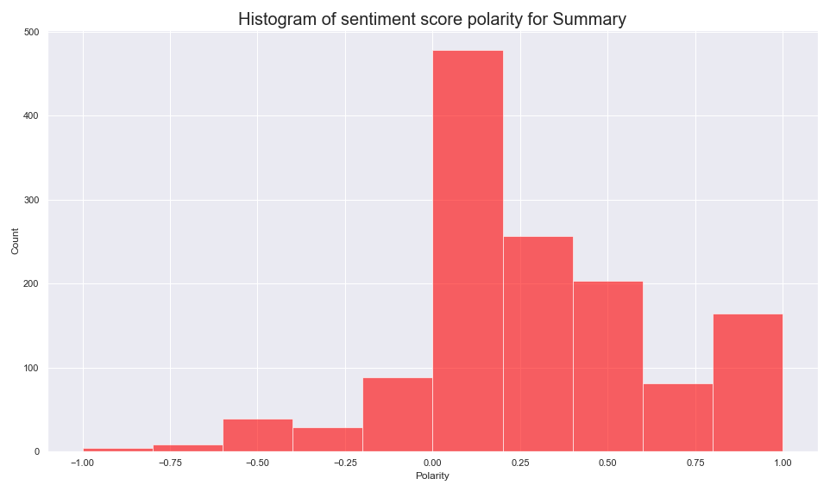

Slide 11
SALES DATA

Slide 12
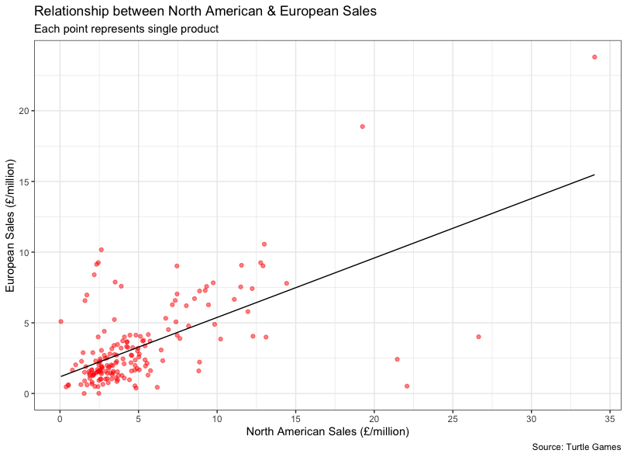
Correlation: 0.621
R-squared: 0.386
Significant relationship
Support with predictions
Similar popularity

Slide 13
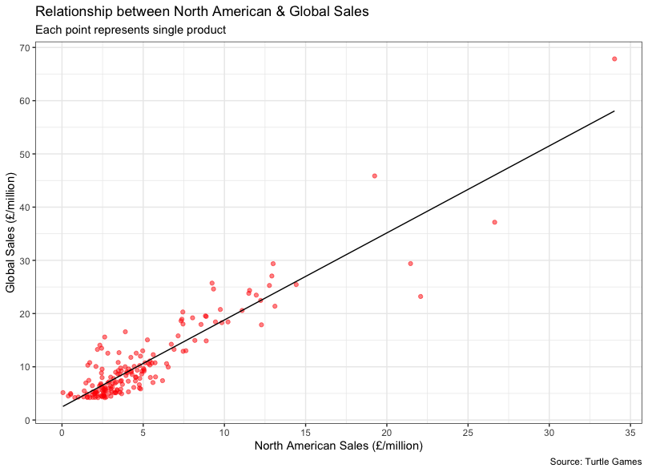
Correlation: 0.916
R-squared: 0.840
Significant relationship
Support with predictions

Slide 14
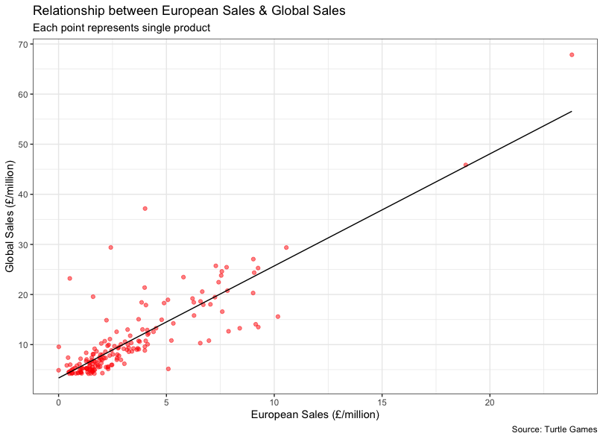
Correlation: 0.849
R-squared: 0.720
Significant relationship
Support with predictions

Slide 15

MLR Model
Predicting Global Sales using EU Sales and NA Sales (Global_Sales ~ EU_Sales + NA_Sales)
Multiple R-Squared: 0.9668
Adjusted R-Squared: 0.9664

Slide 16
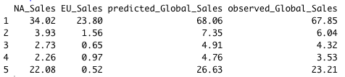
MLR – Predicted vs Observed

Slide 17
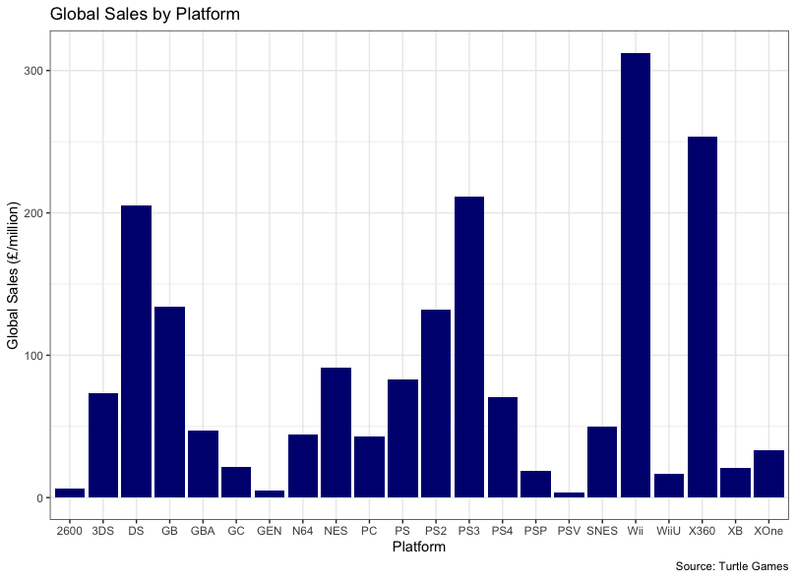

Slide 18
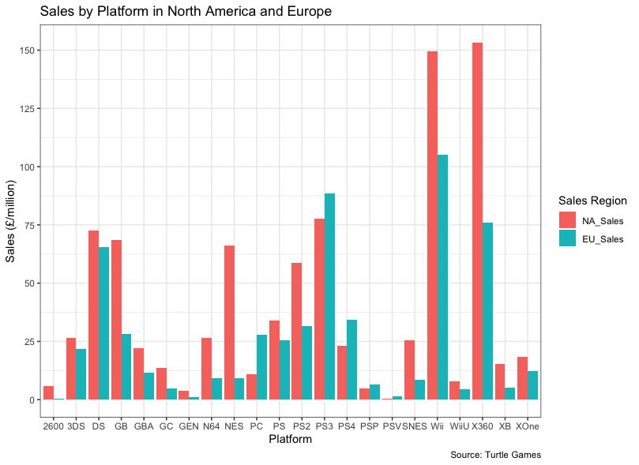

Slide 19
Conclusions and next steps
Reviews:
Positive relationships between
loyalty points and spending score
loyalty points and remuneration
Customer sentiment largely positive and neutral
Potential to explore themes where polarity was < 0.00
Create strategies to increase spending score based on remuneration clusters.

Slide 20
Conclusions and next steps
Sales:
Strong correlations between sales in EU and NA
Linear regression models confirm the above for all sales data
MLR provides a more realistic model
Wii, X360, PS3 and DS best performing platforms globally
NA performing better than EU, except on PS3, PC, PS4, PSP
Significant variations in sales between regions for Wii and X360

