Slide 1
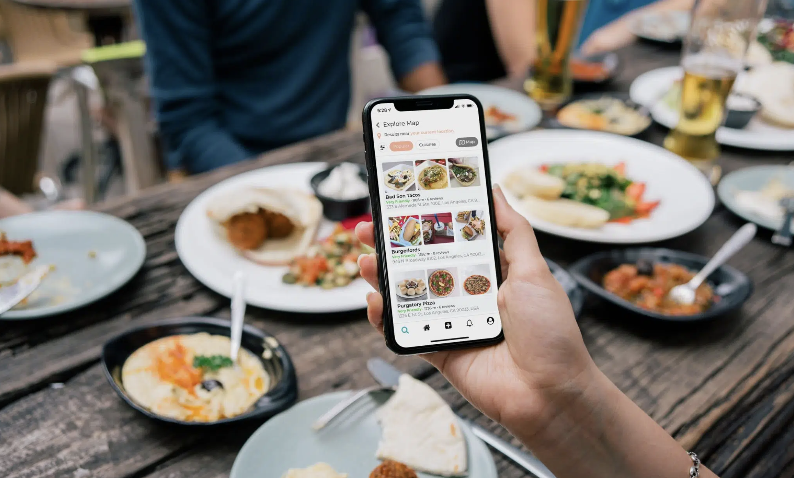

Member-Get-Member Analysis

Slide 2
Agenda
Outline member-get-member scheme
Data cleaning and wrangling
Criteria for ‘good’
Financial analysis & general insights
Impact on consumer behaviour

Slide 3
Member-Get-Member
Refer a friend scheme
Define ‘good’:
Financial – cost vs revenue
By city
Does it affect consumer behaviour
Amount spent
Frequency of orders

Slide 4
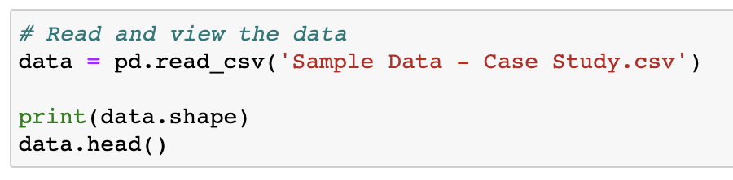
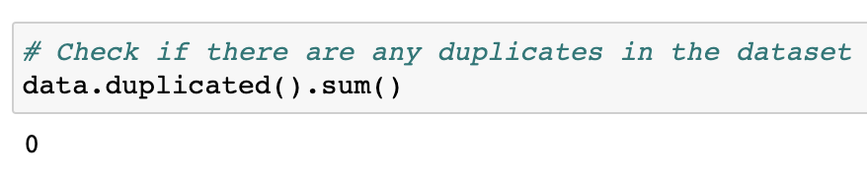
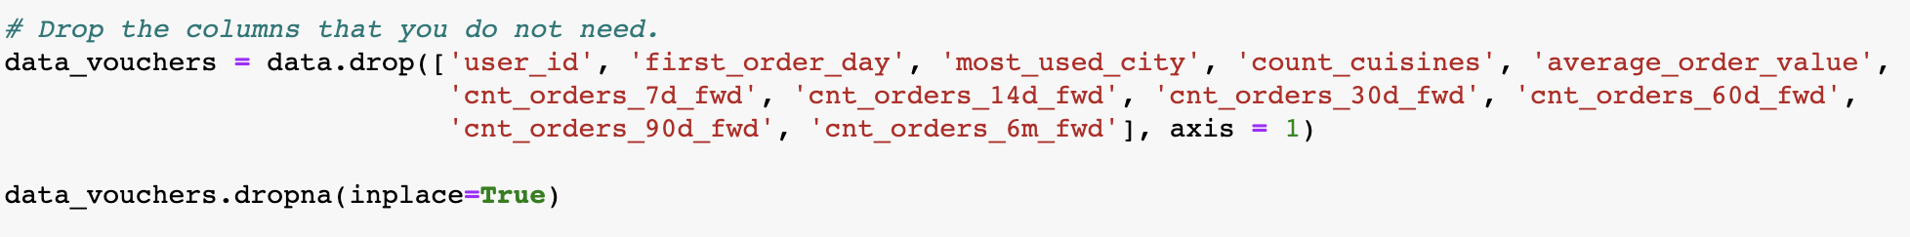
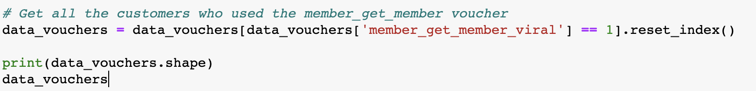
Data Cleaning & Wrangling

Slide 5
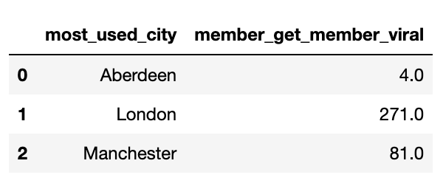
Cost vs Revenue
Total cost: £7,120.00
Total revenue (after 6 months): £12,642.48
Profit: £5,522.48
Total revenue (after 7 days): £10,268.87
Profit (after 7 days): £3,148.87

Slide 6
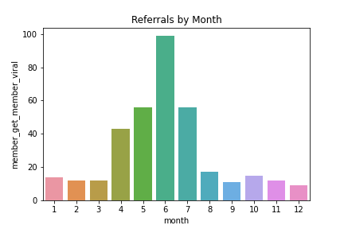
Referrals by Month

Slide 7
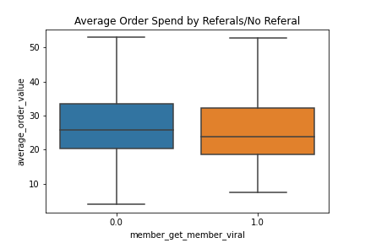
Consumer Behaviour – Avg Order Spend

Slide 8
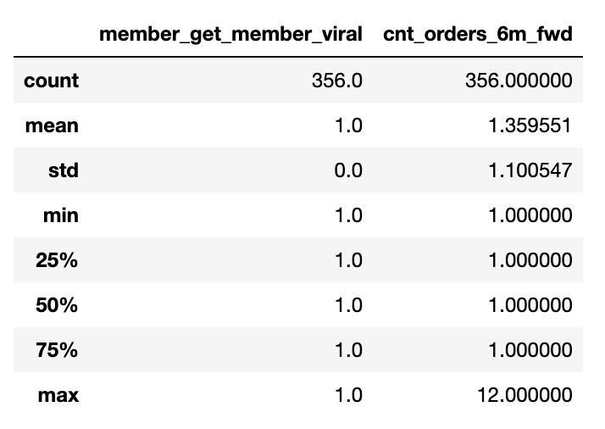
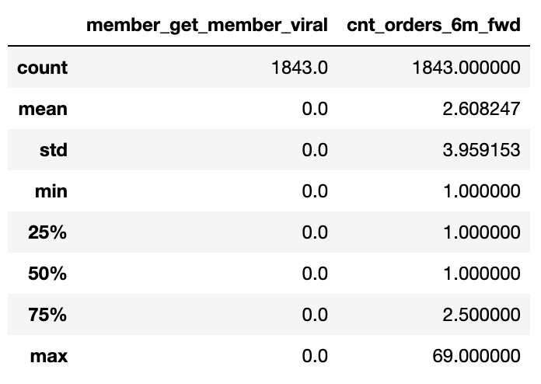
Consumer Behaviour – Order Freq.
Used referral:
Did not use referral:

Slide 9
Conclusions
Profit generating scheme
Quick return on investment (within 7 days)
Peak referrals in spring – early summer
London by far most popular
Referred customers are not spending/ordering more
Next steps:
Marketing strategies for Aberdeen and Manchester
Boosting usage in autumn and winter – more annual data
Customer retention – app usage data

