Slide 1

Bluetooth PANs
IEEE 802.15

Slide 2

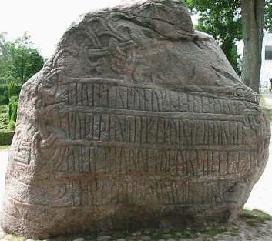
Bluetooth History
Harald Blaatand “Bluetooth” II
  King of Denmark 940-981 AC
This is one of two Runic stones erected in his capital city of Jelling
  The stone’s inscription (“runes”) says:
    Harald had dark hair
    Harald united Denmark & Norway
    Harald believed that devices should seamlessly communicate [wirelessly]
http://en.wikipedia.org/wiki/Harald_I_of_Denmark

Slide 3
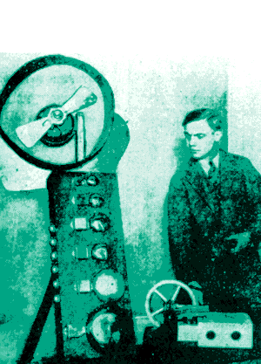

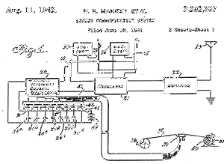
Frequency Hopping Spread Spectrum
Invented by Hedy Lamarr and George Antheil during 1941
Hedy knew that "guided" torpedos were much more effective hitting a target. The problem was that radio-controlled torpedos could easily be jammed by the enemy.
One afternoon she realized "we're talking and changing frequencies" all the time. At that moment, the concept of frequency-hopping was born.
Antheil gave Lamarr most of the credit, but he supplied the player piano technique. Using a modified piano roll in both the torpedo and the transmitter, the changing frequencies would always be in synch. A constantly changing frequency cannot be jammed.

Slide 4
Overview
Universal short-range wireless capability
Uses 2.4-GHz band
Available globally for unlicensed users
Devices within 10 m can share up to 720 kbps of capacity
Supports open-ended list of applications
  Data, audio, graphics, video

Slide 5
Bluetooth Application Areas
Data and voice access points
  Real-time voice and data transmissions
Cable replacement
  Eliminates need for numerous cable attachments for connection
Ad hoc networking
  Device with Bluetooth radio can establish connection with another when in range

Slide 6
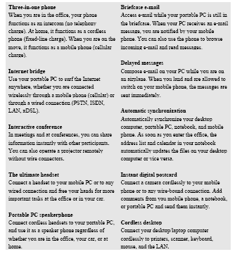
Bluetooth User Scenarios

Slide 7
Bluetooth Standards Documents
Core specifications
  Details of various layers of Bluetooth protocol architecture
  IEEE 802.15.1
Profile specifications
  Use of Bluetooth technology to support various applications
  Bluetooth consortium

Slide 8
Protocol Architecture
Bluetooth has a layered protocol architecture
  Core protocols
  Cable replacement and telephony control protocols
  Adopted protocols
Core protocols
  Radio
  Baseband
  Link manager protocol (LMP)
  Logical link control and adaptation protocol (L2CAP)
  Service discovery protocol (SDP)

Slide 9
Bluetooth Protocol Technology
The following MAC procedures support the asynchronous connectionless or connection-oriented (ACL) and synchronous connection-oriented (SCO) link delivery services:
  The baseband (BB) layer, specifying the lower level operations at the bit and packet levels, e.g., forward error correction (FEC) operations, encryption, cyclic redundancy check (CRC) calculations, Automatic Repeat Request (ARQ) Protocol.
  The link manager (LM) layer, specifying connection establishment and release, authentication, connection and release of SCO and ACL channels, traffic scheduling, link supervision, and power management tasks.
  The Logical Link Control and Adaptation Protocol (L2CAP) layer, forming an interface to standard data transport protocols. It handles the multiplexing of higher layer protocols and the segmentation and reassembly (SAR) of large packets. The data stream crosses the LM layer, where packet scheduling on the ACL channel takes place. The audio stream is directly mapped on an SCO channel and bypasses the LM layer. The LM layer, though, is involved in the establishment of the SCO link. Control messages are exchanged between the LM layer and the application.
  The 2.4 GHz industrial, scientific, and medical (ISM) band PHY signaling techniques and interface functions that are controlled by the IEEE 802.15.1-2005 MAC.
  Above the L2CAP layer may reside the Serial Cable Emulation Protocol based on ETSI TS 07.10 (RFCOMM), Service Discovery Protocol (SDP), Telephone Control Protocol specification (TCS), voice-quality channels for audio and telephony, and other network protocols. These protocols are necessary for interoperability for end-user products, but are outside the scope of this standard.

Slide 10
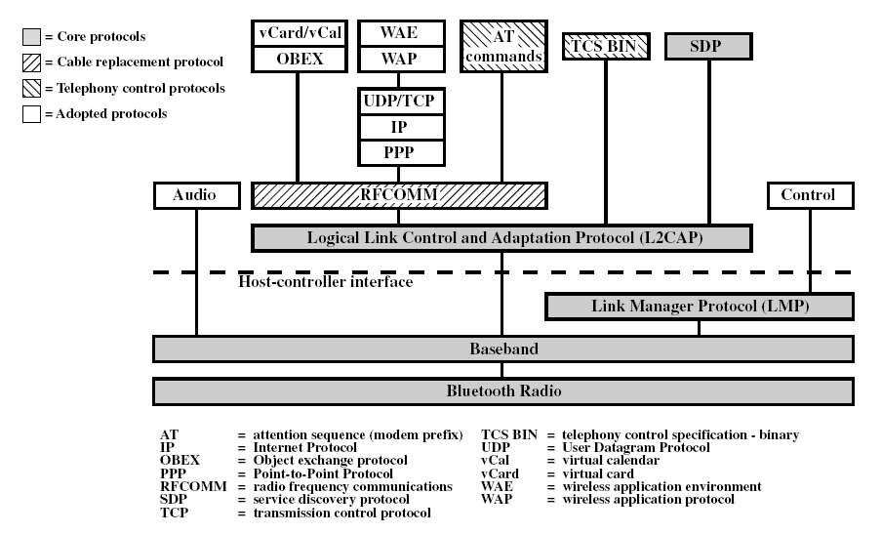
Protocol Stack

Slide 11
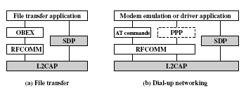
Usage Models

Slide 12
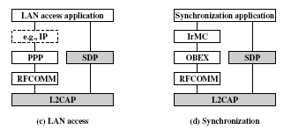
Usage Models

Slide 13
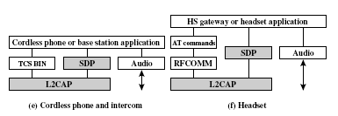
Usage Models

Slide 14
Piconets and Scatternets
Piconet
  Basic unit of Bluetooth networking
  Master and one to seven slave devices
  Master determines channel and phase
Scatternet
  Device in one piconet may exist as master or slave in another piconet
  Allows many devices to share same area
  Makes efficient use of bandwidth
  Not implemented in COTS equipment

Slide 15
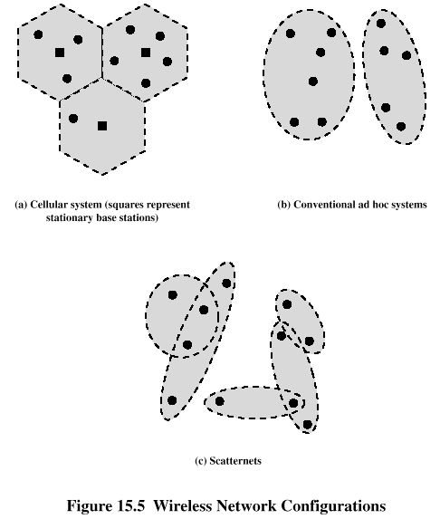
Wireless Network Configurations

Slide 16
Bluetooth Overview
Applications
TCP/IP
HID
RFCOMM
Application Framework and Support
Data
Control
Host Controller Interface
Audio
L2CAP
Link Manager and L2CAP
Link Manager
Logical Link Control & Adaptation Protocol
Baseband
Radio & Baseband
RF
A hardware/software description
An application framework

Slide 17
Bluetooth CONOPS
The RF (PHY) operates in the unlicensed ISM band at 2.4 GHz. The system employs a frequency hop transceiver to combat interference and fading and provides many frequency hopping spread spectrum (FHSS) carriers. RF operation uses a shaped, binary frequency modulation to minimize transceiver complexity. The symbol rate is 1 Msymbol/s supporting the bit rate of 1 Mb/s.
During typical operation, a physical radio channel is shared by a group of devices that are synchronized to a common clock and frequency hopping pattern. One device provides the synchronization reference and is known as the master. All other devices are known as slaves. A group of devices synchronized in this fashion form a piconet. This is the fundamental form of communication in the technology.
Devices in a piconet use a specific frequency hopping pattern, which is algorithmically determined by fields in the device address and the clock of the master. The basic hopping pattern is a pseudo-random ordering of the 79 frequencies in the ISM band. The hopping pattern may be adapted to exclude a portion of the frequencies that are used by interfering devices. The adaptive hopping technique improves coexistence with static (nonhopping) ISM systems when these are collocated.
The physical channel is subdivided into time units known as slots. Data are transmitted between devices in packets, which are positioned in these slots. When circumstances permit, a number of consecutive slots may be allocated to a single packet. Frequency hopping takes place between the transmission or the reception of packets. This standard provides the effect of full duplex transmission through the use of a time-division duplex (TDD) scheme.

Slide 18
CONOPS (cont.)
Above the physical channel, there is a layering of links and channels and associated control protocols. The hierarchy of channels and links from the physical channel upwards is physical channel, physical link, logical transport, logical link, and L2CAP channel.
Within a physical channel, a physical link is formed between any two devices that transmit packets in either direction between them. In a piconet physical channel, there are restrictions on which devices may form a physical link. There is a physical link between each slave and the master. Physical links are not formed directly between the slaves in a piconet.
The physical link is used as a transport for one or more logical links that support unicast synchronous, asynchronous and isochronous traffic, and broadcast traffic. Traffic on logical links is multiplexed onto the physical link by occupying slots assigned by a scheduling function in the resource manager.
A control protocol for the BB layer and PHY is carried over logical links in addition to user data. This is the LMP. Devices that are active in a piconet have a default asynchronous connection-oriented (ACL) logical transport that is used to transport the LMP signalling. For historical reasons, this is referred to as the ACL logical transport. The default ACL logical transport is the one that is created whenever a device joins a piconet. Additional logical transports may be created to transport synchronous data streams when this is required.
The LM function uses LMP to control the operation of devices in the piconet and provide services to manage the lower architectural levels (i.e., PHY and BB). The LMP is carried only on the default ACL logical transport and the default broadcast logical transport.
Above the BB, L2CAP provides a channel-based abstraction to applications and services. It carries out segmentation and reassembly (SAR) of application data and multiplexing and demultiplexing of multiple channels over a shared logical link. L2CAP has a protocol control channel that is carried over the default ACL logical transport. Application data submitted to the L2CAP may be carried on any logical link that supports the L2CAP.

Slide 19
Radio & Modulation
frequency synthesis: frequency hopping
  2.400-2.4835 GHz
  2.402 + k MHz, k=0, …, 78
  1,600 hops per second
conversion bits into symbols: modulation
  GFSK (BT = 0.5; 0.28 < h < 0.35);
  1 MSymbols/s
transmit power
  0 dbm (up to 20dbm with power control)
receiver sensitivity
  -70dBm @ 0.1% BER

Slide 20
Frequency Hopping (FH)
Resists interference and multipath effects
Provides a form of multiple access among co-located devices in different piconets
Total bandwidth divided into 1 MHz channels
FH occurs by jumping from one channel to another in pseudorandom sequence
Hopping sequence shared across entire piconet
Piconet access:
  Bluetooth devices use time division duplex (TDD)
  Access technique is TDMA
  FH-TDD-TDMA

Slide 21
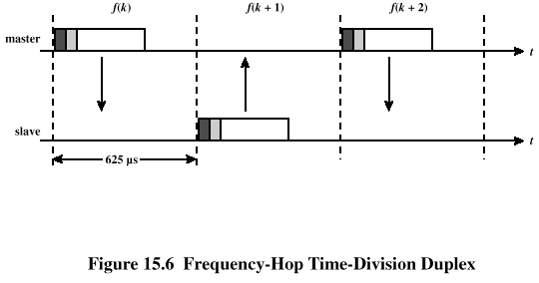
Frequency Hopping
Each frame uses a single hop frequency for its duration

Slide 22
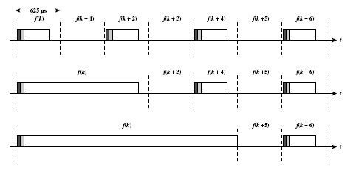
Multislot Frames

Slide 23
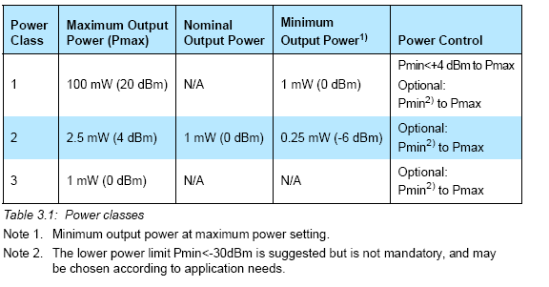
Transmit Power
The power steps shall form a monotonic sequence, with a maximum step size of 8 dB and a minimum step size of 2 dB.
A class 1 equipment with a maximum transmit power of +20 dBm must be able to control its transmit power down to 4 dBm or less.

Slide 24
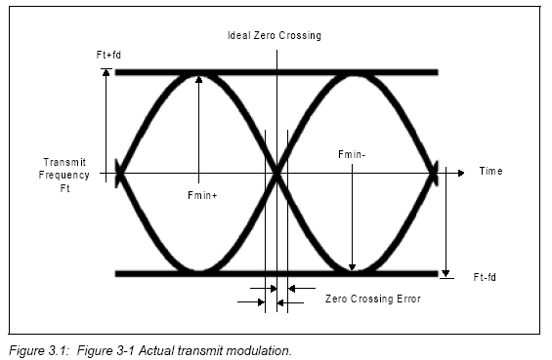
Eye Pattern
Modulation is GFSK (Gaussian Frequency Shift Keying) with a BT=0.5.
The data transmitted has a symbol rate of 1 Ms/s.

Slide 25
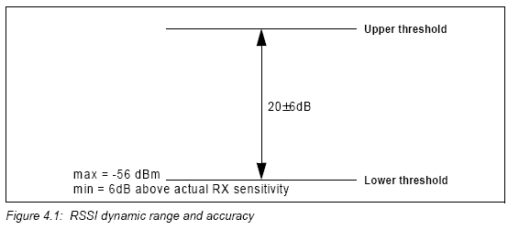
RECEIVER SIGNAL STRENGTH INDICATOR
The RSSI measurement compares the received signal power with two threshold levels, which define the Golden Receive Power Range. The lower threshold level corresponds to a received power between -56 dBm and 6 dB above the actual sensitivity of the receiver. The upper threshold level is 20 dB above the lower threshold level to an accuracy of +/- 6 dB
Optional function

Slide 26
Bluetooth Protocol
Bluetooth uses a 625 μs slotted channel. A Time-Division Duplex (TDD) scheme is used for full duplex transmission. Information is exchanged through frames. Each frame is transmitted on a different hop frequency. A frame nominally covers a single slot, but can be extended to cover up to five slots.
The Bluetooth protocol uses a combination of circuit and frame switching.
Slots can be reserved for synchronous frames. Bluetooth can support an asynchronous data channel, up to three simultaneous synchronous voice channels, or a channel which simultaneously supports asynchronous data and synchronous voice. Each voice channel supports a 64 kb/s synchronous (voice) channel in each direction. The asynchronous channel can support maximal 723.2 kb/s asymmetric (and still up to 57.6 kb/s in the return direction), or 433.9 kb/s symmetric.

Slide 27
Baseband protocol
Standby
  Waiting to join a piconet
Inquire
  Ask about available radios
Page
  Connect to a specific radio
Connected
  Actively on a piconet (master or slave)
Park/Hold
  Low-power connected states
Unconnected:
Standby
Standby
Detach
Connecting
states
Inquiry
Page
T =2s
tpcl
T =0.6s
tpcl
Active
states
Transmit
Connected
data
AMA
AMA
T =2ms
T =2ms
tpcl
tpcl
Low-power
states
PARK
HOLD
PMA
AMA
releases
AMA address

Slide 28
Baseband link types
Polling-based (TDD) frame transmissions
  1 slot: 0.625msec (max 1600 slots/sec)
  master/slave slots (even-/odd-numbered slots)
  polling: master always “polls” slaves
Synchronous connection-oriented (SCO) link
  “circuit-switched”
    periodic single-slot frame assignment
  symmetric 64Kbps full-duplex
Asynchronous connection-less (ACL) link
  Frame switching
  asymmetric bandwidth
    variable frame size (1-5 slots)
      max. 721 kbps (57.6 kbps return channel)
      108.8 - 432.6 kbps (symmetric)
0 1 2 3 4 5 6 7 8 9 10 11 12 13 14 15 16 17 18 19 20 21 22
master
SCO
slave
ACL

Slide 29
Bluetooth Frame Fields
Access code
  used for timing synchronization, offset compensation, paging, and inquiry
Header
  used to identify frame type and carry protocol control information
Payload
  contains user voice or data and payload header, if present

Slide 30
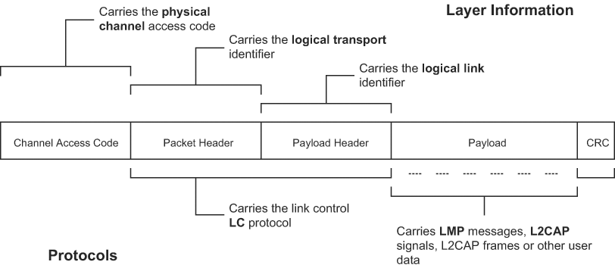
Bluetooth Frame Structure
Frame
ACCESS CODE - based on identity and system clock of Master
Provides means for synchronization; Unique for channel;
Used by all frames on the channel

Slide 31
Types of Access Codes
Channel access code (CAC)
  identifies a piconet
Device access code (DAC)
  used for paging and subsequent responses
Inquiry access code (IAC)
  used for inquiry purposes

Slide 32
Access Code
Preamble – used for DC compensation
  0101 if LSB of sync word is 0
  1010 if LSB of synch word is 1
Sync word – 64-bits, derived from:
  7-bit Barker sequence
  Lower address part (LAP)
  Pseudonoise (PN) sequence
Trailer
  0101 if MSB of sync word is 1
  1010 if MSB of sync word is 0

Slide 33
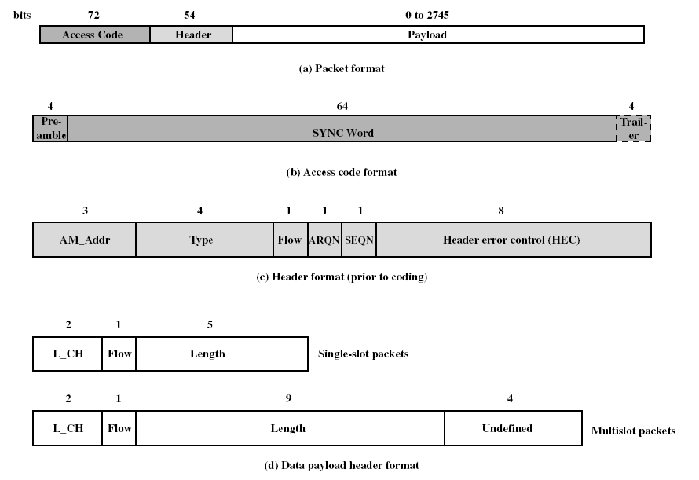
Bluetooth Baseband Format
Frame
Frame
Frames
Frame

Slide 34
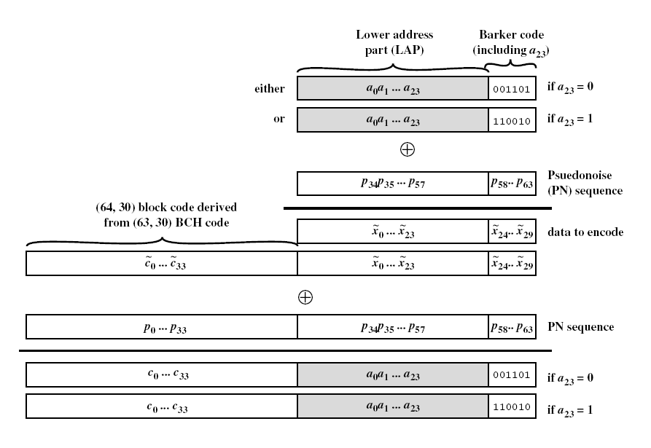
Sync Word Construction

Slide 35
Frame Header Fields
AM_ADDR
  contains “active mode” address of one of the slaves
Type
  identifies type of frame
Flow
  1-bit flow control
ARQN
  1-bit acknowledgment
SEQN
  1-bit sequential numbering schemes
Header error control (HEC)
  8-bit error detection code

Slide 36
Payload Format
Payload header
  L_CH field – identifies logical channel
  Flow field – used to control flow at L2CAP level
  Length field – number of bytes of data
Payload body
  contains user data
CRC
  16-bit CRC code

Slide 37
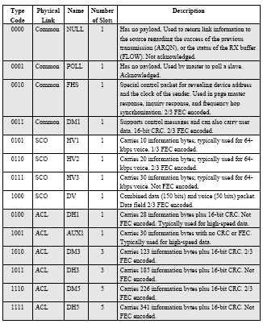
Bluetooth Frame Types

Slide 38
Error Correction Schemes
1/3 rate FEC (forward error correction)
  Used on 18-bit frame header, voice field in HV1 frame
2/3 rate FEC
  Used in DM frames, data fields of DV frame, FHS frame and HV2 frame
ARQ
  Used with DM and DH frames

Slide 39
ARQ Scheme Elements
Error detection
  destination detects errors, discards frames
Positive acknowledgment
  destination returns positive acknowledgment
Retransmission after timeout
  source retransmits if frame is unacknowledged
Negative acknowledgment and retransmission
  destination returns negative acknowledgement for errored frames, source retransmits

Slide 40
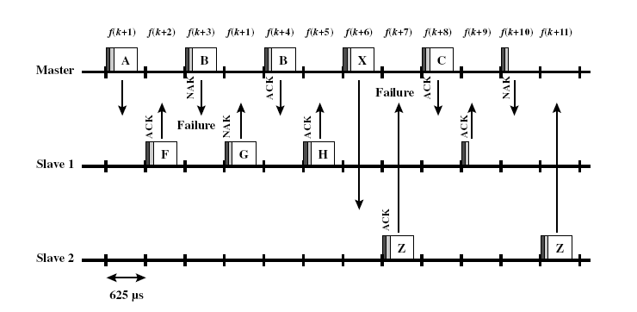
Retransmission Operation

Slide 41
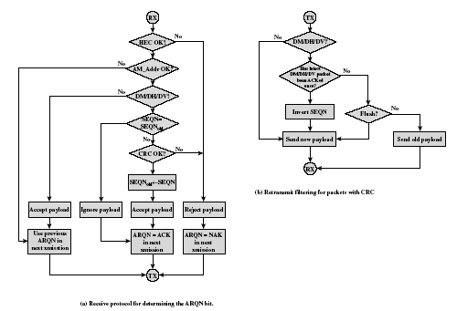
Fast ARQ Scheme

Slide 42
Logical Channels
Link control (LC)
Link manager (LM)
User asynchronous (UA)
User isochronous (UI)
Use synchronous (US)

Slide 43
Channel Control
States of operation of a piconet during link establishment and maintenance
Major states
  Standby – default state
  Connection – device connected

Slide 44
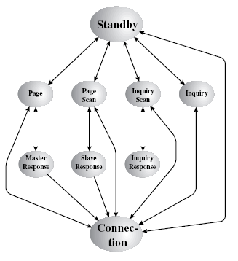
State Transition Diagram

Slide 45
Channel Control
Interim substates for adding new slaves
  Page – device issued a page (used by master)
  Page scan – device is listening for a page
  Master response – master receives a page response from slave
  Slave response – slave responds to a page from master
  Inquiry – device has issued an inquiry for identity of devices within range
  Inquiry scan – device is listening for an inquiry
  Inquiry response – device receives an inquiry response

Slide 46
Inquiry Procedure
Potential master identifies devices in range that wish to participate
  Transmits ID frame with inquiry access code (IAC)
  Occurs in Inquiry state
Device receives inquiry
  Enter Inquiry Response state
  Returns FHS frame with address and timing information
  Moves to page scan state

Slide 47
Page Procedure
Master uses devices address to calculate a page frequency-hopping sequence
Master pages with ID frame and device access code (DAC) of specific slave
Slave responds with DAC ID frame
Master responds with its FHS frame
Slave confirms receipt with DAC ID
Slaves moves to Connection state

Slide 48
Slave Connection State Modes
Active – participates in piconet
  Listens, transmits and receives frames
Sniff – only listens on specified slots
Hold – does not support ACL frames
  Reduced power status
  May still participate in SCO exchanges
Park – does not participate on piconet
  Still retained as part of piconet

Slide 49
Bluetooth Audio
Voice encoding schemes:
  Pulse code modulation (PCM)
  Continuously variable slope delta (CVSD) modulation
Choice of scheme made by link manager
  Negotiates most appropriate scheme for application

Slide 50
Bluetooth Link Security
Elements:
  Authentication – verify claimed identity
  Encryption – privacy
  Key management and usage
Security algorithm parameters:
  Unit address
  Secret authentication key
  Secret privacy key
  Random number

Slide 51
LMP PDUs
General response
Security Service
  Authentication
  Pairing
  Change link key
  Change current link key
  Encryption
Time/synchronization
  Clock offset request
  Slot offset information
  Timing accuracy information request
Station capability
  LMP version
  Supported features

Slide 52
LMP PDUs
Mode control
  Switch master/slave role
  Name request
  Detach
  Hold mode
  Sniff mode
  Park mode
  Power control
  Channel quality-driven change between DM and DH
  Quality of service
  Control of multislot packets
  Paging scheme
  Link supervision

Slide 53
L2CAP LLC & Adaptation Protocol
Provides a link-layer protocol between entities with a number of services
Relies on lower layer for flow and error control
Makes use of ACL links, does not support SCO links
Provides two alternative services to upper-layer protocols
  Connection service
  Connection-mode service

Slide 54
L2CAP Logical Channels
Connectionless
  Supports connectionless service
  Each channel is unidirectional
  Used from master to multiple slaves
Connection-oriented
  Supports connection-oriented service
  Each channel is bidirectional
Signaling
  Provides for exchange of signaling messages between L2CAP entities

Slide 55
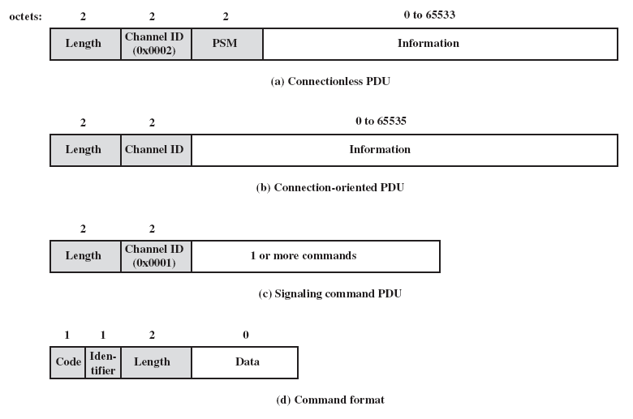
L2CAP Formats

Slide 56
L2CAP Frame Fields for Connectionless Service
Length – length of information payload, PSM fields
Channel ID – 2, indicating connectionless channel
Protocol/service multiplexer (PSM) – identifies higher-layer recipient for payload
  Not included in connection-oriented frames
Information payload – higher-layer user data

Slide 57
Signaling Frame Payload
Consists of one or more L2CAP commands, each with four fields
  Code – identifies type of command
  Identifier – used to match request with reply
  Length – length of data field for this command
  Data – additional data for command, if necessary

Slide 58
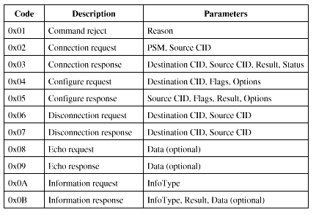
L2CAP Signaling Command Codes

Slide 59
L2CAP Signaling Commands
Command reject command
  Sent to reject any command
Connection commands
  Used to establish new connections
Configure commands
  Used to establish a logical link transmission contract between two L2CAP entities

Slide 60
L2CAP Signaling Commands
Disconnection commands
  Used to terminate logical channel
Echo commands
  Used to solicit response from remote L2CAP entity
Information commands
  Used to solicit implementation-specific information from remote L2CAP entity

Slide 61
Flow Specification Parameters
Service type
Token rate (bytes/second)
Token bucket size (bytes)
Peak bandwidth (bytes/second)
Latency (microseconds)
Delay variation (microseconds)

Slide 62
References
IEEE 802.15.1
  http://standards.ieee.org/getieee802/802.15.html
Bluetooth SIG
  http://www.bluetooth.com/bluetooth/
WikiPedia
  http://en.wikipedia.org/wiki/Bluetooth
Hedy Lamarr / George Antheil Bio
  http://www.hypatiamaze.org/h_lamarr/scigrrl.html

