Slide 1
Bluetooth Tutorial
Radio, Baseband, L2CAP and LMP Specifications
Apurva Kumar
(www.research.ibm.com/people/k/kapurva)
Research Staff Member
IBM India Research Lab

Slide 2
Bluetooth Physical Layer:
Radio Specifications
Transmitter
Operates in the 2.4 GHz unlicensed ISM band.
79 hop frequencies: f = 2402+k MHz, k= 0,..78.
Nominal output power = 0 dBm (1 mW).
GFSK modulation: BT=0.5, 0.28 < m < 0.35.

Slide 3
Bluetooth Radio Specification
Receiver
BER < 10⁻³ for:
  –70dBm input power level.
  11 dB carrier to co-channel interference ratio.

Slide 4
Bluetooth Baseband: General
Symbol rate = 1 Ms/s.
Slotted channel with slot time = 625 μs.
Time-division duplex (TDD) for full-duplex.
Supports synchronous (voice) channel of 64 kbps in each direction.
Supports asynchronous channels of upto 721 kb/s (asymmetric) or 432.6 kb/s (symmetric)

Slide 5
Baseband: Physical Channel
Pseudo-random hopping sequence hopping through 79 frequencies.
Hopping sequence determined by address of the piconet master.
Master starts transmission in even slot while slaves start in odd slots.
Packet transmissions can extend to 5 slots.
Single hop frequency for each transmission.

Slide 6
Baseband: Physical Links
Two types of links between master and slaves:
  Synchronous connection oriented (SCO)
  Asynchronous connection less (ACL)
SCO is a point to point link.
SCO link reserves slots at regular intervals.
ACL is a packet switched link between master and all slaves in the piconet.
Slaves return packets on ACL link if they are addressed by the master in the preceding slot.

Slide 7

Baseband: Packets
Access code identifies a piconet.
Access code used for piconet communication derived from the master’s address.
Access codes used in inquiry, paging.

Slide 8

Baseband: Packet Header
AM_ADDR: 3 bits: address of slave in piconet.
TYPE: One of 16 possible packet types
FLOW: Used to stop flow on ACL link.
ARQN: Positive or negative acknowlegement.
SEQN: Inverted for each new transmitted packet.
HEC: Header-error check.
The entire header is protected by 1/3 rate FEC.

Slide 9
Baseband: Packet type summary
Type | Payload header (bytes) | User payload (bytes) | FEC | Symmetric max. rate (kbps) | Asymmetric max. rate (kbps) Forward Reverse
DM1 | 1 | 0-17 | 2/3 | 108.8 | 108.8 | 108.8
DH1 | 1 | 0-27 | no | 172.8 | 172.8 | 172.8
DM3 | 2 | 0-121 | 2/3 | 258.1 | 387.2 | 54.4
DH3 | 2 | 0-183 | no | 390.4 | 585.6 | 86.4
DM5 | 2 | 0-224 | 2/3 | 286.7 | 477.8 | 36.3
DH5 | 2 | 0-339 | no | 433.9 | 723.2 | 57.6
ACL packet types

Slide 10
Baseband: Error Correction
Both forward and backward error correction.
1/3 rate FEC: used for headers and voice.
2/3 rate FEC: used for DM packets.
Stop and wait ARQ.
CRC is used to detect error in payload.
Broadcast packets are not acked.

Slide 11
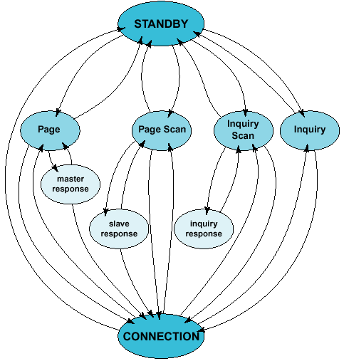
Baseband: Overview of states
Major states:
  Standby
  Connection
7 sub-states: used in device discovery
procedures.

Slide 12
Baseband: Inquiry procedure
To discover other units in range.
ID packets containing GIAC are transmitted by inquiring device.
ID packets sent on inquiry hopping sequence derived from GIAC.
Inquirer sends 2 ID packets at different frequencies in even slots and waits for response(s) in the odd slots.
32 inquiry hop frequencies are split in two 16 hop parts (trains) A and B. Each train lasts 10msec (16 slots).
A scanning device listens at one of 32 inquiry frequencies for 11.25 msec at least once every 2.56 sec.
A/B trains of ID packets are repeated 256 times each.

Slide 13
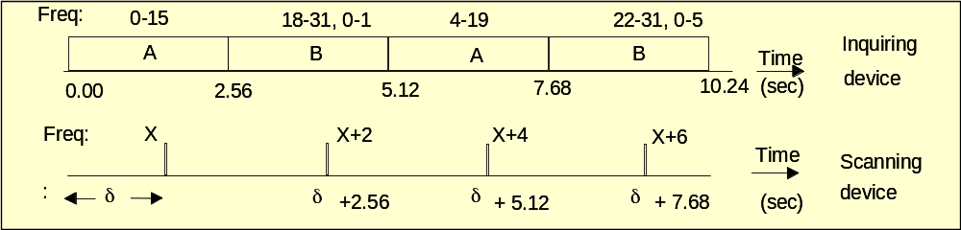
Baseband: Inquiry and inquiry scan
On receiving an ID packet, scanning unit backs off for a random time (max 0.64 sec).
On receiving another ID packet after waking up, the scanning unit returns an FHS packet.

Slide 14
Baseband: Paging procedure
To connect to already known units.
The 32 hop page sequence is derived from address of the paged device.
A/B trains are transmitted once, 128 or 256 times depending upon the paging mode.
The paged device does scanning continuously, or once every 1.28 sec or 2.56 sec.

Slide 15
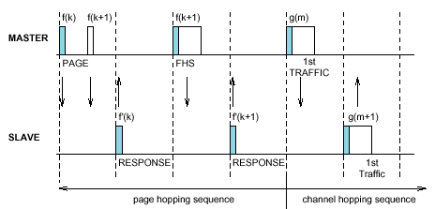
Baseband: Paging and page scan

Slide 16
Baseband: Connection state
Active mode:
  Bluetooth unit listens for each master transmission.
  Slaves not addressed can sleep through a transmission.
  Periodic master transmissions used for sync.
Sniff mode:
  Unit does not listen to every master transmission.
  Master polls such slaves in specified sniff slots.

Slide 17
Baseband: Connection state
Hold mode
  Master and slave agree on a time duration for which the slave is not polled.
  Typically used for scanning, paging, inquiry or by bridge slaves to attend to other piconets.
Park mode
  Slave gives up AM_ADDR.
  Listens periodically for a beacon transmission to synchronize and uses PM_ADDR/AR_ADDR for unparking.

Slide 18
Baseband: Payload header
L_CH FLOW LENGTH
L_CH FLOW LENGTH
Undefined
2 1 5
2 1 9 4
Single slot packet
Multi-slot packet
L_CH field: type of logical channel.
  00 reserved.
  01/10 L2CAP.
  11 LMP.
Flow bit: used to restrict L2CAP traffic on the ACL link.
Length: number of bytes in the payload body.

Slide 19

Link Manager Protocol (LMP)
Used for link set-up, security and control.
All LMP messages are single slot packets.
Priority higher than user data (L2CAP).
Payload body for LM PDUs:

Slide 20
LMP: General PDUs
LMP_accepted PDU
  Opcode = 3
  Content = Opcode accepted.
LMP_not_accepted PDU
  Opcode = 4
  Content
    Opcode rejected
    Reason

Slide 21
LMP: Connection Establishment
Paging
unit
Paged
unit
Baseband page procedures
LMP procedures requiring no
interaction between LM and
higher layers
LMP_host_connection_request
LMP_accepted/LMP_not_accepted
Other LMP procedures
LMP_setup_complete
LMP_setup_complete

Slide 22
LMP: Other procedures
LMP exchanges are also used for:
  Authentication, pairing, encryption.
  Exchanging clock/slot offset information.
  Switching of master/slave roles.
  Changing power modes.
  QoS negotiation.

Slide 23
Logical Link Control and Adaptation Protocol (L2CAP)
Defined for only ACL links.
L2CAP layer provides protocol multiplexing, segmentation & reassembly, QoS control.
L_CH field in the payload header:
  10, start of L2CAP packet.
  01, continuation of L2CAP packet.
Provides connection-oriented and connection-less service.

Slide 24
L2CAP: Functional requirements
Protocol multiplexing: Distinguishes between upper-layer protocols like SDP, RFCOMM.
Segmentation of larger packets from higher layers into smaller baseband packets.
Allows QoS parameters to be exchanged during connection establishment.
Allows efficient mapping of protocol groups to piconets.

Slide 25
L2CAP: General Operation
L2CAP channel end-points are represented by channel identifiers (CIDs).
An L2CAP channel is uniquely defined by 2 CIDs and device addresses.
Reserved CIDs
  0x0001: Signaling channel
  0x0002: Connection-less reception
  0x0003-0x003F: Reserved for future use

Slide 26
L2CA layer: Operation between layers
Transfers data between higher layer protocols and lower layer protocols.
Signaling with peer L2CAP implementation.
L2CA layer should be able to accept events from lower/upper layers.
L2CA layer should be able to take appropriate actions in response to these events.

Slide 27
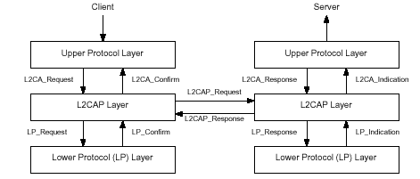
L2CA layer: Events and Actions

Slide 28
L2CA layer: Events
Types of events:
  LP to L2CA events, e.g.
    LP_ConnectCfm: confirms connection at the baseband.
    LP_ConnectInd: informs of a new baseband connection.
  L2CAP to L2CAP signaling events, e.g.
    L2CAP_ConnectReq: Received a connection request pkt.
    L2CAP_ConnectRsp: Positive response received.
  L2CAP to L2CAP data event: data packet received.
  Upper layer to L2CAP events, e.g.
    L2CA_ConnectReq: Request for L2CAP channel.

Slide 29
L2CA layer: Actions
Types of actions:
  L2CA to LP actions, e.g.
    LP_ConnectReq: Request lower layer for a connection.
    LP_ConnectRsp: Accepting previous connection indication.
  L2CAP to L2CAP signaling actions, e.g.
    L2CAP_ConnectReq: Transmitted a connection request pkt.
    L2CAP_ConnectRsp: Positive response transmitted.
  L2CAP to L2CAP data action: data packet transmitted.
  Upper layer to L2CAP actions, e.g.
    L2CA_ConnectInd: Indicates to upper layer that a connection request has been received.

Slide 30
L2CAP: Signaling
Signaling command are sent on CID=0x0001.
L2CAP signaling is used for:
  L2CAP channel establishment.
  Configuring parameters related to
    Quality of service.
    Specifying MTU.
  Closing an L2CAP channel.
Exchanging application specific information.

Slide 31
Other Bluetooth protocols
RFCOMM: Provides emulation of serial ports over L2CAP.
Service Discovery Protocol (SDP):
  Provides attribute based searching of services.
  Provides for browsing through available services.
  Provides means of discovering new services.
  Provides removal of unavailable services.

Slide 32
Bluetooth profiles
Describe configuration of the Bluetooth stack for different types of applications.
Specify minimum requirements from Bluetooth layers for each profile.
Generic access profile give recommendations and common requirements for access procedures.

Slide 33
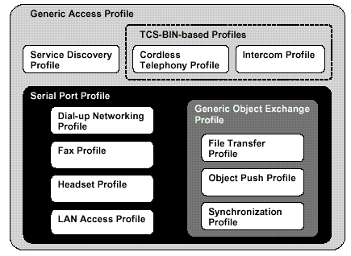
Bluetooth profiles

