Slide 1
Tropospheric and stratospheric climatologies

Slide 2
Background Information
Previously, using chemical lateral boundary conditions (CLBC) from MACC Reanalysis (updated every 6 hours) has been shown to improve surface ozone prediction during stratospheric intrusion events
The DynOzone method uses ozonesonde data to provide CLBC’s for the regional GEM-MACH model
Using the CLBC’s defined by the ozonesonde dataset worked the better define the ozone field in the tropopause region, but tropospheric ozone was generally too high. This resulted in better definition of the surface ozone but overexpression of tropospheric ozone nonetheless
The following second half of the presentation will display some results using the DynOzone + MACC Reanalysis derived CLBC’s, along with comparisons to DynOzone + Ozonesonde, MOZART4 (seasonal averaged), and MACC Reanalysis derived CLBC’s

Slide 3
Preliminary Results
Preliminary results were run on Hadar
The intention of reducing tropospheric ozone in the DynOzone method + MACC Reanalysis dataset looks successful
However, the impact of stratospheric intrusion isn’t as prevalent in surface and lower stratospheric ozone levels

Slide 4
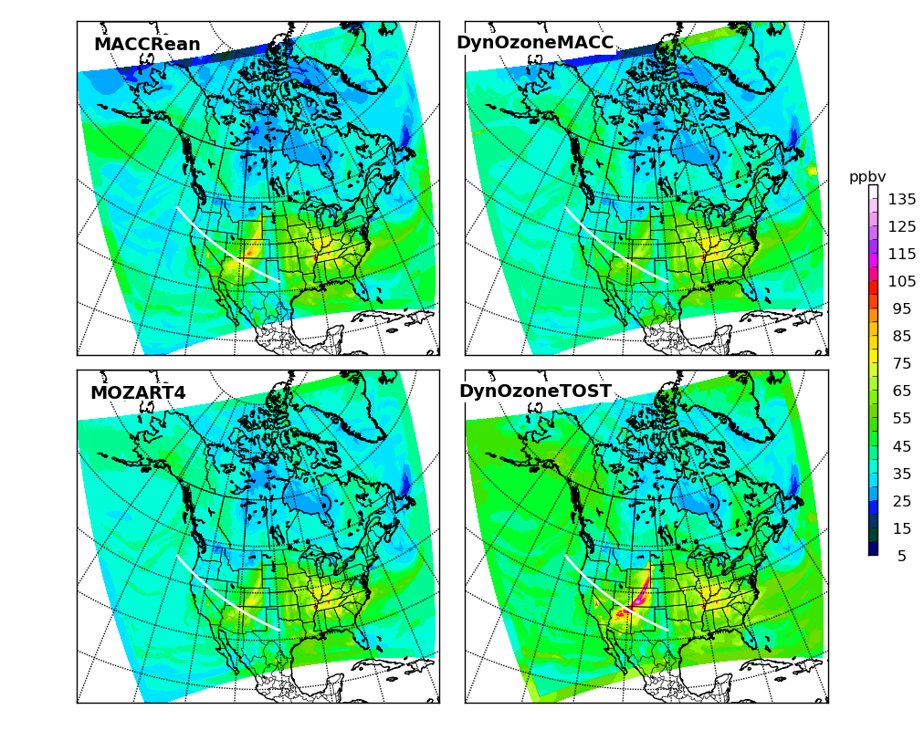
Comparison of the four CLBC strategies modelling the surface level ozone for the regional GEM-MACH at April 13, 2010 21:00:00 GMT. An intrusion can be noted over western United States. The white intersecting contour is the location of the vertical cross sections produced.

Slide 5
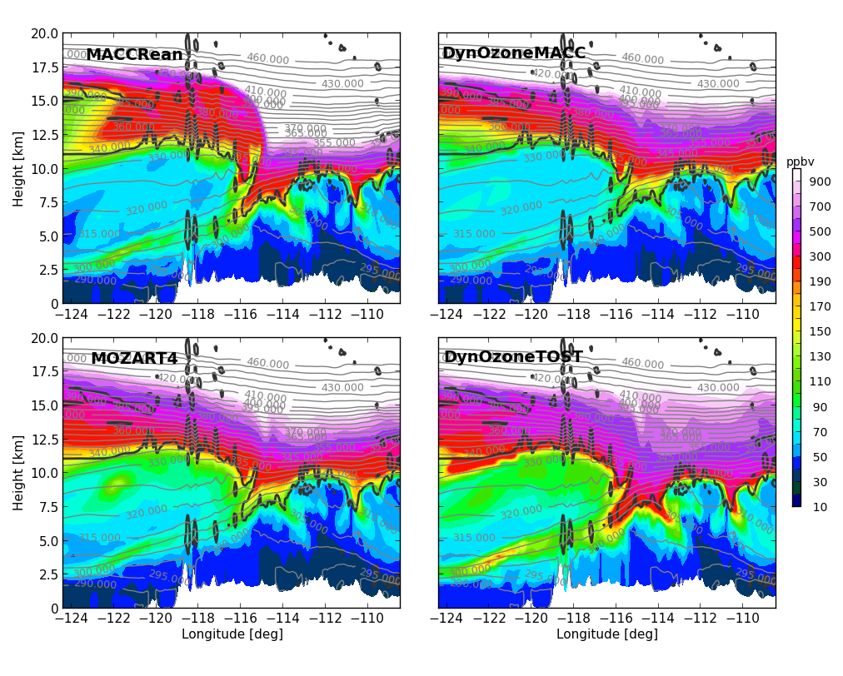
Comparison of the four CLBC strategies modelling the vertical cross section intersecting the stratospheric intrusion in the western United States at April 13, 2010 21:00:00 GMT. An intrusion can be noted over around -117 to -113 degrees on the longitude axis by the sudden increase in tropospheric ozone

Slide 6
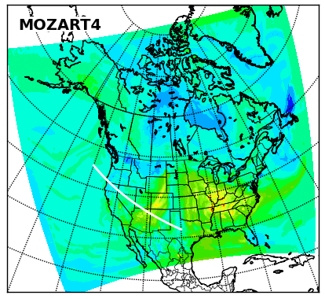
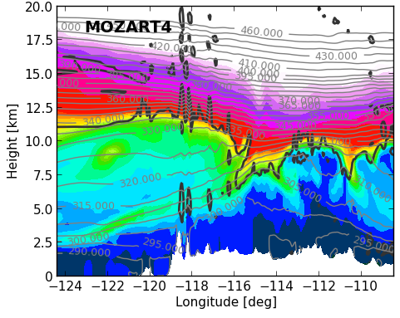
Stratospheric intrusion analysis/MOZART4
On the surface level, MOZART4 CLBC’s did fairly well in comparison to the three other methods regarding representation of the stratospheric intrusion
It portrays more surface level ozone than the DynOzone + MACC Reanalysis method, and less than both the MACC Reanalysis and DynOzone + Ozonesonde methods

Slide 7
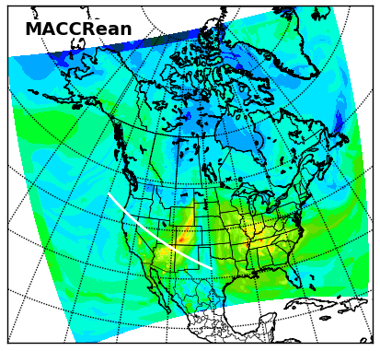
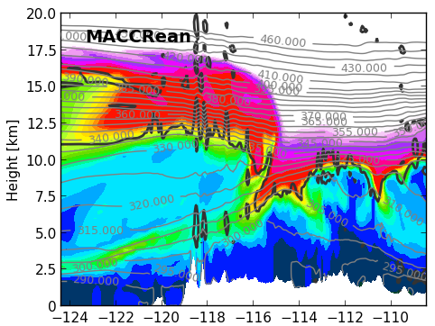
Stratospheric intrusion/MACC Reanalysis
On the surface level, MACC Reanalysis CLBC’s overly expressed the surface ozone concentrations. This is especially present in the stratospheric intrusion over western United States
It portrays more surface level ozone than the MOZART4 and DynOzone + MACC Reanalysis methods, and less than the DynOzone + Ozonesonde method
The MACC Reanalysis method presents its overrepresentation of tropospheric ozone in both figures. Whereas the overrepresentation isn’t as severe as the DynOzone + Ozonesonde method, it does

Slide 8
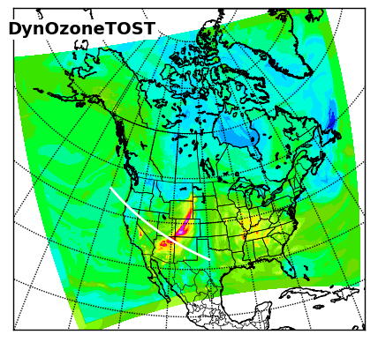
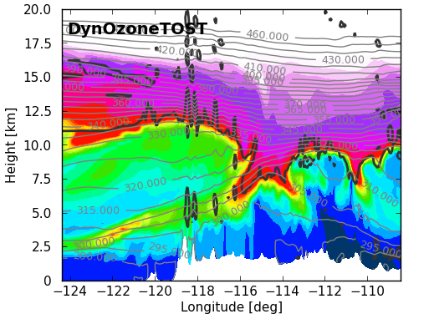
Stratospheric intrusion analysis/DynOzone + Ozonesonde
On the surface level, the DynOzone + Ozonesonde method distinguishes itself from the other three methods by expressing the most ozone on a surface level. This is present all across the surface, in nearly all areas including the intrusion
Looking at the vertical cross section, this overestimation is present yet again. The red contour level are almost all beyond the tropopause and into the troposphere.

Slide 9
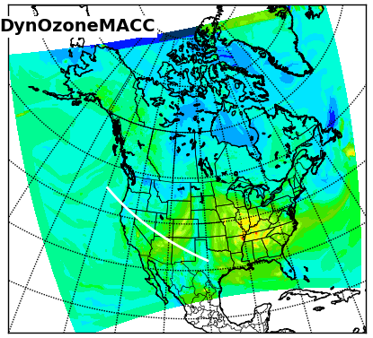
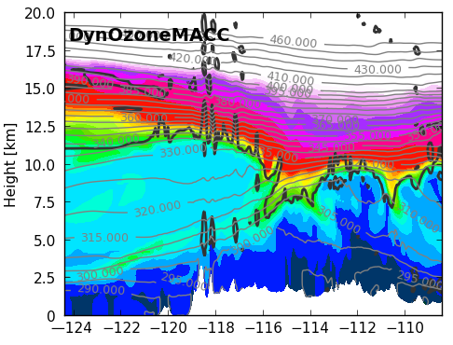
Stratospheric intrusion analysis/DynOzone + MACC Reanalysis
On the surface level, the DynOzone + MACC Reanalysis method is underrepresenting the stratospheric intrusion, presenting too weak of representation
This is also represented in the vertical cross section, where the high contour values do not create a representative shape around the stratospheric intrusion as a result of this low expression of ozone in the area of the intrusion
It is, however, overall much lower than the DynOzone + Ozonesonde, which was intended

Slide 10
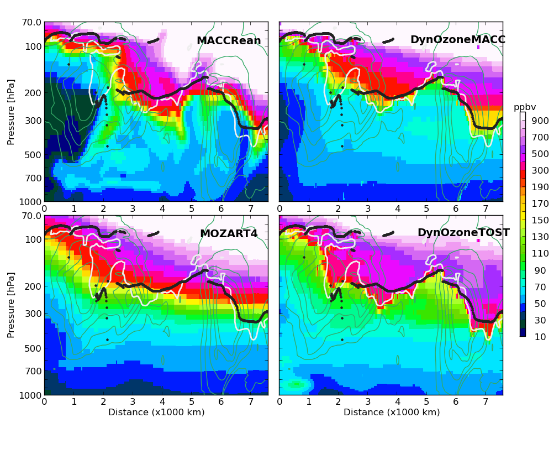
Comparison of the four CLBC models over the western lateral boundary for GEM-MACH at April 13, 2010 21:00:00 GMT. The black contour is the thermal tropopause, the white contour is a dynamic tropopause based off a potential vorticity contour of 2.0 PVU. The teal contours are the kinetic energy from GEM-MACH indicating location of any jet streams through the lateral boundaries.

Slide 11
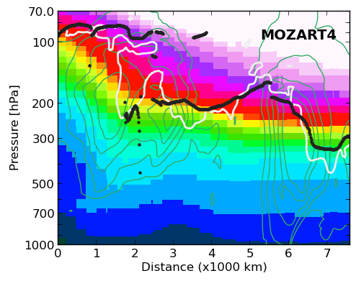
Western LBC/MOZART4
The current data set for the regional GEM-MACH model with chemical lateral boundary conditions isn’t ideal for definition of the ozone field at the tropopause
Using seasonal averaged chemical lateral boundary conditions based on MOZART4 provides an inaccurate model, due to the blending of the shape of the tropopause
Tropospheric ozone modelled off seasonally averaged MOZART4 based western lateral boundary conditions on April 13th, 2010. The black contour is the thermal tropopause, the white contour is a dynamic tropopause based off a potential vorticity contour of 2.0 PVU. The teal contours are the kinetic energy from GEM-MACH indicating location of any jet streams through the lateral boundaries.

Slide 12
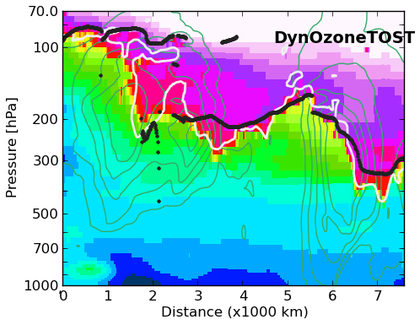
Western LBC/Ozonesonde based DynOzone
Previously, it was found that using chemical lateral boundary conditions based on ozonesonde climatologies and the DynOzone method provides a stronger shape around the tropopause contours
Noticeably, the 2.0 PVU contour is considerably closer to the quick shift between tropospheric and stratospheric ozone
Tropospheric ozone modelled off Ozonesonde based western lateral boundary conditions and the DynOzone method on April 13th, 2010. The black contour is the thermal tropopause, the white contour is a dynamic tropopause based off a potential vorticity contour of 2.0 PVU. The teal contours are the kinetic energy from GEM-MACH indicating location of any jet streams through the lateral boundaries.

Slide 13
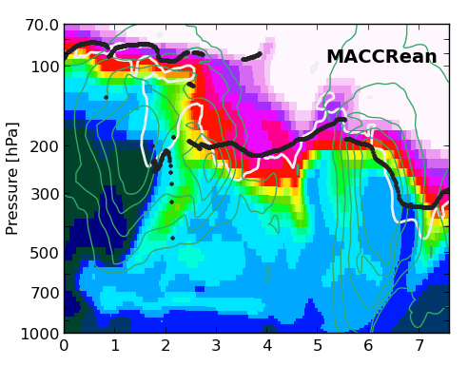
Western LBC/MACC Reanalysis
Using chemical lateral boundary conditions based on the ECMWF’s MACC Reanalysis also provides a strong shape around contours, however, the tropospheric ozone is found to be too high.
Similar to the DynOzone + ozonesonde CLBC model, the 2.0 PVU contour is considerably closer to the quick shift between tropospheric and stratospheric ozone
The problem with the MACC Reanalysis arises with its overestimation of ozone below the 2.0 PVU contour
Tropospheric ozone modelled off seasonally averaged MACC Reanalysis based western lateral boundary conditions on April 13th, 2010. The black contour is the thermal tropopause, the white contour is a dynamic tropopause based off a potential vorticity contour of 2.0 PVU. The teal contours are the kinetic energy from GEM-MACH indicating location of any jet streams through the lateral boundaries.

Slide 14
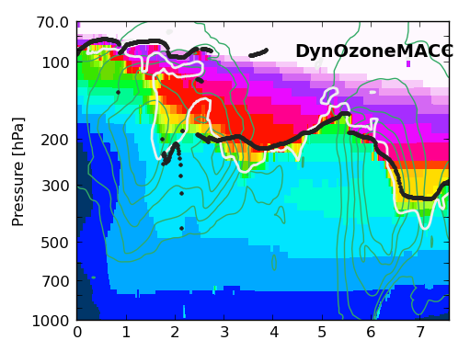
Western LBC/MACC Reanalysis DynOzone
Using the MACC Reanalysis dataset with the DynOzone method, there does not exist enough ozone in the stratospheric portions of the tropopause
Tropospheric ozone modelled off MACC Reanalysis + DynOzone method based western lateral boundary conditions on April 13th, 2010. The black contour is the thermal tropopause, the white contour is a dynamic tropopause based off a potential vorticity contour of 2.0 PVU. The teal contours are the kinetic energy from GEM-MACH indicating location of any jet streams through the lateral boundaries.

Slide 15
Next Steps
For the period of April to June 2010, the CLBC’s will be tested for the regional GEM-MACH on Hare and Brooks
Currently, a benchmark is being ran using MOZART4 seasonal climatologies on Brooks
It’s current date of analysis is $ENTERDATE
The MACC Reanalysis and DynOzone method CLBC’s will also be ran with MACC Reanalysis updated every 6 hours and DynOzone method CLBC’s ran on the same period for further comparison
Further surface analysis will be run on the new system to compare with station data

Slide 16
Final notes
A (more technically detailed) report will follow this presentation in the coming days (August 28-31)

