Slide 1
CPSC 526 Network System Security
Tutorial 01

Slide 2
Goal
In this tutorial we will …
Learn what is socket
How to create a simple client server application
You will then create a more complex application

Slide 3
What is a socket?
“A socket is a quick connection that allow data transmission between two processes on the same machine or different machine over a network”

Slide 4
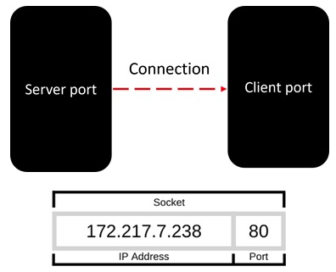
How sockets work?
Sockets listen for incoming connections
To establish a connection, you need IP address and port number
Image taken from tutorialspoints.com

Slide 5
Socket Programming
“Socket programming is the method of using socket to enable communication between different devices over a network”
Client-server architecture used:
The party that you are trying to connect (server)
The other party (client)

Slide 6
Python Socket module
Python has a socket library that can be used to create, manage and work with sockets. Some important functions from the library are:
socket(): Creates a new socket
bind(): Associates the socket to a specific address and port
listen(): Starts listening for incoming connections on the socket
accept(): Accepts a connection from a client and returns a new socket for communication.
connect(): Establishes a connection to a remote server.
send(): Sends data through the socket.
recv(): Receives data from the socket.
close(): Closes the socket connection

Slide 7
A practical example
Now let’s create a TCP client-server application in python

