Slide 1
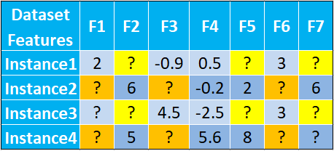
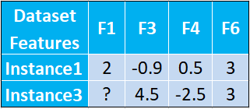
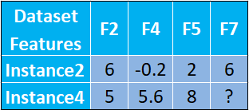
Without compaction
#Feature = 7
Total vacuum count=14
Single
Model
Training
(no compaction)
Instance4 feature vector
Missing values (i.e.,
vacuums): F1, F3, F6, F7
Instance4 feature set={F2,F4,F5}
Compaction
By clustering
After compaction
#Feature=4
Total vacuum count=1
Training
Training
Ensemble of Models
Model 1
Model 2
? = missing value

