Slide 1
NAVISENCE
FINAL YEAR PROJECT
NAVISENSE
Real-Time Object Detection App
Environment Detection for the Visually Impaired
PROJECT TEAM
SUPERVISOR
Muhammad Ali Raza Ansari
BSCS51F22S008 — Team Leader
Prof. Muhammad Fahad
Muhammad Abdullah Zammad
BSCS51F22S036
PROJECT MANAGER
Dr. Muhammad Ilyas
Muhammad Hassan Javed
BSCS51F22S040
University of Sargodha · Department of Computer Science
EDBP-2025

Slide 2
THE PROBLEM
2.2
Limited Awareness
White canes detect ground obstacles but cannot identify what the object actually is.
High Cost
Wearable AI devices like OrCam MyEye are prohibitively expensive for most users.
BILLION
people worldwide live with vision impairment
Internet Required
Many existing camera-based apps depend on cloud APIs, making them useless in low-connectivity areas.
Privacy Concerns
Cloud-based vision apps continuously upload camera frames containing personal context.
Source: World Health Organization, 2023
NAVISENCE · EDBP-2025
2 / 13

Slide 3
OUR SOLUTION
What is NAVISENSE?
A fully offline mobile application that uses on-device AI to help visually impaired users perceive their surroundings through spoken audio feedback.
Detects Objects
Direction
Estimates Distance
Text To Speech
100% Offline
bag · car · chair · door
person · stair · tree
Left · Center · Right
based on object position
Near · Medium · Far
per-class calibration
Car · Center · Far
based on object position
No internet · No cloud
No data leaves device
"Real-time perception in your pocket. No internet. No subscription. No compromise."
NAVISENCE · EDBP-2025
3 / 13

Slide 4
HOW IT WORKS
System Workflow
1
2
3
4
5
6
Camera
Preprocess
Model Detection
Parse + NMS
Spatial Tags
Speech
YUV420 frame
(~30 fps)
YUV→RGB · resize (416 * 416)
INT8 inference
(TFLite, 4 threads)
Per-class threshold
Margin filter
Position + Distance
per-class
Stability gate
flutter_tts
NAVISENCE · EDBP-2025
5 / 13

Slide 5
BUILT WITH
Tech & Tool Stack
DATASET PREPARATION
MODEL TRAINING
APPLICATION DEVELOPMENT
Google
Google Colab
Android Studio
Collect images for dataset
Training environment (GPU)
Use as a IDE
Android Smartphone
YOLOv8 nano + Ultralytics + Python
Flutter (Dart)
Use phone to take real environment images
Object detection model (Ultralytics)
Cross-platform framework (Dart)
Roboflow
TensorFlow Lite
TTS + GetX + Git & Github
Dataset annotation
On-device inference runtime
Tech & Tool use during app development
NAVISENCE · EDBP-2025
6 / 13

Slide 6
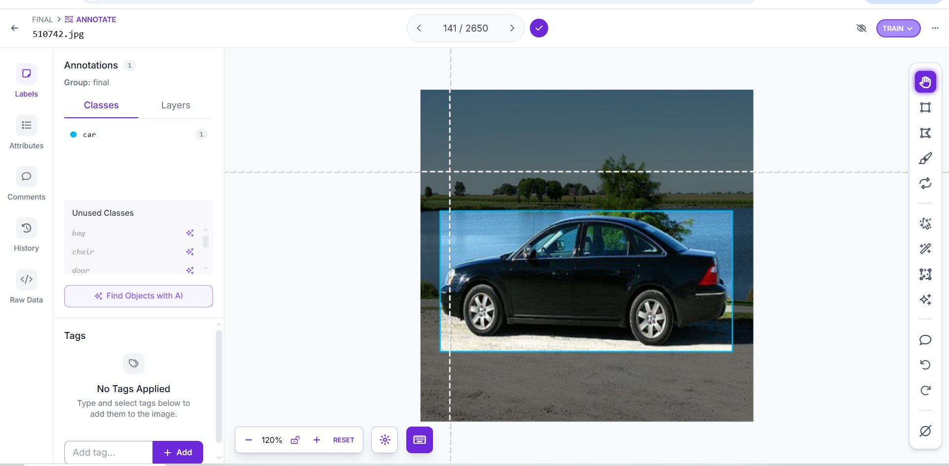
BUILT WITH
DATASET PREPARATION – ROBOFLOW OVERVIEW
OUTPUT
BUILT WITH
CLASS ID
HEIGHT
WIDTH
X-AXIS
Y-AXIS
NAVISENCE · EDBP-2025
6 / 13

Slide 7
THE MODEL
YOLOv8 Nano · Short Overview
Single Stage
Detector
Real Time Detection
TFLite
INT8 Quantization
real-time throughput
80-120 ms per frame
Smartphone support format
Reduce model size
Offline
Run offline on Smartphone

Slide 8
RESULTS
Flutter Application - Performance Metrics
~5 fps
~600 ms
3 MB
22 MB
real-time throughput
object-to-speech latency
model size (INT8)
total APK size
~1s
App Latency
NAVISENCE · EDBP-2025
9 / 13

Slide 9
LANDSCAPE
Existing Assistive Solutions
Object
Identification
Direction +
Distance
Offline
Affordable
White Cane
—
—
✓
✓
Guide Dog
—
—
✓
—
SmartCane / WeWALK
—
Partial
✓
—
OrCam MyEye
✓
Partial
Partial
—
Microsoft Seeing AI
✓
—
—
✓
NAVISENSE
✓
✓
✓
✓
NAVISENCE is the only solution that combines object identification, spatial awareness, offline operation, and affordability in one package.
NAVISENCE · EDBP-2025
4 / 13

Slide 10
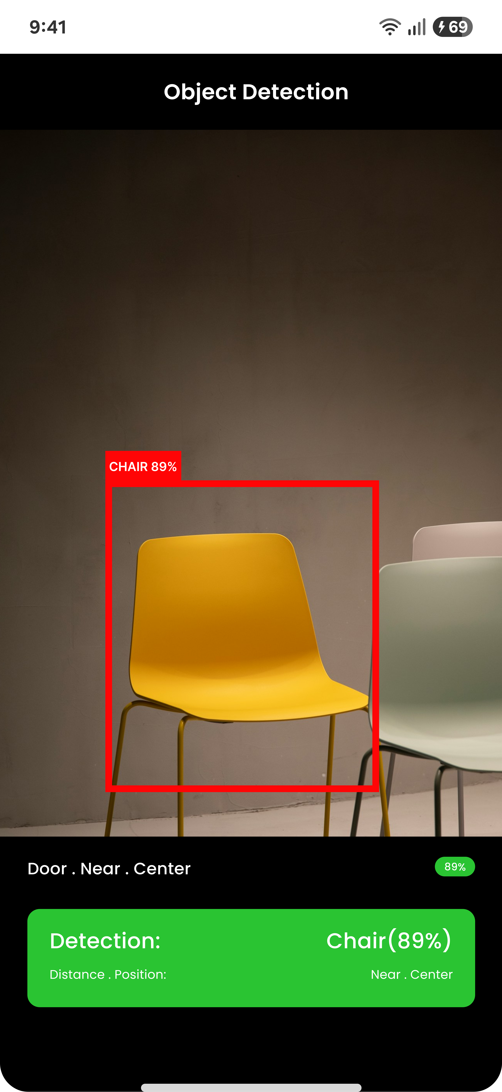
SHORT UI
Graphical User Interface

Slide 11
REAL PROBLEMS SOLVED
Engineering Challenges
Phantom Detections
Misclassification (Person→ bag)
CAUSE App announced random objects at startup before camera stabilized.
CAUSE Out-of-vocabulary objects forced into nearest class.
FIX 1.2-second warmup gate + 2-frame stability filter.
FIX Per-class confidence thresholds + margin filter rejecting low top-1/top-2 gaps. Train model on real data.
Detection Broke on Rotation
CAUSE Phone tilted physically — model saw upright frame of sideways world.
FIX sensors_plus accelerometer + dynamic rotation compensation.
NAVISENCE · EDBP-2025
10 / 13

Slide 12
HONEST ASSESSMENT
Limitations & Future Work
CURRENT LIMITATIONS
FUTURE ENHANCEMENTS
—
Fixed 7-Class Vocabulary
+
Expand Class Set
Unknown objects (laptop, bottle) get forced into the nearest known class.
Retrain with 15-20 classes including common household objects.
—
Heuristic Distance
+
True Distance Estimation
Bounding-box size with per-class thresholds — not true metric distance.
Lightweight depth model (MiDaS variant) for metric distance.
—
Lighting Sensitive
+
GPU Delegate
Performance degrades in low light or with strong backlight.
NNAPI / GPU inference to halve latency on supported devices.
—
English-Only Output
+
Multilingual Speech
flutter_tts supports more languages — not yet configured.
Urdu, Hindi, Arabic — configurable in app settings.
NAVISENCE · EDBP-2025
11 / 13

Slide 13
CONCLUSION
We built a real-time computer vision app that runs entirely on a phone, with no internet, no cloud, and no compromise on user privacy.
01
02
03
It Works
It Solves a Real Problem
It's Honest About Limits
~5 fps real-time detection. ~600 ms latency from object to speech. Stable across rotation, lighting, and motion within documented limits.
Offline, affordable, private — the three constraints that disqualify most existing solutions for users in low-connectivity regions.
Documented failure modes, scope boundaries, and future work. No claims it cannot defend.
NAVISENCE · EDBP-2025
12 / 13

Slide 14
LIVE DEMO
Real device · real-time detection · fully offline
1
Single object detection
2
Position changes (left / center / right)
3
Distance changes (near as user approaches)
4
Multi-object scene
NAVISENCE · EDBP-2025
8 / 13

Slide 15
THANK YOU
Questions · Discussion · Live Demo
NAVISENCE Team
Ali Raza Ansari · Muhammad Abdullah Zammad · Muhammad Hassan Javed
University of Sargodha · Department of Computer Science · EDBP-2025

