Slide 1
ENVIRONMENT DETECTION FOR BLIND USERS
Project Manager: Dr. Muhammad Ilyas
Internal Advisor: Prof. Muhammad Fahad
Project Team:
Ali Raza Ansari (BSCS51F22S008) — Team Leader
Abdullah Zammad (BSCS51F22S036) — Team Member
M. Hassan (BSCS51F22S040) — Team Member

Slide 2
Introduction
Millions of people with visual impairments struggle to navigate and understand their surroundings independently. Traditional tools like canes and guide dogs help with movement, but cannot identify specific objects. Modern technology now enables smartphones to perform real-time object detection.
This project creates a mobile app that helps visually impaired users "see" their environment through AI-powered object detection and voice feedback.

Slide 3
Project Overview
What does this system do?
Detects objects in real-time using the smartphone camera
Uses artificial intelligence to recognize what's around the user
Speaks out the names of detected objects through audio feedback
Works completely offline on Android phones
Designed to be simple, safe, and easy to use

Slide 4
Key Features
✓ Real-Time Detection - Instantly identifies objects as you point your camera ✓ Voice Feedback - Speaks object names clearly using text-to-speech ✓ Works Offline - No internet connection needed ✓ Lightweight - Runs smoothly on standard Android devices ✓ User-Friendly - Simple interface designed for visually impaired users ✓ Smart Alerts - Only announces objects it's confident about

Slide 5
Technology Stack
Tools and Technologies:
App Development: Flutter (for Android)
Detection Model: computer vision model YOLOv8 (advanced object detection), SSD etc.
Model manage : Tflite use to work with ai model
AI Model Training: Google collab , Python
Voice Output: Text-to-Speech Engine
Image Preprocessing: OpenCV

Slide 6
How It Works
Step-by-Step Process:
Camera captures live video from the environment
Images are processed directly on the phone
AI model identifies objects in the scene
Results are converted into spoken words
User hears what objects are nearby through audio

Slide 7
System Architecture
The Flow:
Camera Input ↓ Image Preprocessing ↓ YOLOv8 AI Model (TensorFlow Lite) ↓ Object Detection Results ↓ Text-to-Speech Conversion ↓ Audio Feedback to User

Slide 8
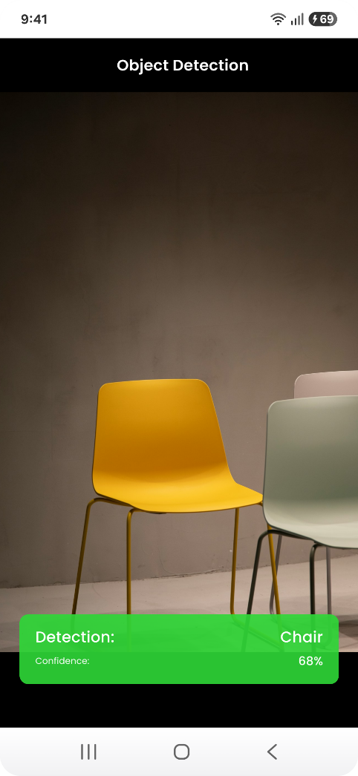
Prototype
What we've built:
Working camera interface in Flutter
Real-time video preview
Live object detection
Confidence level

Slide 9
Conclusion
Summary:
Successfully created a working system that detects objects in real-time on mobile devices, provides practical assistance for visually impaired individuals, and maintains user privacy by working completely offline. Can be expanded with features like distance navigation guidance
Impact: This system can improve independence and safety for visually impaired people in their daily lives.

Slide 10
Thank You! Questions?

