Slide 1
KNN and Probability

Slide 2
Classification
Definition
Classification can take two distinct meanings in Machine Learning
Unsupervised Learning
We may be given a set of observations with the aim of establishing the existence of classes or clusters in the data
Supervised Learning
We may know for certain that there are so many classes, and the aim is to establish a rule that we can use to classify a new observation into one of the existing classes
k-NN is a supervised method for classification

Slide 3
Classification
A few classification examples:
A Person arrives at the emergency room with a set of symptoms that could possibly be attributed to one of three medical conditions. Which of the three conditions does the individual have?
An online banking service must be able to determine whether or not a transaction being performed on the site is fraudulent, on the basis of the user’s IP address, past transaction history, and so forth.
On the basis of DN sequence data for a number of patients with and without a given disease, a biologist would like to figure out which DNA mutations are disease-causing and which are not.

Slide 4
Classification
There are many possible techniques that a classifier might use to predict a qualitative response. Today we will discuss k-NN
k-Nearest Neighbors
Naïve Bayes
Logistic Regression
Tree – based methods

Slide 5
Classification
A few issues to keep in mind when building a classifier
Accuracy. There is the reliability of the rule, usually represented by the proportion of correct classifications, although it may be that some errors are more serious than others, and it may be important to control the error rate for some key class.
Speed. In some circumstances, the speed of the classifier is a major issue. A classifier that is 85% accurate may be preferred over one that is 95% accurate if it is 100 times faster in testing (and such differences in time-scales are not uncommon in neural networks for example).
Such considerations would be important for the automatic reading of postal codes, or automatic fault detection of items on a production line for example.

Slide 6
Classification
A few issues to keep in mind when building a classifier
Comprehensibility. If it is a human operator that must apply the classification procedure, the procedure must be easily understood else mistakes will be made in applying the rule. It is important also, that human operators believe the system.
Training Time. Especially in a rapidly changing environment, it may be necessary to learn a classification rule quickly, or make adjustments to an existing rule in real time. “Quickly” might imply also that we need only a small number of observations to establish our rule.

Slide 7
K-Nearest Neighbors

Slide 8
Simple approach for k-NN
Simple goal:
Predict the label of a data point by:
Looking at the ‘k’ closest labeled data points (neighbors)
Uses a majority vote
One of the easiest algorithms to interpret, oftentimes used as a baseline for measuring model performance
Memory-Based Learning
Also known as “case-based” or “example-based” learning
Intuition behind memory-based learning
Similar inputs map to similar outputs
If true, we just have to define “similar”
Not all similarities created equal…

Slide 9
Memory-Based Learning
How do we determine “similar”?
For instance, if we wanted to:
Predict Brian’s weight
Who are the similar people?
Similar age, diet, height, waistline, activity level …
Predict Brian’s IQ
Similar occupation, writing style, undergraduate degree, SAT score, …
How do we calculate variously ranges in similarity?
Need some metric…
Distance

Slide 10
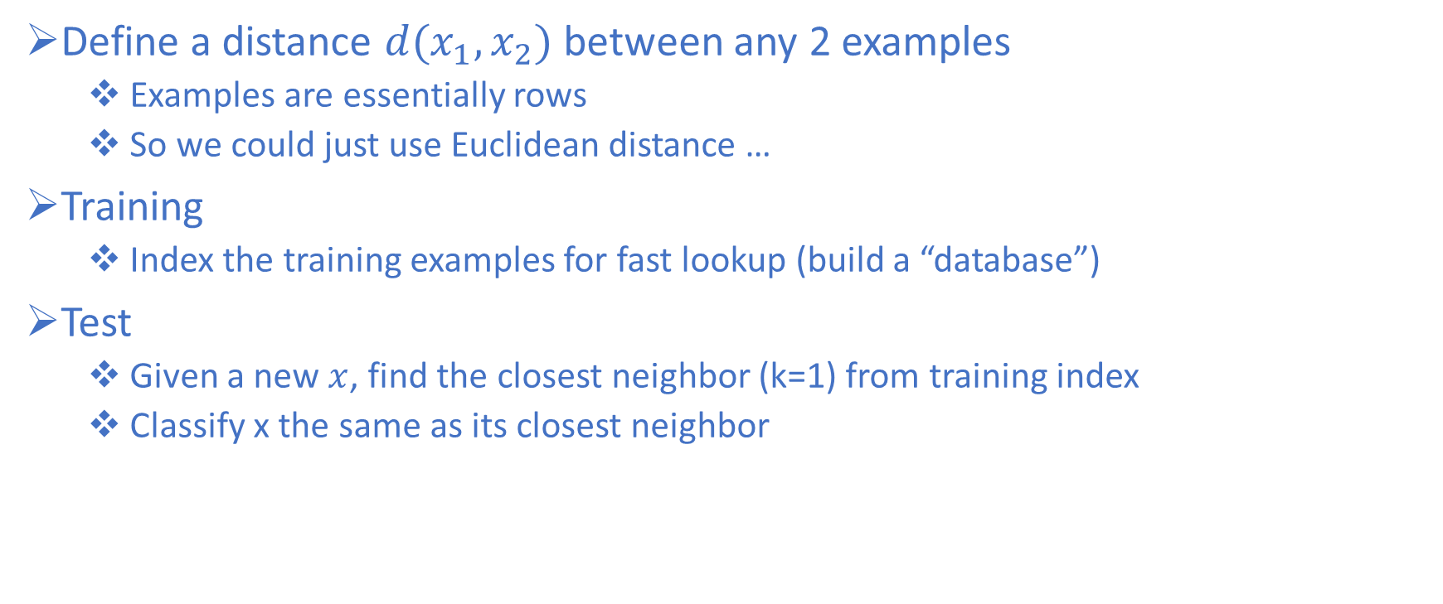
k-NN Approach
Define a distance $d(x_{1},x_{2})$between any 2 examples
Examples are essentially rows
So we could just use Euclidean distance …
Training
Index the training examples for fast lookup (build a “database”)
Test
Given a new $x$, find the closest neighbor (k=1) from training index
Classify x the same as its closest neighbor

Slide 11
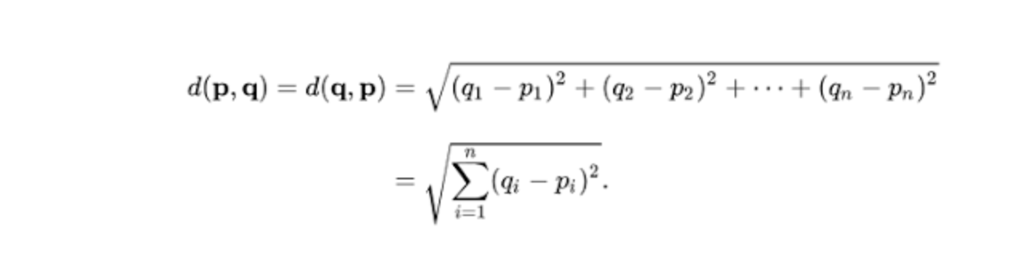
k-NN Approach
Euclidean Distance Equation:
p & z are the current data and q is new, think of p & z as the training and q as the test.
Subtracting then squaring row p with q. Then summing and taking the sqrt.
Do the same with z and compare
 | x1 | x2 | x3 | x4 | x5 | x6 | x7 | x8 | Result
q | 3 | 2 | 2 | 5 | 6 | 2 | 1 | 5
p | 4 | 3 | 3 | 6 | 4 | 4 | 5 | 6
Euclidean | 1 | 1 | 1 | 1 | 4 | 4 | 16 | 1 | 5.39
z | 3 | 2 | 2 | 5 | 6 | 2 | 1 | 5
Euclidean | 0 | 0 | 0 | 0 | 0 | 0 | 0 | 0 | 0

Slide 12
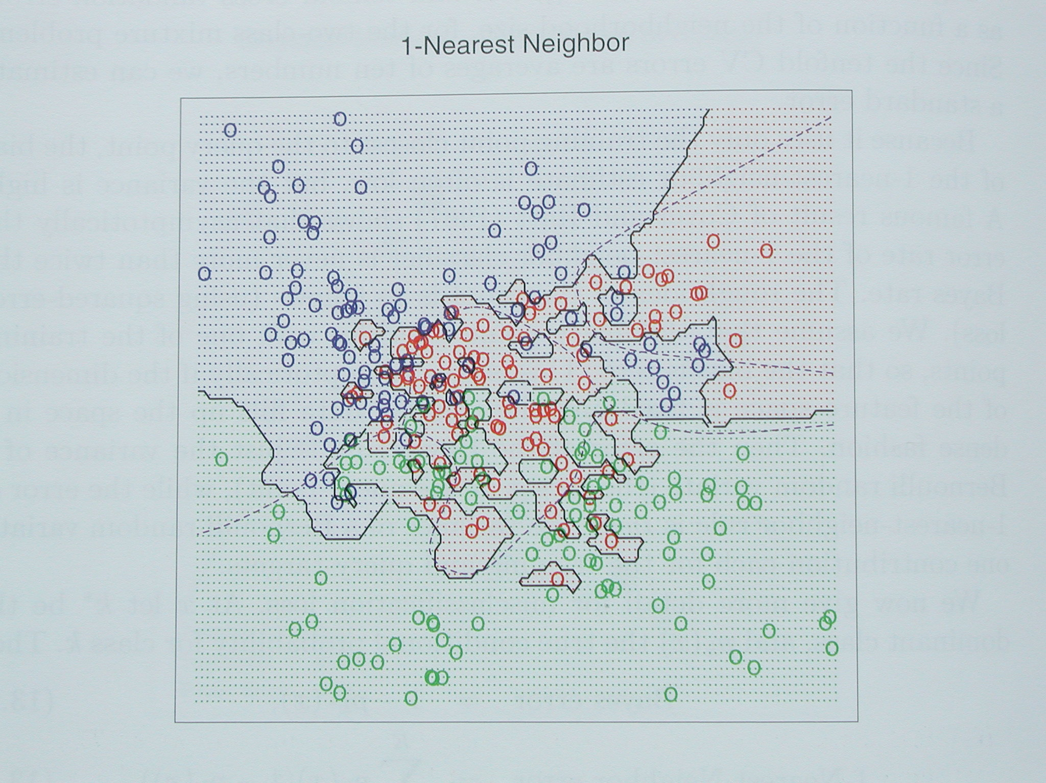
kNN Decision Boundaries
kNN can learn complex decision boundaries

Slide 13
kNN
Instead of picking the (1) nearest neighbor, what if we picked the k-Nearest Neighbors and have them vote?
Choosing k points is more reliable in the following cases:
Noise in training vectors x
Noise in training labels y
Overlapping classes
o
k=1
+
o
o
o
o
x_2
o
o
o
o
o
+
+
o
o
o
+
o
+
+
+
+
+
+
+
+
x_1

Slide 14
kNN
Instead of picking the (1) nearest neighbor, what if we picked the k-Nearest Neighbors and have them vote?
Choosing k points is more reliable in the following cases:
Noise in training vectors x
Noise in training labels y
Overlapping classes
Why?
o
X
+
o
o
o
k=1
o
o
o
o
o
o
+
+
o
o
+
o
o
x_2
+
+
+
+
+
+
+
+
x_1

Slide 15
kNN Decision Boundaries
Consider this example with R,G,B classes with significant overlap

Slide 16
kNN Decision Boundaries
Consider this example with R,G,B classes with significant overlap
k=1 Decision Boundary
Looks complex
Overfitting?

Slide 17
kNN Decision Boundaries
k=1 Decision Boundary
Looks complex
Overfitting?
What if we were to increase k?

Slide 18
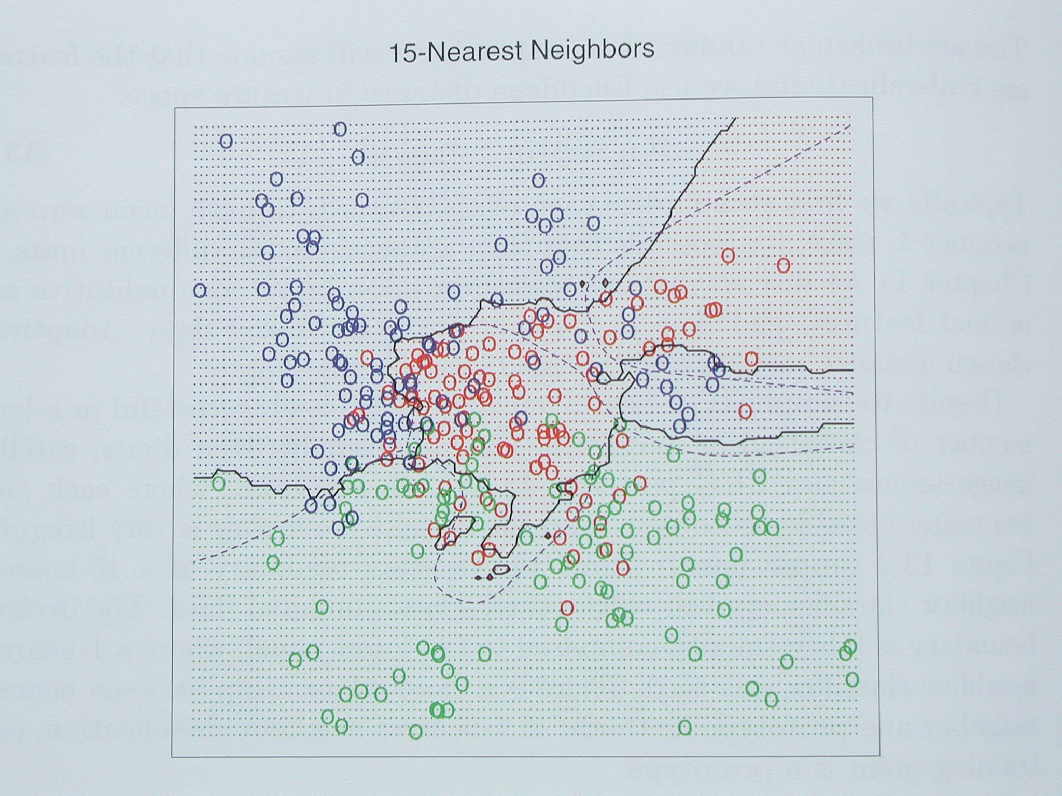
kNN Decision Boundaries
k=1 Decision Boundary
Looks complex
Overfitting?
What if we were to increase k?
K=15 Decision boundary

Slide 19
kNN Decision Boundaries
k=1 Decision Boundary
Looks complex
Overfitting?
What if we were to increase k?
K=15 Decision boundary
Smoother boundaries

Slide 20
kNN Decision Boundaries
k=1 Decision Boundary
Looks complex
Overfitting?
What if we were to increase k?
K=15 Decision boundary
Smoother boundaries
Generalizes better on unseen data

Slide 21
kNN Decision Boundaries
k=1 Decision Boundary
Looks complex
Overfitting?
What if we were to increase k?
K=15 Decision boundary
Smoother boundaries
Generalizes better on unseen data
What makes the boundaries smoother?

Slide 22
kNN Decision Boundaries
k=1 Decision Boundary
Looks complex
Overfitting?
What if we were to increase k?
K=15 Decision boundary
Smoother boundaries
Generalizes better on unseen data
What makes the boundaries smoother?
Let’s look at a two-class (binary) example

Slide 23
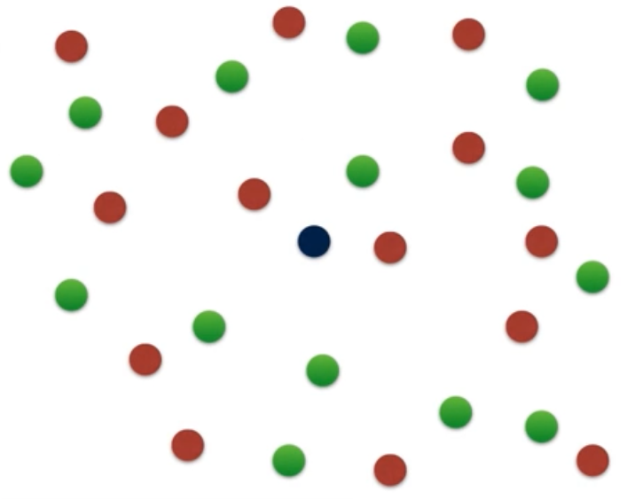
k-NN Graphical Example
Consider this two-dimensional dataset with points classified as Red or Green

Slide 24
k-NN Graphical Example
Consider this two-dimensional dataset with points classified as Red or Green
We want to Classify this point

Slide 25
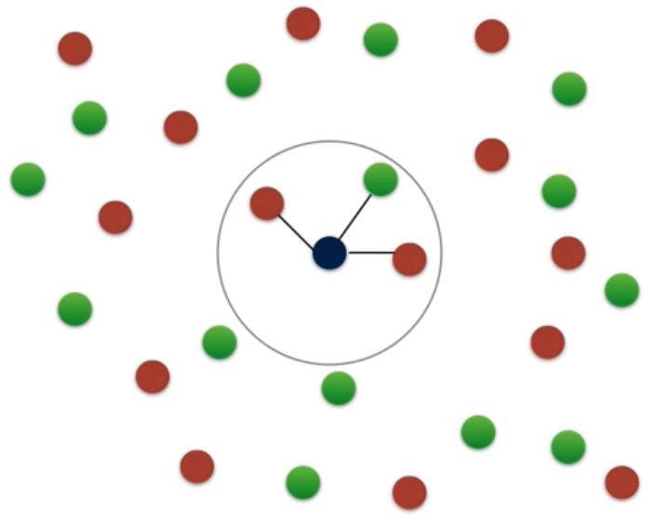
k-NN Graphical Example
Consider this two-dimensional dataset with points classified as Red or Green
We want to Classify this point
If we consider k=3 neighbors

Slide 26
k-NN Graphical Example
Consider this two-dimensional dataset with points classified as Red or Green
We want to Classify this point
If we consider k=3 neighbors
Measured by some distance
d

Slide 27
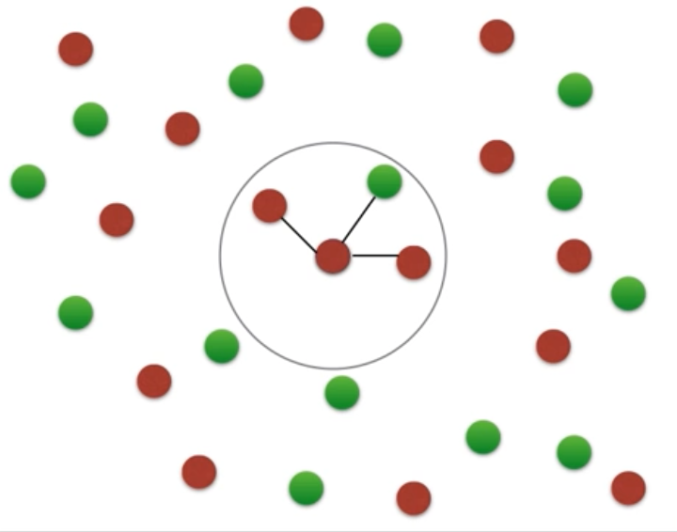
k-NN Graphical Example
Consider this two-dimensional dataset with points classified as Red or Green
We want to Classify this point
If we consider k=3 neighbors
Measured by some distance
The point is classified as Red

Slide 28
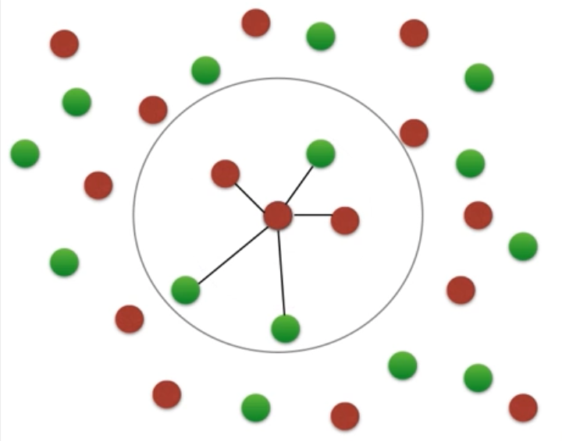
k-NN Graphical Example
Consider this two-dimensional dataset with points classified as Red or Green
We want to Classify this point
If we consider k=3 neighbors
Measured by some distance
The point is classified as Red
If we consider k=5 neighbors

Slide 29
k-NN Graphical Example
Consider this two-dimensional dataset with points classified as Red or Green
We want to Classify this point
If we consider k=3 neighbors
Measured by some distance
The point is classified as Red
If we consider k=5 neighbors
Measured by some distance
d

Slide 30
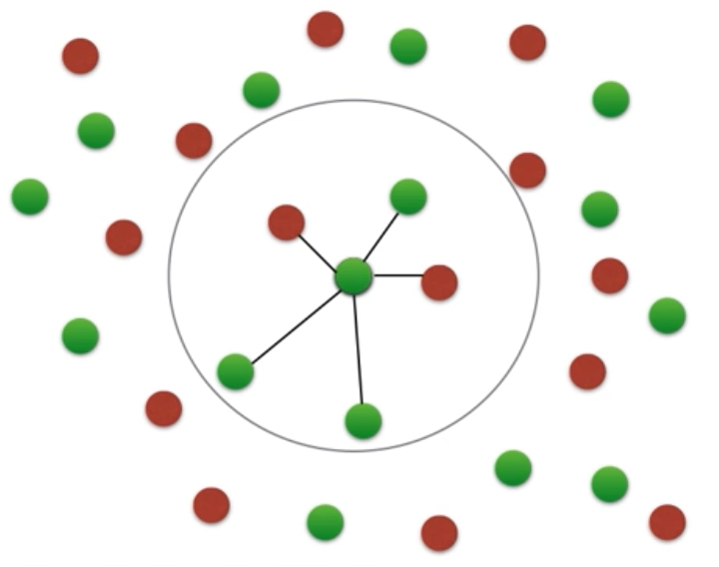
k-NN Graphical Example
Consider this two-dimensional dataset with points classified as Red or Green
We want to Classify this point
If we consider k=3 neighbors
Measured by some distance
The point is classified as Red
If we consider k=5 neighbors
Measured by some distance
The point is classified as Green

Slide 31
k-NN Graphical Example
Consider this two-dimensional dataset with points classified as Red or Green
We want to Classify this point
If we consider k=3 neighbors
Measured by some distance
The point is classified as Red
If we consider k=5 neighbors
Measured by some distance
The point is classified as Green
So, how do we know what k to choose?

Slide 32
How to choose “k”
Odd k (often 1, 3, or 5):
Avoids problem of breaking ties (in a binary classifier)
Large k:
Less sensitive to noise (particularly class noise)
Better probability estimates for discrete classes
Larger training sets allow larger values of k
Small k:
Captures fine structure of problem space better
May be necessary with small training sets
Balance between large and small k

Slide 33
kNN distance problem
Problem:
What if the input represents weight in milligrams?
Then small differences in physical weight dimension have a huge effect on distances, overwhelming other features
Should really correct for these arbitrary “scaling” issues
This leads to Standard Scaling
Rescale weights so that standard deviation = 1
o
o
o
o
o
o
o
o
o
o
o
o
o
bad
o
o
o
o
o
attribute_2
o
+
attribute_2
o
o
o
+
+
+
+
+
+
+
+
+
+
+
+
+
+
+
+
+
weight (lb)
weight (mg)

Slide 34
More kNN Details
Nonparametric - makes no explicit assumptions about the underlying distribution of the input
Instance/memory-based learning means that this algorithm doesn’t explicitly learn a model. Instead, it chooses to memorize the training instances which are subsequently used as “knowledge” for the prediction phase
Learns arbitrarily complicated decision boundaries
Lazy learner - method that generalizes data in the testing (deployment) phase, rather than during the training phase – designed to be continuously updating as new data comes in
A benefit of lazy learning is that it can quickly adapt to changes,
Think Netflix recommendations, new options are appearing constantly so have a static training set it’s really valuable.
Very fast training time, but very slow prediction (has to search for the nearest neighbors)

Slide 35
Advantages of k-NN
Simple and fast to deploy
Little to no training time
Easy to interpret/explain
Naturally handles multiclass datasets
Non-parametric
Does not assume any probability distributions on the input data

Slide 36
Disadvantages of k-NN
Storage of model takes a lot of disk space (contains entire training dataset)
Curse of Dimensionality - often works best with 25 or fewer dimensions
There is little difference between the nearest and farthest neighbor in high dimensional data (starts to normalize to 1)
Computationally expensive predictions (large search problem to find nearest neighbors)
Might be impractical in industry settings
Need to normalize - suffers from skewed class distributions
If one type of category occurs much more than another, classifying an input will be more biased towards that one category (dominates the majority vote since it is more likely to be neighbors with the input)

