Slide 1
Advanced Image Analysis
a.a. 2017-2018, 2nd semester
Module 1
Introduction
Alessandro Bria
Contract Professor
and Post-doc Researcher
email: a.bria@unicas.it

Slide 2
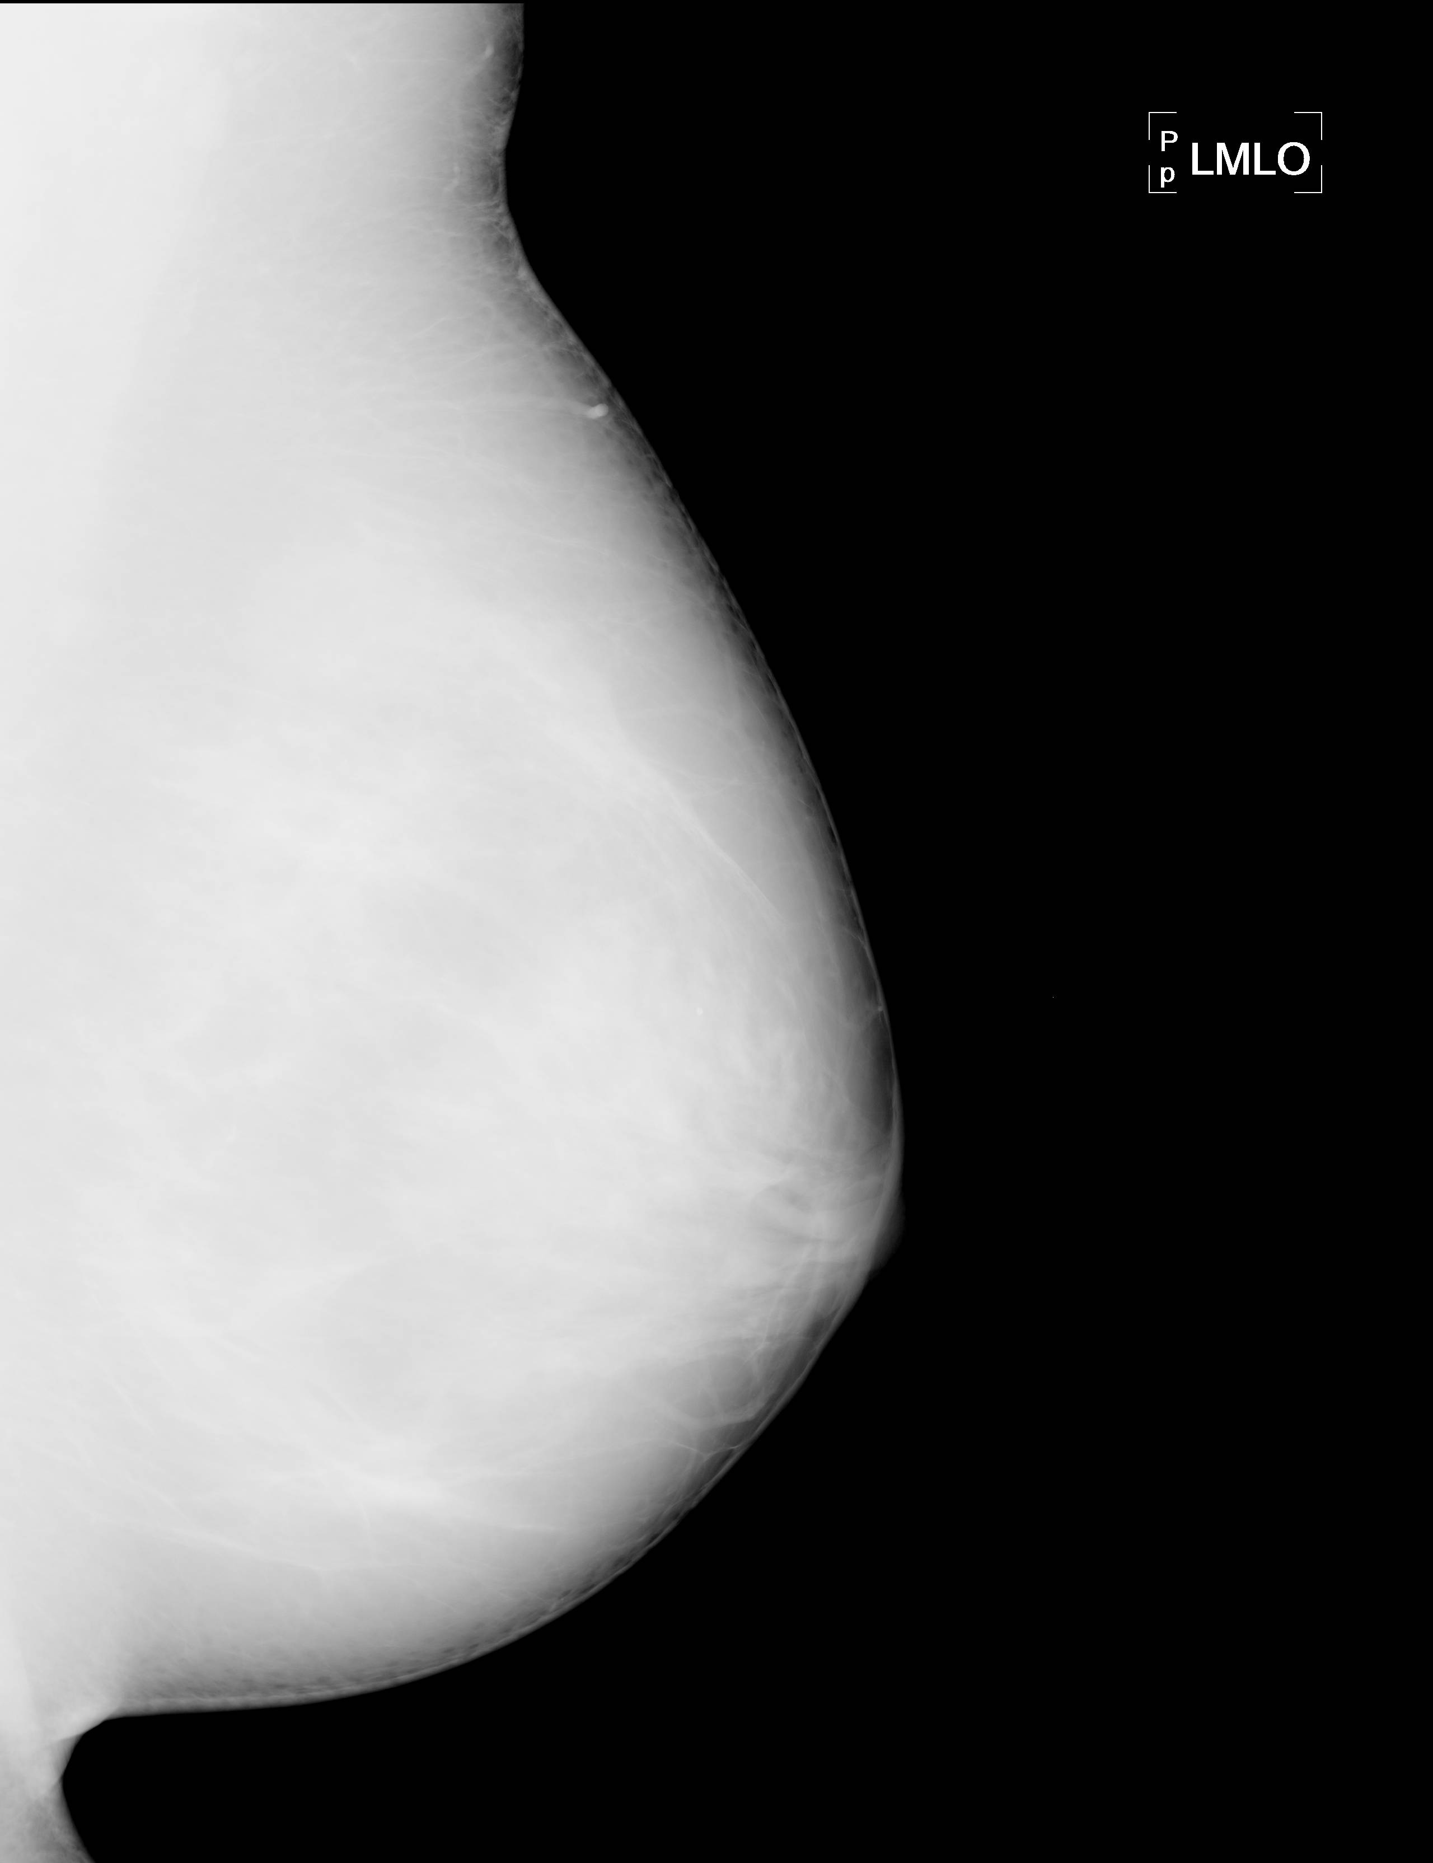
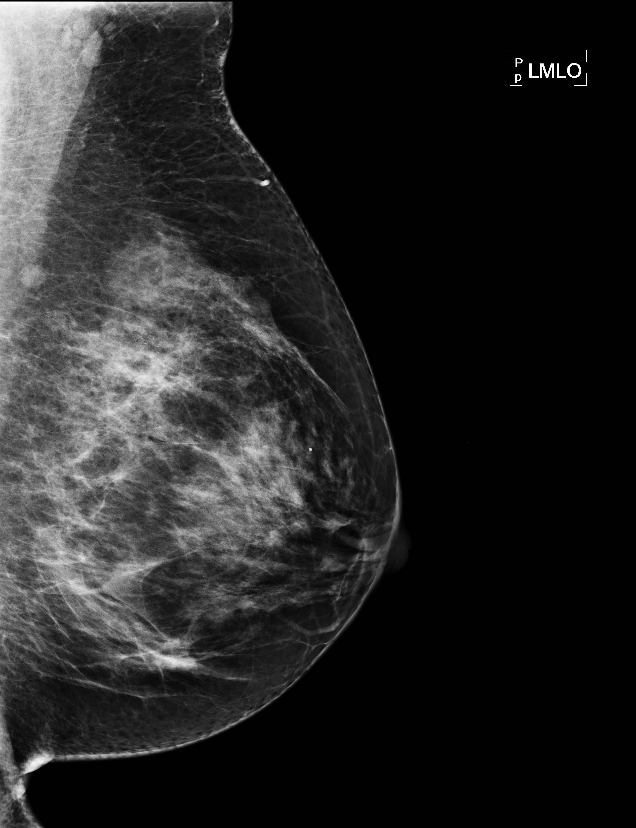
Image Processing vs. Image Analysis
image processing can be thought of as a transformation of an image into an image
i.e. starting from an image a modified/enhanced image is obtained
image representation, enhancement, restoration, compression, ...
unprocessed (raw) mammogram
processed mammogram

Slide 3
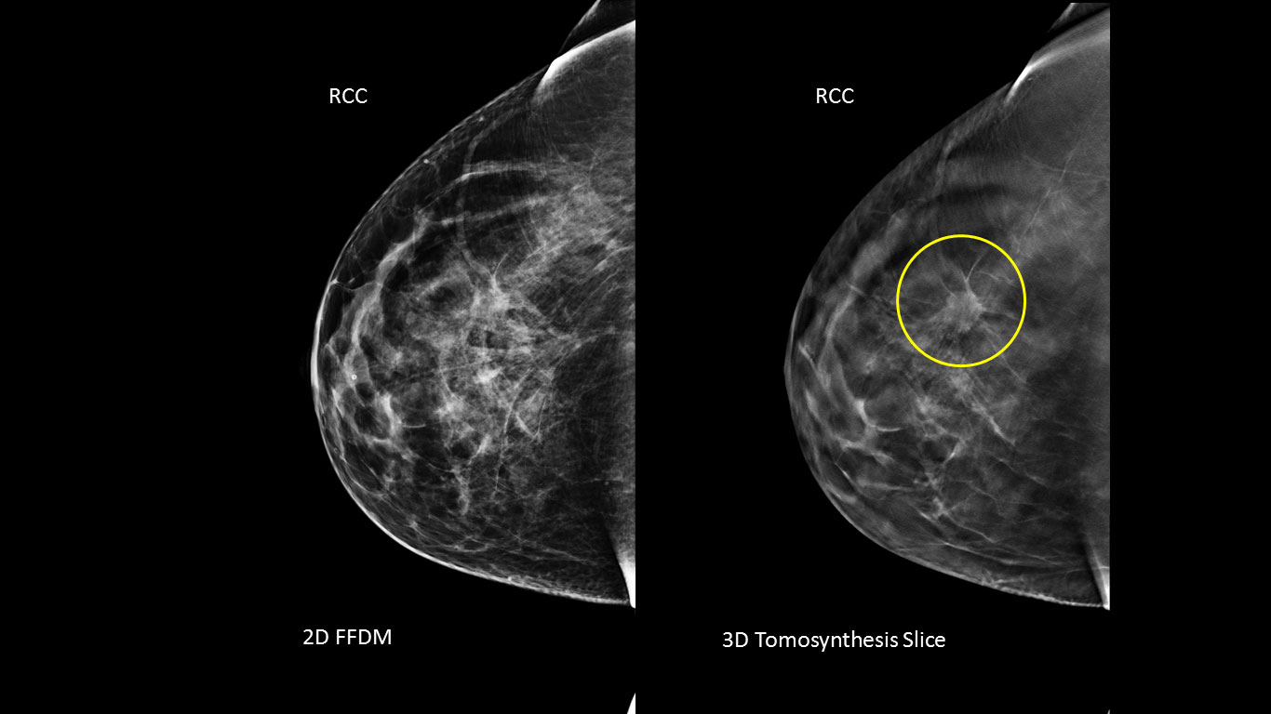
Image Processing vs. Image Analysis
image analysis is a transformation of an image into meaningful information representing a description or a decision
can (and often does) take advance from image processing
for instance, consider a mammogram:
description: extract a set of candidate lesions and, for each of them, extract a series of discriminative measures (features) like shape descriptors, texture descriptors, ...
decision: based on a set of decision rules (human-designed or machine-learned) applied on the region descriptors, distinguish malignant lesions from the others

Slide 4
Course Program
color image processing (Guest Professor: Adrian Galdran)
because colors do matter in image analysis (e.g. retinal fundus color images)
grayscale mathematical morphology
enhances specific objects in the image based on their shape and intensity profile
image segmentation
region-based (region-growing, watershed, mean-shift)
edge-based (Marr-Hildreth, Canny)
image descriptors
shape descriptors (Fourier contour descriptors, geometric moments, Hu moments)
texture descriptors (Haar features, LBP features, HOG features)
optical flow motion estimation
sparse (Lucas-Kanade) and dense methods (Farneback).

Slide 5
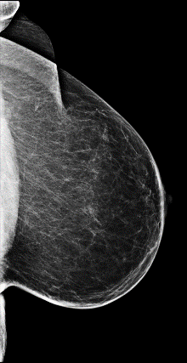
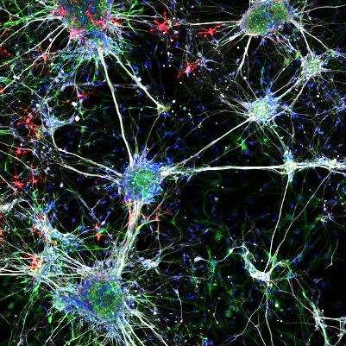
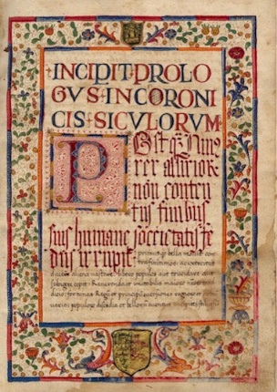

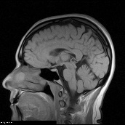
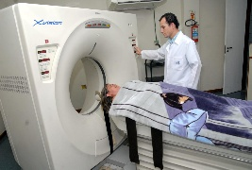
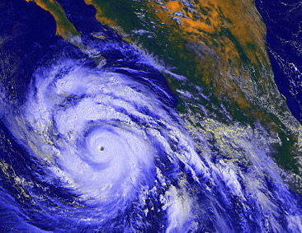
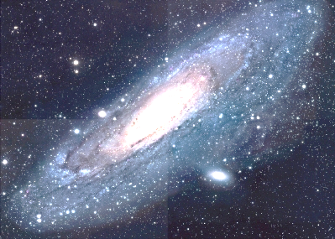
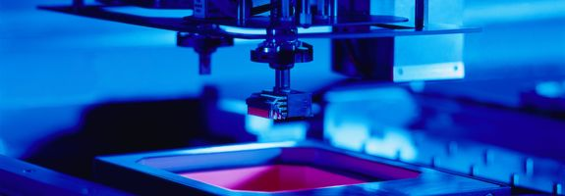
Applications (1/n)
medicine
(Computer-Aided Diagnosis)
microscopy
handwritten / optical character recognition
meteorology
astronomy
industry processes

Slide 6
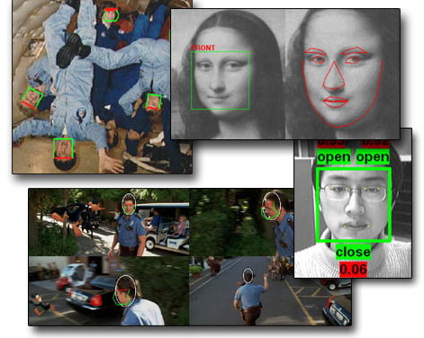
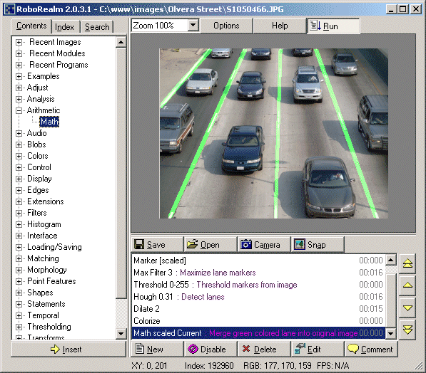
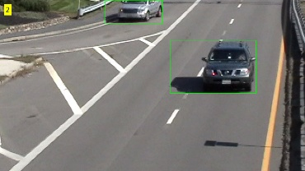
Applications (2/n)
Computer Vision

Slide 7
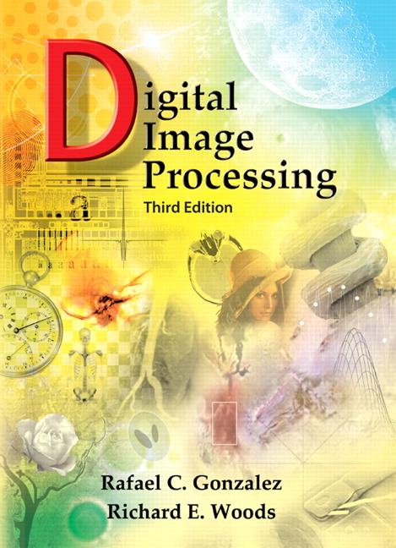
Materials
book
R.C. Gonzalez, R.E. Woods, Digital Image Processing (2nd or 3rd ed.)
slides
available on Google Classroom (.pptx format)
uploaded 1-2 days before the lecture
labs
made by me in C++ with a lot of comments
available within 1-2 days after the lecture
use the images in the /example_images folder of the project CMake/C++ template

Slide 8

Tools
Open source Computer Vision (Intel, 1999) is a library written in C/C++ mainly aimed at real-time computer vision
free, open-source and cross-platform
fast
widely considered the fastest image processing and analysis library available
simple to use
MATLAB-style functions, few templates (unlike ITK), good documentation
see the "Introduction to OpenCV" course from the 2018 MAIA Winter School

Slide 9
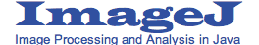
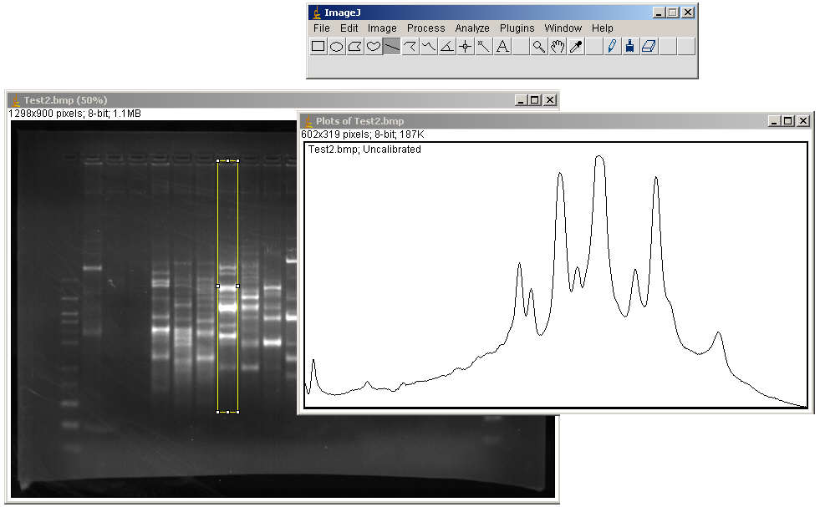
Tools
open-source and cross-platform tool (implemented in Java)
designed in 1997 at National Institutes of Health (Maryland, USA), it is today widely used for assisted processing and analysis of 2/3/4D images (mainly bioimages)

Slide 10
Schedule
Adrian Galdran (visiting MAIA Scholar)
Color image processing
AIA break + Easter break
no lectures
Workers' day
no lecture on May 1st
P
P
P
P
P
P
March 12th
course starts /
introduction /
Color image processing starts
March 22nd
Color image processing ends
April 5th
Project Presentation Day
May 28th
course ends
P
= project sessions (April 10, 17, 24, May 8, 15, 22)

Slide 11
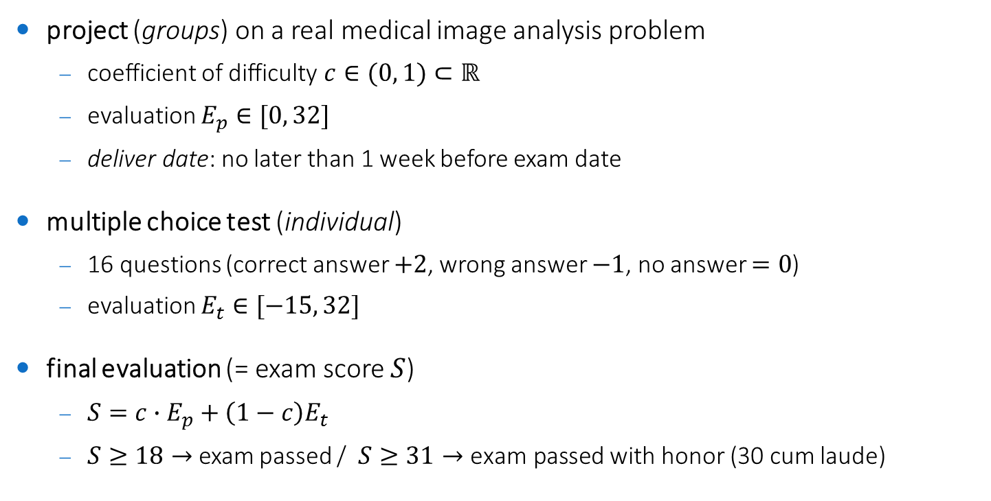
Exam
project (groups) on a real medical image analysis problem
coefficient of difficulty $c∈(0, 1)⊂ℝ$
evaluation $E_{p}∈[0, 32]$
deliver date: no later than 1 week before exam date
multiple choice test (individual)
16 questions (correct answer $+2$, wrong answer $−1$, no answer $=0$)
evaluation $E_{t}∈[−15, 32]$
final evaluation (= exam score $S$)
$S=c∙E_{p}+\left(1−c\right)E_{t}$
$S≥18→$ exam passed / $S≥31→\text{exam} \text{passed}$ with honor (30 cum laude)

Slide 12
Project
made by groups (2, 3 or 4 students)
implemented in C++/OpenCV or other languages/libraries
6+ project sessions during the classes + autonomous work at home
projects drafts (including image datasets) will be made available on April 5th
you can propose your own project, if suited for this course (ask first)
projects can be shared with the Pattern Recognition course if they use machine learning
project evaluation is based on:
methodology: is the method sound and well-conceived? How much original?
implementation: is the code reusable / well commented?
results: are the results close enough to the state-of-the-art [details in project drafts]?
conference paper: write a full conference paper on your project!
good papers will be submitted to ISBI 2019 (deadline August 2018) or other conferences!

Slide 13
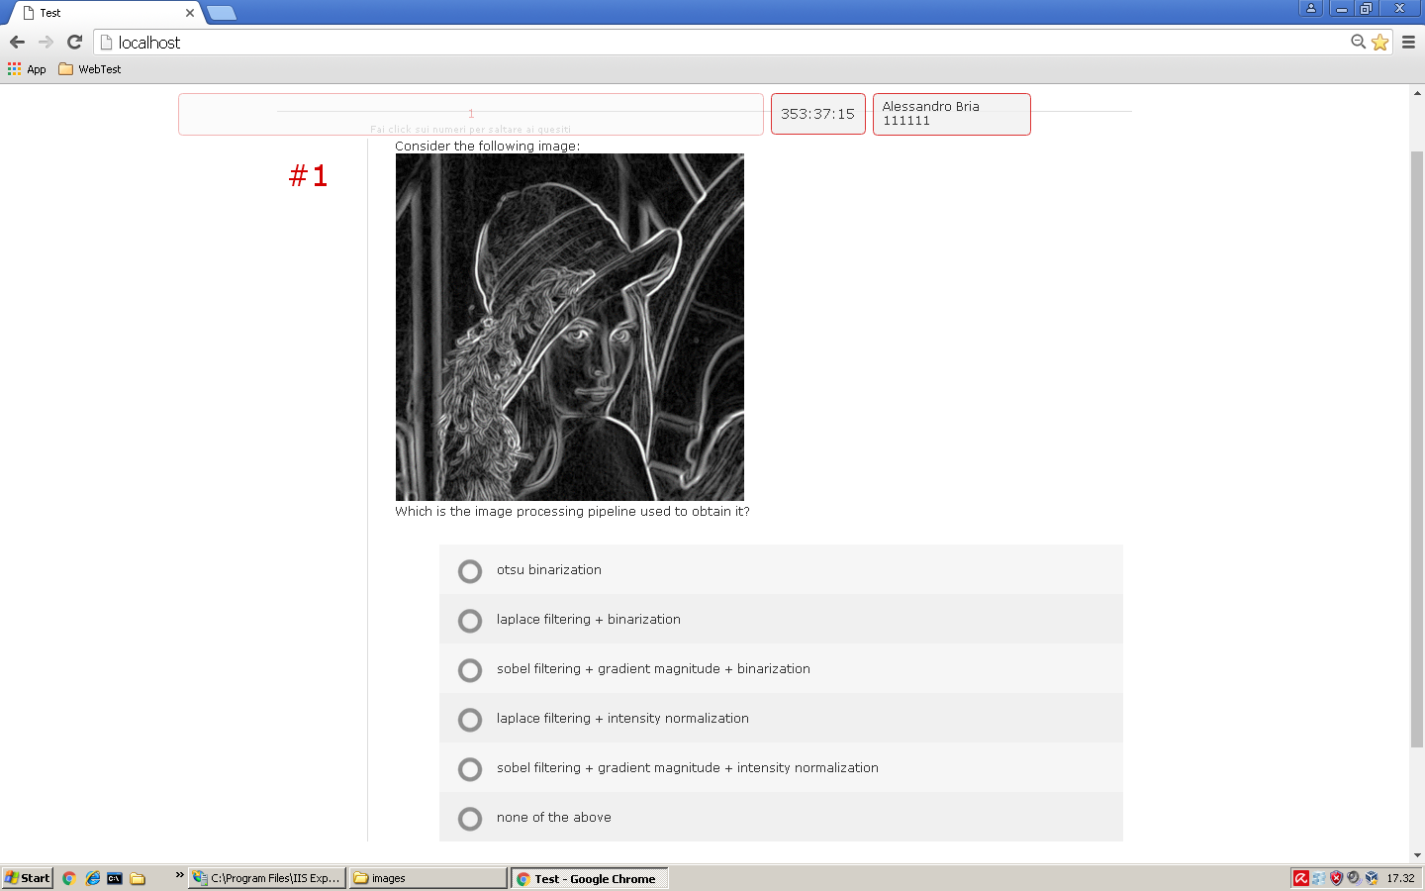
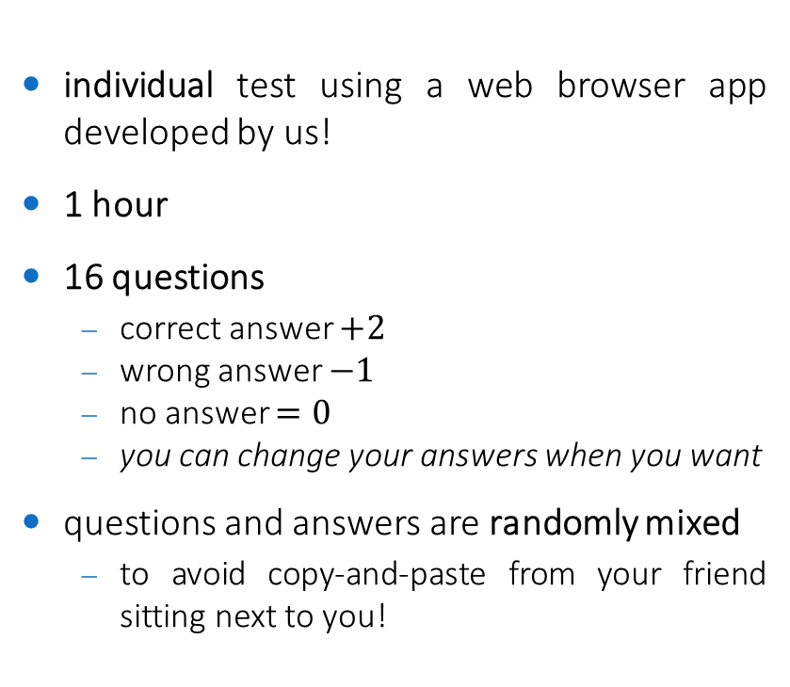
Multiple Choice Test
individual test using a web browser app developed by us!
1 hour
16 questions
correct answer $+2$
wrong answer $−1$
no answer $=0$
you can change your answers when you want
questions and answers are randomly mixed
to avoid copy-and-paste from your friend sitting next to you!

Slide 14
Exam Dates
3 dates in June-July 2018
to be defined

Slide 15


