Slide 1
Advanced Image Analysis
a.a. 2017-2018, 2nd semester
Project
Optic Disc Segmentation in Color Fundus Images
Alessandro Bria
Contract Professor
and Post-doc Researcher
email: a.bria@unicas.it

Slide 2
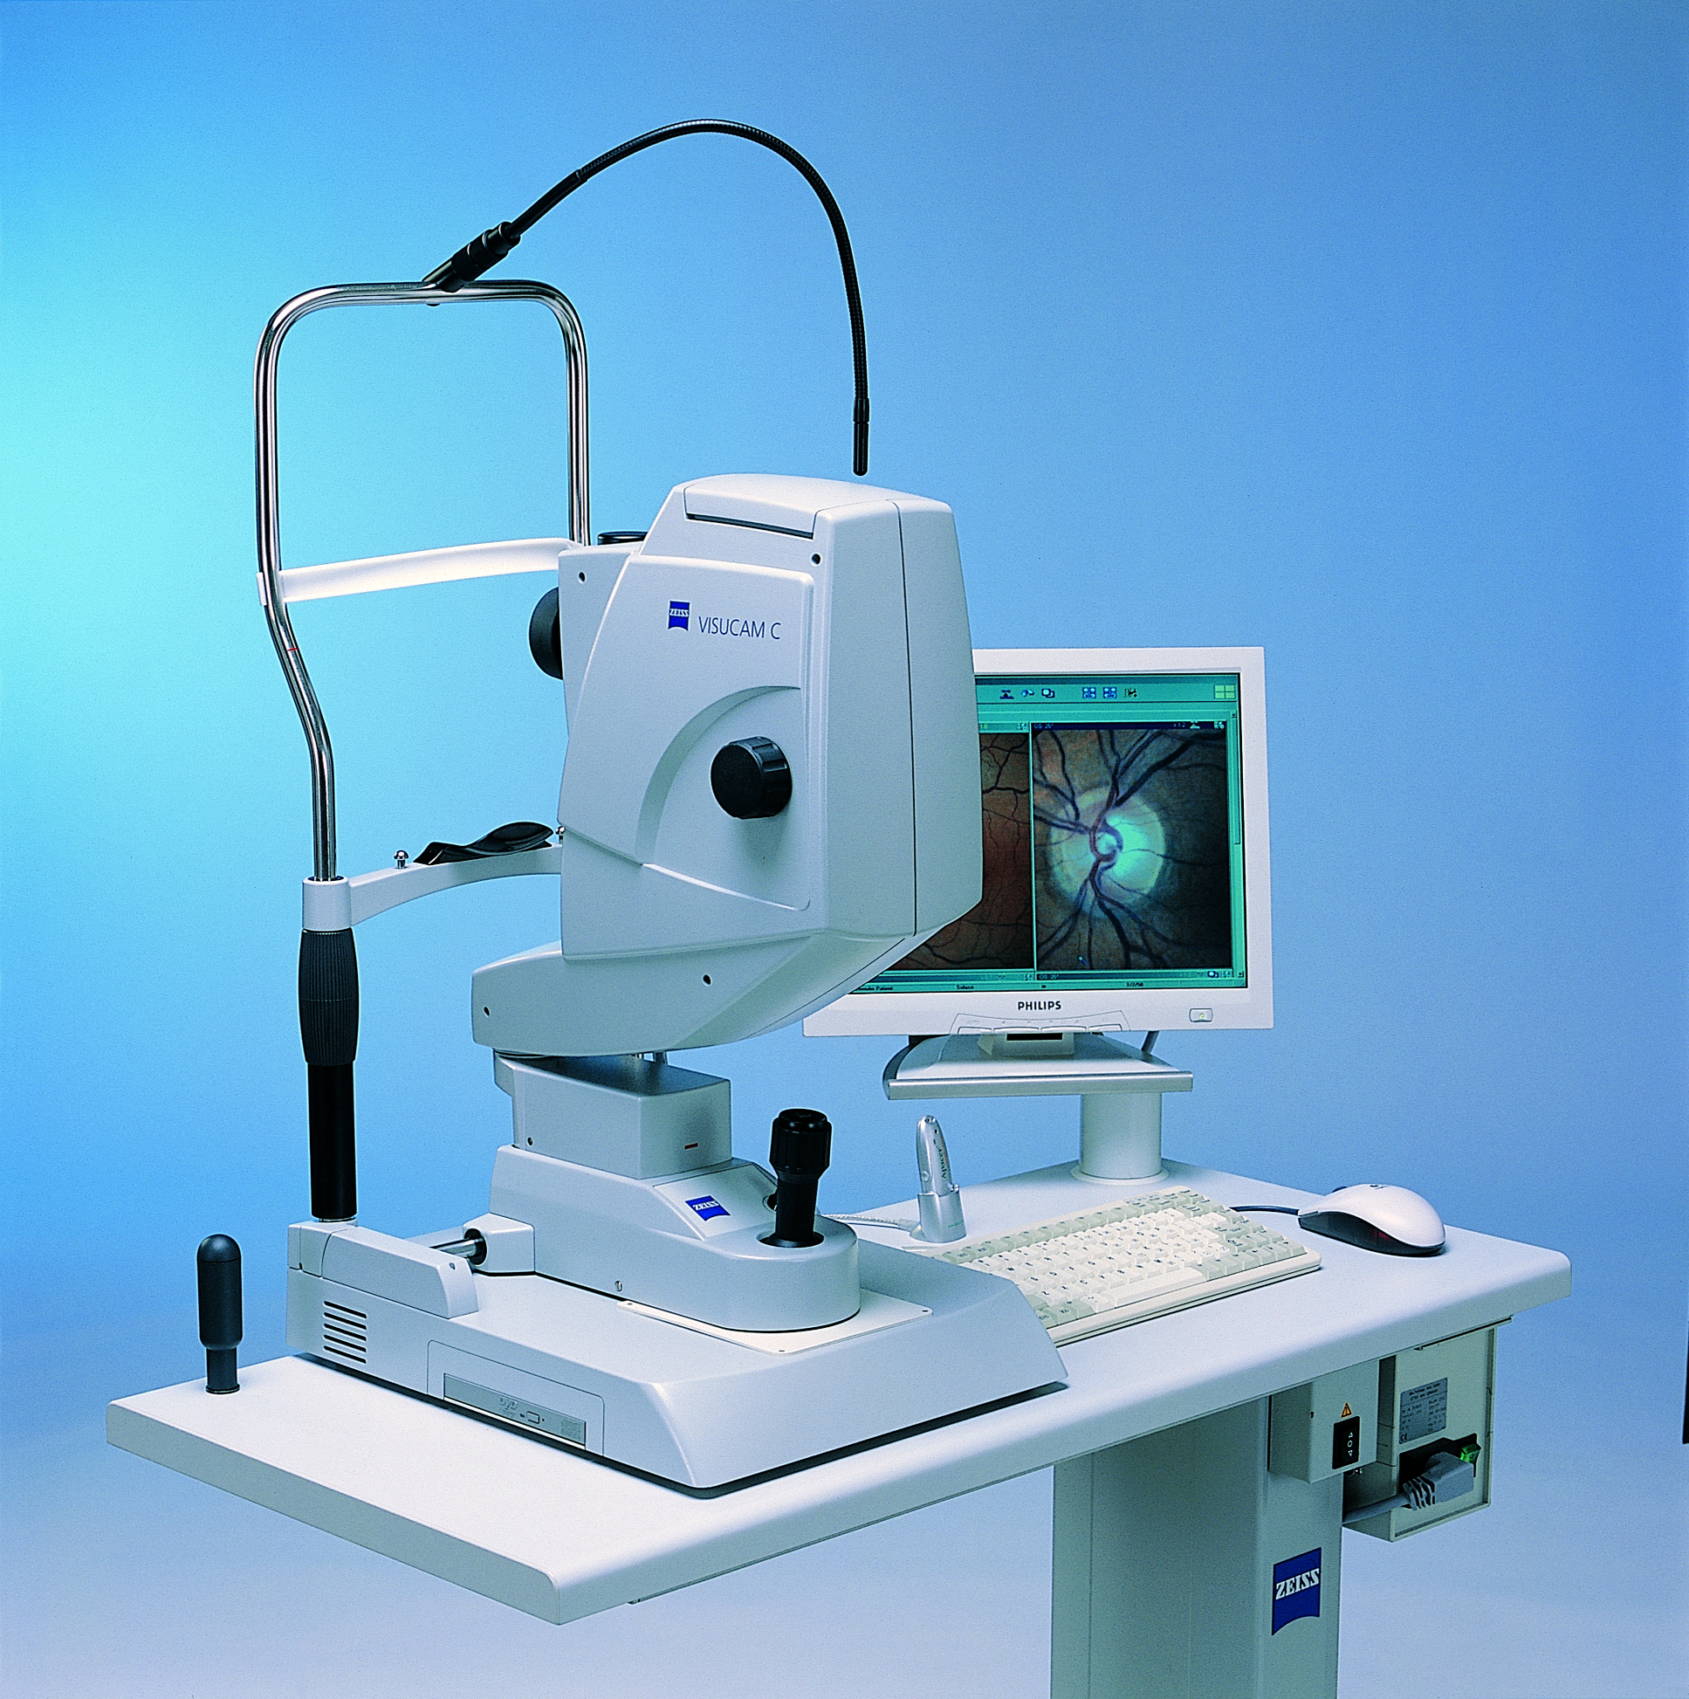
Motivations
retinal color fundus images are widely used for diagnosis, screening and treatment of cardiovascular and ophthalmologic diseases
early glaucoma detection is key to preventing vision loss yet there is a lack of noticeable early symptoms
automatic delineation of the optic disc features has potential to improve glaucoma management by allowing for this asymmetry to be considered in the measurements

Slide 3
Goal
implement a reusable module for automated Optic Disc Segmentation
a must-have module in most Computer Aided Diagnosis (CAD) systems that work on these kind of images
Optic Disc Segmentation
vessel segmentation
microaneurism detection
...
input images
CAD system
binary images

Slide 4
Materials
2 widely used datasets (DRIVE, DRiDB), each containing:
color fundus images
/<dataset>/images
FOV binary masks
/<dataset>/masks
manual annotations
/<dataset>/groundtruths

Slide 5

Coefficient of difficulty
base coefficient of difficulty
$c=0.4$
no bonuses

Slide 6
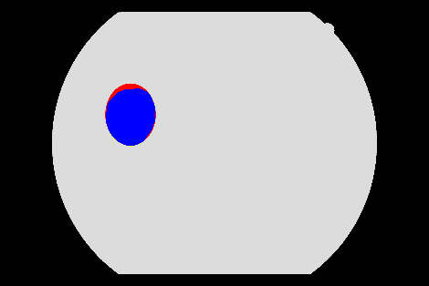
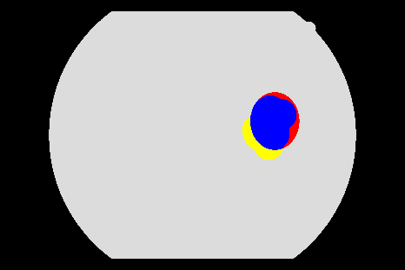
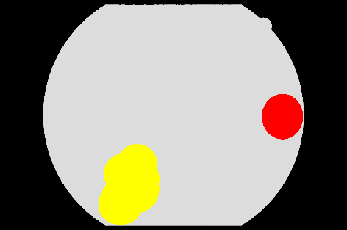









Performance evaluation
Jaccard index (JC)
$JC=\frac{tp}{tp + fp + fn}$
$tp$ : pixels $≠0$ in the output and in the groundtruth
$fp$: pixels $≠0$ in the output and $=0$ in the groundtruth
$fn$: pixels $=0$ in the output and$≠0$ in the groundtruth
$$0.80$$
state-of-the-art
$$0.75$$
publication level
$$0.70$$
excellent
$$0.65$$
good
$$0.60$$
fair
$$0.55$$
adequate
$$0.50$$
fairly adequate
...
...
...
$$0.30$$
poor

Slide 7
Constraints
implementation in any language/framework
C++/OpenCV suggested (but not mandatory)
reusable module
the code must be commented
it should be super-easy to process another set of images different from the one you used!
same parameters for all the images in one dataset
unless parameters are self-adjusted on each image
it is ok to use different parameters on different datasets
machine learning
optional / not required
if used, use the first half of each dataset for testing, and the second half for training

Slide 8
Code snippets
how to calculate the Jaccard Index?
adapt and modify /code-snippets/compute-segmentation-accuracy.cpp
how to load all images within a folder w/o knowing their file names?
see /code-snippets/load-all-images-within-folder.cpp

