Slide 1
Advanced Image Analysis
a.a. 2017-2018, 2nd semester
Project
Skin Lesion Segmentation
Alessandro Bria
Contract Professor
and Post-doc Researcher
email: a.bria@unicas.it

Slide 2
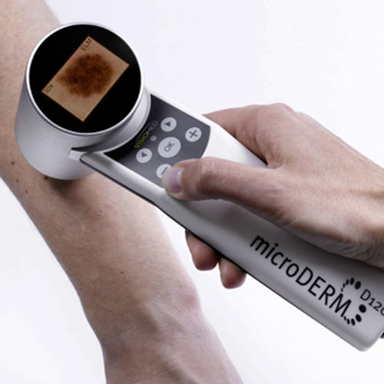
Motivations
skin cancer is the most prevalent form of cancer in many western countries
the skin is examined using dermoscopy
magnifier + nonpolarized light source + liquid medium + transparent plate
the diagnostic accuracy of expert visual analysis is only about 75-84%
computerized diagnosis / CAD recently proved to be very effective (Nature, 2017)
skin lesion segmentation is often required prior to the classification into malignant and benign types

Slide 3
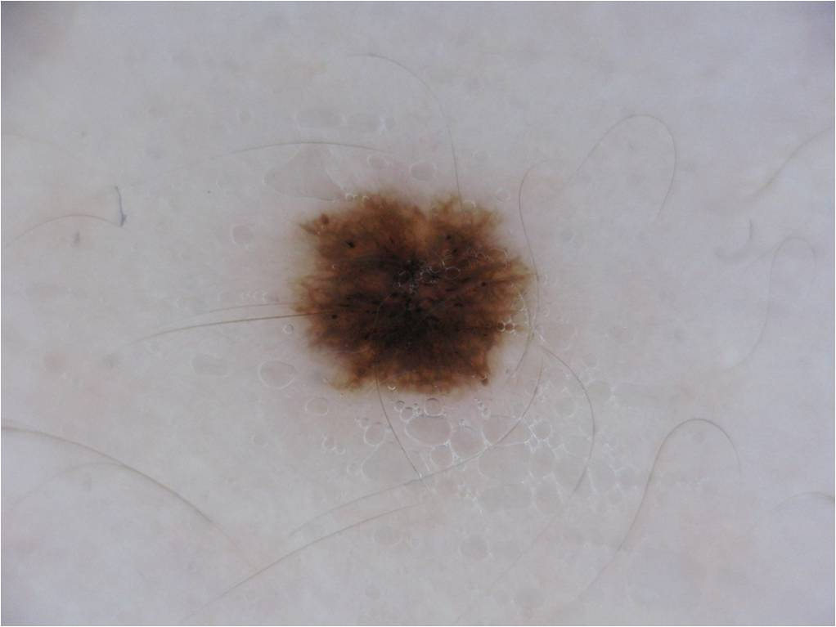

Goal
implement a reusable module for automated Skin Lesion Segmentation
a module often required in Computer Aided Diagnosis (CAD) systems that work on these kind of images
Skin Lesion Segmentation
Lesion Feature Extraction
Lesion Classification
input images
CAD system
binary images

Slide 4
Materials
200 images taken from the ISIC 2017 challenge:
note: the original ISIC 2017 dataset contains 2,000 (training) + 150 (validation) + 600 (test) images!
dermatoscopic images
/<dataset>/images
manual annotations
/<dataset>/groundtruths

Slide 5
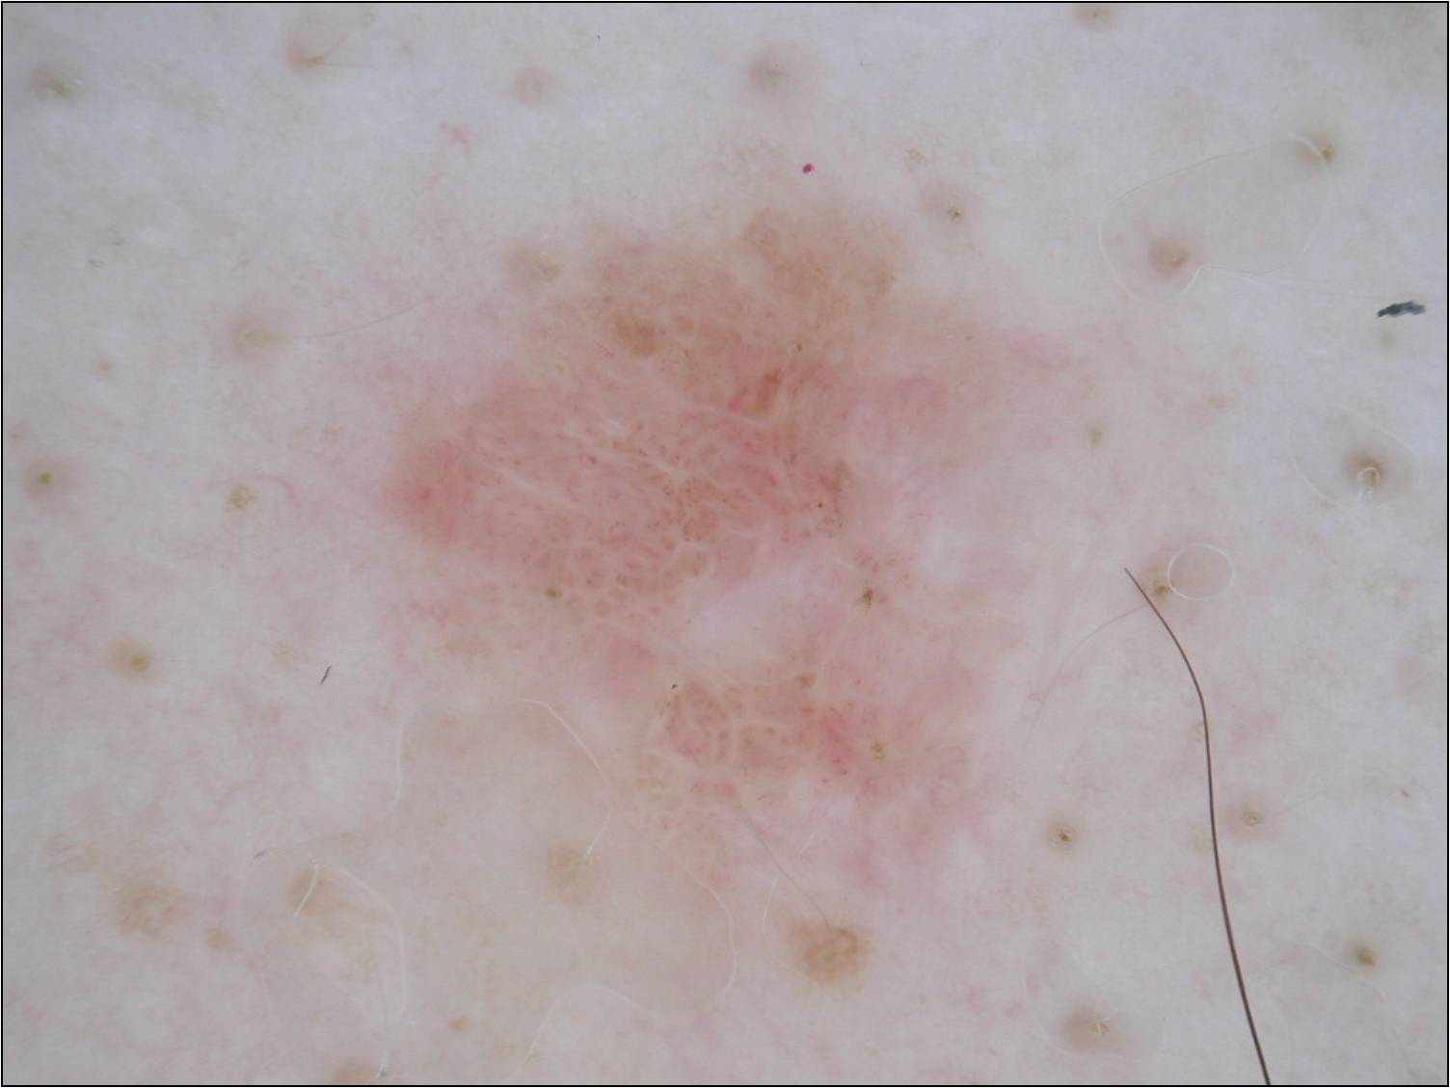

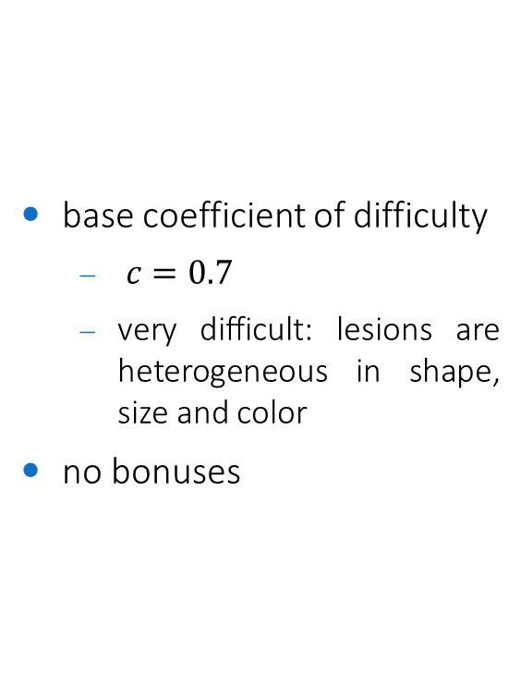
Coefficient of difficulty
base coefficient of difficulty
$c=0.7$
very difficult: lesions are heterogeneous in shape, size and color
no bonuses

Slide 6
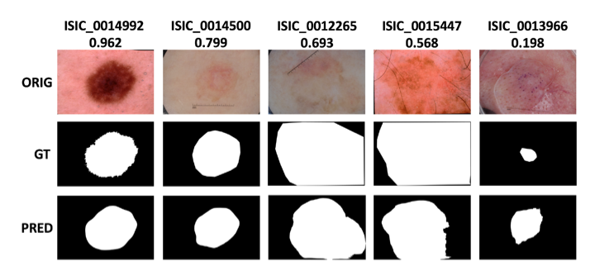









Performance evaluation
Jaccard index (JC)
$JC=\frac{tp}{tp + fp + fn}$
$tp$ : pixels $≠0$ in the output and in the groundtruth
$fp$: pixels $≠0$ in the output and $=0$ in the groundtruth
$fn$: pixels $=0$ in the output and$≠0$ in the groundtruth
$$0.80$$
state-of-the-art
$$0.75$$
publication level
$$0.70$$
excellent
$$0.65$$
good
$$0.60$$
fair
$$0.55$$
adequate
$$0.50$$
fairly adequate
...
...
...
$$0.30$$
poor

Slide 7
Constraints
implementation in any language/framework
C++/OpenCV suggested (but not mandatory)
reusable module
the code must be commented
it should be super-easy to process another set of images different from the one you used!
same parameters for all the images
unless parameters are self-adjusted on each image
machine learning
optional / not required
if used, use the first half of each dataset for testing, and the second half for training
if you need more data, you can also use the original ISIC 2017 challenge dataset!

Slide 8
Code snippets
how to calculate the Jaccard Index?
adapt and modify /code-snippets/compute-segmentation-accuracy.cpp
how to load all images within a folder w/o knowing their file names?
see /code-snippets/load-all-images-within-folder.cpp

