Slide 1
Advanced Image Analysis
a.a. 2017-2018, 2nd semester
Project
Retinal Vessel Segmentation in Color Fundus Images
Alessandro Bria
Contract Professor
and Post-doc Researcher
email: a.bria@unicas.it

Slide 2
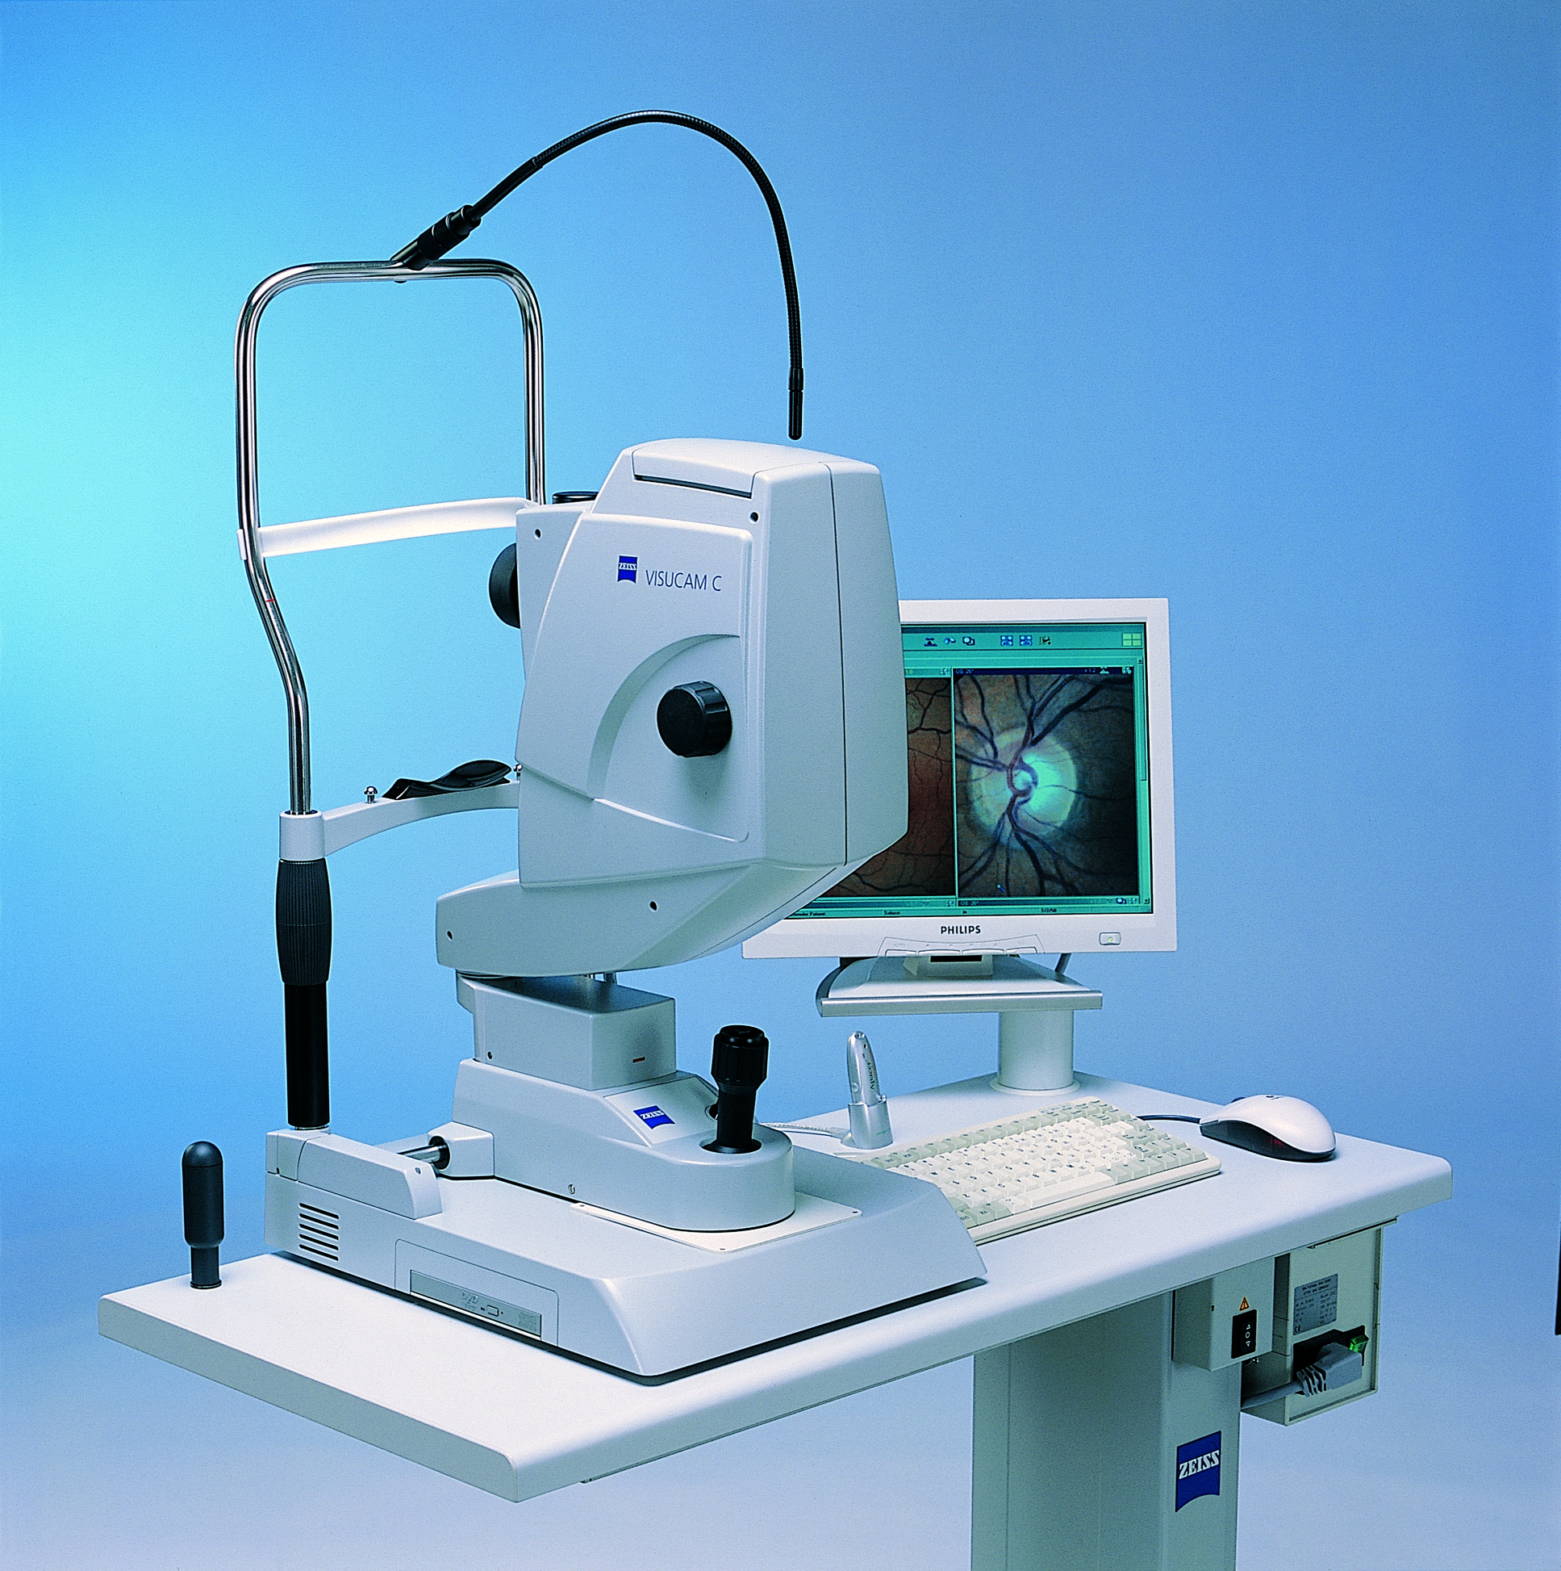
Motivations
retinal color fundus images are widely used for diagnosis, screening and treatment of cardiovascular and ophthalmologic diseases
morphological attributes such as length, width, and branching angles can be extracted from the vascular tree to detect the presence and the severity of these disorders
manual segmentation is hardly feasible
automatic segmentation is desired

Slide 3
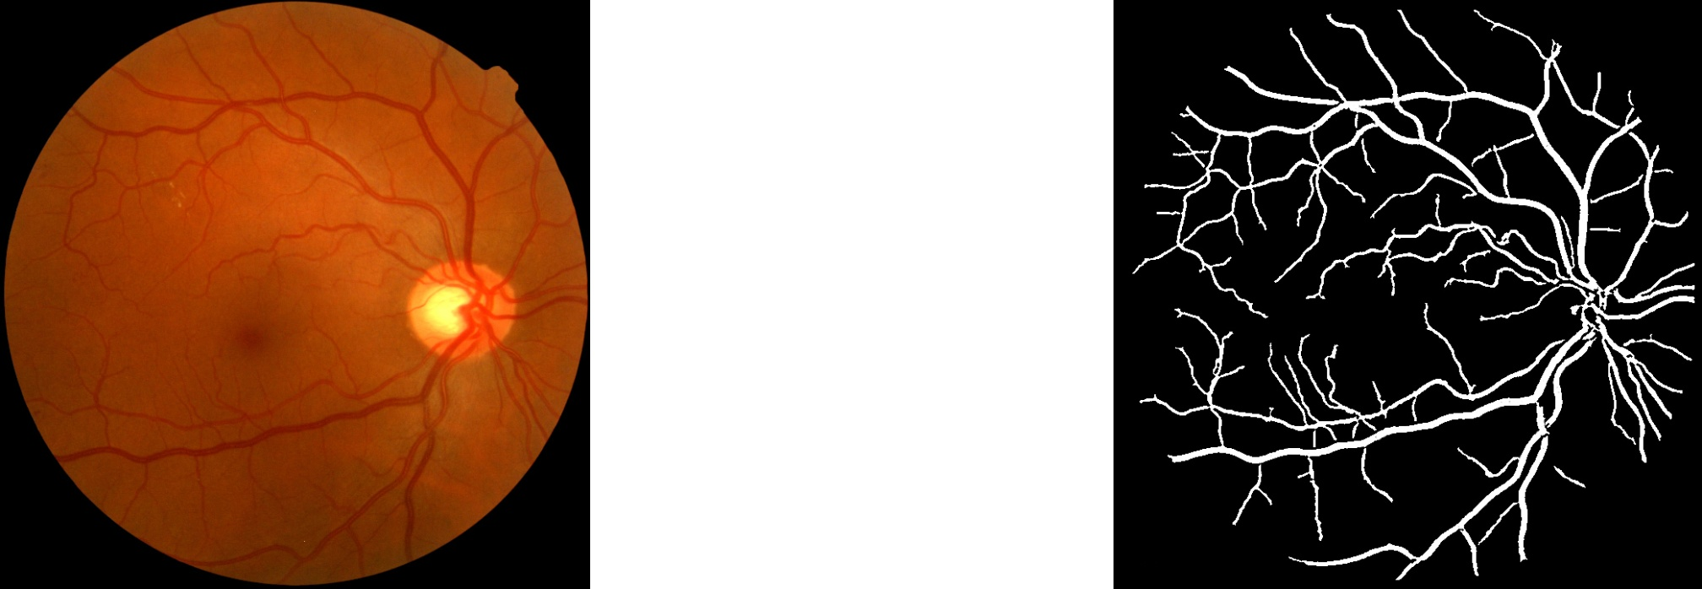
Goal
implement a reusable module for automated retinal vessel segmentation
a must-have module in most Computer Aided Diagnosis (CAD) systems that work on these kind of images
vessel segmentation
optic disk detection
microaneurism detection
...
input images
CAD system
binary images

Slide 4
Materials
3 widely used datasets (DRIVE, CHASEDB1, STARE), each containing ^{(*)}:
color fundus images
/<dataset>/images
FOV binary masks
/<dataset>/masks
manual annotations
/<dataset>/groundtruths
^{(*)} CHASEDB1 has no masks, you have to generate them!

Slide 5
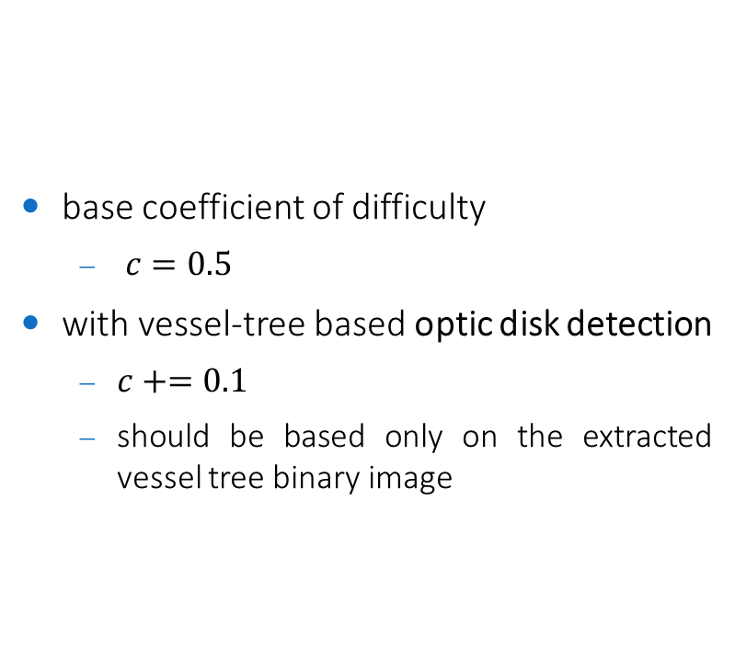
Coefficient of difficulty
base coefficient of difficulty
$c=0.5$
with vessel-tree based optic disk detection
$c+=0.1$
should be based only on the extracted vessel tree binary image

Slide 6
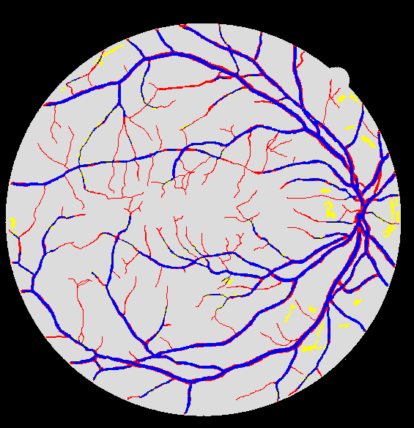









Performance evaluation
segmentation accuracy (ACC) within the FOV
$ACC=\frac{true positives + true negatives }{total number of pixels in the FOV}$
$$95.0\%$$
state-of-the-art
$$94.5\%$$
publication level
$$94.0\%$$
excellent
$$93.5\%$$
good
$$93.0\%$$
fair
$$92.5\%$$
adequate
$$92.0\%$$
fairly adequate
...
...
...
$$88.0\%$$
dummy method

Slide 7
Constraints
implementation in any language/framework
C++/OpenCV suggested (but not mandatory)
reusable module
the code must be commented
it should be super-easy to process another set of images different from the one you used!
same parameters for all the images in one dataset
unless parameters are self-adjusted on each image
it is ok to use different parameters on different datasets
machine learning
optional / not required
if used, use the first half of each dataset for testing, and the second half for training

Slide 8
Code snippets
how to calculate the accuracy?
see /code-snippets/compute-segmentation-accuracy.cpp
how to visually see on the image where the method fails?
see visual evaluation in /code-snippets/compute-segmentation-accuracy.cpp
how to load all images within a folder w/o knowing their file names?
see /code-snippets/load-all-images-within-folder.cpp
an example of vessel segmentation?
see /code-snippets/example.cpp
based on global thresholding on the inverse intensity image (dummy method)
achieves up to 88% accuracy for some thresholds!

Slide 9
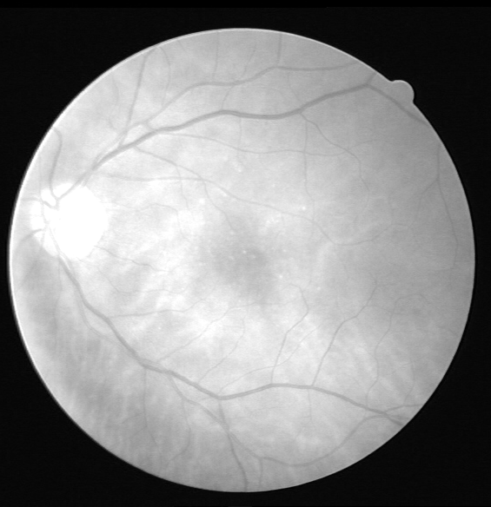
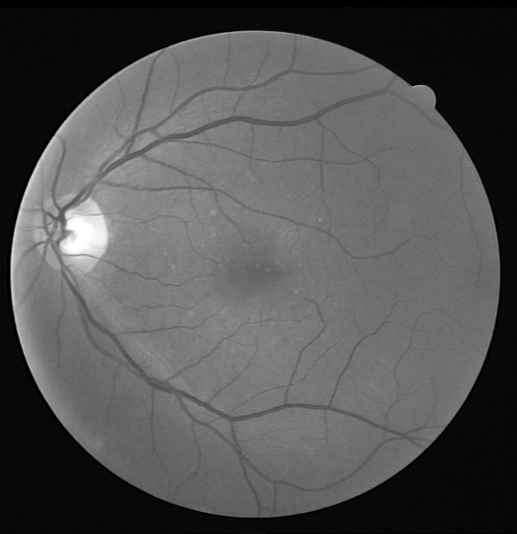
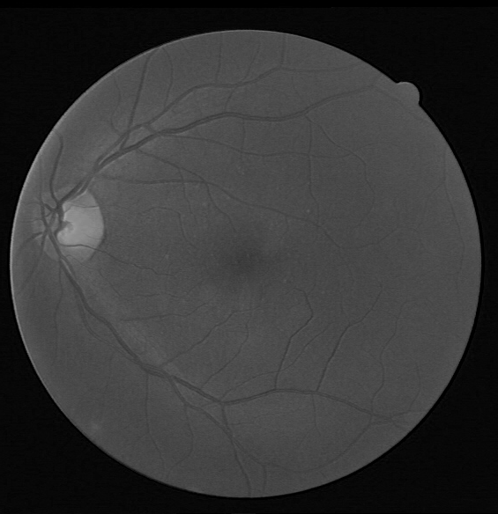
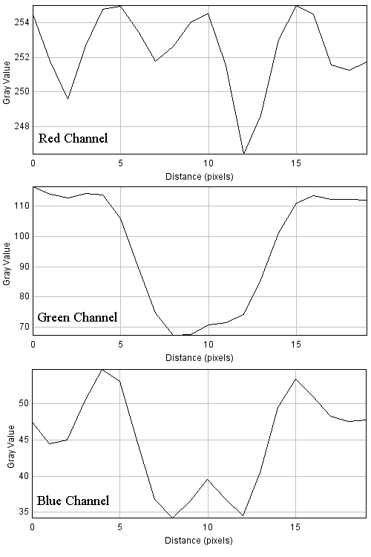
Hints (1/2)
the intensity profile of the vessels differs among the R,G,B channels

Slide 10
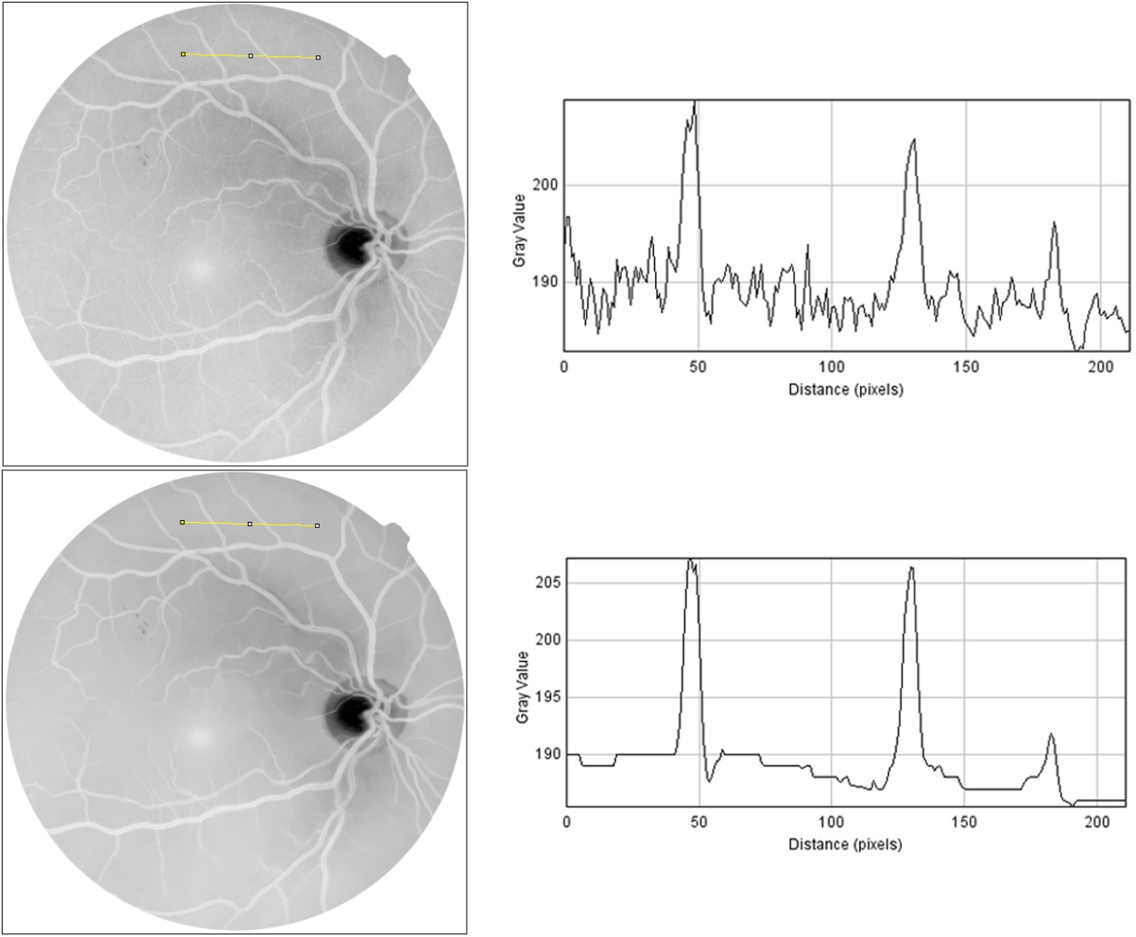
Hints (2/2)
edge-preserving smoothing can remove high-frequency noise while preserving the vessel structure
e.g. non-local means denoising, bilateral filtering, ...

