Slide 1
Computer Aided Diagnosis Diagnosis in Dermoscopic Images using Deep Learning
Ali Berrada

Slide 2
Tools
Colaboratory
Online Jupyter notebook
Tesla K80 GPU
Python 3
Keras library

Slide 3
Challenge 1
Binary classification: Nevus vs Non-Nevus (lesion)
Train set:
2400 lesion images
2400 nevus images
Validation set:
600 lesion images
600 nevus images

Slide 4
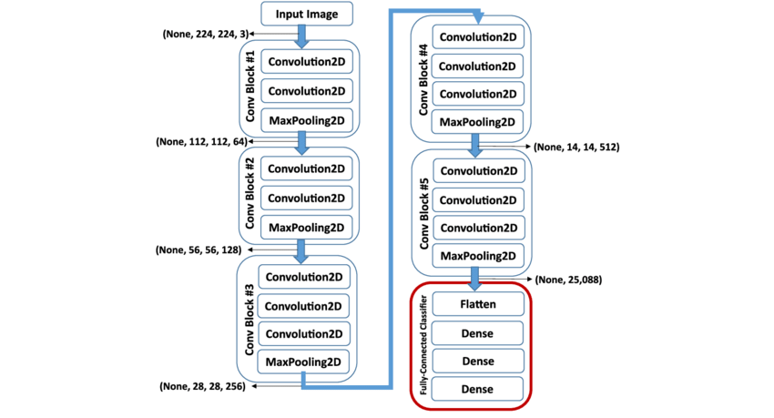
Challenge 1
Transfer learning
VGG16 model pre-trained with "imagenet" weights

Slide 5
Challenge 1
Prediction: last layer replaced with a dense layer of 2 units and “softmax” activation function.
Similar to “sigmoid” function in this case.
Fine Tune: top layers (i.e. after bottleneck) trainable
Optimizer: SGD
learning rate = 0.00001
momentum = 0.9
Batch size: 16

Slide 6
Challenge 1
Data augmentation
Horizontal flip
Random zoom range: [0.8, 1.2]
Shift range: 10%
Rotation range: 180°

Slide 7
Challenge 1
Training
200 epochs with data augmentation
loss: 0.1523 - acc: 0.9415 - val_loss: 0.3115 - val_acc: 0.8758
20 epochs without data augmentation
loss: 0.0361 - acc: 0.9979 - val_loss: 0.3138 - val_acc: 0.8858
100 epochs with data augmentation
loss: 0.1105 - acc: 0.9613 - val_loss: 0.3200 - val_acc: 0.8825
50 epochs without data augmentation
loss: 0.0057 - acc: 1.0000 - val_loss: 0.3662 - val_acc: 0.8900
100 epochs with data augmentation
loss: 0.0792 - acc: 0.9717 - val_loss: 0.3286 - val_acc: 0.9008

Slide 8
Challenge 1
Validation set accuracy: 90.08%
Metrics
Class | Precision | Recall | F1-Score | Support
0 - Lesion | 0.91 | 0.89 | 0.90 | 600
1 - Nevus | 0.89 | 0.92 | 0.90 | 600

Slide 9
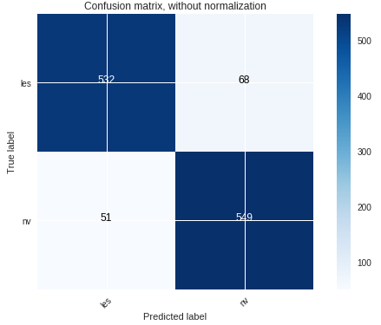
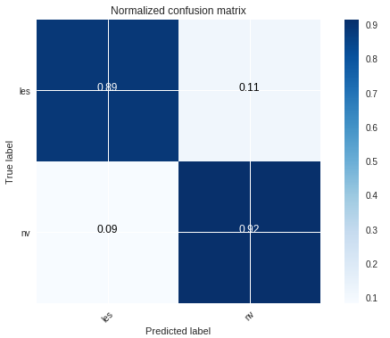
Challenge 1
Confusion matrix:

Slide 10
Challenge 2
Multi-class classification:
Basal Cell Carcinoma (bcc)
Seborrheic Keratose (bkl)
Melanoma (mel)
Train set:
400 bcc images
800 bkl images
800 mel images
Validation set:
100 bcc images
200 bkl images
200 mel images

Slide 11
Challenge 2
Transfer learning
VGG16 model pre-trained with "imagenet" weights but without top layers (i.e. classification block)
Custom top layers
2 blocks of:
Dense layer with 1024 hidden and ReLu activation
Batch Normalization
Dropout with 0.1 rate
Dense (prediction) layer of 3 units and “softmax” activation function.

Slide 12
Challenge 2
Fine Tune: all layers are trainable
Optimizer:
Initial: RMSprop, learning rate = 0.001
Fine tune: Adam, learning rate = 0.0001
Batch size: 64
Image size: 150 x 150

Slide 13
Challenge 2
Data augmentation
Horizontal flip
Random zoom range: [0.8, 1.2]
Shift range: 10%
Rotation range: 180°

Slide 14
Challenge 2
Training before fine tune
100 epochs with data augmentation
loss: 5.9552e-04 - acc: 0.8263 - val_loss: 0.8971 - val_acc: 0.7220
10 epochs without data augmentation
loss: 3.3667e-05 - acc: 0.9937 - val_loss: 1.3240 - val_acc: 0.7140
Training after fine tune
42 epochs with data augmentation
loss: 4.4776e-04 - acc: 0.8585 - val_loss: 0.3956 - val_acc: 0.8660

Slide 15
Challenge 2
Validation set accuracy: 86.60%
Metrics
Class | Precision | Recall | F1-Score | Support
0 - bcc | 0.89 | 0.86 | 0.87 | 100
1 - bkl | 0.84 | 0.88 | 0.86 | 200
2 - mel | 0.88 | 0.85 | 0.87 | 200

Slide 16
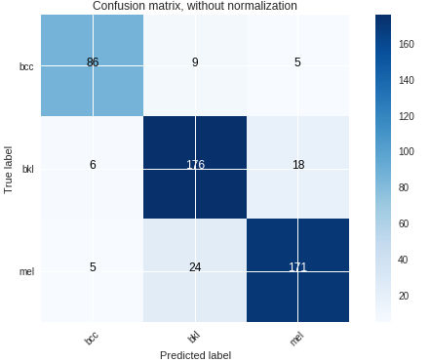
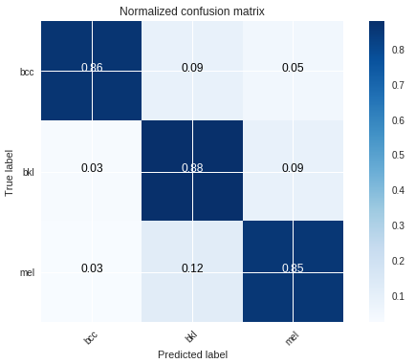
Challenge 2
Confusion matrix:

Slide 17
Reference
Deep Convolutional Neural Networks with transfer learning for computer vision-based data-driven pavement distress detection

