Slide 1
Hurricane Forecasting Using
Robust Locally Weighted Regression
Ali Yahya

Slide 2
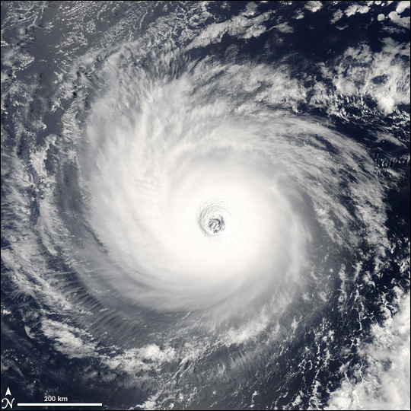
Project View at 1,000,000 ft.
Forecast model parameters:
  maximum wind speed
  minimum central pressure
  radius of maximum wind speed
  radius of outer closed isobar
Project goal:
  device a predictive model for any one feature given the remaining features
  develop an understanding of the intricate relationships between features
Motivation:
  incomplete/inconsistent data
  better understanding of each parameter’s side-effects

Slide 3
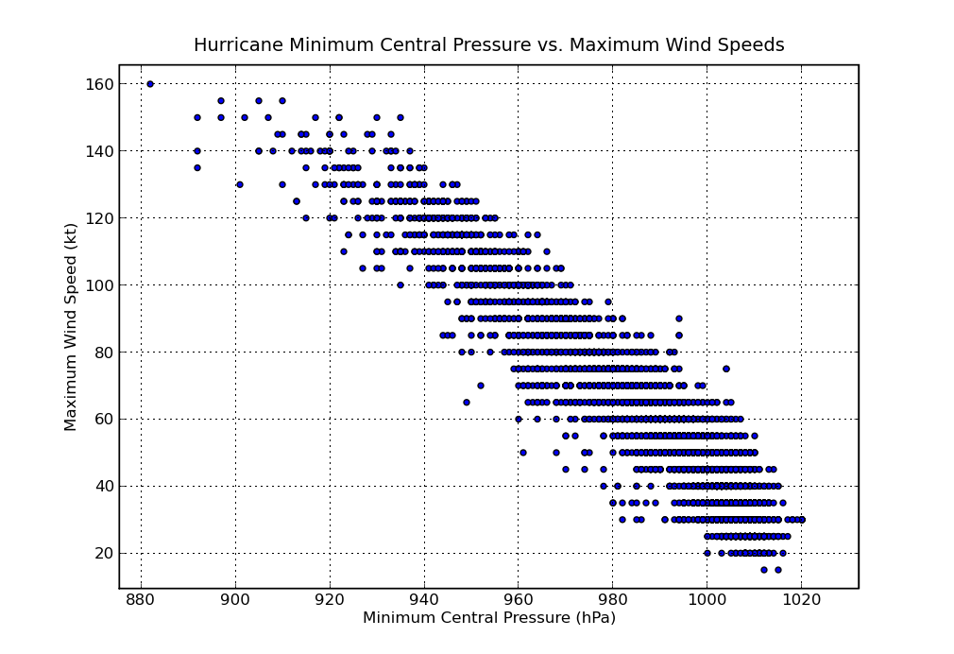
Looking for Patterns
Data collection:
processed data from ~10,000 hurricanes
payed attention to correlations between model features
Correlations Observed:
Min. Pressure vs. Max. Speed
Pressure vs. Max. Speed Radius
Max. Speed vs. Max. Speed Radius
Longitude vs. Max. Speed

Slide 4
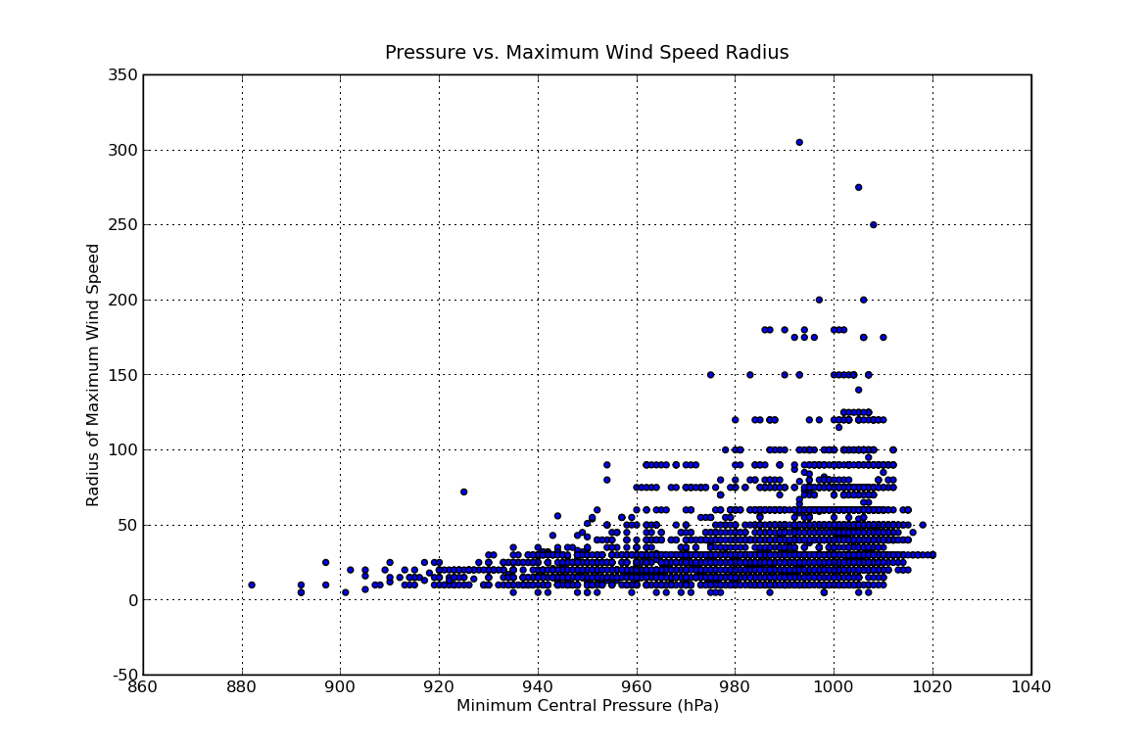
Looking for Patterns
Data collection:
processed data from ~10,000 hurricanes
payed attention to correlations between model features
Correlations Observed:
Min. Pressure vs. Max. Speed
Pressure vs. Max. Speed Radius
Max. Speed vs. Max. Speed Radius
Longitude vs. Max. Speed

Slide 5
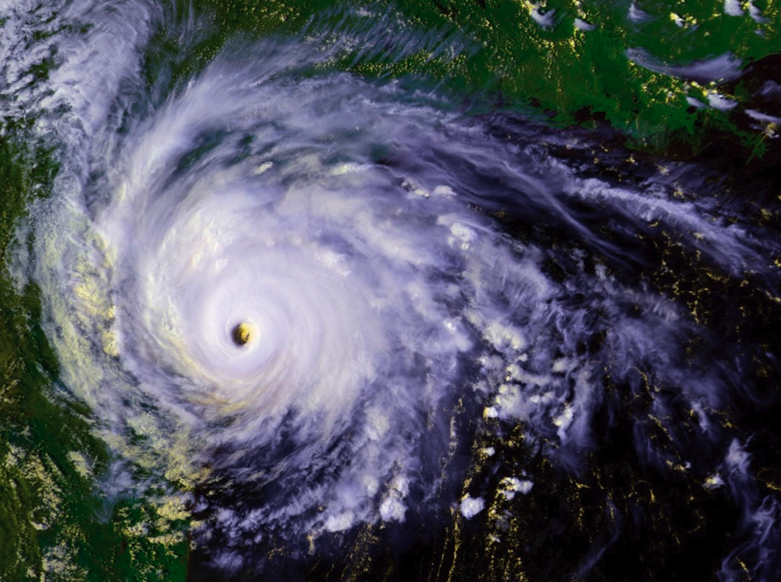
Looking for Patterns
Data collection:
processed data from ~10,000 hurricanes
payed attention to correlations between model features
Correlations Observed:
Min. Pressure vs. Max. Speed
Pressure vs. Max. Speed Radius
Max. Speed vs. Max. Speed Radius
Longitude vs. Max. Speed
Hurricane Bret, 1999
Maximum Wind Speed Radius: 305 nm

Slide 6
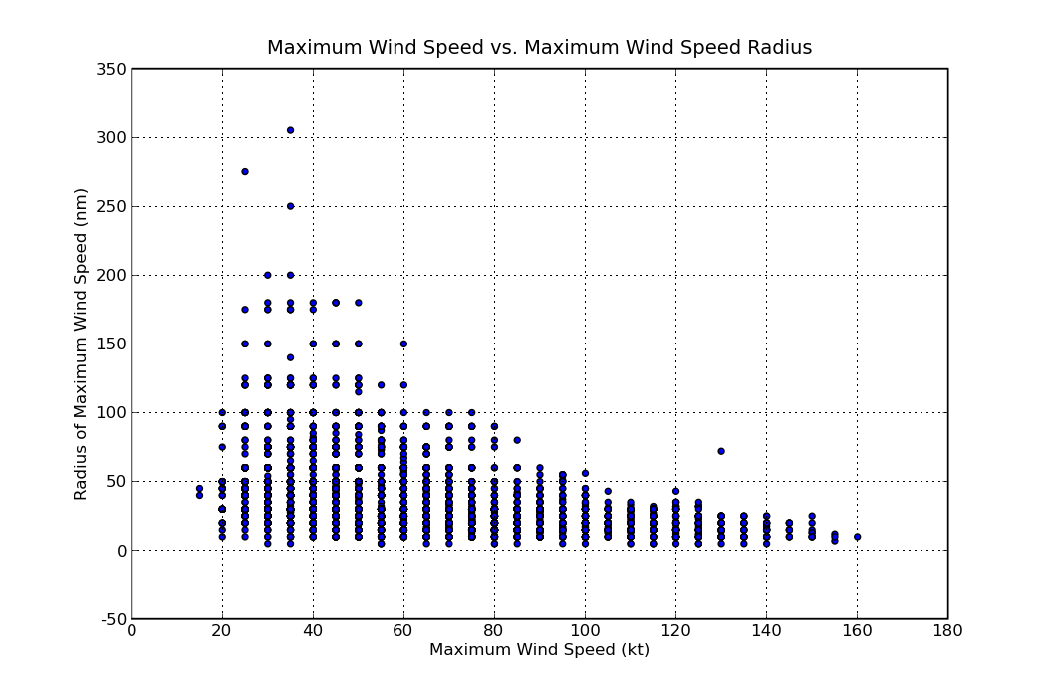
Looking for Patterns
Data collection:
processed data from ~10,000 hurricanes
payed attention to correlations between model features
Correlations Observed:
Min. Pressure vs. Max. Speed
Pressure vs. Max. Speed Radius
Max. Speed vs. Max. Speed Radius
Longitude vs. Max. Speed

Slide 7
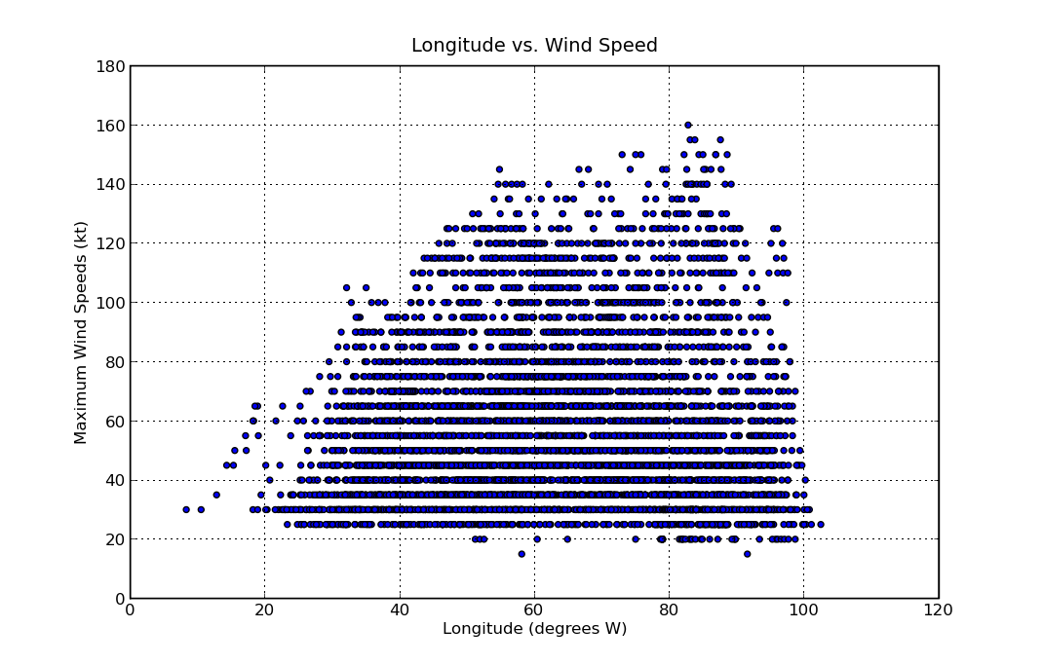
Looking for Patterns
Data collection:
processed data from ~10,000 hurricanes
payed attention to correlations between model features
Correlations Observed:
Min. Pressure vs. Max. Speed
Pressure vs. Max. Speed Radius
Max. Speed vs. Max. Speed Radius
Longitude vs. Max. Speed

Slide 8

Formalized Observations
Implemented LOESS,
A machine learning algorithm based on Locally Weighted Regression
Forecast model is a hyperplane in n-dimensional space, where n is the number of parameters
Allows the following:
Where:
X is a matrix containing historical hurricane data,
x_query is a vector containing info about a new hurricane;
info about one of the hurricane’s features will be missing
the return value is a prediction for the missing features

Slide 9
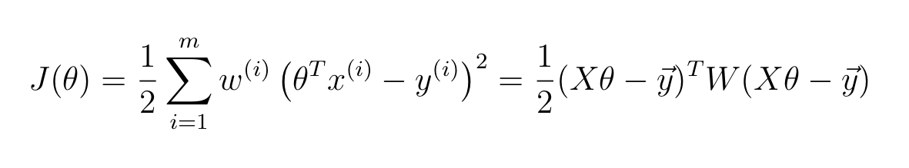
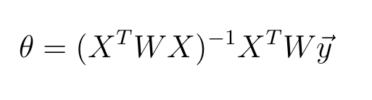
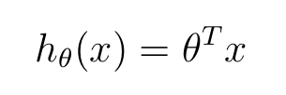
Algorithm Details
The algorithm minimizes the following cost function with respect to Theta :
Differentiating the cost function, setting equal to zero, and solving for theta yields a closed form solution to the minimization problem:
Theta can then be used to compute a prediction for any given query x:
RESULT: Average percent error for hypotheses across ~2,000 data points:
8.4%

Slide 10
The End
Project is Open Source:
https://github.com/ali01/loess.py
References:
Cleveland, W.S. (1979). "Robust Locally Weighted Regression and Smoothing Scatterplots". Journal of the American Statistical Association 74 (368): 829–836. doi:10.2307/2286407. MR0556476. JSTOR 2286407.
"Worldwide Tropical Cyclone Names.". National Hurricane Center.National Oceanic and Atmospheric Administration. 2009. Retrieved 2009-05-07.
NHC Hurricane Research Division (2006-02-17). "Atlantic hurricane best track ("HURDAT")". NOAA. Retrieved 2007-02-22.

