Slide 1
AMP®-Parkinson's Disease Progression Prediction
BY: alI zamin

Slide 2
Goal of the Competition
The goal of this project is to the predict MDS-UPDR scores of patients to measure development of Parkinson’s disease. The MDS-UPDR scores are a comprehensive assessment of non-motor and motor systems that are related to Parkinson’s. Creating a model based on trained data of protein and peptide levels while compare and contrasting patients with Parkinson’s disease against age-matched control group.
MDS-UPDR stands for Movement Disorder Society –Sponsored Revision of the Unified Parkinson’s Disease Rating
Motor: Speech, facial expression, hand movements
Non-motor: cognitive impairment, depressed mood, apathy
Updr_1: Non-motor experience of daily living
Updr_2: Motor experience of daily living
Updr_3: Motor examination
Updr_4: Motor Complications

Slide 3
What is Parkinson’s Disease?
Parkinson’s disease is a progressive brain disorder that affect a person’s daily life by crippling their movement, cognition, sleep, and body functions. Currently there is no cure for Parkinson’s Disease. Research has show that protein or peptides irregularities have a part in increasing the effects of the disease.

Slide 4
Dataset Information
Parkinson’s dataset contains 9 attributes within 4 files detailing information about train_peptides(981,834x6), train_proteins(232,741x5), train_clinical_data(2,615x8), supplement_clinical _data(2,223x8)
Attribute | Description
visit_id | ID code for the visit
visit_month | The month of the visit, relative to the first visit by the patient
patient_id | An ID code for the patient
UniProt | The UniProt ID code for the associated protein. There are often several peptides per protein
Peptide | The sequence of amino acids included in the peptide.

Slide 5
Dataset Information
Attribute | Description
PeptideAbundance | The frequency of the amino acid in the sample.
NPX | Normalized protein expression
updrs_[1-4] | The patient's score for part N of the Unified Parkinson's Disease Rating Scale
upd23b_clinical_state_on_medication | Whether or not the patient was taking medication such as Levodopa during the UPDRS assessment.

Slide 6
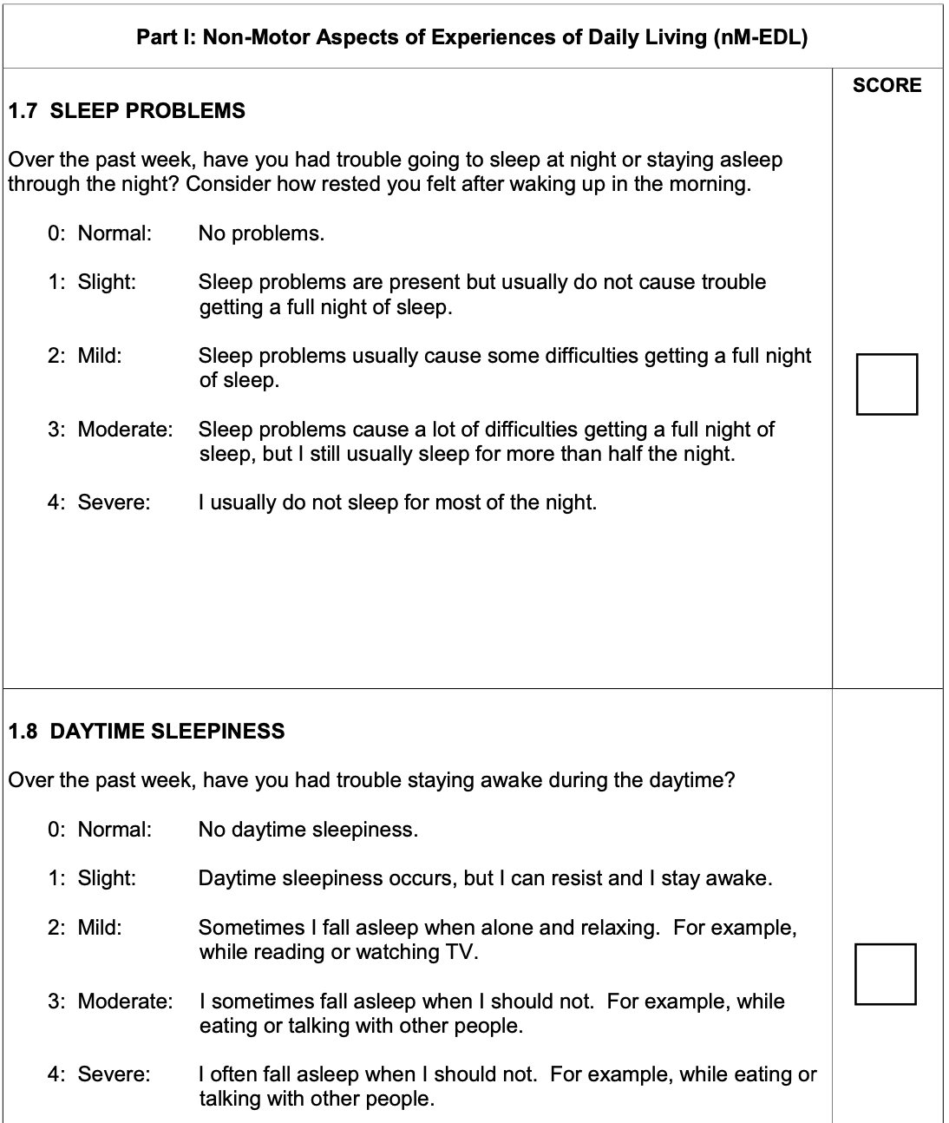
How was MDS-UPDRS data collected?
The MDS-sponsored revision of the UPDRS (MDS-UPDRS) was studied by the International Parkinson and Movement Disorder Society by using a questionnaire answered by the patient and caregiver to measure the patient’s process of Parkinson’s and the it has effect it has on daily life but over seen by an investigator to check for completeness and clarity of the form.

Slide 7
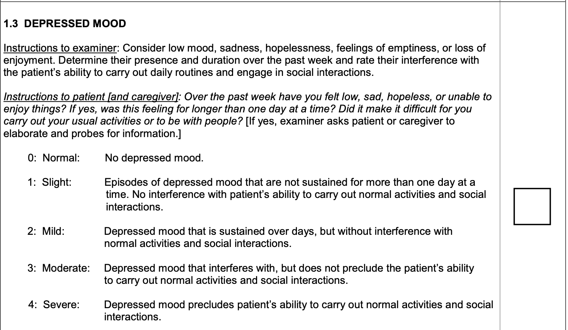
Updr_1: Non-motor experience of daily living
Part 1 contains two separate categories of testing the patients progress for non-motor experiences of daily living. For ‘1A’ the caregiver and the patient are both giving results from a survey of how the behavior of the patient.
Questions are related to cognitive impairment, hallucinations and psychosis, depressed mood, anxious mood, apathy, features of dopamine dysregulation syndrome.
1B is a survey of questions that can be completed by the patient with or without the caregiver while still being over seen by the investigator.
sleep problems, daytime sleepiness, pain and other sensations, urinary problems, constipation problems, light headedness on standing, fatigue

Slide 8
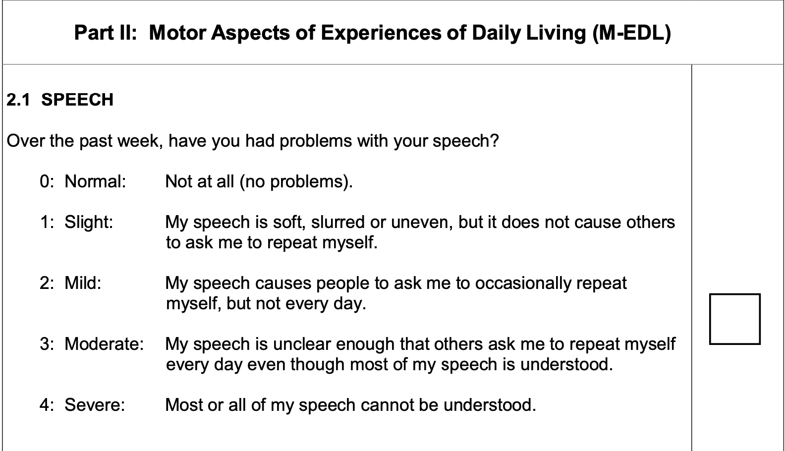
Updr_2: Motor experience of daily living
Part 2 is completed by the patient by testing the patients through a questionnaire on their speech, saliva and drooling, chewing and swallowing, eating tasks, dressing, hygiene, handwriting, doing hobbies and other activities, turning in bed, tremor, (getting out of bed, a car, or a deep chair), walking and balance, freezing

Slide 9
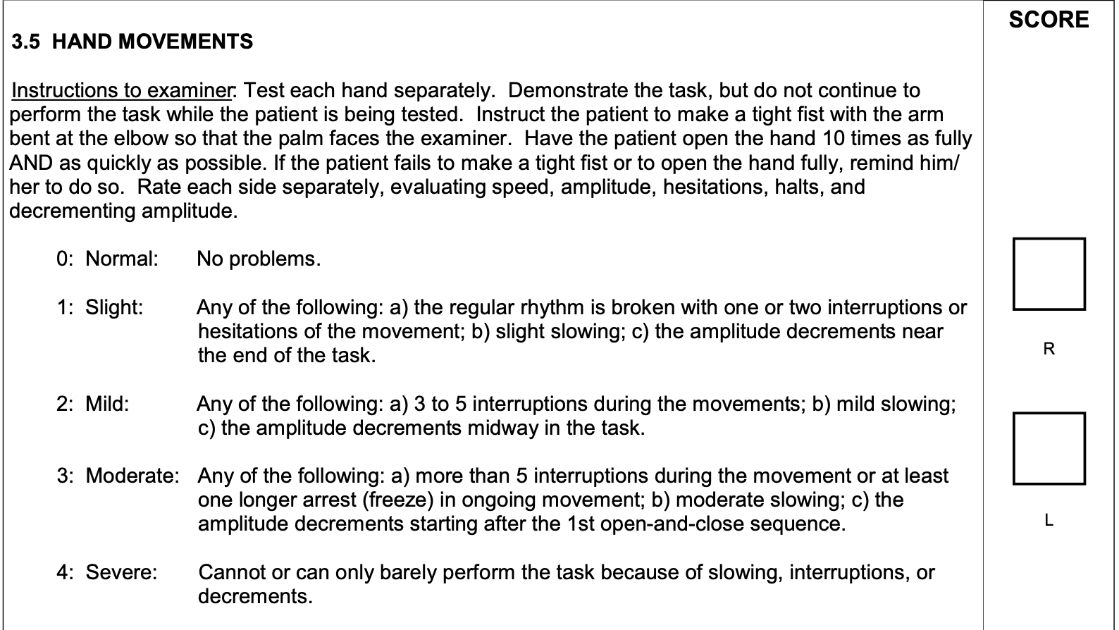
Updr_3: Motor examination
Part 3 is testing the motor skills of the patient by giving the patient instructions and completed by the rater. Such as moving their left and right side of their body. The questionnaire is mark ON for if the medication has a good effect on the patient and good motor functions or OFF if the patient has bad motor functions even while they are taking medication
speech, facial expression, rigidity, finger tapping, hand movements, pronation-supination movements of hands, toe tapping, leg agility, arising from chair, gait, freezing of gait, postural stability, posture, global spontaneity of movement (body bradykinesia), postural tremor of the hands, kinetic tremor of the hands, rest tremor amplitude, constancy of rest tremor, dyskinesia impact on part iii ratings, hoehn and yahr stage

Slide 10
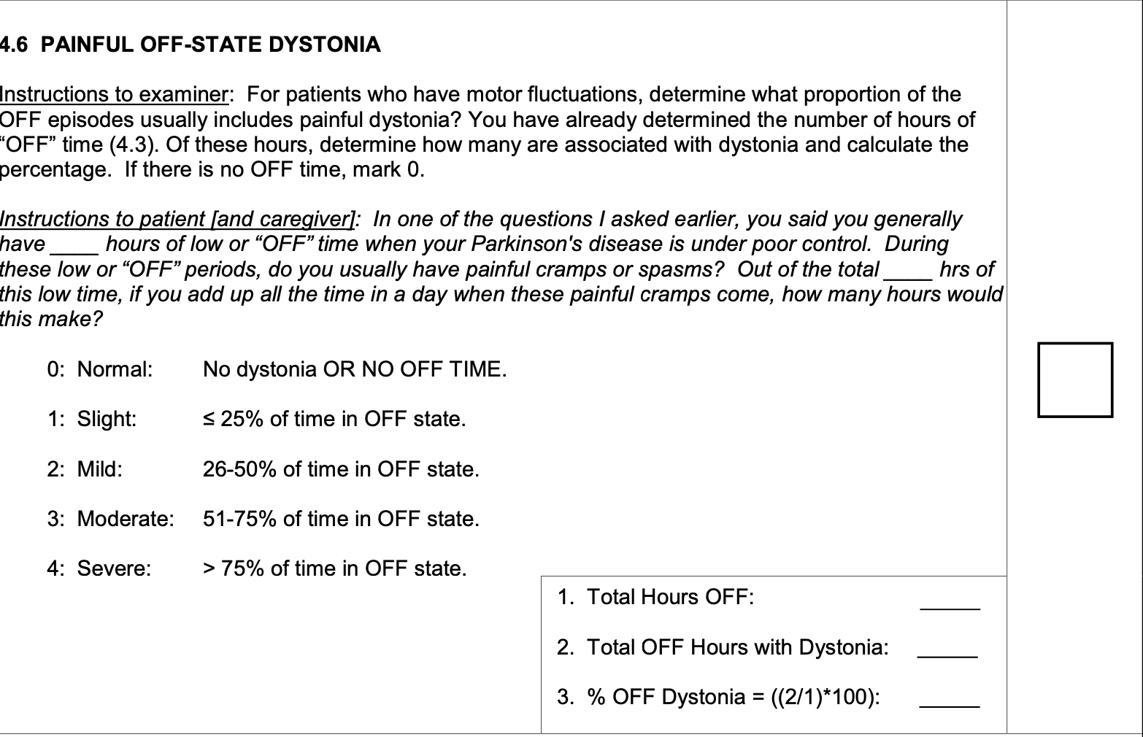
Updr_4: Motor Complications
Part 4 is based on historical and objective data from dyskinesias and motor functions which incorporates the OFF-state of dystonia. By asking the patient questions based on their response to time spent with dyskinesias, functional impact of dyskinesias, time spent in the off state, functional impact of fluctuations, complexity of motor fluctuations, painful off-state dystonia
Dyskinesias is when a patient has involuntary random moments. Such as jerking, wiggling, and twitching
motor function is the variable response to the medication

Slide 11
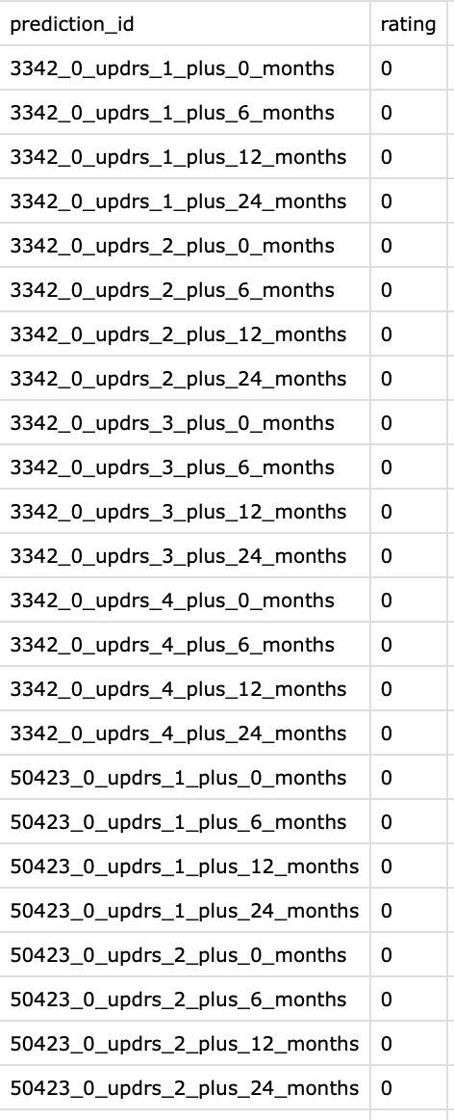
Sample Submission
Prediction_id contains (visit_id, updrs_#, visit_month)
Visit_month uses data from months of (0, 6, 12, 24)
Rating is the UPDRS prediction

Slide 12
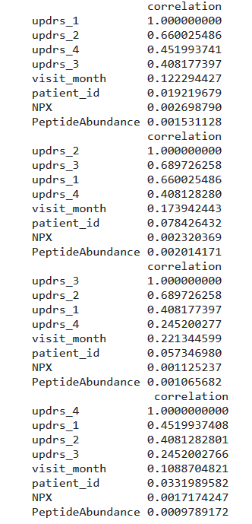
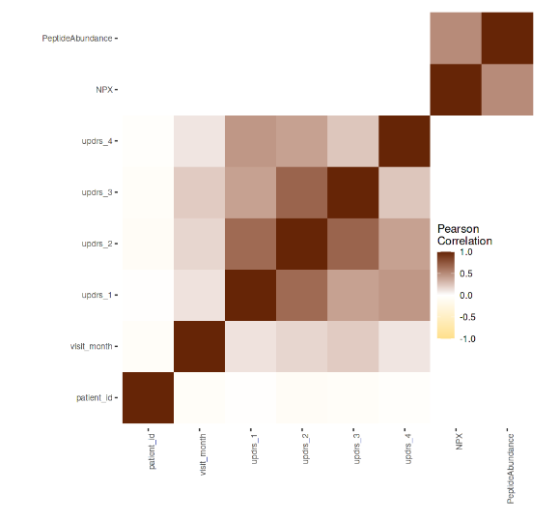
Correlations
The variable updrs_1 correlates the most with updrs_2
updrs_2 correlates the most with updrs_3
updrs_3 correlates the most with updrs_2
updrs_4 correlates the most with updrs_1

Slide 13
Data Pre-Processing
Joined all the 4 datasets using primary keys “patient_id, visit_month, UniProt”
Remove all missing values in the merged datasets.
Converted all the categorical values into their columns using dummy variables.
The dataset resulted with around 1200 columns.

Slide 14
Modelling Technique and Evaluation
Linear Regression.
Model evaluation using SMAPE.
Lasso Regression

Slide 15
Important features
Using lasso regression we found that visit_month, upd23b_clinical_state_on_medication_on, and upd23b_clinical_state_on_medication_off.

Slide 16
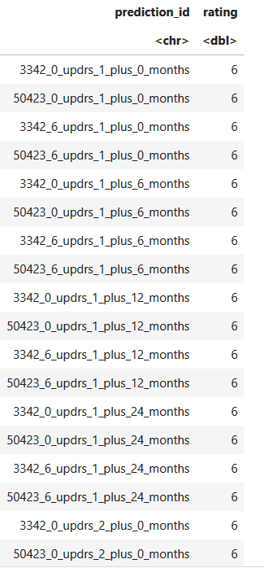
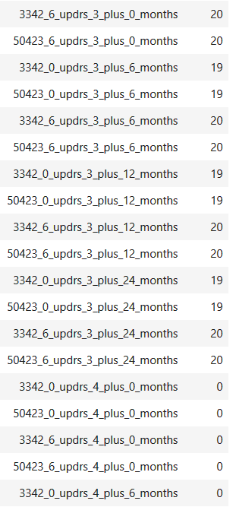
Result

Slide 17
Conclusion
We obtained the resulted table. However, due to some blackened error, we couldn’t submit our notebook to the competition. As a result, we don’t have our SMAPE score.
Different machine models.
Time Series analyst

Slide 18
Reference
https://www.movementdisorders.org/MDS-Files1/PDFs/Rating-Scales/MDS-UPDRS_English_FINAL.pdf
https://www.kaggle.com/code/gunesevitan/amp-pdpp-eda/notebook#7.-Progression
https://www.kaggle.com/code/renataghisloti/simple-linearregression-updated-56-6-smape/notebook

