Slide 1
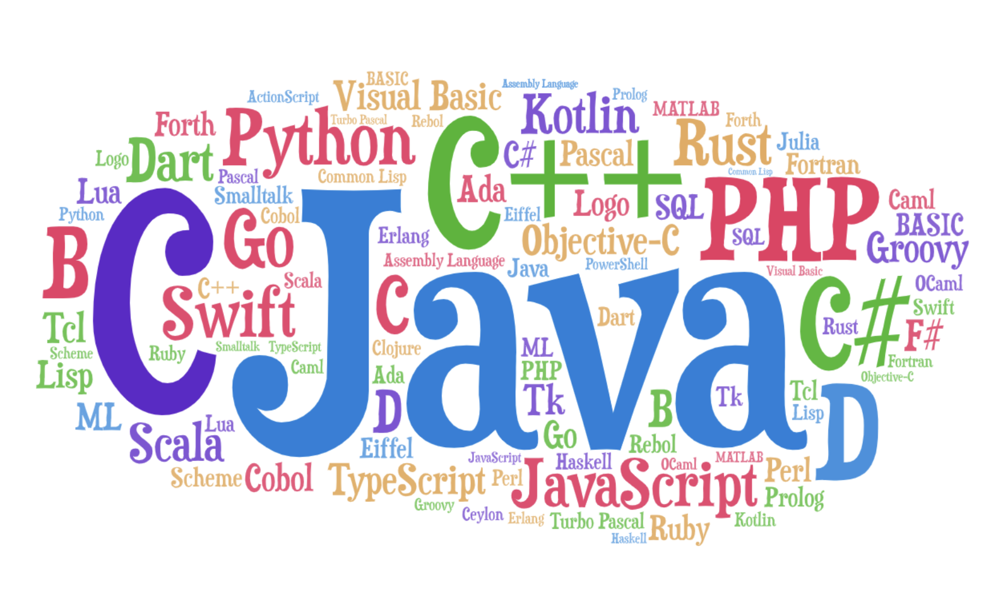

University Database
Presented By: Syed Altamash Masroor & Ali Salman

Slide 2

Content
Project Introduction
Problem Statement
Provided Solution
7 Steps For Entity Relation Diagram
SQL Database Diagram
QNA

Slide 3
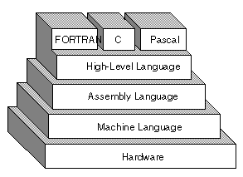
Project Introduction
This project is a model of University Database.
Our aim of this database system is to provide ease to the user and handle the data in an effective way.
In this project we create normalized tables and relationship among them.

Slide 4

Problem Statement
A database for university, in which there are teaching and non teaching staff and one can distinguish between them, also these staff should be working in the departments and should have designation. In this database their must be students who is registered in some department, done some sort of internship and these students also made some projects and worked on some technology. These students can also have sessions (Spring & Fall) and can be able to enroll in courses .

Slide 5

Solution
This database solve all the mentioned statements in the previous problem statement with this database user can easily identify any teaching and non teaching faculty, user can easily check which employees is working in which department and likewise students can also be identified according to their respective departments as well as student can be categorized according to their projects and their internship. User can also identify that which technology is used by which students and for which project.

Slide 6
7 Step For Entity Relation Diagram
Step 1: Gather Data
Collection of data in University Management system
Step 2: Identify Entities
Designation
EmployessProfile
EmpType
Department
Students
Projects
Session
CourseProfile
Technology
Internship

Slide 7
Step 3: Identify the Attributes
Designation: (DesignationId,DesignationLabel)
EmployessProfile:(EmpId,EmpTypeId,DepId,Fname,LName,Email,ContactNumber,Age,DateOfBirth,DateOfJoining,DesignationId)
EmpType: (EmpTypeId,EmpType)
Departments: (DepId,DepName)
Students:(StuId,DepId,FName,LName,Email,Age,DateOfBirth,Semester,DateOfAdmission)
Projects: (ProjectId,ProjectName,StyId,TechId,SessionId,InstructorId,SupervisorId,CourseId)
Session: (SessionId,SessionName)
CourseProfile: (CourseId,CourseName)
Technology: (TechId,TechName)
Internship: (InternId,StuId,OrganizationName,DurationWeeks,InternDesignation)
Step 4: Sort Entity Set
Designation (Strong)
EmployessProfile (Strong)
EmpType (Strong)
Department (Strong)
Students (Strong)
Projects (Strong)
Session (Strong)
CourseProfile (Strong)
Technology (Strong)
Internship (Strong)

Slide 8
Step 5: Identify the Attributes
Designation: (DesignationId-PK,DesignationLabel)
EmployessProfile: (EmpdD-PK,EmpTypeId,DepId,FName-Composite,LNameComposite,Email,ContactNumber-MultiValued,Age-Derived,DateofBirth,DateofJoining,Designationid)
EmpType: (EmpTypeId-PK,EmpType)
Departments: (DepId-PK,DepName)
Students: (StuId-PK,DepId,FName-Composite,LName-Composite,Email,Age-Derived,DateOfBirth,Semester,DateOfADmission)
Projects: (ProjectId-PK,ProjectName,StuId,TechId,SessionId,IntructorId,SupervisorId,CourseId)
Session: (SessionId-PK,SessionName)
CourseProfile: (CourseId-PK,CourseName)
Technology: (TechId-PK,TechName)
Internship: (InternId-PK,StuId,OrganizationName,DurationWeeks,INternDesignation)
Step 6: Identify the Relation
EmployeeProfile Has a EmpType
EmployeeProfile Has a Designation
EmployeeProfile Works In Department
Department Has Students
Students Has Internships
Student Made Project
Project Has Session
Project Has a Technology
Project Has a CourseProfile
Step 7: ERD

Slide 9
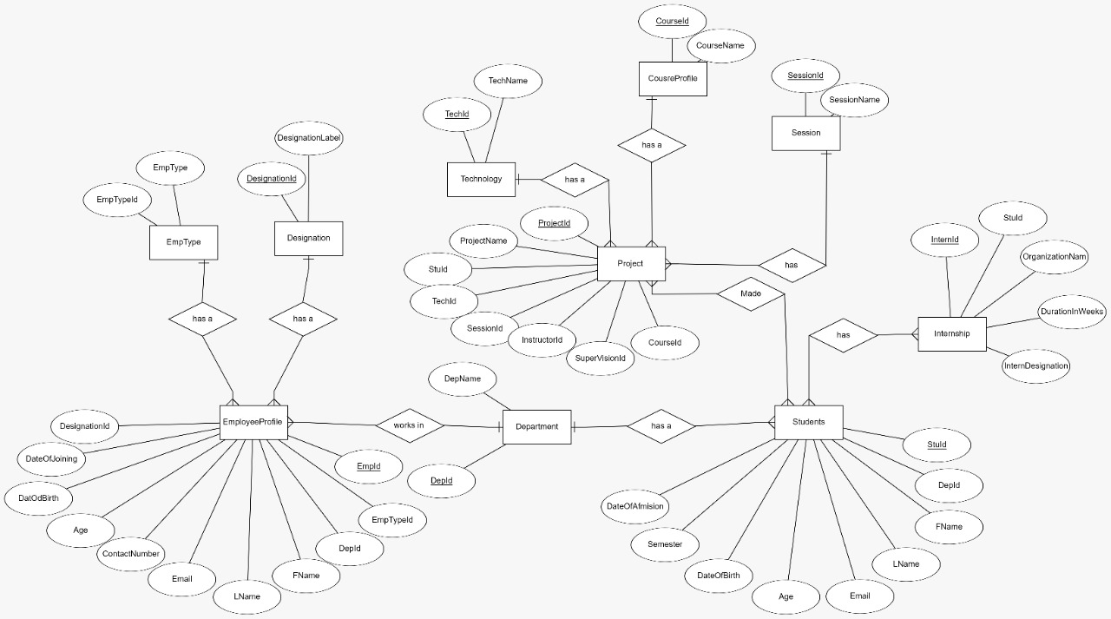
Entity-Relation Diagram

Slide 10
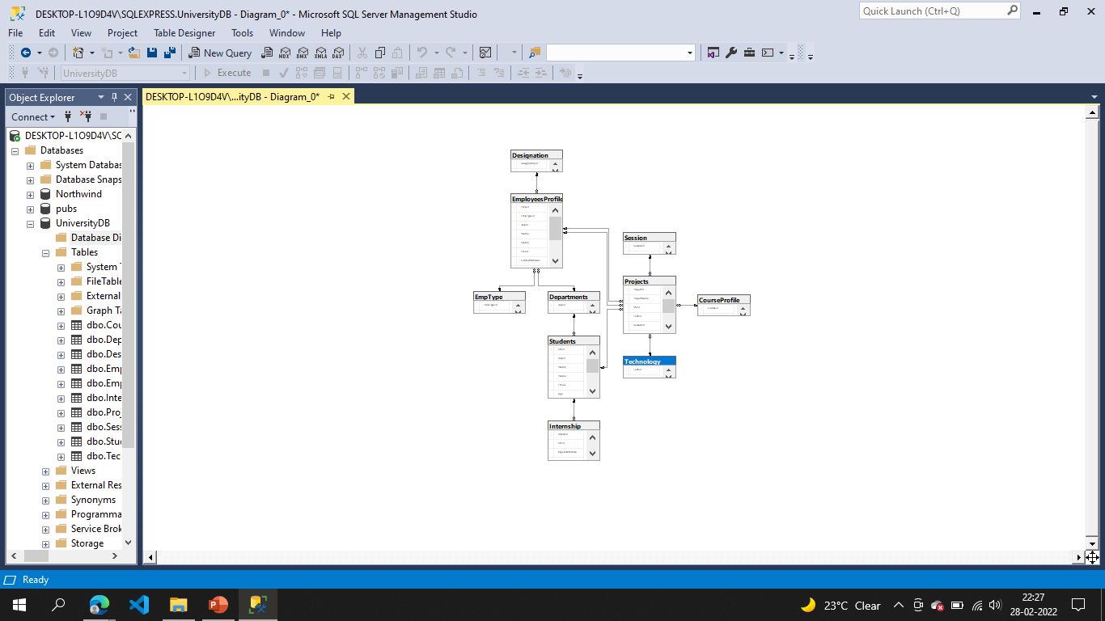
SQL Database Diagram

Slide 11
Question/Answers

Slide 12
Thank You!

