Slide 1

Solubility data sourcing from Pubchem database
Mushtaq Ali
Prof. Dr. Stefan Bräse & Dr Nicole Jung
Institute of Biological and Chemical Systems (IBCS)

Slide 2

What is Pubchem
PubChem is open Chemistry database from National Institutes of Health, since 2004.
It has information on Chemical structure, Chemical and physical properties the compound ,biological activities, patents, health, safety , toxicity data and many others
PubChem data are contributed by many data sources like government agencies ,chemical vendor, journal publishers and more
112 Million , Unique Compound chemical structure extracted from PubChem substance records.

Slide 3
Steps for data sourcing
Find the compound smiles along with compound id
Write the code which can source data of a compound
3 .Get the Experimented solubility of the compound
4. Clean the data
5 Save the data

Slide 4
COMPOUND SMILES AND COMPOUND ID
Compounds records are accessed by CID number
2 . https://pubchem.ncbi.nlm.nih.gov/rest/pug_view/data/compound/2244/xml
CID for Aspirin
3. Link to get the smiles along with CID
https://chemistry.stackexchange.com/questions/122109/how-to-get-the-smiles-of-all-compounds-on-pubchem
ftp://ftp.ncbi.nlm.nih.gov/pubchem/Compound/Extras/CID-SMILES.gz
Number of compounds with above link is 111,40,3065 along with Compound identification number and smiles

Slide 5
Method for sourcing the data
There are two methods to obtaining the data from PubChem programmatically: PUG-REST and PUG-View . PUG-REST provides data which computed by PubChem like Molecular weight, Heavy atom count etc https://pubchem.ncbi.nlm.nih.gov/rest/pug//compound/name/aspirin/property/MolecularWeight
Complete list of the computed properties
https://pubchemdocs.ncbi.nlm.nih.gov/pug-rest#_Toc494865567
PUG-VIEW provides data which is collected from other sources , experimental data of the compound like melting point , Solubility etc CID for Aspirin https://pubchem.ncbi.nlm.nih.gov/rest/pug_view/data/compound/2244?heading= Solubility
Complete list of the computed properties
https://pubchemdocs.ncbi.nlm.nih.gov/pug-rest#_Toc494865567

Slide 6
PROGRAM FOR SOURCING THE DATA
Import and install the required library
From the smiles get the CID
Code to get the data from PubChem
def cid_sol(id)
x=https://pubchem.ncbi.nlm.nih.gov/rest/pug_view/data/compound/%s/xml
data=requests.get(x % id)
html = BeautifulSoup(data.content, "xml")
solubility = html.find(name='TOCHeading’ , string='Solubility’)
if solubility == None:
return None
else:
solub=solubility.find_next_sibling('Information').find(name='String').string
return solub
4.Getting the solubility raw data like
“ less than 1 mg/mL at 73° F (NTP, 1992) “

Slide 7
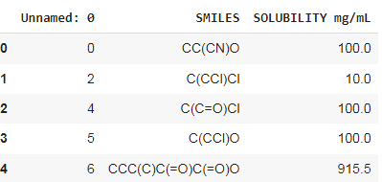
CLEAN AND SAVE THE DATA
Once we have source the raw solubility data
Clean the data with Regular expression which takes the text data as input and can provide the numerical value of the text Raw data : “ less than 1 mg/ml at 73° F (NTP, 1992)
Clean data will have just a Number which is 1 .
Final solubility of the given smile would be 1 mg/m
This solubility data along with smiles saved in the disk for future
Above snippets show the clean data
smiles along with solubility in mg/mL

Slide 8
Update on PubChem source data
Total smiles present over PubChem- 111.4 million
Source Phase | Total smiles procesed | Raw solubility source | Final clean solubilty
1 | 0-10000k (10 million) | 62169 | 20769
2 | 10000k-2000k(10 million) | 6753 | 6081
3 | 20000k-30000k(10 million) | Going on….
4
Till date sourced approx. 20% data from PubChem ( around 25 million)

Slide 9
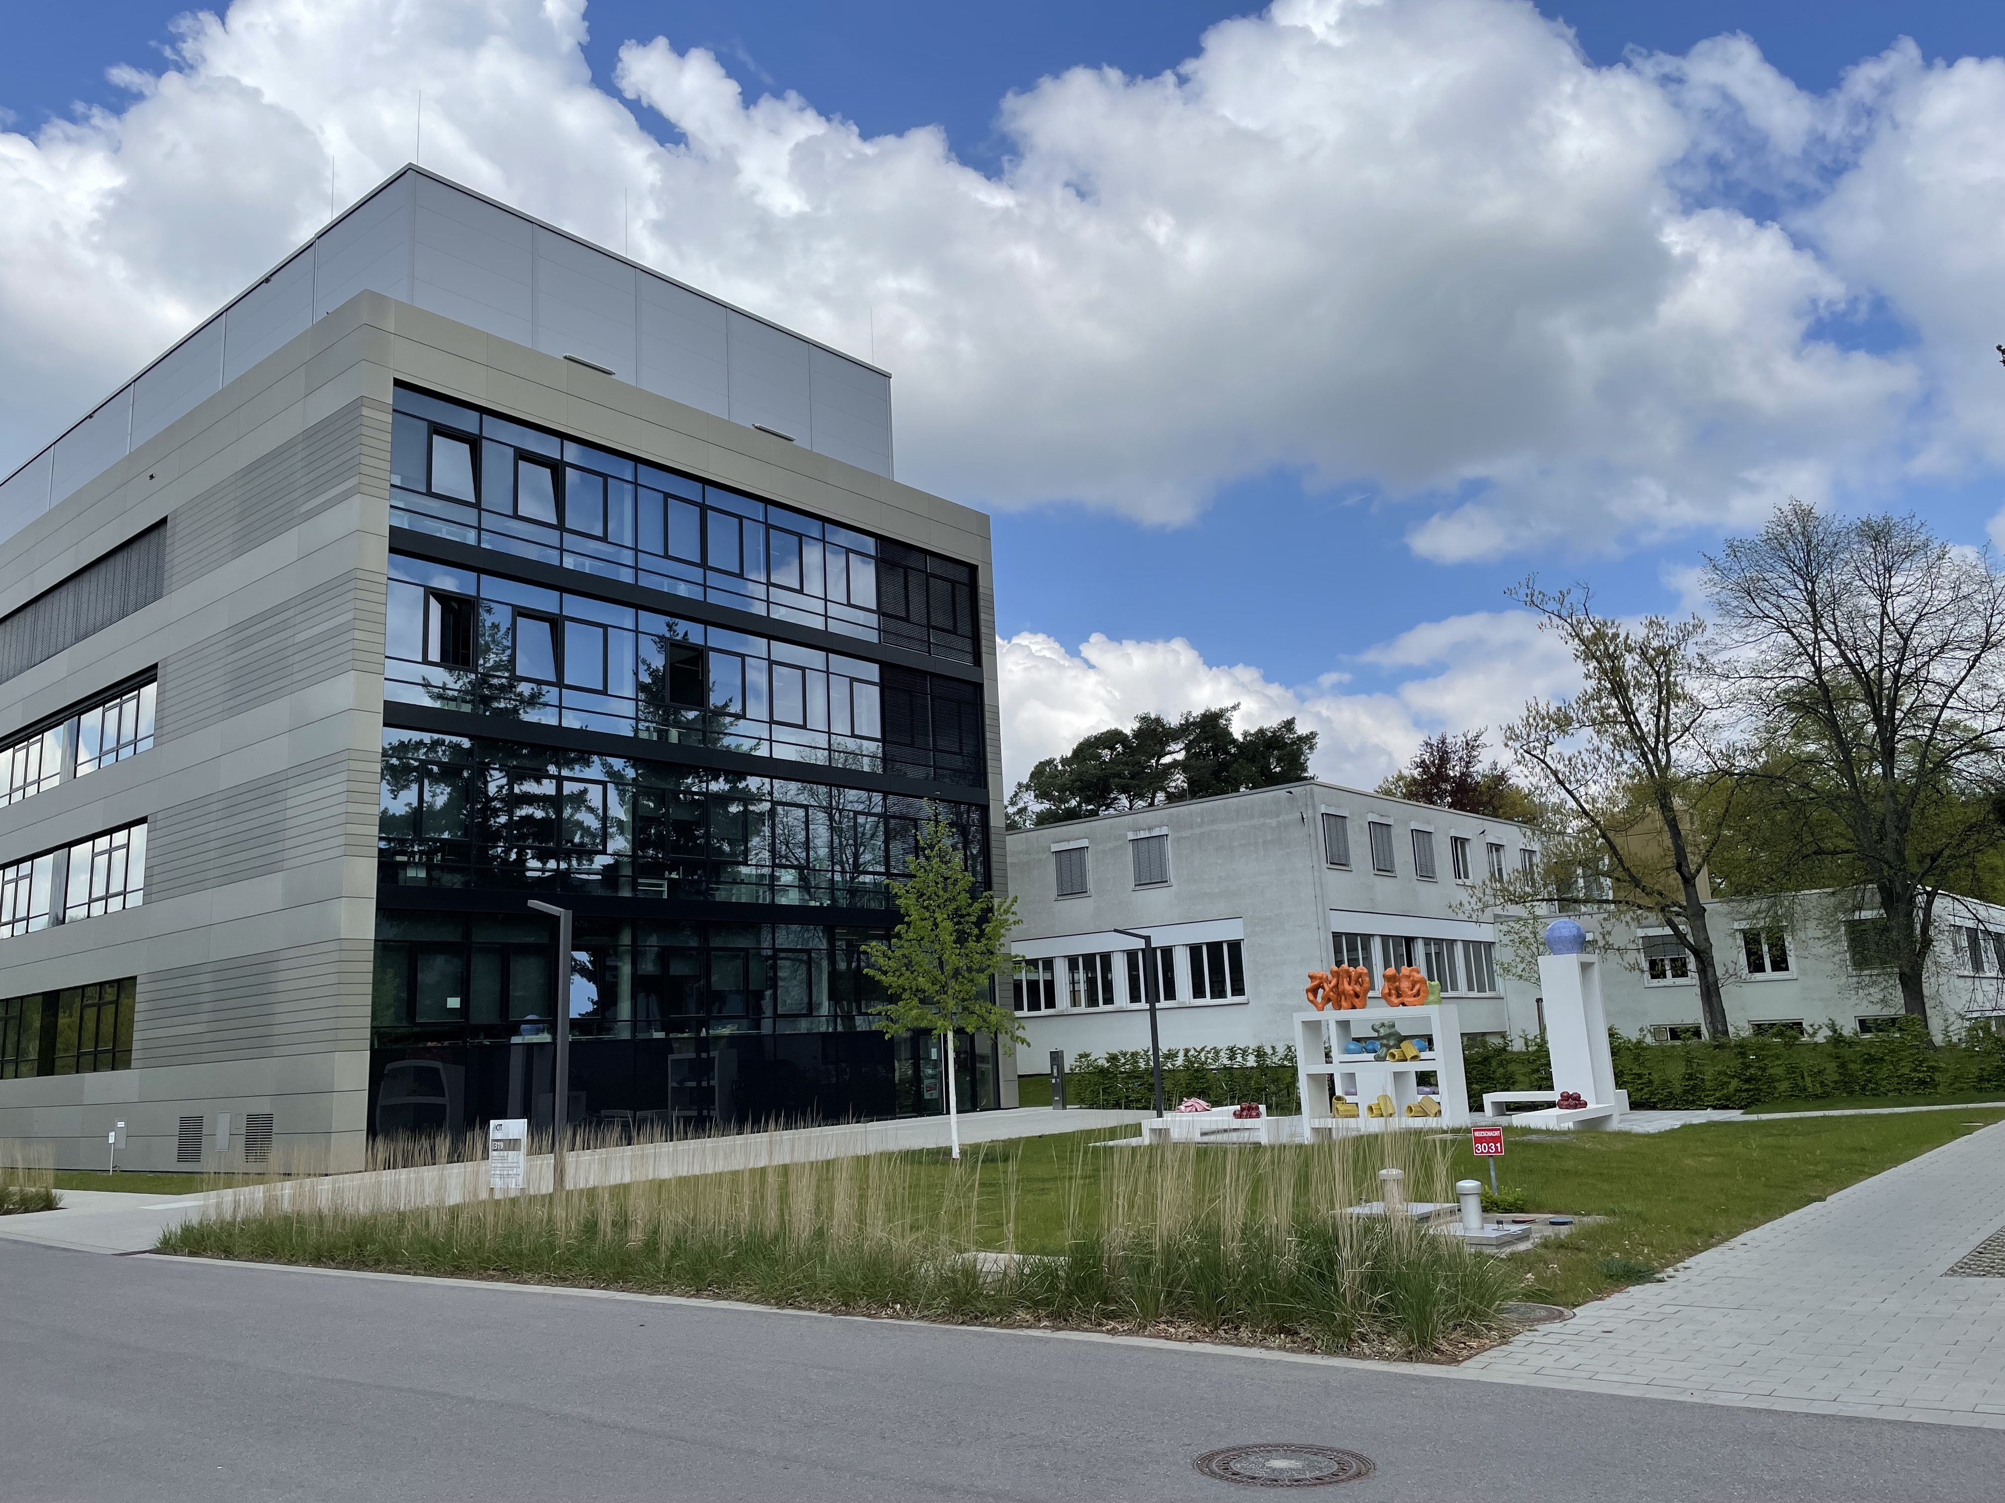
IBCS – FMS

