Slide 1
Extra-Evaluation: Securing Privacy in MQTT-based Systems
Andy Li

Slide 2
Problem Introduction
Scenario: In a disaster response operation, victims rely on drones to transmit distress messages to a C2 system via MQTT.
Issue: MQTT messages may contain sensitive information like location data and victim severity level – if intercepted, misuse of this data could lead to tracking, profiling, or privacy violations.
Goal: As such, we want to implement a secure MQTT system that can protect vulnerable messages using privacy-enhancing technologies.

Slide 3
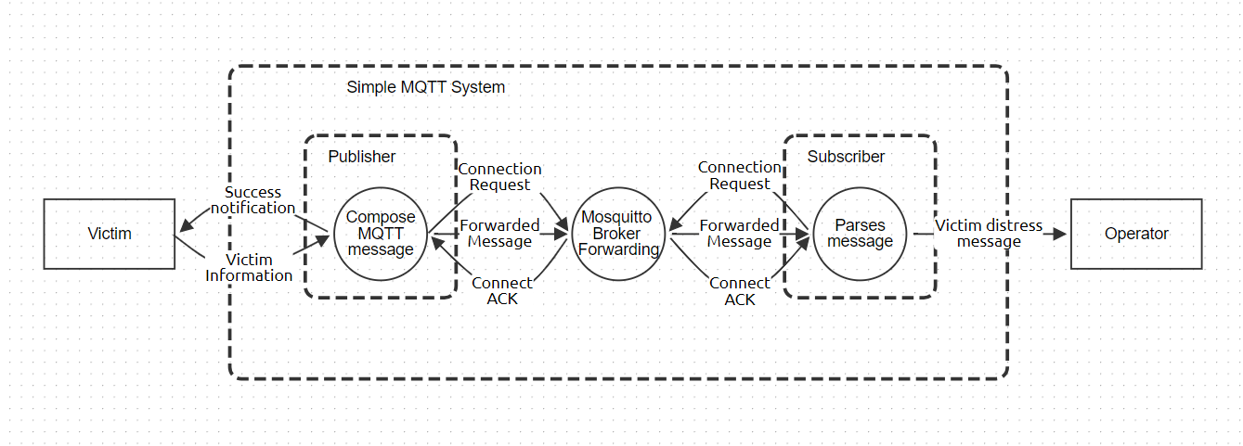
Threat Model – DFD to Describe System

Slide 4
LINDDUN Threat Model: Elicit Threats and Manage Mitigations
LINDDUN Privacy Threats | MQTT Scenario Example | Mitigations
Linkability | If the same victim appears using the same topic or ID each time, an observer could link the messages to one person | Use pseudonymous IDs and hashed topic names
Identifiability | Sensitive victim information in payload could identify a person even if their name isn’t present | Tokenize the sensitive information (location data) and encrypt payload before publishing
Non-repudiation | Victims cannot deny sending a specific distress message due to MQTT broker log | Anonymize broker log information
Detectability | Based on the existence of the MQTT message, a malicious actor can infer information about the person in distress | Used padding in payload to prevent deduction of message type based on payload size inspection and add delays to make it harder to infer.
Disclosure of Information | Without TLS, MQTT messages are readable in transit | Encryption on the payload and TLS can prevent disclosure in transit
Unawareness | Victims are unaware of how metadata and message retention are handled | Inform users via privacy notices and provide transparency on how data is processed.
Non-compliance | The system transmits personal data without encryption and collects/processes data without obtaining informed consent from the user. | Ensure user consent is provided and use data minimization to avoid unnecessary metadata.

Slide 5
Scenario/Experiment Description
The system consists of:
Victim: sends distress messages with victim ID, location, severity
MQTT broker: forwards messages
CMC Operator: receives and analyzes messages
Topic names like “victim/distress” are easily guessable, allowing any MQTT client to subscribe if they know the topic, and messages are sent in plaintext containing raw data in the base system.
To solve this, I will implement pseudonymization, tokenization, and payload encryption PETs, with SHA-256 hashes and Fernet symmetric encryption in this experiment.
Both the base system and the one enhanced with PETs will be compared based on the system behavior and metrics.

Slide 6
MQTT System without PETs

Slide 7
Privacy-Enhancing Technologies
Pseudonymization/Tokenization: replace user IDs and topic names with hashes, and locations with tokens.
Reduces Linkability: utilizing hashed identifiers makes it significantly harder to link different messages to the same victim over time.
Reduces Identifiability: replacing data that could be used to identify a person with tokens/hashes makes it harder to associate messages with specific victims.
Encrypted payloads: More secure transmission of messages
Ensures Confidentiality and Integrity: only authorized subscribers with the shared secret key can decrypt the message, preventing attackers from accessing sensitive data in plaintext or tampering with it.
Prevents Disclosure of Information: intercepted messages cannot be decrypted without the key, protecting the MQTT message information.

Slide 8
MQTT System Implementing PETs

Slide 9
Analysis
Metrics | No PETs | With PETs
Payload Structure | Plaintext JSON containing the victim id, location, severity, and sent timestamp | Hashed victim ID, tokenized location, severity, and timestamp, with the JSON encrypted using Fernet
MQTT Overhead | 100 bytes | 248 bytes
Latency | ~0.0019 seconds | ~0.0067 seconds
Linkability Risk | High (topics and IDs follow common, static patterns) | Low (pseudonymized topic names and victim identifiers)
Identifiability Risk | High (victim data is exposed in plaintext JSON) | Low (pseudonymized topics/IDs and tokenized location data)
Disclosure of Information Risk | High (payload is easily readable in transit) | Low (encrypted payload protects against disclosure)

Slide 10
Analysis (Continued)
Effectiveness:
Pseudonymization/Tokenization strongly reduces identifiability and linkability risks by replacing real identifiers with hashes or tokens. It is difficult to directly tie data to individuals, even if intercepted.
Payload Encryption protects against disclosure of information risks, ensuring that they are unreadable even if attackers captures MQTT traffic (a common risk for MQTT systems without any encryption).
Overhead:
The CPU overhead for hashing and tokenization is minimal, but it adds additional logic complexity to the program, as location tokenization is required to be reversible so that operators can direct rescue operations.
Encryption involves higher CPU processing overhead, as the payload size increased significantly after the PET implementation (by almost 150%).
In addition, both have greater storage requirements to maintain the shared secret key (secret.key) and token mapping (token_mapping.json).
Trade-offs:
Supports privacy regulations (like GDPR) but requires additional management of tokens.
Ensures secure communication on insecure networks, but also requires secure channels to share/manage the secret key
Overall, reduced privacy risks (linking, identifying, disclosure of information) but increased message size and latency.

Slide 11
Final Remarks

