Slide 1
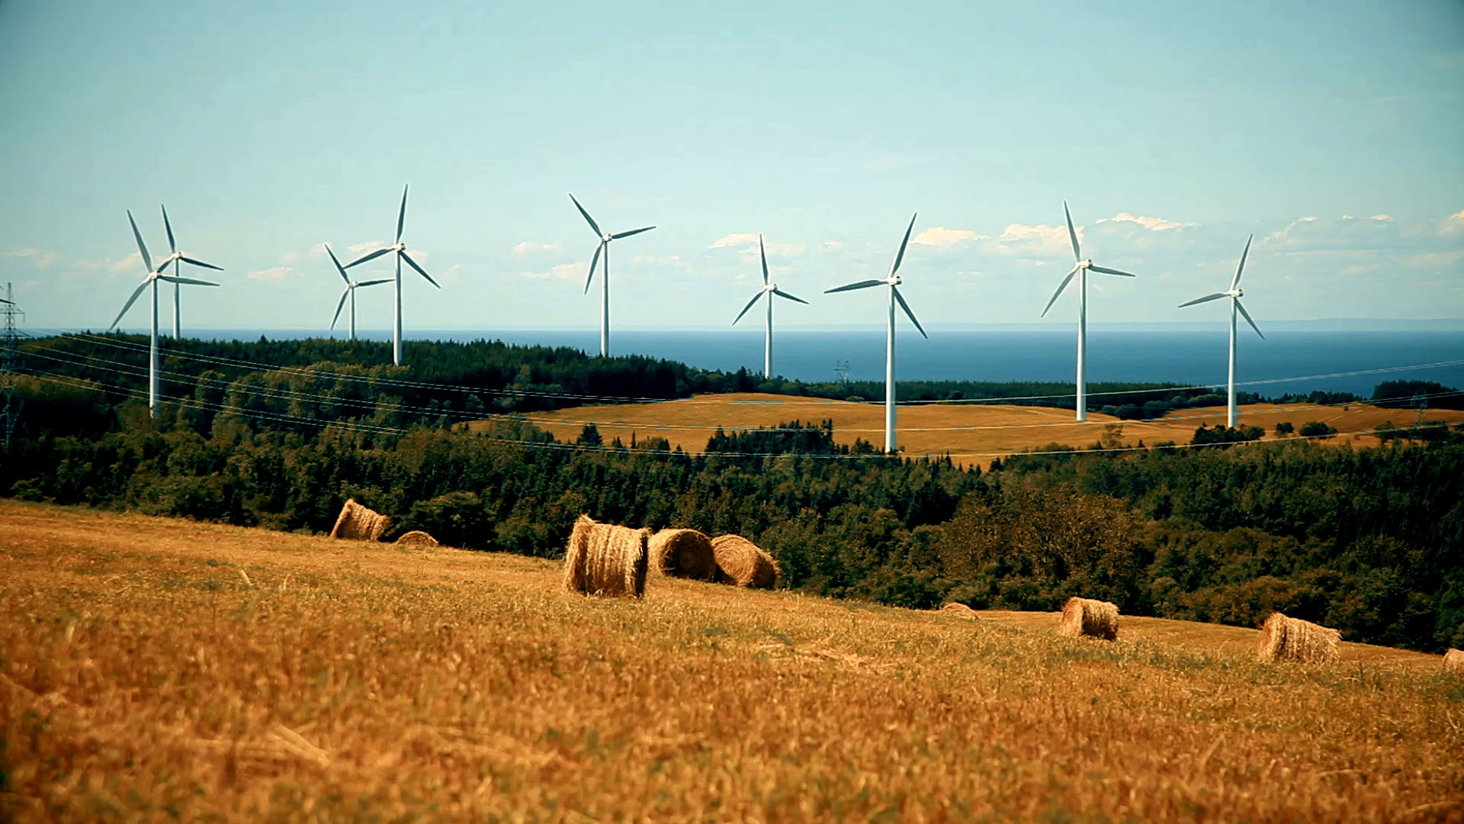
Wind turbines

Slide 2
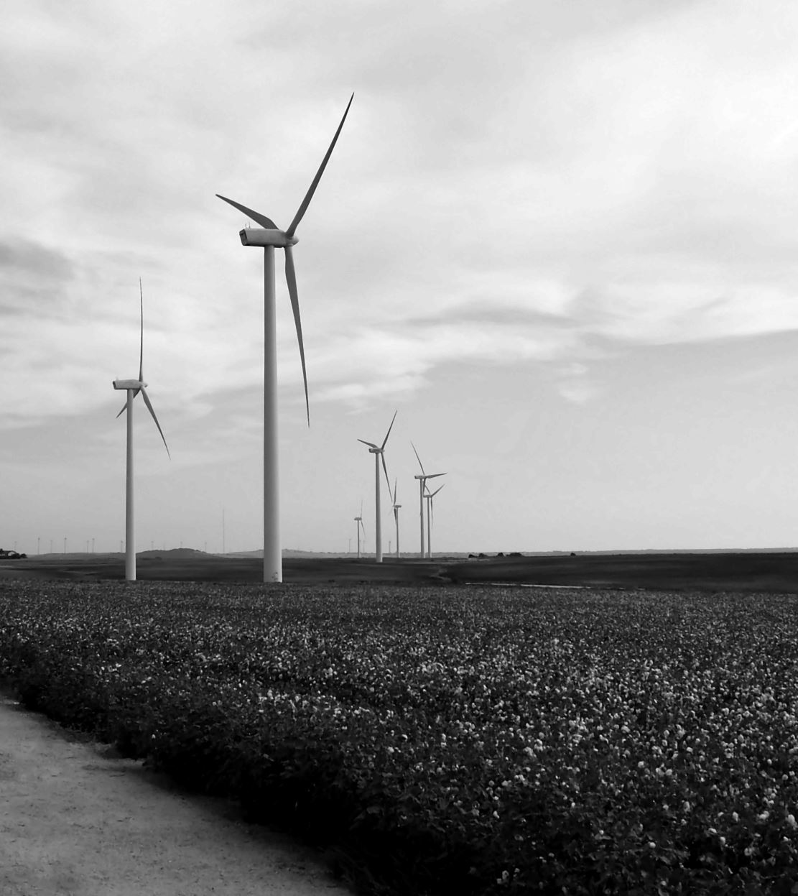
Problem statment
The costs of establishing wind farms have risen by 35% due to technological upgrades and the specific demands of site selection. Investors in this sector incur massive expenses; without a precise analysis of historical data, they risk selecting suboptimal sites or inefficient turbines, thereby reducing financial returns.

Slide 3
Objectives
Identify the keys that affect the decision
Identify the top counties in leading
analyze the growth of turbine capacity over the years
examine the physical evolution of hub height
compare the market share of GE Wind, Vestas, and other OEMs
Recommendations

Slide 4
Define keys
States
Year of production
Turbine heights
Turbine capacity
The manufacturers

Slide 5
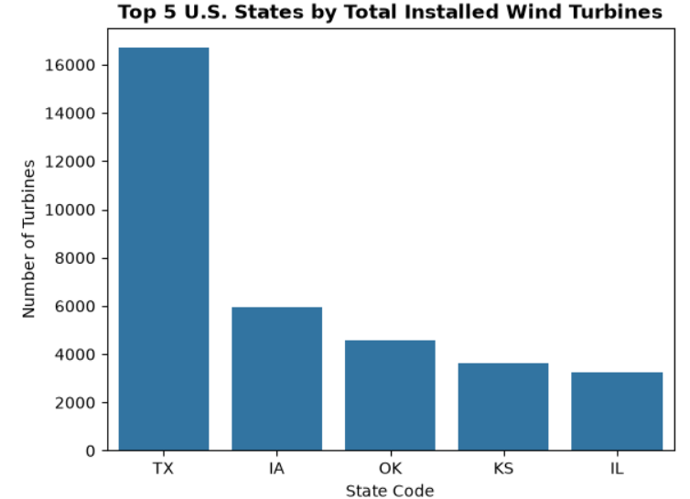

Slide 6
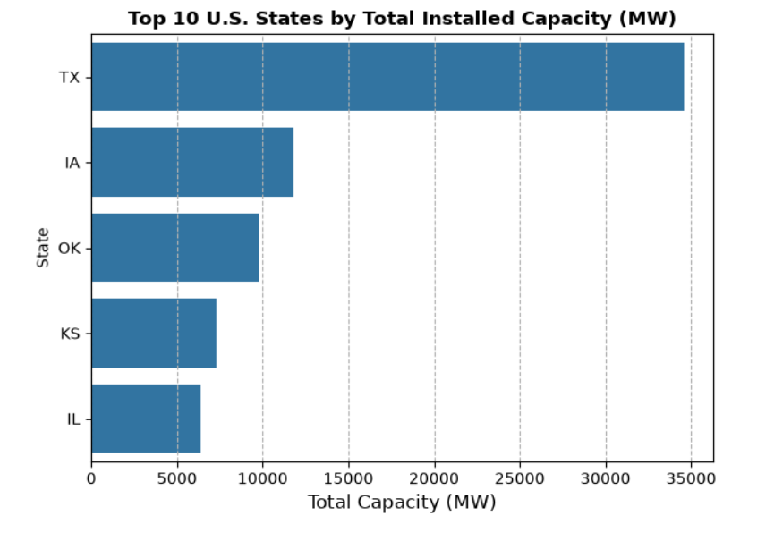

Slide 7
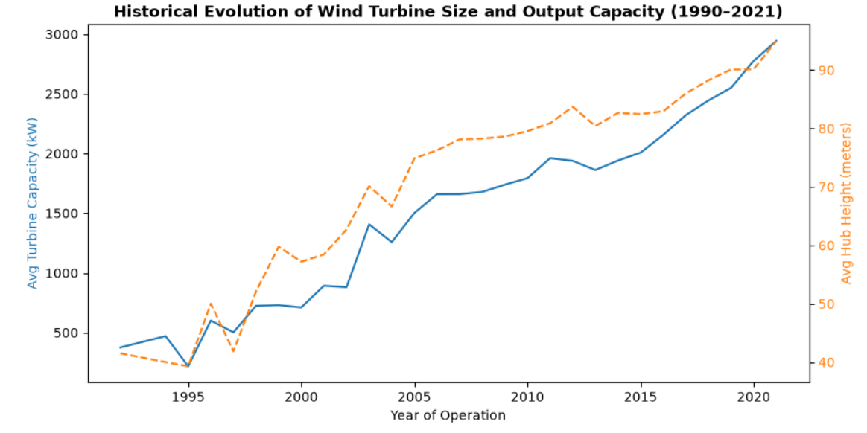

Slide 8
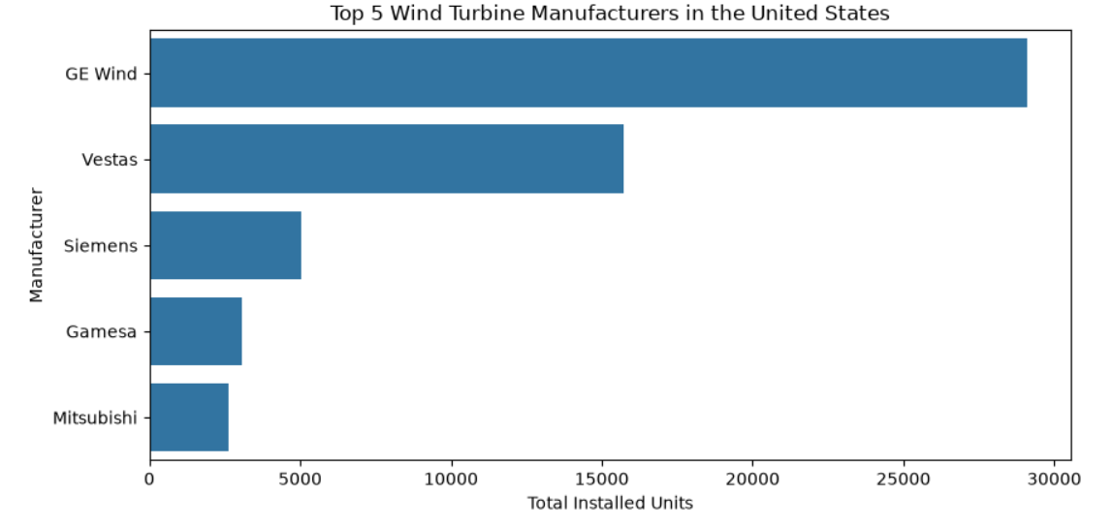

Slide 9
Recommendations
Optimize Site Selection: Focus capital allocation on high-density hubs like Texas and the Midwest to leverage existing transmission infrastructure and streamline grid connection timelines.
Standardize High-Capacity Technology: Deploy modern turbines with high capacities to maximize energy yield per square mile and offset rising capital expenditures through reduced operational footprints.
Mitigate OEM & Financing Risks: Partner with Tier-1 manufacturers (GE Wind and Vestas) to secure bankable project financing and ensure long-term availability of spare parts and maintenance services

Slide 10
Thank You

