Slide 1

Design:
Mitch Alexander
Suneil Rakhra
Art:
Kate Gostanska
Tom Watson
Vladislav Prokudin
Stanislav Valov
Programming:
Alisdair Muircroft
Sean Cameron
Andrew Lindsay
Audio:
Ross Dalziel
Michael Rennie

Slide 2
Specification & Requirements
Using Unity
Using agile development/SCRUM
Either to help students cope with:
  Transition to university
  Stress of university life
  Transition from university to the job market

Slide 3
Solution
Our game:
  Focuses on stresses of university life
  Target market is 17-25 year olds, especially those entering further education
  Raising awareness of balancing different activities in academic life – studying, socialising, working

Slide 4
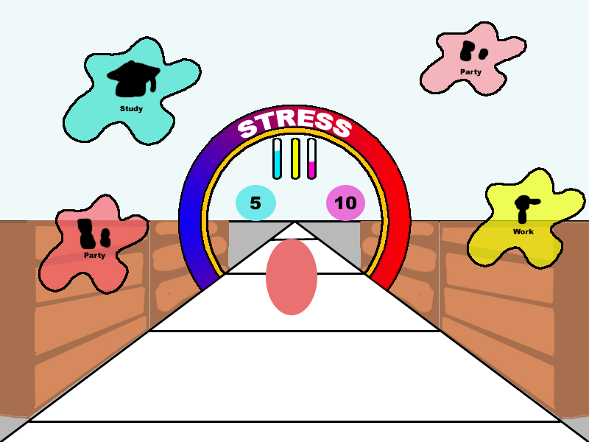
Mechanics
ACTIVITY METERS
Fill up/decrease
by clicking ACTION
If meter depletes – STRESS!
If player hits event and meter's too low – STRESS!
STRESS METER
Fills up when
activity meters
decrease /
hitting events
If Stress hits
maximum,
GAME OVER!
ACTION
Represents
activities in
academic life
STUDY, WORK,
PARTY
Rock/paper/
scissors – PARTY
increases Social Skills,
decreases Money
LEVEL
Player character
continually moving forward
EVENT COUNTDOWN
At 0, event appears
to test level in activity
meters
s

Slide 5
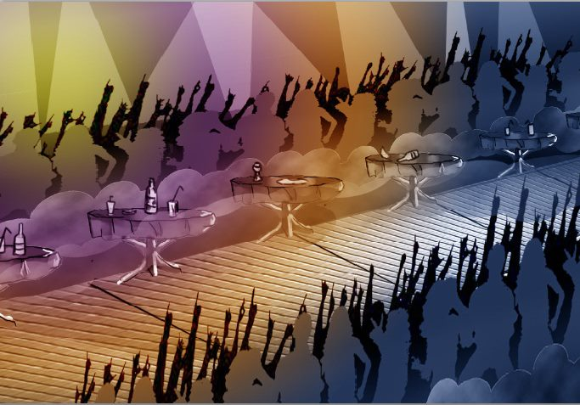
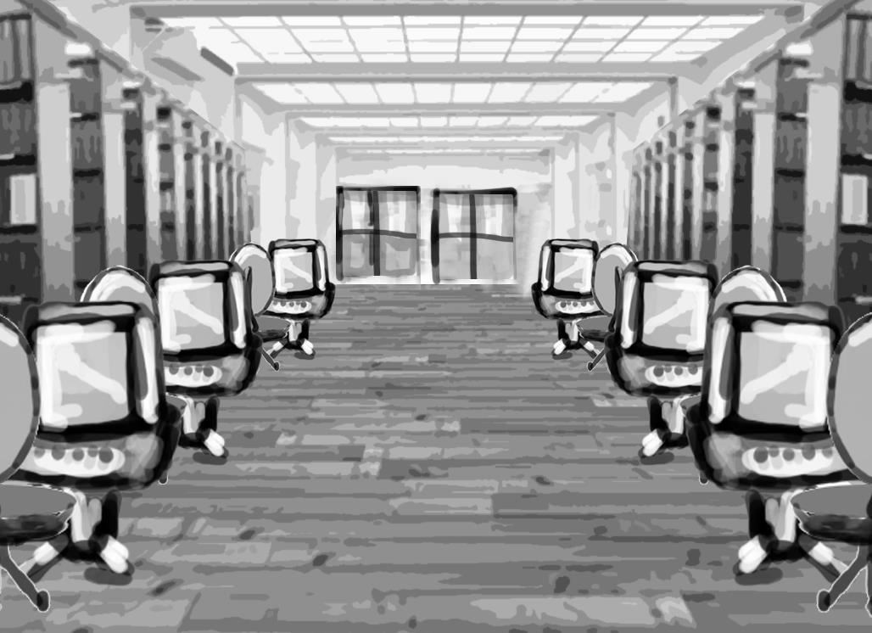
Environment Art
Simple, somewhat realistic
Environments include study rooms/exam halls, party/club, work/shop

Slide 6
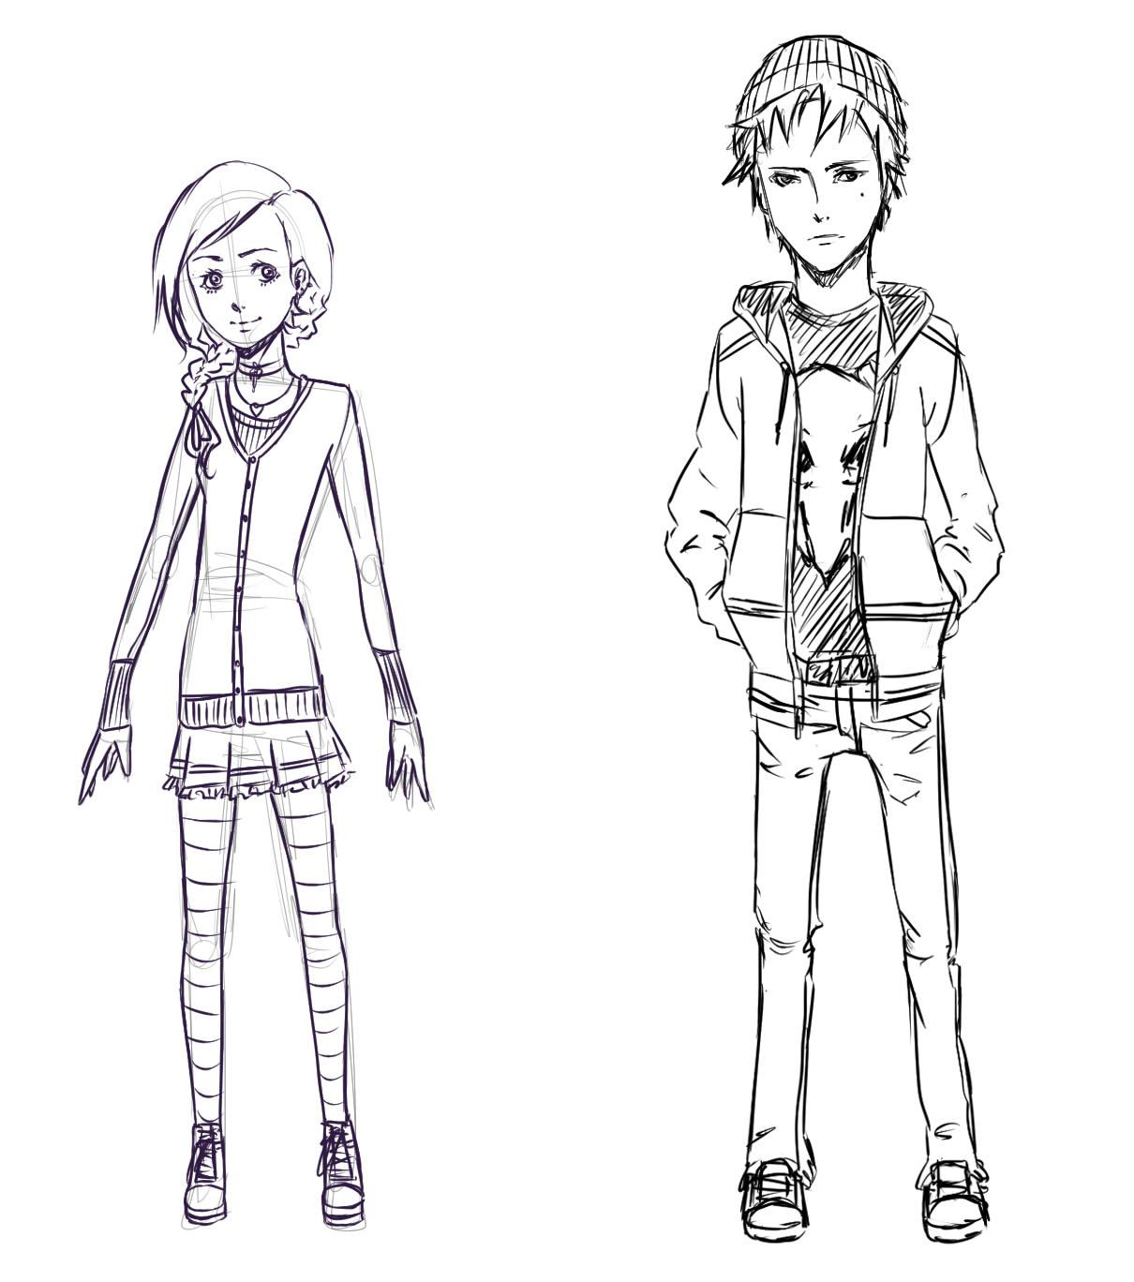
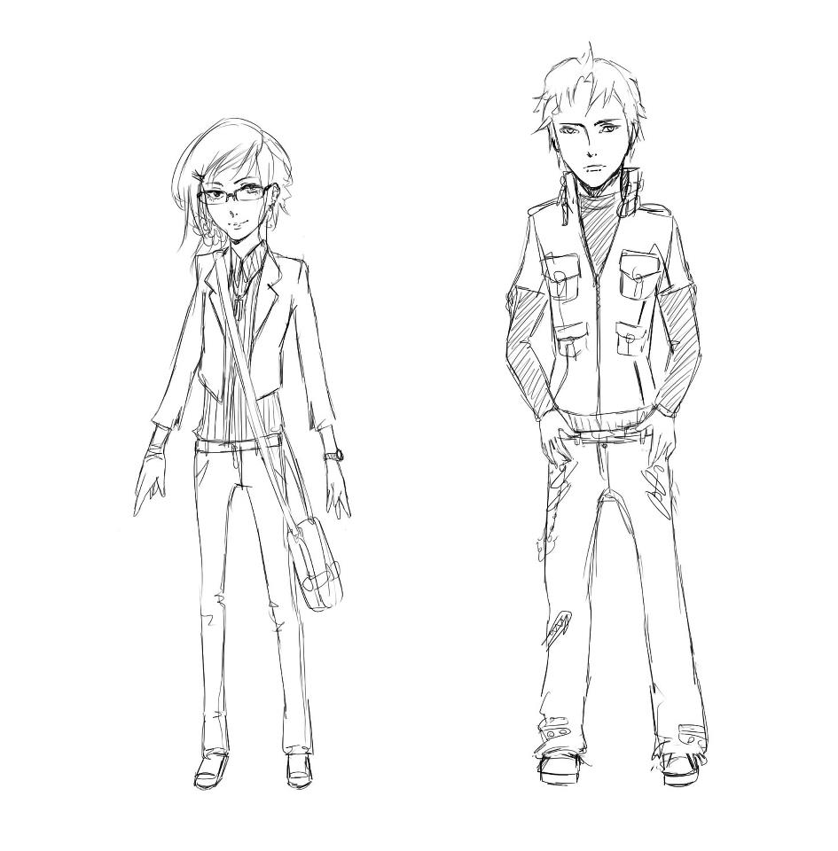
Character art
Female student as main character
  Possibly adding further characters later
Somewhat representative of target audience

Slide 7
Programming
So far the Windows prototype includes:
  Random Spawning
  Timed destruction
  Level System
  Moving Ground
  Collision for Level Changing
  Main Menu Skeleton
  Simple GUI

Slide 8
Social Media
Check out our progress on:
Facebook – ProjectShoogle
Twitter – ProjectShoogle
Wordpress – projectshoogle.wordpress.com
Tumblr – projectshoogle.tumblr.com
Thanks for listening!

