Slide 1
SOC Alert Monitoring & Log Correlation
Using Wazuh SIEM
MOHAMMED ALI
CYBERSECURITY & ETHICAL HACKING

Slide 2
Project Objective
Primary Objective
Monitor and analyze security alerts generated by Wazuh SIEM deployed on a local virtual machine environment.
Investigation Goals
Collect and classify authentication, SELinux audit, and system logs from a connected Linux agent.
Correlate events to trace a complete attack chain: failed logins → brute force → successful login session.
Map detected behaviors to MITRE ATT&CK framework and compliance standards (NIST, GDPR, PCI-DSS).
Scope
Environment: Wazuh Manager (192.168.0.111) + Agent (192.168.0.112) on local network — Apr 8–9, 2026.
Log types analyzed: PAM auth, syslog, journald, SELinux auditd, Windows Event (Admin agent 004).

Slide 3
SIEM Tool Used: Wazuh
Tool: Wazuh (Open-Source SIEM / XDR Platform)
Deployed on local VM; Manager IP: 192.168.0.111 | Agent IP: 192.168.0.112 (wazuh-server)
Category: Open-source SIEM/XDR | Used in enterprise SOCs as an alternative to Splunk and IBM QRadar
Why Wazuh Was Selected
Free and fully open-source — suitable for lab-based SOC simulation
Native support for log collection, rule-based alerting, MITRE ATT&CK mapping, and compliance (NIST, PCI-DSS, HIPAA, GDPR)
Built-in Threat Hunting, Vulnerability Detection, and File Integrity Monitoring modules visible in dashboard
Dashboard Modules Observed (from screenshots)
Endpoint Security: Configuration Assessment, Malware Detection, File Integrity Monitoring
Threat Intelligence: Threat Hunting, Vulnerability Detection, MITRE ATT&CK
Security Operations: IT Hygiene, PCI DSS, GDPR, HIPAA, NIST 800-53, TSC compliance modules
Cloud Security: Docker, AWS, Google Cloud, GitHub, Office 365, Microsoft Graph API integration

Slide 4
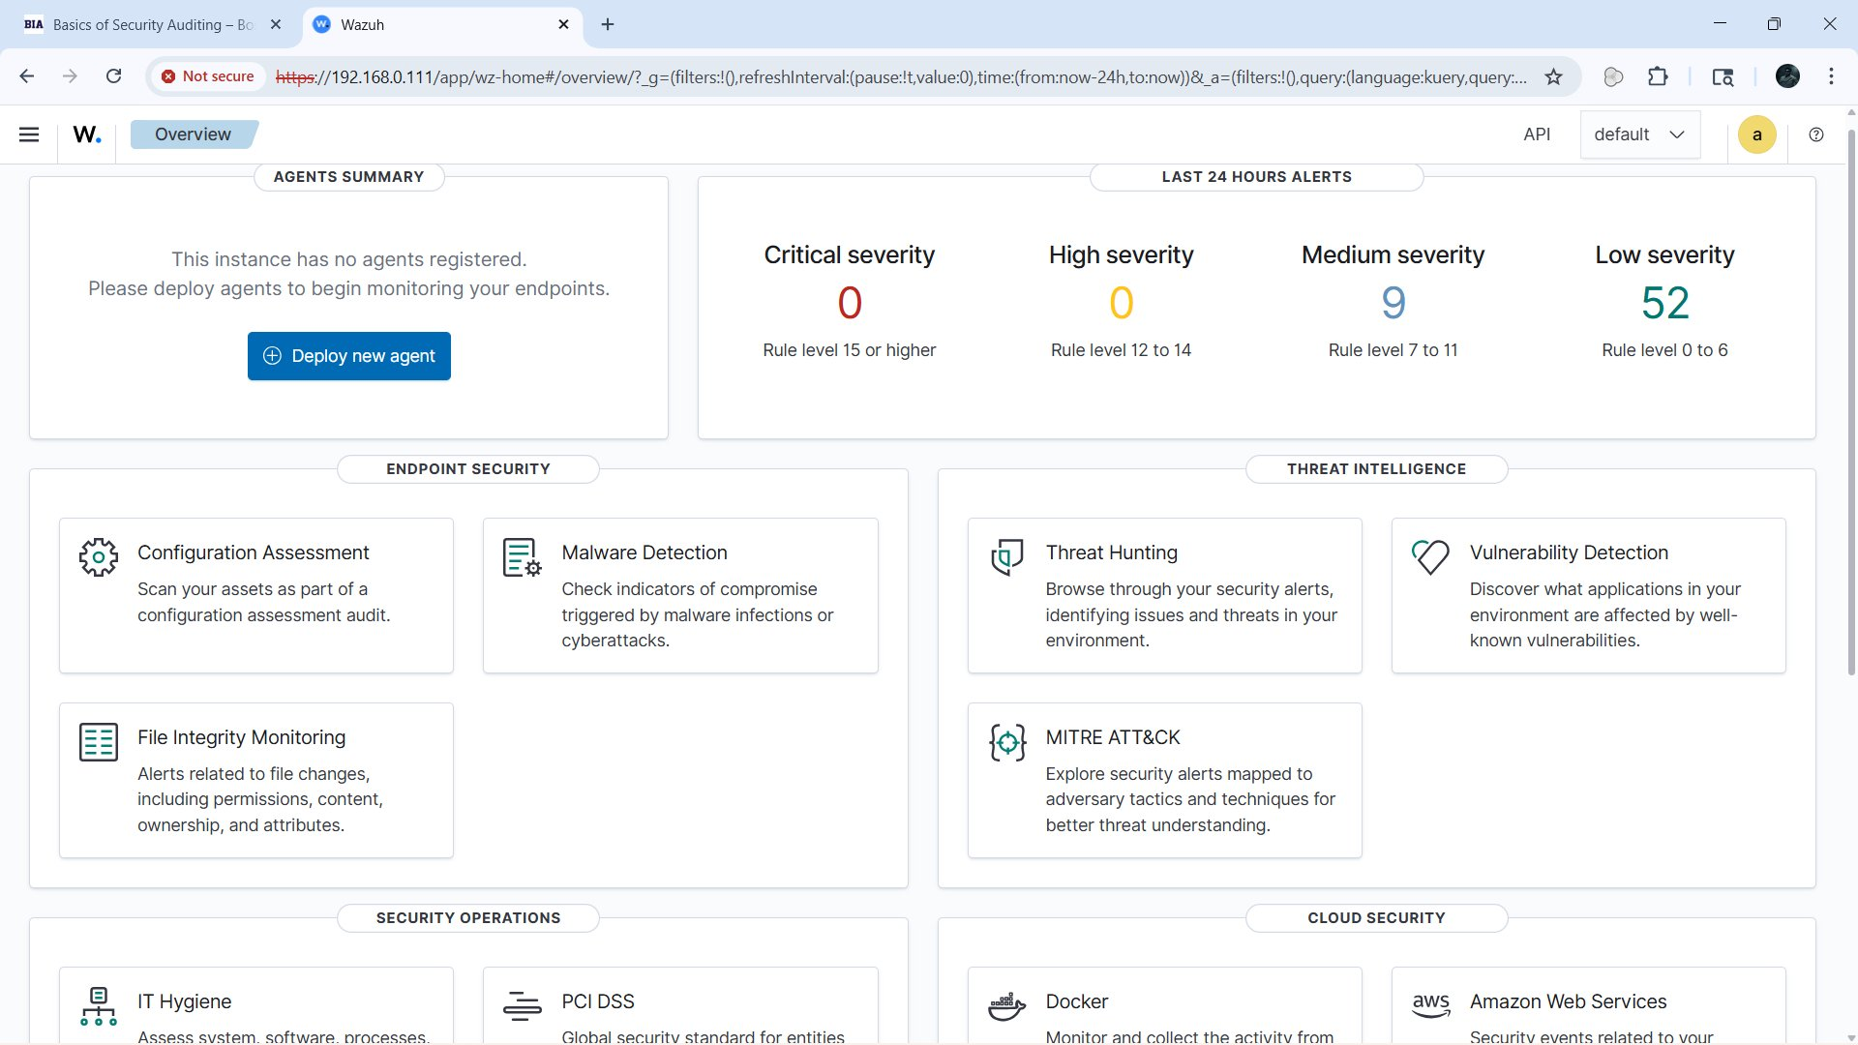
Wazuh Dashboard

Slide 5
Architecture & Lab Setup
Lab Environment (Evidence from Screenshots)
Wazuh Manager: 192.168.0.111 — hosts the SIEM dashboard, indexer, alerting engine and rule repository
Linux Agent: 192.168.0.112 | hostname: wazuh-server | agent name: wazuh-server | agent ID: 000
Windows Agent: 192.168.0.110 | agent name: Admin | agent ID: 004 — forwarding Windows Event logs (EventID 16384)
Agent Deployment Status (Before vs After)
Before: “This instance has no agents registered” — 9 Medium + 52 Low alerts (base noise only)
After: Active (1), Disconnected (0) — alert jump to 361 Medium + 188 Low (confirmed in dashboard screenshots)
Log Collection Pipeline
journald → Wazuh Agent (192.168.0.112) → Manager (192.168.0.111:1514) → OpenSearch Indexer → Dashboard
/var/log/audit/audit.log → auditd decoder → SELinux AVC rules triggered (Rule 80730)
Index: wazuh-alerts-4.x-2026.04.08 | 652 available fields | 35 events in 15-min Threat Hunting window

Slide 6
Log Sources & Data Collection
Authentication Logs (journald / PAM)
Source: journald | Decoder: pam | Agent: wazuh-server (000)
Events: PAM: Login session opened (Rule 5501), PAM: User login failed (Rule 5503), unix_chkpwd: Password check failed (Rule 5557)
Full log example: “wazuh-server login[5757]: pam_unix(login:session): session opened for user wazuh-user(uid=1000) by (uid=0)”
SELinux / Audit Logs (/var/log/audit/audit.log)
Decoder: auditd | Type: AVC | Rule 80730 (Level 3) — SELinux permission check
Full log: “type=AVC msg=audit: avc: denied {open/read/getattr} for pid=5757 comm=login path=/var/lib/update-motd/motd”
Syslog (access_control)
Rule 2501 (Level 5): “syslog: User authentication failure”
Full log: “FAILED LOGIN 1 FROM tty1 FOR wazuh-user, Authentication failure” — Apr 8, 2026 @ 18:23:36
Windows Event Logs (Admin Agent 004)
Agent IP: 192.168.0.110 | EventID 16384 | Source: Software Protection Platform Service — scheduled restart events

Slide 7
Alert Detection
24-Hour Alert Summary (Dashboard Evidence)
Critical (Rule level ≥15): 0 | High (Rule level 12–14): 0
Medium (Rule level 7–11): 361 alerts — Primary concern for investigation
Low (Rule level 0–6): 188 alerts — Background noise, SELinux AVC denials
Key Alerts Triggered (from Threat Hunting view)
Rule 2501 (Level 5): syslog: User authentication failure — Apr 8 @ 23:53:36 | firedtimes: 4
Rule 5503 (Level 5): PAM: User login failed — Apr 8 @ 23:53:34 | agent: wazuh-server
Rule 5557 (Level 5): unix_chkpwd: Password check failed — Apr 8 @ 23:53:34
Rule 80730 (Level 3): Auditd: SELinux permission check — Apr 8 @ 23:53:46 | firedtimes: 4–6
Rule 5501 (Level 3): PAM: Login session opened — Apr 8 @ 23:53:46 | firedtimes: 8 (escalating pattern)
Event Spike Observed
Threat Hunting timeline (23:39–23:54) shows 35 total hits; sharp event spike at 23:53–23:54 UTC (see screenshot)

Slide 8
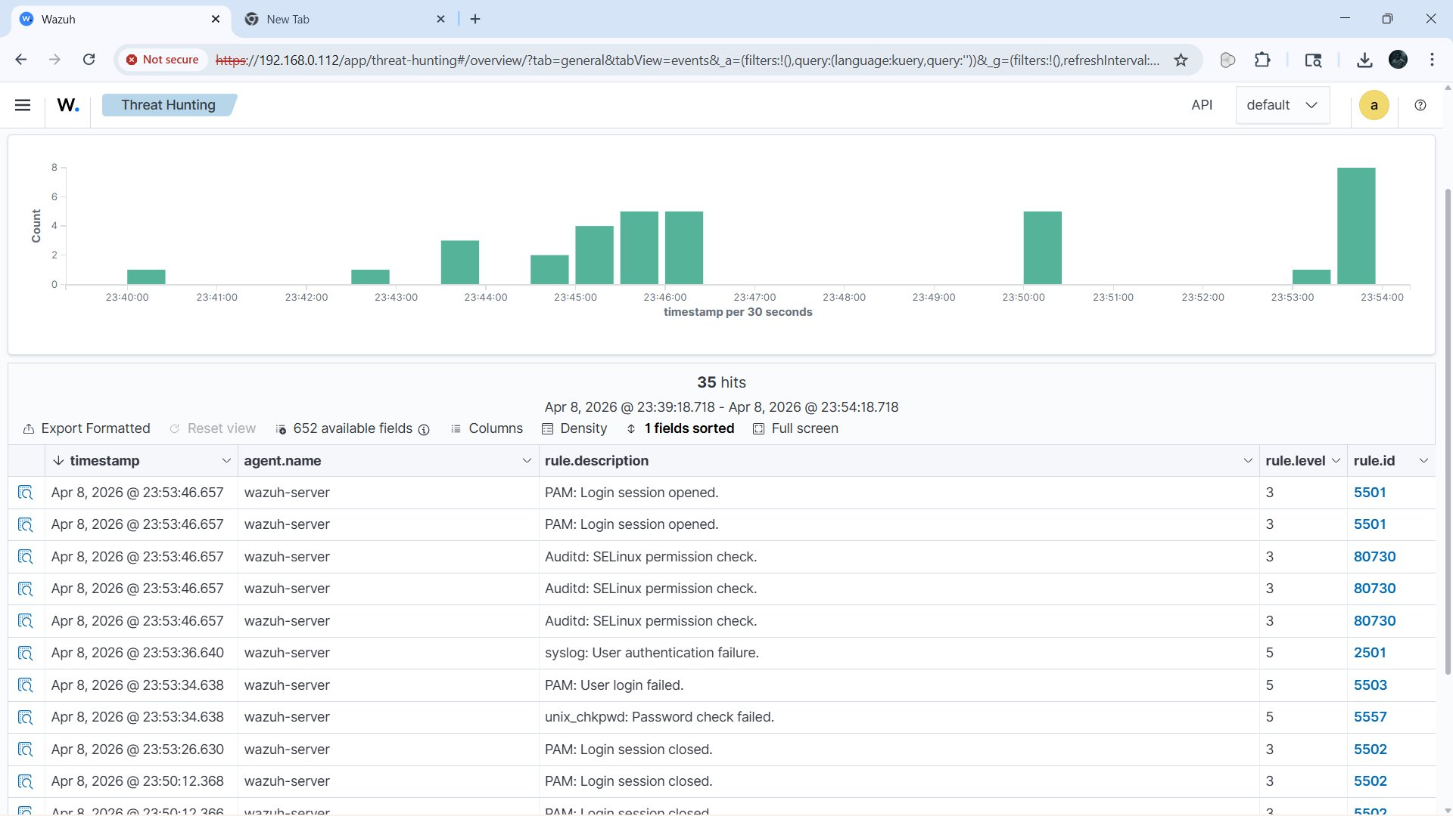
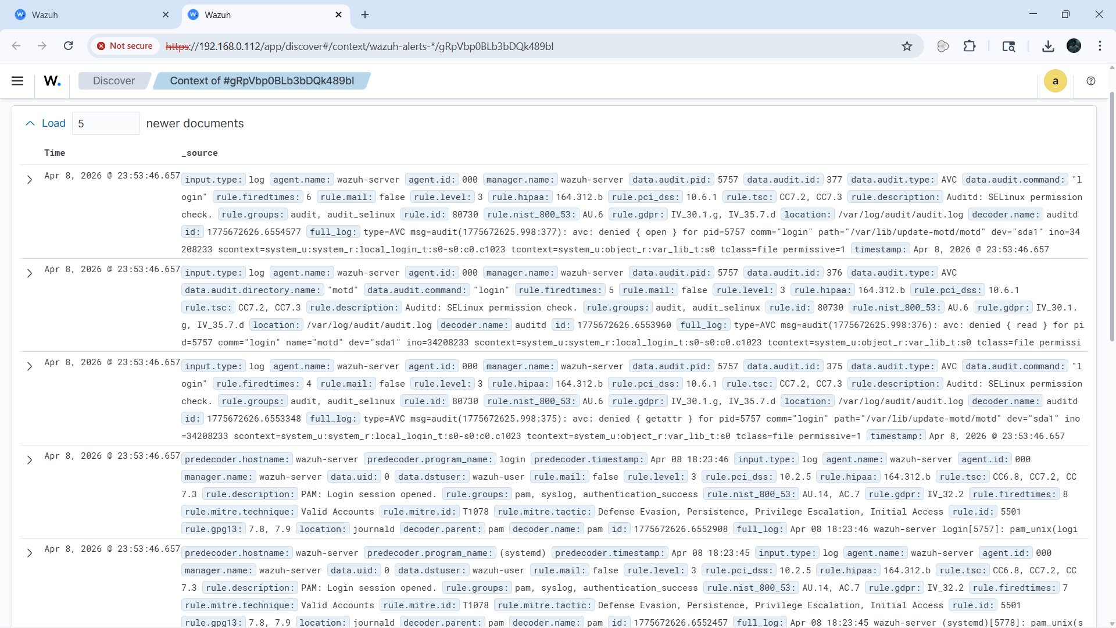
Key Alerts Triggered and Alert Summary

Slide 9
SOC Investigation Steps
Step 1: Initial Failed Login Detected
Apr 8 @ 18:23:36 | Rule 2501 (Level 5)
syslog: FAILED LOGIN 1 FROM tty1 FOR wazuh-user. Rule groups: access_control, authentication_failed. Firedtimes: 4
Step 2: Password Check Failure Confirmed
Apr 8 @ 23:53:34 | Rules 5503 + 5557 (Level 5)
PAM: User login failed + unix_chkpwd: Password check failed. Confirms brute-force pattern against wazuh-user account.
Step 3: SELinux AVC Denial During Login
Apr 8 @ 23:53:46 | Rule 80730 (Level 3)
auditd: avc denied {open, read, getattr} for pid=5757 comm=login path=/var/lib/update-motd/motd. SELinux blocked file access during login process.
Step 4: Successful Login Session Established
Apr 8 @ 18:23:46 | Rule 5501 (Level 3) | Firedtimes: 8
PAM: Login session opened for wazuh-user (uid=1000) by (uid=0). MITRE T1078: Valid Accounts. Tactics: Initial Access, Persistence, Privilege Escalation.
Step 5: Windows Agent Activity (Admin 004)
Apr 9 @ 00:02:07 | EventID 16384 | Agent IP: 192.168.0.110
Software Protection Platform Service restart scheduled. Separate from Linux auth chain — system maintenance activity on Admin host.

Slide 10
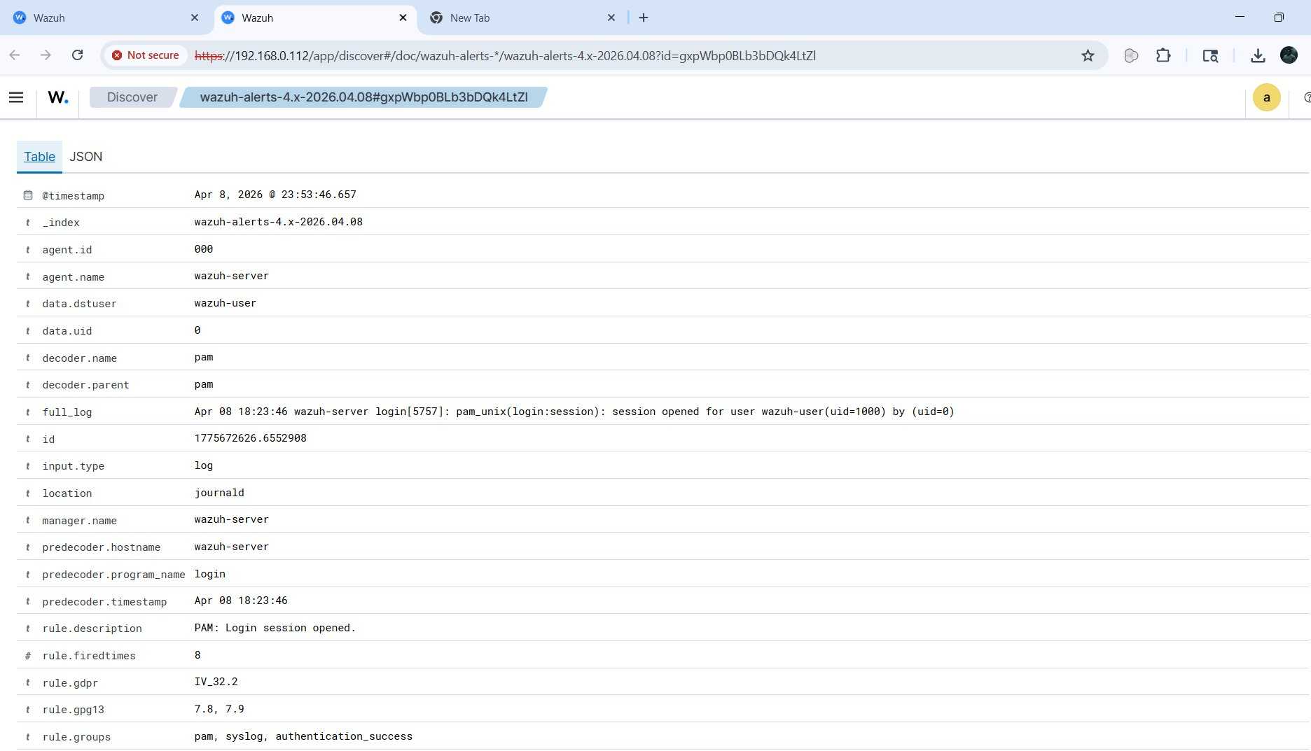
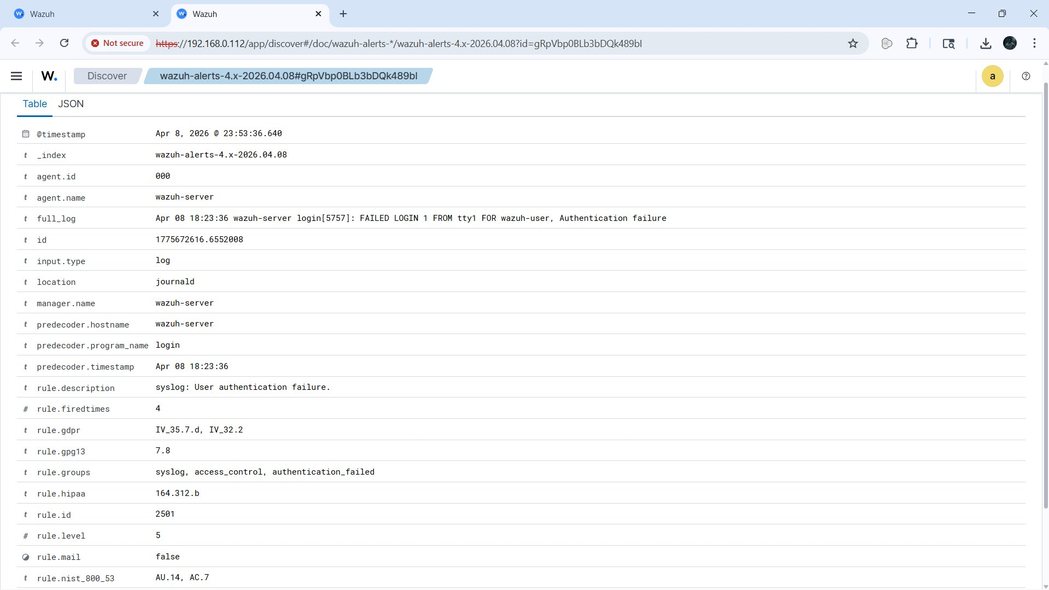
Log Activity And Alerts

Slide 11
Log Correlation & Timeline
Correlated Attack Chain — Apr 8, 2026 (Evidence-Based)
18:23:36 │ Rule 2501 (L5) │ syslog: FAILED LOGIN from tty1 for wazuh-user │ groups: authentication_failed
18:23:46 │ Rule 5501 (L3) │ PAM: Login session opened for wazuh-user(uid=1000) │ firedtimes: 8
23:53:34 │ Rule 5503 (L5) │ PAM: User login failed │ pid=5757 │ decoder: pam
23:53:34 │ Rule 5557 (L5) │ unix_chkpwd: Password check failed │ agent: wazuh-server
23:53:46 │ Rule 80730 (L3) │ auditd: SELinux AVC denied {open/read/getattr} │ path: /var/lib/update-motd/motd │ firedtimes: 4–6
23:53:46 │ Rule 5501 (L3) │ PAM: Login session opened (2nd session) │ MITRE T1078 │ tactic: Initial Access + Persistence
Cross-Log Correlation Findings
Same pid=5757, comm=login traced across PAM (journald) AND auditd (AVC denial) — confirms unified login process activity
Rule group correlation: authentication_failed → pam+syslog → audit_selinux → authentication_success — complete kill chain traced
Compliance flags auto-mapped: PCI-DSS 10.2.4/10.2.5, HIPAA 164.312.b, NIST AU.14/AC.7, GDPR IV.32.2, TSC CC6.1–CC7.3
Threat Hunting View — 35 Events in 15-Minute Window
Timeline 23:39–23:54 UTC | Events escalate sharply at 23:53 — spike of 8 events in 30-second interval confirms automated/rapid login attempts

Slide 12
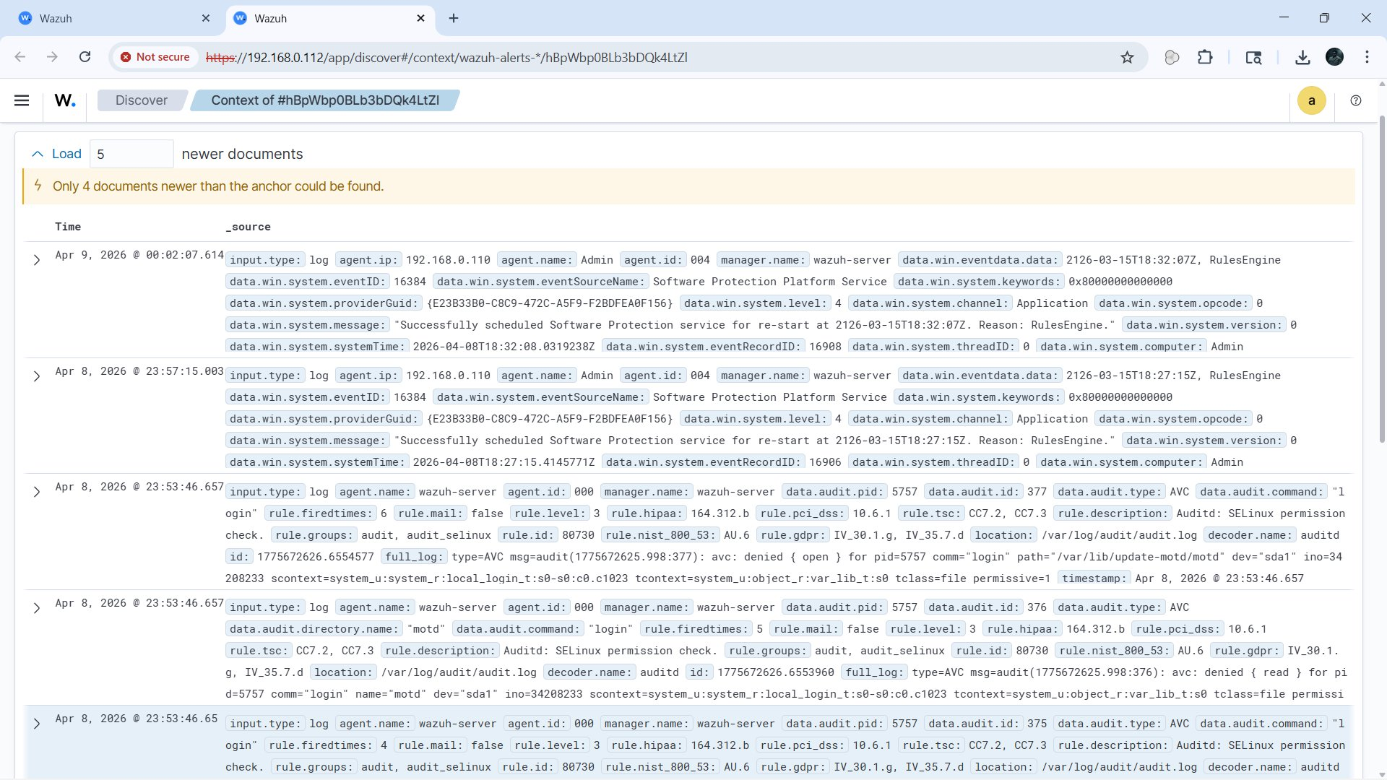
Log Correlation & Attack Chain Timeline

Slide 13
Findings & Impact Analysis
Confirmed Attack Pattern: Brute Force → Successful Login
From log evidence: FAILED LOGIN followed by Rule 5501 (session opened, firedtimes: 8) confirms repeated attempts leading to access
Affected account: wazuh-user (uid=1000) | Attack vector: Local tty1 terminal (physical/console access)
MITRE ATT&CK Classification
T1078 — Valid Accounts (observed in log metadata: rule.mitre.id: T1078)
Tactics mapped: Defense Evasion, Persistence, Privilege Escalation, Initial Access (all from screenshot rule detail)
Compliance Violations Triggered
PCI-DSS 10.2.4 & 10.2.5: Invalid logical access attempts logged and alerted
HIPAA 164.312.b: Audit controls — SELinux AVC and PAM logs captured the unauthorized access attempt
NIST 800-53 AU.14, AC.7: Session audit and access control limits both triggered and logged
Risk Assessment
Console-based attack (tty1) indicates physical or hypervisor-level access — high risk in production environment
SELinux AVC denials indicate system access controls are active; attacker unable to fully read /var/lib/update-motd/motd

Slide 14
Recommendations & Conclusion
Recommendations (Evidence-Based)
Enable account lockout: Rules 5503/5557 fired repeatedly without auto-block — configure active response to lock wazuh-user after 3 failures on tty1
Restrict console access: tty1 login should be disabled for non-root service accounts; enforce PAM tty restrictions in /etc/pam.d/login
Tune SELinux: Rule 80730 AVC denials fire in permissive mode — switch to enforcing mode to actively block unauthorized file reads at pid=5757
Alert threshold tuning: Escalate Rule 2501 (auth failure) from Level 5 to Level 7+ to surface it in Medium alert category for faster SOC triage
Whitelist benign events: EventID 16384 Software Protection Platform Service restarts (Admin agent 004, IP 192.168.0.110) are scheduled tasks — suppress as false positives
Expand coverage: 1 active agent monitored — deploy Sysmon on Windows endpoints for process-level and network-level visibility
Conclusion
Wazuh SIEM successfully detected and correlated the brute-force → valid login attack chain (Apr 8, 2026, 18:23–23:53) across PAM, syslog and SELinux auditd
MITRE T1078 (Valid Accounts) confirmed — full compliance traceability across PCI-DSS, HIPAA, NIST 800-53, GDPR demonstrates Wazuh as a production-grade open-source SIEM
References
Wazuh Documentation: https://documentation.wazuh.com
MITRE ATT&CK T1078: https://attack.mitre.org/techniques/T1078 | NIST SP 800-53: https://csrc.nist.gov

Slide 15
Questions ?

Slide 16
Thank You!
MOHAMMED ALI
CYBERSECURITY & ETHICAL HACKING

