Slide 1





Container
Data representation
Hclustering
Dataset
Process trees
Clustered
data type

Slide 2




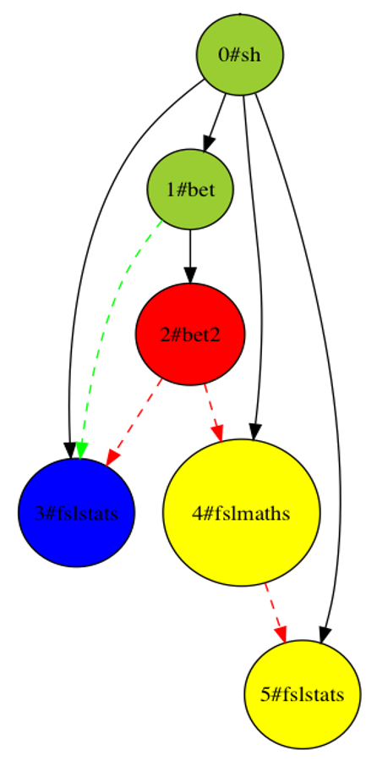

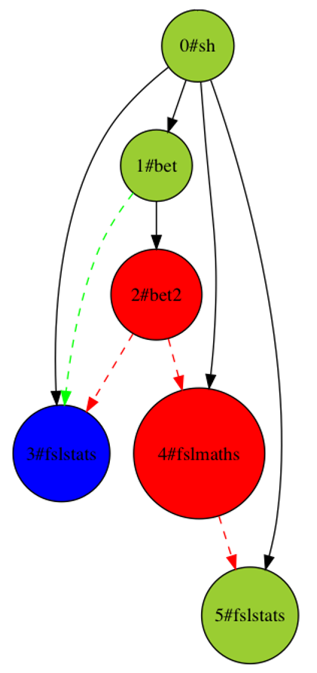
Cond1 (fixed)
(Output1)
Difference file
Data type x
Checksum
(Output2)
Cond2
YES
Need modifications?
Classification
NO
Process tree type x
Process graph

Slide 3
Cond1 (fixed)
Find temp and multi-write files
(Output1)
Difference file (A)
Data type x
Checksum
YES
capture other files?
(Output2)
NO
Cond2
Process tree type x
NO
End of pipeline exe
YES
Labelling (B)
Process graph

Slide 4
Iterative classification
Notes:
Condition-_1 = CentOS6
Condition2 = CentOS7

Slide 5
Classification of processes based on the input/output files
Notes:
Red: create errors
Blue: remove errors
Yellow: propagate errors
Green: transparent processes
And edges are in:
Plain black: process tree relation
Colored dashed: file dependencies
Green: files with no errors
Red: files with errors

Slide 6
PreFreeSurfer results
Processes that introduce errors in PreFreeSurfer pipeline
Out of 117 output data files, 92 files were found to be different between CentOS6 and CentOS7 for all subjects
Fig 4. Number of occurrences of errors in prefreesurfer, red and blue bars indicate the processes which create and remove errors respectively.
Pipeline elements | Process name
 | FLIRT | FNIRT | new_inwarp | Fslstats | Fslmaths | Convertwarp
ACPC-Alignment
Brain-Extraction
Distortion-Correction
Atlas-Registration
BiasField-Correction
Create Error Remove Error
Table 1. Process name along with the pipeline elements that introduce errors
Notes:
Fslstats: calculate a mean value of the image T1wmulT2w_brain_norm_modulate.nii.gz
Fslmaths: Create a mask using a threshold at Mean - 0.5*Stddev, with filling of holes to remove any non-grey/white tissue.
Convertwarp: Forward warp the fieldmap magnitude and register to TXw image (transform phase image too)

Slide 7
FreeSurfer results
Processes that introduce errors in FreeSurfer pipeline
61 files were found to be different between CentOS6 and CentOS7 (23 .nii.gz files and 38 .mgz files)
Fig 4. Number of occurrences of errors in FreeSurfer pipeline, subject 103818, red and blue bars indicate the processes which create and remove errors respectively.
Notes:
File conversion from nifty to mgz

