Slide 1
Road Network Lahore

Slide 2
METHODOLOGY
Thinning
Convert to graph
Graphs
Single Line Segmentation Masks
Google Map Images
Segmentation
Segmentation Masks
Distance Transform
Width Information
Georeference
Threshold
Manually resolving
Issues
GeoJson file
Merge
Georeferenced Graphs

Slide 3
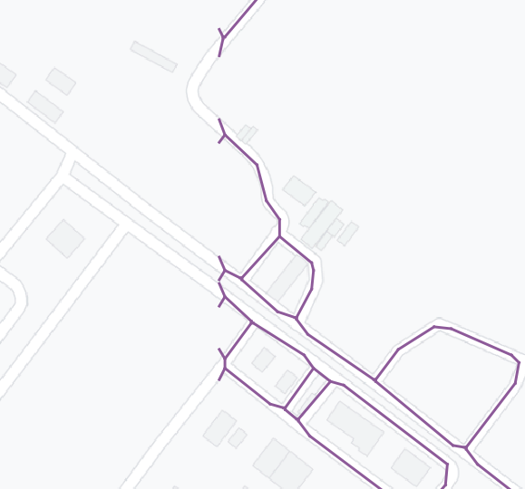
ISSUES
Discontinuity at boundaries while merging.
Resolved (manually)

Slide 4
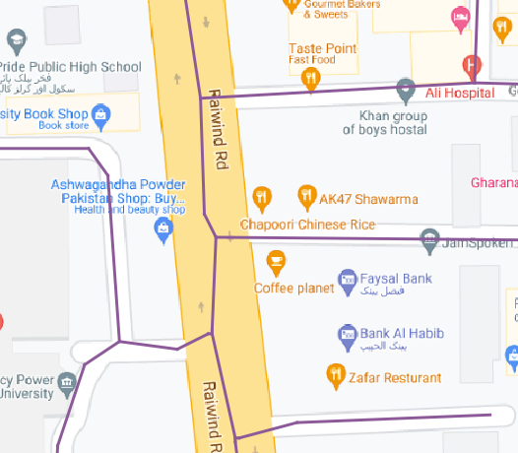
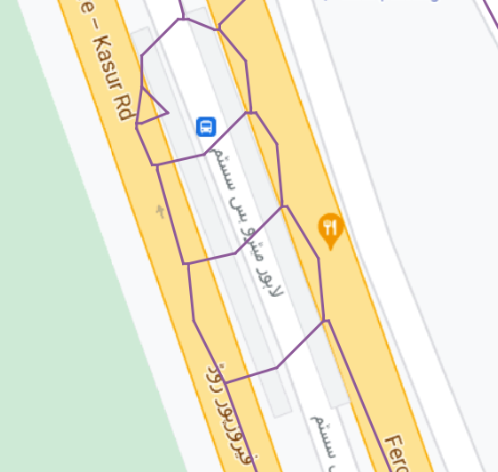
ISSUES
False lines for main roads
Resolving (manually)

Slide 5
CLASSIFICATION OF ROADS
United States of America
Arterials
Interstates
Other Freeways and Expressways
Other Principal Arterials
Minor Arterials
Non-Arterials
Collectors
Local Roads
United Kingdom
Special Roads (Motorways)
“A” Roads
“B” Roads
Classified unnumbered “C” Roads
Unclassified “U”

Slide 6
CLASSIFICATION OF ROADS
India
National Highways
State Highways
District Roads
Rural Roads
Urban Roads
Project Roads
Sri Lanka
Expressways
National Roads
Provincial Roads
Local Authority Roads
Other Road

Slide 7
CLASSIFICATION OF ROADS
Pakistan (as per NTRC)
Motorways
Expressways
National Highways
Primary Roads
Secondary Roads
Local Roads

Slide 8
ATTRIBUTES
Name
Length
Class
Primary, Secondary, Local
Material
Asphalt, Mud
Type
Main, Overhead, Underpass, Service
U-Turn (binary)
Speed

Slide 9
Future Directions
Imbed direction in network
Methodology finalized
Help in labeling

