Slide 1


Project 01
Analytics for National Parks
—
Jenny Jo Connor, Bhuvanewari Seshadri,
Ali Syed, David E Gonzalez y Plate Yves-Andre Chapuis

Slide 2
National Parks

Slide 3

Outline
Project Objectives
Methodology
Data Source/Data Toolkits
Prototype Overview
Flow-Based Analysis
Analysis Sample Data
Prototype Walk-thru
Summary

Slide 4
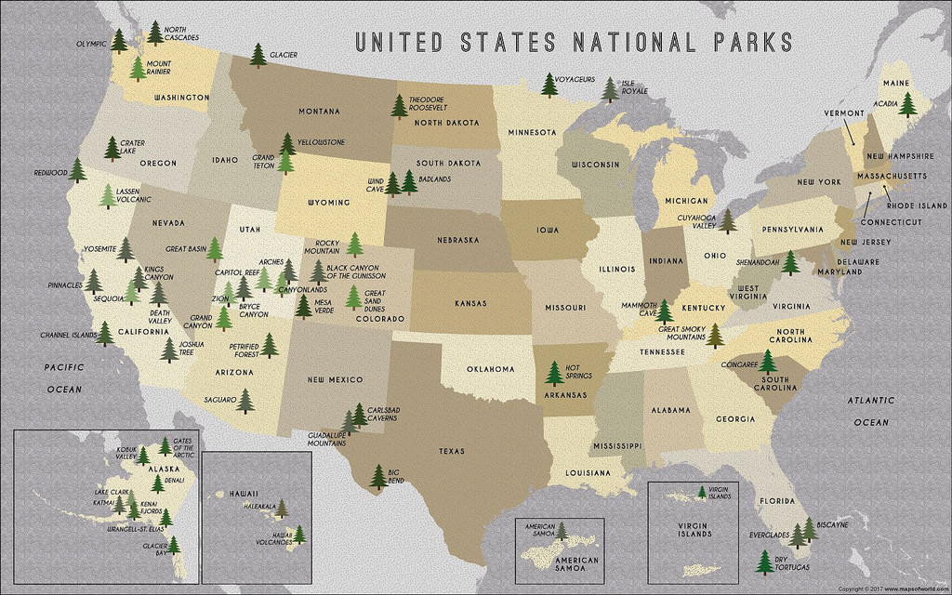

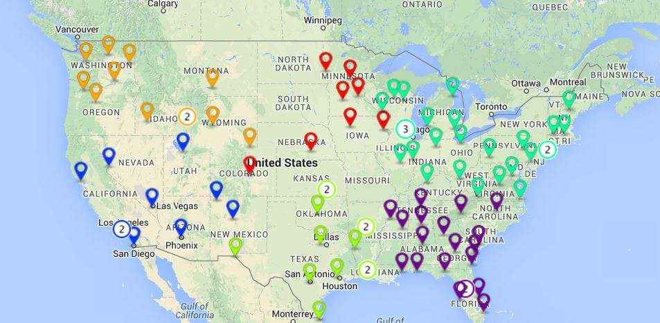
1. Project Objectives
Data Source
Determine the factors that lead to national parks attractivity
Build an analytic tool for processing data leading to our goal
Weakness and opportunities the NPS faces in targeting tomorrow’s park visitors
Analysis
Decision
Data Visualization

Slide 5
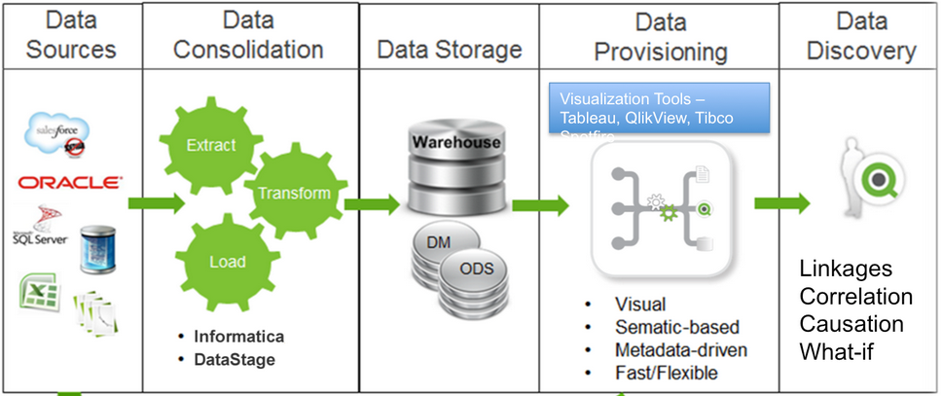
2. Methodology

Slide 6

3. Data Source / Data Toolkits
National Park Service
TripAvisor
U.S. Census
URL: https://www.nps.gov/planyourvisit/index.htm
URL: https://https://www.tripadvisor.com/
URL: https://www.census.gov/data/data-tools.html
Collecting data via APIs of the site
Collecting data via CSVs
Collecting data manually from reviews
Collecting data via CSVs
Collecting data via APIs of the site

Slide 7
3. Data Source / Data Toolkits
Statistical Methods
Tools
User Experience Research
Sentiment analysis
Time series analysis
Data mining
Multilevel modeling
Missing data imputations
Classification and clustering
Survival analysis
Pattern recognition
Principal component and factor analysis
AB testing
Machine learning
Forecasting
Propensity score matching
Logistic, multinomial and multiple linear regression techniques
Network analysis

Slide 8
3. Data Source / Data Toolkits
Statistical Methods
Tools
User Experience Research
Languages
Python
R
SQL
Javascript
NodeJS
Libraries
SciPy
Pandas
Scikit-learn
GPText
OpenNLP
Mahout
Folium
Data Engineering
Profiling
ETL
Job notices
APIs
Optimized data pipelines
Optimized data storage/access
Jupyter Notebook
Visualization
D3.js
Gephi
R
Leaflet
PowerBI
ggplot2
shiny

Slide 9
3. Data Source / Data Toolkits
Statistical Methods
Tools
User Experience Research
Iterative Prototyping
Photo journaling and documenting
Service blueprinting
Journey mapping
Ride-alongs
Process mapping
Ethnographic field research and user observation
Usability testing

Slide 10





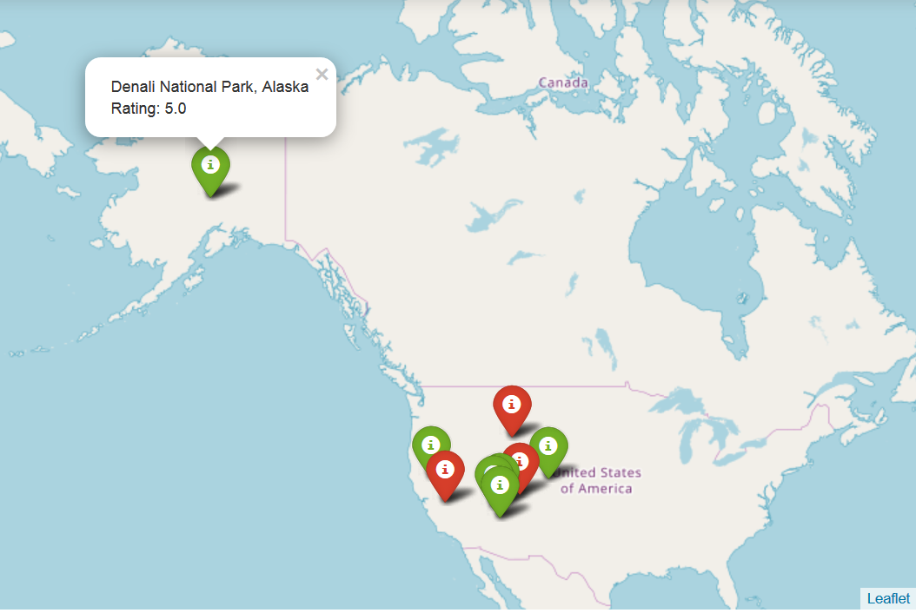
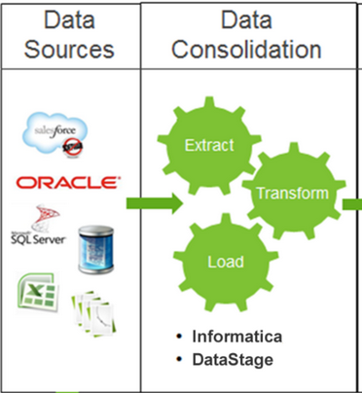
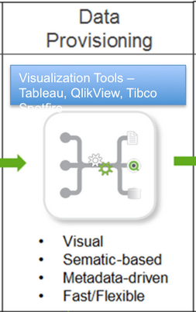
4. Prototype Evaluation

Slide 11
5. Flow-Based Analysis
Develop the tool to :
help analysis and decision for reaching and encouraging more visitors that meet a similar demographic
assess the weaknesses and opportunities the NPS faces in targeting tomorrow's park visitors.

Slide 12
Sample Data Gathered for Analysis

Slide 13
Top 3 Parks Per Season
Spring
Great Smokey Mountains
Saugaro
Grand Canyon
Summer
Great Smokey Mountains
Grand Teton
Yellowstone
Fall
Great Smokey Mountains
Saugaro
Grand Canyon
Winter
Great Smokey Mountains
Saguaro
Grand Teton

Slide 14
Bottom 3 Parks Per Season
Spring
Kenai Fjords
Apostle Island
Lassen Volcanic
Summer
Guadalupe
Big Bend
Apostle Island
Fall
Kenai Fjords
Apostle Island
Guadalupe
Winter
Apostle Island
Kenai Fjords
Guadalupe

Slide 15
Visitor Trends & Population By State

Slide 16
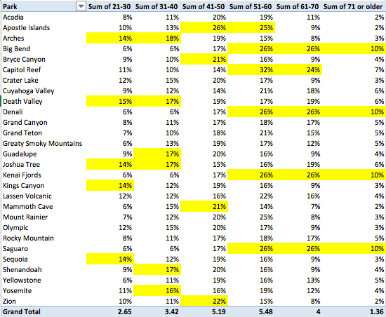
Park Visitor Representation By Age
Park Visitor Representation by Age
Income by age bracket
Age | Meidan | Mean
25-34 | $148,745 | $196,662
35-44 | $177,518 | $236,665
45-54 | $190,227 | $260,734
55-64 | $161,424 | $227,138
65-74 | $117,440 | $177,733

Slide 17
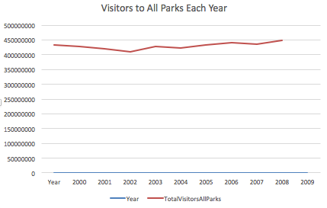
Visitor Trends

Slide 18
Visitor Trends
Race/Ethnicity | 2000 | 2009 | % Change
White/Caucasian | 74% | 78% | + 4% Increase
Latino/Hispanic | 12% | 9% | - 3% Decrease
Black/African-American | 11% | 7% | - 4% Decrease

Slide 19
Visitor Trends
10% increase among minority groups who were able to name a national park in 2009 v. 2000.
Why Don’t You Go to Parks? Top 3 Among All Groups:
Lack of Awareness about Park Units
Too Far Away
High Food and Hotel Costs
2009 Survey Data
Income by Race/Ethnicity
Race/Ethnicity | Median Income | Mean Income
White/Caucasian | $61,698 | $86,133
Latino/Hispanic | $47,675 | $66,815
Black/African American | $40,065 | $58,122
The wage gap is steadily consistent among all age groups.
2010 Census Data

Slide 20
Visitor Trends Takeaways
Key Takeaways:
Access to information is a perceive challenge. The Parks have launched a Find Your Park campaign in an attempt to address this; however, an interactive map to help people easily connect people with parks based on a variety of factors – activities, age groups, best time of year to go, and more.
The Parks are clearly challenged in being relevant to key minority groups, and census data shows we are becoming a more diverse society every year.
Social media influencers for hiking/outdoors lack minority representation.

Slide 21
Interesting…
Did you know Latino/Hispanic in Tucson largely don’t know what Saguaro National Park is?
It’s in their backyard, and they are completely disconnected from it. And this group makes up 42% of the population there. A major park is not relevant to half the population of the local area. That’s what’s interesting.

Slide 22
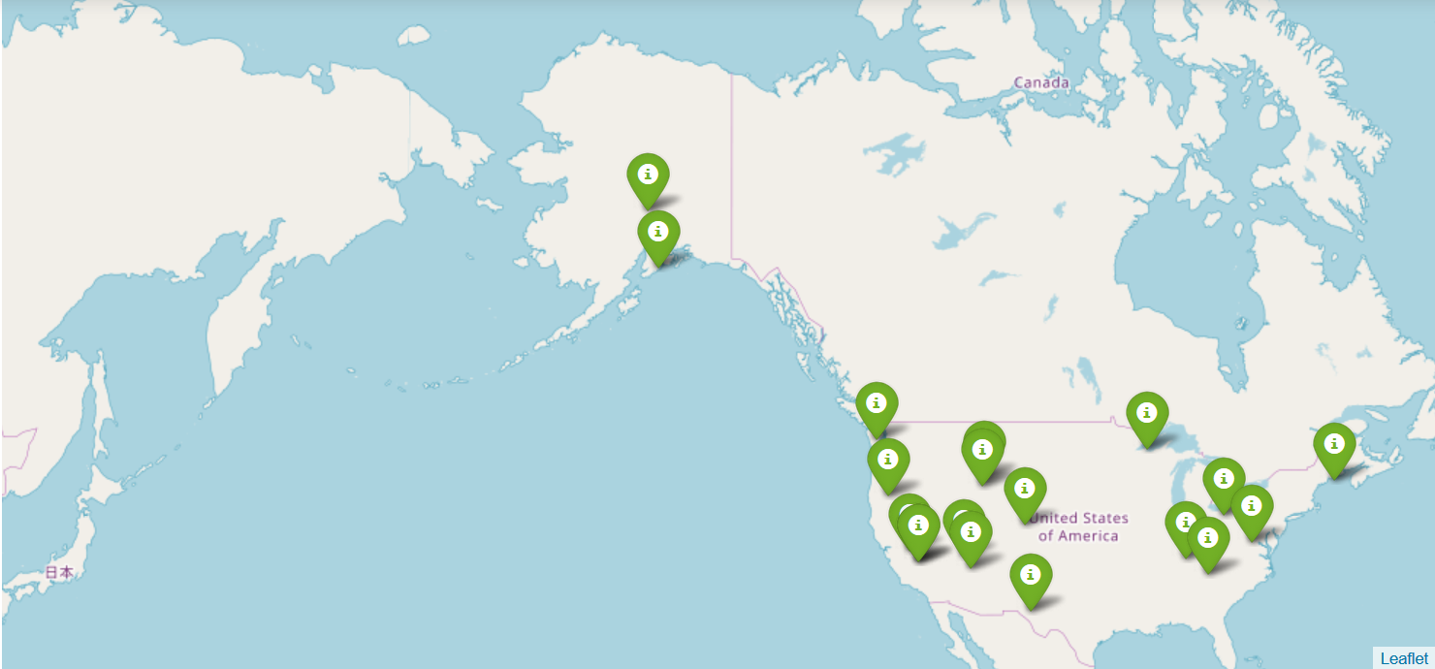
6. Prototype Walk-thru
Mapping Points

Slide 23
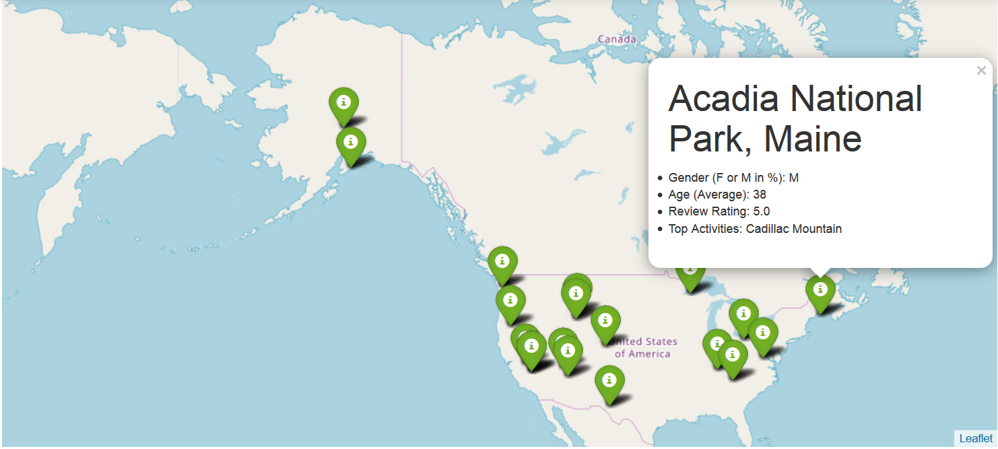
6. Prototype Walk-thru
Mapping Points

Slide 24
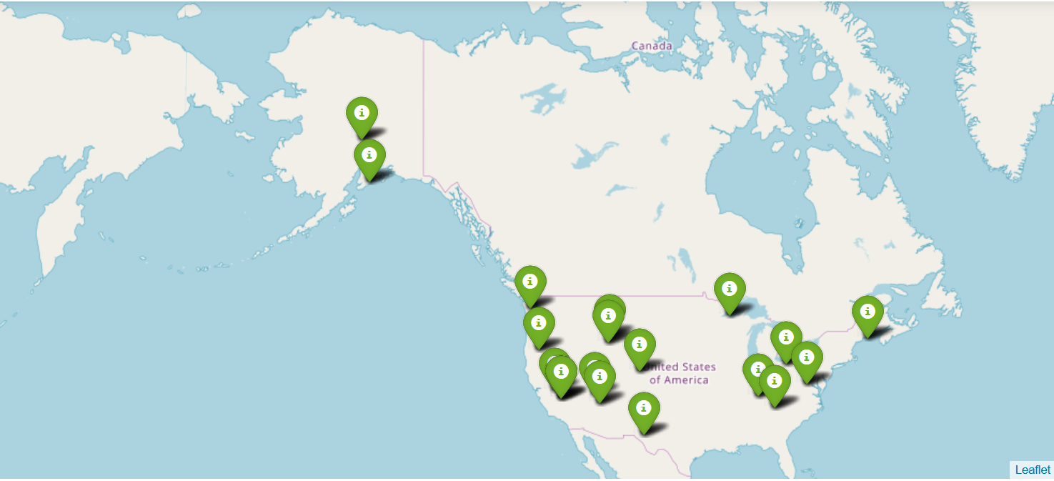

6. Prototype Walk-thru
More Interactive

Slide 25
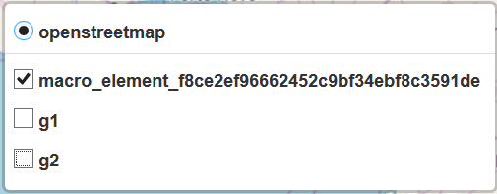
6. Prototype Walk-thru
More Interactive
Season
Winter
Spring
Summer
Fall

Slide 26
6. Prototype Walk-thru
More Interactive
Gender
Female
Male

Slide 27
7. Summary
Our final project was a collaboration of two projects, and our goal as a combined team was to find areas where our unique visions could overlap to generate even more powerful and meaningful information.
The result of our group's final collaboration is:
A journey in analyzing and visualizing today's National Parks Visitors
Creating a tool to reach and encourage more visitors that meet a similar demographic
Finally, assessing the weaknesses and opportunities the NPS faces in targeting tomorrow's park visitors

Slide 28
Appendix

Slide 29
Appendix
1.
?
?

Slide 30
End

