Slide 1
STORZONE
Worldwide Stores In One App

Slide 2
Overview:
Available for both android and iOS
Available in French, English (« Candara » as default font) and Arabic
It is an automated dropshipping app
Simple to use : you only have to select a brand’s or store’s website, navigate on it in the app , then add a product to the STORZONE’s cart 🛒

Slide 3
Presentation:
App in portrait, not available in landscape mode
At the opening you have to Log in or continue as a guest
Log in can be by creating account , or using Facebook or Google
Authentication by SMS to verify the phone number is necessary
The app remembers the account on the device
After a logo page while loading , we enter the First and main page which is the stores list with their logos

Slide 4
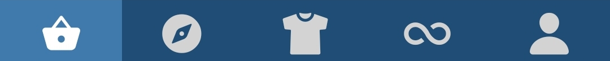
We have on the bottom five pages :
Stores list
In app navigation
Selected sales
Buying assistant
Account management

Slide 5
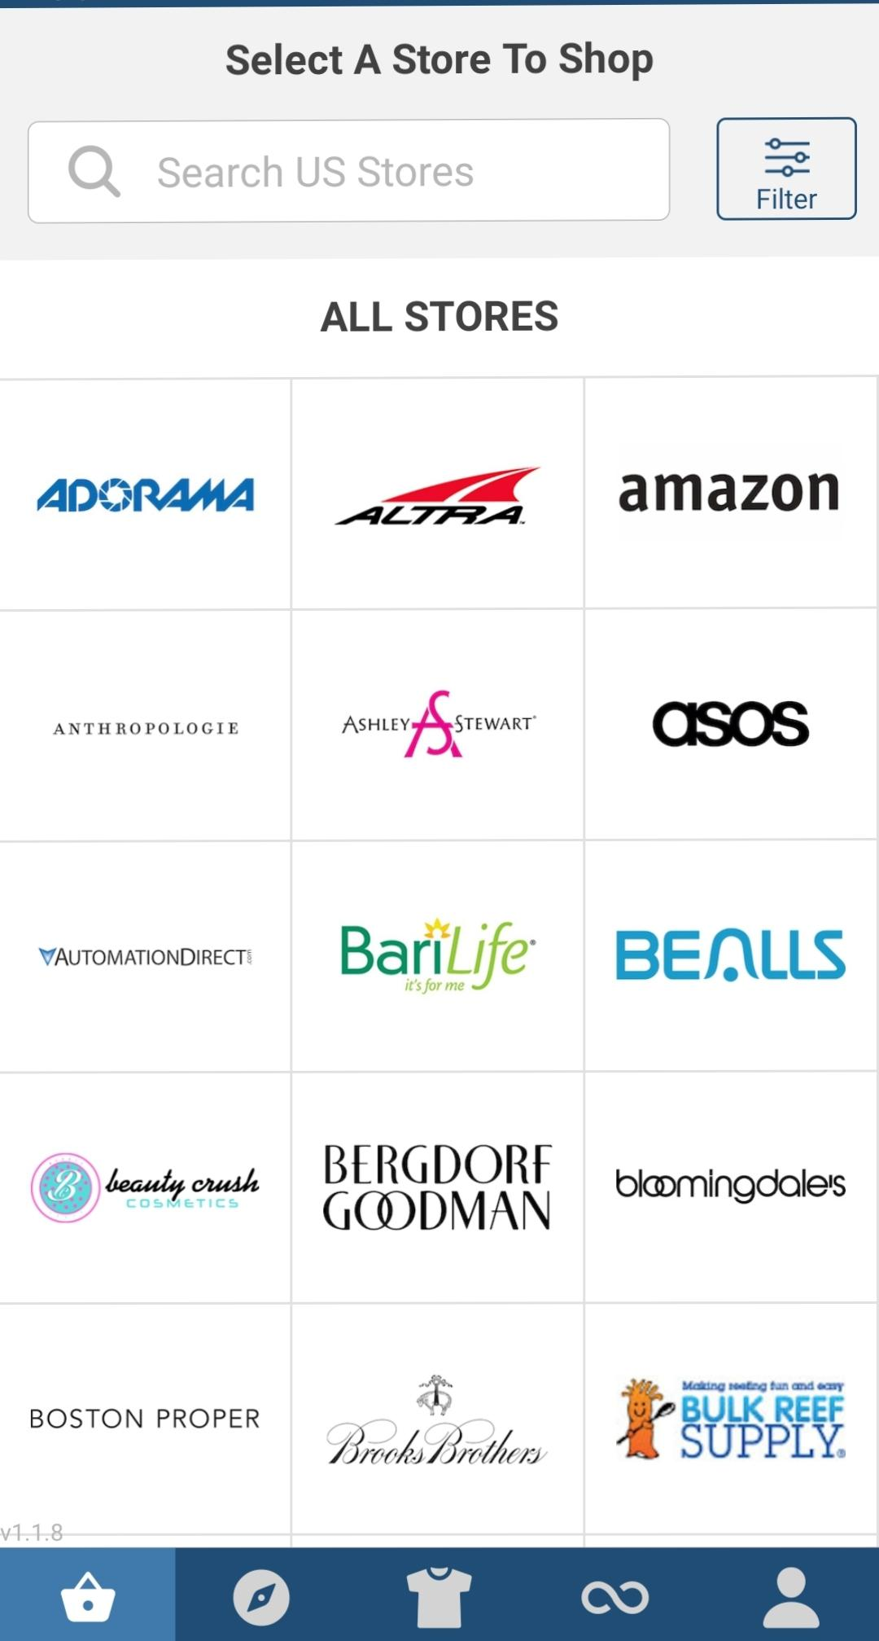
Stores List:
Sorted by country : we have France, USA, UK, Spain, and Italy
May be a search tool to search the brand by category or specialty (for example: general stores, fashion, electronics,shoes,…) and one shop can be in one or multiple categories
(the first list that can be modified later will be sent in another file with corresponding URL)

Slide 6
In app navigation:
It is the most important part
The client will navigate and select the product (Size, color) then does not click on the « add to cart » in that page but a button will be enabled or appears named « add to storzone cart »
The concept is that this navigator first downloads the requested page and display it with modifications : the price is modified when displayed raised by 15% automatically
This navigation page will have on top: Previous, next,and refresh (may be also save page) buttons

Slide 7
Selected sales:
It is a page where the administrator adds selected sales depending on tendance and clients preference of the moment
A scrolling page where photos and titles are displayed, something like Instagram post

Slide 8
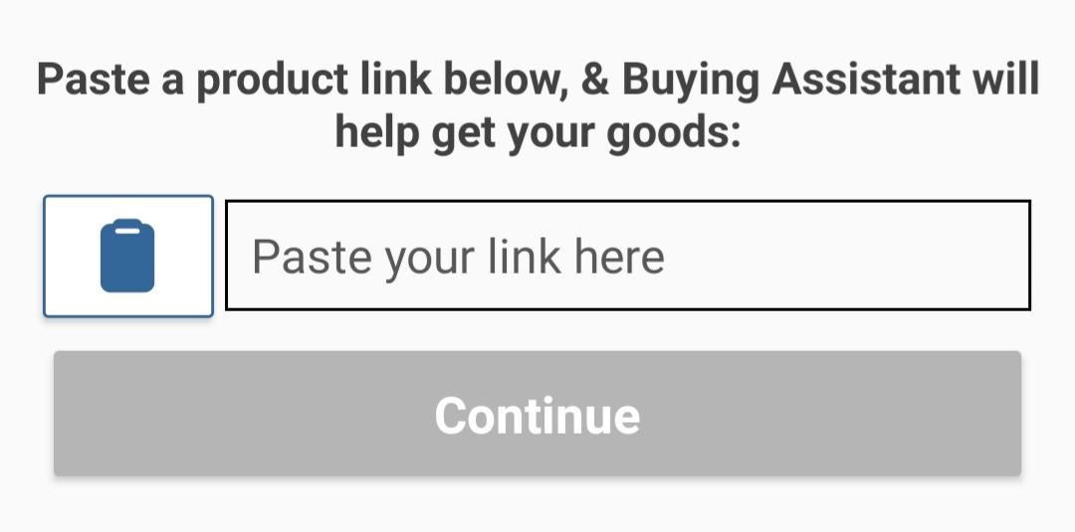
Shopping assistant:
A page that displays a box where the client paste a product URL
That URL will be sent to the admin and the admin buys it for the client
This is for the products that are not available on shops presented in the app

Slide 9
Account page
Personal infos
Help and contacts
Orders (with status confirmed,sent, received)
How it works : screenshots that we can swipe explaining how to use the app
Sign out

Slide 10
The cart 🛒
On the top right of all pages
Shows selected items
We can modify quantity
Displays real time shipping cost by integrating a 3PL script
Payment methods:
Credit card (Visa , Mastercard)
PayPal
Local payment (appears ONLY if the shipping address is in Algeria)

Slide 11
Emails and notifications:
The client will be noticed of every step of the shopping process
Notifications on the device
Email

