Slide 1
Soccer Match outcome Prediction
CS4840 - Intro to Machine Learning
Ali Aljaffer

Slide 2
Problem Statement
With the steady increase in popularity of soccer over the past decades, I wanted to build a model to predict the outcome of a soccer match between two international teams. The three expected outcomes are:
Home team win (or simply Away loss)
Home team loss (or simply Away win)
Tie
There are many factors to consider for the outcome of a match, such as recent match history, head-to-head record for the two teams, FIFA (International football association) ranking, and more.
For the FIFA rankings, I will use cashncarry’s FIFA World Ranking 1992-2023 dataset. [1] And for the match history and outcome, I will use martj42’s International football results from 1872 to 2023 dataset. [2]

Slide 3
The two datasets’ info
FIFA Ranking (64757 rows) International Football Results (45315 rows)
# Column Non-Null Count Dtype
--- ------ -------------- -----
0 rank 64757 non-null int64
1 country_full 64757 non-null object
2 country_abrv 64757 non-null object
3 total_points 64757 non-null float64
4 previous_points 64757 non-null float64
5 rank_change 64757 non-null int64
6 confederation 64757 non-null object
7 rank_date 64757 non-null object
# Column Non-Null Count Dtype
--- ------ -------------- -----
0 date 45315 non-null object
1 home_team 45315 non-null object
2 away_team 45315 non-null object
3 home_score 45315 non-null int64
4 away_score 45315 non-null int64
5 tournament 45315 non-null object
6 city 45315 non-null object
7 country 45315 non-null object
8 neutral 45315 non-null bool

Slide 4
Feature preprocessing
Since FIFA rankings start from 1992, and the matches history starts from 1872, we have a mismatch of dataset dates if we plan to utilize FIFA ranking as a feature. Thus, I have removed all games that were played before 01-01-1993. We end up with 38,842 rows of match data.
Using the FIFA rankings dataset, I created a DataFrame containing two important features: the year, and the total points in that year. This enables us to easily access a certain country’s rank and points for the year that the match happened in.
Further, some countries that appear in the match history dataset do not appear in the FIFA rankings one, so I removed those.
I encoded the countries’ names to a numerical value. Also, I consolidated the tournament type to just be three values: cup, tournament, and friendly. It is assumed that friendly matches are more relaxed, thus probably had a higher goal count and/or unexpected wins by lower-ranked teams.

Slide 5
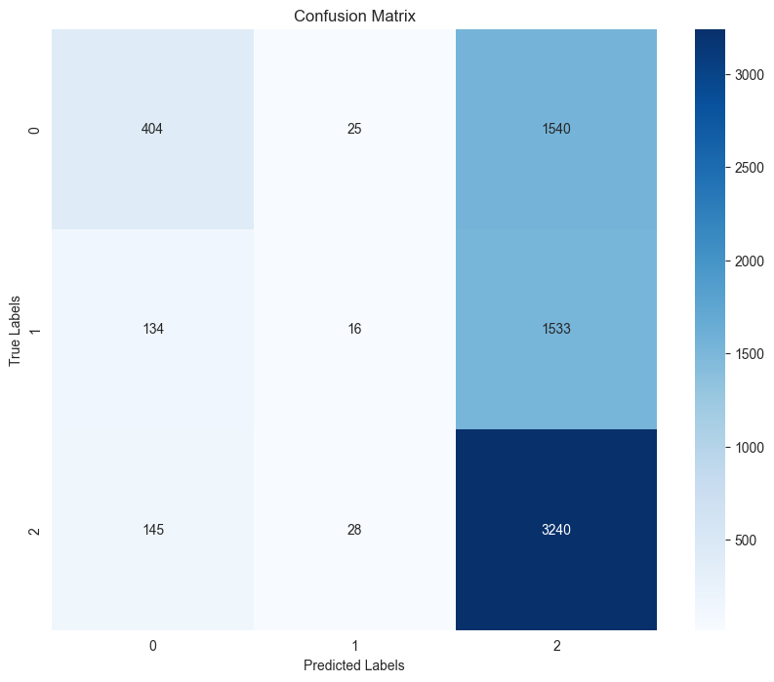
RESULTS OF FIRST TRAINING (Confusion mtx. for Grad-boosting)
Using only the base features (5) from the FIFA match results to train three models: SVM-OneVsOne, Logistic Regression for Multi-class classification (Softmax), and Gradient Boosting, we end up with the following:
Model | Accuracy | F1-Score
SVM – OneVsOne | 0.483 | 0.217
Logistic Regression – Softmax | 0.485 | 0.224
Gradient Boosting Classifier | 0.518 | 0.330

Slide 6
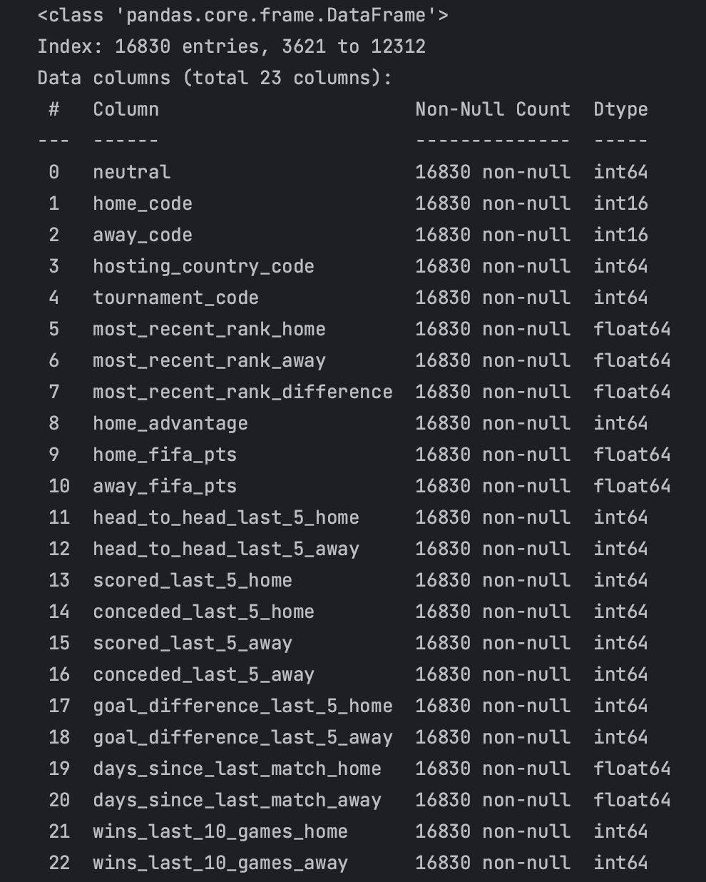
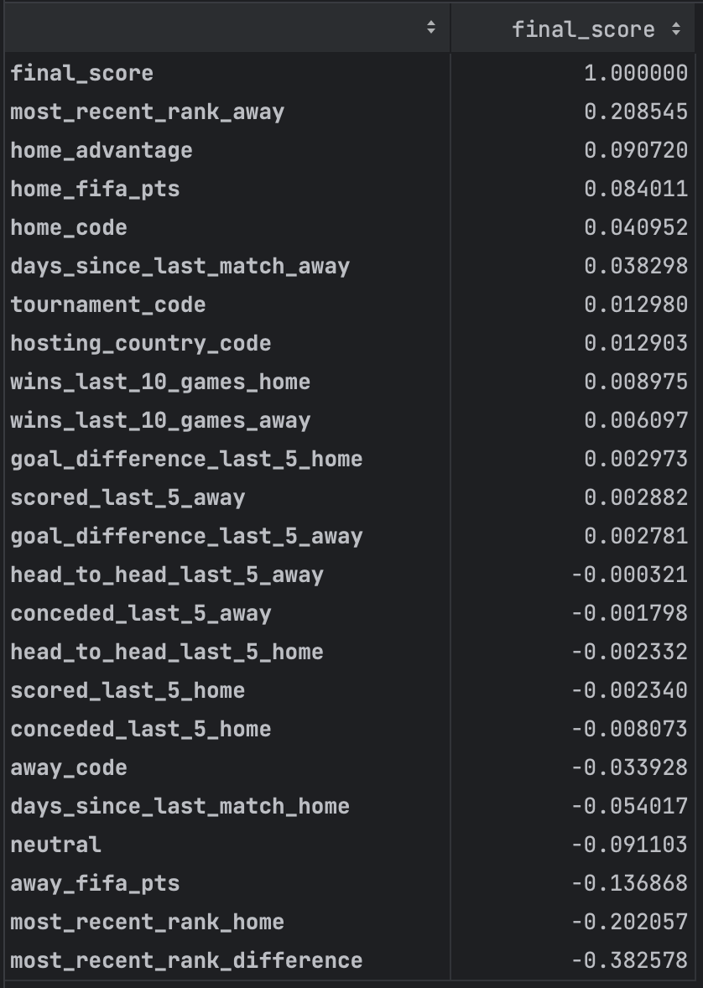
Extra Features added
Feature Correlation with ‘final_score’
home_advantage – Checks if the game is being played at home team’s turf.
(home/away)_fifa_pts – The amount of FIFA points that the (home/away) team has on the day of the match.
head_to_head_last_5_(home/away) – A count of the number of times that the Home team won vs the specific away team in their last 5 matches played against each other.
(scored/conceded)_last_5_(home/away) – Looks at the number of goals scored/conceded by the home/away team in their last 5 teams, regardless of opponent. Also, a column that looks at the difference in goals scored and goals conceded in the last 5 matches.
And more features such as number of wins in their last 10 matches, days since last match played, etc.
Columns after feature addition

Slide 7
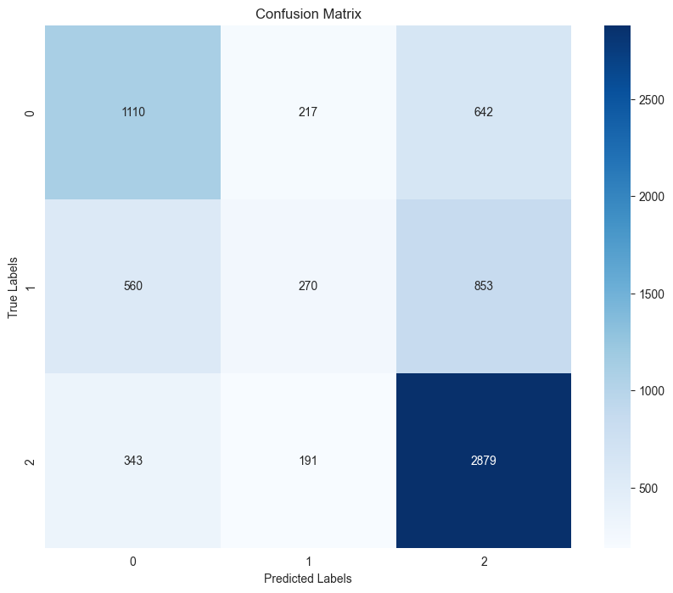
Re-Training with more features (Grad-boosting results)
Class | Precision | Recall | F1-Score | Support
0 – Home Loss | 0.55 | 0.56 | 0.56 | 1969
1 - Tie | 0.40 | 0.16 | 0.23 | 1683
2 – Home Win | 0.66 | 0.84 | 0.74 | 3414
Accuracy: | 0.6028*
As we can see, our accuracy improve by a lot! Over +8% increase over our previous value. However, we can see that the values are poor for the class 1. In total, we have 23 features.
* Using 70/30 train/test split.

Slide 8
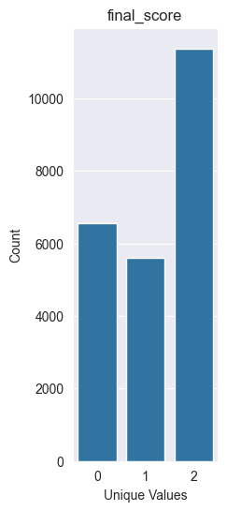
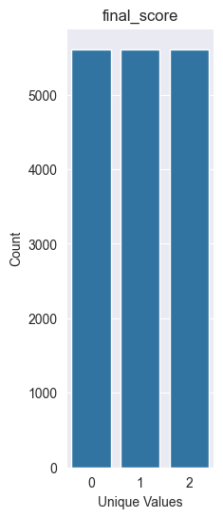
Resampling
Looking at the value counts of the matches, I noticed an imbalance of samples.
Class 2 (Home Win) - 11375 samples
Class 0 (Home Loss) – 6563 samples
Class 1 (Tie) – 5610 samples
We can see that we have way more samples for wins than losses or ties. We’ll balance our data by lowering the count of wins and losses to match the count of ties.

Slide 9
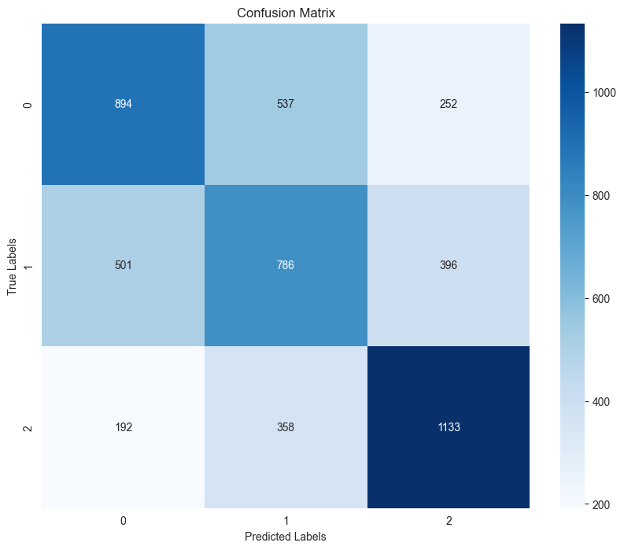
Results post-balancing (Grad-boosting results)
Value differences are based on the previous table’s values
Class | Precision | Recall | F1-Score | Support
0 – Home Loss | 0.56 (-0.01) | 0.53 (-0.03) | 0.55 (-0.01) | 1683
1 - Tie | 0.47 (+0.07) | 0.47 (+0.31) | 0.47 (+0.24) | 1683
2 – Home Win | 0.64 (-0.02) | 0.67 (-0.17) | 0.65 (-0.09) | 1683
Accuracy: | 0.5571 (-0.05)
The accuracy went down, and so did the metrics for class 2 and 1, but now our data samples are well balanced. Now we can switch to a different model and see if we can get better results.
* Using 70/30 train/test split.

Slide 10
Random tree embedding
Random Tree Embedding is the process of transforming the dataset into a higher-dimensional representation by coding datapoints according to which leaf of each tree it is sorted into. [3] After transforming the datapoints, they are passed into another classifier model. The model I used is ExtraTreesClassifier.
Extra Trees model is similar to a random forest – It is made up of many decision trees. However, it does not use bootstrapping and unlike random forest which decides the best split, Extra Trees does the splitting randomly.
Notes:
Capture complex relationships, avoid underfitting, and improve separation for classification

Slide 11
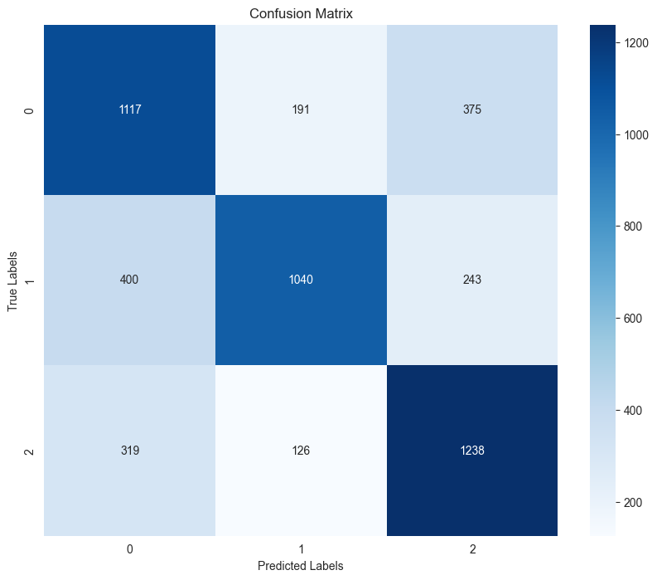
Results post-balancing (Random Tree Embedding results)
Value differences are based on the previous table’s values
Class | Precision | Recall | F1-Score | Support
0 – Home Loss | 0.61 (+0.05) | 0.66 (+0.13) | 0.63 (+0.08) | 1683
1 - Tie | 0.77 (+0.30) | 0.62 (+0.15) | 0.68 (+0.21) | 1683
2 – Home Win | 0.67 (+0.03) | 0.74 (+0.07) | 0.70 (+0.05) | 1683
Accuracy: | 0.672 (+0.12)

Slide 12
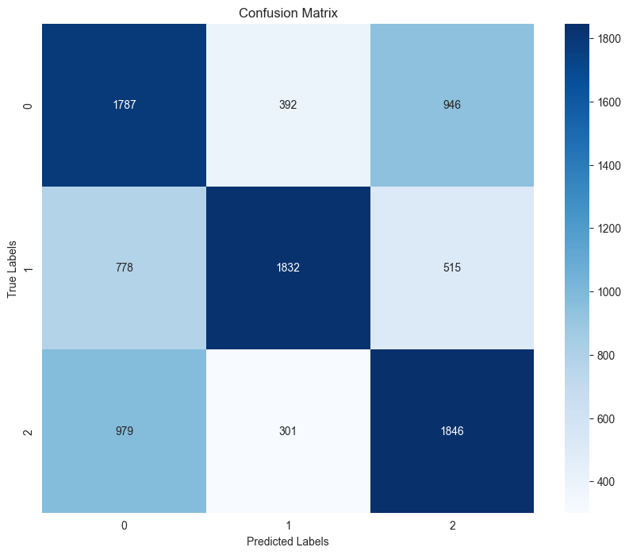
What if fifa ranking and points were excluded?
Value differences are based on the previous table’s values
Class | Precision | Recall | F1-Score | Support
0 – Home Loss | 0.50 (-1.1) | 0.57 (-0.09) | 0.54 (-0.9) | 3125
1 - Tie | 0.74 (-0.04) | 0.59 (-0.03) | 0.65 (-0.03) | 3125
2 – Home Win | 0.56 (-1.1) | 0.59 (-1.5) | 0.57 (-1.3) | 3125
Accuracy: | 0.583 (-0.09)

Slide 13
Results
Model | Accuracy | Avg. F1-Score | Rank
SVM – OneVsOne | 0.483 | 0.217 | 4th
Logistic Regression – Softmax | 0.485 | 0.224 | 3rd
Gradient Boosting Classifier | 0.518 | 0.330 | 2nd
Random Tree Embedding | 0.672 | 0.67 | 1st

Slide 14
Challenges and future plans
Challenges
The data at the start didn’t have enough features to figure out a good relation.
I did a lot of feature preprocessing and adding of more extracted features.
Needing to undersample meant possibly losing data that could’ve helped improve the metrics better.
Future plans
Drawing inspiration from Monday’s presentations, I believe implementing a Long Short-Term Memory model would benefit my dataset, since I look at historical (past) data to predict future outcomes.
Try to include more features, such as shootout performance (Penalties) for tournaments that do not allow ties (such as cups)
Multi-output regression to predict the match score (# of goals) for both teams rather than just the outcome. (Support Vector

Slide 15
References
[1] FIFA world ranking 1993-202, cashncarry, Kaggle.com. https://www.kaggle.com/datasets/cashncarry/fifaworldranking
[2] International Football results from 1872 to 2023, martj42, Kaggle.com. https://www.kaggle.com/datasets/martj42/international-football-results-from-1872-to-2017
[3] RandomTreesEmbedding, scikit-learn.
https://scikit-learn.org/stable/modules/generated/sklearn.ensemble.RandomTreesEmbedding.html

