Slide 1

3 Things I like
3 Things I don’t like
• The post statistics positioned in an easy accessible way
• The post status ,position and format
• The post text color ,comfortable to read
• The Actions ,placement ,could be better
• The placeholder ,could be transparent
• The account/date details well aligned and spaced between

Slide 2

Design Suggestion sketch
Post Type
Post Status

Slide 3
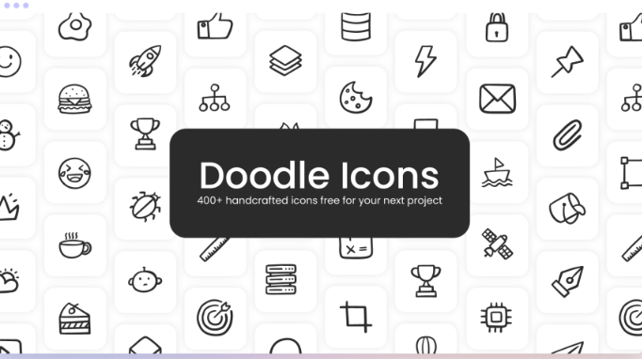
Set of icons
I prefer to use Doodle Icons , this set has solid clear edges ,more details ,friendly looking nice to the eye

Slide 4

Colors :
I would use the green for the Published
The green color means everything is right
Used Colors
Grey for the scheduled ,
This color point to something disabled
Orange for the Need Approval ,
since orange attract attention
Red for the Error ,
since red express danger

