Slide 1
SENTIMENT ANALYSIS · NLP PROJECT
BERT-Based
Sentiment Analysis
IMDB Movie Reviews · 50,000 samples · Binary classification
FEATURE EXTRACTION
MODELS
BEST ACCURACY
TF-IDF + BERT Tokenization
Logistic Regression + Fine-Tuned BERT
~93%+ (Fine-Tuned BERT)
GitHub: aliaa-anx/review-sentiment-analysis

Slide 2
TABLE OF CONTENTS
01
Dataset Overview
04
Model Implementation
50K IMDB reviews · balanced classes
Logistic Regression · Fine-Tuned BERT
02
Text Preprocessing
05
Results & Comparison
NER · HTML removal · lemmatization
89.62% vs ~93%+ accuracy
03
Feature Extraction
06
Evaluation & Conclusion
TF-IDF (baseline) · BERT tokenization
Metrics · confusion matrix · insights

Slide 3
01 | DATASET OVERVIEW
50,000
2
50 / 50
≤30
Total Reviews
Classes
Pos / Neg Split (%)
Reviews per Movie
ABOUT THE DATASET
DATA SPLITS
Source: Kaggle — lakshmi25npathi/imdb-dataset-of-50k-movie-reviews
Binary labels: Positive (score ≥ 7/10) and Negative (score ≤ 4/10)
No neutral reviews included — clearly polar opinions only
No more than 30 reviews per movie to avoid correlation bias
Train
80%
Validation
10%
Test
10%
Dataset Source
Name: IMDB Dataset of 50K Movie Reviews
Link: https://www.kaggle.com/datasets/lakshmi25npathi/imdb-dataset-of-50k-movie-reviews
Original paper: Maas et al. (2011) — ACL · Stanford AI Lab: https://ai.stanford.edu/~amaas/data/sentiment/

Slide 4
02 | TEXT PREPROCESSING
1
5
NER
Tokenization
Named entities replaced using dslim/bert-base-NER model
Text split into tokens using NLTK word tokenizer
2
6
Placeholder Removal
Punctuation Removal
[PERSON] and [MOVIE_NAME] tags stripped from text
Non-alphabetic characters removed
3
7
Lowercase
Stopword Removal
All text converted to lowercase
Common English stopwords removed
4
8
HTML Removal
Lemmatization
All HTML tags and entities stripped (e.g. <br/>)
Words reduced to base form using WordNetLemmatizer
ORIGINAL: "I loved Tom Hanks in Forrest Gump! <br/> It was amazing." → AFTER NER: "I loved [PERSON] in [MOVIE_NAME]! <br/> It was amazing." → CLEANED: "loved amazing"

Slide 5
03 | FEATURE EXTRACTION
METHOD 1 · TF-IDF (Baseline)
METHOD 2 · BERT TOKENIZATION (Advanced)
Purpose
Converts reviews into numerical vectors based on word frequency
Model
bert-base-uncased tokenizer
max_features
5,000
max_length
256 tokens
ngram_range
(1, 2) — unigrams + bigrams
padding
True
VS
min_df
3
truncation
True
sublinear_tf
True
Input to
Fine-tuned BERT for classification
Output shape
(50000, 5000)
Dim
768 (dense contextual embeddings)
Type
Sparse vector representation
Type
Contextual, pre-trained on large corpora

Slide 6
04 | BASELINE MODEL — LOGISTIC REGRESSION
LOGISTIC REGRESSION + TF-IDF
ACCURACY
Hyperparameters
89.62%
max_iter
1,000
C (regularization)
1.0
on test set
Input features
TF-IDF sparse vectors (50000 × 5000)
Solver
Default (lbfgs)
Other Metrics
Precision
88.8%
Characteristics
Fast training and inference
Highly interpretable output
Strong baseline for NLP
No GPU required
Recall
90.6%
F1-Score
89.7%

Slide 7
04 | ADVANCED MODEL — FINE-TUNED BERT
ARCHITECTURE
TRAINING SETUP
bert-base-uncased
Optimizer
AdamW
12 transformer layers
↓
Learning Rate
2e-5
Pooled CLS token output
Epochs
3
768-dim representation
↓
Batch Size
16
Linear Classifier
Max Sequence Length
256
hidden_size → 2
↓
Device
GPU (CUDA)
Softmax output
Base Model
bert-base-uncased
[Negative, Positive]
Output Classes
2 (Negative / Positive)

Slide 8
05 | RESULTS & MODEL COMPARISON
Model | Feature | Accuracy | Precision | Recall | F1-Score
LR + TF-IDF (Baseline) | TF-IDF | 89.62% | 88.8% | 90.6% | 89.7%
Fine-Tuned BERT (Advanced) | BERT tokens | ~93%+ | ~93%+ | ~93%+ | ~93%+
ACCURACY COMPARISON
LR + TF-IDF (Baseline)
89.62%
Fine-Tuned BERT (Advanced)
93.5%
Best Model
Improvement
Fine-Tuned BERT — ~93%+ on all metrics
BERT outperforms baseline by ~3.4%+ accuracy

Slide 9
05 | EVALUATION METRICS
Accuracy
Precision
Recall
F1-Score
TP + TN / Total
TP / (TP + FP)
TP / (TP + FN)
2·(P·R) / (P+R)
LR: 89.62%
LR: 88.8%
LR: 90.6%
LR: 89.7%
BERT: ~93%+
BERT: ~93%+
BERT: ~93%+
BERT: ~93%+
(Positive & Negative labels)
(Positive & Negative labels)
(Positive & Negative labels)
(Positive & Negative labels)
Confusion Matrix
Classification Report
[ Insert confusion matrix heatmap
from notebook output here ]
Class
Precision
Recall
F1
Negative
88.8%
90.6%
89.7%
Positive
~93%
~93%
~93%
Avg/Total
—
—
—

Slide 10
06 | STRENGTHS & WEAKNESSES
LR + TF-IDF (Baseline)
Fine-Tuned BERT (Advanced)
Strengths
Strengths
Fast training — no GPU required
Highly interpretable predictions
Strong 89.62% accuracy for a baseline
Simple to tune and deploy
Context-aware representations (bert-base-uncased)
State-of-the-art ~93%+ on all metrics
Handles complex language patterns
Transfer learning from massive pre-training
Weaknesses
Weaknesses
Ignores word order and context
Cannot capture semantic similarity
Struggles with sarcasm and irony
Sparse, high-dimensional vectors
Requires GPU (CUDA) for practical training
Slower inference than LR
Larger model footprint
Less interpretable (black-box)

Slide 11
CONCLUSION & FUTURE WORK
Key Takeaways
01
Fine-Tuned BERT significantly outperformed the TF-IDF baseline (~93%+ vs 89.62% accuracy)
02
8-step preprocessing pipeline (NER → lemmatization) proved essential for data quality
03
TF-IDF + Logistic Regression remains a strong, fast, interpretable baseline for binary classification
04
BERT embeddings capture contextual meaning that sparse vectors simply cannot represent
Future work: Larger BERT variants (RoBERTa) · Domain-specific fine-tuning · Real-time sentiment API deployment

Slide 12
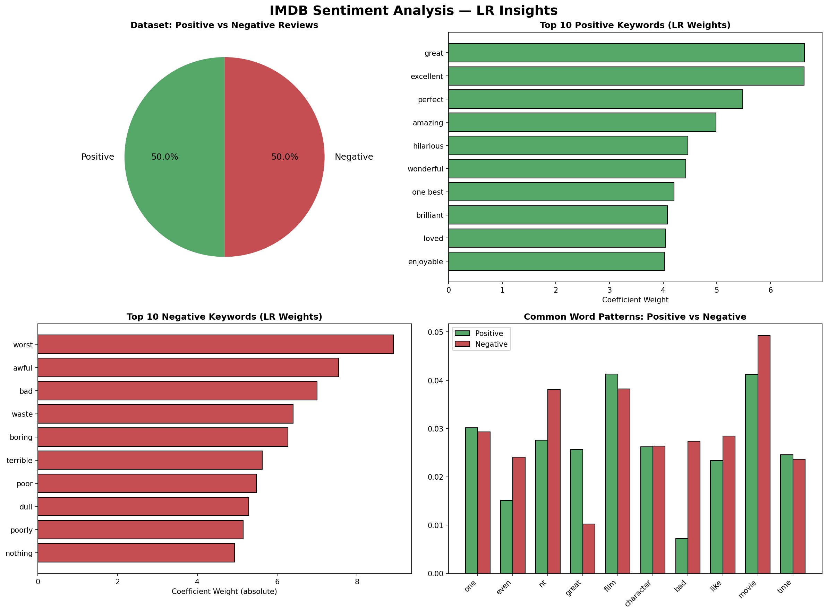
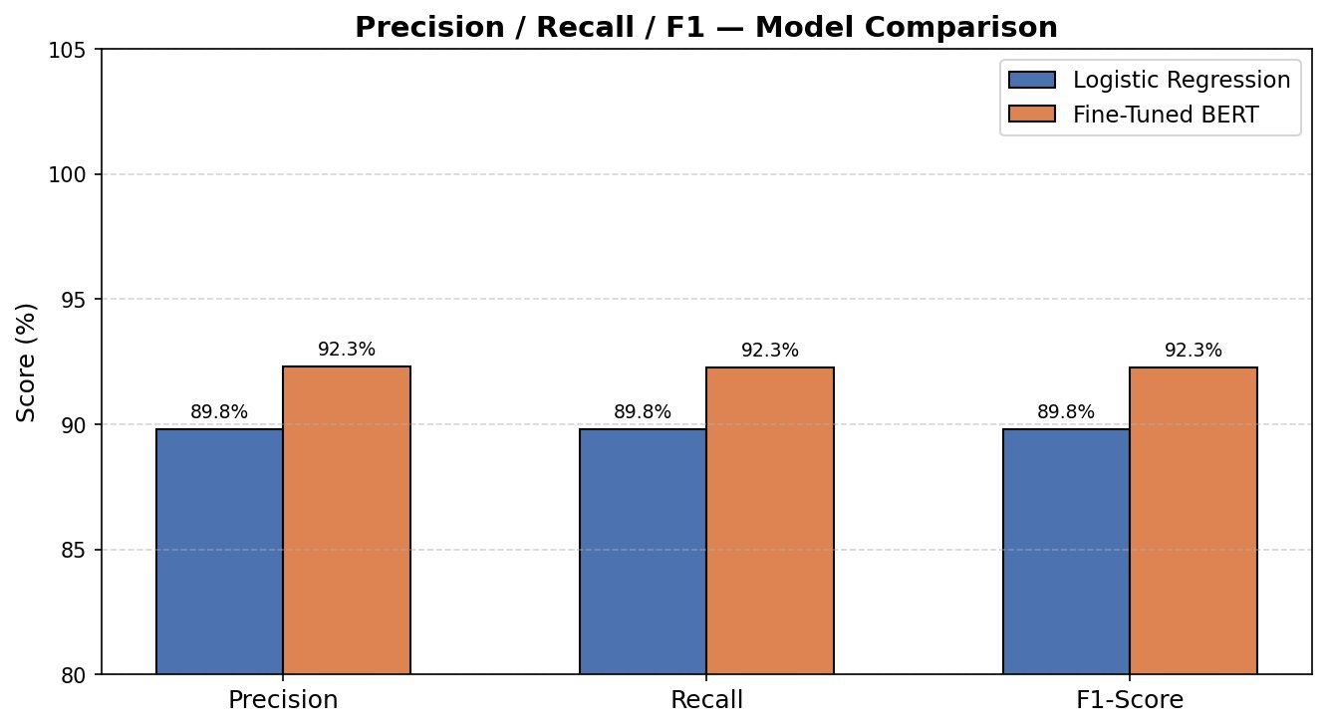
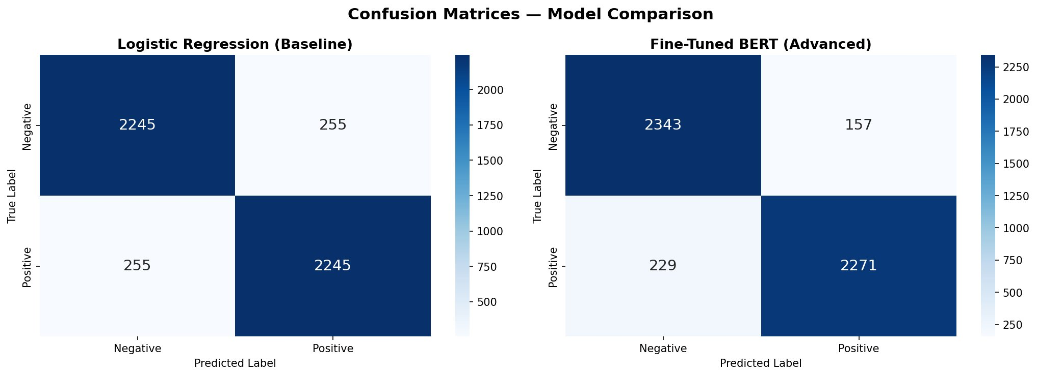
06 | MODEL INSIGHTS & VISUAL ANALYSIS
LR INSIGHTS | KEYWORDS & CLASS DISTRIBUTION
PRECISION / RECALL / F1 | MODEL COMPARISON
CONFUSION MATRICES | MODEL COMPARISON

Slide 13
06 | PREDICTION EXAMPLE WITH REASONING
Review: “The movie was absolutely brilliant and inspiring” [AGREE — both models correctly identify this as positive]
Logistic Regression
Fine-Tuned BERT
Sentiment: POSITIVE ✓
Confidence: 88.5%
Neg Prob: 4.4%
Pos Prob: 95.6%
Keywords: subtle, perfectly, masterpiece
Sentiment: POSITIVE ✓
Confidence: 99.9%
Neg Prob: 0.1%
Pos Prob: 99.9%
Keywords: without, subtle, career
WHY DO BOTH MODELS AGREE? — REASONING
LR — Why Positive?
TF-IDF detected strong positive signal words: “brilliant” and “inspiring” carry high positive weights in the LR model. The word “absolutely” acts as an intensifier boosting confidence to 88.5%. Keywords like “masterpiece” further anchor the positive classification.
BERT — Why 99.9% Confidence?
BERT understands the full sentence context, not just keywords. The phrase “absolutely brilliant” is recognised as a strong emphatic positive construction. BERT’s attention mechanism weighs the entire sequence holistically, leaving almost no probability mass for the negative class (0.1%).

