Slide 1
Final Presentation:
California Home Price Prediction
Alia Alami

Slide 2
The Business Question
Can we accurately forecast California home values from neighborhood-level demographics and geography; and use that to forecast price?
Who this matters to
Market backdrop
Why
Home Buyers: Avoid overpaying and identify undervalued neighborhoods
Home Sellers/ Real Estate Agents: price homes competitively to sell faster and maximize profit
Investors / Flippers:
Spot opportunities earlier
The 1990 California housing dataset remains a benchmark, capturing the core drivers of home values, income, location, and density, that still shape pricing today.
California housing prices vary massively (up to ~30x) depending on location, income, and density.

Slide 3
DATASET OVERVIEW
Source: 1990 U.S. Census describing housing conditions across California districts (block groups).
Each row represents one geographic district and includes aggregated housing metrics and demographic indicators.
The target variable is median_house_value, the median home sale price within that district.
20,640
10
207
1990
Distinct Observations
Features
Missing Values
Data Source Year

Slide 4
FEATURES & TARGET VARIABLE
GEOGRAPHIC & HOUSING FEATURES
Coordinates: Longitude, Latitude of the District
Median age of houses in the district
Total number of rooms across homes
Total bedrooms*
Total population in the district
Number occupied housing units (households)
ECONOMIC & CATEGORICAL FEATURES
Median household income (scaled)
Ocean Proximity (Categorical)
TARGET VARIABLE
Median House Sale Price in a District
*This field had 207 missing values which was filled with the median value

Slide 5

PROJECT OBJECTIVES
01
Predict house value for any California tract.
METRICS USED
R²
Share of variance in price; explains price variation.
MAE
Average prediction error.
RMSE
Penalizes big mistakes (expensive homes).
02
Test whether a neural network beats OLS.
03
Quantify which features drive price and by how much.

Slide 6
KEY DATA OBSERVATIONS
GEOGRAPHIC CLUSTERING
INCOME AS PREDICTOR
MULTICOLLINEARITY
Long/lat observations are primarily located in central California.
Median income shows the strongest correlation with home value; higher income districts command higher prices.
Total rooms, bedrooms, households, and population are highly correlated and were removed from the model.
DISTRIBUTION SKEW
OCEAN PROXIMITY
PRICE CAPPING
Right-skewed distribution was addressed via log transformation.
Coastal and near-bay districts have notably higher median home values than inland districts.
Target variable is capped at $500,000, limiting representation of high-value homes.

Slide 7
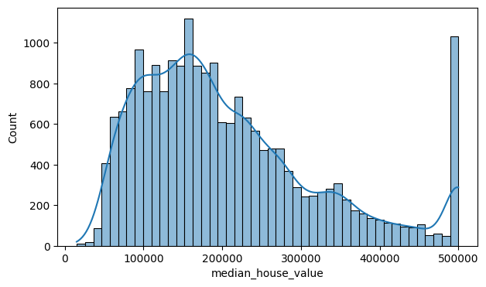
MEDIAN_HOUSE_VALUE
Key Statistics
• Right-skewed Distribution: 0.978
• Median Tract Value: $179,000
• Mean Value: $206,586
Data Adjustments
Price Capping: Values capped at $500,001 to limit the influence of high-value outliers on model accuracy.
Log1p Transformation: Applied to address skewness, resulting in a near-symmetric distribution (-0.173).
Right skewed Distribution (0.978)
Cap at $500,001
Median tract value ($179,000)
Mean ($206,586)
Log1p transformation brings new skew to (-0.173) ~ near symmetric
Cap was applied to limity any models accur

Slide 8
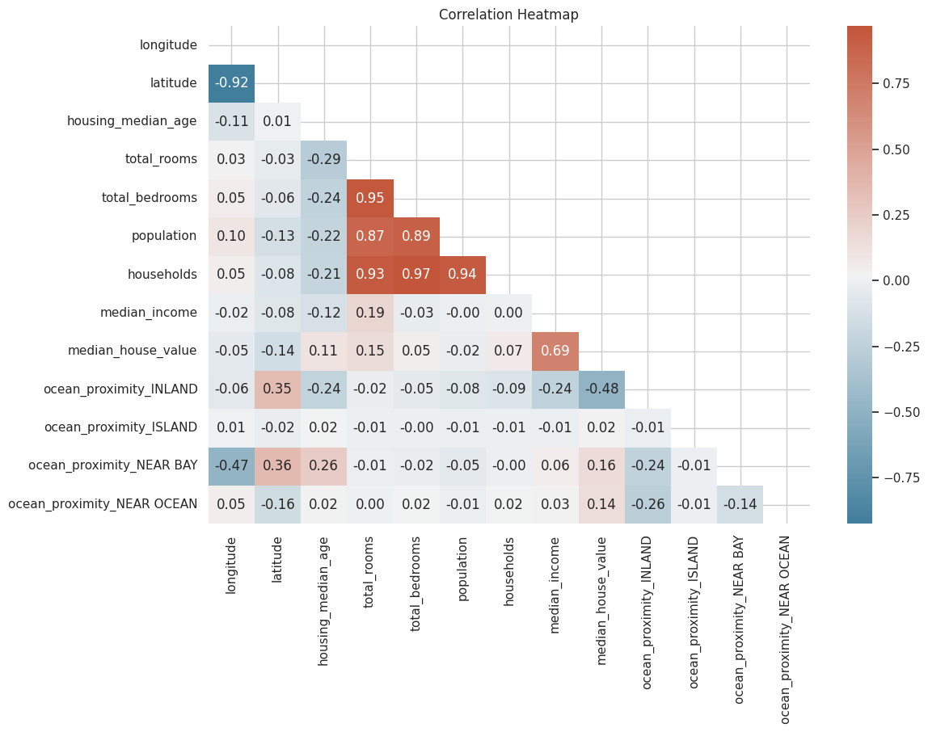
HEATMAP
Key Inferences
• r = 0.69
(median income ~ median house value)
• Total rooms, total bedrooms, population, households |r| > 0.85 ~ multicollineraity
• Latitude shows negative correlation with price.
• Latitude/longtiude correlate at r = -0.92

Slide 9
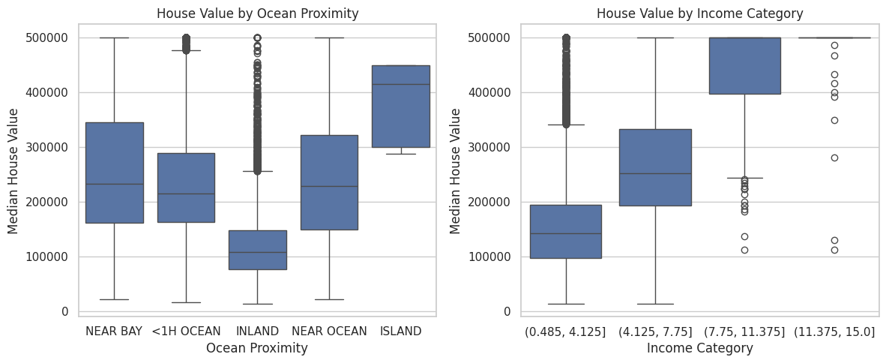
TARGET VISUILIZATIONS
Ocean proximity is a strong, non-linear regional signal
$500k ceiling flattens the top
Location and income dominate - they are also two features our models rely on the most.

Slide 10
Data Preparation & Addressing Redundancies
filter_alt
layers
check_circle
1. Refining the Dataset
Removing Extremes: Removed top 1% prices to prevent outliers from skewing the "normal" house baseline.
Simplifying Categories: Converted location tags (Inland/Ocean) into Yes/No numerical switches for processing.
2. Solving Overlap
The Issue: Multicollinearity between "total rooms" and "population" confused the model.
The Fix: Combined overlapping stats into "bedrooms per household" and dropped redundant columns.
3. Final Math Checks
Unique Value (VIF): Guaranteed every feature brought unique info; dropped map coordinates.
Leveling the Field: Scaled data so population size (5,000) didn't outweigh income levels (4).
These steps ensure a robust dataset, allowing the Neural Network to focus on meaningful patterns.

Slide 11

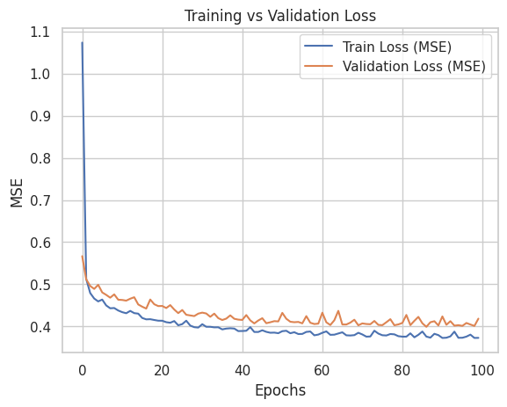
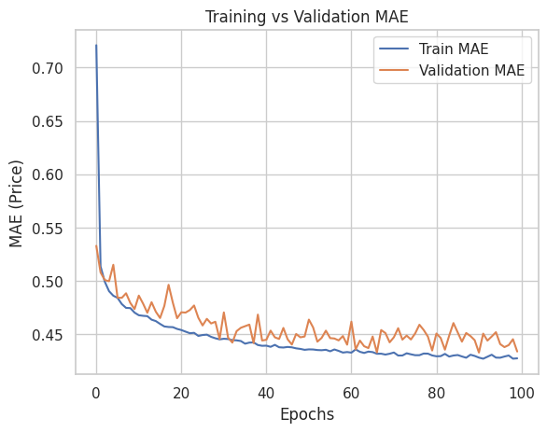
Model Selection, Evaluation, & Next Steps
Choosing Our Prediction Tools
Standard Regression: The Transparent Approach. Provides a clear receipt of how features drive price.
Neural Network: The Advanced Approach. Uncovers hidden, complex market patterns AI-style.
The Trade-off: Regression can oversimplify, while Neural Networks act as a "black box" harder to explain.

Slide 12
Conclusions
Selected Model: Neural Network (R² = 0.68, MAE = $43,452)
Neural Network vs OLS
What the Model Tells Us
Performance Improvement:
Neural Network R²: 0.68
OLS R²: 0.617
The Neural Network offers a superior fit for the housing data compared to traditional linear regression.
Typical Deviation (MAE)
Average price prediction error: $43,452.09
Impact of Outliers (RMSE)
Higher at $63,016.24, indicating extreme pricing outliers.
Explains ~70% of variance in CA housing prices.
Neural network features successfully capture the complex dynamics of the California housing market.

Slide 13

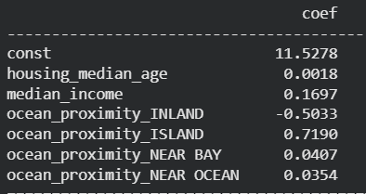
OLS Considerations: Key Market Drivers
OLS Considerations: Key Market Drivers
Positive Drivers
Neighborhood Income:
Strongest everyday driver. Every 1-unit increase jumps home value by ~17%.
The "Island" Premium:
Being on an island drives up baseline value by over 70% vs. standard coastal properties.
Negative Drivers
Moving Inland:
Moving to an "Inland" region slashes expected value by roughly 50% compared to properties near the ocean.

Slide 14
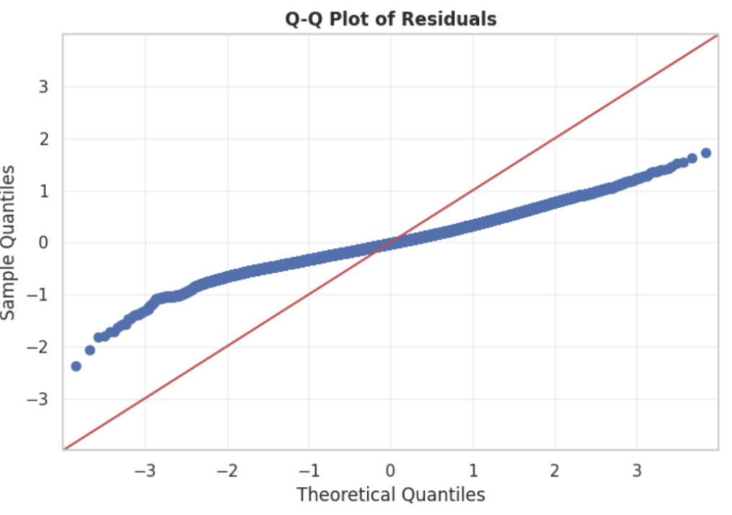
Model Diagnostics & Assumptions Validation
Linearity: The model assumes a straight-line relationship.This mostly holds based on the residual plots.
Multicollinearity: Some variables were too similar to each other. We removed them to make the model more stable.
Homoscedasticity: Errors should be evenly spread. In our case, errors are larger for very cheap and very expensive homes.
Normality of Residuals: Errors are roughly normally distributed, which is acceptable.

Slide 15
Limitations & Challenges
Data & Temporal Constraints
Statistical Performance
1990 Census data: Market dynamics have shifted significantly since collection.
No temporal data: Model cannot account for market cycles or regional trends.
$500K price cap: Underperforms significantly on luxury properties.
Heteroscedasticity: Errors are unevenly distributed across price ranges.
The Unexplained 30%
Struggling with Extremes
Missing Variables: Our best model explains ~70% of housing price variance.
Significant price factors remain uncaptured by the current feature set.
Outlier Impact: Average error is ~$43,000, but RMSE jumps to >$63,000 due to outliers.
High "strict penalty" error reveals sensitivity to extreme housing prices.
Addressing these limitations is key to improving model reliability for real-world deployment.

Slide 16


FUTURE MODEL IMPROVEMENTS
Better Models
Better Evaluation
VGradient Boosting (XBoost / LightGBM)
Tree-based ensembles typically outperform plain Neural Gradient
Boosting (XGBoost / LightGBM) Tree-based ensembles typically outperform plain Neural Networks on tabular data with mixed feature types. Lower training time and built-in feature importance provide a strong baseline to beat.
Robust OLS (HC3 Standard Errors) Address detected heteroscedasticity by switching to heteroscedasticity consistent standard errors. Maintains interpretability while producing statistically valid coefficient confidence intervals.
Segmented Models Train separate models per price tier (budget / mid-market / luxury) and per region (Bay Area, LA, Central Valley). Reduces within-segment variance and improves accuracy for each sub-market.
Hyperparameter Tuning Apply grid search or Bayesian optimization to the Neural Network (layers, neurons, dropout, learning rate). Even modest tuning often yields 3–7% R² gains with the same architecture.
Cross-Validation Replace single train/test split with 5-fold or 10-fold cross-validation.
SHAP Explainability Use SHAP (SHapley Additive exPlanations) to generate per-prediction feature contributions.
Threshold-Based Alerts Define acceptable prediction error bands (e.g., ±15%). Flag predictions outside this band for human review rather than passing them directly to clients, improving reliability at deployment.
Benchmark Against Zillow Zestimate Compare model MAE against publicly reported Zestimate accuracy (~2–4% median error). This positions the model in competitive context and identifies the gap to close in future iterations.

