Slide 1
Elegance Atelier
Aliaa Abbas – 3747
Salma Tharwat – 3787
Nayera AbdelSamie - 4032
Esraa Hussein – 4375

Slide 2
Executive Summary
This is a proposed plan for a professional soiree atelier in Egypt, initially in the city of Alexandria, Why specifically this city?? Because Alexandria is the perfect combination between modernism and the old culture.
Our project will provide as an initial phase a mini workshop located in “Kafr Abdu”; where most of the targeted category of customers live. That way it would be more easily accessible.
The mini workshop will speedily grow to be a huge company with its well-known worldwide brand soon it will have its own fashion show that will be made all over the world especially in the city of fashion (France). Moreover, it will not be restricted to soiree only but also all kind of clothes, however how that will happen? And what is the special features that will make it different from other ateliers?

Slide 3
Vision
“A better interaction with life”
Elegance atelier aims to develop a collaborative movement which will transform social and environmental standards in the fashion industry within a short period of time.

Slide 4
Goals
The eradication of exploitation, hardship and environmental damage from the supply chains to the fashion industry and the practices of fashion businesses.
The raising of customers awareness in relation to elegant fashion.
The creation of a model and precedent for fashion industry change which can be drawn from and built upon by other fashion companies.

Slide 5
Market Overview
In an inflated Market of readily manufactured clothes, the scarcity of designer brands and taylor made clothes that are original and fit well allows for the proposed project to strive.
While most existent ateliers specialize in Soiree dresses, the specialization of our atelier to also include casual wear helps broaden the target audiences and increase sales as well as attract new customers that do not normally go to existing ateliers

Slide 6
SWOT ANALYSIS
S -> “Strength” : Service quality, Good location, Reliability, original products customized to client preferences, Relatively economical.
W -> “Weakness” : Designing and Manufacturing is naturally timely.
O -> “Opportunity”: Growth rate , Progress in fashion in Egypt.
T -> “Threat”: High Competition

Slide 7
Legal study
Health Department Permits
IDs of all partners
Bank statements for all Partners
Taxing Statements of partners
Contracts for all Heads and employees
Photocopies of valid professional practicing License
Photocopies of IDs
Contracts for Water, Electricity and Gas supplies at the corresponding governmental centers.

Slide 8
Organizational Structure
The 4 Founders.
Main Taylor
Head of Technical & Financial
Head of Marketing & Sales
Head of Public Relations
Head of Human Resources

Slide 9
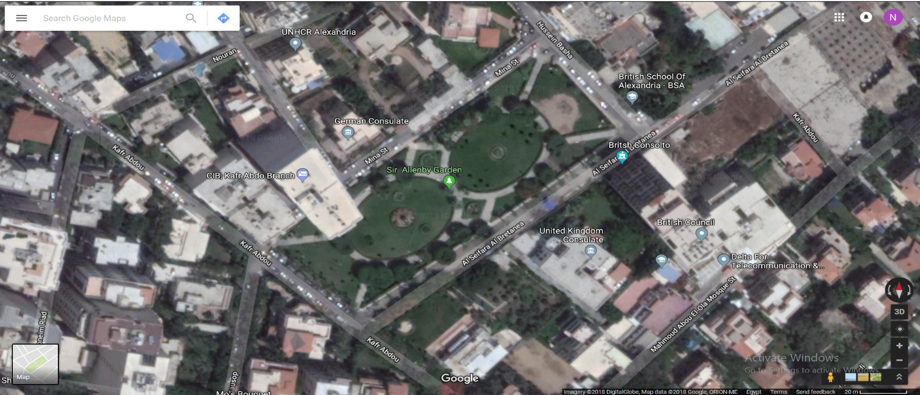
Technical Analysis
Location

Slide 10
Technical Analysis
Reach & Accessibility
The Location Allows for easy accessibility and Reach to the Atelier
Infrastructural Condition
Location in a newly built and well structured building with all sources (Water, electricity, Fuel) reachable with newest technology
Costs & Construction Requirements
Infrastructural condition requires little costs other than final finishes to the Atelier (Internal Designs & preparations)

Slide 11
Marketing Analysis
Target Audience
Ladies
Teenagers
Young Adults
People with a love of Taylor made clothes

Slide 12
Marketing Analysis
Sales Plan
Clients will order a certain item and describe their idea of the design and
When they would like it to be ready and our Fashion Designers will work on them together.
We commit to delivering the designs within the period the client asks for

Slide 13
Marketing analysis
Marketing Plan
Social Media: Through online pages on Facebook & Instagram as well as paid ads.
Fliers & Posters

Slide 14
Financial Analysis
Investment Costs
Insurance for Atelier Rentals (one-month rental) | 10,000
Sewing Machines (20 machines*1500/machine) | 22,500
Electronic Equipment | 20,000
Security System | 10,000
Software System | 5,000
Interior Preparation | 100,000
Furniture | 40,000
Paperwork Costs | 10,000
Project Insurances & Preliminary Taxes | 40,000
Total Investment Costs | 257,500

Slide 15
Financial Analysis
Materials
Estimated15 customers/day = 450 customers/month = 5400 customer/year
Estimated ~2 meters of materials per order = 10,800 metre/year
Estimated Median of L.E 80/metre = 864,000 L.E/year
Accessories
Estimated 5000 L.E/Month for buttons, clips, etc.. = 60,000 L.E/year
Total = L.E 924,000
Salaries = L.E 300,000
Rentals = L.E 120,000
Marketing = L.E 19,200

Slide 16
Financial Analysis
Annual Running Costs
Total Annual Cash Out
Materials** | 924,000
Equipment Maintenance | 5,000
Premises Maintenance | 2,000
Software Maintenance | 1,000
Employee Uniforms (20 employees*150/uniform) | 3,000
Material Shipping (12*1000 per monthly ships) | 12,000
Water and Electricity | 3,000
Total | 950,000
Materials/Maintenance | 950,000
Rentals | 120,000
Salaries | 300,000
Marketing Costs | 19,200
Total | 1,389,200

Slide 17
Financial Analysis
Total Annual Cash In
Based on our average Calculations of expected turnout and supply and demand we expect a yearly Income of L.E 2,160,000 through Sales of Client orders
Estimated 15 customers/day = 450 customers/month = 5400 customer/year
Estimated Price of a piece = 400 L.E
Total = 400 L.E/Order * 5400 Orders/Year = L.E 2,160,000

Slide 18
Financial Analysis
Income Statement
 | Year 1 | Year 2 | Year 3 | Year 4 | Year 5
Total Revenue | 2,160,000 | 2,160,000 | 2,160,000 | 2,160,000 | 2,160,000
Cost Depreciation (257,500/5) Operation Cost | 51,500 1,389,200 | 51,500 1,389,200 | 51,500 1,389,200 | 51,500 1,389,200 | 51,500 1,389,200
Total | 1,440,700 | 1,440,700 | 1,440,700 | 1,440,700 | 1,440,700
Profit Before Tax Tax (25%) | 719,300 179,825 | 719,300 179,825 | 719,300 179,825 | 719,300 179,825 | 719,300 179,825
Profit After Tax | 539,475 | 539,475 | 539,475 | 539,475 | 539,475
Add depreciation | 51,500 | 51,500 | 51,500 | 51,500 | 51,500
Net cash Flow | 590,975 | 590,975 | 590,975 | 590,975 | 590,975

Slide 19
Financial Analysis
Cash Flow Forecast
 | Year 0 | Year 1 | Year 2 | Year 3 | Year 4 | Year 5
Cash Inflow(I) | 257,500 | 2,160,000 | 2,160,000 | 2,160,000 | 2,160,000 | 2,160,000
Cash Outflow(II) Op (Cost+Tax) Total | 257,500 | 1,389,200 + 179,825 = 1,569,025 | 1,389,200 + 179,825 = 1,569,025 | 1,389,200 + 179,825 = 1,569,025 | 1,389,200 + 179,825 = 1,569,025 | 1,389,200 + 179,825 = 1,569,025
NCF (I-II) PWF 10% NPW | 0 1 0 | 590,975 0.9174 542,161 | 590,975 0.8417 497,424 | 590,975 0.7222 426,802 | 590,975 0.7084 418,647 | 590,975 0.6804 402,099

Slide 20
Thank You..

