Slide 1
Problem Solving by Search
‹#›
CHAPTER 3
Stuart Russell and Peter Norvig, Artificial Intelligence: A Modern Approach, Global Edition 3/E
Artificial Intelligence - Modern Approach

Slide 2
Outline
‹#›
Problem formulation: representing sequential problems.
Example problems.
Planning for solving sequential problems without uncertainty.
Basic search algorithms

Slide 3
Environment Type Discussed In this Lecture
‹#›
Fully Observable
Static Environment
yes
Deterministic
yes
Sequential
yes
no
Discrete
no
yes
Discrete
no
yes
Planning, heuristic search
Control, cybernetics
Vector Search: Constraint Satisfaction
Continuous Function Optimization

Slide 4
Choice in a Deterministic Known Environment
‹#›
Without uncertainty, choice is trivial in principle: choose what you know to be the best option.
Trivial if the problem is represented in a look-up table.
Option | Value
Chocolate | 10
Coffee | 20
Book | 15
This is the standard problem representation in decision theory (economics).

Slide 5
Computational Choice Under Certainty
‹#›
But choice can be computationally hard if the problem information is represented differently.
Options may be structured and the best option needs to be constructed.
E.g., an option may consist of a path, sequence of actions, plan, or strategy.
The value of options may be given implicitly rather than explicitly.
E.g., cost of paths need to be computed from map.

Slide 6
Problem Types
Deterministic, fully observable -> single-state problem
Agent knows exactly which state it will be in; solution is a sequence
Non-observable -> conformant problem
Agent may have no idea where it is; solution (if any) is a sequence
Nondeterministic and/or partially observable -> contingency problem
percepts provide new information about current state solution is a contingent plan or a policy often interleave search, execution
Unknown state space -> exploration problem (“online”)

Slide 7
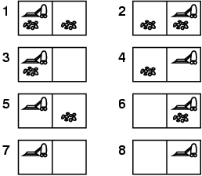
Sequential Action Example
‹#›
Deterministic, fully observable: single-state problem
Agent knows exactly which state it will be in; solution is a sequence
Vacuum world: everything observed
Romania: The full map is observed
Single-state:
Start in #5. Solution??
[Right, Suck]

Slide 8
Example: Romania
‹#›
On holiday in Romania; currently in Arad.
Formulate goal:
be in Bucharest
Formulate problem:
states: various cities
actions: drive between cities
Find solution:
sequence of cities, e.g., Arad, Sibiu, Fagaras, Bucharest

Slide 9
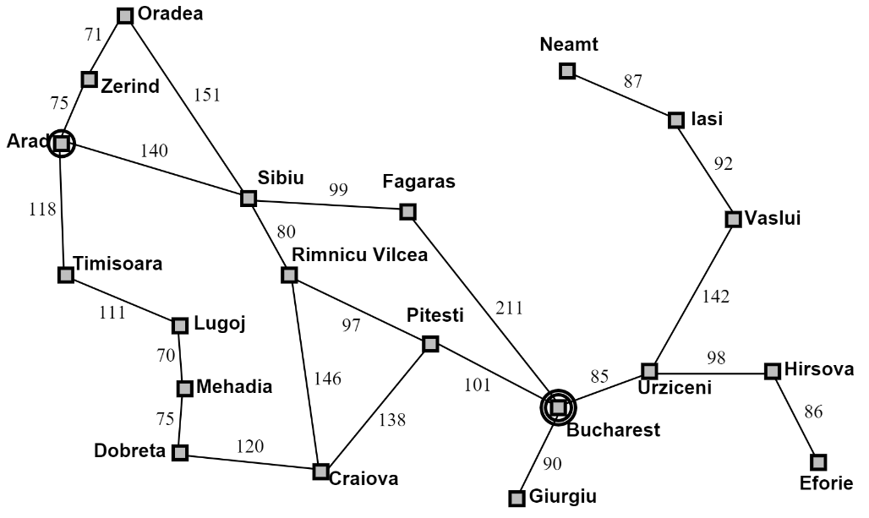
Example: Romania
‹#›
Abstraction: The process of removing details from a representation Is the map a good representation of the problem? What is a good replacement?

Slide 10
Single-state problem formulation
A problem is defined by 4 items:
initial state e.g., “at Arad”
Successor function S(x)= set of action–state
Goal test, can be
explicit, e.g., x = “at Bucharest”, or “checkmate” in chess
implicit, e.g., NoDirt(x)
Path cost (additive) e.g., sum of distances, number of actions executed, etc. c(x, a, y) is the step cost, assumed to be ≥ 0
A solution is a sequence of actions leading from the initial state to a goal state

Slide 11
The successor function
Successor function: for a given state, returns a set of action/new-state pairs.
Vacuum-cleaner world: (A, dirty, clean) → (’Left’, (A, dirty, clean)),(’Right’, (B, dirty, clean)), (’Suck’, (A, clean, dirty)), (’NoOp, (A, dirty, clean))
Romania: In(Arad) → ((Go(Timisoara), In(Timisoara), (Go(Sibiu), In(Sibiu)), (Go(Zerind), In(Zerind))

Slide 12
Size of space
8-puzzle: 9!/2 = 181, 000 states (easy)
15-puzzle: ∼ 1.3 trillion states (pretty easy)
24-puzzle: ∼ 1025 states (hard)
TSP, 20 cities: 20! = 2.43 × 1018 states (hard)

Slide 13
Selecting a state space
‹#›
Real world is complex
state space must be abstracted for problem solving
(Abstract) state = set of real states
(Abstract) action = complex combination of real actions
e.g., "Arad -> Zerind" represents a complex set of possible routes, detours, rest stops, etc.
(Abstract) solution =
set of real paths that are solutions in the real world
Each abstract action should be "easier" than the original problem

Slide 14
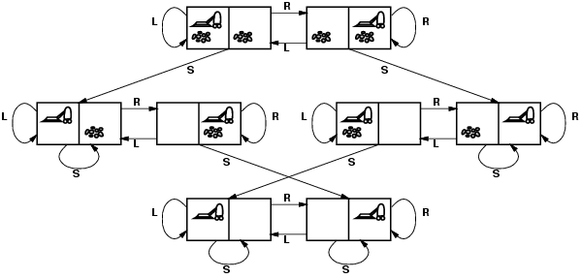
Vacuum world state space graph
‹#›
states?
actions?
goal test?
path cost?

Slide 15
Vacuum world state space graph
‹#›
states? integer dirt and robot location
actions? Left, Right, Suck
goal test? no dirt at all locations
path cost? 1 per action

Slide 16
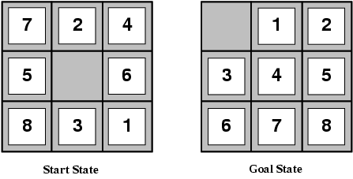
Example: The 8-puzzle
‹#›
states?
actions?
goal test?
path cost?

Slide 17
Example: The 8-puzzle
‹#›
states? locations of tiles
actions? move blank left, right, up, down
goal test? = goal state (given)
path cost? 1 per move
[Note: optimal solution of n-Puzzle family is NP-hard]

Slide 18
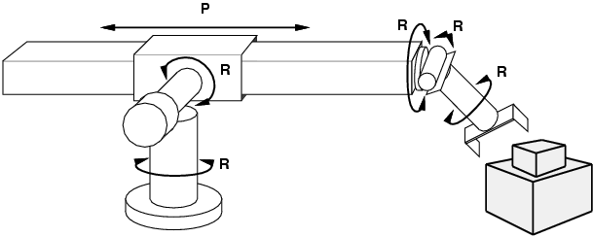
Example: robotic assembly
‹#›
states?: real-valued coordinates of robot joint angles parts of the object to be assembled
actions?: continuous motions of robot joints
goal test?: complete assembly
path cost?: time to execute

Slide 19
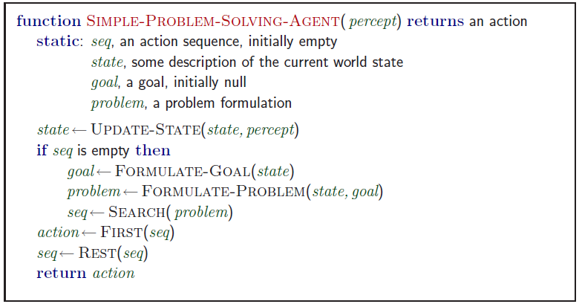
Problem-solving agents
‹#›
Note: this is offline problem solving; solution executed “eyes closed.”

Slide 20
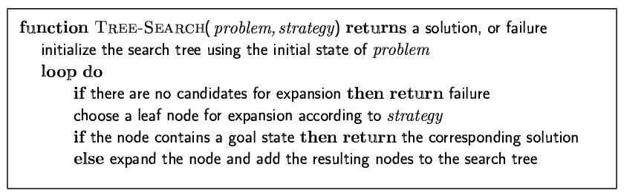
Tree search algorithms
‹#›
Basic idea:
offline, simulated exploration of state space by generating successors of already-explored states (a.k.a.~expanding states)

Slide 21
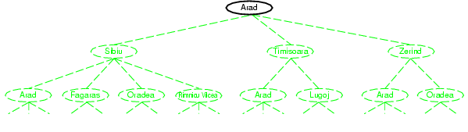
Tree search example
‹#›

Slide 22
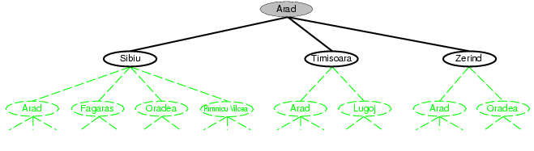
Tree search example
‹#›

Slide 23
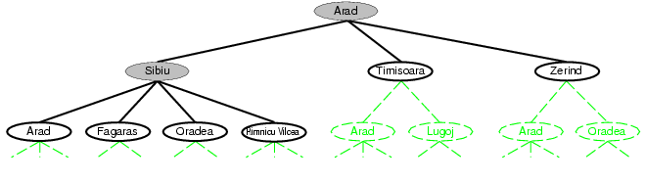
Tree search example
‹#›

Slide 24
Search Graph vs. State Graph
‹#›
Be careful to distinguish
Search tree: nodes are sequences of actions.
State Graph: Nodes are states of the environment.
We will also consider soon search graphs.
Demo: http://aispace.org/search/

Slide 25
Search strategies
‹#›
A search strategy is defined by picking the order of node expansion
Strategies are evaluated along the following dimensions:
completeness: does it always find a solution if one exists?
time complexity: number of nodes generated
space complexity: maximum number of nodes in memory
optimality: does it always find a least-cost solution?
Time and space complexity are measured in terms of
b: maximum branching factor of the search tree
d: depth of the least-cost solution
m: maximum depth of the state space (may be ∞)

Slide 26
Search Strategies
Uninformed (blind) search
Informed Search
Adversarial Search (Game Theory)

Slide 27
Uninformed search strategies
‹#›
Uninformed search strategies use only the information available in the problem definition
Uninformed search (blind search)
Breadth-first search
Depth-first search
Depth-limited search
Iterative deepening search

Slide 28
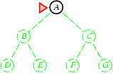
Breadth-first search
‹#›
Expand shallowest unexpanded node
Implementation:
is a FIFO queue, i.e., new successors go at end

Slide 29
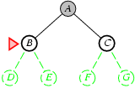
Breadth-first search
‹#›
Expand shallowest unexpanded node
Implementation:
is a FIFO queue, i.e., new successors go at end

Slide 30
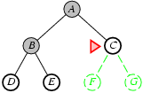
Breadth-first search
‹#›
Expand shallowest unexpanded node
Implementation:
is a FIFO queue, i.e., new successors go at end

Slide 31
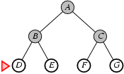
Breadth-first search
‹#›
Expand shallowest unexpanded node http://aispace.org/search/
Implementation:
is a FIFO queue, i.e., new successors go at end

Slide 32
Properties of breadth-first search
‹#›
Complete? Time? Space? Optimal?
Complete? Yes (if b is finite)
Time? 1+b+b²+b³+… +b^{d} + b(b^{d}-1) = O(b^{d+1})
Space? O(b^{d+1}) (keeps every node in memory)
Optimal? Yes (if cost = 1 per step)
Space is the bigger problem (more than time)

Slide 33
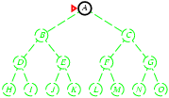
Depth-first search
‹#›
Expand deepest unexpanded node
Implementation:
LIFO queue, i.e., put successors at front

Slide 34
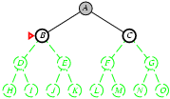
Depth-first search
‹#›
Expand deepest unexpanded node
Implementation:
LIFO queue, i.e., put successors at front

Slide 35
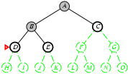
Depth-first search
‹#›
Expand deepest unexpanded node
Implementation:
LIFO queue, i.e., put successors at front

Slide 36
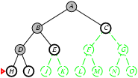
Depth-first search
‹#›
Expand deepest unexpanded node
Implementation:
frontier = LIFO queue, i.e., put successors at front

Slide 37
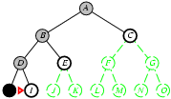
Depth-first search
‹#›
Expand deepest unexpanded node
Implementation:
LIFO queue, i.e., put successors at front

Slide 38
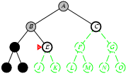
Depth-first search
‹#›
Expand deepest unexpanded node
Implementation:
LIFO queue, i.e., put successors at front

Slide 39
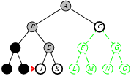
Depth-first search
‹#›
Expand deepest unexpanded node
Implementation:
LIFO queue, i.e., put successors at front

Slide 40
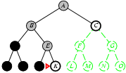
Depth-first search
‹#›
Expand deepest unexpanded node
Implementation:
LIFO queue, i.e., put successors at front

Slide 41
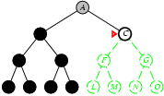
Depth-first search
‹#›
Expand deepest unexpanded node
Implementation:
LIFO queue, i.e., put successors at front

Slide 42
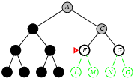
Depth-first search
‹#›
Expand deepest unexpanded node
Implementation:
LIFO queue, i.e., put successors at front

Slide 43
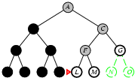
Depth-first search
‹#›
Expand deepest unexpanded node
Implementation:
LIFO queue, i.e., put successors at front

Slide 44
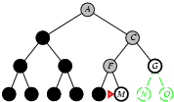
Depth-first search
‹#›
Expand deepest unexpanded node http://aispace.org/search/
Implementation:
LIFO queue, i.e., put successors at front

Slide 45
Properties of depth-first search
‹#›
Complete? Time? Space? Optimal?
Complete? No: fails in infinite-depth spaces, spaces with loops
Modify to avoid repeated states along path (graph search)
🡪 complete in finite spaces
Time? O(b^{m}): terrible if maximum depth m is much larger than solution depth d
but if solutions are dense, may be much faster than breadth-first
Space? O(bm), i.e., linear space! Store single path with unexpanded siblings.
Seems to be common in animals and humans.
Optimal? No. Important for exploration (on-line search)

Slide 46
Depth-limited search
‹#›
depth-first search with depth limit l,
i.e., nodes at depth l have no successors
Solves infinite loop problem
Common AI strategy: let user choose search/resource bound. Complete? No if l < d:
Time? O(b^{l}):
Space? O(bl), i.e., linear space!
Optimal? No if l > b

Slide 47
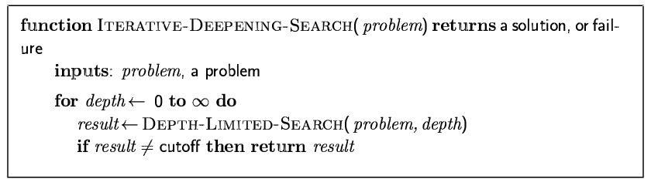
Iterative deepening search
‹#›

Slide 48
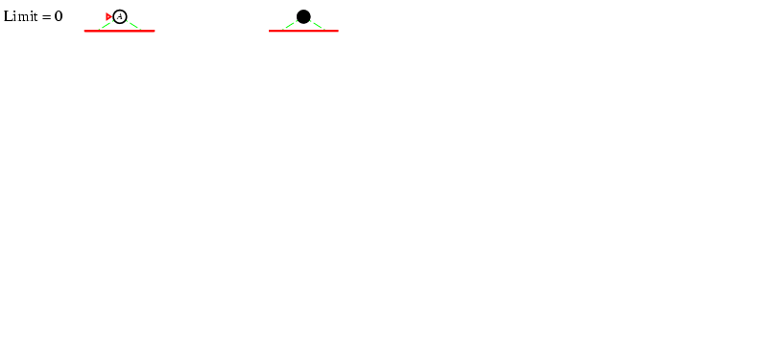
Iterative deepening search l =0
‹#›

Slide 49
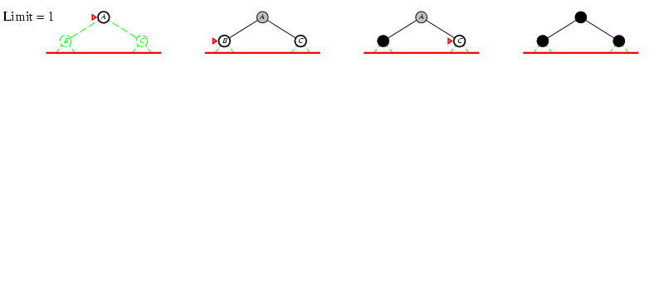
Iterative deepening search l =1
‹#›

Slide 50
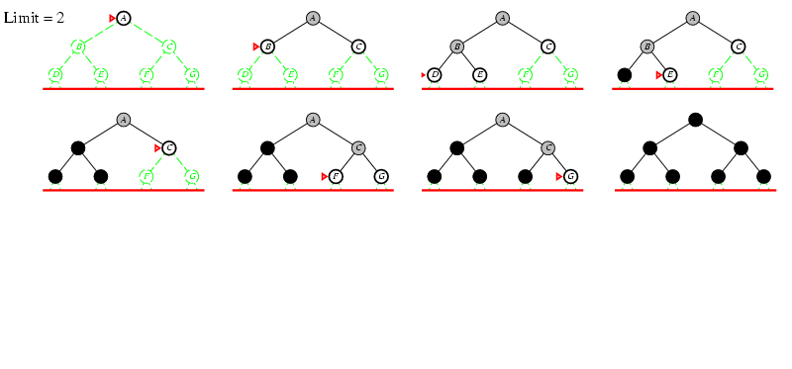
Iterative deepening search l =2
‹#›

Slide 51
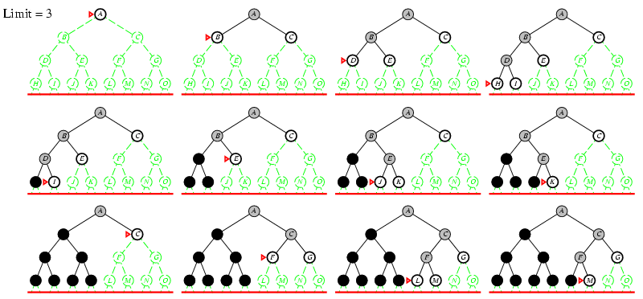
Iterative deepening search l =3
‹#›

Slide 52
Iterative deepening search
‹#›
Number of nodes generated in a depth-limited search to depth d with branching factor b:
N_{DLS} = b⁰ + b¹ + b² + … + b^{d-2} + b^{d-1} + b^{d}
Number of nodes generated in an iterative deepening search to depth d with branching factor b:
N_{IDS} = (d+1)b⁰ + d b¹ + (d-1)b² + … + 3b^{d-2} +2b^{d-1} + 1b^{d}
For b = 10, d = 5, N_{DLS} = 1 + 10 + 100 + 1,000 + 10,000 + 100,000 = 111,111 N_{IDS} = 6 + 50 + 400 + 3,000 + 20,000 + 100,000 = 123,456
Overhead = (123,456 - 111,111)/111,111 = 11%

Slide 53
Properties of iterative deepening search
‹#›
Complete? Yes
Time? (d+1)b⁰ + d b¹ + (d-1)b² + … + b^{d} = O(b^{d})
Space? O(bd)
Optimal? Yes, if step cost = 1

Slide 54
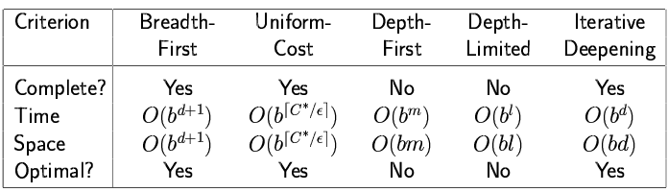
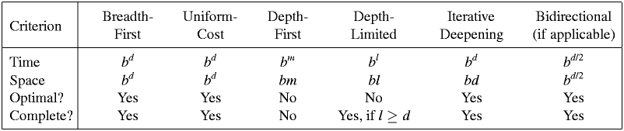
Summary of algorithms
‹#›

Slide 55
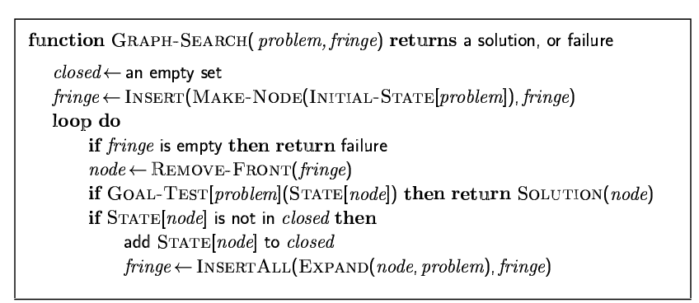
Graph search
‹#›
Simple solution: just keep track of which states you have visited.
Usually easy to implement in modern computers.

Slide 56
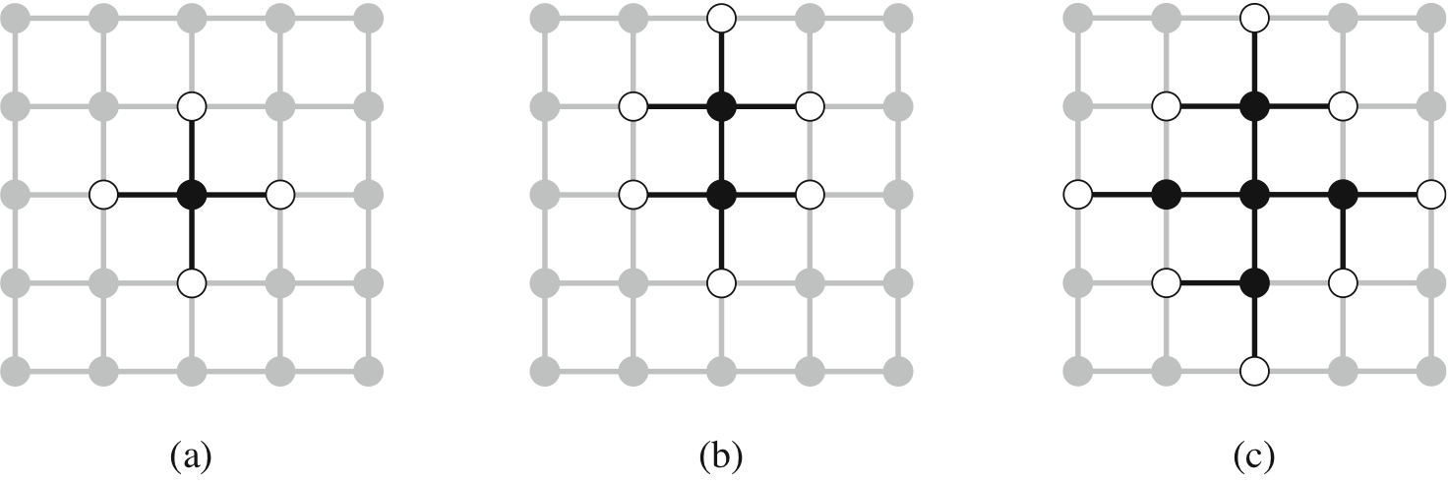
The Separation Property of Graph Search
‹#›
Black: expanded nodes.
White: frontier nodes.
Grey: unexplored nodes.

Slide 57
Summary
‹#›
Problem formulation usually requires abstracting away real-world details to define a state space that can feasibly be explored
Variety of uninformed search strategies
Iterative deepening search uses only linear space and not much more time than other uninformed algorithms

Slide 58
End of Chapter 3

Slide 59
Informed search algorithms
CHAPTER 4
Stuart Russell and Peter Norvig, Artificial Intelligence: A Modern Approach, Global Edition 3/E

Slide 60
Outline
Best-first search
A* search
Heuristics

Slide 61
Environment Type Discussed In this Lecture
‹#›
Fully Observable
Static Environment
yes
Deterministic
yes
Sequential
yes
no
Discrete
no
yes
Discrete
no
yes
Planning, heuristic search
Control, cybernetics
Vector Search: Constraint Satisfaction
Continuous Function Optimization

Slide 62
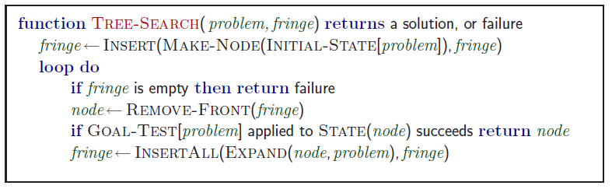
Review: Tree search
A search strategy is defined by picking the order of node expansion
Which nodes to check first?

Slide 63
Knowledge and Heuristics
Simon and Newell, Human Problem Solving, 1972.
S&N: intelligence comes from heuristics that help find promising states fast.

Slide 64
Best-first search
Idea: use an evaluation function f(n) for each node
estimate of "desirability"
Expand most desirable unexpanded node
Implementation:
Order the nodes in frontier in decreasing order of desirability
Special cases:
greedy best-first search
A* search

Slide 65
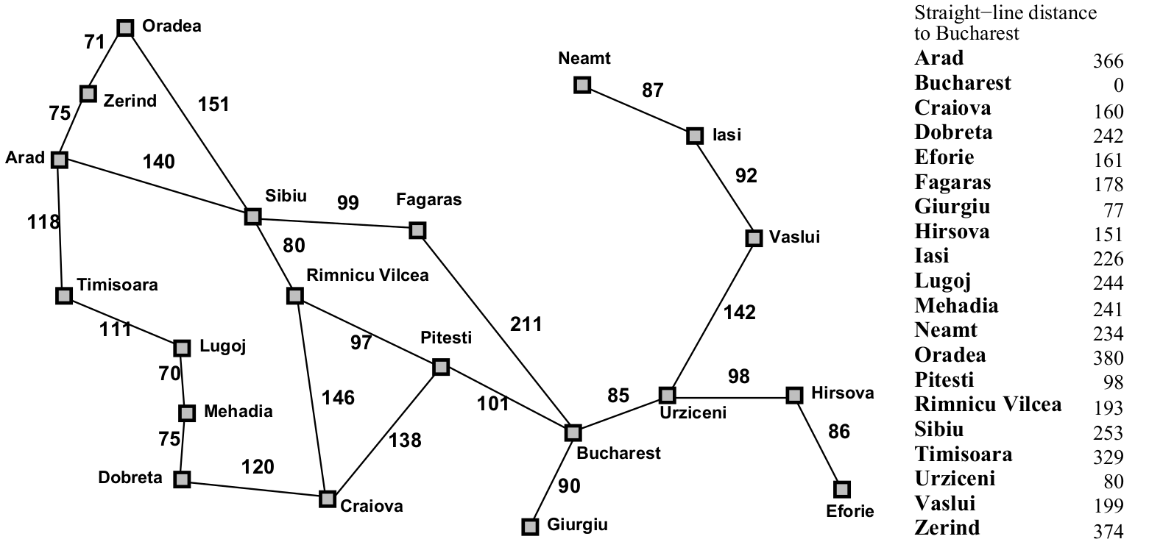
Romania with step costs in km

Slide 66
Greedy best-first search
Evaluation function
f(n) = h(n) (heuristic)
= estimate of cost from n to goal
e.g., h_{SLD}(n) = straight-line distance from n to Bucharest
Greedy best-first search expands the node that appears to be closest to goal

Slide 67
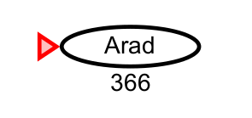
Greedy best-first search example

Slide 68
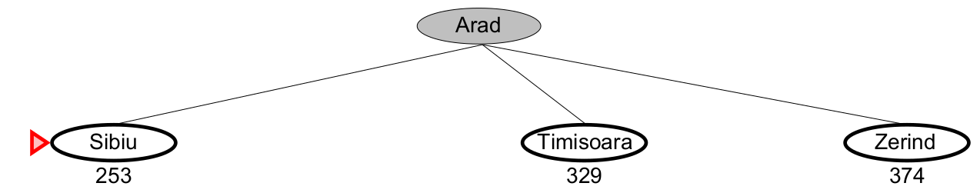
Greedy best-first search example

Slide 69
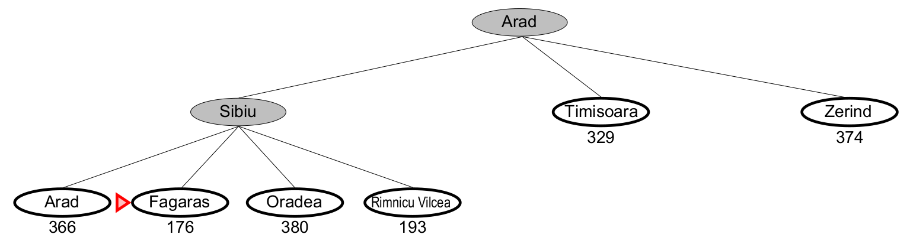
Greedy best-first search example

Slide 70
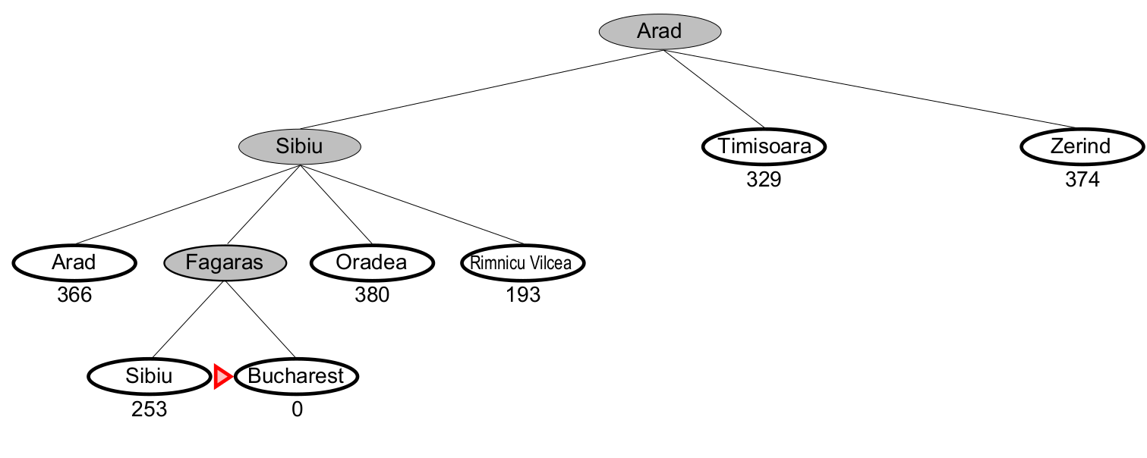
Greedy best-first search example
http://aispace.org/search/

Slide 71
Properties of greedy best-first search
Complete? No – can get stuck in loops,
e.g. as Oradea as goal
Iasi -> Neamt -> Iasi -> Neamt …..
Time? O(b^{m}), but a good heuristic can give dramatic improvement
Space? O(b^{m}) -- keeps all nodes in memory
Optimal? No

Slide 72
A* search
Idea: avoid expanding paths that are already expensive.
Very important!
Evaluation function f(n) = g(n) + h(n) g(n) = cost so far to reach n
h(n) = estimated cost from n to goal
f(n) = estimated total cost of path through n to goal

Slide 73
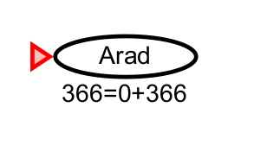
A* search example

Slide 74
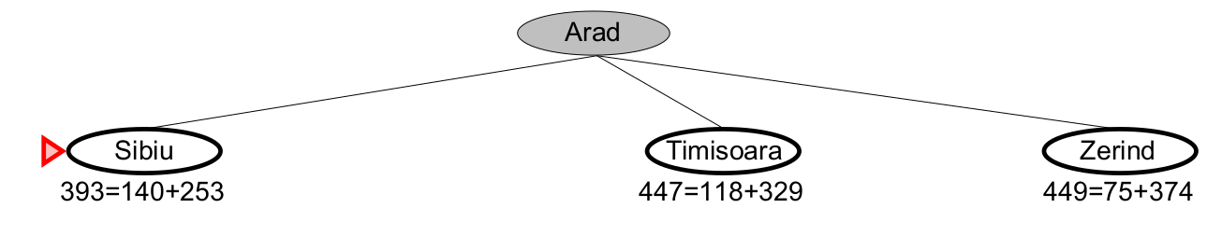
A* search example

Slide 75
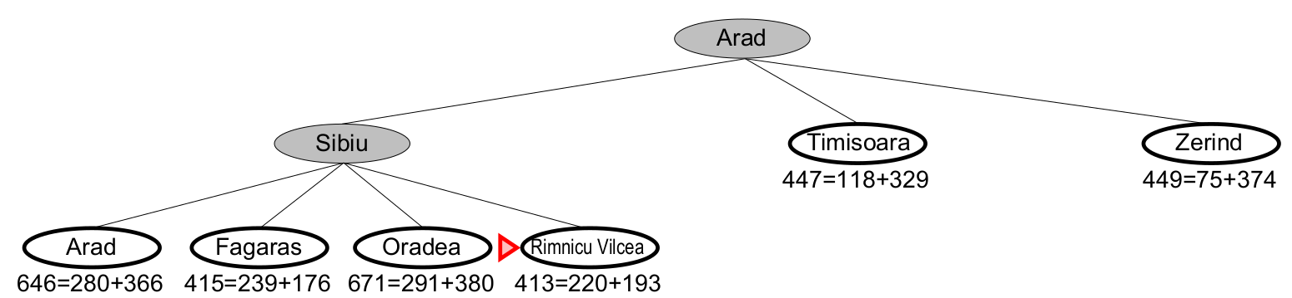
A* search example

Slide 76
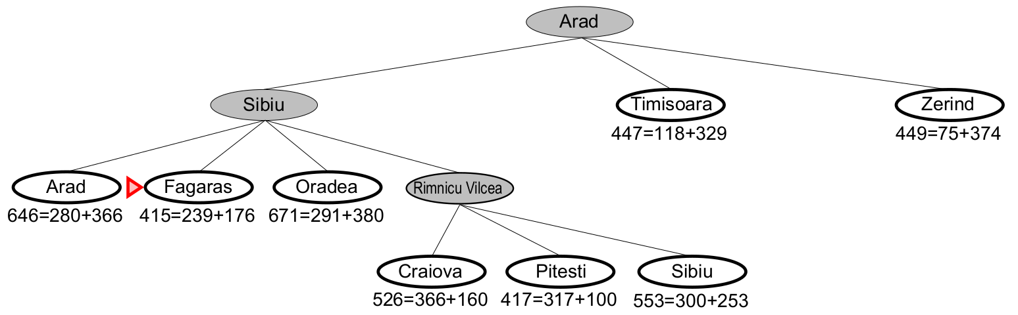
A* search example

Slide 77
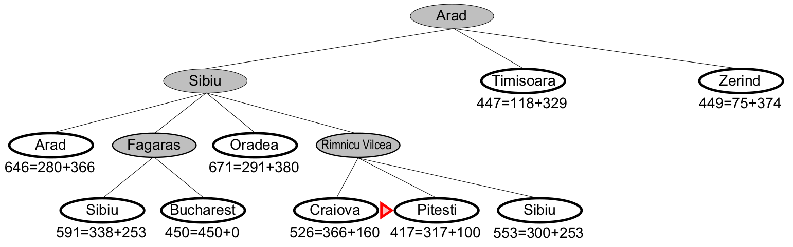
A* search example

Slide 78
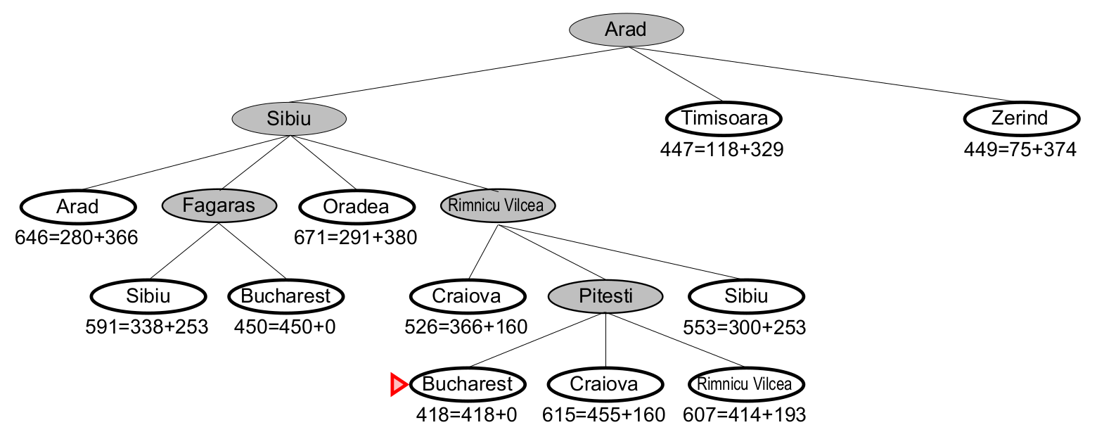
A* search example
http://aispace.org/search/
We stop when the node with the lowest f-value is a goal state.
Is this guaranteed to find the shortest path?

Slide 79
Properties of A*
Complete? Yes (unless there are infinitely many nodes with f ≤ f(G) )
Time? Exponential
Space? Keeps all nodes in memory
Optimal? Yes

Slide 80
Summary
Heuristic functions estimate costs of shortest paths
Good heuristics can dramatically reduce search cost
Greedy best-first search expands lowest h
incomplete and not always optimal
A∗ search expands lowest g + h
complete and optimal
also optimally efficient (up to tie-breaks)

