Slide 1
Adversarial Search and Game-Playing
CHAPTER 6
Stuart Russell and Peter Norvig, Artificial Intelligence: A Modern Approach, Global Edition 3/E

Slide 2
Environment Type Discussed In this Lecture
Fully Observable
Turn-taking: Semi-dynamic
Deterministic and non-deterministic
yes
Multi-agent
yes
Sequential
yes
no
Discrete
no
yes
Discrete
yes
Game Tree Search
Game Matrices
Continuous Action Games
Notes:
Discuss discrete variables a little bit.

Slide 3
Adversarial Search
Examine the problems that arise when we try to plan ahead in a world where other agents are planning against us.
A good example is in board games.

Slide 4
Typical AI assumptions
Two agents whose actions alternate
Utility values for each agent are the opposite of the other
creates the adversarial situation
Fully observable environments

Slide 5
Search vs. Games
Search – no adversary
Solution is (heuristic) method for finding goal
Heuristic techniques can find optimal solution
Evaluation function: estimate of cost from start to goal through given node
Examples: path planning, scheduling activities
Games – adversary
Solution is strategy (strategy specifies move for every possible opponent reply) “unpredictable opponent”
Optimality depends on opponent.
Time limits force an approximate solution
Evaluation function: evaluate “goodness” of game position
Examples: chess, checkers, Othello, backgammon

Slide 6
Types of Games
 | deterministic | Chance moves
Perfect information | Chess, checkers, go, othello | Backgammon, monopoly
Imperfect information (Initial Chance Moves) | Bridge, Skat, blind tic tac to | Poker, scrabble, blackjack
https://playtictactoe.org/
https://cardgames.io/backgammon/
Notes:
If Nature is not a player, then poker etc. involve chance moves like drawing cards, tiles. The other card games involve no more chance. Play with class.

Slide 7
Game Setup
Two players: MAX and MIN
MAX moves first and they take turns until the game is over
Winner gets award, loser gets penalty.
Games as search:
Initial state: e.g. board configuration of chess
Successor function: list of (move,state) pairs specifying legal moves.
Terminal test: Is the game finished?
Utility function: Gives numerical value of terminal states. E.g. win (+1), lose (-1) and draw (0) in tic-tac-toe or chess
Notes:
Explain these conventions carefully. Maybe contrast with general game trees.

Slide 8
Size of search trees
b = branching factor
d = number of moves by both players
Search tree is O(b^{d})
Chess
b ~ 35
d ~100
- search tree is ~ 10 ¹⁵⁴ (!!)
- completely impractical to search this
Game-playing emphasizes being able to make optimal decisions in a finite amount of time

Slide 9
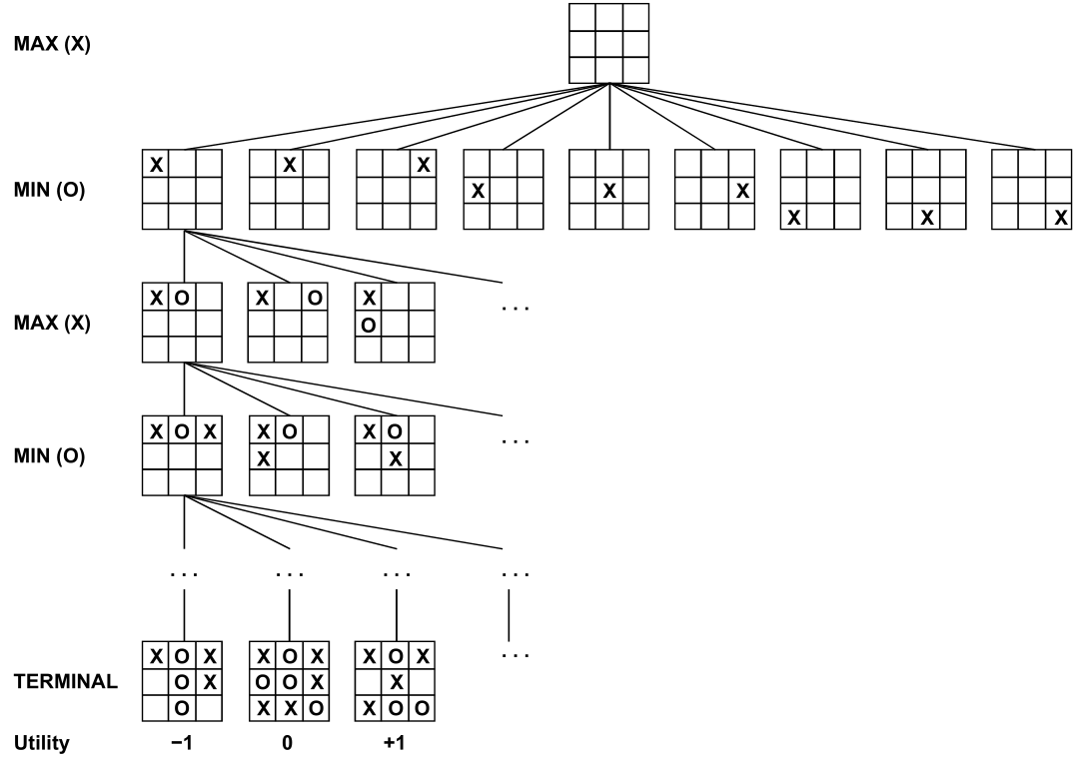
Partial Game Tree for Tic-Tac-Toe

Slide 10
Minimax strategy: Look ahead and reason backwards
Find the optimal strategy for MAX assuming an infallible MIN opponent
Need to compute this all the down the tree
Assumption: Both players play optimally!
Given a game tree, the optimal strategy can be determined by using the minimax value of each node.

Slide 11
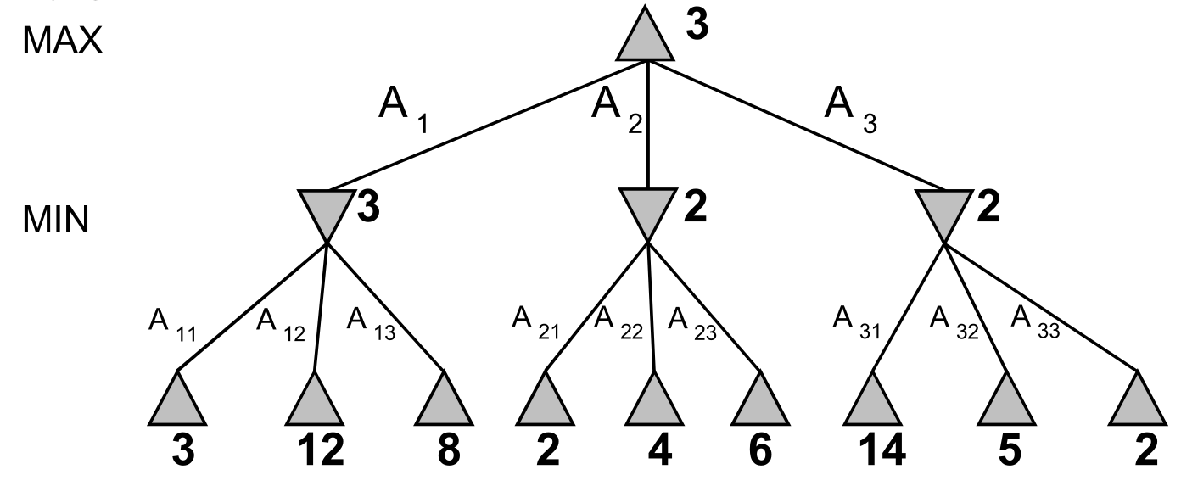
MinMax

Slide 12
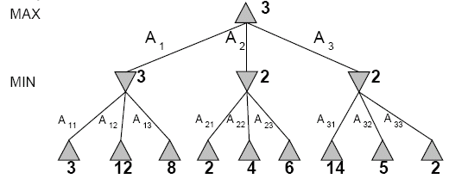
Two-Ply Game Tree
Notes:
Chocolate playing: max gets x number of chocolates, min has to give up x number of chocolates.

Slide 13
Two-Ply Game Tree

Slide 14
Two-Ply Game Tree
Notes:
Ply = 2 half moves

Slide 15
Two-Ply Game Tree
Minimax maximizes the utility for the worst-case outcome for max
The minimax decision

Slide 16
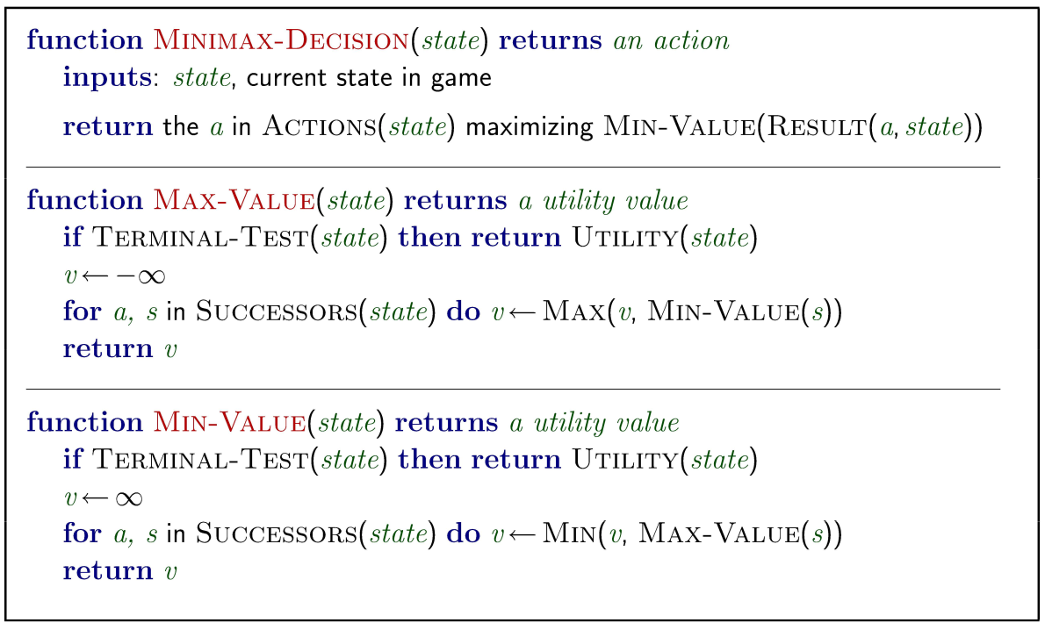
Minmax Algorithm

Slide 17
Minmax Algorithm Steps
Step 1: First, generate the entire game tree starting with the current position of the game all the way upto the terminal states. This is how the game tree looks like for the game tic-tac-toe.
Let us understand the defined terminology in terms of the diagram above.
The initial state is the first layer that defines that the board is blank it’s MAX’s turn to play.
Successor function lists all the possible successor moves. It is defined for all the layers in the tree.
Terminal State is the last layer of the tree that shows the final state, i.e whether the player MAX wins, loses, or ties with the opponent.
Utilities in this case for the terminal states are 1, 0, and -1 as discussed earlier, and they can be used to determine the utilities of the other nodes as well.

Slide 18
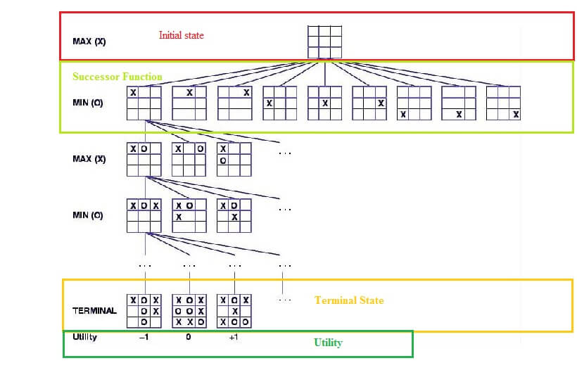
step 1

Slide 19
Minmax Algorithm Steps
Step 2: Apply the utility function to get the utility values for all the terminal states.
Step 3: Determine the utilities of the higher nodes with the help of the utilities of the terminal nodes.
Calculate the utility for the left node(red) of the layer above the terminal. Since it is the move of the player MIN, we will choose the minimum of all the utilities. For this case, we have to evaluate MIN{3, 5, 10}, which we know is certainly 3. So the utility for the red node is 3.

Slide 20
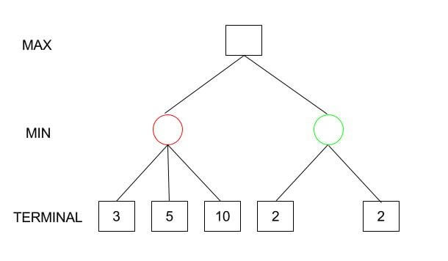
Step 2, 3

Slide 21
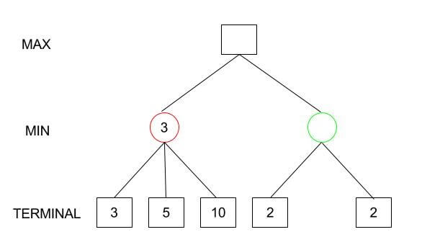
Step 2, 3

Slide 22
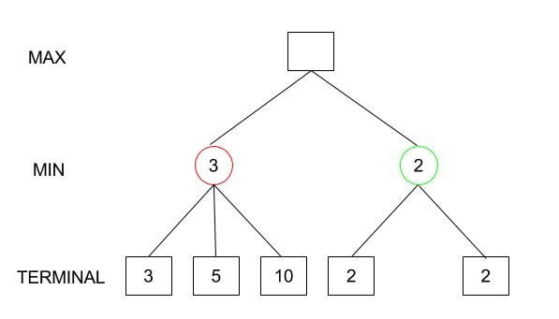
Step 2, 3

Slide 23
Minmax Algorithm Steps
Step 4: Calculate the utility values with the help of leaves considering one layer at a time until the root of the tree.
Step 5: Eventually, all the backed-up values reach to the root of the tree, i.e., the topmost point. At that point, MAX has to choose the highest value.

Slide 24
Minmax Algorithm Steps
In our example, we only have 3 layers so we immediately reached to the root but in actual games, there will be many more layers and nodes. So we have to evaluate MAX{3,2} which is 3.
Therefore, the best opening move for MAX is the left node(or the red one). This move is called the minimax decision as it maximizes the utility following the assumption that the opponent is also playing optimally to minimize it.
To summarize: Minimax Decision = MAX{MIN{3,5,10},MIN{2,2}} = MAX{3,2} = 3

Slide 25
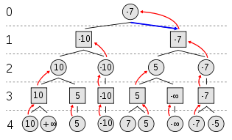
Example of Algorithm Execution
MAX to move
Notes:
Can have negative values too

Slide 26
Properties of minmax
Optimal? Yes, if the tree is finite
Optimal? Yes
Time complexity? O(b^m)
Space Complexity O(bm)

Slide 27
Minimax Algorithm
Complete depth-first exploration of the game tree
Assumptions:
Max depth = d, b legal moves at each point
E.g., Chess: d ~ 100, b ~35
do we need to explore every path?
Criterion | Minimax
Time | O(b^{d})
Space | O(bd)
☹
☺

Slide 28
Practical problem with minimax search
Number of game states is exponential in the number of moves.
Solution: Do not examine every node
=> pruning
Remove branches that do not influence final decision
Revisit example …

Slide 29
Minmax optimization
Game trees are, in general, very time consuming to build, and it’s only for simple games that it can be generated in a short time.
If there are b legal moves, i.e., b nodes at each point and the maximum depth of the tree is m, the time complexity of the minimax algorithm is of the order bm(O(bm)).
It is viable to find the actual minimax decision without even looking at every node of the game tree.
Hence, we eliminate nodes from the tree without analyzing, and this process is called pruning.

Slide 30
Alpha-beta pruning
If we apply alpha-beta pruning to a standard minimax algorithm, it returns the same move as the standard one, but it removes (prunes) all the nodes that are possibly not affecting the final decision.

Slide 31
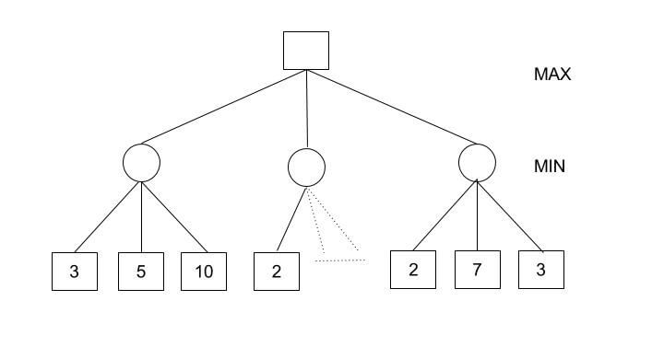
Alpha-beta pruning
Consider the following tree
Minimax Decision = MAX{MIN{3,5,10}, MIN{2,a,b}, MIN{2,7,3}} = MAX{3,c,2} = 3

Slide 32
Alpha-beta pruning
MIN{2,a,b} would certainly be less than or equal to 2, i.e., c<=2 and hence MAX{3,c,2} has to be 3.
We could have reached a conclusion without looking at those nodes. And this is where alpha-beta pruning comes into the picture.

Slide 33
A few definitions
Alpha: It is the best choice so far for the player MAX. We want to get the highest possible value here.
Beta: It is the best choice so far for MIN, and it has to be the lowest possible value.
Note: Each node has to keep track of its alpha and beta values. Alpha can be updated only when it’s MAX’s turn and, similarly, beta can be updated only when it’s MIN’s chance.

Slide 34
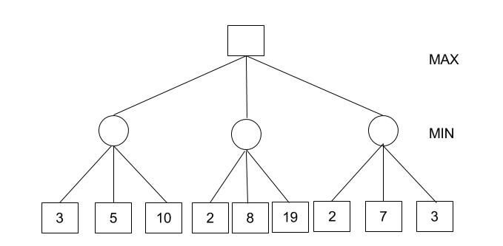
Alpha-beta pruning algorithm steps
1 - Initialize alpha = -infinity and beta = infinity as the worst possible cases. The condition to prune a node is when alpha becomes greater than or equal to beta.

Slide 35
Alpha-beta pruning algorithm steps
2- Start with assigning the initial values of alpha and beta to root and since alpha is less than beta we don’t prune it.
3 - Carry these values of alpha and beta to the child node on the left. And now from the utility value of the terminal state, we will update the values of alpha and be, so we don’t have to update the value of beta. Again, we don’t prune because the condition remains the same. Similarly, the third child node also. And then backtracking to the root we set alpha=3 because that is the minimum value that alpha can have.

Slide 36
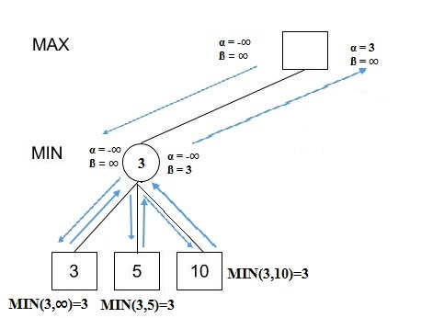
Alpha-beta pruning algorithm steps

Slide 37
Alpha-beta pruning algorithm steps
4 - Now, alpha=3 and beta=infinity at the root. So, we don’t prune. Carrying this to the center node, and calculating MIN{2, infinity}, we get alpha=3 and beta=2.
5 - Prune the second and third child nodes because alpha is now greater than beta.
6 - Alpha at the root remains 3 because it is greater than 2. Carrying this to the rightmost child node, evaluate MIN{infinity,2}=2. Update beta to 2 and alpha remains 3.

Slide 38
Alpha-beta pruning algorithm steps
7 - Prune the second and third child nodes because alpha is now greater than beta.
8 - Hence, we get 3, 2, 2 at the left, center, and right MIN nodes, respectively. And calculating MAX{3,2,2}, we get 3. Therefore, without even looking at four leaves we could correctly find the minimax decision.

Slide 39
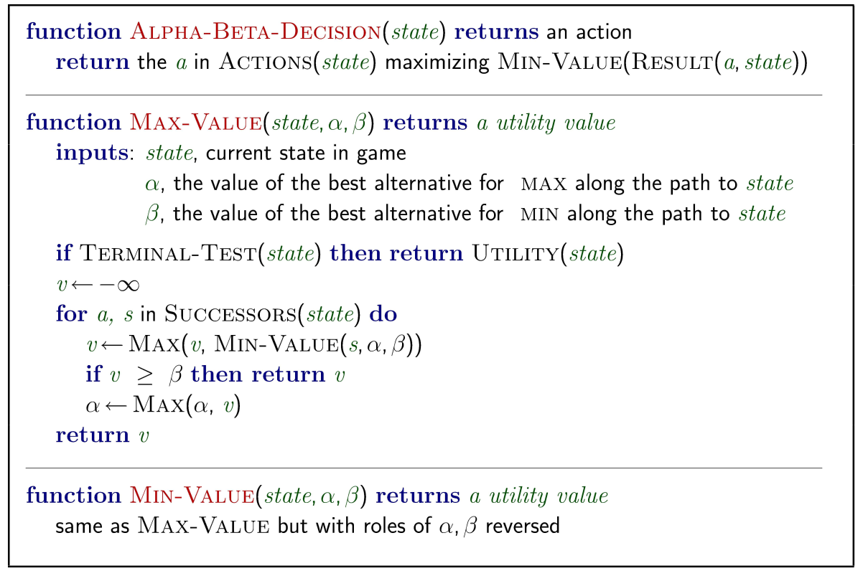
Alpha-beta pruning algorithm steps

Slide 40
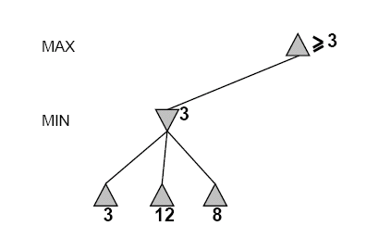
Alpha-Beta Example
Do DF-search until first leaf
Range of possible values
[-∞,+∞]
[-∞, +∞]

Slide 41
Alpha-Beta Example (continued)
[-∞,+∞]
[-∞,3]

Slide 42
Alpha-Beta Example (continued)
[-∞,+∞]
[-∞,3]

Slide 43
Alpha-Beta Example (continued)
[3,+∞]
[3,3]

Slide 44
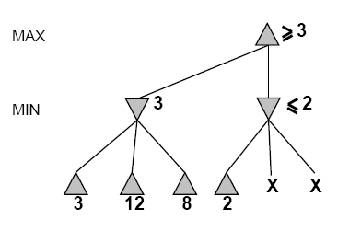
Alpha-Beta Example (continued)
[3,+∞]
This node is worse
for MAX
[3,3]
[-∞,2]

Slide 45
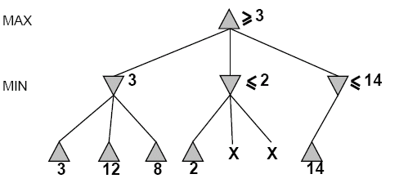
Alpha-Beta Example (continued)
[3,14]
,
[3,3]
[-∞,2]
[-∞,14]

Slide 46
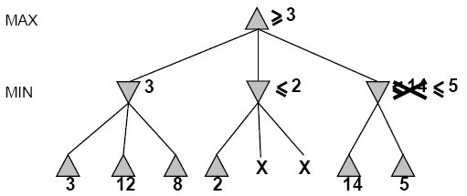

Alpha-Beta Example (continued)
[3,5]
,
[3,3]
[−∞,2]
[-∞,5]

Slide 47
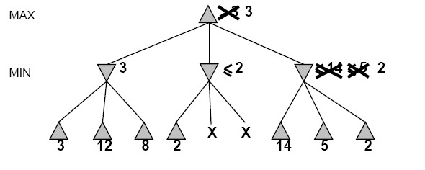
Alpha-Beta Example (continued)
[3,3]
[3,3]
[−∞,2]
[2,2]

Slide 48
Alpha-Beta Example (continued)
[3,3]
[3,3]
[-∞,2]
[2,2]

Slide 49
Alpha-beta Algorithm
Depth first search – only considers nodes along a single path at any time
α = highest-value choice that we can guarantee for MAX so far in the current subtree.
β = lowest-value choice that we can guarantee for MIN so far in the current subtree.
update values of α and β during search and prunes remaining branches as soon as the value is known to be worse than the current α or β value for MAX or MIN.
Alpha-beta Demo.

Slide 50
Effectiveness of Alpha-Beta Search
Worst-Case
branches are ordered so that no pruning takes place. In this case alpha-beta gives no improvement over exhaustive search
Best-Case
each player’s best move is the left-most alternative (i.e., evaluated first)
in practice, performance is closer to best rather than worst-case
In practice often get O(b^{(d/2)}) rather than O(b^{d})
this is the same as having a branching factor of sqrt(b),
since (sqrt(b))^{d} = b^{(d/2)}
i.e., we have effectively gone from b to square root of b
e.g., in chess go from b ~ 35 to b ~ 6
this permits much deeper search in the same amount of time
Typically twice as deep.

Slide 51
Example
-which nodes can be pruned?
MAX
MIN
MAX
3
5
6
4
1
2
7
8
Notes:
Nothing actually.

Slide 52
Final Comments about Alpha-Beta Pruning
Pruning does not affect final results
Entire subtrees can be pruned.
Good move ordering improves effectiveness of pruning
Repeated states are again possible.
Store them in memory = transposition table

Slide 53
Practical Implementation
How do we make these ideas practical in real game trees?
Standard approach:
cutoff test: (where do we stop descending the tree)
depth limit
better: iterative deepening
cutoff only when no big changes are expected to occur next (quiescence search).
evaluation function
When the search is cut off, we evaluate the current state
by estimating its utility using an evaluation function.

Slide 54
Static (Heuristic) Evaluation Functions
An Evaluation Function:
estimates how good the current board configuration is for a player.
Typically, one figures how good it is for the player, and how good it is for the opponent, and subtracts the opponents score from the players
Othello: Number of white pieces - Number of black pieces
Chess: Value of all white pieces - Value of all black pieces
Typical values from -infinity (loss) to +infinity (win) or [-1, +1].
If the board evaluation is X for a player, it’s -X for the opponent.
Many clever ideas about how to use the evaluation function.
e.g. null move heuristic: let opponent move twice.
Example:
Evaluating chess boards,
Checkers
Tic-tac-toe

Slide 55
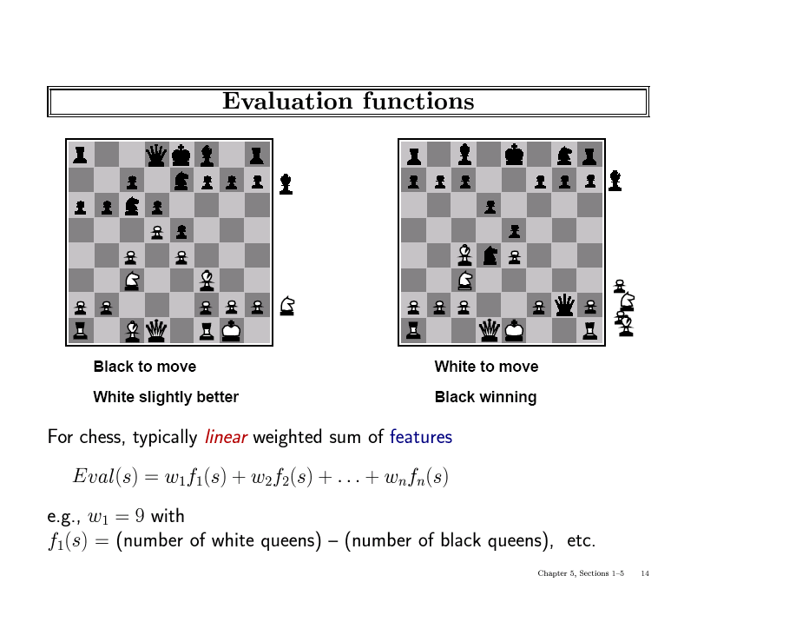

Slide 56
Iterative (Progressive) Deepening
In real games, there is usually a time limit T on making a move
How do we take this into account?
using alpha-beta we cannot use “partial” results with any confidence unless the full breadth of the tree has been searched
So, we could be conservative and set a conservative depth-limit which guarantees that we will find a move in time < T
disadvantage is that we may finish early, could do more search
In practice, iterative deepening search (IDS) is used
IDS runs depth-first search with an increasing depth-limit
when the clock runs out we use the solution found at the previous depth limit

Slide 57
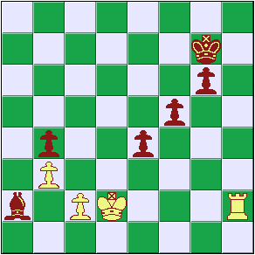
Heuristics and Game Tree Search
The Horizon Effect
sometimes there’s a major “effect” (such as a piece being captured) which is just “below” the depth to which the tree has been expanded the computer cannot see that this major event could happen it has a “limited horizon”

Slide 58
The State of Play
Checkers:
Chinook ended 40-year-reign of human world champion Marion Tinsley in 1994.
Chess:
Deep Blue defeated human world champion Garry Kasparov in a six-game match in 1997.
Othello:
human champions refuse to compete against computers: they are too good.
Go:
human champions refuse to compete against computers: they are too bad b > 300 (!)
See (e.g.) http://www.cs.ualberta.ca/~games/ for more information

Slide 59
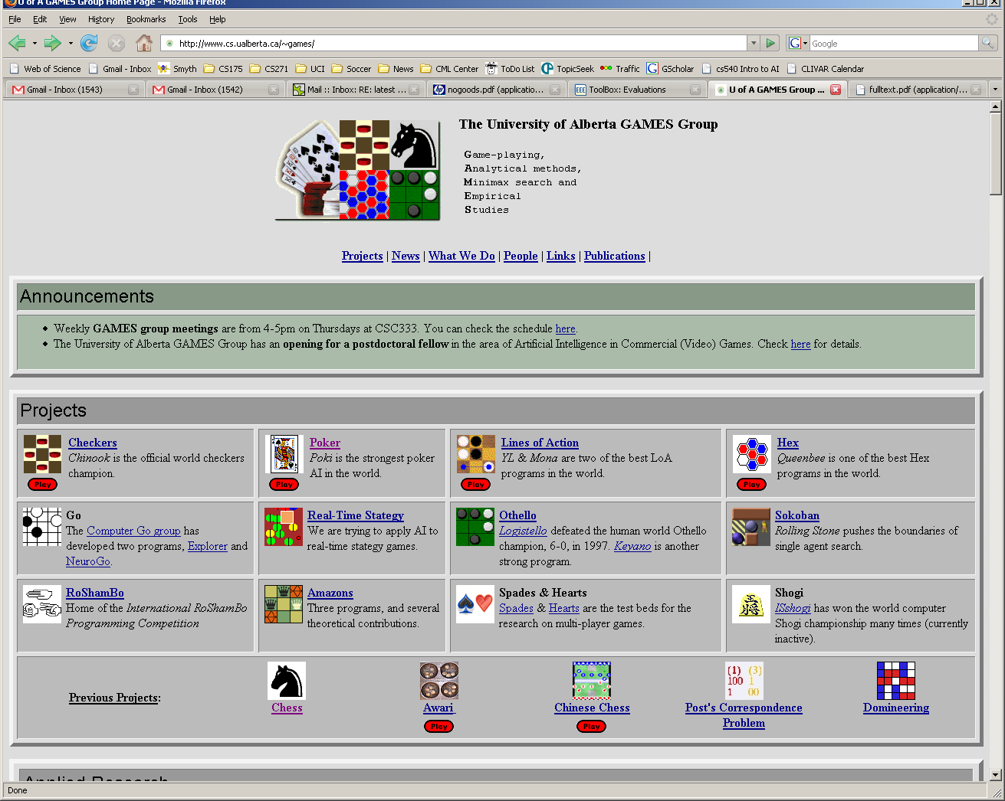

Slide 60
Deep Blue
1957: Herbert Simon
“within 10 years a computer will beat the world chess champion”
1997: Deep Blue beats Kasparov
Parallel machine with 30 processors for “software” and 480 VLSI processors for “hardware search”
Searched 126 million nodes per second on average
Generated up to 30 billion positions per move
Reached depth 14 routinely
Uses iterative-deepening alpha-beta search with transpositioning
Can explore beyond depth-limit for interesting moves

Slide 61
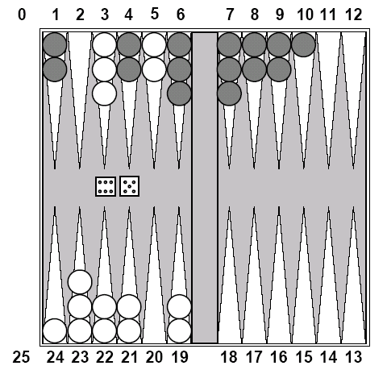
Chance Games.
Backgammon
your element of
chance

Slide 62
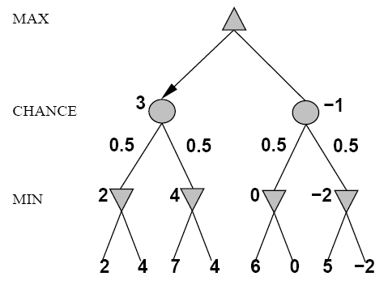
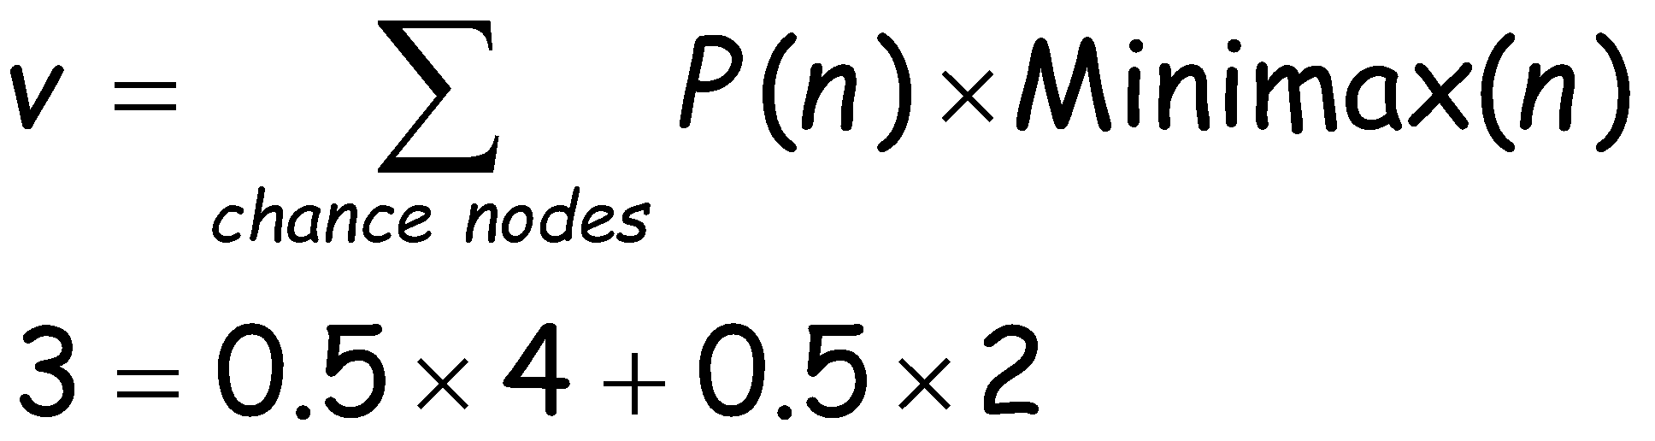
Expected Minimax
Interleave chance nodes
with min/max nodes
Again, the tree is constructed
bottom-up

Slide 63
Summary
Game playing can be effectively modeled as a search problem
Game trees represent alternate computer/opponent moves
Evaluation functions estimate the quality of a given board configuration for the Max player.
Minimax is a procedure which chooses moves by assuming that the opponent will always choose the move which is best for them
Alpha-Beta is a procedure which can prune large parts of the search tree and allow search to go deeper
For many well-known games, computer algorithms based on heuristic search match or out-perform human world experts.
Notes:
Add something on retrograde analysis

Slide 64
AI Games vs. Economics Game Theory
Seminal Work on Game Theory: Theory of Games and Economic Behavior, 1944, by von Neumann and Morgenstern.
Agents can be in cooperation as well as in conflict.
Agents may move simultaneously/independently.
Notes:
Add something on retrograde analysis

Slide 65
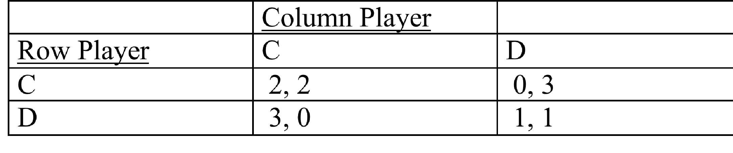
Example: The Prisoner’s Dilemma
Other Famous Matrix Games:
Chicken
Battle of The Sexes
Coordination
Notes:
Add something on retrograde analysis

Slide 66
Solving Zero-Sum Games
Perfect Information: Use Minimax Tree Search.
Imperfect Information: Extend Minimax Idea with probabilistic actions.
von Neumann’s Minimax Theorem: there exists an essentially unique optimal probability distribution for randomizing an agent’s behaviour.
Notes:
Add something on retrograde analysis

Slide 67
Matching Pennies
Why should the players randomize?
What are the best probabilities to use in their actions?
 | Heads | Tails
Heads | 1,-1 | -1,1
Tails | -1,1 | 1,-1
Notes:
Suppose that the row player announces their probability. What is the best one to use?

Slide 68
Nonzero Sum Game Trees
The idea of “look ahead, reason backward” works for any game tree with perfect information.
I.e., also in cooperative games.
In AI, this is called retrograde analysis.
In game theory, it is called backward induction or subgame perfect equilibrium.
Can be extended to many games with imperfect information (sequential equilibrium).
Notes:
Add something on retrograde analysis

Slide 69
Backward Induction Example: Hume’s Farmer Problem
1
H
Not H
2
notH1
2
Not H2
H1
H2
2 2
0 3
3 0
1 1

Slide 70
Summary: Solving Games
 | Zero-sum | Non zero-sum
Perfect Information | Minimax, alpha-beta | Backward induction, retrograde analysis
Imperfect Information | Probabilistic minimax | Nash equilibrium
Nash equilibrium is beyond the scope of this course.
Notes:
Add something on retrograde analysis

Slide 71
Single Agent vs. 2-Players
Every single agent problem can be considered as a special case of a 2-player game. How?
Make one of the players the Environment, with a constant utility function (e.g., always 0).
The Environment acts but does not care.
An adversarial Environment, with utility function the negative of agent’s utility.
In minimization, Environment’s utility is player’s costs.
Worst-Case Analysis.
E.g., program correctness: no matter what input user gives, program gives correct answer.
So agent design is a subfield of game theory.

Slide 72
Single Agent Design = Game Theory
Von Neumann-Morgenstern Games
Decision Theory = 2-player game, 1st player the “agent”, 2nd player “environment/nature”
(with constant or adversarial utility function)
From
General
To
Special
Case
Markov Decision Processes
Planning Problems
Notes:
Mention that problem of computing best reply = problem of optimal planning in game with nature.

Slide 73
Example: And-Or Trees
If an agent’s actions have nondeterministic effects, we can model worst-case analysis as a zero-sum game where the environment chooses the effects of an agent’s actions.
Minimax Search ≈ And-Or Search.
Example: The Erratic Vacuum Cleaner.
When applied to dirty square, vacuum cleans it and sometimes adjacent square too.
When applied to clean square, sometimes vacuum makes it dirty.
Reflex agent: same action for same location, dirt status.

Slide 74
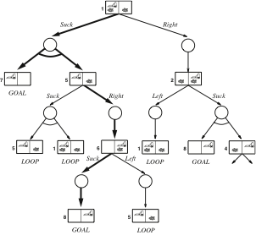
And-Or Tree for the Erratic Vacuum
The agent “moves” at labelled OR nodes.
The environment “moves” at unlabelled AND nodes.
The agent wins if it reaches a goal state.
The environment “wins” if the agent goes into a loop.

Slide 75
Summary
Game Theory is a very general, highly developed framework for multi-agent interactions.
Deep results about equivalences of various environment types.
See Chapter 17 for more details.

