Slide 1
Networking. IP Addresses. IPv4/IPv6. Subnetting and masks.

Slide 2
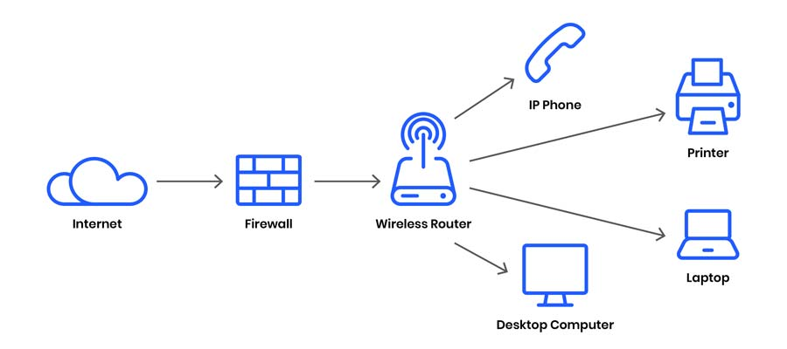
What is computer networking
A computer network is defined as a system that connects two or more computing devices for transmitting and sharing information. Computing devices include everything from a mobile phone to a server. These devices are connected using physical wires such as fiber optics, but they can also be wireless.
A computer network is a collection of two or more computer systems that are linked together. A network connection can be established using either cable or wireless media. Hardware and software are used to connect computers and tools in any network.

Slide 3
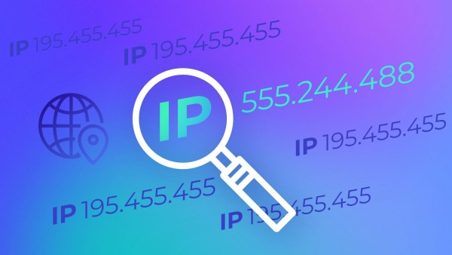
IP addresses
An IP address is a unique address that is used to identify computers or nodes on the internet. IP stands for "Internet Protocol," which is the set of rules governing the format of data sent via the internet or local network. This address is just a string of numbers written in a certain format. It is generally expressed in a set of numbers for example 192.155.12.1. Here each number in the set is from 0 to 255 range. Or we can say that a full IP address ranges from 0.0.0.0 to 255.255.255.255. And these IP addresses are assigned by IANA(known as Internet Corporation For Internet Assigned Numbers Authority).
IP addresses are the identifier that allows information to be sent between devices on a network: they contain location information and make devices accessible for communication. The internet needs a way to differentiate between different computers, routers, and websites

Slide 4
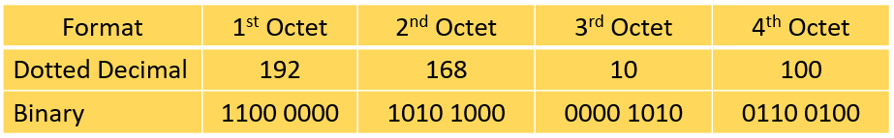
What is IPv4?
IP stands for Internet Protocol and v4 stands for Version Four (IPv4). IP version four addresses are 32-bit integers which will be expressed in decimal notation. Example- 192.0.2.126 could be an IPv4 address.
IPv4 addresses are expressed as a set of four numbers in decimal format, and each set is separated by a dot. Thus, the term ‘dotted decimal format.’ Each set is called an ‘octet’ because a set is composed of 8 bits. The figure below shows the binary format of each octet in the 192.168.10.100 IP address:
A number in an octet can range from 0 to 255. Therefore, the full IPv4 address space goes from 0.0.0.0 to 255.255.255.255. The IPv4 address has two parts, the network part and the host part. A subnet mask is used to identify these parts.

Slide 5
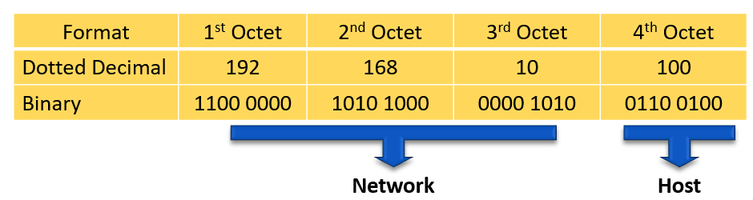
IPv4 Address Format
Network Part
The network part of the IPv4 address is on the left-hand side of the IP address. It specifies the particular network to where the IPv4 address belongs. The network portion of the address also identifies the IP address class of the IPv4 address.
Host Part
The host portion of the IPv4 address uniquely identifies the device or the interface on your network. Hosts that have the same network portion can communicate with one another directly, without the need for the traffic to be routed.

Slide 6
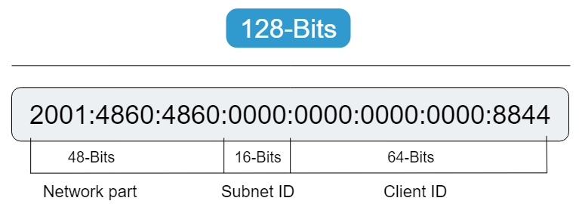
What is IPv6
Internet Protocol Version 6 (IPv6) is a network layer protocol that enables data communications over a packet switched network.
A main advantage of IPv6 is increased address space.
IPv4 uses a 32-bit address for its Internet addresses. That means it can provide support for 2^32 IP addresses in total around 4.29 billion. That may seem like a lot, but all 4.29 billion IP addresses have now been assigned, leading to the address shortage issues we face today.
IPv6 utilizes 128-bit Internet addresses. Therefore, it can support 2^128 Internet addresses—340,282,366,920,938,463,463,374,607,431,768,211,456 of them to be exact. The number of IPv6 addresses is 1028 times larger than the number of IPv4 addresses. So there are more than enough IPv6 addresses to allow for Internet devices to expand for a very long time.

Slide 7
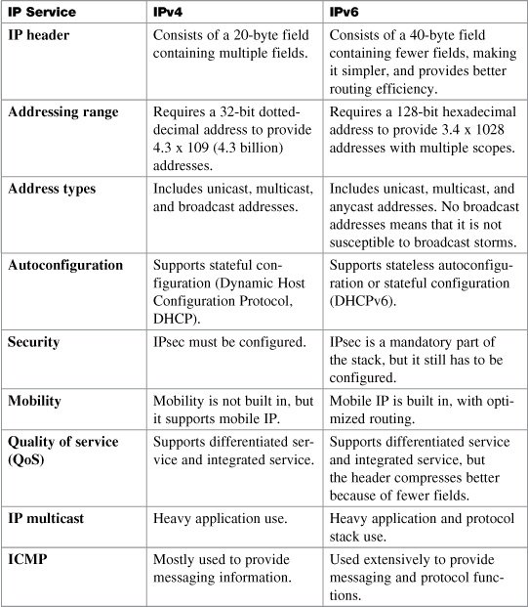
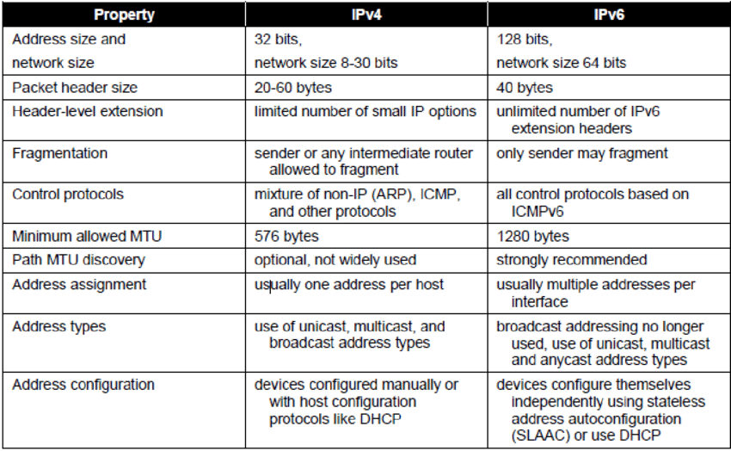
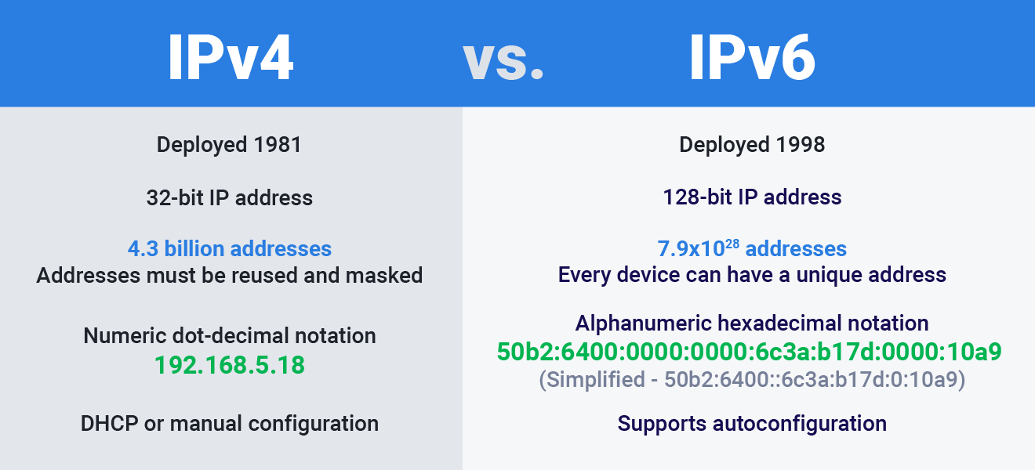

Slide 8
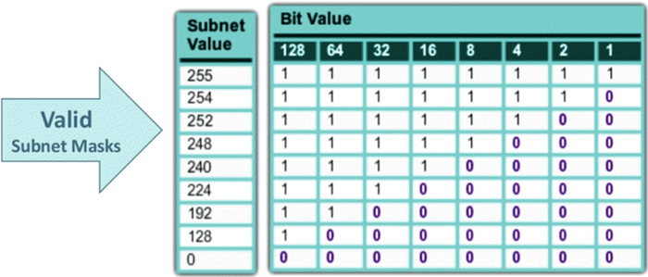
Subnetting and masks
Subnetting is the practice of dividing a network into two or smaller networks. It increases routing efficiency, which helps to enhance the security of the network and reduces the size of the broadcast domain.
A subnet mask is a 32 bits address used to distinguish between a network address and a host address in IP address. A subnet mask identifies which part of an IP address is the network address and the host address. They carry the destination IP address, which a router will match with a subnet.

Slide 9
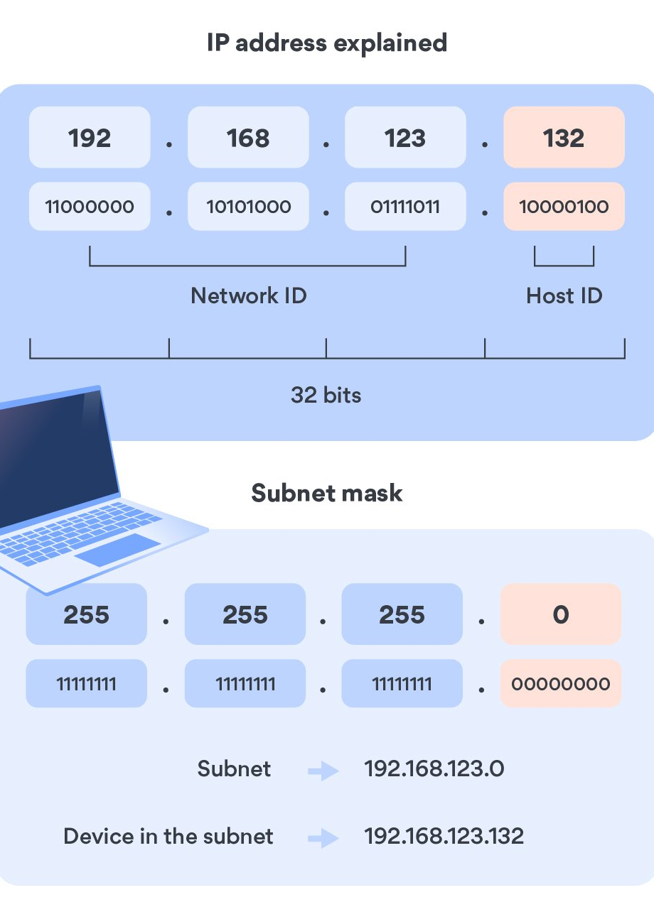
Subnet mask explained
Just like every address is defined by a street name and a house number, an IP address consists of a network component and a host component. Let’s take 192.168.123.132 as an example. The first three octets (192.168.123.) represent the network and the last octet identifies a machine on your network.
IP addresses consist of 32 binary bits (4 x 8), but since they are long and complex, we use a dot decimal system.
192.168.123.132 = 11000000.10101000.01111011.10000100
The subnet mask reflects the network portion in an IP address. It might look something this:
255.255.255.0 = 11111111.11111111.11111111.00000000
When you combine them, you get:
11000000.10101000.01111011.00000000 (network address: 192.168.123.0) 00000000.00000000.00000000.10000100 (host address: 000.000.000.132)
192.168.123.0 is your subnet, while 192.168.123.132 is a destination address (a device in your subnet). However, if you’re using a VPN, your IP will change depending on the server you’re connected to.

Slide 10
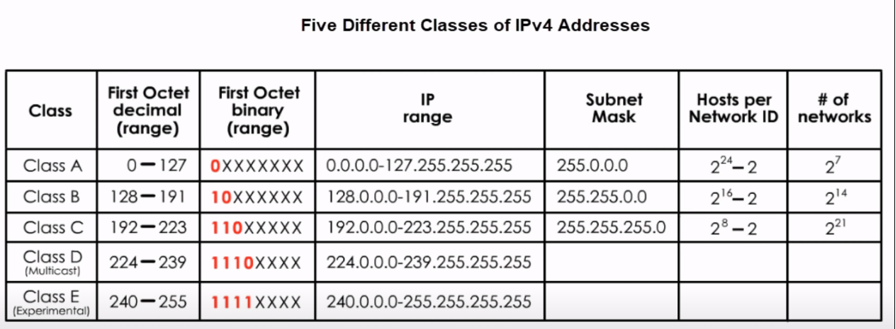
What are the different classes of IP addresses?
IP addresses are divided into three classes: A, B, and C. Classes D and E also exist, but they are not used by end users. Each class has a different default subnet mask, and you identify the class by looking at the first octet of an IP address.
Class A IP address
Class A networks use a subnet mask of 255.0.0.0 and have 0-127 as their first octet. It allows 126 networks and almost 17 million hosts per network.
Class B IP address
Class B uses a subnet mask of 255.255.0.0 and has 128-191 as its first octet. It is used by medium and large networks. Class B allows around 16,000 networks and 65,000 hosts per network.
Class C IP address
Class C is used for local area networks (LAN) and allows 2 million networks with 254 hosts each. Class C uses a subnet mask of 255.255.255.0 and has 192-223 as its first octet.
Class D IP address
Class D is reserved for multicasting (transmitting streaming media and other data for multiple users). It ranges from 224 to 239 and doesn't have a subnet mask as multicasting is not destined for a particular host.
Class E IP address
Class E ranges from 240 to 255 and also doesn’t have a subnet mask. It is used for experimental and study purposes.
It’s worth noting, however, that the classful IP addressing is outdated. Classless Inter-Domain Routing, or CIDR, is a much more efficient way of allocating IP addresses.

