Slide 1


VIRTUAL PRIVATE
NETWORKS (VPN)

Slide 2
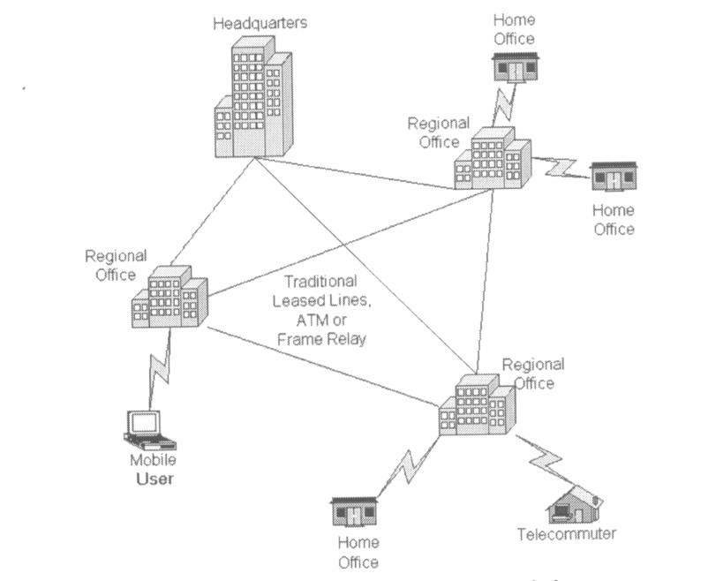
Traditional Connectivity

Slide 3
What is VPN?
Virtual Private Network is a type of private network that uses public telecommunication, such as the Internet, instead of leased lines to communicate.
Became popular as more employees worked in remote locations.
Terminologies to understand how VPNs work.

Slide 4
Private Networks
vs.
Virtual Private Networks
Employees can access the network (Intranet) from remote locations.
Secured networks.
The Internet is used as the backbone for VPNs
Saves cost tremendously from reduction of equipment and maintenance costs.
Scalability

Slide 5
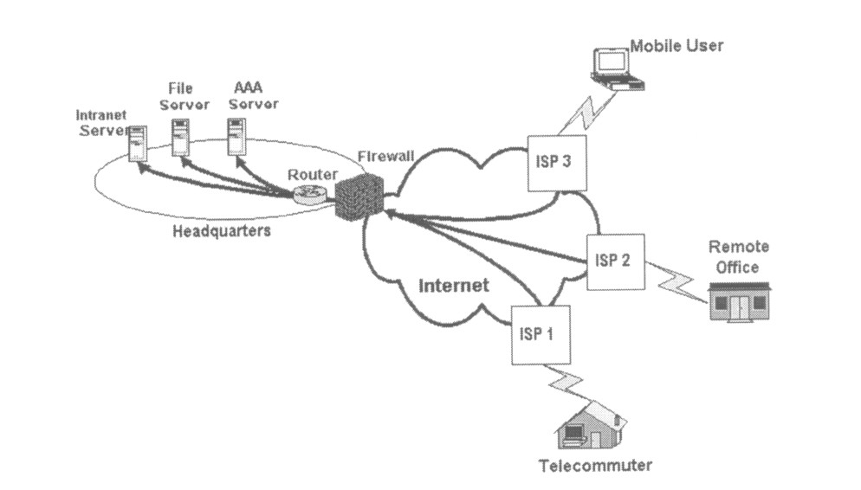
Remote Access Virtual Private
Network

Slide 6
Brief Overview of How it Works
Two connections – one is made to the Internet and the second is made to the VPN.
Datagrams – contains data, destination and source information.
Firewalls – VPNs allow authorized users to pass through the firewalls.
Protocols – protocols create the VPN tunnels.

Slide 7
Four Critical Functions
Authentication – validates that the data was sent from the sender.
Access control – limiting unauthorized users from accessing the network.
Confidentiality – preventing the data to be read or copied as the data is being transported.
Data Integrity – ensuring that the data has not been altered

Slide 8
Encryption
Encryption -- is a method of “scrambling” data before transmitting it onto the Internet.
Public Key Encryption Technique
Digital signature – for authentication

Slide 9
Tunneling
A virtual point-to-point connection
made through a public network. It transports encapsulated datagrams.
Original Datagram
Encrypted Inner Datagram
Datagram Header
Outer Datagram Data Area
Data Encapsulation [From Comer]
Two types of end points:
Remote Access
Site-to-Site

Slide 10
Four Protocols used in VPN
PPTP -- Point-to-Point Tunneling Protocol
L2TP -- Layer 2 Tunneling Protocol
IPsec -- Internet Protocol Security
SOCKS – is not used as much as the ones above

Slide 11
Types of Implementations
What does “implementation” mean in VPNs?
3 types
Intranet – Within an organization
Extranet – Outside an organization
Remote Access – Employee to Business

Slide 12
Advantages
VS.
Disadvantages

Slide 13
Advantages: Cost Savings
Eliminating the need for expensive long-distance leased lines
Reducing the long-distance telephone charges for remote access.
Transferring the support burden to the service providers
Operational costs

Slide 14
Advantages: Scalability
Flexibility of growth
Efficiency with broadband technology

Slide 15
Disadvantages
VPNs require an in-depth understanding of public network security issues and proper deployment of precautions
Availability and performance depends on factors largely outside of their control
Immature standards
VPNs need to accommodate protocols other than IP and existing internal network technology

Slide 16
Conclusion
It can be seen that creating and managing a VLAN can be quite a complex task
The LAN administrator needs to have a clear understanding about how VLANs work
We must know the commands needed in order to configure and set up the switches in his network.

