Slide 1
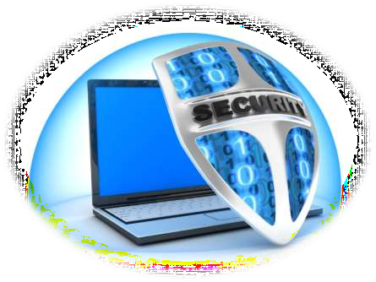
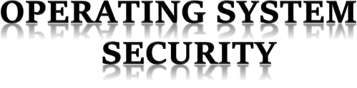

Slide 2
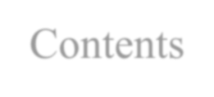

Contents
Introduction
OS Security Issues
Security Threats In OS Precautions For OS Security
The Most Secure OS
Conclusion Reference

Slide 3

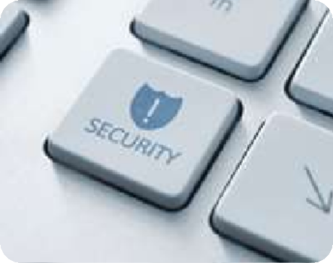

Introduction
What is Operating System(OS) ?
An operating system is a set of programs designed to
run other programs on a computer.
OS Security generally refers to the protection of Information stored, as well as the Data we deal with in realtime, while using a Computer System.
Security of an OS depends upon how the system is being used by the administrator and how well it is maintained.

Slide 4


OS Security
Issues
Physical Security
Among the
issues to be
considered
Authentication
these are the
Software Vulnerabilities
important
ones:-
Malwares

Slide 5








Security Threats In OS
Some of the Main Security Threats of OS are :-
Unauthorized Access of the system by cracking the Access Security Methods and spoofing Authentication for gaining full access of the system.
Unauthorized use of resources by installation of daemons running an unknown file server, or logging every activity of target’s System like keystrokes , screenshots etc.
Theft of confidential information, such as credit-card numbers, Account Passwords, programming source codes, secret formulas, medical information, financial information, etc.

Slide 6






Security Threats continue…
Some of the Main Security Threats of OS are :-
Malicious Modification of data, which may have serious indirect consequences. For example:- A popular game or other program's source code could be modified before being released to the public to open up security holes on systems.
Viruses are one of the greatest dangers for systems. If they are
once on the system , they can do a lot of damage to the system.
Denial of Service, DOS - Preventing authenticated users from using the system, often by overloading the system with an excess of requests for service and to forcefully shut down the system.

Slide 7

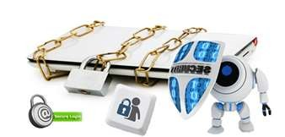
Precautions for OS Security
To Secure Our System and to
Bios Security
avoid the Security breaches
we must take some
User Accounts Security
precautions in our OS.
Data Security
So we have to ensure of the
Antivirus Security
Shown Security
Components:-
Firewall

Slide 8

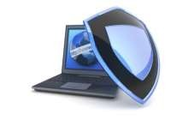


Precautions continue…
Bios Security
Bios is the boot menu where the machine selects a
OS to boot.
We should Set up a Bios Settings Security password to ensure that nobody can change your Bios settings to load any other OS by which any one cant be able to hack your user accounts Passwords.
Be careful when setting it up if you forgot the password you may not be able to Boot. So only set Password for Bios settings not for Boot.

Slide 9
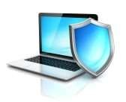
Precautions continue…
User Accounts Security
Mostly all of us login to our systems by using passwords but it is less secure because we always set a simple password which can be easily guessed.
So we need to set a complex password using alphanumeric characters, symbols, Upper Case and lower case letters.
Your Password must be strong enough that can’t be guessed or cracked by various Brute force or Dictionary Attacks.

Slide 10
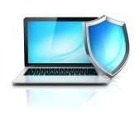
Precautions continue…
Data Security
Data security is Quite important because our private and confidential data needs better Protection to avoid the danger of data stealth.
It Can Only be done if we lock and Encrypt Our Sensitive Data with a strong password and a highly secure Encryption(128 bit/256 bit) method.
Bit Locker Comes With Windows Default. Various Data Security Softwares Available on the internet. E.g.:-Folder Lock, Folder Protect , Data Locker etc.

Slide 11



Precautions continue…
Antivirus Security
Antivirus has the vital role in OS Security and its not preloaded in any system although there is windows defender in every windows os which provides a basic protection fom wellknown threats.
We Need a good Antivirus Program {Having a good Threat Sense Technology} to secure our systems from viruses like; Trojans, Worms, Spywares, Key loggers, Link Exploits….etc.
E.g.:-Eset, Quick Heal, Norton etc.

Slide 12


Precautions continue…
Firewall
Firewall is a Security wall between the Network and the OS.Every connection to outside or inside the OS both requires permission from Firewall.
As Windows OS got Firewall but it is not interactive, for which unwanted programs gets internet access and transmit data from the System.
So we must install a Personal Firewall to manually Block those unwanted programs to access internet and to restrict them from sending and receiving Data over the Network.
E.g.:-Netpeeker Personal Firewall

Slide 13

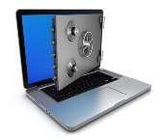
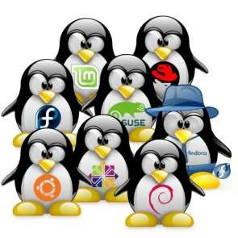

The Most Secure OS
Windows is the most used OS among computers that’s why it becomes priority of attacker’s to attack windows users and it’s made quite easy for them by the availability of more no. of viruses and malwares for windows platform .
Nowadays Linux and other UNIX-based Systems are the most secure operating systems.
Because it has very less number of viruses and malwares as compared to windows.
E.g.:-Ubuntu, OpenSuse ,Fedora, RedHat etc.
Linux OS

Slide 14

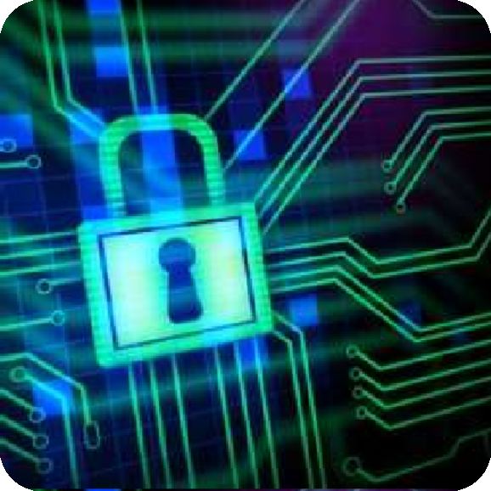
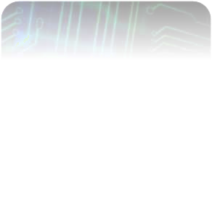
Conclusion
The security of Operating System depends on us because the more precautions we will take the more secure our Operating System will be.
Note:-
# Always make sure that your antivirus is up-to-date and it provides genuine protection from all the latest threats. # ‘Laptop Users’ if you are not using your webcam then disable it from the device manager its quite obvious that someone watching you from your webcam.

Slide 15





References

Slide 16



Any Questions

Slide 17

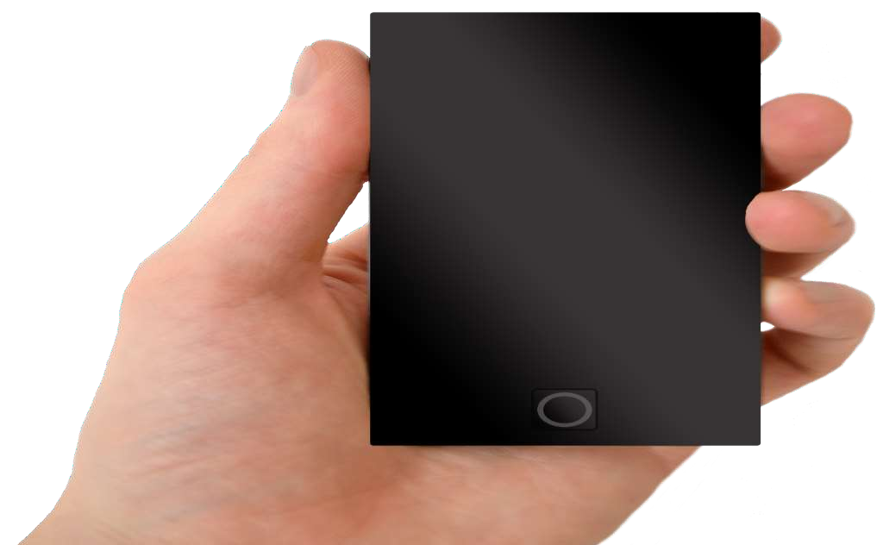
12:10
Thank
You

