Slide 1
Cloud Storage

Slide 2




Presentation Outline
Definition
History
Video
Advantages
Potential concerns
Applications
Conclusion

Slide 3
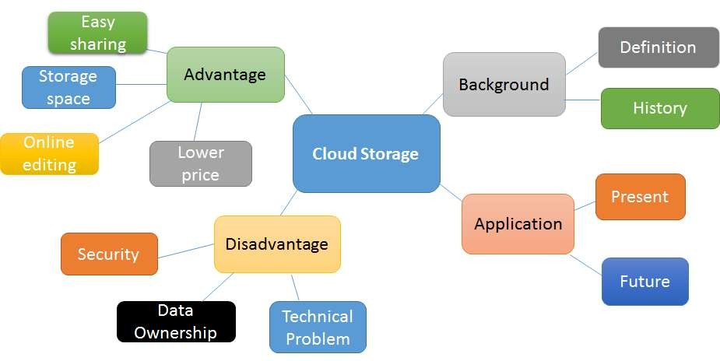
Mind map

Slide 4
Definition
W› hat is Cloud storage?
Model of data storage where the digital data is stored in logical
pools
The physical storage spans multiple servers
Physical servers is owned and managed by a hosting company
These cloud companies are responsible for keeping the data
available and accessible
People buy or lease storage capacity to store more data

Slide 5

Definition
C› loud storage
Services may be accessed through a web service application
programming interface (API)
Or by applications that utilize the API

Slide 6
History
1960s Cloud computing had been invented by Joseph Carl Robnett Licklider
1959 A book Sirens of Titan mentioned this technology as " a cloud that does all the heavy thinking for everybody“
1994 AT&T launched PersonaLink Services. The storage was one of the
first to be all web-based
2006 Cloud storage service AWS S3 was introduced by Amazon
Web Services
2007
2012
Dropbox , OneDrive(SkyDrive), Box was established
Google drive was established

Slide 7
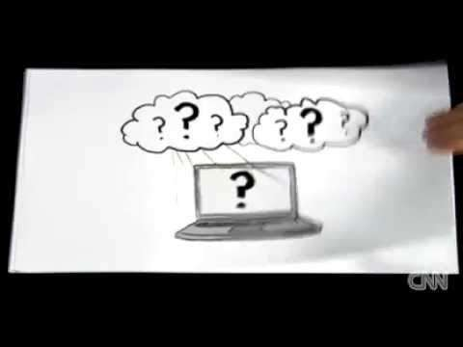
Video

Slide 8
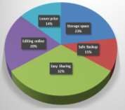
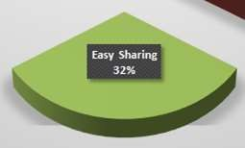
Advantage - Easy Sharing
According to survey,
32% of respondents agree
Major reason for respondent to use cloud storage
Convenient to share with other users
→ by using few clicks of mouse

Slide 9
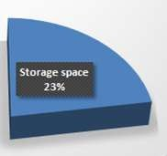
Advantage - Storage space
According to survey,
23% of respondents use cloud storage
→ Due to storage space
Invisible storage space
→Won’t take up physical space

Slide 10

Advantage - Editing online
According to survey,
20% of respondents use cloud storage
→ Because of online editing
Allow multiple people to collaborate
→ On a single file or document
→ At the same time

Slide 11
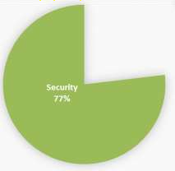
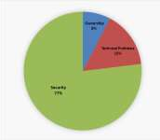
Potential Concerns - Security
Based on the survey,
77% of respondents concern about
the problem of security
Possible to be attacked by hackers
Not 100% safe
Sensitive information can be stolen

Slide 12
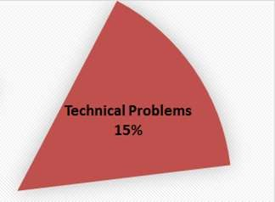
Potential Concerns - Technical Problem
Based on the survey,
15% of respondents concern about
the technical problem
Network problems
→ No Internet connection, the cloud storage system can’t be function

Slide 13

Potential Concerns - Data Ownership
Based on the survey,
8% of respondents concern about
the ownership problem
Hard to identify the data owner
Have lots of ownership questions
→ “Who type and upload the data”

Slide 14


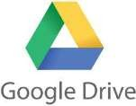
Applications
4 Types of Cloud Storage
Personal
Public
Business
Hybrid
Examples
Google Drive
iCloud
SkyDrive
Dropbox

Slide 15
Possible Application In The Future
40% of interviewees who didn’t use cloud storage before would like to try due to the big trend for using it
Another 40% because of its convenience to share to data with others
One-fifth enjoy editing the data with others at the same
time through Cloud Storage
This survey result indicates there will be more possible applications of cloud storage in the future

Slide 16
Conclusion
Cloud Storage is a top IT innovation
Being widely used in recent years
Bring conveniences to all users
Have potential dangers
Users should be careful of the security problems
We suggest the cloud storage system providers to improve it
The trend of using the cloud storage system will
continue to rise

Slide 17


