Slide 1
Dungeon & Dragons Second Build – Design Document
Ali Afzal 40039690
Arad Masoum abady 40039403
Chao Wang 25162130
Anita Rai 40038782
Jing Sun 27750986

Slide 2
Introduction:
The Dungeon & Dragons game follows the MVC architecture in parts having models, views and controllers. The code is organized in 13 different packages comprised of 53 classes.

Slide 3
Programming Methodology
We used Extreme Programming which is a successful methodology as it focuses on customer satisfaction. It also ensures customers that any requirement would have a proper response. It also emphasizes team working and communication. The design is simple and releases are small at the end of each short time period.
Iterative and Incremental Development: we use iterations during software development to bring focus on fewer functionality at a time. Each development cyclic process contains prototyping, realizing, testing, analyzing and integration.

Slide 4
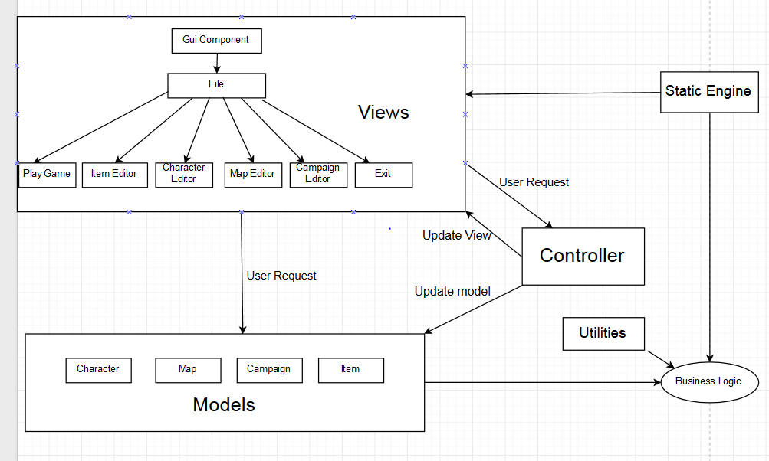
Design Pattern: MVC

Slide 5
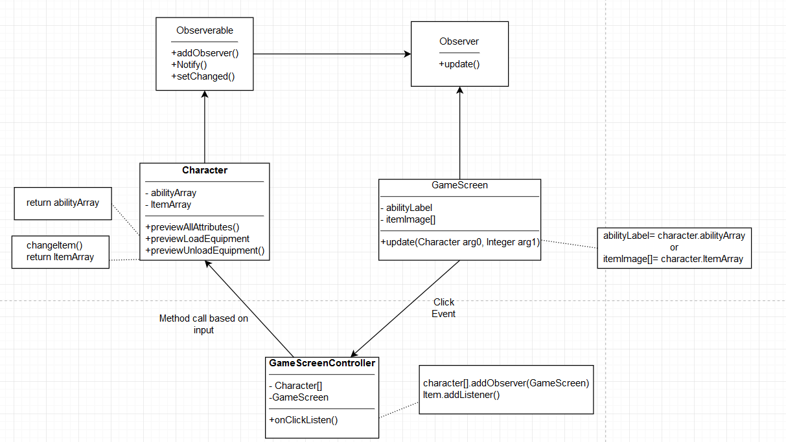
Design Pattern: Observer

Slide 6
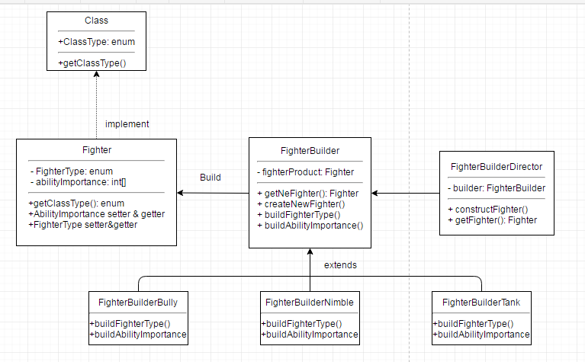
Design Pattern: Builder

Slide 7
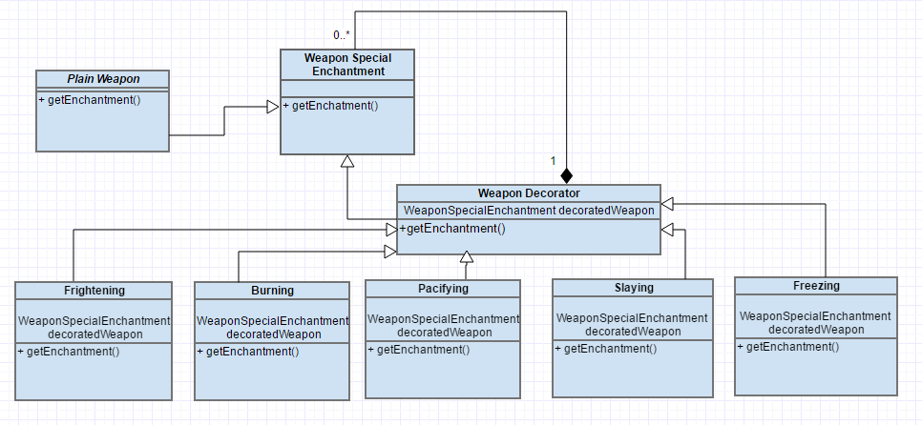
Design Pattern: Decorator

Slide 8
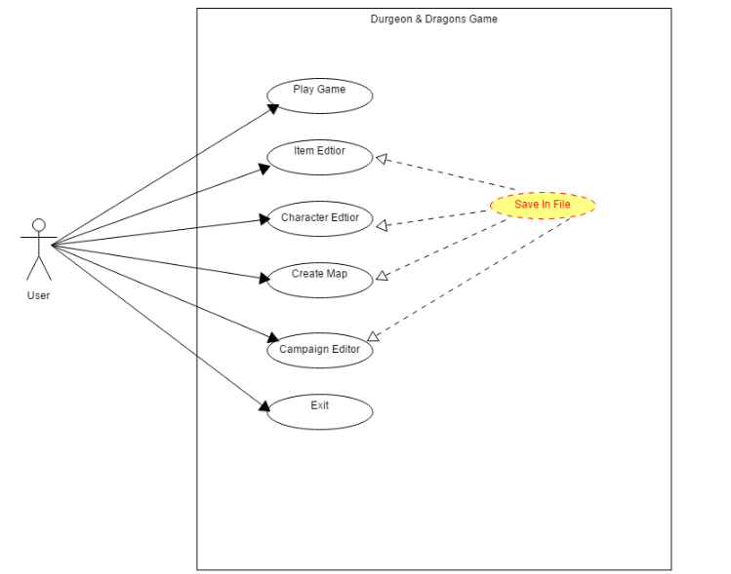
Use Case Diagram

Slide 9
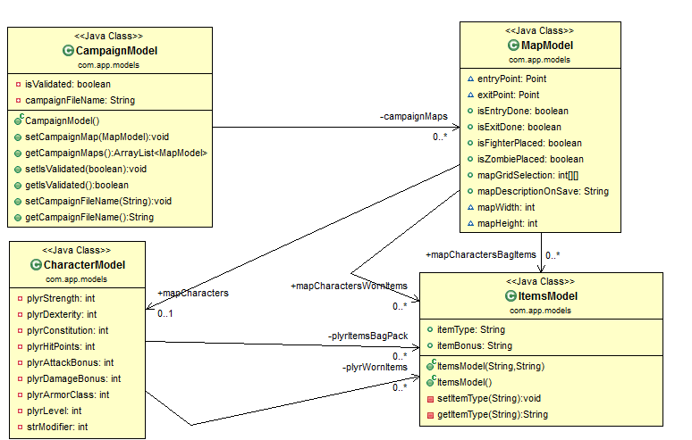
Class Diagram <Models>

Slide 10
Prototyping
Throwaways:
build it, break it
Evolutionary:
one step at a time

Slide 11
Prototyping
Pros:
Simple Design
Fast deliverable
Less dependency
Early Design platform
Cons:
Not user friendly
First Prototype: Throw away
Language: Java
Framework: Swing
Required: Eclipse or other IDEs
Launch OS: Windows
File storage: .txt
Second Prototype: Evolutionary
Language: Java
Framework: libGDX
Required: Android SDK installed
Launch OS: Windows, Android
File storage: .json
Pros:
Adapt to Gaming Framework
Attriactive GUI
Multi-platform support
Cons:
Effort on deployment
Highly coupled with multiple framework

Slide 12
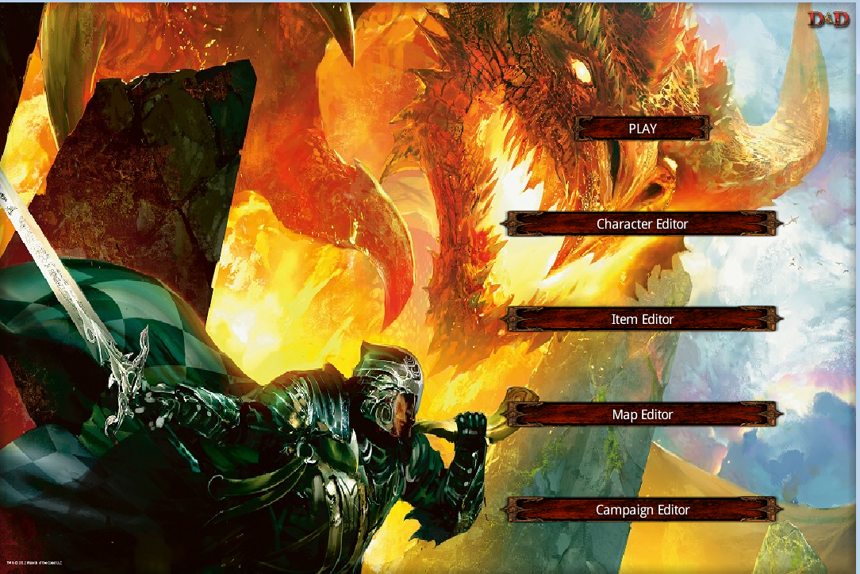
Final Design
Libgdx framework, open source Api available.
Feature exposure
Familiar and friendly for Android users
Gaming animation brings more fun

Slide 13
Repository
We used Git which is a distributed revision control system. It is aimed at speed, data integrity and support for distributed work.
Each build is consider a branch.
Merge branch to Master root after demo.

Slide 14
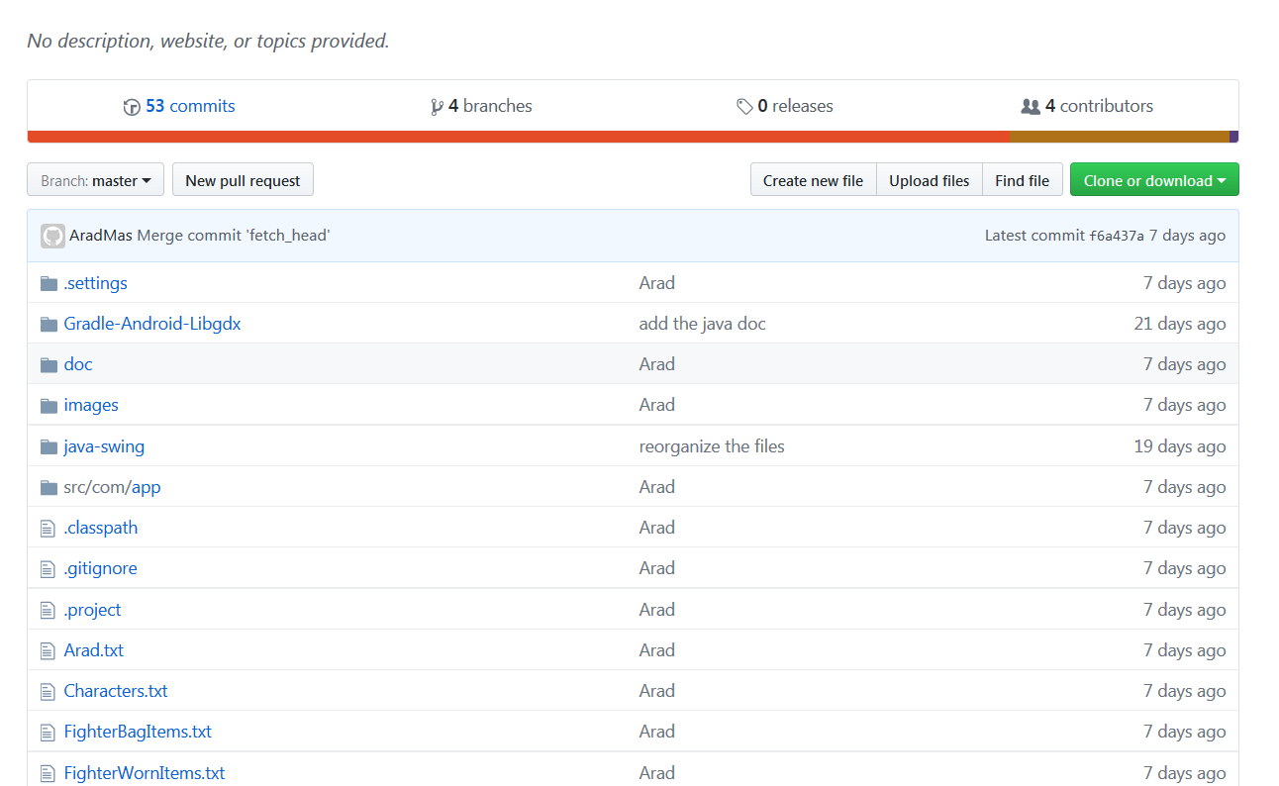
Repository

Slide 15
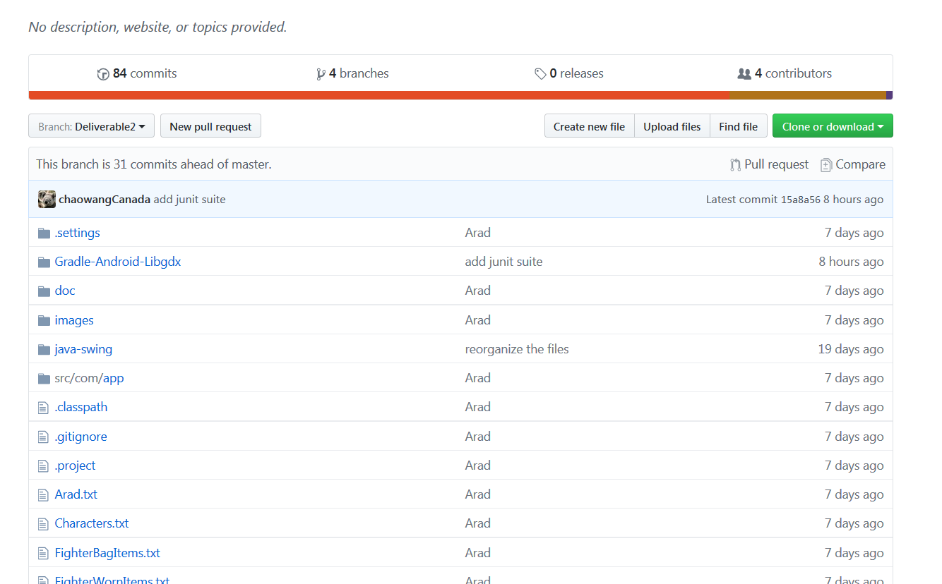
Repository

Slide 16
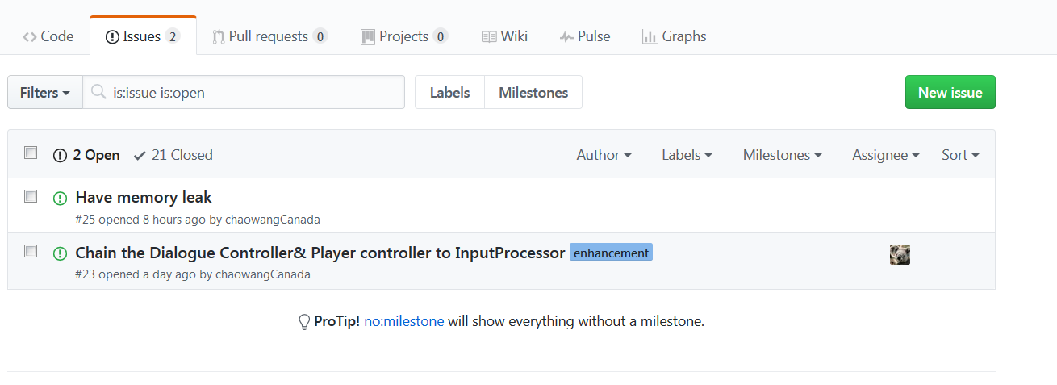
Continuous Integration & Testing

Slide 17
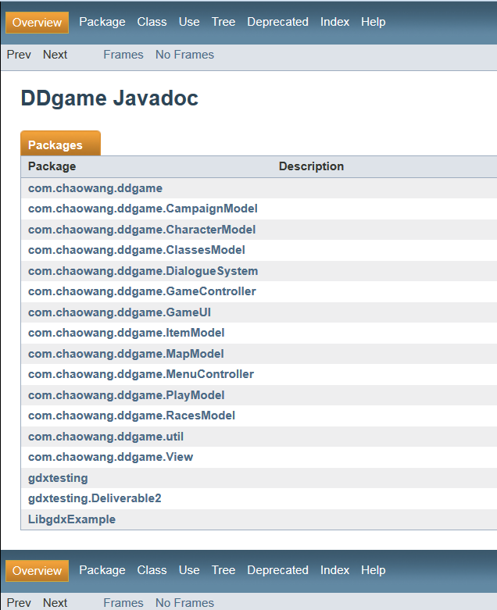
API Documentation
We used JavaDoc for files, classes and methods.
Unit testing framework
We used Junit for test cases of most of important parts of the project.

Slide 18
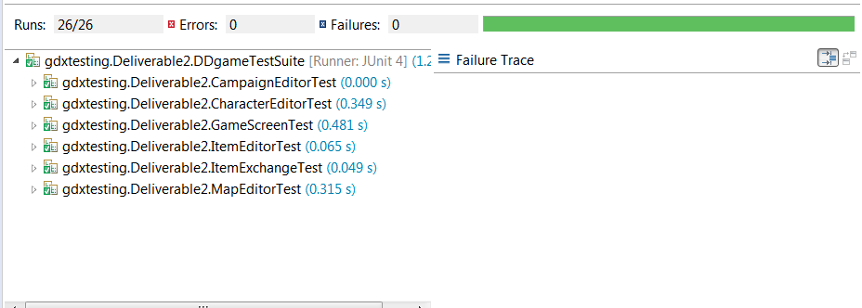
Unit testing
One unit test suite
1-1 relationship between a test class and a tested class

Slide 19
Coding Standards
To build enterprise Java applications, which are reliable, scalable and maintainable, it is Important for development teams to adopt proven design techniques and good coding standards. The adoption of coding standards results in code consistency, which makes it Easier to understand, develop and maintain the application. In addition by being aware of and following the right coding techniques at a granular level, the programmer can make the code more efficient and performance effective.

Slide 20
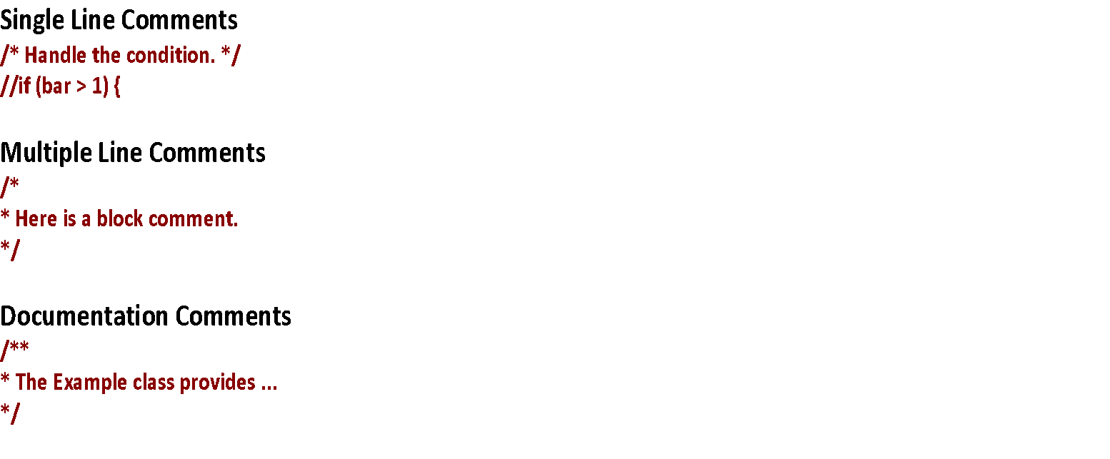
Commenting
Class Declaration
Java source are named as *. java while the compiled Java byte code is named as *.class file.
Each Java source file contains a single public class or interface. Each class must be placed in
a separate file. This also applies to non‐public classes too.

Slide 21
Variable Declaration
Class Variables ‐ All class variables are declared in camel case.
Example: public String plyrType;
Local Variables‐ All local variables are declared in camel case.
Example: Int i = 0 ;
Constants ‐ All constants are written in capital letters and the ones which need to be reused are
declared in the file AppStatics.java
Example: public static final int CHILD_POPUP_WINDOW_WIDTH = ( int ) WINDOW_WIDTH ‐ 100;
File Organization
All classes are declared as part of a package.
Example:
Models are organized under the package : com . app . models

Slide 22
Method Names
All method names are written in camel case. All method names begin with a strong action verb.
Example :
public calculateAbiliyScores(){}
Use of the prefixes get and set for getter and setter methods.
Example :
public String getPlayerType () {}
If the method returns a boolean value, use is or check as the prefix for the method
name.
Example :
public boolean isEntryDone () {)

Slide 23
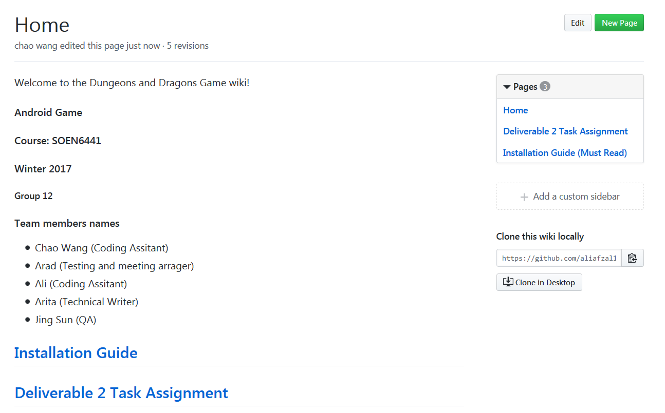
Documentation:
We used GitHub wiki

Slide 24
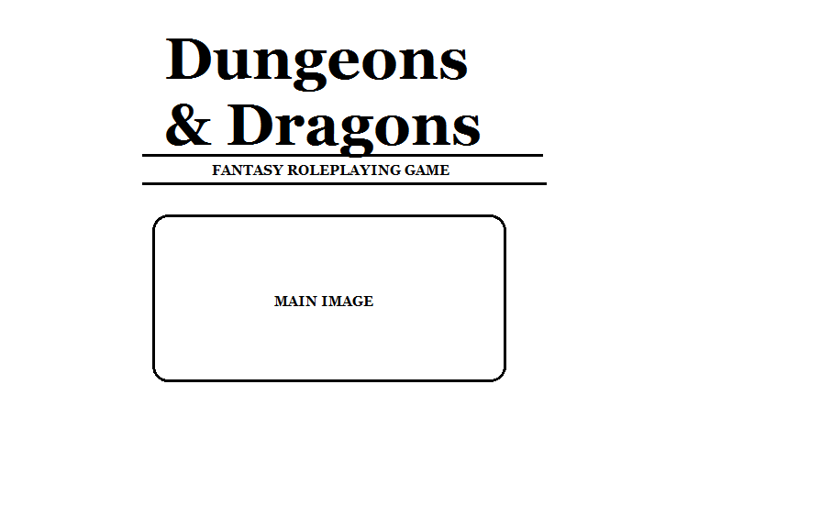
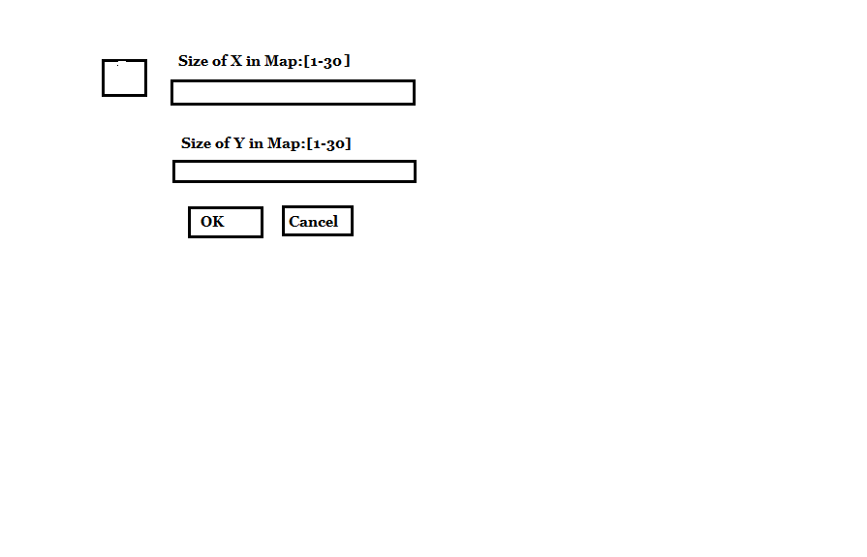
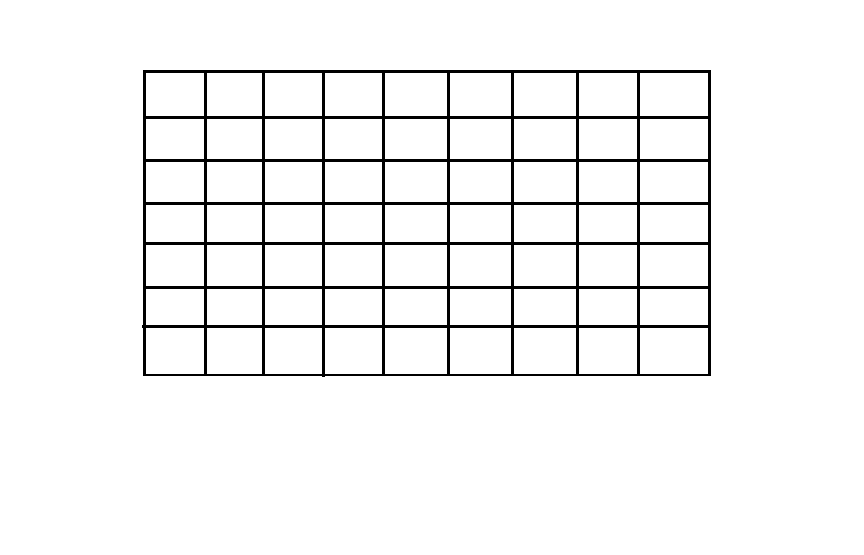
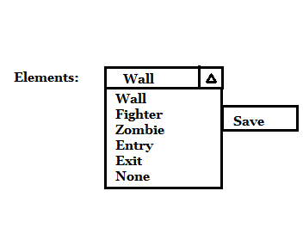
UI Design

Slide 25
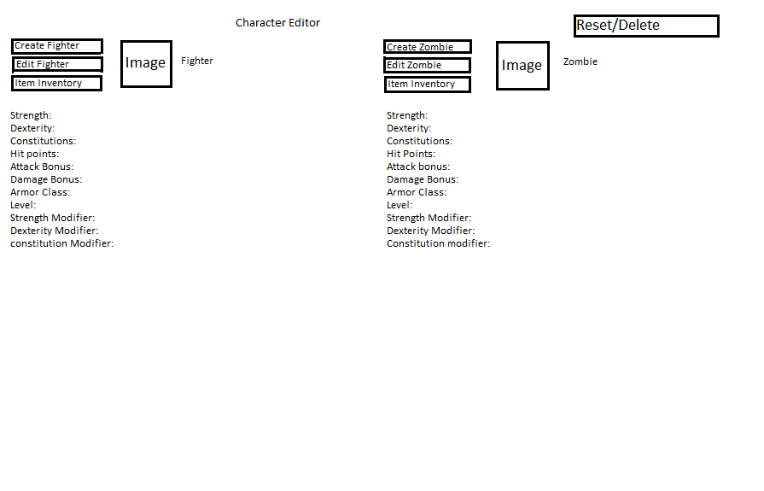
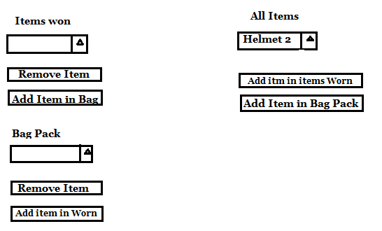
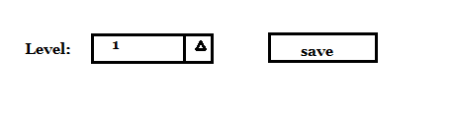
UI Design

Slide 26
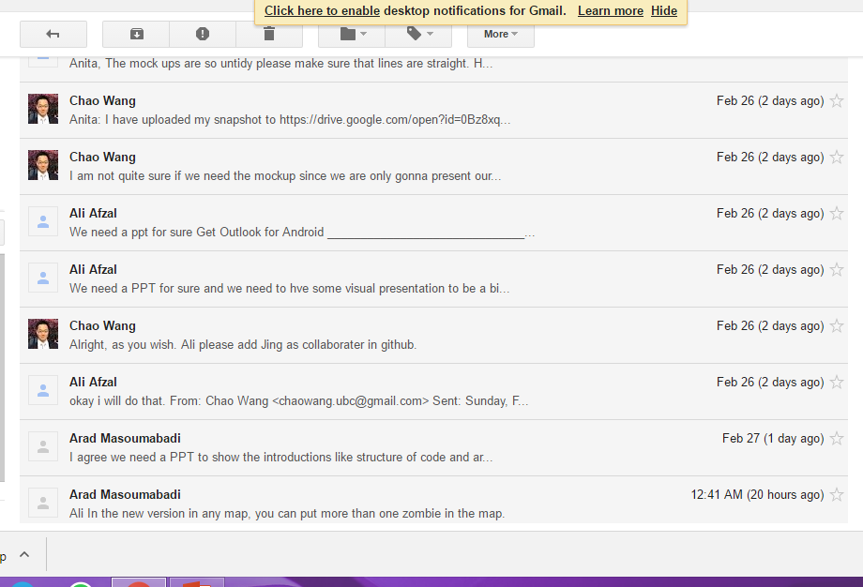
Communication
We used Gmail group to communicate each other and also Google Drive to share documentation.

Slide 27
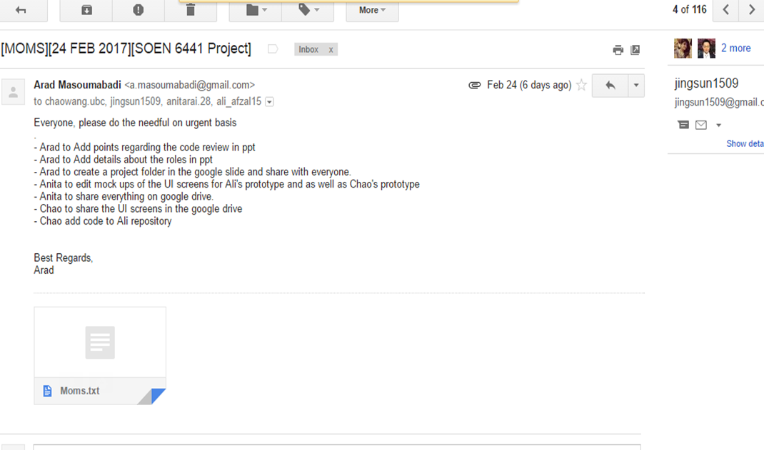

Slide 28
Packages:
com.app.menus
-This package contains all the GUI objects [Buttons, Combos, Labels Lists) for respective menus.
com.app.guiComponent
-This package contains the UI components like Menu Bar, Panels and Images.
com.app.controller
-This package holds all the action listeners for their respective menus in the com.app.menus package. The UI checks are also embedded in the respective controller classes.
com.app.models
-This package is comprised of all model class such as Character, Item, Map and Campaign.

Slide 29
Packages:
com.app.mapValidation
-This package holds the logic for map validation once the system is about to save the map.
com.app.staticEngine
-It contains all the static and constant data which is not changing frequently.
-This has been done for easy maintenance of code.
com.app.utilities
-This package consists of classes for file storage and other helper classes which are assisting to perform complex functions in simpler methods.
com.app.testing
-This contains of all the test cases for unit testing few of the main functionalities in the game.
-Also contains the test suite
com.app.gameEngine
-This is main class package from where the threads and processes initiates.

Slide 30
References
Ken Auer and Roy Miller. Extreme Programming Applied: Playing To Win, Addison–Wesley.
Kent Beck: Extreme Programming Explained: Embrace Change, Addison–Wesley.
Kent Beck and Martin Fowler: Planning Extreme Programming, Addison–Wesley.
Kent Beck and Cynthia Andres. Extreme Programming Explained: Embrace Change, Second Edition, Addison–Wesley.
"Initial revision of "git", the information manager from hell". Github. 8 April 2005. Retrieved 20 December 2015
Torvalds, Linus (2005-04-07). "Re: Kernel SCM saga..". linux-kernel (Mailing list). "So I'm writing some scripts to try to track things a whole lot faster.“
Torvalds, Linus (2007-06-10). "Re: fatal: serious inflate inconsistency". git (Mailing list).

