Slide 1
Week 4
Conditional Statements & Loops

Slide 2
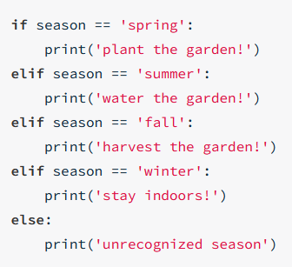
If statements
Act according to a condition
Take care of indention (4 spaces/Tab)
Check the conditions from top to botton
Stop if a condition is met

Slide 3
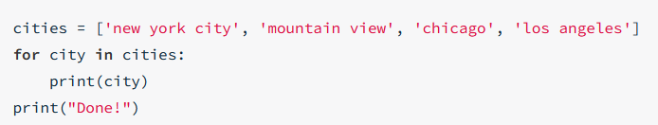
For statments
Use for if you know the number of iterations or you want to iterate over a pre-defined set of objects
Use range(N) to repeat the loop for N-iterations
range(start, stop, step)
range(start, stop)
range(stop)

Slide 4


Iterating over dicts

Slide 5
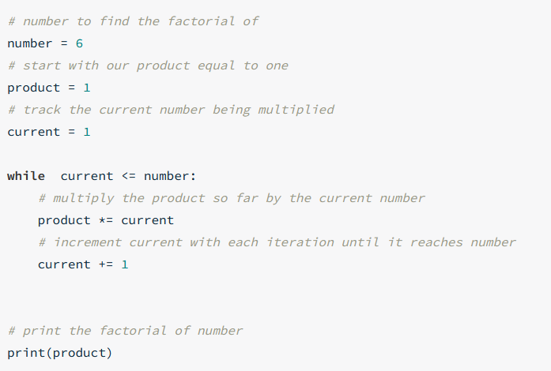
While statement
Iterate till a condition is met

Slide 6
Break & Continue
Break: breaks a loop
Continue: skip a single iteration of loop

Slide 7
Guss the number
Select a random value between 1, 100
Ask user to guess the number
If the guess is correct print
„Congrats! You win“
If the guess is incorrect print
„Try again! You have <x> more choices“
x is the number of remaining guesses
The maximum of number of guesses is 6
After 6 incorrect guesses print
„You lost!“

Slide 8
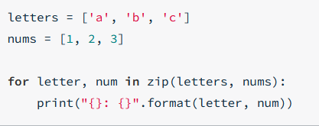

Zip & enumerate

Slide 9
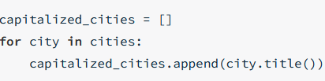
List Comprehensions

Slide 10
Dooz 2.0
Modifiy the previous version of dooz to:
Play till there is a winner
Check the validity of user inputs
If the cell is already ticked or is out of range, ask user to re-enter the value
Check if there is a winner, if yes print „User<x> wone the game!“ and exit the program
After getting valid inputs from user print out the dooztable

