Slide 1
Week 2

Slide 2
Arithmetic Operators
+, -, *, /, **, %, //
Priority:
PEMDAS
Parentheses
Exponents
Multiplication and Division
Addition and Subtraction

Slide 3
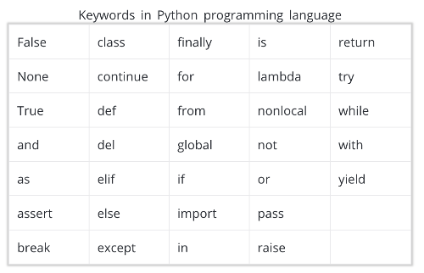
Variables
var_name = var_value
A=3
Variable name rules:
Allowed characters: alphanumeric and _
No space
Case sensitive
Can not start with a number
Do not used reserved keywords
Use camelCase convention
thisParamName

Slide 4
Variable Types
int(integer)
A=2
Float
A=2.0
String
A=”2”
A=’2’
Boolean
A=True
A=False
A == 2
Python automatically determines the variable types
Use type(varName) to determine the type of a vairbale
Divide by Zero Exception

Slide 5

Quiz 1
You are an ESA eingineer in charge of developing a new rocket which has to fly back from the exoplanet Kepler-452b (aka. Earth 2.0). What is the escape speed for this planet? What is its ratio compared to earth?

Slide 6
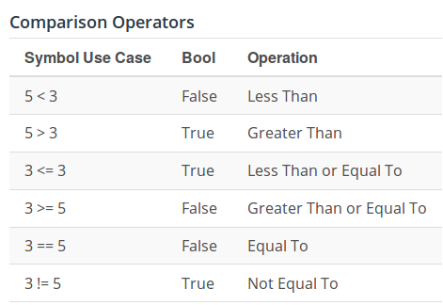
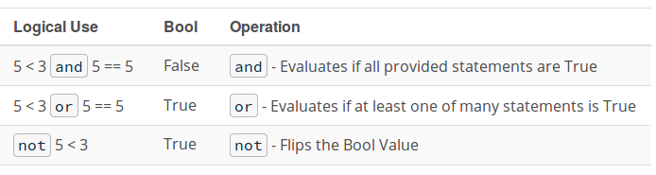
Comparison & Logical Operators
Comparison operators result in boolean values
Logical operators operate on boolean values

Slide 7
Strings
A list of characters surrounded by
Single quotes
‘This is a string’
Double quotes
“This is a string”
Escape character
Add “\” before reserved characters to print them
Print(‘\’’) → ‘
\, ‘, “, \n, \t, ...
Add two string
“Hello” + ‘ ‘ + “World” → “Hello World”
F-String:
print(f“Hello {name}”)
len() returns the length of an object
len(“hello”) → 5

Slide 8
Quiz 2
store this address as a string in a variable: C:\user\docs\Letter.txt
Print “The file is saved under <address>”

Slide 9
Type conversion & Reading from Input
convert to Y: Y(variable)
int(1.2) → 1
str(1.2) → “1.2”
float(“1.2”) → 1.2
read user input from console using
input(“message: ”)
returns a string
you may need to convert the format

Slide 10
String Methods
Methods are specific functions that operate on a specific type of object e.g. strings
Check out the built-in types documentation here:
https://docs.python.org/3/library/stdtypes.html
Some example methods:
name=”ali”
name.upper() → “ALI”
"The sum of 1 + 2 is {}".format(1+2) → “The sum of 1 + 2 is 3”
'1,2,3'.split(',')→ ['1', '2', '3']

Slide 11
Quiz
write a program that
asks the name of the player and prints a greeting message with the name in capital case
asks the user to enter the number of letters in his/her name
compares the entered value with the number of letter in his/her name and prints “True” if it matches and “False” if it does not match (without conditional statement)
Example run:
What is your name?
Ali
Hello ALI
How many letters are in your name?
4
False

